Slide 1
Determinants of Health
by
Prof. Mamduh A. El-Messeiry
B.Sc., M.P.H.; Dr. P.H. Sc.
YEAR
1439-1440 Hajji
2018 - 2019 Gregorian

Slide 2
 | objectives
 | By the end of this lecture students will be able to: Understand the spectrum of health in relation to health and sickness Define; health, disease, illness and wellbeing Define and understand the detriments of health; biological, behavioral, socio and cultural, environmental, socioeconomic, health services, and aging and gender Understand the concepts of “right to health “ and “health for all”

Slide 3
What is Determinants of Health?

Slide 6
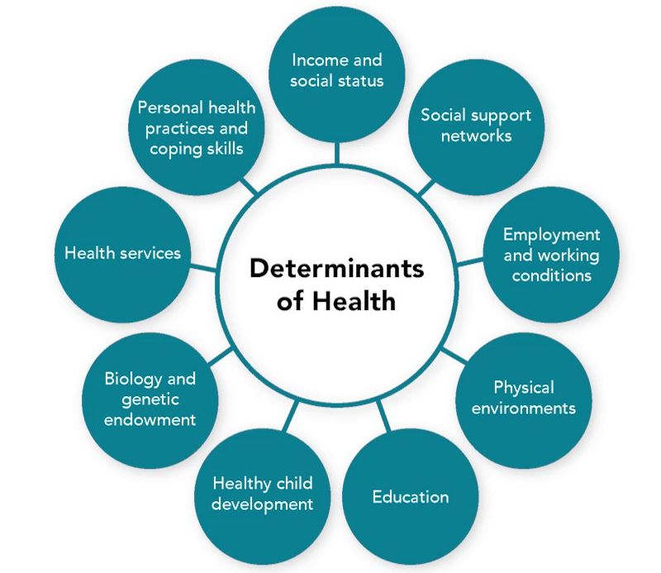

Slide 7
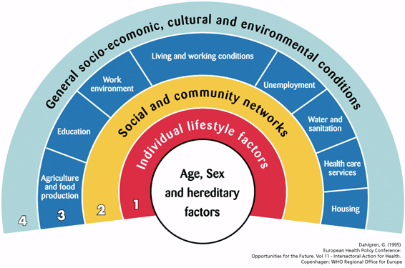

Slide 8
Spectrum of health
Health is a dynamic
phenomenon
Transition is often
gradual, and where one
state ends and
begins is a
other
matter of
judgment

Slide 9
Ecology of health
Ecology derived from the greek word ‘oikos’ meaning a house
Human ecosystem includes
Natural environment
Man-made environment (physical, chemical, biological, psychological)
According to this concept, health seen as an equilibrium between man and his environment

Slide 10
Environment affects health?
Urbanization
Industrialization
Deforestation
Dams and canals
Examples: Malaria, Filariasis, Schistosomiasis,
Bhopal gas tragedy, Chernobyl nuclear accident

Slide 11
Importance of ecology
Ecological considerations should be built into
planning of prevention of disease
Important for control of disease like malaria,
filariasis, cholera, etc.
The greatest improvement in human health can be achieved through understanding environmental factors

Slide 12
Definitions
Objective
– Standard of living/ Level of living
Subjective
– Quality of life

Slide 13
Objective definitions
Standard of Living |  |  | Level of Living
As per WHO |  |  | As per United Nations
– income |  |  | – occupation
– occupation |  |  | – housing
– housing |  |  | – food consumption
– sanitation |  |  | – health
– nutrition |  |  | – education
– health |  |  | – social security
– education |  |  | – clothing
– recreation | and | other | – recreation and leisure
service
– human rights

Slide 14
Subjective definition
Quality of Life
As per WHO
Factors that determine
health
happiness
education
social and intellectual attainments التحصيل
freedom of action
justice
freedom of expression

Slide 15
Physical Quality of Life Index (PQLI)
It includes three
indicators such as
Infant mortality
Life expectancy at 1yr
Literacy
For each component, performance of a country is placed on a scale of 0 to 100

Slide 16
Human Development Index (HDI)

Slide 17
HDI 2014 world map

Slide 18
Human Development Index (HDI)
• HDI values range: 0 to + 1
– HDI India is 0.554 (Rank 136 out of 186 countries) [2012]
- HDI for KSA 0.847 Rank 38 (2018)
• Human poverty index [HPI] is complementary to HDI

Slide 19
Estimation of HDI by New Method (2010 onwards)
• Goalposts for HDI:
Dimension Country Maximum value Minimum value
Life expectancy Japan 83.4 20.0
Mean years of
schooling Czech Republic 13.1 0
Expected years
of schooling Capped at 18.0 0
Combined
education index New Zealand 0.978 0
Per capita
income (PPP $) Qatar 107,721 100
Calculation of each dimension index:
Actual value – Minimum value
=
Maximum value – Minimum value
• HDI is Geometric mean of 3 dimension indices = ILife1/3 X IEducation1/3 X IIncome1/3

Slide 21
Human Poverty Index
HPI 1 and 2
It measures 3 dimensions
A long and healthy life
Knowledge
A decent standard of living

Slide 22
Gender-related Development Index (GDI)

Slide 23
Other measures
Inequality-adjusted Human Development Index
(IHDI)
Gender Inequality Index (GII)
Multidimensional Poverty Index (MPI)
Gini Index

Slide 24
Cultural Competence
Culture is the blended patterns of human behavior that include "language, thoughts, communications, actions, customs, beliefs, values, and institutions of racial, ethnic, religious, or social groups." Cultural competence is "a set of congruent behaviors, attitudes, and policies that come together in a system, agency, or among professionals that enables effective work in cross-cultural situations." "Competence" in the term cultural competence implies that an individual or organization has the capacity to function effectively "within the context of the cultural beliefs, behaviors, and needs presented by consumers and their communities."

Slide 25
Determinants of Health
Factors that contribute to a person's current state of health. These factors may be biological, socioeconomic, psychosocial, behavioral, or social in nature. Scientists generally recognize five determinants of health of a population:
Biology and genetics. Examples: sex and age
Individual behavior. Examples: alcohol use, injection drug use (needles), unprotected sex, and smoking
Social environment. Examples: discrimination, income, and gender
Physical environment. Examples: where a person lives and crowding conditions
Health services. Examples: Access to quality health care and having or not having health insurance

Slide 26
Health Disparity تفاوت
A type of difference in health that is closely linked with social or economic disadvantage. Health disparities negatively affect groups of people who have systematically experienced greater social or economic obstacles to health. These obstacles stem from characteristics historically linked to discrimination or exclusion such as race or ethnicity, religion, socioeconomic status, gender, mental health, sexual orientation, or geographic location. Other characteristics include cognitive, sensory, or physical disability

Slide 27
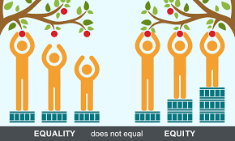
Health Equity إنصاف
When all people have "the opportunity to 'attain their full health potential' and no one is 'disadvantaged from achieving this potential because of their social position or other socially determined circumstance'

Slide 28
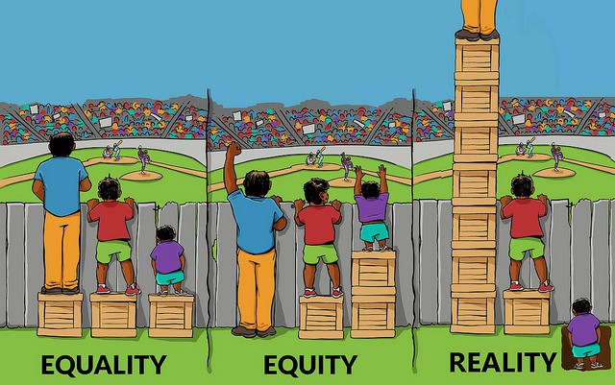
Health Inequality عدم مساواة
Differences, variations, and disparities in the health achievements of individuals and groups of people

Slide 29
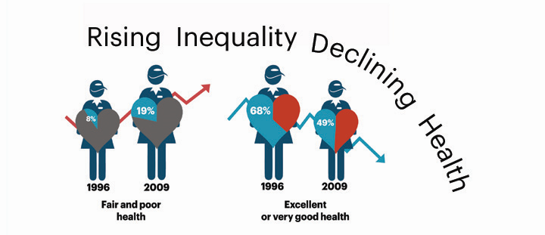
Health Inequity
A difference or disparity in health outcomes that is systematic, avoidable, and unjust

Slide 30
Health Literacy
Whether a person can obtain, process, and understand basic health information and services that are needed to make suitable health decisions.
Health literacy includes the ability to understand instructions on prescription drug bottles, appointment cards, medical education brochures, doctor's directions, and consent forms. It also includes the ability to navigate complex health care systems. Health literacy is not simply the ability to read. It requires a complex group of reading, listening, analytical, and decision-making skills and the ability to apply these skills to health situations

Slide 31
Index of Disparity
A regression-based measure that is used by scientists and retains the inherent order of categories like education or income but incorporates the population weights of the categories.
The size of each category is taken into account by placing the groups on an axis that reflects the cumulative proportion of the population represented by the ordered groups.
The index of disparity can be absolute (slope referred to as Slope Index of Inequality) or relative (slope referred to as Relative Index of Inequality)

Slide 32
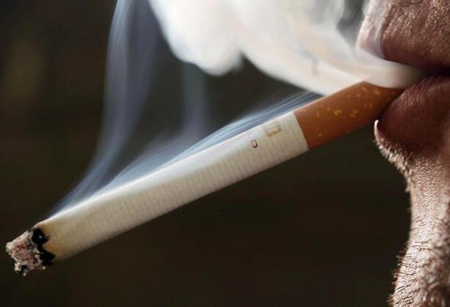
Individual Risk Factors
Characteristics of a person that may explain health or behavior. Some examples include a person's age or whether a person smokes.

Slide 33
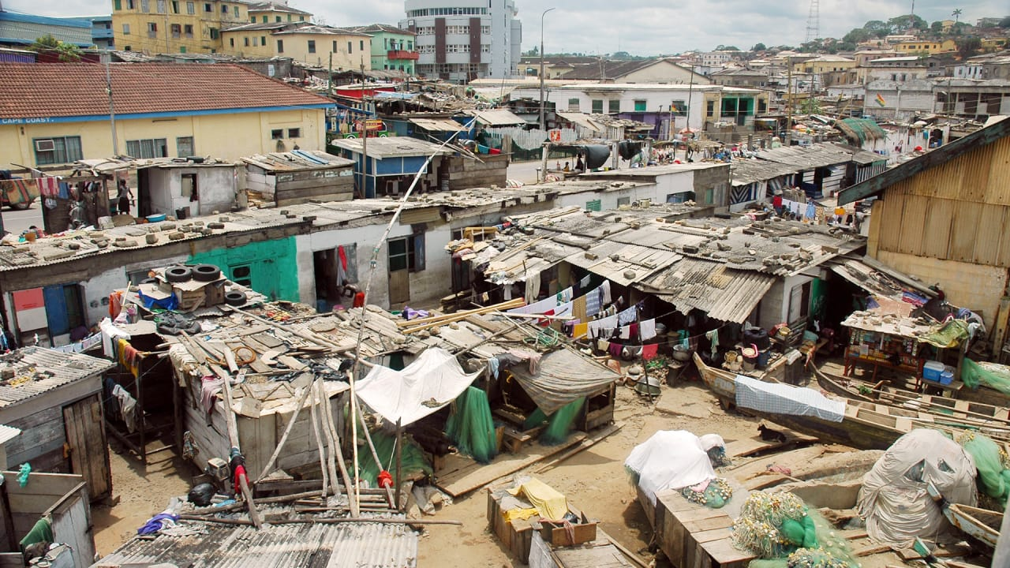
Poverty
When a person or group of people lack human needs because they cannot afford them. Human needs include clean water, nutrition, health care, education, clothing, and shelter.
The U.S. Social Security Administration originally developed the definitions that are used to help calculate and determine poverty.
Families or people with income below a certain limit are considered to be below the poverty level.

Slide 34
Social Determinants of Health
The complex, integrated, and overlapping social structures and economic systems that are responsible for most health inequities.
These social structures and economic systems include the social environment, physical environment, health services, and structural and societal factors. Social determinants of health are shaped by the distribution of money, power, and resources throughout local communities, nations, and the world

Slide 35
Socioeconomic Gradient in Health درجة الميل
This term refers to the stepwise fashion health outcomes improve as socioeconomic position improves.
This gradient can be measured by a person's income, occupation, or the highest level of education he or she has

Slide 36
Socioeconomic Position
An aggregate concept that includes both resource-based and prestige-based measures, which are linked to both childhood and adult social class position. Resource-based measures refer to material and social resources and assets, including income, wealth, and educational credentials.
Terms used to describe inadequate resources include "poverty" and "deprivation." Prestige-based measures refer to a person's rank or status in a social hierarchy.
Prestige-based measures are typically evaluated with reference to people's access to and consumption of goods, services, and knowledge, that are linked to their occupational prestige, income, and education level

Slide 37
Socioeconomic Status
A composite measure that typically incorporates economic, social, and work status.
Economic status is measured by income.
Social status is measured by education, and
work status is measured by occupation.
Each status is considered an indicator. These three indicators are related but do not overlap

Slide 38
The right to health
The right to health is the economic, social and cultural right to a universal minimum standard of health to which all individuals are entitled.
The concept of a right to health has been enumerated in international agreements which include the Universal Declaration of Human Rights, International Covenant on Economic, Social and Cultural Rights and the Convention on the Rights of Persons with Disabilities.
There is debate on the interpretation and application of the right to health due to considerations such as how health is defined, what minimum entitlements are encompassed in a right to health, and which institutions are responsible for ensuring a right to health.

Slide 39
Health For All
Health For All is a programming goal of the World Health Organization (WHO), which envisions securing the health and well being of people around the world that has been popularized since the 1970s. It is the basis for the World Health Organization's primary health care strategy to promote health, human dignity, and enhanced quality of life.

Slide 40
References
1. Keppel, K., Pearcy, J., Klein, R., Measuring progress in Healthy People 2010. 2004, National Center for Health Statistics: Hyatsville, Maryland.
2. U.S. Department of Health and Human Services, What is Cultural Competency?, Office of Minority Health (HHS).
3. Preamble to the Constitution of the World Health Organization as adopted by the International Health Conference, N.Y., 19-22 June, 1946; signed on 22 July 1946 by the representatives of 61 States (Official Records of the World Health Organization, no. 2, p. 100) and entered into force on 7 April 1948.
4. U.S. Department of Health and Human Services, Healthy People 2020 Draft. 2009, U.S. Government Printing Office.
5. Braveman, P.A., Monitoring equity in health and healthcare: a conceptual framework. Journal of health, population, and nutrition, 2003. 21(3): p. 181.
6. Kawachi, I., A glossary for health inequalities. Journal of Epidemiology and Community Health, 2002. 56(9): p. 647

Slide 41
7. Whitehead, M. and Whitehead, The concepts and principles of equity and health. Health Promotion International, 1991. 6(3): p. 217.
8. U.S. Department of Health and Human Services, Healthy People 2010: Understanding and Improving Health. 2000, Government Printing Office: Washington, DC: U.S.
9. Commission on Social Determinants of Health (CSDH), Closing the gap in a generation: health equity through action on the social determinants of health. Final report of the Commission on Social Determinants of Health. 2008, World Health Organization: Geneva.
10. Jones, C., Jones CY, Perry GS, Barclay G, Jones CA, Addressing the Social Determinants of Children's Health: A Cliff Analogy. Journal of Health Care for the Poor and Underserved, 2009. 20(4a): p. 1.
11. Krieger, N., D.R. Williams, and N.E. Moss, Measuring Social Class in US Public Health Research: Concepts, Methodologies, and Guidelines. Annual Review of Public Health, 1997. 18(1): p. 341-378.
12. Adler, N.E., Socioeconomic status and health: The challenge of the gradient. American psychologist, 1994. 49(1): p. 15.

