Slide 1
Demography

Slide 2
Objectives
Defining demography
What forces are affecting the demography of a population
For a country status to be changed from developing to a developed country; What are the stages it has to pass through?

Slide 3
Definition of demography
Is the scientific study of a human population.
It focuses on three phenomenon:
Changes in population size.
The composition of the population
The distribution of the population

Slide 4
Demographic forces (determinants of population change)
Mortality
Fertility
Migration

Slide 5
Mortality rate
is the number of deaths in a particular population per unit of time.
Average risk of dying of a person in the group during a span of time.

Slide 7
Fertility rate
It is the average number of children born to women during their reproductive years.
For the population in a given area to remain stable, an overall total fertility rate of 2.1 is needed, assuming no immigration or emigration occurs.

Slide 9
Examples
http://worldpopulationreview.com/countries/birth-rate-by-country/
http://worldpopulationreview.com/countries/death-rate-by-country/
http://worldpopulationreview.com/countries/saudi-arabia-population/

Slide 10
Demographic cycle
Also known as demographic transition
Some countries have passed through high fertility and high mortality conditions to a low fertility and low mortality conditions, both aiming at low growth of population. These two conditions have been referred to as the “old and new balance” with an in between period of imbalance.

Slide 11
Demographic cycle
FIRST STAGE
It is high stationary stage, characterized by balance of high birth rate and high death rate
Pre Modern times. It was true for all human populations up until the late 18th. C. when the balance was broken in western Europe.

Slide 12
Demographic cycle
SECOND STAGE (Early expanding)
Death rate < Birth rate (unchanged or increased in some)
The decline in death rate started to be observed in Europe in the late 18th C.
Many country in South Asia and Africa in this stage

Slide 13
Demographic cycle
THIRD STAGE (Late expanding)
The death rate declines further and the birth rate tends to fall
e.g. India, China, Singapore

Slide 14
Demographic cycle
FOURTH STAGE (Low stationary)
Low birth rate and low death rate
Zero population growth or close to zero
Most industrialized countries

Slide 15
Demographic cycle
FIFTH STAGE (Declining)
Population starts to shrink because birth rate is declining further and becoming lower than death rate
e.g. East Europe
http://worldpopulationreview.com/

Slide 17
Relation between growth rate and population
Rating | Annual rate of growth % | # of years required for the population to double in size
Stationary population | No growth
Slow growth | Less than 0.5 | More than 139
Moderate growth | 0.5 to 1.0 | 139 - 70
Rapid growth | 1.0 to 1.5 | 70 - 47
Very rapid growth | 1.5 to 2.0 | 47 - 35
“Explosive growth” | 2.0 to 2.5 | 35 - 28
 | 2.5 to 3.0 | 28 - 23
 | 3.0 to 3.5 | 23 - 20
 | 3.5 to 4.0 | 20 - 18

Slide 18
Population Growth (Population Growth= Natural Increase + Net Migration)
The equation can also be expressed in terms of rates.(by dividing each element by the mid year population expressed per 1000).
Population Growth rate however is usually expressed in percentage which helps us calculate the rate at which the population of a country or a community is growing.
The principle of compound growth rate is applied to calculate the effects of population growth rate on future population .

Slide 19
Population Growth
A population growing at the rate of 01 % per year, How many years it will take for this population to double?
100 years
70 years
50 years
It is estimated that the Saudi Population in 2018 is around 33.55 million. How long it will take for this population to double at growth rate of 1.87% per year?

Slide 20
Population Pyramids
Objectives:
Definition
How to read a population pyramid
Knowing the different shapes of population pyramids
Importance of population pyramids

Slide 21
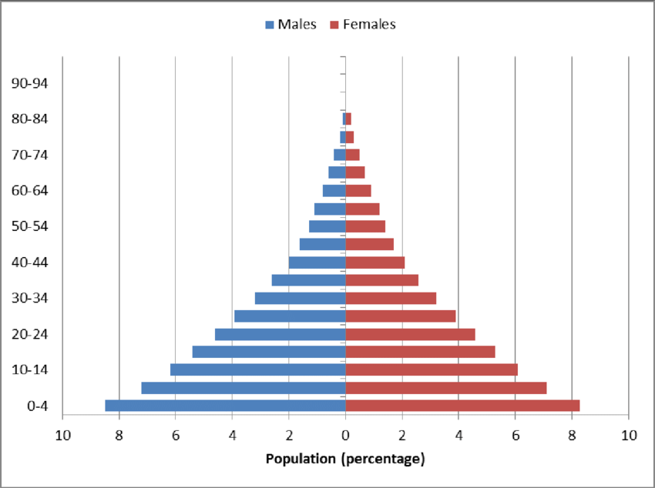
Population Pyramid
Is a graphical illustration that shows the distribution of various age groups by sex in a population.

Slide 22
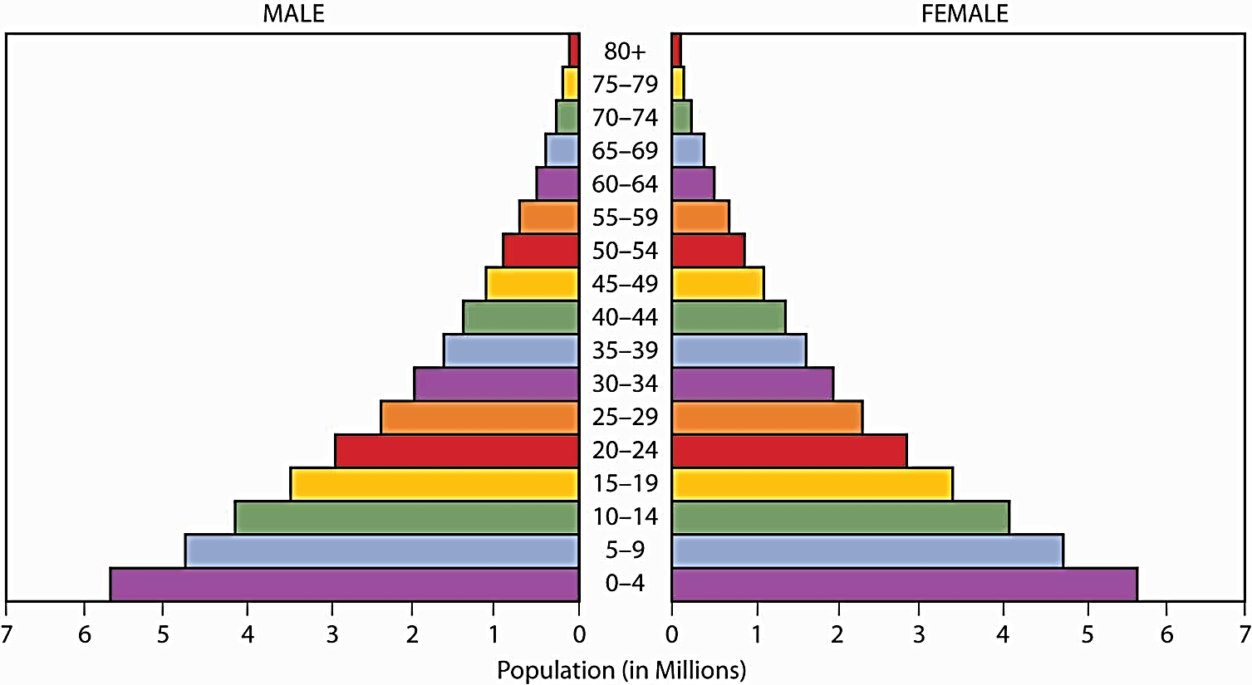
Halves - Males : Females
Base -Births; population adding to itself
-Wide base reflects high births
-Narrow base reflects low births
Apex -Oldest people; reflects those living old age
-Tapering apex reflects few living to old age
-Broad apex reflects many living to old age
Height -Life span; increase height reflects increase life span
Side -Change in population size due to death or migration

Slide 23
Less than 15 -Represents the size of dependent youth < 15
-Large size in rapidly growing population
-Small size in slowly growing population
60 + years -Represents the size of dependent old ≥ 60
-Large size in population with longer life span
-Small size in population with short life span
Median age -Age that divide the population into two halves
-Small in population with high births
-Large in population with low births

Slide 24
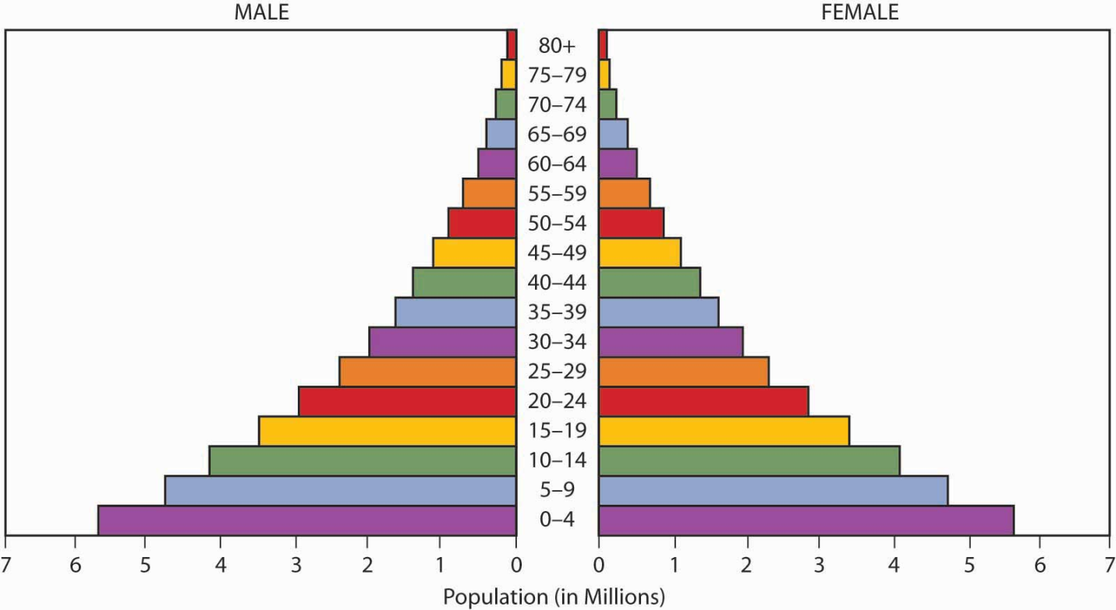
Apex= People living to old age
People ≥ 60 years=
Old dependency
Side= mortality and migration
Height= life span
Median age
People < 15 years=
Young dependency
Base= births

Slide 25
Types of population Pyramid
Expanding population pyramid
Stationary population pyramid
Constrictive population pyramid

Slide 26
Expansive
Expansive or expanding pyramid usually presents itself in the form of triangular shape with concaved edges
High population growth due to:
High birth rate
Shorter life expectancy
(high death rate)
Usually associated with lower standard of living

Slide 27
Stationary
It is showing unchanging pattern of fertility and mortality
Age groups almost equal, but it is expected to see smaller figures at the oldest age groups

Slide 28
Constrictive
Narrow base
Apex wider
It is more common when immigrants are factored out
Indicated:
High level of education
Use of birth control
Good health care system

Slide 29
Importance of population Pyramid
It gives valuable information for human resource planners
Wide base vs. Narrow base, what to do?
If proportion of old age population is high, what to do?
Market researchers
Product developers
The importance comes from what it tells us. e.g:
https://quizlet.com/121200998/the-importance-of-population-pyramids-and-resources-flash-cards

Slide 30
Thank You

