Slide 1
Tuberculosis

Slide 2
OBJECTIVES
• Understand the epidemiology and global burden of TB
• List the sign and symptoms and risk factors of different types of TB, with particular emphasis on pulmonary TB
• Describe trends and state reasons for resurgence of pulmonary TB
• List population subgroups at risk for pulmonary TB
• Draw the cycle of infection of pulmonary TB
• Describe measures for prevention and control for pulmonary TB
• Describe the role of WHO to address the global burden of TB, particularly directly observed therapy short course (DOTS) for pulmonary TB

Slide 3
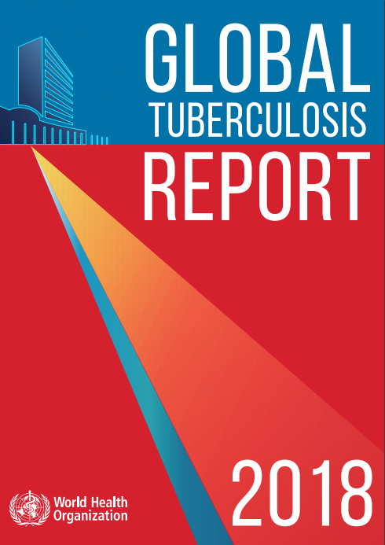
Epidemiology And Global Burden

Slide 4
Global Impact Of Tuberculosis
About 2 billion people, are infected by TB bacteria
1.8 million will die each year, making TB the leading infectious disease killer in the world.
10.4 million individuals who become ill with TB each year
  approximately four million are “missed” each year by health systems
  do not get the care they need
  allowing the disease to continue to be transmitted

Slide 5
Global Impact Of Tuberculosis
Resistance to anti-TB drugs can occur when these drugs are misused or mismanaged
  Patients do not complete their full course of treatment
  Wrong treatment
  Wrong dose
  Wrong length of time for taking the drugs
  Drugs is not always available
  Drugs are of poor quality

Slide 6
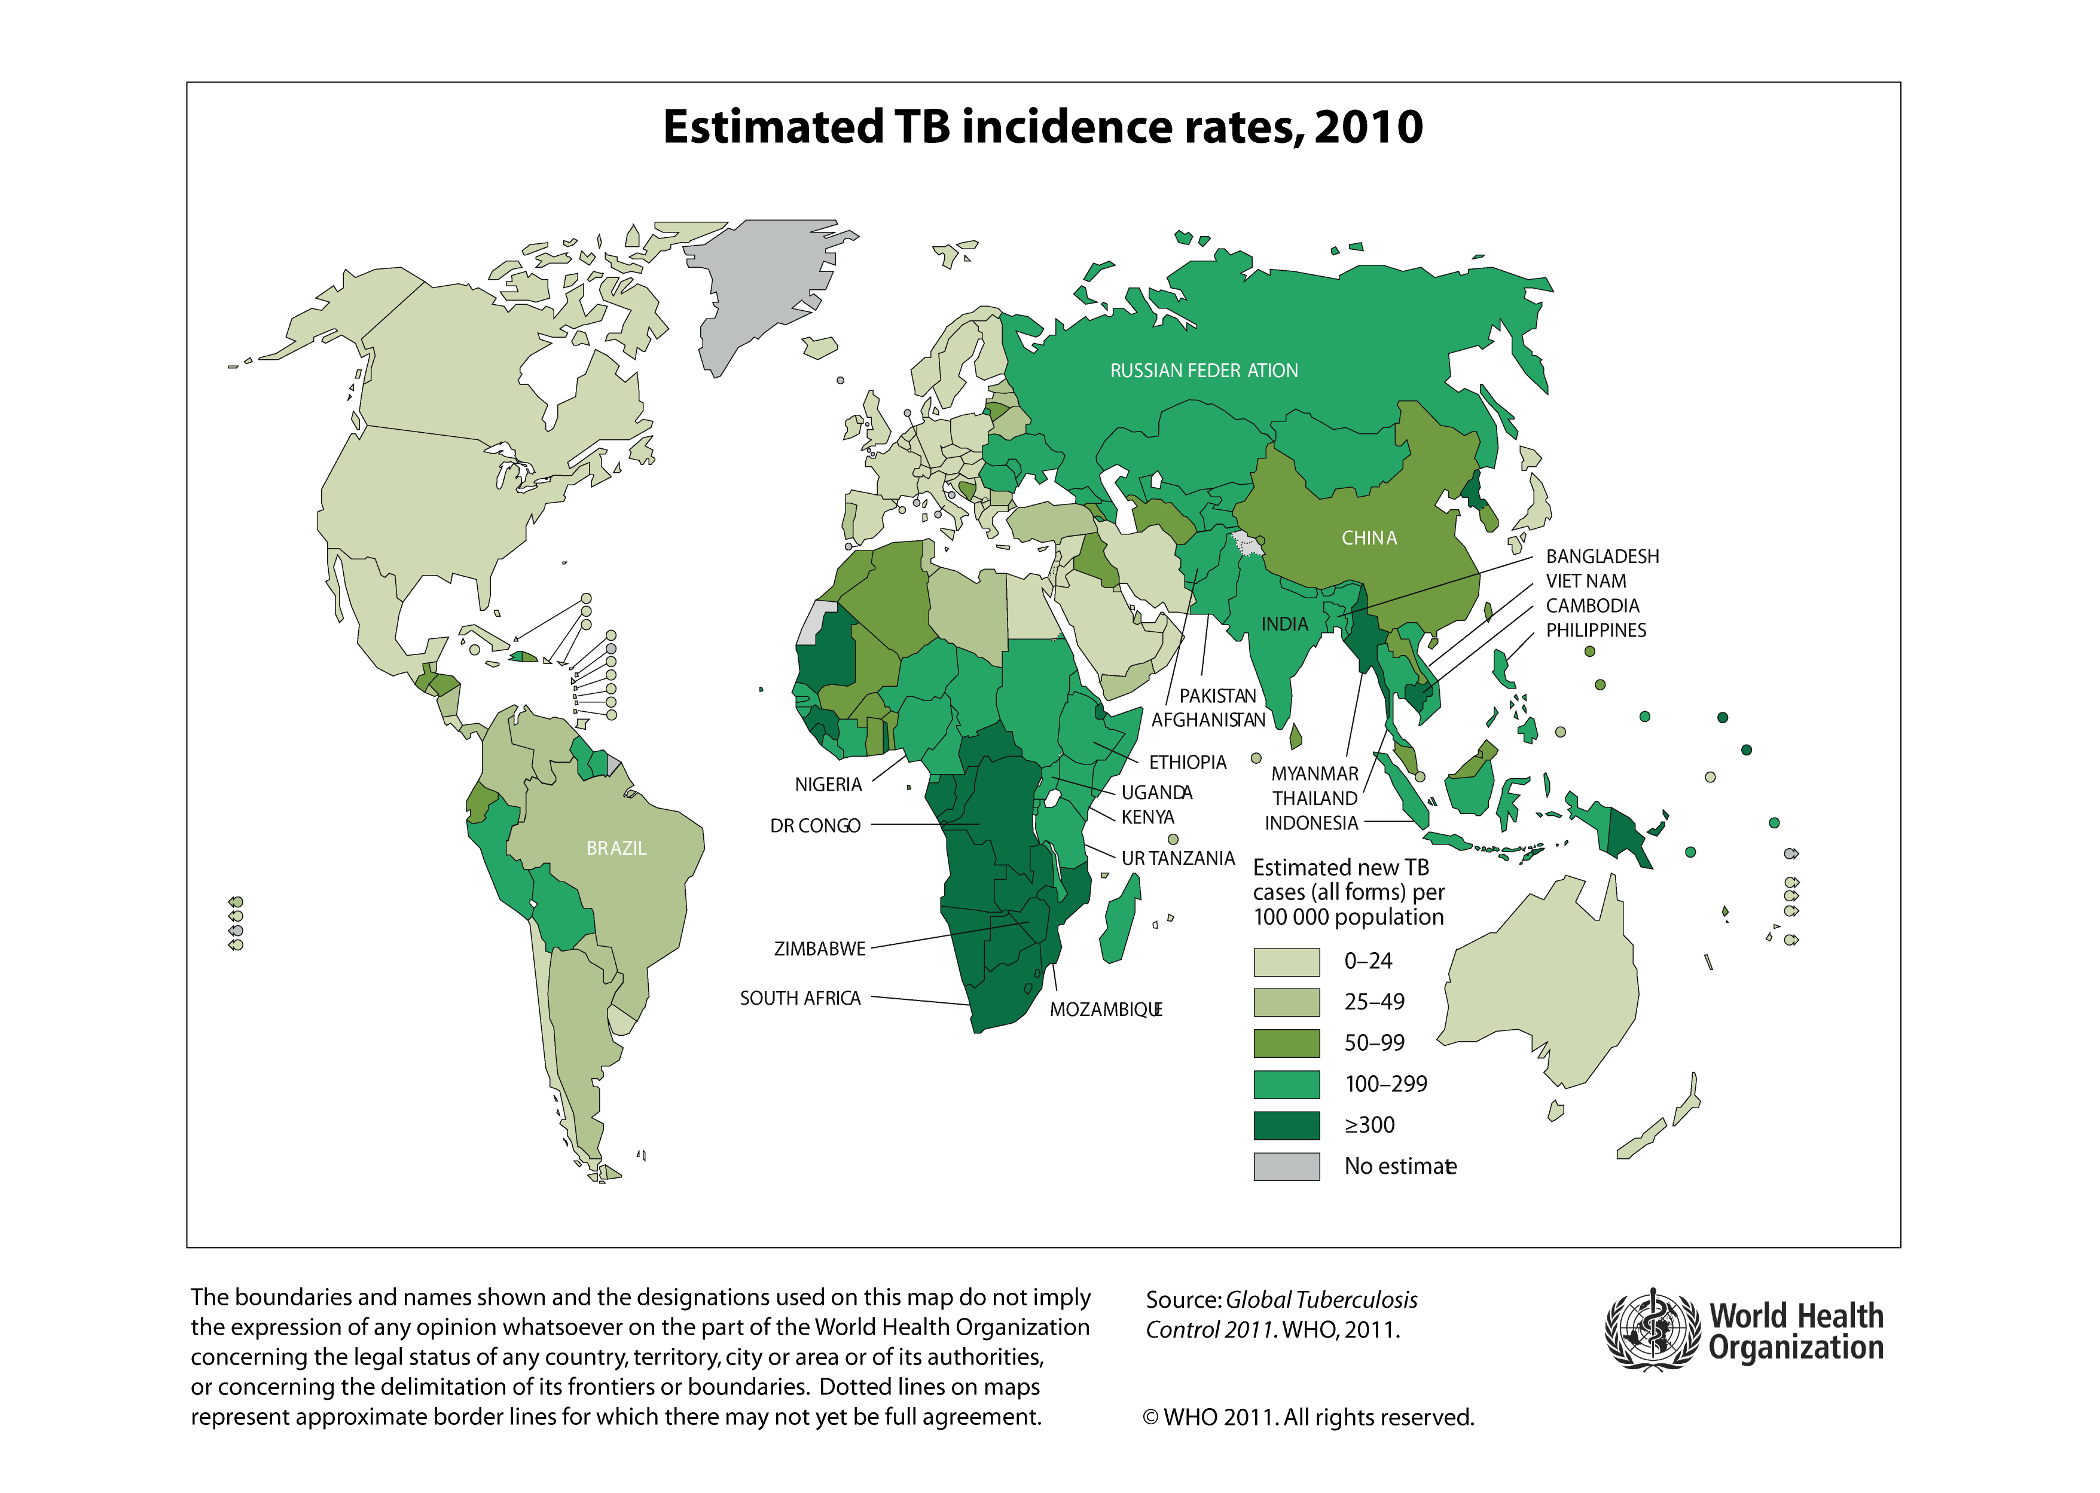
Global burden of TB disease
In 2014, TB surpassed HIV as the #1 infectious disease killer worldwide
In 2015, 10.4M cases
WHO Global Tuberculosis Report 2016: http://www.who.int/tb/publications/global_report/en/
Notes:
Surpassed HIV in 2014 as the #1 infectious disease killer worldwide

Slide 7
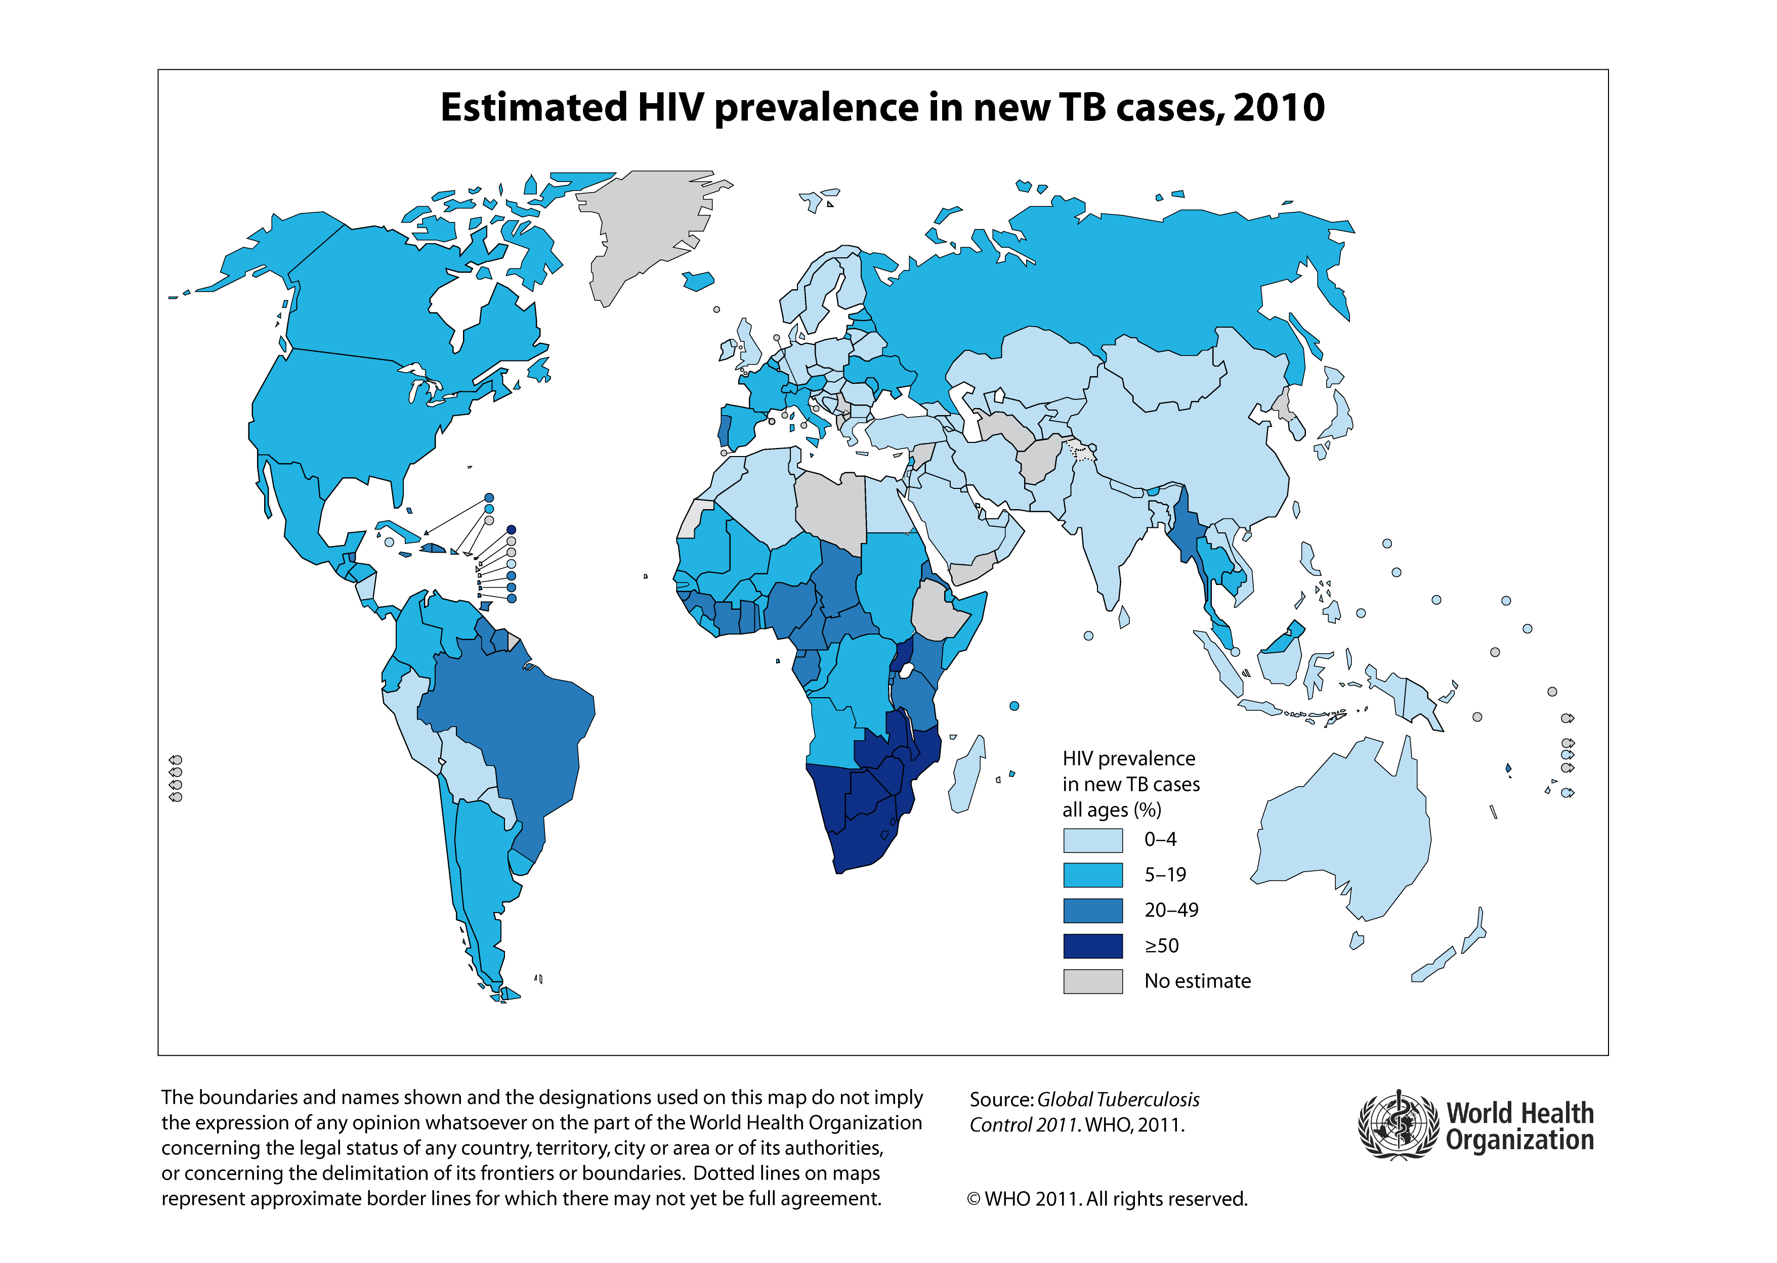

Slide 8
Global Impact Of Tuberculosis
Multidrug resistant tuberculosis (MDR-TB)
  TB resistant to two of the most important drugs used to treat TB: Isoniazid (INH) and Rifampin (RIF)
Extensively drug resistant TB (XDR-TB)
  A rare type of MDR-TB that is resistant to isoniazid and rifampin, plus any fluoroquinolone and at least one of three injectable second-line drugs (i.e., amikacin, kanamycin, or capreomycin)
  Because XDR-TB is resistant to the most potent TB drugs, patients are left with treatment options that are much less effective.
  special concern for persons with HIV infection or other conditions that can weaken the immune system
    More likely to develop TB disease once they are infected
    Higher risk of death once they develop TB

Slide 9
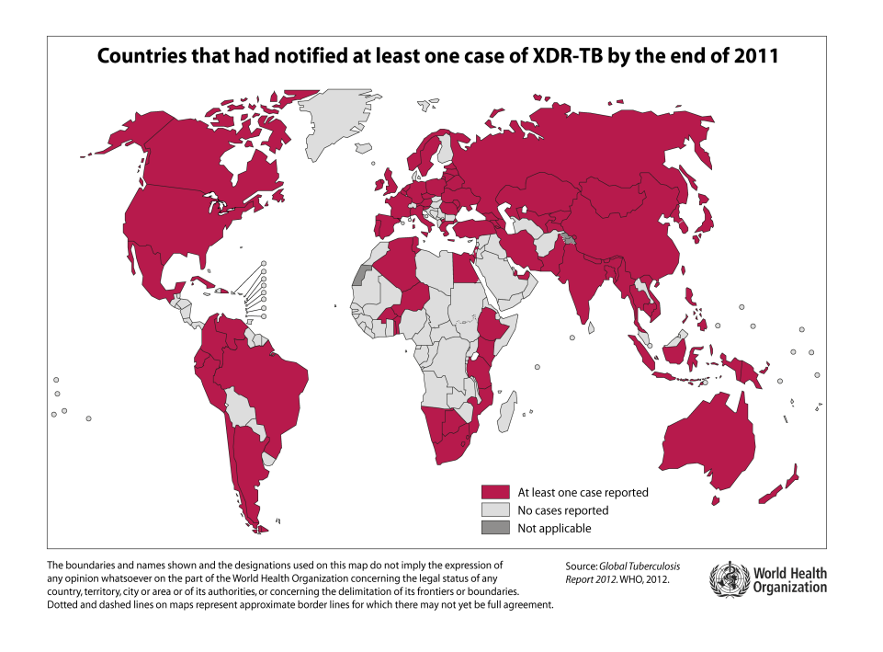
MDR- and XDR-TB: Global Health Emergencies
Multidrug-resistant TB:
Mycobacterium tuberculosis resistant to isoniazid and rifampin:
480,000 incident cases in 2015
Extensively drug-resistant TB:
M. tuberculosis resistant to isoniazid, rifampin, fluoroquinolones, and injectable agents

Slide 10
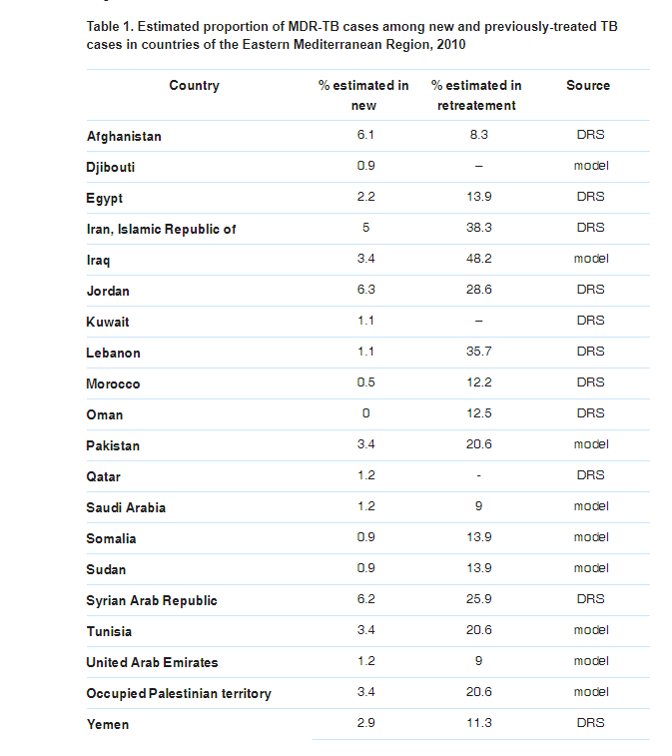
The proportion of multidrug-resistant TB (MDR-TB) cases

Slide 11
TB re-emerges
1990s TB re-emerges as a threat
  TB-HIV co-infection
  Drug-resistant TB
  Globalization allows TB to travel

Slide 12
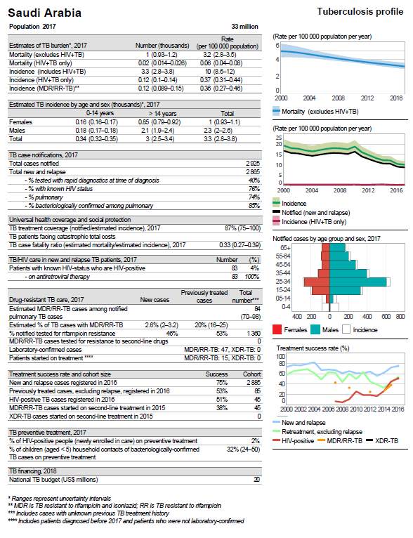
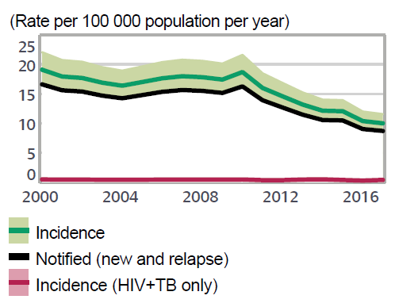

Saudi Arabia
Tuberculosis profile

Slide 13
Tuberculosis
caused by
  bacterium called Mycobacterium tuberculosis.
The bacteria usually attack the lungs,
but TB bacteria can attack any part of the body
  such as the kidney, spine, and brain.
Not everyone infected with TB bacteria becomes sick.
two TB-related conditions exist:
  latent TB infection (LTBI)
  TB disease.

Slide 14
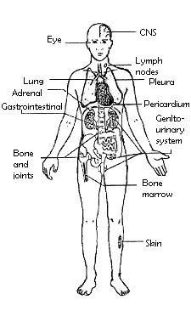
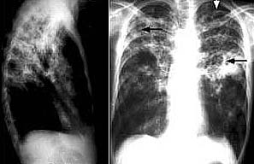
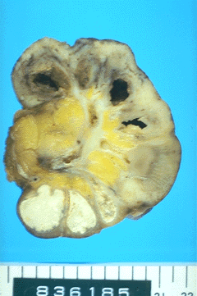
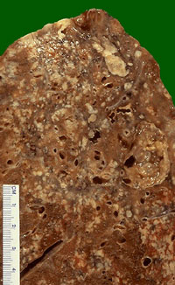
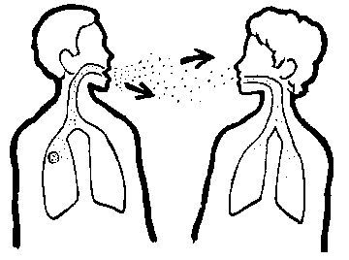
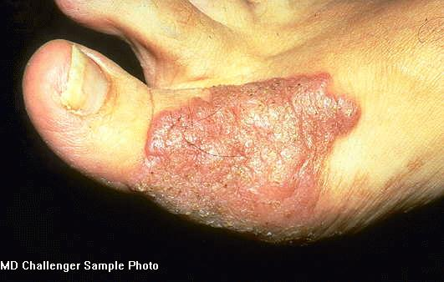
TB – A Multi-system Infection
TB: Airborne Transmission

Slide 15
How TB Spreads
TB bacteria are spread through the air from one person to another
The TB bacteria are put into the air when a person with TB disease of the lungs or throat coughs, speaks, or sings
People nearby may breathe in these bacteria and become infected.

Slide 16
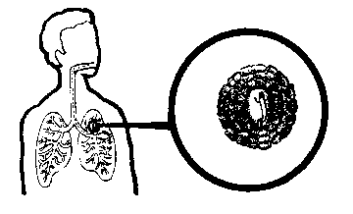
TB Invades/Infects the Lung
Effective immune
response
Infection limited
to small area of lung
Immune response
insufficient

Slide 17


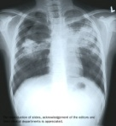
Natural History of TB Infection
Exposure to TB
No infection
(70-90%)
Infection
(10-30%)
Latent TB
(90%)
Active TB
(10%)
Never develop
Active disease
Untreated
Treated
Die within 2 years
Survive
Die
Cured

Slide 18
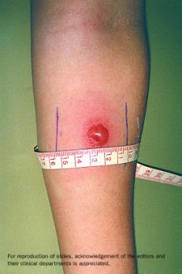
Latent TB vs. TB Disease
Latent TB (LTBI) (Goal = prevent future active disease)
TB Infection
No Disease
NOT SICK
NOT INFECTIOUS
Usually positive TB skin test reaction or positive TB blood test
May develop TB disease if they do not receive treatment for latent TB infection
people who have a weak immune system, the bacteria become active, multiply, and cause TB disease.

Slide 19

Latent TB vs. TB Disease
TB Infection
Goal treat to cure, prevent transmission
SICK (usually)
INFECTIOUS if PULMONARY (usually)
NOT INFECTIOUS if not PULMONARY (usually)

Slide 20
Diagnosing Latent TB Infection & Disease
Most persons, but not everyone, with TB disease have one or more symptoms of TB disease
All persons with either symptoms or a positive TB test result should be evaluated for TB disease
If a person has symptoms, but a negative TB test result, they should still be evaluated for TB disease

Slide 21
Diagnosing Latent TB Infection
Diagnosis of Latent TB Infection
person has a positive TB test result and a medical evaluation does not indicate TB disease.

Slide 22
Diagnosing Latent TB Infection
treatment for latent TB infection
chances of developing TB disease by considering their risk factors
Persons who have been recently infected with TB bacteria
Persons with medical conditions that weaken the immune system
Overall, about 5 to 10% of infected persons who do not receive treatment for latent TB infection will develop TB disease at some time in their live

Slide 23
Persons with Medical Conditions that Weaken the Immune System
HIV infection (the virus that causes AIDS)
Substance abuse
Silicosis
Diabetes mellitus
Severe kidney disease
Low body weight
Organ transplants
Head and neck cancer
Medical treatments such as corticosteroids or organ transplant
Specialized treatment for rheumatoid arthritis or Crohn’s disease

Slide 24
Diagnosing TB Disease
Diagnosed by medical history, physical examination, chest x-ray, and other laboratory tests.
TB disease is treated by taking several drugs as recommended by a health care provider.

Slide 25
Diagnosing TB Disease
TB disease should be suspected in persons who have any of the following symptoms:
  Unexplained weight loss
  Loss of appetite
  Night sweats
  Fever
  Fatigue

Slide 26
Diagnosing TB Disease
If TB disease is in other parts of the body (extrapulmonary), symptoms will depend on the area affected
If TB disease is in the lungs (pulmonary), symptoms may include:
  Coughing for longer than 3 weeks
  Hemoptysis (coughing up blood)
  Chest pain

Slide 27
Diagnosing TB Disease
Test for TB Infection
The Mantoux tuberculin skin test (TST)
TB blood test can be used to test for M. tuberculosis infection
Chest Radiograph
may suggest TB, but cannot be used to definitively diagnose
chest radiograph may be used to rule out the possibility of pulmonary TB in a person who has had a positive reaction to a TST or TB blood test and no symptoms of disease.

Slide 28
Diagnosing TB Disease
Diagnostic Microbiology
The presence of acid-fast-bacilli (AFB) on a sputum smear or other specimen often indicates TB disease
does not confirm a diagnosis of TB because some acid-fast-bacilli are not M. tuberculosis
culture is done on all initial samples to confirm the diagnosis

Slide 29
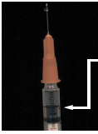
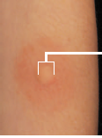


Tuberculin skin test
0.1 ml PPD
(1)
Erythema
Edema
Induration
(2)
(3)
(4)

Slide 30
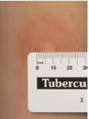
Tuberculin skin test
Report induration size in mm
Induration = Previous exposure to M. protein
Size
10 + mm = positive
5 - <10 mm = positive in immune compromised
≥ 15 mm = suggestive of infection rather than BCG
Induration

Slide 31
Contact Investigation
When a person is found to have TB disease, the health department looks for people who might have been exposed to TB germs
If the health department thinks that you might have been exposed to TB germs, they will give you a TB test

Slide 32
Contact of a case
Tuberculin negative
Tuberculin positive
Repeat tuberculin
Chest radiography
Tuberculin negative
Tuberculin positive
X-ray negative
X-ray positive
BCG vaccine
Chemoprophylaxis
Treatment
TUBERCULIN TESTING IN MANAGING CONTACTS

Slide 33
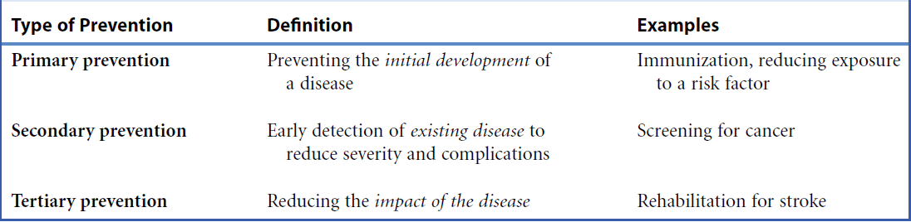

Slide 34

Prevention and control
Agent
Reservoir
Transmission
Susceptible host
Protection
Identify & treat
Contact
Air borne
Minimize exposure

Slide 35
prevention & control
Minimize exposure
Protection of susceptible
Identification and treatment
Isolation of case
(respiratory precautions)
Concurrent disinfection (patients’ items)
Ventilation exposure to sunlight
Cleaning floor with disinfectant
BCG vaccine: Live attenuated vaccine, 0.1ml IM injection in the left deltoid within 40 days of birth
Improve nutrition status
Anti-tuberculosis drugs
Control transmission
Increase host resistance
Eliminate reservoir

Slide 36
DIRECTLY OBSERVED THERAPY SHORT COURSE (DOTS)
Strategy to improve compliance
Fixed Dose Combination therapy (FDC) - ALL IN ONE tablet
2 months
4 months
Initial phase
Maintenance phase
(2 HRZE)
Isoniazid (H)
Rifampicin (R)
Pyrazinamide (Z)
Ethambutol (E)
(4 HR) daily or (4 HR)_{3 (three times per week)}
Isoniazid (H)
Rifampicin (R)
First line medications

Slide 37
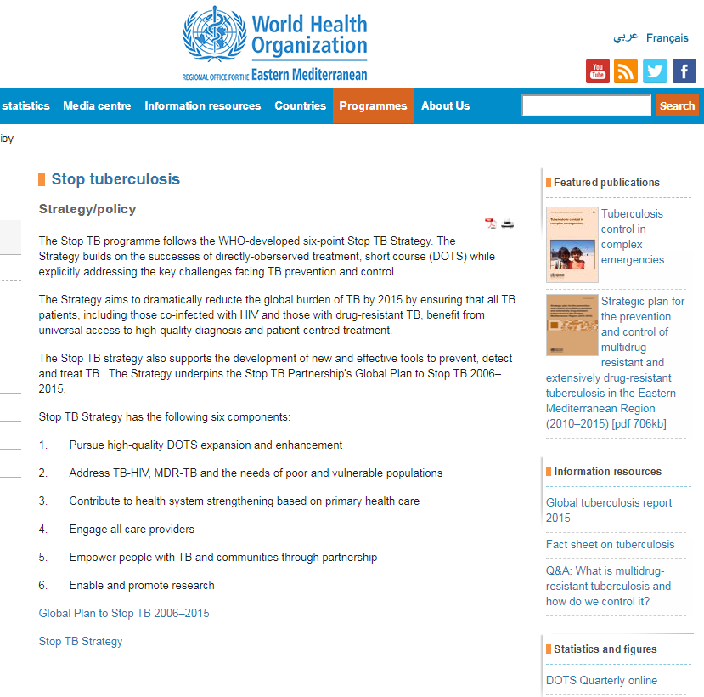

Slide 38
https://www.cdc.gov/tb/topic/basics/tbprevention.htm

