Slide 1
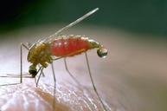
Malaria
Dr. Armen TOrchyan
Dr. Afnan YOunis

Slide 2
Objectives:
Epidemiology of malaria
Clinical picture
Mode of transmission
Risk factors
Prevention and control

Slide 3
Malaria is a life-threatening disease caused by Plasmodium parasites that are transmitted to people through the bites of infected mosquitoes.
Nearly half of the world's population is at risk of malaria.
Young children, pregnant women and non-immune travelers from malaria-free areas are particularly vulnerable to the disease
Notes:
3.2 billion people live in areas at risk of malaria transmission in 106 countries and territories.
The World Health Organization estimates that in 2015 malaria caused 212 million clinical episodes, and 429,000 deaths.

Slide 4
High risk groups
Malaria in pregnant women
Malaria in pregnancy increases the risk of maternal and fetal anaemia, stillbirth, spontaneous abortion, low birth weight and neonatal death.
Malaria in infants
Infants born to mothers living in endemic areas are vulnerable to malaria from approximately 3 months of age, when immunity acquired from the mother starts to wane.
Malaria in children under five
In high-transmission areas of the world, children under 5 years of age (including infants) are the most vulnerable group.
Malaria in HIV/AIDS patients
Co-infection and interaction between these two diseases have major public health implications. HIV infection increases the risk of malaria infection, severe malaria and death, while malaria may result in the worsening of clinical AIDS.
Malaria in migrants and mobile populations
Migrants, refugees and other mobile population groups often lack partial immunity to malaria, and have limited access to prevention, diagnostic testing and treatment services.

Slide 5
Definitions
• Malaria elimination: “interruption of local transmission of a specified malaria parasite species in a defined geographical area as a result of deliberate activities. Continued measures are required to prevent re-establishment of transmission.”
• “Certification of malaria elimination: granted by WHO after proving beyond reasonable doubt that the chain of local malaria transmission by Anopheles mosquitoes has been fully interrupted in an entire country for at least three consecutive years.”
•“When a country has zero locally acquired malaria cases for at least three consecutive years, it can request WHO to certify its malaria-free status”.

Slide 6
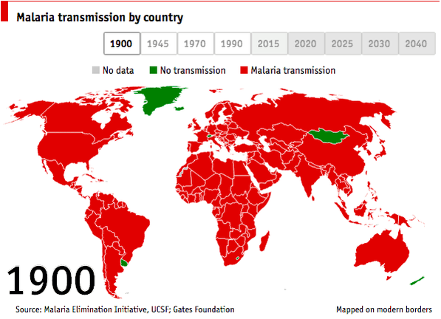

Slide 7
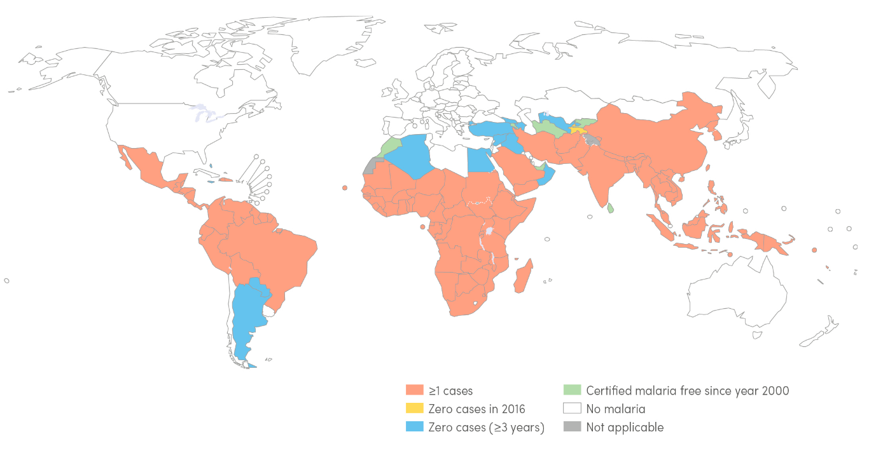
Countries with indigenous cases in 2000 and their status by 2016

Slide 8
Malaria cases
In 2016, an estimated 216 million cases of malaria occurred worldwide
Most malaria cases in 2016 were in the WHO African Region (90%), followed by the WHO South-East Asia Region (7%) and the WHO Eastern Mediterranean Region (2%)
Of the 91 countries reporting indigenous malaria cases in 2016, 15 countries – all in sub-Saharan Africa, except India – carried 80% of the global malaria burden.
In 2016, there were an estimated 445 000 deaths from malaria globally
The WHO African Region accounted for 91% of all malaria deaths in 2016, followed by the WHO South- East Asia Region (6%).
More than two-thirds (70%) of all malaria deaths occur in children under 5.

Slide 9
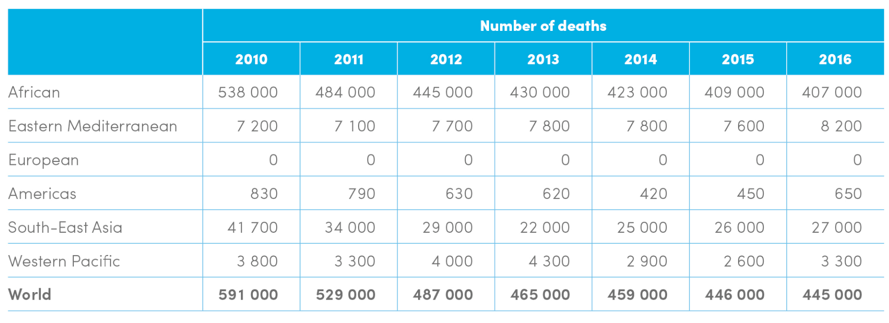
Estimated number of malaria deaths by WHO region, 2010-2016

Slide 11
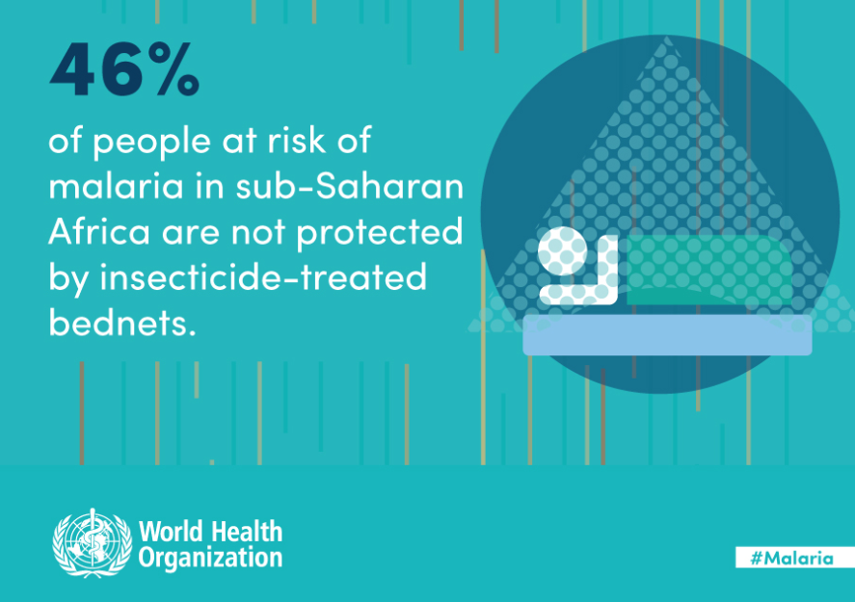

Slide 12
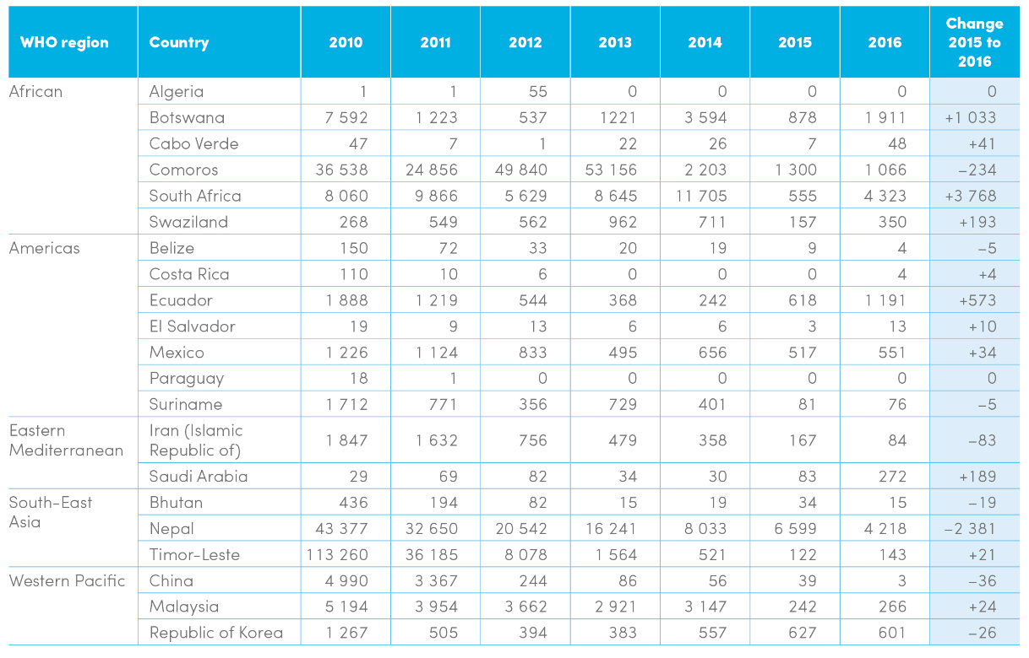
Trends in indigenous malaria cases in the E-2020 countries
E-2020, malaria eliminating countries for 2020

Slide 13
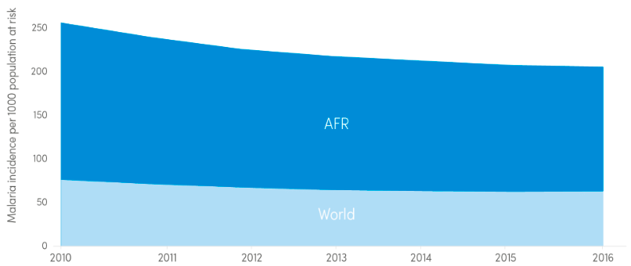
Trends in malaria case incidence rate, 2010 - 2016

Slide 14
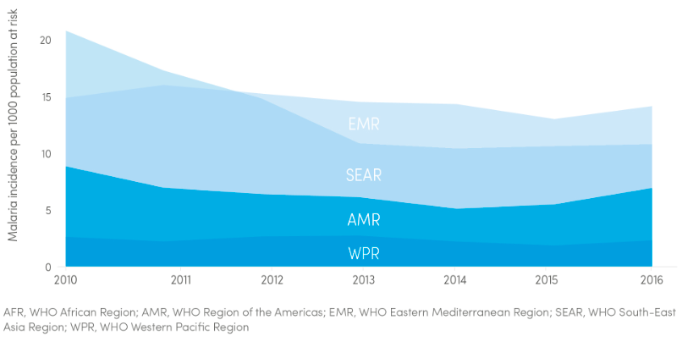
Trends in malaria case incidence rate, 2010 - 2016

Slide 15
Epidemiology
The incidence rate of malaria is estimated to have decreased by 18% globally, from 76 to 63 cases per 1000 population at risk, between 2010 and 2016.
During the same period, malaria mortality rates decreased worldwide by 60% among all age groups, and by 65% among children under 5.
An estimated 6.2 million malaria deaths have been averted globally since 2000.
In 2014, 13 countries reported zero cases of the disease and 6 countries reported fewer than 10 cases.

Slide 16
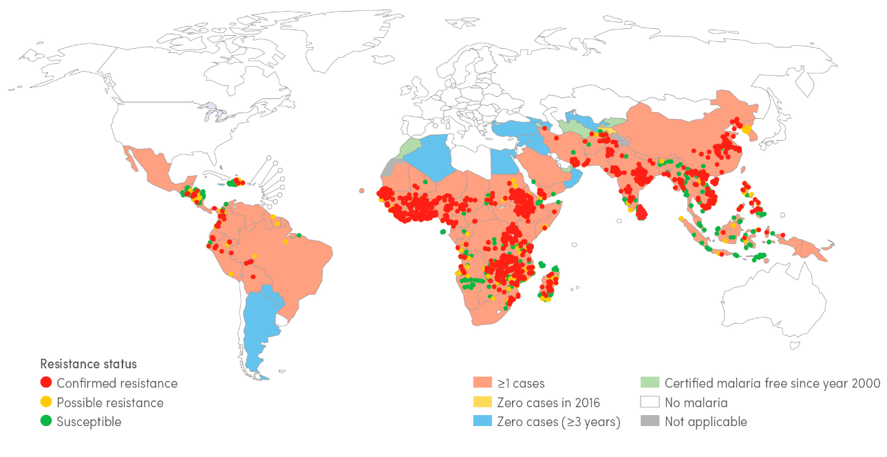
Reported pyrethroid resistance status of malaria vectors, 2010-16

Slide 17
Malaria in Saudi Arabia
Areas at the southern region are at risk of malaria transmission, specifically Asir and Jizan. The Dominant Malaria Species in Saudi Arabia is P. Falciparum .
Saudi Arabia achieved a decrease in malaria cases and case incidence rates of ≥75%.

Slide 18
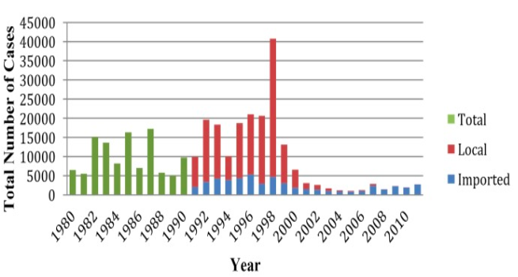
Indigenous cases of malaria Saudi Arabia 2014 :

Slide 19
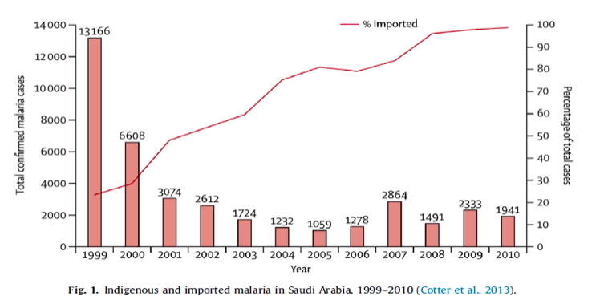
Imported malaria in Saudi Arabia 1999-2010 :

Slide 20
Malaria in Saudi Arabia
Malaria outbreak in 1998.
Since then, only a few cases were reported
In 2012 , only 82 cases of malaria were reported..
The proportion of imported malaria has increased from 23% to 99% of total detected cases.
Notes:
In Saudi Arabia there are considerable reduction in disease morbidity and parasite rate were achieved in the past two decades.

Slide 21
Imported malaria: via asymptomatic travelers from malaria endemic areas, sustains a threat for possible resurgence of local transmission:
Workers, immigrants, pilgrims.

Slide 22
Analytical Epidemiology Triad:
HOST
AGENT
ENVIRONMENT

Slide 23
Species affecting humans
P. falciparum, which is found worldwide in tropical and subtropical areas, and especially in Africa where this species predominates. P. falciparum can cause severe malaria because it multiples rapidly in the blood, and can thus cause severe blood loss (anemia). In addition, the infected parasites can clog small blood vessels. When this occurs in the brain, cerebral malaria results, a complication that can be fatal.
P. vivax, which is found mostly in Asia, Latin America, and in some parts of Africa. Because of the population densities especially in Asia it is probably the most prevalent human malaria parasite. P. vivax (as well as P. ovale) has dormant liver stages (“hypnozoites”) that can activate and invade the blood (“relapse”) several months or years after the infecting mosquito bite.
P. ovale is found mostly in Africa (especially West Africa) and the islands of the western Pacific. It is biologically and morphologically very similar to P. vivax. However, differently from P. vivax, it can infect individuals who are negative for the Duffy blood group, which is the case for many residents of sub-Saharan Africa. This explains the greater prevalence of P. ovale (rather than P. vivax ) in most of Africa.
P. malariae, found worldwide, is the only human malaria parasite species that has a quartan cycle (three-day cycle). (The three other species have a tertian, two-day cycle.) If untreated, P. malariae causes a long-lasting, chronic infection that in some cases can last a lifetime. In some chronically infected patients P. malariae can cause serious complications such as the nephrotic syndrome.
P. knowlesi is found throughout Southeast Asia as a natural pathogen of long-tailed and pig-tailed macaques. It has recently been shown to be a significant cause of zoonotic malaria in that region, particularly in Malaysia. P. knowlesi has a 24-hour replication cycle and so can rapidly progress from an uncomplicated to a severe infection; fatal cases have been reported.

Slide 24
Reservoir
A human reservoir is one who harbors the sexual forms of the parasite
Children are more likely to be gametocyte carriers than adults
The child is thus epidemiologically a better reservoir than the adult
P. knowlesi is a species that naturally infects macaques living in Southeast Asia. Humans living in close proximity to populations of these macaques may be at risk of infection with this zoonotic parasite.

Slide 25
Plasmodium Parasites:
The parasites are spread to people through the bites of infected female Anopheles mosquitoes (vector).
Which bite mainly between dusk and dawn.
Five parasite species that cause malaria in humans
P. falciparum and P. vivax pose the greatest threat.
Other modes of transmission:
From mother to unborn child
Blood transfusion
Notes:
P. falciparum is the most prevalent malaria parasite on the African continent. It is responsible for most malaria-related deaths globally.
P. vivax is the dominant malaria parasite in most countries outside of sub-Saharan Africa.

Slide 26
Plasmodium Parasites transmission and lifecycle:
Notes:
When an Anopheles mosquito bites an infected person, a small amount of blood infected with microscopic malaria parasites is taken.
The parasite grows and matures in the mosquito's gut for 7 days or more, then travels to the mosquito's salivary glands.
When the mosquito next takes a blood meal, these parasites mix with the saliva, are injected with the bite, and the transmission of malaria is complete.
Once in the blood, the parasites travel to the liver and enter liver cells, to grow and multiply.
After as few as seven days or as long as several years, the parasites leave the liver cells and enter red blood cells, which normally carry oxygen in the blood to tissues that need it.
Once in the red blood cells, the malaria parasites continue to grow and multiply. After they mature, the infected red blood cells rupture, freeing the parasites to attack and enter other red blood cells.

Slide 27
Incubation period
Following the infective bite by the Anopheles mosquito, a period of time (the “incubation period”) goes by before the first symptoms appear.
The incubation period in most cases varies from 7 to 30 days. The shorter periods are observed most frequently with P. falciparum and the longer ones with P. malariae.
Antimalarial drugs taken for prophylaxis by travelers can delay the appearance of malaria symptoms by weeks or months, long after the traveler has left the malaria-endemic area. (This can happen particularly with P. vivax and P. ovale, both of which can produce dormant liver stage parasites; the liver stages may reactivate and cause disease months after the infective mosquito bite.)
Such long delays between exposure and development of symptoms can result in misdiagnosis or delayed diagnosis because of reduced clinical suspicion by the health-care provider. Returned travelers should always remind their health-care providers of any travel in areas where malaria occurs during the past 12 months.

Slide 28
Symptoms
Infection with malaria parasites may result in a wide variety of symptoms, ranging from absent or very mild symptoms to severe disease and even death.
Early symptoms |  | Severe illness
Fever | If not treated early might progress to | Severe anemia
Headache |  | Respiratory distress
Chills |  | Cerebral malaria
 |  | Multiorgan failure
Notes:
acute febrile illness., symptoms usually appear 10–15 days after the infective mosquito bite.
The first symptoms – fever, headache, and chills– may be mild and difficult to recognize as malaria.
If not treated within 24 hours, can progress to severe illness, often leading to death.
severe anaemia, respiratory distress, cerebral malaria. In adults, multi-organ involvement is also frequent.

Slide 29
Risk factors:
The most vulnerable are persons with no or little immunity against the disease in areas with high transmission (such as Africa south of the Sahara).
Young children, who have not yet developed partial immunity to malaria
Pregnant women, whose immunity is decreased by pregnancy.
Travelers or migrants coming from areas with little or no malaria transmission, who lack immunity.

Slide 30
Immunity against malaria (protection)
Genetic Factors: Biologic characteristics present from birth can protect against certain types of malaria: (having the sickle cell trait)
Acquired Immunity: newborns in endemic areas will be protected during the first few months by maternal antibodies.
Repeated attacks of malaria
Notes:
having the sickle cell trait) are relatively protected against P.falciparum malaria
3- Behavioral Factors:
War
migrations
tourism.
may expose non-immune individuals to an environment with high malaria transmission

Slide 31
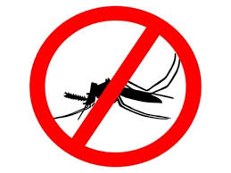
Control:
The main way to reduce malaria transmission at a community is vector control
Insecticide-treated mosquito nets (ITNs)
Indoor spraying with residual insecticides
Antimalarial medications
Vaccination

Slide 32
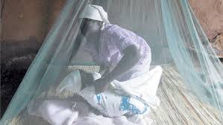
Insecticide-treated mosquito nets (ITNs)
For all at-risk persons
Provision of free long lasting insecticide nets (LLINs)
Everyone sleeps under a LLIN every night.
Effective from 2-3 years

Slide 33
Indoor spraying with residual insecticides
At least 80% of houses in targeted areas are sprayed
Protection depends on type of insecticide. Effective from 3-6 moths.
Notes:
Indoor spraying:
Its full potential is realized when at least 80% of houses in targeted areas are sprayed.
Indoor spraying is effective for 3–6 months, depending on the insecticide used and the type of surface on which it is sprayed.
DDT can be effective for 9–12 months in some cases.

Slide 34
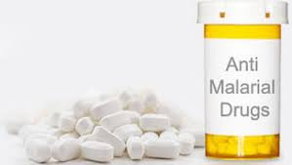
Antimalarial medications
To travelers
Pregnant women
Infants in endemic areas
Seasonal chemoprevention
Notes:
For travellers, malaria can be prevented through chemoprophylaxis, which suppresses the blood stage of malaria infections, thereby preventing malaria disease.
sulfadoxine- pyrimethamine for pregnant women living in high transmission areas, at each scheduled antenatal visit after the first trimester.
Infants living in high-transmission areas of Africa, 3 doses of intermittent preventive treatment with sulfadoxine- pyrimethamine is recommended delivered alongside routine vaccinations.
Seasonal Malaria Chemoprevention as an additional malaria prevention strategy for areas of the Sahel sub-Region of Africa. Involves the administration of monthly courses of amodiaquine plus sulfadoxine- pyrimethamine to all children under 5 years of age during the high transmission season

Slide 35
Vaccine
Still under trial
Notes:
Mosquirix – is an injectable vaccine that provides partial protection against malaria in young children

Slide 36
Prevention And Control of malaria in KSA
The current elimination strategy in Saudi Arabia focuses mainly on:
Targeting high risk areas for sustained preventative measures such as (Long lasting insecticide treated nets, Indoor residual spraying)
Management of infection through rapid confirmed diagnosis and treatment.
Individual case follow up and reactive surveillance with appropriate treatment and vector control.
Active case detection at borders with screening and treatment.

Slide 37
References:
http://www.who.int/mediacentre/factsheets/fs094/en/.
http://www.cdc.gov/malaria/about/biology/human_factors.html
World malaria report 2017, World Health Organization

