Slide 1
Outbreak Investigation
Dr Armen Torchyan
Department of Family and Community Medicine

Slide 2
Objectives
Understand what constitutes to an outbreak
Distinguish between endemic and epidemic
Learn the importance of investigating an outbreak
List the steps of an outbreak investigation
Describe types of studies used to investigate an outbreak
Read an epidemic curve and use it in estimating the incubation period
Calculate the attack rate from outbreak investigation data

Slide 3
Key terms
Sporadic: a disease that occurs infrequently and irregularly.
Endemic: the habitual presence of a disease within a given geographic area.
Hyperendemic: persistent, high levels of disease occurrence.
Epidemic: the occurrence of more cases of disease than expected in a given area or among a specific group of people over a particular period of time. Usually, the cases are presumed to have a common cause or to be related to one another in some way
Outbreak: epidemic limited to localized increase in the incidence of disease
Cluster: aggregation of cases in a given area over a particular period without regard to whether the number of cases is more than expected
Pandemic: An epidemic that has spread over several countries or continents, usually affecting a large number of people.

Slide 4
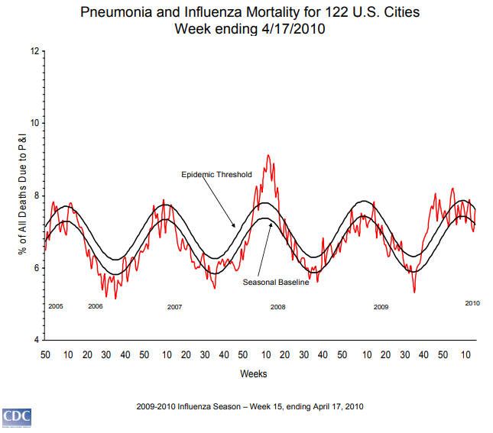

Slide 5
Outbreak settings
Most outbreaks are caused by exposure to contaminated food, water, or direct contact with others
Food borne outbreaks: most common
Waterborne outbreaks: infection occurs by either ingesting contaminated water or swimming in contaminated water
Community/institution acquired outbreaks: most widely varied
Others
Illness can be minor “self-limited” diseases, or major deadly diseases
Successful investigation of an outbreak can lead to positive advances in future protection of public health

Slide 6
Food-borne Outbreaks
The most common outbreak is in a food borne setting.
A food-borne outbreak is generally considered to exist if there are more than two reports of a similar illness from the same food source, frequently in a restaurant or at a community dinner.
A food-borne outbreak may have a widely varied number of cases, and has no seasonal distribution.
While the food-borne outbreak is the most common, in only about 50% of the outbreaks is the food culprit identified, so a large number of these outbreaks go unsolved.

Slide 7
Water-borne Outbreaks
In disease that occurs from a water-borne outbreak, infection occurs by either ingesting water contaminated by pathogens or by swimming in water contaminated by pathogens.
Most often, these outbreaks are common source types.
The numbers of cases in these outbreaks can be variable and often unknown.
The most common agents responsible for water-borne outbreaks are norovirus, Shigella, Giardia, Crytosporidiosis, and E. coli.

Slide 8
Community/Institution Acquired
The most widely varied of the outbreak settings
Include most all types of infectious diseases, such as respiratory diseases and gastrointestinal diseases.
Transmitted most often by person-to-person transmission in schools, hospitals, daycare, nursing homes, prisons, and high density living areas such as military barracks, hotels, and even airplanes.
Some common agents that cause the diseases acquired in a community setting include norovirus, varicella, influenza, rhinovirus, parasites, and adenovirus.

Slide 9
Exercise
1. 22 cases of legionellosis occurred within 3 weeks among residents of a particular neighborhood (usually 0 or 1 per year)
2. Average annual incidence was 364 cases of pulmonary tuberculosis per 100,000 population in one area, compared with national average of 134 cases per 100,000 population
3. Over 20 million people worldwide died from influenza in 1918–1919
4. Single case of histoplasmosis was diagnosed in a community
5. About 60 cases of gonorrhea are usually reported in this region per week, slightly less than the national average
Epidemic disease
Hyperendemic
Pandemic
Sporadic
Endemic

Slide 10
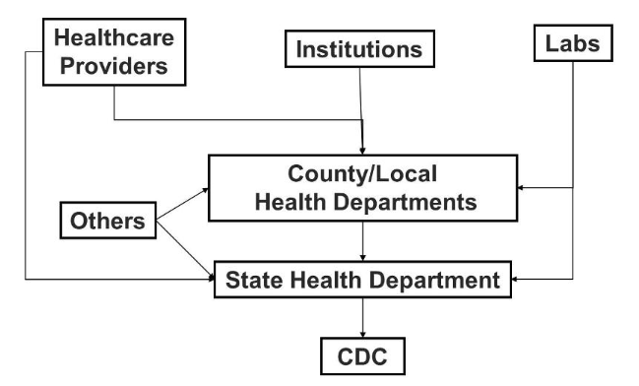
Detecting outbreaks
https://healthmap.org/en/
Regular, timely analysis of surveillance data
Reports of cases of notifiable diseases
Alert clinicians call the health department.
Patients or community members can report to the health department

Slide 11
Epidemic Patterns
Common-source
Point - everyone becomes ill within one incubation period
Continuous - exposed over a period of days, weeks, or longer
Intermittent - intermittent nature of the exposure
Propagated
Mixed
Other

Slide 12
Common-source
All cases of the infectious disease are acquired from the same source in a limited period of time and in a limited geographical location.
It is also characterized by very minimal (or zero) transmission from person to person.
Generally, a common source outbreak has a smaller number of cases than a propagated outbreak and is often caused by contaminated food or water.
A typical example of a common source epidemic is a food borne illness caused by exposure to one specific food or restaurant.
Common source epidemics are usually characterized by a dramatic single “peak” of cases.
Many common source outbreaks go unreported since they are generally small in numbers andoften don’t come to the attention of public health authorities.

Slide 13
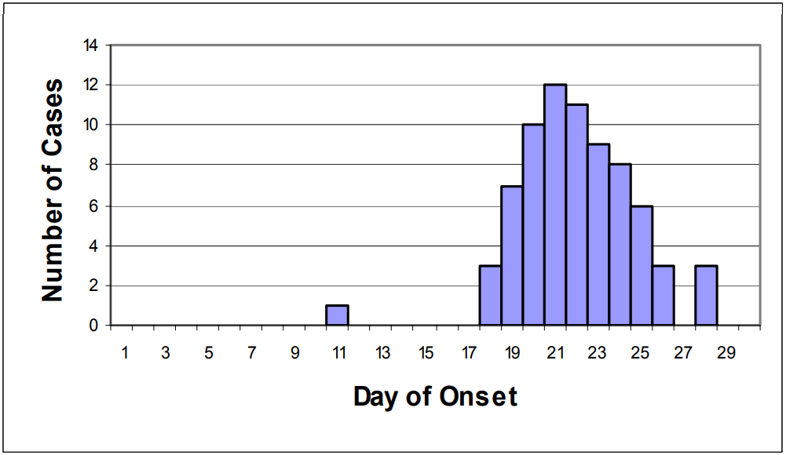
Common-source Point
Focus on Field Epidemiology, Volume 1, Issue 5

Slide 14
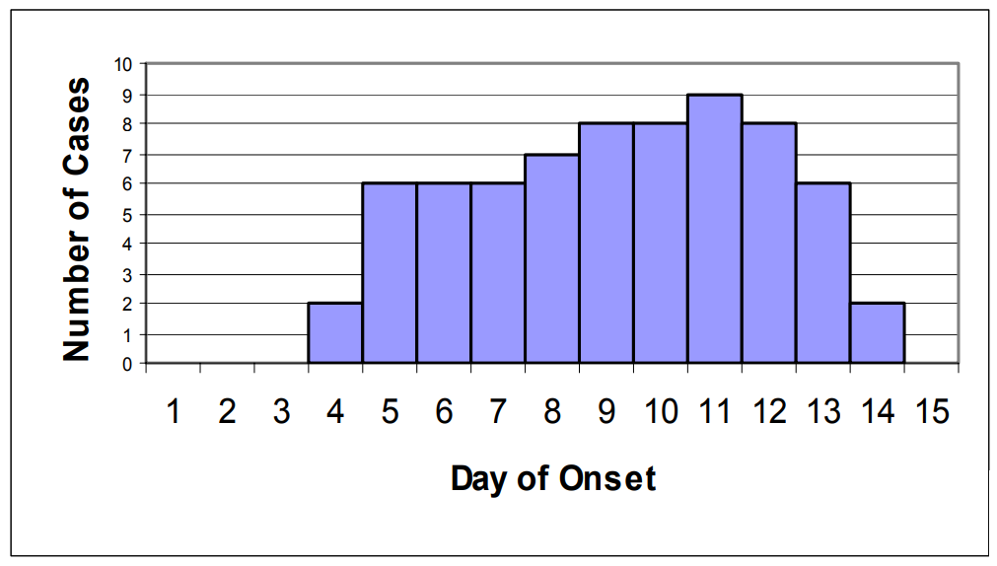
Common-source Continuous
Focus on Field Epidemiology, Volume 1, Issue 5

Slide 15
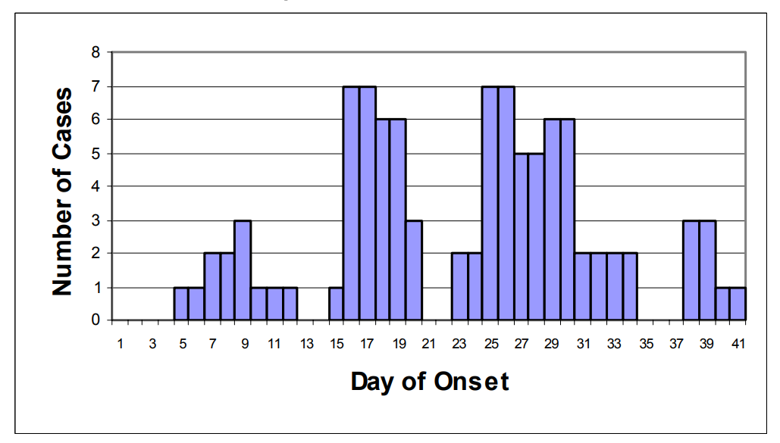
Common-source Intermittent
Focus on Field Epidemiology, Volume 1, Issue 5

Slide 16
Propagated
Characterized by an outbreak that continues over an extended period of time.
This outbreak has individuals exposed to the original source, but then will also have secondary infections in individuals exposed to those initially ill people via person-to-person spread.
The propagated epidemic usually lasts for a longer period of time and has various numbers of “peaks” of cases over time.
The initial source often resolves, but the outbreak continues by affected persons infecting other persons.
Propagated outbreaks often result in larger numbers of cases than common source outbreaks.
Most outbreaks of respiratory diseases, such as influenza, are propagated outbreaks, as well as some food or water borne outbreaks such as those occurring from norovirus infections.

Slide 17
Propagated
Focus on Field Epidemiology, Volume 1, Issue 5

Slide 18
Exercise
1. 21 cases of shigellosis among children and workers at a day care center over a period of 6 weeks, no external source identified incubation period for shigellosis is usually 1—3 days)
2. 36 cases of giardiasis over 6 weeks traced to occasional use of a supplementary reservoir (incubation period for giardiasis 3–25 days or more, usually 7–10 days)
3. 43 cases of norovirus infection over 2 days traced to the ice machine on a cruise ship (incubation period for norovirus is usually 24–48 hours)
Propagated
Intermittent or continuous common source
Point source

Slide 19
Making Epidemic Curves
1. Plot the number of reported cases on the y-axis.
2. Plot the date/time of symptom onset on the x-axis.
3. Choose an appropriate time interval for the x-axis, or try several to see which best represents the data.
4. Include pre-outbreak time on the x-axis to show the “baseline” disease level and to show visually when the outbreak began.
5. Label the x and y-axes clearly.
6. Give the epi curve a descriptive, self-explanatory title.
7. Include more detailed information, such as cases by geographic location or by symptom, if helpful.
8. To be technically correct, make the bars touch each other (unless there are periods of time with no cases, in which case there will be space between the bars).

Slide 20
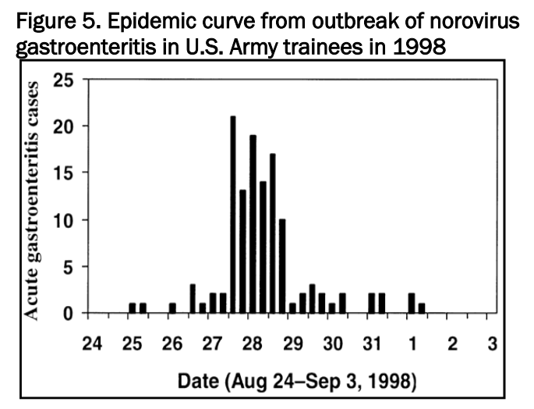

Slide 21
Steps in an Outbreak Investigation
Each day, health departments learn about cases or outbreaks that require investigation.
Although the U.S. CDC receives over 1000 reported outbreaks per year, this is likely only the tip of the iceberg
Many times outbreaks are not seen in their entirety and never reported
75 million food-borne illnesses in the U.S. each year are estimated to be part of an outbreak that is not reported
Epidemiologists have an “outbreak cookbook”
The 10 steps of an outbreak investigation assist epidemiologists in investigating an outbreak
Allows investigators to have the best success in determining the cause of the outbreak and preventing future cases of the same disease

Slide 22
Steps in an Outbreak Investigation
Steps organized into categories that:
Identify that a problem exists
Measure the problem
Find the responsible agent
Prevent it from occurring further
Each step is dependent on the successful completion
and information obtained in the previous step(s)

Slide 23
Steps in an Outbreak Investigation
Confirm the Diagnosis
Confirm the Existence of an Outbreak/Epidemic
Define a Case and Count Cases
Orient Data in Terms of Person, Place and Time
Determine Who Is at Risk
Develop a Hypothesis and Test It
Determine Control Measures
Plan a More Systematic Study
Execute Disease Control and Prevention Measures
Prepare a Written Report
Identify that a problem exists
Measure the problem
Find the responsible agent
Prevent it from occurring further
Table 9-2
The Steps of an Outbreak Investigation

Slide 24
Step 1: Confirm the Diagnosis
Symptoms need to be reviewed.
Disease must be properly diagnosed:
“Re-look” at records and visit existing cases
Ensure suspected illness is properly diagnosed
Confirm laboratory results/rule out errors
Visit/assess patients (cases)
Summarize clinical and laboratory findings

Slide 25
Step 2: Confirm the Existence of an Outbreak/Epidemic
Very important to establish that the disease being seen in the community is in fact an outbreak
Investigations can be costly and time consuming
Normal rate of illness in the population must be known
Time is critical
What is expected number of disease?
Use Health Department Surveillance data
Use hospital discharge records
Use vital records
Use registries
May need to use neighboring rates
Last resort: conduct a survey

Slide 26
Step 2: Confirm the Existence of an Outbreak/Epidemic
Establishing existence of a disease uses concept of epidemic threshold
Normal rates of disease over time used to determine range of normal high and low limits
Normal high limit used to determine if there is an excess
Any amount of disease over threshold is considered to be excess of normal

Slide 28
Step 3: Define a Case and Count Cases
Case classification (definition) should include:
Clinical symptoms (± 1 symptom can change accuracy)
Laboratory verification
Restrictions of person, place, and time
Do not include the exposure or risk factor you are interested in evaluating
Must classify if cases are “confirmed, suspected, or probable”
Count cases:
Important to find and count all cases that exist
Cast a wide net
Health clinics, hospitals
Advertise
Ask other cases

Slide 29
Meningococcal Disease —Case Definition
Clinical case definition
An illness with sudden onset of fever (>38.5°C rectal or >38.0°C axillary) and one or more of the following: neck stiffness, altered consciousness, other meningeal sign or petechial or puerperal rash.
Laboratory criteria for diagnosis
Positive cerebrospinal fluid (CSF) antigen detection or positive culture.
Case classification
Suspected: A case that meets the clinical case definition.
Probable: A suspected case as defined above and turbid CSF (with or without positive Gram stain) or ongoing epidemic and epidemiological link to a confirmed case.
Confirmed: A suspected or probable case with laboratory confirmation.
Source: Pan American Health Organization. Case Definitions Meningococcal Disease. Epidemiological Bulletin 2002; 22(4):14–5.

Slide 30
Line listing
Focus on Field Epidemiology, Volume 1, Issue 4

Slide 31
Step 4: Orient Data in Terms of Person, Place, and Time
Get to know your data
Descriptive Epidemiology
Person: age, race, gender, medical status, exposures
Place: map cases (GIS)
Map attack rates, not numerators
Time: Epidemic curve
Orienting groups of cases by time provides more information about the outbreak and possible cause
Graphing number of cases over time provides an epidemic curve
Earliest set of cases to appear on graph can identify date of first exposure
Can help identify type of outbreak and secondary attack rate

Slide 33
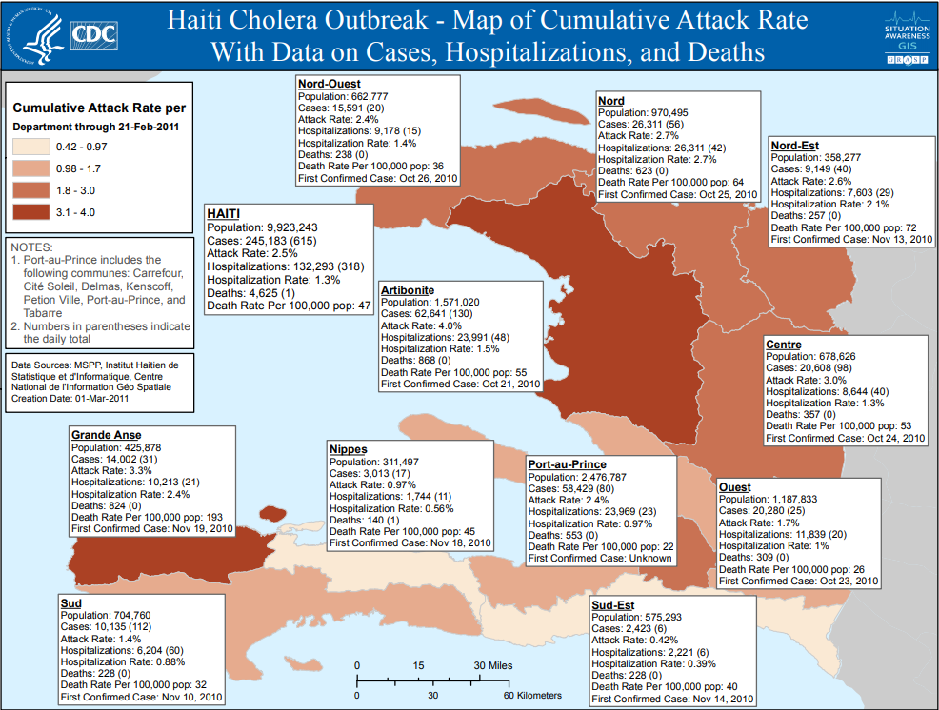

Slide 34
Epidemic curve
See Figure 9-2

Slide 35
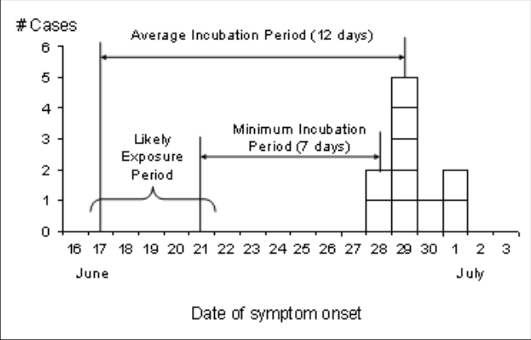
Epidemic curve
Figure 9-2
Example of an Epidemic Curve

Slide 36
Step 5: Determine Who is at Risk
Necessary to gather information from subjects who are not cases
Population at risk is important because:
It will be the population used as controls
Approach subjects for a study to test the hypothesis to find the cause of the outbreak
It defines the population for whom prevention and control measures will be targeted

Slide 37
Step 5: Determine Who is at Risk
Where did the cases come from
Using definition of cases, identify population with the same criteria
Geographic location
Time period
Population characteristic
Look for any remaining cases in population at risk
This population will also be the target of prevention and control measures
Table 9-7
Step 5: Define and Investigate the Population at Risk

Slide 39
Step 6: Develop a Hypothesis and Test It
Develop a hypothesis to confirm the cause of disease
Include suspected etiologic agent
Include mode of transmission
Identifies expected exposures to transmit the disease
Specifies population
Test the hypothesis using a study design
Case-control study if the population is not well defined and speed of investigation is important
Cohort study if the population is small and well defined
Table 9-8
Step 6: Develop a hypothesis and test it

Slide 40
Example of a Cohort Study
A community in Massachusetts experienced an outbreak of Salmonellosis. Health officials noted that an unusually large number of cases had been reported during a span of several days. Descriptive epidemiology was conducted, and hypothesis-generating interviews indicated that all of the disease people had attended a parent-teacher luncheon at a local school. The descriptive epidemiology convincingly indicated that the outbreak originated at the luncheon, but which specific dish was responsible? The investigators needed to establish which dish was responsible in order to clearly establish the source and to ensure that appropriate control measures were undertaken.

Slide 41
Risk Ratio = (Incidence in the exposed group) / (Incidence in the unexposed group)

Slide 43
Example of a Case-Control Study
Within a short period of time 20 cases of hepatitis A were identified in the Marshfield area. The epidemic curve suggested a point source epidemic, and the spot map showed the cases to be spread across the entire South Shore of Massachusetts. Hypothesis-generating interviews resulted in five food establishments that were candidate sources.
The investigators identified as many cases as possible, and they selected a sample of non-diseased people as a comparison group (the controls). The "controls" were were matched to the cases with respect to age, gender, and neighborhood of residence. Investigators then ascertained the prior exposures of subjects in each group, focusing on food establishments and other possibly relevant exposures they had had during the past two months.
Figure 9-3
Food-Specific 2 X 2 Table for Fictitious Illness and Food

Slide 44
Odds Ratio = (10/19) / (9/19) = 1.1
Odds Ratio = (18/7) / (1/29) = 75

Slide 45
Exercise
You are called to help investigate a cluster of 17 persons who developed brain cancer in an area over the past couple of years. Most, perhaps all, used cell phones. Which study design would you choose to investigate a possible association between cell phone use and brain cancer?
A case-control study is the design of choice

Slide 46
Step 7: Determine Control Measures
Important to control current outbreak and prevent future outbreaks
Control measures completely dependent on the identified source of the outbreak
May include treating carriers of infection and vaccinating population at risk
May include comprehensive training programs

Slide 47
Step 7: Determine Control Measures
Destroy implicated food
Close water source or beaches
Treat carriers
Vaccinate susceptible population
Training
Etc.
Table 9-9
Step 7: Determine Control Measures

Slide 49
Step 8: Plan a More Systematic Study
It may be necessary to continue to study the outbreak with a more comprehensive design
Initial study may be inconclusive
Reconsider hypothesis
Revisit patients
Expand exposures
Utilize additional lab specimens
Additional or more refined control group
Utilize a more comprehensive design
Perform research to expand knowledge
Table 9-10
Step 8: Perform a More Systematic Study

Slide 50
Steps 9: Execute Disease Control and Prevention Measures
As investigation wraps up, it is important to use all information available to prevent the spread or resurgence of outbreak
Activities include:
Implement the necessary control and prevention measures
Treat carriers
Vaccinate susceptible population
Etc.
Surveillance for future disease occurrence
Regular communication with affected population and health care facilities

Slide 51
Step 10: Prepare a Written Report
A written report should be prepared in a usual scientific format and should include information about:
The setting and the methods used
Results of any data collection and analysis
The identified causative agent and source
Recommendations for control and prevention
Report should be written for members of affected community

Slide 52
Summary
Disease outbreaks can be large or small
In order to determine source of outbreak, there are standard steps that should be taken to:
Identify there is a problem
Measure the outbreak
Find the responsible agent
Controlling the outbreak/prevention of further cases

Slide 53
References
Centers for Disease Control and Prevention. Principles of Epidemiology in Public Health Practice, 3rd Edition. Atlanta, GA: CDC; 2006 (updated in 2012)
Macera CA, Shaffer R, Shaffer PM. Introduction to Epidemiology: Distribution and Determinants of Disease. Clifton Park, NY: Delmar; 2012.
LaMorte WW. Outbreak Investigations. Boston University School of Public Health; 2016. Available online:http://sphweb.bumc.bu.edu/otlt/MPH-Modules/PH/Outbreak/index.html

