Slide 1
Reporting and Surveillance
Dr Armen Torchyan
Department of Family and Community Medicine

Slide 2
Objectives
By the end of this session, you will be able to:
• Define surveillance
• Know aims and uses of surveillance system
• Understand the different types of surveillance systems
• Recognize the elements of surveillance system
• Be able to assist in establishing and evaluation a surveillance system

Slide 3
A Public Health Approach

Slide 4
A Public Health Approach
Risk Factor Identification
Intervention
Evaluation
Surveillance
Implementation
4

Slide 5
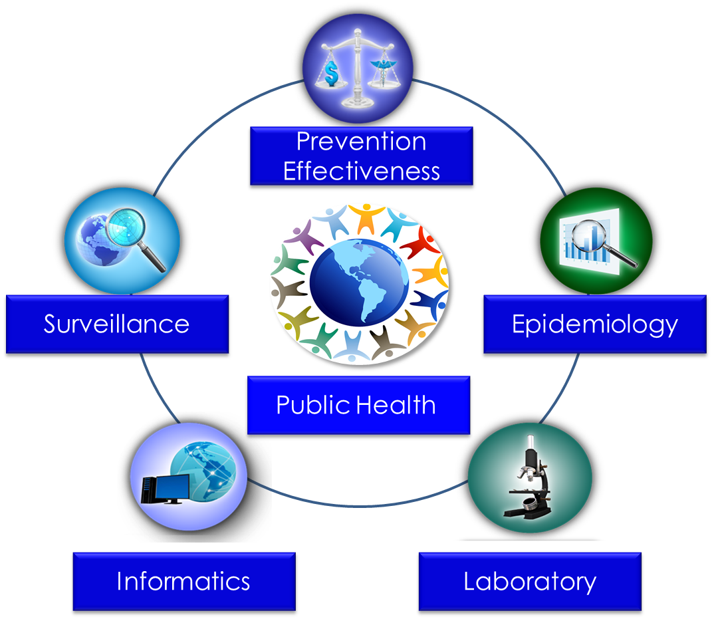
Public Health Core Sciences

Slide 6
What is Public Health Surveillance?
6

Slide 7
Public Health Surveillance Defined
The ongoing, systematic collection, analysis, and interpretation of health-related data essential to planning, implementation, and evaluation of public health practice, closely integrated with the timely dissemination of these data to those responsible for prevention and control
Adapted from: Thacker SB, Birkhead GS. Surveillance. In: Gregg, MB, ed. Field epidemiology. Oxford, England: Oxford University Press; 2008.

Slide 8
Public Health Surveillance Keywords
systematic
ongoing
collection
analysis
interpretation
dissemination
health-related data
linked to public health practice

Slide 9
Goal of Public Health Surveillance
Provide information that can be used for health action by public health personnel, government leaders, and the public to guide public health policy and programs
Smith PF, Hadler JL, Stanbury M, et al. Blueprint version 2.0: updating public health surveillance for the 21st century. J Public Health Manag Pract 2013;19:231–9.

Slide 10
Knowledge Check
Public Health Surveillance is the ________, __________ collection, analysis, and interpretation of health-related data.
A. systemic, short-term B. ongoing, systemic
C. ongoing, systematic
D. methodical, ongoing

Slide 11
Knowledge Check
What is the goal of public health surveillance?
A. To give public health personnel policies to regulate
B. To provide information to be used for public health action
C. To guide Congress in enacting public health laws
D. To keep the public aware of new diseases

Slide 12
Public Health Surveillance
Role and Uses
12

Slide 13
Uses of Public Health Surveillance
Identify patients and their contacts for treatment and intervention
Detect epidemics, health problems, changes in health behaviors
Estimate magnitude and scope of health problems
Measure trends and characterize disease
Monitor changes in infectious and environmental agents
Assess effectiveness of programs and control measures
Develop hypotheses and stimulate research

Slide 14
Public Health Headlines
Whooping Cough Kills Five in California;
State Declares an Epidemic
New CDC Report Shows Adult Obesity Growing or Holding Steady in All States
Increase Seen in Deaths from
Pneumonia and Flu
Number of Rare E. Coli Cases
In U.S. Rose Last Year
Percentage of New Yorkers Smoking
is Down to 14%

Slide 15
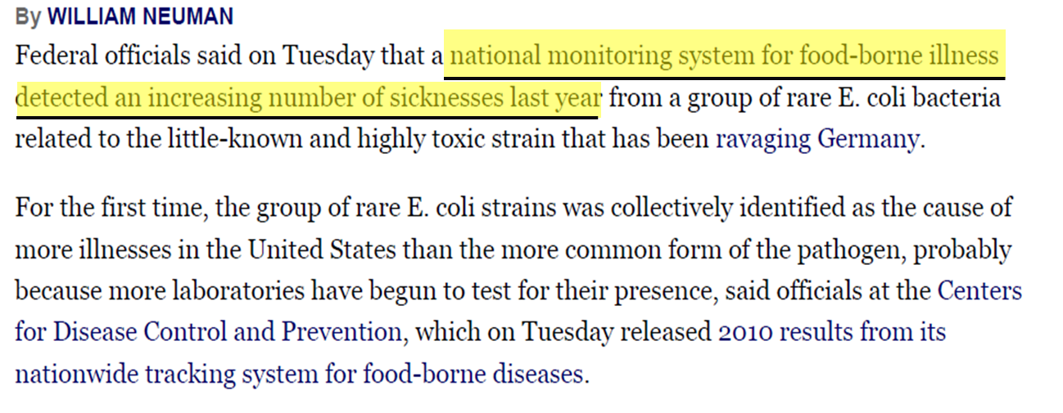
Number of Rare E. Coli Cases
In U.S. Rose Last Year
Neuman W. Number of Rare E. Coli Cases In U.S. Rose Last Year. The New York Times. June 7, 2011. http://www.nytimes.com. Accessed July 8, 2014.

Slide 16
Knowledge Check
Identify the surveillance uses that can be linked to
the New York Times E. coli article.
Measure trends of a particular disease
Estimate the magnitude of the problem
Monitor changes in infectious and environmental agents
Assess effectiveness of programs and control measures
All of the above

Slide 17
Public Health Surveillance
Types and Attributes
17

Slide 18
Types of Public Health Surveillance
Passive Surveillance
Active Surveillance
Diseases are reported by health care providers
Simple and inexpensive
Limited by incompleteness of reporting and variability of quality
Health agencies contact health providers seeking reports
Ensures more complete reporting of conditions
Used in conjunction with specific epidemiologic investigation

Slide 19
Other Types of Public Health Surveillance
Sentinel Surveillance
Reporting of health events by health professionals who are selected to represent a geographic area or a specific reporting group.
e.g. haemophilus influenzae type b, pneumococcus.
Can be active or passive
Syndromic Surveillance
Focuses on one or more symptoms rather than a physician-diagnosed or laboratory-confirmed disease

Slide 20
Surveillance System Attributes
Attribute | Question It Answers
Usefulness | How useful is the system in accomplishing its objectives?
Data quality | How reliable are the available data? How complete and accurate are data fields in the reports received by the system?
Timeliness | How quickly are reports received?
Flexibility | How quickly can the system adapt to changes?
Simplicity | How easy is the system’s operation?

Slide 21
Surveillance System Attributes
Attribute | Question It Answers
Stability | Does the surveillance system work well? Does it break down often?
Sensitivity | How well does it capture the intended cases?
Predictive value positive | How many of the reported cases meet the case definition?
Representativeness | How good is the system at representing the population under surveillance?
Acceptability | How easy is the system’s operation?

Slide 22
Knowledge Check
The New York State Department of Health contacts the health providers in District A every Friday to obtain the number of patients examined with Influenza. What type of surveillance is this?
Passive
Active

Slide 23
Public Health Surveillance Process
23

Slide 24
Surveillance Process
Data Collection
Before collecting data, decide on the overarching goal of the system
Data Analysis
Data Interpretation
Data Dissemination
Link to Action

Slide 25
Data Sources for Public Health Surveillance
Reported diseases or syndromes
Electronic health records (e.g., hospital discharge data)
Vital records (e.g., birth and death certificates)
Registries (e.g., cancer, immunization)
Surveys (e.g., STEPS Noncommunicable Disease Risk Factors Survey)

Slide 26
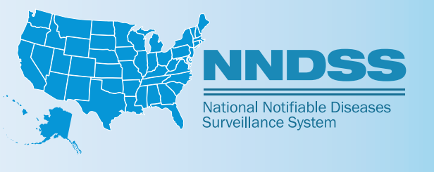
National Notifiable Disease Surveillance
Nationally Notifiable Disease Surveillance System (NNDSS)
Health Electronic Surveillance Network (HESN)

Slide 27
Internationally Notifiable Diseases
Reporting to WHO is required for cases of
Smallpox
Poliomyelitis (wild type)
Human influenza caused by any new subtype
Severe acute respiratory syndrome (SARS)

Slide 28
Surveillance Data Analysis
Data Collection
Who will analyze the data?
What methodology will they use?
How often will they analyze the data?
Data Analysis
Data Interpretation
Data Dissemination
Link to Action

Slide 29
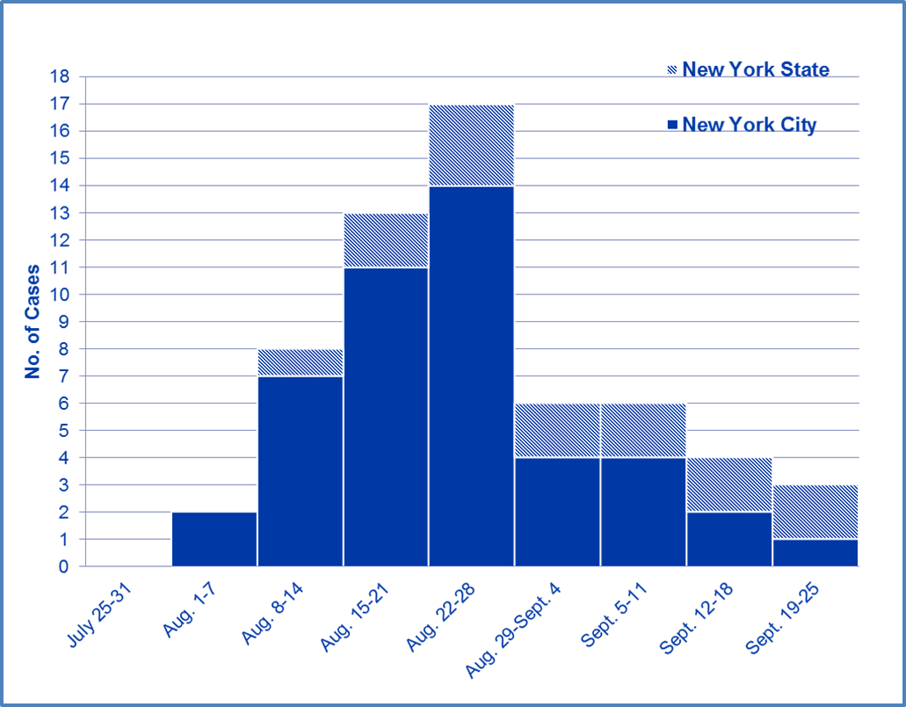
Patients Hospitalized with West Nile Virus Infection, by Week, New York, 1999
Week of illness onset
Nash D, Mostashari F, Fine A, et al. Outbreak of West Nile virus infection in the New York City area in 1999. N Engl J Med. 2001;344:1807–14.

Slide 30
Surveillance Data Analysis by Place
Laboratory-Confirmed WNV Human Cases — August–September 1999
Map Courtesy of the New York City Department of Health and Mental Hygiene

Slide 31
Data Analysis by Person Do you notice any patterns in the rates?
Demographics for Persons Hospitalized for WNV and Population Rates of Infection
Characteristic | No. of Patients (%) | Population at Risk | Rate of Infection per Million Population
Age (years)
0–19 | 2 (3) | 2,324,081 | 0.9
20–29 | 1 (2) | 1,553,981 | 0.6
30–39 | 3 (5) | 1,549,111 | 1.9
40–49 | 1 (2) | 1,177,190 | 0.8
50–59 | 9 (15) | 867,331 | 10.4
60–69 | 12 (22) | 814,838 | 16.0
70–79 | 18 (31) | 534,785 | 33.7
≥80 | 12 (20) | 281,054 | 42.7
Age category (years)
≥50 | 52 (88) | 2,498,008 | 20.8
<50 | 7 (12) | 6,604,363 | 1.1
Sex
Male | 31 (53) | 4,289,988 | 7.2
Female | 28 (47) | 4,812,383 | 5.8
Race
White | 41 (69) | 5,983,901 | 6.9
Nonwhite | 9 (15) | 3,118,470 | 2.9
Unknown | 9 (15) | -- | --
Borough or county of residence
New York City
Brooklyn (Kings) | 3 (5) | 2,300,664 | 1.3
Bronx | 9 (15) | 1,203,789 | 7.5
Manhattan | 1 (2) | 1,487,536 | 0.7
Queens | 32 (54) | 1,951,599 | 16.4
Staten Island (Richmond) | 0 | 379,999 | 0.0
New York State
Nassau | 6 (10) | 1,287,348 | 4.7
Westchester | 8 (14) | 847,866 | 9.1
Nash D, Mostashari F, Fine A, et al. Outbreak of West Nile virus infection in the New York City area in 1999. N Engl J Med. 2001;344:1807–14.

Slide 32
Surveillance Data Interpretation
Data Collection
Data interpretation is closely coupled with data analysis
Data Analysis
Data
Interpretation
Data
Dissemination
Link to Action

Slide 33
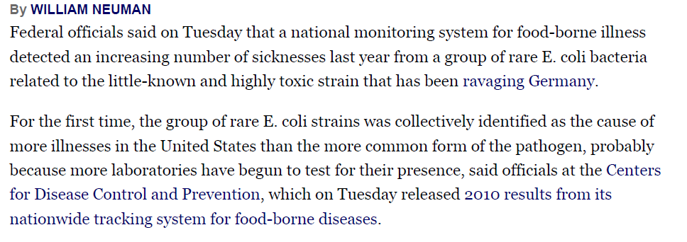
What Can Account for an
Apparent Increase in Cases?
Number of Rare E. Coli Cases
In U.S. Rose Last Year
Neuman, W. Rare E. Coli Cases Rose In the U.S. Last Year. New York Times June 7, 2011. http://www.nytimes.com. Accessed July 9, 2014.

Slide 34
Data Dissemination
Data Collection
Health agency newsletters, bulletins, or alerts
Surveillance summaries and reports
Medical and epidemiologic journal articles
Press releases and social media
Data Analysis
Data Interpretation
Data Dissemination
Link to Action

Slide 35
Data Dissemination Target Audiences
Public health practitioners
Clinicians and other health care providers
Policy and other decision makers
Community organizations
The general public

Slide 36
Surveillance Link to Action
Data Collection
Public health surveillance should always have a
link to action
Data Analysis
Data
Interpretation
Data
Dissemination
Link to Action

Slide 37
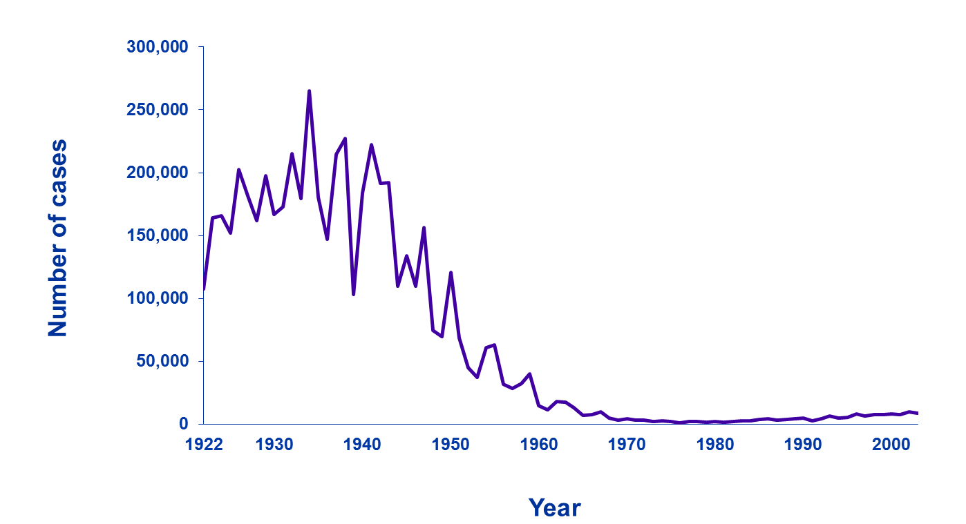
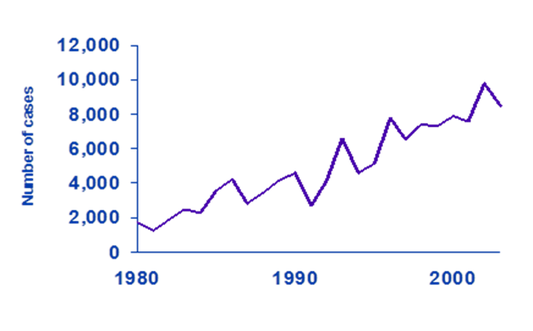
Link to Action
Monitor trends and patterns in disease, risk factors, and agents
Pertussis (Whooping Cough) Cases, by Year — United States, 1922–2000
Source: Centers for Disease Control and Prevention (CDC). National Notifiable Diseases Surveillance System and Supplemental Pertussis Surveillance System and 1922-1949, passive reports to the US Public Health Service. Atlanta, GA: US Department of Health and Human Services, CDC. Available at: http://www.cdc.gov/pertussis/images/incidence-graph.jpg.

Slide 38
Knowledge Check
Choose the option that is NOT a part of the public health surveillance process.
Data dissemination
Data storage
Link to action
Data collection

Slide 39
Knowledge Check
In data interpretation, by identifying the ___________,
________, and _____________, you can more easily determine how and why the health event occurred.
disease, risk, occurrence
person, protocol, risk
person, place, time
risk, protocol, disease

Slide 40
Knowledge Check
Choose the option that is NOT a source of data used for public health surveillance.
Administrative data systems
Vital records
Newspaper articles
Disease notifications

Slide 41
Public Health Surveillance-Based Action
Describe the burden of or potential for disease
Monitor trends and patterns in disease, risk factors, and agents
Detect sudden changes in disease occurrence and distribution
Provide data for programs, policies, and priorities
Evaluate prevention and control efforts

Slide 42
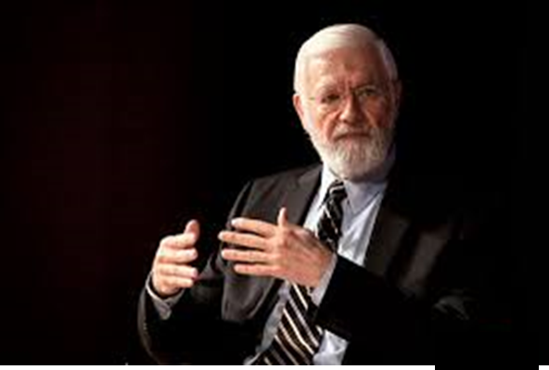
“The reason for collecting, analyzing, and disseminating information on a disease is to control that disease. Collection and analysis should not be allowed to consume resources if action does not follow.”
—William Foege, 1976
Photo: Kay Hinton, Emory University
Foege WH, Hogan RC, Newton LH. Surveillance projects for selected diseases. Int J Epidemiol 1976;5:29–37.

Slide 43
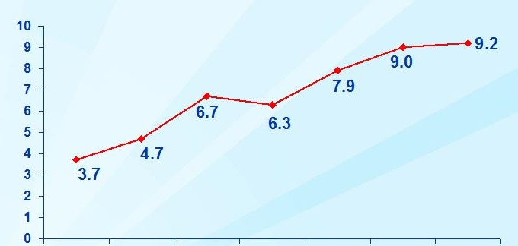
Link to Action Provide data for programs, policies, and priorities
% Reporting diabetes
1994–95
1996–97
1998–99
2000–01
2002
2003
2004
Year
Kim M, Berger D, Matte T. Diabetes in New York City: public health burden and disparities. New York: New York City Department of Health and Mental Hygiene; 2006. http://www.nyc.gov/html/doh/downloads/pdf/epi/diabetes_chart_book.pdf.

Slide 44
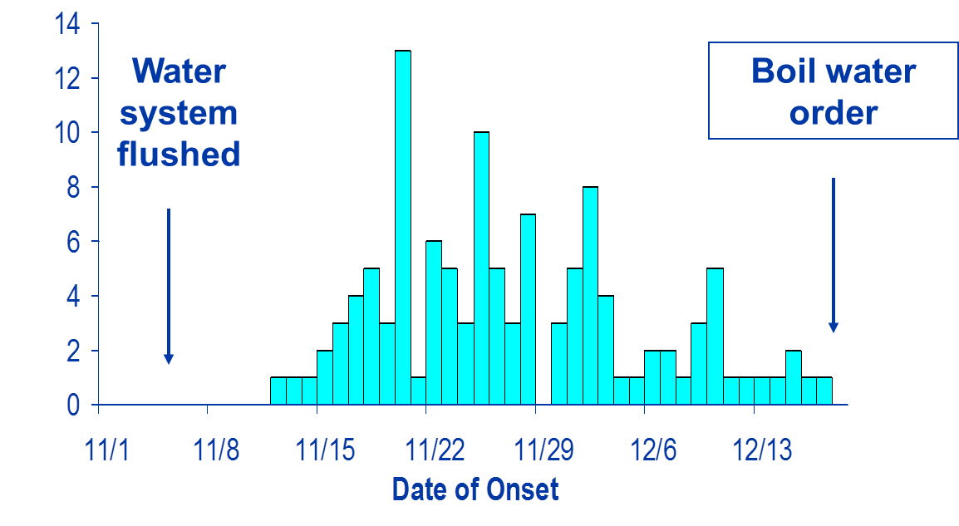
Link to Action Evaluate prevention and control efforts
Boil-water
order
Water
system flushed
No. of cases
Date of onset
Swerdlow DL, Woodruff BA, Brady RC, et al. A waterborne outbreak in Missouri of Escherichia coli O157:H7 associated with bloody diarrhea and death. Ann Intern Med 1992;117:812–9.

Slide 45
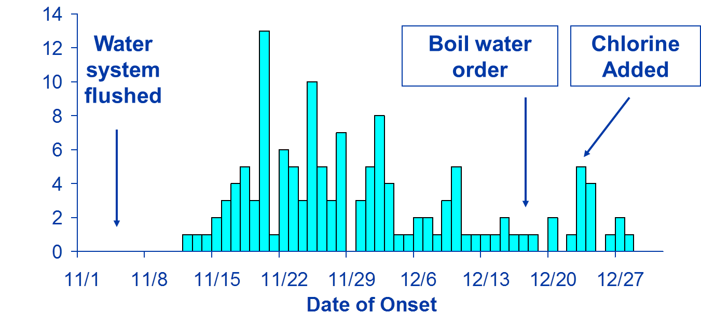
Link to Action Evaluate prevention and control efforts (continued)
Boil-water
order
Chlorine added
Water
system flushed
No. of cases
Date of onset
Swerdlow DL, Woodruff BA, Brady RC, et al. A waterborne outbreak in Missouri of Escherichia coli O157:H7 associated with bloody diarrhea and death. Ann Intern Med 1992;117:812–9.

Slide 46
Types of notification in the Saudi ministry of health
Immediate
Weekly
Monthly
Weekly zero reporting
Notification to the decision makers in MOH

Slide 47
Immediate notification
This is for class I diseases that need immediate action, notification is by fax or phone or electronically through HESN.
The Health Electronic Surveillance Network (HESN) is an electronic reporting system was developed for reporting infectious diseases.
When the case is reported in HESN, the public health department in the region and the ministry of health headquarters can view it immediately to take the appropriate action.

Slide 48
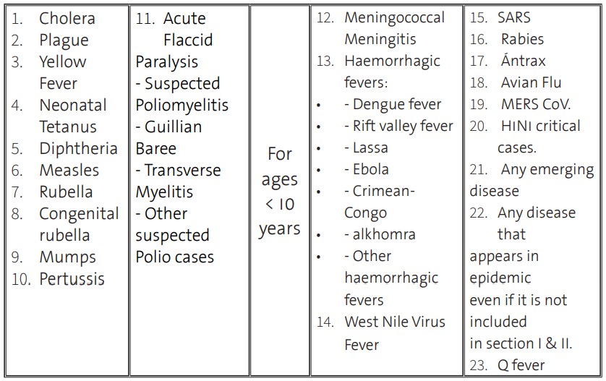
Class I diseases

Slide 49
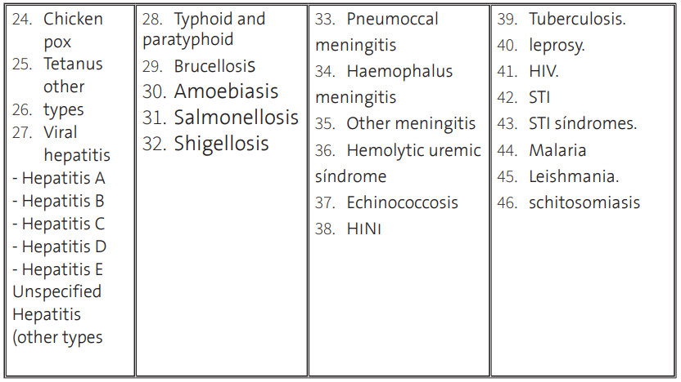
Weekly notification
This is for class II diseases which will be sent from the health units to the regional health affairs.

Slide 50
Weekly zero reporting
All acute flaccid paralysis cases in children less than 15 years.
All suspected measles, rubella and mumps cases.
H1N1
Notifications are sent from regions and other sectors to infectious disease directorate.

Slide 51
Monthly notification
This includes all infectious diseases notified to the regional health affairs which in turn notify the deputy minister for public health.

Slide 52
Notification to the decision makers in MOH
Meningococcal meningitis, cholera, plague, yellow fever and poliomyelitis diseases:
Are notified to deputy minister for public health then to his Excellency deputy minister for health affairs.
To his Excellency minister in occurrence of outbreaks.
All infectious diseases are notified to his Excellency minister monthly.
Any disease appears in epidemic is notified to his Excellency deputy minister for health affairs and to his Excellency minister.
The quarter report is notified to his Excellency minister, his Excellency deputy minister for health affairs, and the concerned people, and also the yearly report

Slide 53
References
Introduction to Public Health Surveillance. Public Health 101 Series. Centers for Disease Control and Prevention.
AlSwaidi, FM, et al. Public Health Surveillance, Technical Guidelines. Surveillance and Data Mangement Unit, Ministry of Health, Saudi Arabia. 2017.

