Slide 1
INFECTIOUS DISEASE IN HAJJ
Abdullah M Assiri
Adult infectious diseases consultant
Assistant deputy minister for preventive health
Ministry of health

Slide 2
Risk of infections in mass gatherings

Slide 3
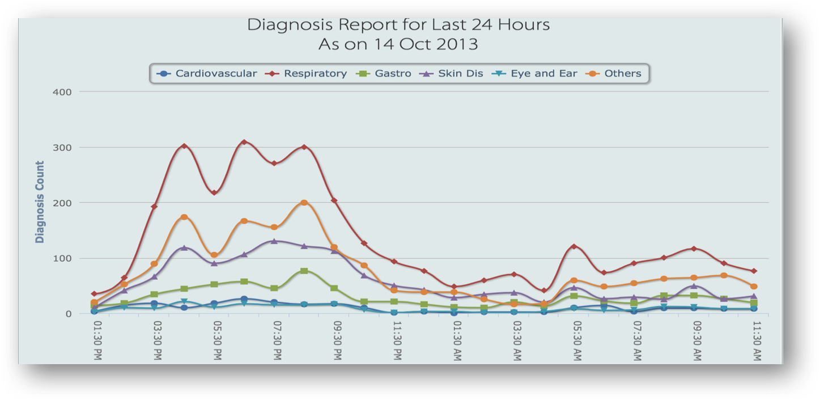
Major health challenges to the pilgrims and the local population at all stages of the Hajj
Traditionally, in hajj
Acute respiratory infections and
Food borne illnesses predominates
Memish et al; Lancet 2014; 383: 2073–82

Slide 4
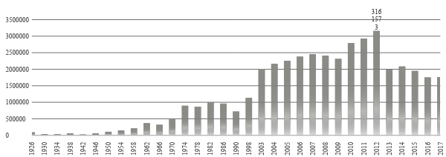
Hajj

Slide 5
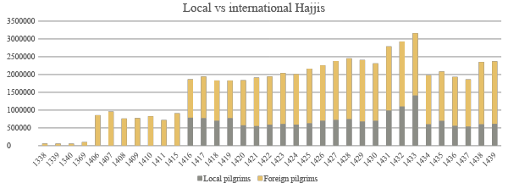
Majority of Hajjis are international

Slide 6
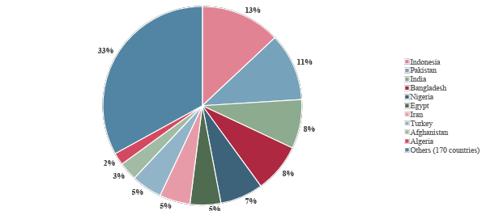
>180 nationalities
50% of Hajjis come from 5 countries

Slide 7
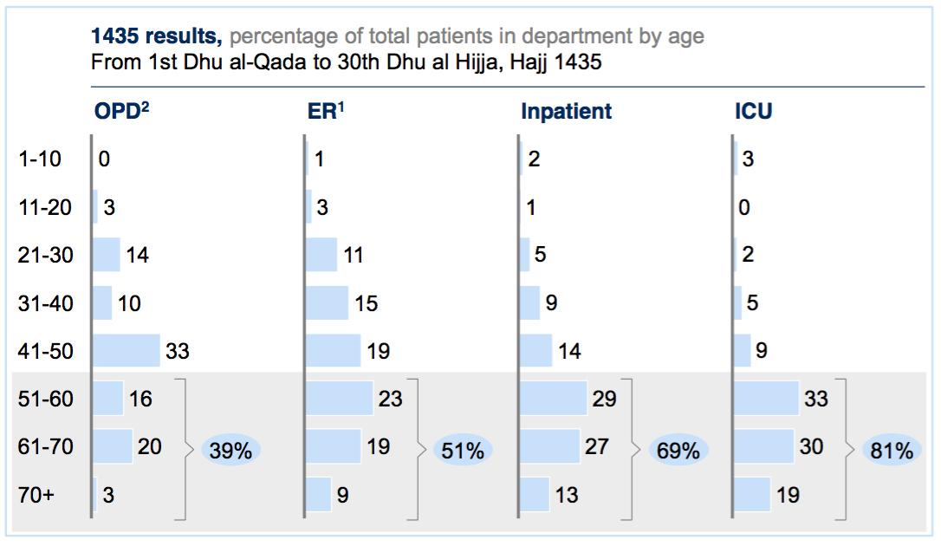
Majority are above 50 y

Slide 8
Public health action plan
Operational structure
HR management
Field teams
Inter-ministerial coordination
Hajj Health requirements
POE operational plan
MERS CoV plan
Vaccination campaign
ID Surveillance teams
Hajj health missions
Food and water safety
VBD related activities
IPC in Hajj
Health education activities

Slide 9
Health requirements for Hajj and Umra
General health recommendation
Vaccination requirements
Vector Borne Diseases related requirements
Food Borne Diseases related requirements
Emerging and re emerging diseases specific recommendations

Slide 10
Health requirements for Hajj and Umra:
Vaccination
External Hajjis:
Mandatory:
Valid meningococcal vaccine certificate for all
Valid yellow fever vaccine certificate for selected countries
Valid Poliomyelitis vaccine certificate for selected countries
Recommended:
Seasonal influenza vaccine for all
Pneumococcal vaccine for certain population

Slide 11
Health requirements for Hajj and Umra:
Vaccination
Internal Hajjis:
Mandatory:
Valid meningococcal vaccine certificate for all
Seasonal influenza vaccine for all
Recommended:
Pneumococcal vaccine for certain population

Slide 12
Health requirements for Hajj and Umra:
Vaccination
Valid certificate:
Meningococcal vaccine
One dose of polysaccharide quadrivalent meningococcal vaccine within 3 years OR
One dose of conjugate quadrivalent meningococcal vaccine within 5 years
Yellow fever vaccine
One dose of Yellow fever vaccine valid for lifetime
Poliomyelitis vaccine
for countries with active wild polio transmission; at least one dose of Oral (live attenuated) bivalent Poliomyelitis vaccine(bOPV) or inactivated Poliomyelitis vaccine (IPV) at within 4 weeks to 12 months
for countries with active vaccine-derived polio transmission; at least one dose of inactivated Poliomyelitis vaccine (IPV) at within 4 weeks to 12 months

Slide 13
Health requirements for Hajj and Umra:
Vaccination
Seasonal influenza vaccine:
Use available vaccine.
If hajj happens during summer:
use southern hemisphere vaccine for both internal and external hajjis
Timing of vaccine availability may vary but generally If hajj happens during winter:
use northern hemisphere vaccine internal hajjis
use southern hemisphere vaccine for external hajjis

Slide 14
Health requirements for Hajj and Umra:
Food items
Health authorities in KSA does not allow hajjis to carry food or beverages on arrival in excess of personal use during travel.
Food for personal use during travel has to be canned in easy to inspect vessels.

Slide 15
Health requirements for Hajj and Umra:
Disease vector control
Health authorities in KSA require airplane and ships arriving from Dengue and Zika endemic countries to provide certificate of pesticides spray as per International health regulation

Slide 16
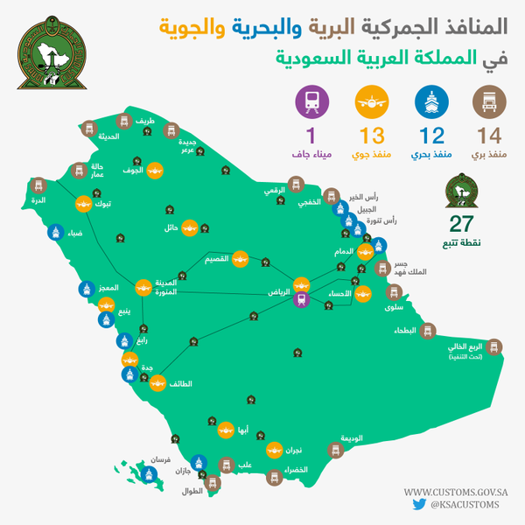
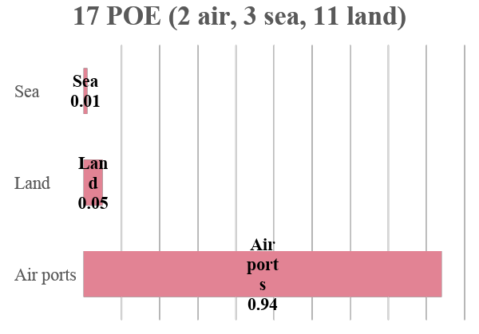
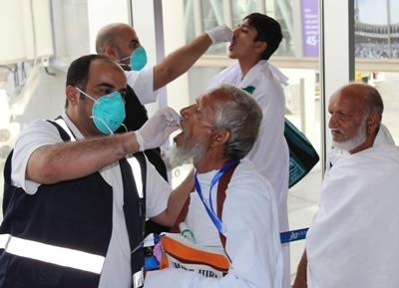

Slide 17
Respiratory infections (including influenza)
Risks
Actions
Majority of Hajjis develop URT post hajj (mostly rhinovirus, coronavirus E229)
Proximity, inadequate respiratory hygiene, stress and extreme of weather
In 2009, fewer than 100 cases of influenza A H1N1 were reported during Hajj at the peak of the pandemic
In one study, One third of participants acquired S. pneumoniae during hajj
Masking (regular mask) is recommended
Influenza vaccine is mandated for internal Hajjis this year
Pneumococcal (polyvalent) vaccine is recommended for high risk individuals

Slide 18
Gastrointestinal infections
Factors that may lead to outbreaks
Actions
Inadequate standards of food preparation and storage
Poor personal hygiene
Asymptomatic carriers of pathogenic bacteria and parasites,
Provision of safe water and food supplies, sanitation, and vector control
Survey of kitchen at hotels and camps to identify potential carriers of gut pathogens and to ensure standards of food hygiene
premade meals (airline style)

Slide 19
Vector-borne diseases
Factors that may lead to VBD
Actions
Aedes, Culex, and Anopheles spp mosquitoes are present in Saudi Arabia
Dengue is endemic around Hajj area
Routine and widespread insecticide spraying campaign year around
Specific teams spray housing units earmarked for pilgrims from dengue- endemic areas such as India, Pakistan, and Bangladesh with long lasting pesticide before the arrival
Insecticide is sprayed aerially over Arafat and Mina

Slide 20
Meningitis (Neisseria meningitidis)
Hajj related outbreaks
The 1421 outbreak
1987, Serogroup A,
Originated from Nepal,
Caused massive outbreak in Africa post Hajj,
Lead to mandatory Bivalent (serogroup A+C) polysaccharide meningococcal vaccine
253 confirmed cases in KSA and 99 cases in other countries,
Case-fatality rate of 28%
Serogroup W135 mostly
Quadrivalent vaccine was mandated in 2002

Slide 21
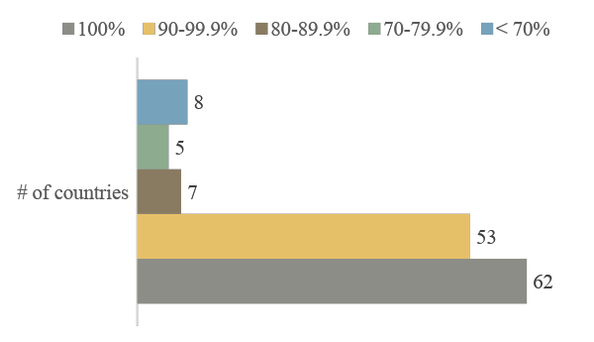
Meningitis (Neisseria meningitidis)
Requirements
Compliance
Universal quadrivalent vaccine:
Polysaccharide 3 years
Conjugate 5 years
Chemoprophylaxis for meningitis built countries at POE

Slide 22
Meningitis (Neisseria meningitidis)
Number of cases of invasive meningococcal disease linked to Hajj from 1995 to 2013
Very effective intervention
Since 2006, only one case of invasive meningococcal disease has been reported during Hajj
Non- Hajj-related cases also declined after the introduction of the ACYW vaccine

Slide 23
Malaria

Slide 24
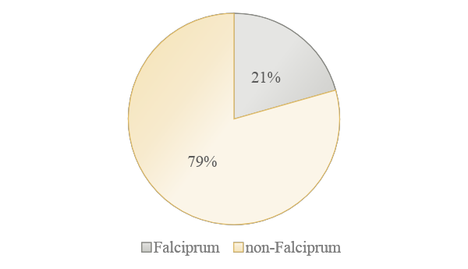
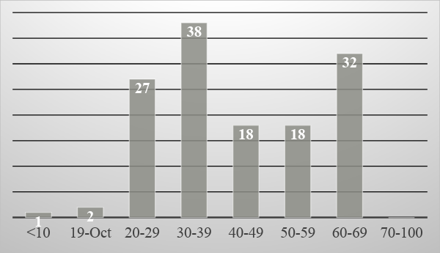
Malaria
Types of Malaria
Malaria cases by age group

Slide 25
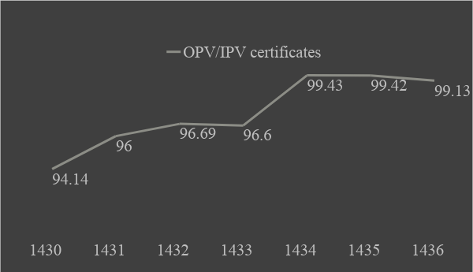
Poliomyelitis
OPV/IPV certificates at POE
Targeted countries (14)
those who have uninterrupted indigenous virus transmission: Afghanistan and Pakistan
those who have had transmission of a circulating vaccine-derived poliovirus within the past 12 months: Guinea, Lao People’s Democratic Republic, Madagascar, Myanmar, Nigeria and Ukraine.
those which remain vulnerable to polio: Iraq, Somalia, Syrian Arab Republic and Yemen.

Slide 26
Yellow fever
Countries with active transmission
Targeted countries (44)
Africa: Angola, Benin, Burkina Faso, Burundi, Cameroon, Central African Republic, Chad, Congo, Côte d’Ivoire, Democratic Republic of the Congo, Equatorial Guinea, Ethiopia, Gabon, Gambia, Ghana, Guinea, Guinea-Bissau, Kenya, Liberia, Mali, Mauritania, Niger, Nigeria, Senegal, Sierra Leone, The Republic of South Soudan, Sudan, Togo and Uganda.
Americas: Argentina, Bolivarian Republic of Venezuela, Brazil, Colombia, Ecuador, French Guyana, Guyana, Panama, Paraguay, Peru, Plurinational State of Bolivia, Suriname and Trinidad and Tobago.

Slide 27
Yellow fever
Requirements
For non-compliance
Must present a valid yellow fever vaccination certificate at POE
Aircrafts and ships must present certificate indicating that it applied disinsection in accordance with methods recommended by WHO
Placed under strict surveillance until the certificate become valid or until a period of not more than 6 days from the last date of potential exposure to infection have lapsed, whichever is earlier.
Inform MOFA

Slide 28
Middle East Respiratory Syndrome
Risk
Actions
No MERS cases in relation to Hajj
One Umra related confirmed case acquired so far (Malaysia, a side visit to a camel farm)
In 1436, Hajj took place immediately after a major outbreak In Riyadh
Around 1300 MERS samples were screened last year, all were negative
Active surveillance during Hajj
On-site molecular labs
Camel ban
Education of HCW
Transfer protocol
Isolation facilities

Slide 29
Other significant infections
Tuberculosis
The risk (of TB during Hajj) is about 10% based on data from before and after screening for latent infection
Most pilgrims come from highly endemic countries
Many travel to Makkah with active disease or infection that is reactivated by stress.
Pulmonary tuberculosis was a leading cause of hospital admission in patients with community-acquired pneumonia.

Slide 30
Public Health services during hajj

Slide 31
Public health activities, examples
18 fixed and 15 mobile surveillance teams in Makkah HCF
15 fixed and mobile surveillance teams in Mina and Arafat HCF

Slide 32
Public health activities, examples
114 isolation rooms in Makkah HCF (65% of the actual need)

Slide 33
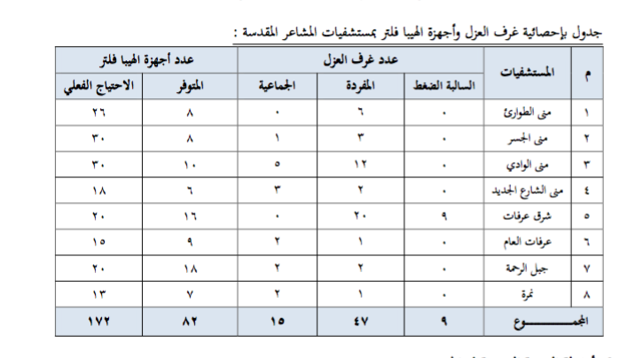
Public health activities, examples
47 isolation rooms in Mina and Arafat HCF and 82 portable HEPA filters (48% of the actual need)

Slide 34
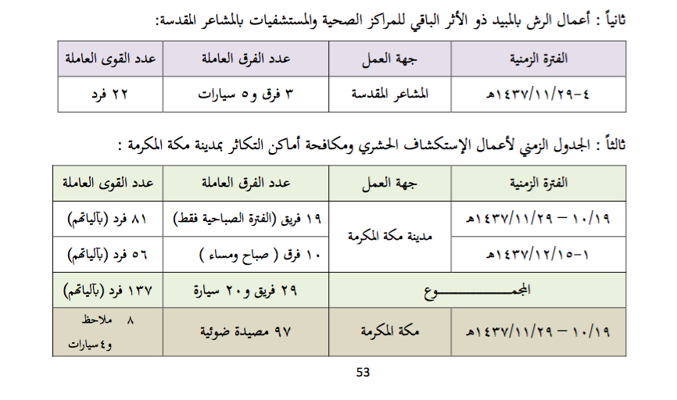
Public health activities, examples
137 vector control personnel
97 mosquitoes traps in Makkah

Slide 35
Public health activities, examples
120 vector control personnel
20 mosquitoes traps in Mina/Arafat

Slide 36
Hajj 1437
Oral Polio vaccine at POE 100%
Meningitis chemoprophylaxis coverage at POE 100%
Polio vaccination certificates compliance 74%
Meningitis vaccination certificates compliance 88%

Slide 37
Conclusion
Infectious diseases risk during mass gathering is significant
KSA lead the world in mass gathering management.
KSA built an extensive system to
prepare
detect/monitor
respond to ID during hajj

Slide 38
THANK YOU

