Slide 1
Cardiomyopathies

Slide 2
Cardiomyopathy
"heart muscle diseases of unknown cause"
Diseases of the myocardium associated with cardiac dysfunction

Slide 3
Classification
Dilated cardiomyopathy (DCM)
Hypertrophic cardiomyopathy (HCM)
Restrictive cardiomyopathy (RCM)
Arrhythmogenic right ventricular cardiomyopathy/dysplasia (ARVC/D)
Unclassified cardiomyopathies

Slide 4
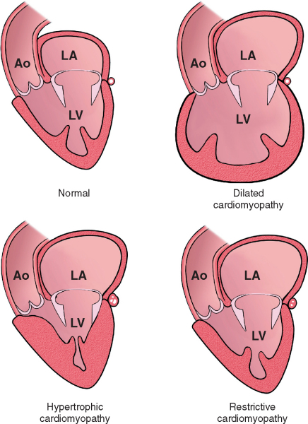

Slide 5
Dilated Cardiomyopathy
Dilated cardiomyopathy is characterized by ventricular dilation and impaired contractile performance, which may involve the left or both ventricles

Slide 6
May develop as a consequence of prior myocarditis or as a result of a recognized toxin, infection, predisposing cardiovascular disease (e.g., hypertension, ischemic or valvular heart disease
When no cause or associated disease is identified, dilated cardiomyopathy has been termed idiopathic
50 to 60% of such patients have familial disease, and disease-causing mutations currently can be identified in 10 to 20% of such families.

Slide 7
Pathobiology
Systolic dysfunction may result from a variety of causes
Altered hemodynamic parameters of decreased stroke volume and increased chamber pressures trigger the recognized neurohumoral changes of heart failure

Slide 8
The insult to myocyte integrity may be relatively acute and may trigger programmed cell death (apoptosis);
Insidious progression is the rule in inherited dilated cardiomyopathy and is also seen with viral persistence, anthracycline toxicity, and autoimmune dilated cardiomyopathy

Slide 9
A trigger with immune-mediated pathogenesis in genetically predisposed individuals
Mutations in genes encoding important structural proteins in 20 to 30% of families with dilated cardiomyopathy
Sarcomeric genes (10%) and lamin A/C (5%)
One third of probands and family members develop low-titer, organ-specific autoantibodies to cardiac α-myosin
Viral persistence has also been implicated as an ongoing trigger of immune-mediated damage

Slide 10
Clinical Manifestations
Gradual decrease in exercise capacity may be appreciated only in retrospect.
The initial presentation is often with acute decompensation triggered by an unrelated problem, such as anemia, thyrotoxicosis, or infection

Slide 11
Symptoms relating to raised filling pressures:
orthopnea, nocturnal cough, paroxysmal nocturnal dyspnea, peripheral edema
Precede symptoms of low cardiac output:
Fatigue, dyspnea on exertion

Slide 12
Diagnosis
Signs or symptoms of heart failure accompanied by indices of advanced left ventricular impairment and dilation
An early diagnosis of dilated cardiomyopathy requires consideration of the common recognized causes:
systemic hypertension, valvular heart disease, associated systemic disorders, high-output states, and the muscular dystrophies

Slide 13
ECG
The changes of early disease are not specific and may include:
left axis deviation and T wave abnormalities.
With progressive and advanced disease, conduction abnormalities develop: PR prolongation, QRS widening, and left bundle branch block

Slide 15
Echocardiogram
As a baseline and for serial assessment to monitor disease progression and the effect of treatment

Slide 16
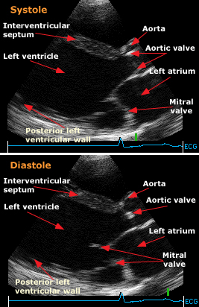

Slide 17
MRI
Gadolinium-enhanced magnetic resonance imaging may be very helpful in differentiating segmental wall motion abnormalities in dilated cardiomyopathy from previous myocardial infarction

Slide 18
Biopsy
Occasionally should be considered in patients with potential unexplained myocarditis.

Slide 19
Treatment
Supportive therapy includes:
Sodium and fluid restriction,
Avoidance of alcohol and other toxins,
Use of established heart failure medications

Slide 20
Alcoholic Cardiomyopathy
Alcohol and its metabolite, acetaldehyde, are cardiotoxins acutely and chronically.
Myocardial depression is initially reversible but, if sustained, can lead to irreversible vacuolization, mitochondrial abnormalities, and fibrosis
The amount of alcohol necessary to produce symptomatic cardiomyopathy in susceptible individuals is not known
Abstinence leads to improvement in at least 50% of patients with severe symptoms, some of whom normalize their left ventricular ejection fractions

Slide 21
Chemotherapy
Doxorubicin (Adriamycin) cardiotoxicity causes characteristic histologic changes on endomyocardial biopsy, with overt heart failure in 5 to 10% of patients who receive doses greater than or equal to 450 mg/m2 of body surface area
Cyclophosphamide and ifosfamide can cause acute severe heart failure and malignant ventricular arrhythmias
5-Fluorouracil can cause coronary artery spasm and depressed left ventricular contractility.
Trastuzumab has been associated with an increased incidence of heart failure

Slide 22
Metabolic Causes
Excess catecholamines, as in pheochromocytoma
Cocaine increases synaptic concentrations of catecholamines by inhibiting reuptake at nerve terminals; the result may be an acute coronary syndrome or chronic cardiomyopathy.

Slide 23
Thiamine deficiency can cause beriberi heart disease, with vasodilation and high cardiac output followed by low output.
Calcium deficiency resulting from hypoparathyroidism, gastrointestinal abnormalities, or chelation directly compromises myocardial contractility.
Hypophosphatemia which may occur in alcoholism, during recovery from malnutrition, and in hyperalimentation, also reduces myocardial contractility.
Patients with magnesium depletion owing to impaired absorption or increased renal excretion also may present with left ventricular dysfunction.

Slide 24
Skeletal Myopathies
Duchenne's muscular dystrophy and Becker's X-linked skeletal muscle dystrophy typically include cardiac dysfunction
Maternally transmitted mitochondrial myopathies such as Kearns-Sayre syndrome frequently cause cardiac myopathic changes

Slide 25
Peripartum Cardiomyopathy
Peripartum cardiomyopathy appears in the last month of pregnancy or in the first 5 months after delivery in the absence of preexisting cardiac disease
Lymphocytic myocarditis, found in 30 to 50% of biopsy specimens, suggests an immune component
The prognosis is improvement to normal or near-normal ejection fraction during the next 6 months in more than 50% of patients.

Slide 26
Hypertrophic Cardiomyopathy
Genetically determined myocardial disease
Defined clinically by the presence of unexplained left ventricular hypertrophy
Pathologically by the presence of myocyte disarray surrounding increased areas of loose connective tissue

Slide 27
Usually familial, with autosomal dominant inheritance.
Abnormalities in sarcomeric contractile protein genes account for approximately 50 to 60% of cases

Slide 28
Gene | Protein | Frequency
MYH7 | β-Myosin heavy chain | 25–35%
MYBPC3 | Cardiac myosin binding protein C | 20–30%
TNNT2 | Cardiac troponin T | 3–5%
TNNI3 | Cardiac troponin I | <5%
TPM1 | α-Tropomyosin | <5%
MYL2 | Regulatory myosin light chain | <5%
MYL3 | Essential myosin light chain | Rare
ACTC | α-Cardiac actin | Rare
TTN | Titin | Rare
TNNC1 | Cardiac troponin C | Rare
MYH6 | α-Myosin heavy chain | Single study
CRP3 | Muscle LIM protein | Rare

Slide 29
Pathology
Typically, heart weight is increased and the interventricular septum is hypertrophic,
Any pattern of thickening may occur
Histologically, the hallmark of hypertrophic cardiomyopathy is myocyte disarray.
Results from the loss of the normal parallel arrangement of myocytes, with cells forming in whorls around foci of connective tissue

Slide 30
Left ventricular hypertrophy is usually associated with:
hyperdynamic indices of systolic performance,
impaired diastolic function,
clinical features suggestive of ischemia

Slide 31
Clinical expression of left ventricular hypertrophy usually occurs during periods of rapid somatic growth,
May be during the first year of life or childhood but more typically during adolescence and, occasionally, in the early 20s

Slide 32
Most patients are asymptomatic or have only mild or intermittent symptoms.
Symptomatic progression is usually slow, age related, and associated with a gradual deterioration in left ventricular function over decades

Slide 33
Symptoms may develop at any age, even many years after the appearance of LVH
Occasionally, sudden death may be the initial presentation

Slide 34
30% of adults develop exertional chest pain
Atypical, prolonged, and noted at rest or nocturnally.
Postprandial angina associated with mild exertion is typical.
Mild to moderate dyspnea is common in adults
20% of patients experience syncope
Palpitations are a frequent complaint
Sustained palpitations are usually caused by supraventricular tachyarrhythmias

Slide 35
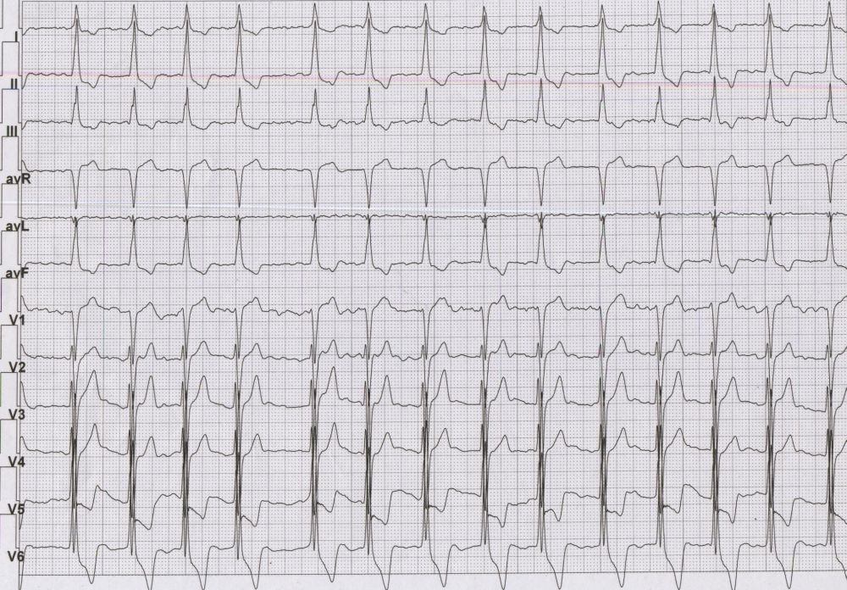

Slide 36
Diagnosis
The initial diagnostic evaluation includes a family history focusing on premature cardiac disease or death

Slide 37
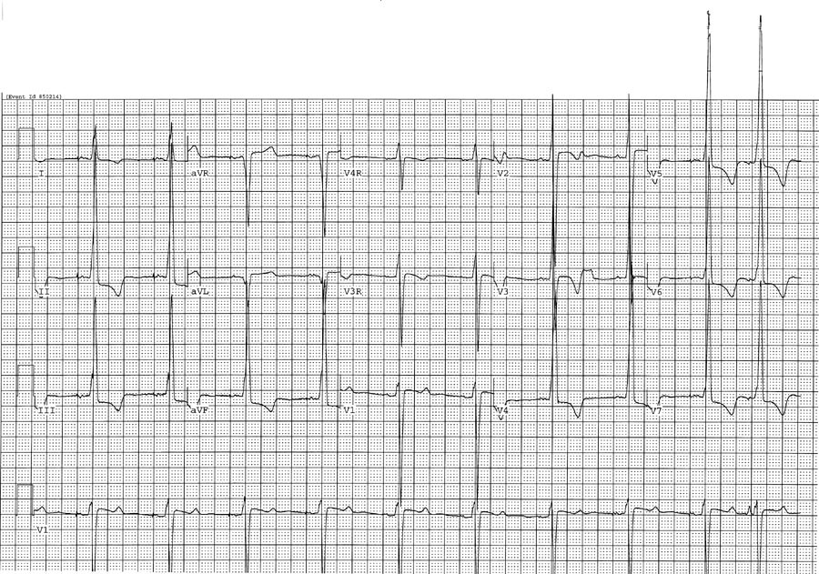

Slide 38
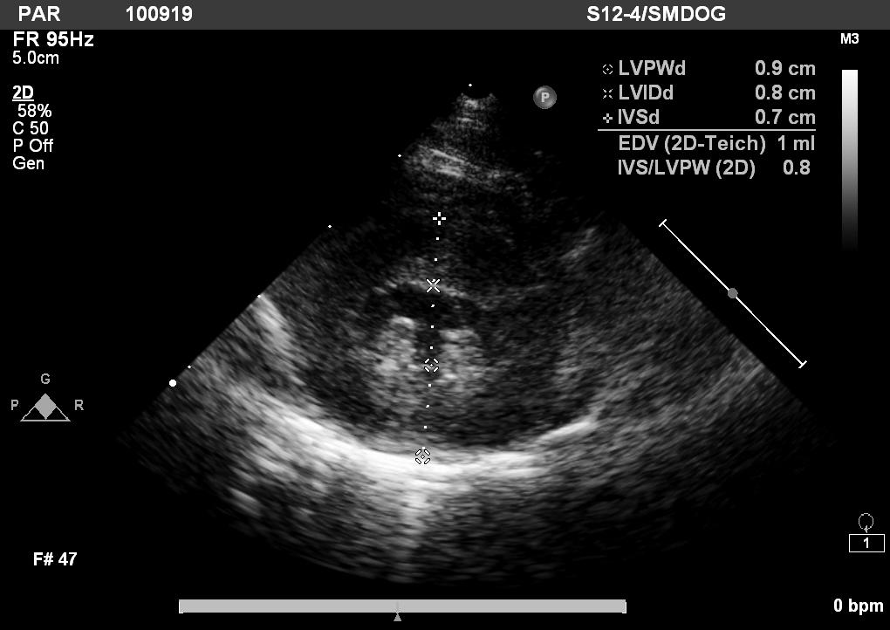
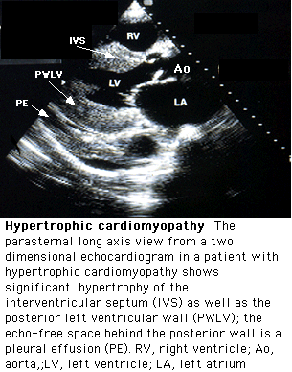

Slide 39
DIAGNOSTIC CRITERIA FOR HYPERTROPHIC CARDIOMYOPATHY
Major Criteria | Minor Criteria
ECHOCARDIOGRAPHY
Left ventricular wall thickness ≥13 mm in the anterior septum or posterior wall or ≥15 mm in the posterior septum or free wall | Left ventricular wall thickness of 12 mm in the anterior septum or posterior wall or of 14 mm in the posterior septum or free wall
Severe SAM of the mitral valve (septal-leaflet contact) | Moderate SAM of the mitral valve (no mitral leaflet-septal contact)
 | Redundant mitral valve leaflets
ELECTROCARDIOGRAPHY
Left ventricular hypertrophy with repolarization changes (Romhilt and Estes) | Complete bundle branch block or (minor) interventricular conduction defects (in left ventricular leads)
T wave inversion in leads I and aVL (≥3 mm) (with QRS-T wave axis difference ≥30 degrees), V₃–V₆ (≥3 mm) or II and III and aVF (≥5 mm) | Minor repolarization changes in left ventricular leads
 | Deep S wave in lead V₂ (>25 mm)
Abnormal Q waves (>40 msec or >25% R wave) in at least two leads from II, III, aVF (in absence of left anterior hemiblock), and V₁–V₄; or I, aVL, V₅–V₆ | Unexplained chest pain, dyspnea, or syncope

Slide 40
Differential Diagnosis
Causes of left ventricular hypertrophy:
-Long-standing systemic hypertension
-Aortic stenosis
-Highly trained athletes

Slide 41
Treatment
In the absence of a specific underlying cause or aggravating factor, treatment is for the various stages of heart failure
Supportive therapy includes sodium and fluid restriction, avoidance of alcohol and other toxins, and use of established heart failure medications

Slide 42
Restrictive Cardiomyopathy
Characterized by impaired filling and reduced diastolic volume of the left and/or right ventricle despite normal or near-normal systolic function and wall thickness

Slide 43
Primary forms are uncommon,
Secondary forms, the heart is affected as part of a multisystem disorder,
Usually present at the advanced stage of an infiltrative disease (e.g., amyloidosis or sarcoidosis) or a systemic storage disease (e.g., hemochromatosis).

Slide 44
Restrictive cardiomyopathy may be familial
Part of the genetic and phenotypic expression of hypertrophic cardiomyopathy caused by sarcomeric contractile protein gene abnormalities

Slide 45
Secondary forms:
- amyloidosis, hemochromatosis, several of the glycogen storage diseases, and Fabry's disease
Reported in association with skeletal myopathy and conduction system disease as part of the phenotypic spectrum caused by mutations in lamin A or C.

Slide 46
CAUSES OF RESTRICTIVE CARDIOMYOPATHIES
INFILTRATIVE DISORDERS
Amyloidosis Sarcoidosis
STORAGE DISORDERS
Hemochromatosis Fabry's disease Glycogen storage diseases
FIBROTIC DISORDERS
Radiation Scleroderma Drugs (e.g., doxorubicin, serotonin, ergotamine)
METABOLIC DISORDERS
Carnitine deficiency Defects in fatty acid metabolism
ENDOMYOCARDIAL DISORDERS
Endomyocardial fibrosis Hypereosinophilic syndrome (Lofler's endocarditis)
MISCELLANEOUS CAUSES
Carcinoid syndrome

Slide 47
Pathophysiology
Increased stiffness of the endocardium or myocardium, induces ventricular pressures to rise disproportionately to small changes in volume until a maximum is reached.

Slide 48
In infiltrative diseases such as amyloidosis or sarcoidosis, the increased stiffness results from infiltrates within the interstitium between myocardial cells.
In the storage disorders, the deposits are within the cells

Slide 49
Clinical Manifestations
Presenting clinical features develop as a consequence of raised ventricular filling pressures
Not distinguishable from those of heart failure resulting from systolic impairment
Atrial dilation and atrial fibrillation are common

Slide 50
Diagnosis
Based on the demonstration of the abnormal filling pattern by Doppler echocardiography
Magnetic resonance imaging is useful to delineate the distribution of disease

Slide 51
Presence of abnormal amyloid protein in amyloidosis,
Noncaseating granuloma in sarcoidosis,
Abnormal iron studies in hemochromatosis,
Reduced α₁-galactosidase levels in Fabry's disease

Slide 52
Arrhythmogenic Right Ventricular Cardiomyopathy
A genetically determined heart muscle disorder characterized by fibrofatty replacement of right ventricular myocardium.
Associated with arrhythmia, heart failure, and premature sudden death.

Slide 53
Inherited as an autosomal dominant disease, usually with incomplete penetrance,
Recessive forms with cutaneous manifestations have been recognized
Recognized mutations account for approximately 40% of cases

Slide 54
Clinical Manifestations
In the early phase, patients are usually asymptomatic
Resuscitated cardiac arrest and sudden death may be the initial manifestations
The overt arrhythmic phase most often first occurs in adolescents and young adults, when patients note palpitations or syncope

Slide 55
The third phase, characterized by diffuse right ventricular disease, usually is recognized in the middle and later decades;
Patients may present with right-sided heart failure despite relatively preserved left ventricular function
In the advanced stage, obvious left ventricular involvement and biventricular heart failure are seen

Slide 56
Treatment
Intracardiac defibrillator with supplemental antiarrhythmic agents

