Slide 1
Heart Failure
Khalid AlHabib
Professor of Cardiac Sciences
Cardiology Consultant

Slide 2
50 y/o man
chest pain for 1 day
ECG: STEMI
Exam: High JVP, chest crackles, S3
Echo: EF 30%
HFrEF

Slide 3
70 y/o F
HTN, DM
SOBOE + LL swelling for 2 weeks
BP 180/100
JVP high, LL edema,chest crackles
Echo: EF 55%
HFpEF

Slide 4
Definition
Heart failure is a complex clinical syndrome
Can result from:
structural or functional cardiac disorder
impairs the ability of the ventricle to fill with or eject blood

Slide 5
Inability of the heart to pump blood at an output sufficient to meet the body’s demands

Slide 6
Characterized by:
signs and symptoms of intravascular and interstitial volume overload and/or
manifestations of inadequate tissue perfusion

Slide 7
Heart failure may result from an acute insult to cardiac function, such as a large myocardial infarction, valvular diseas, myocarditis, and cardiogenic shock
More commonly, from a chronic process

Slide 8
Common Causes
Coronary artery disease
Hypertension
Valvular heart disease
Dilated cardiomyopathy
Notes:
8

Slide 9
Nomenclature
Heart failure vs.
Cardiomyopathy
LV dysfunction
Pulmonary edema

Slide 10
Classification
Left vs. Right
Systolic vs. Diastolic
High output vs. low output

Slide 11
Heart Failure Syndrome
The initial manifestations of hemodynamic dysfunction are a reduction in stroke volume and a rise in ventricular filling pressures under conditions of increased systemic demand for blood flow
This stimulates a variety of interdependent compensatory responses involving the cardiovascular system, neurohormonal systems, and alterations in renal physiology

Slide 12
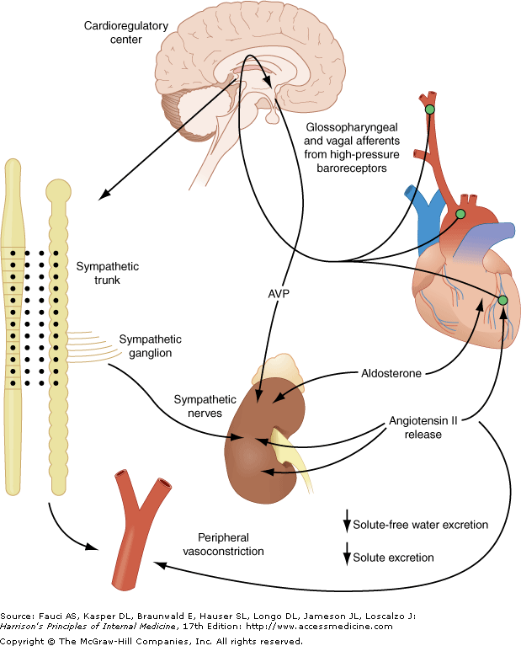

Slide 13
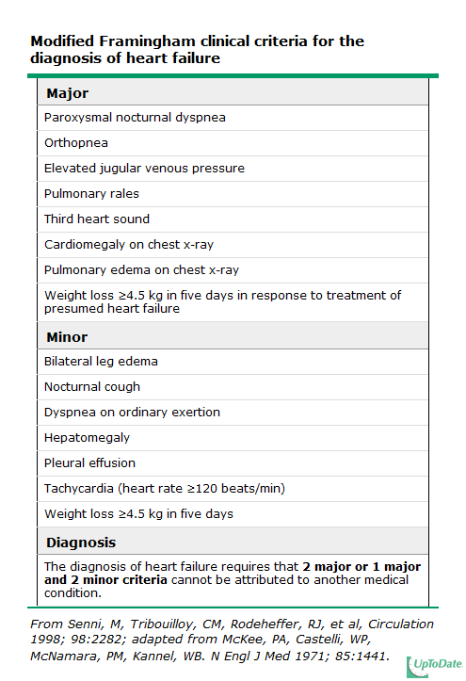
Notes:
13

Slide 14
FACTORS THAT MAY PRECIPITATE ACUTE DECOMPENSATION OF CHRONIC HEART FAILURE

Slide 15
 |  | Discontinuation of therapy (patient noncompliance or physician initiated)
 |  | Initiation of medications that worsen heart failure (calcium antagonists, β-blockers, nonsteroidal anti-inflammatory drugs, antiarrhythmic agents)
 |  | Iatrogenic volume overload (transfusion, fluid administration)
 |  | Dietary indiscretion
 |  | Pregnancy
 |  | Exposure to high altitude
 |  | Arrhythmias
 |  | Myocardial ischemia or infarction
 |  | Worsening hypertension
 |  | Worsening mitral or tricuspid regurgitation
 |  | Fever or infection
 |  | Anemia

Slide 16
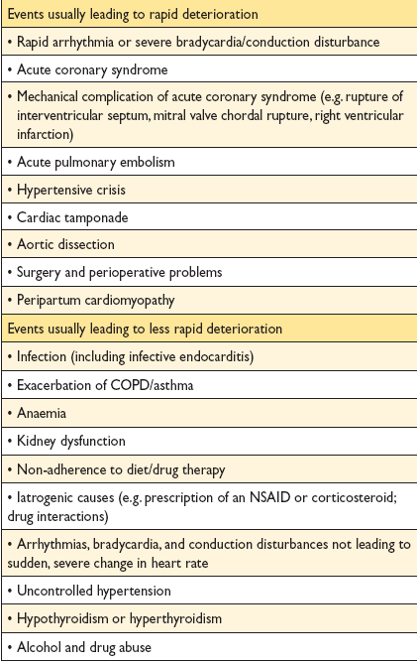

Slide 17
Evaluation

Slide 18
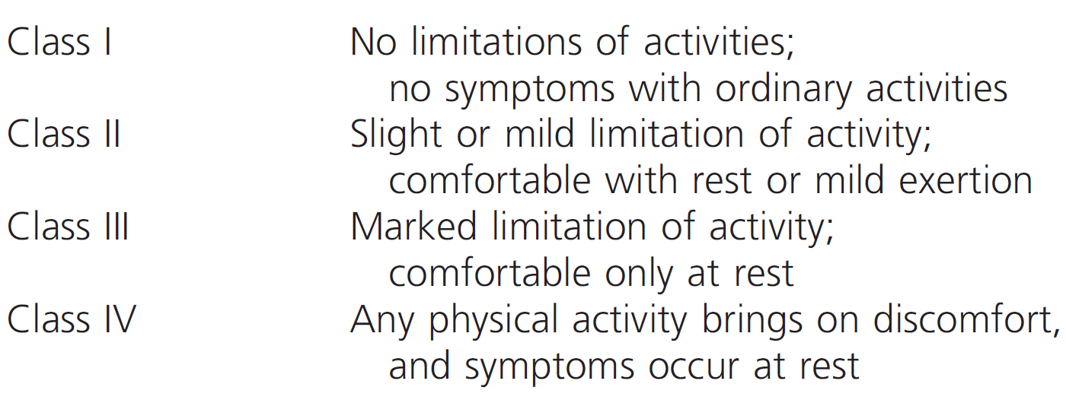
NYHA Classiffication
Notes:
18

Slide 19
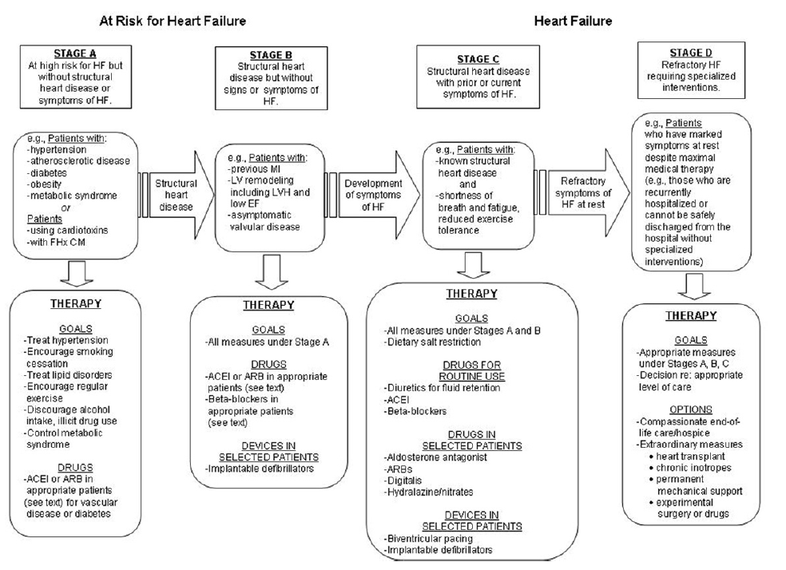
ACC/AHA
Notes:
19

Slide 20
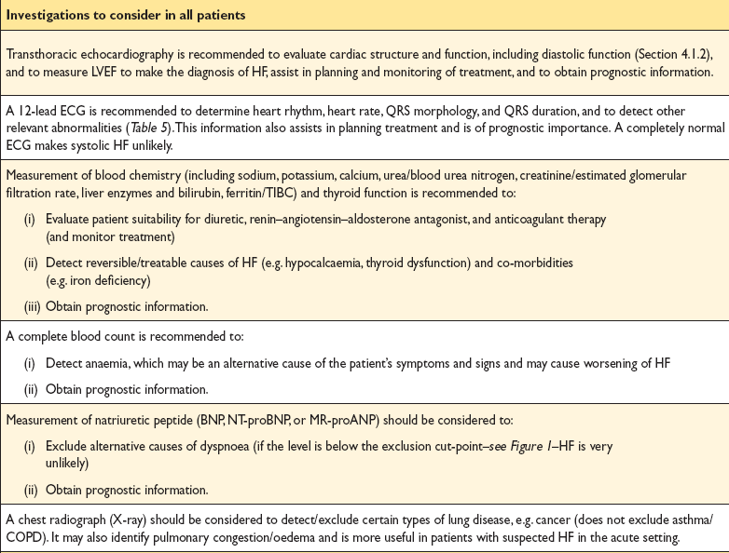

Slide 21
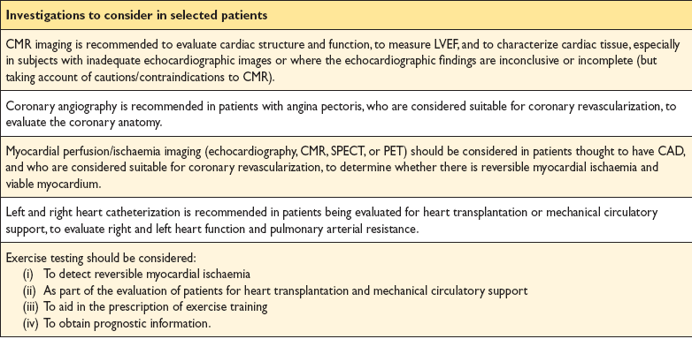

Slide 22
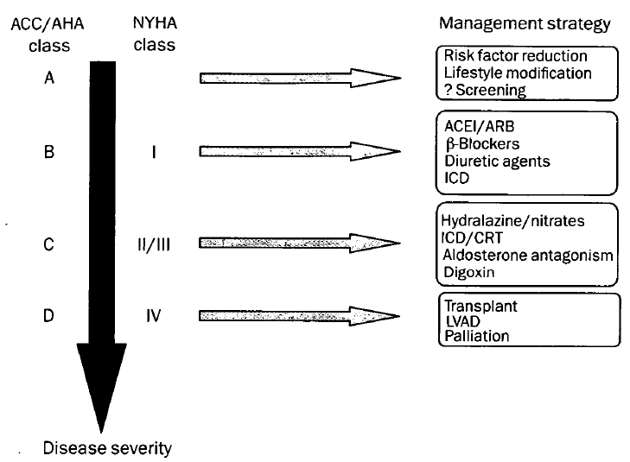
Therapy

Slide 23
56 Y/O gentleman
Diagnosed dilated cardiomyopathy
LVEF 25%
NYHA class II
O/E B/P 112/68 HR 82 bpm
JVP 7 cm water,
Soft S3 and grade 2 PSM
Chest clear,
No LL edema and warm extremities

Slide 24
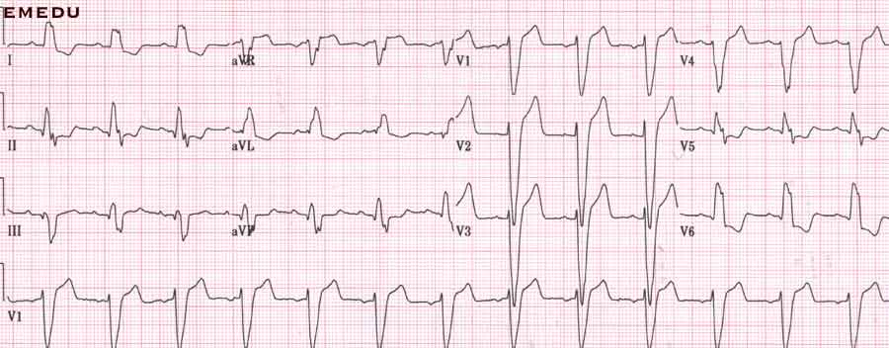

Slide 25
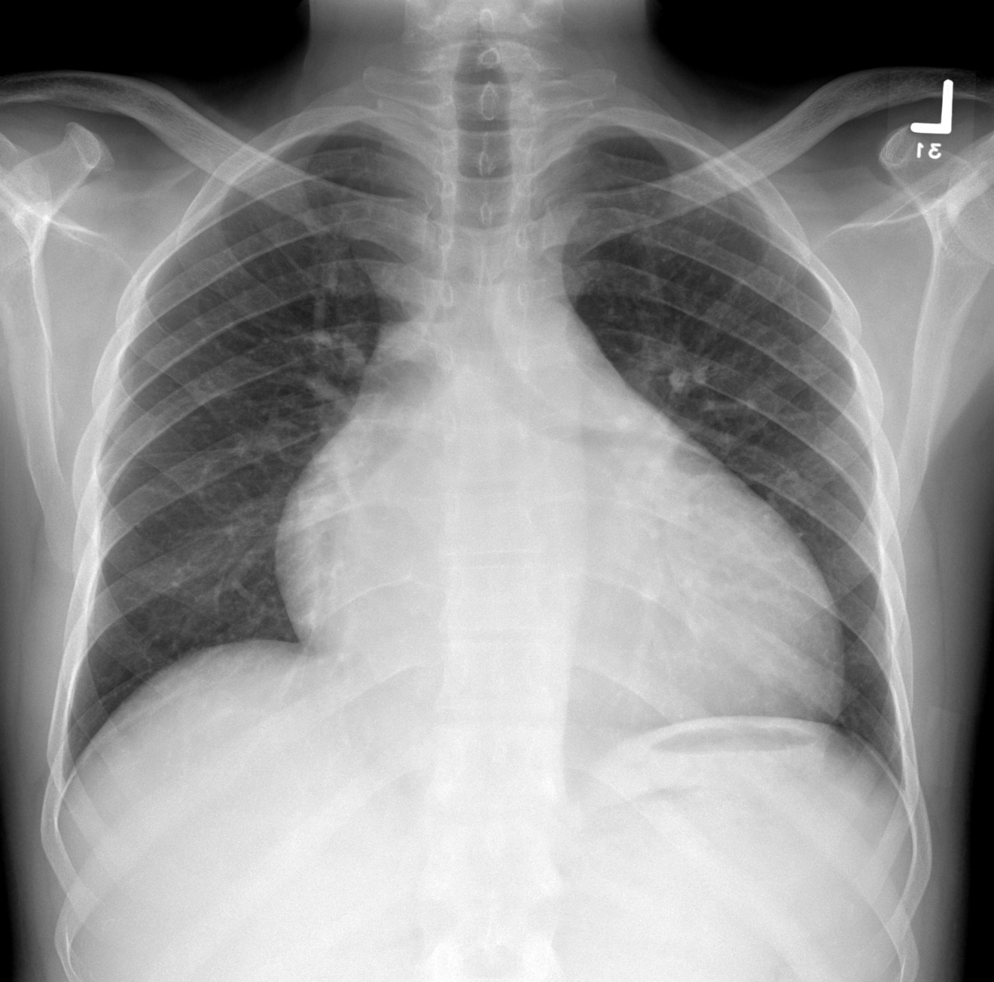

Slide 26
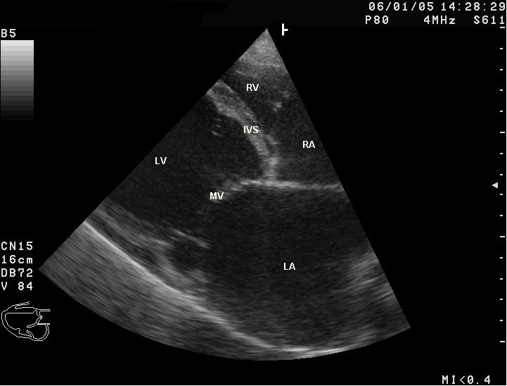

Slide 27
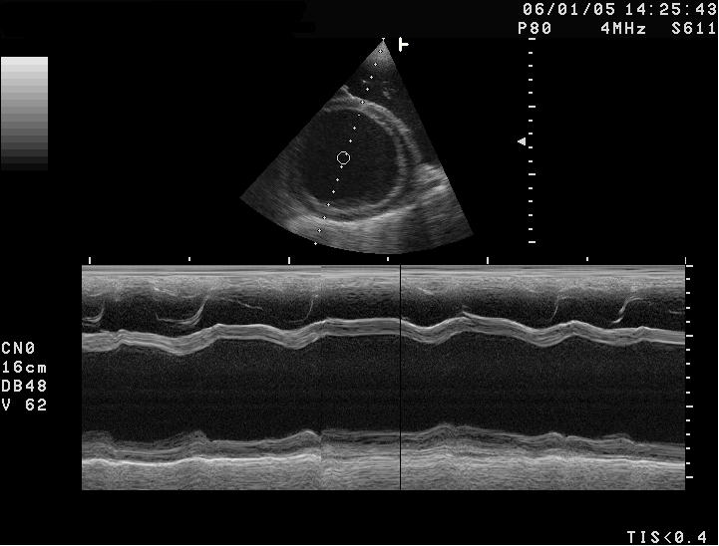

Slide 28
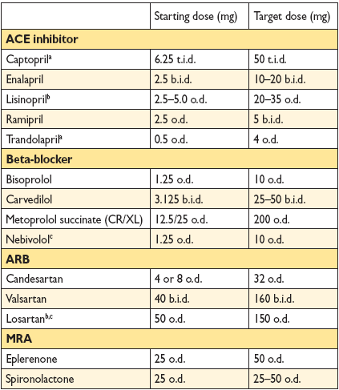

Slide 29
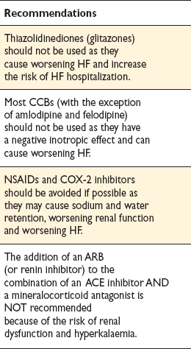
Treatments (or combinations of treatments) that may cause harm in patients with symptomatic (NYHA class
II–IV) systolic heart failure

Slide 32
Acute Heart Failure

Slide 33
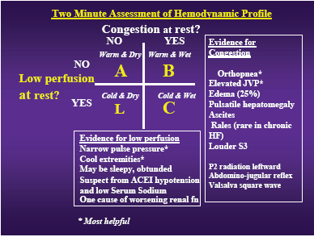
Notes:
33

Slide 34
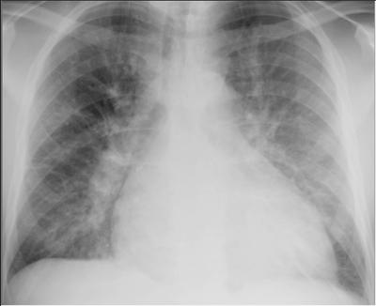

Slide 35
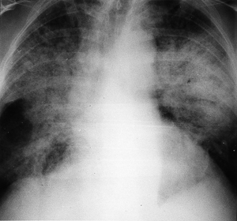

Slide 37
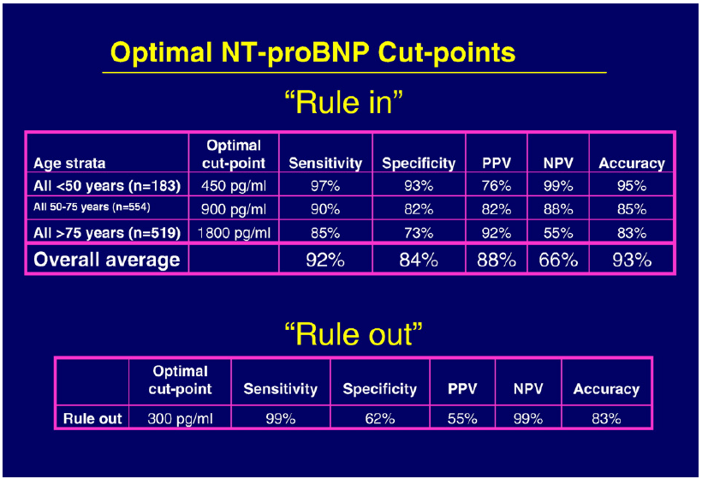

Slide 38
