Slide 1
Rheumatic Fever And RHD
Dr. Rashed Alfagih MBBS MHSc
Consultant Cardiologist KFCC

Slide 2
Lecture Outline
What is ARF And RHD?
Diagnosis
Jones Criteria
Differential Diagnosis
Investigations, Management
Rheumatic Valvular Heart Disease
Prevention

Slide 3
Rhuematic Fever
It represents a delayed immune response to infection with manifestations appearing after a period of 2-4 weeks.
Group A beta hemolytic streptococcal throat infection (Strep. pyogenes).
Age 5-15 yrs
A multisystem disease

Slide 4
Rheumatic Heart Disease (RHD)
RHD is a long term complication of ARF.
Major effect on health is due to damage to heart valves.

Slide 5
Global Burden of RHD
A leading cause of CV morbidity & mortality in young people
Total cases with RHD: 20 Millions
CHF: 3Million, valve surgery required in 1Million
Annual incidence of RF: 0.5 Million, nearly half develop carditis
Estimated deaths from RHD: 250,000/YR
Imposes a substantial burden on health care systems with limited budgets.

Slide 6
Epidemiologic Background
The incidence of RF and the prevalence of RHD has declined substantially in Europe, North America and other developed nations
This decline has been attributed to improved hygiene, reduced household crowding, and improved medical care.

Slide 7
Epidemiologic Background
The major burden is currently found in low and middle income countries (India, middle east), and in selected indigenous populations of certain developed countries (Australia and Newzealand).
A disease of poverty and low socioeconomic status.
In underdeveloped countries RHD is the leading cause of CV death during the first five decades of life.

Slide 8
Epidemiologic Background
The incidence in indigenous population of Australia: 53-380 cases/100000 people/yr in 5-14 yrs age group.
In Saudi Arabia: incidence 30 cases/100000 people/yr and prevalence 310/100000 people in 6-15 yrs age group.

Slide 9
Diagnosis of ARF
No single test to diagnose ARF.
The symptoms and signs are shared by many inflammatory and infectious diseases.
Accurate diagnosis is important.
Overdiagnosis will result in individuals receiving treatment unnecessarily.
Underdiagnosis may lead to further episodes of ARF causing damage, and the need for valve surgery, and or premature death.

Slide 10
Diagnosis of ARF
Diagnosis is primarily clinical and is based on a constellation of signs and symptoms, which were initially established as the Jones criteria
In 1944 Dr. TD Jones published a set of guidelines for diagnosis of ARF “Jones Criteria”
Subsequently Modified in 1965, 1984 and 1992 by AHA
Revised recently -2015 by AHA

Slide 11
Modified Jones Criteria 1992

Slide 12
Mnemonic for Jone’s criteria
Recent Strep infection.
J nes Criteria (Major Criteria)
J Joints (Polyartheritis).
Carditis (Pancarditis).
N Nodules.
E Erythema marginatum.
S Sydenham’s chorea.
Minor criteria:
Fever, ESR, Arthralgia, Long PR interval.

Slide 13
Carditis
Occurs in 50-70% of cases
Only manifestation of ARF that leaves permanent damage
May be subclinical.
Myocardium, endocardium, and pericardium.
Tachycardia is common; its absence makes the diagnosis of myocarditis unlikely.
Murmurs of MR or AR may occur in acute stage while mitral stenosis occurs in late stages
Cardiomegaly and CHF may occur
Notes:
Tachycardia (out of proportion to the degree of fever) is common; its absence makes the
diagnosis of myocarditis unlikely.

Slide 14
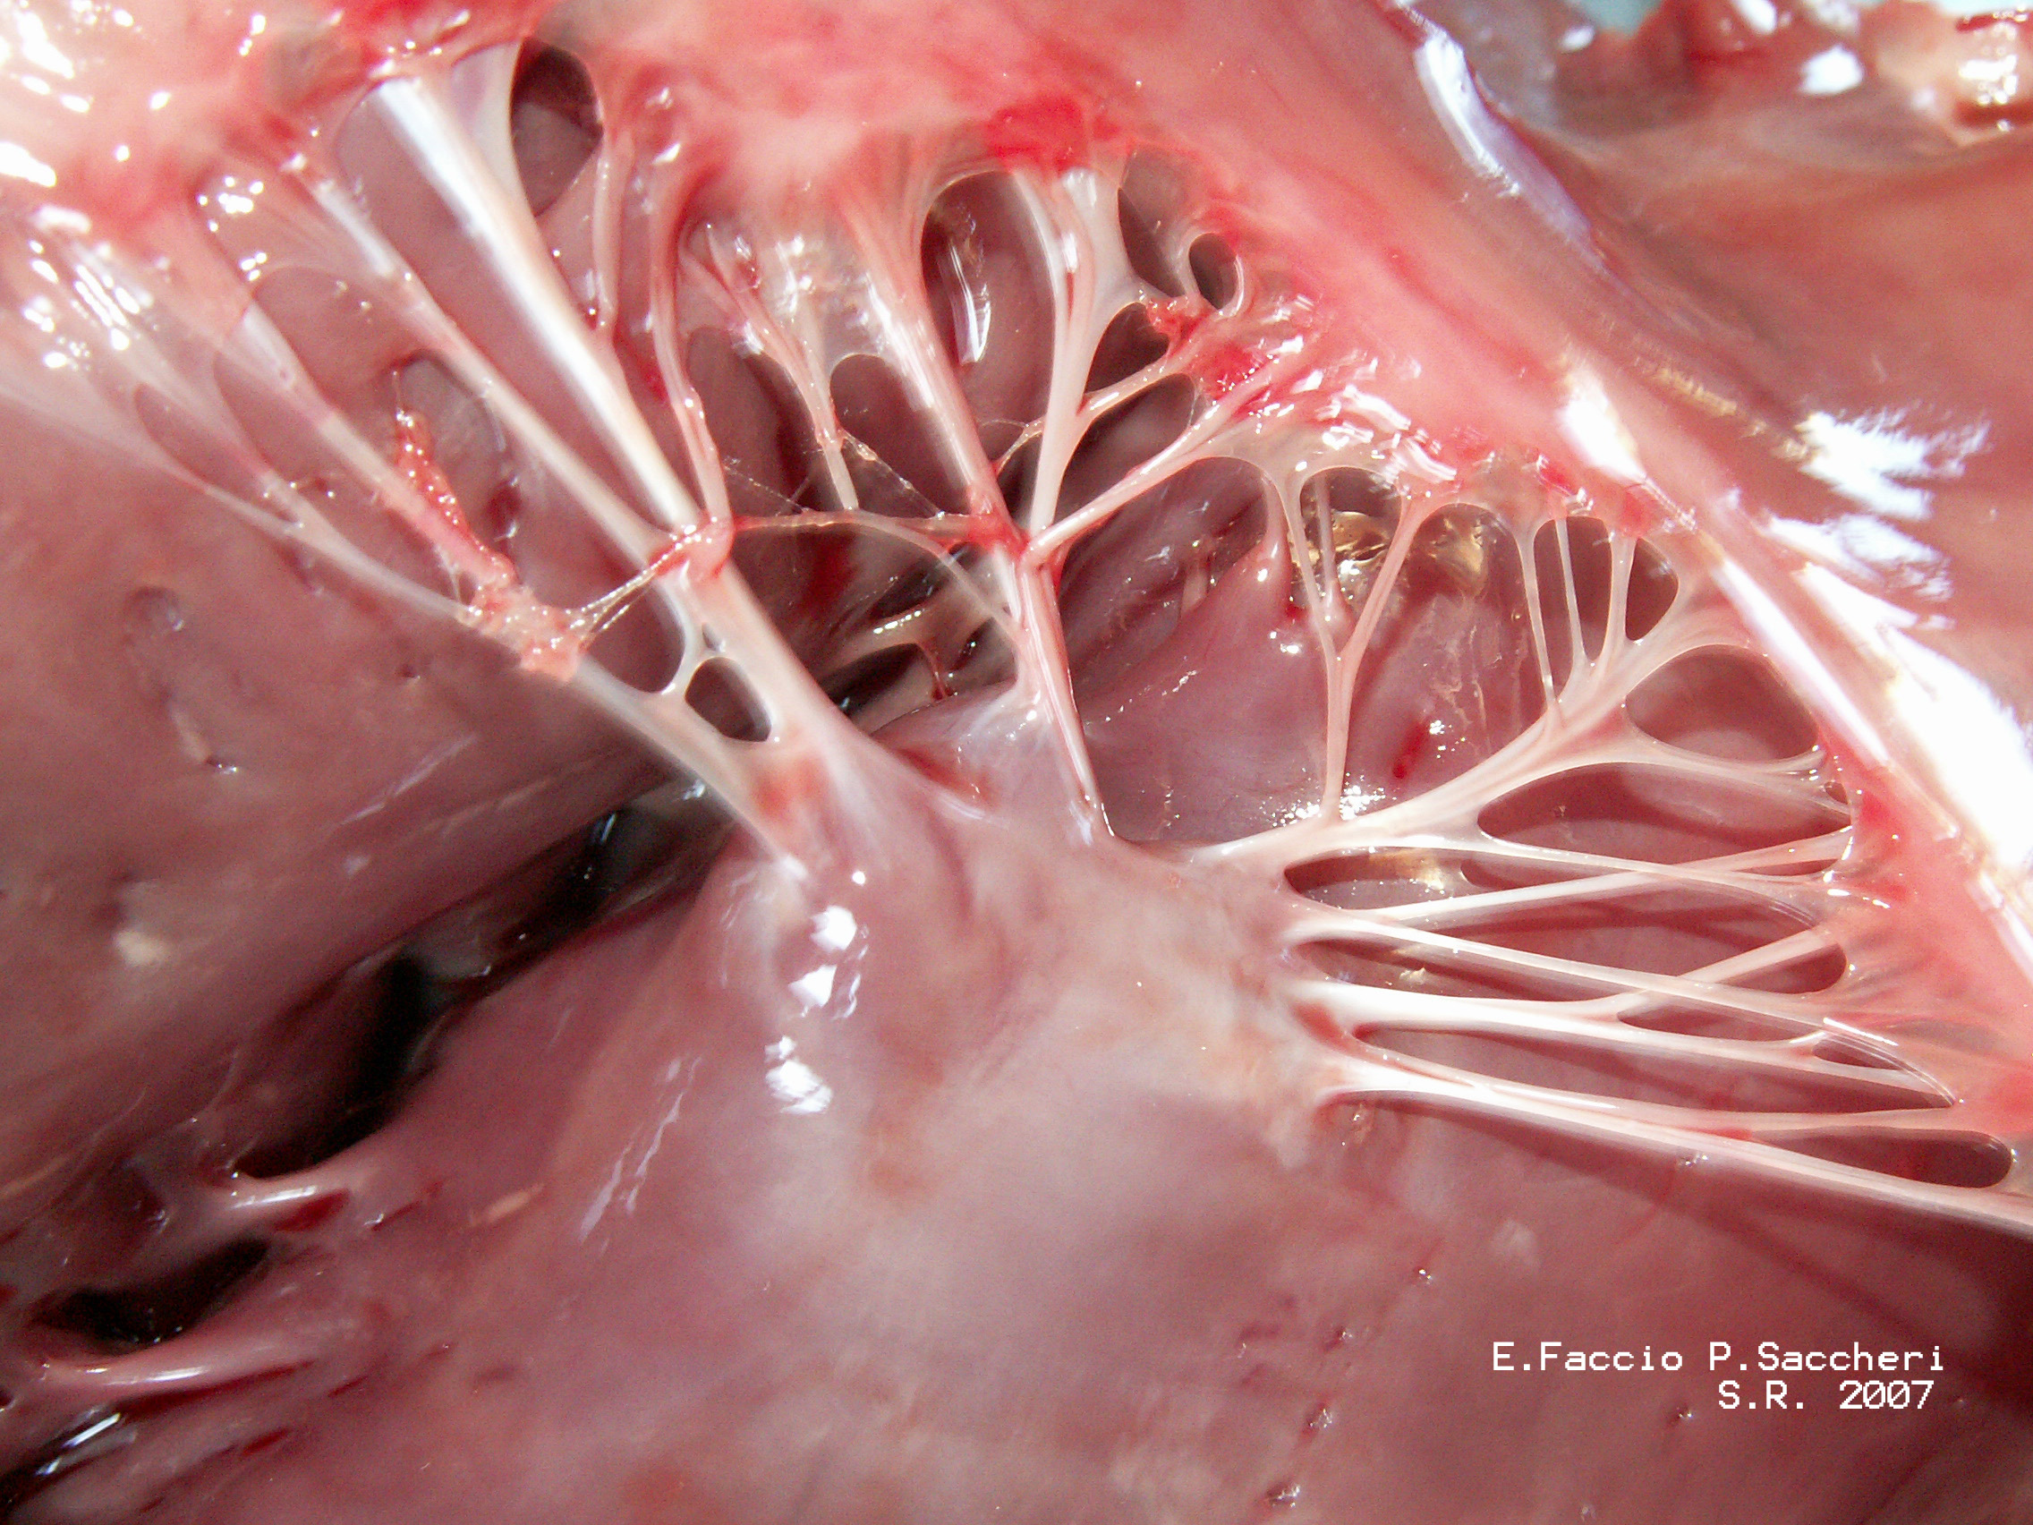

Slide 15
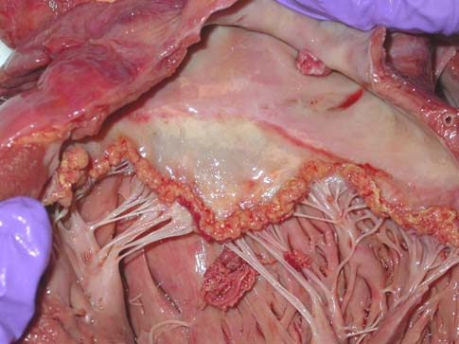
Confluent verrucae located on the atrial surface of the mitral valve consistent with acute rheumatic involvement of the heart
Pediatric Cardiology; Mar2008, Vol. 29 Issue 2, p299

Slide 16
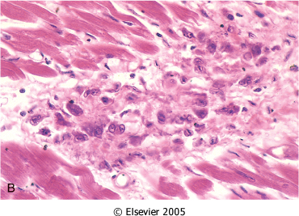
Pathologic Lesions
Ashcoff nodules.
Fibrinoid degeneration of connective tissue, inflammatory cells.

Slide 17
Arthritis
Common: present in 35-66%
Earliest manifestation of ARF
Large joints: The knees and ankles, shoulders, elbows
“Migrating”, “Fleeting” polyarthritis
Duration short < 1 week
Rapid improvement with salicylates
Does not progress to chronic disease

Slide 18
Sydenham Chorea
Also known as Saint Vitus’dance
Occur in 10-30%, extrapyramidal manifestation, female predominnce
Abrupt Purposeless involuantry movements of muscles of face, neck, trunk, and limbs.
Delayed manifestation of ARF (months).
Clinically manifest as clumsiness, deterioration of handwriting,emotional lability or grimacing of face.

Slide 20
Subcutaneous Nodules
Occur in 10%.
Usually 0.5 – 2 cm long.
Firm non-tender.
Occur over extensor surfaces of joints, on bony prominences, tendons, spine.
Short lived: last for few days.
Associated with severe carditis .

Slide 21
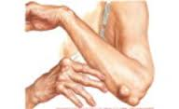
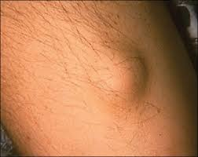
Subcutaneous Nodules

Slide 22
Erythema Marginatum
Present in <6%
Less common, but highly specific manifestation of ARF
Reddish border, pale center, round or irregular serpiginous borders, non-pruritic, transient rash
Occurs on trunk, abdomen or proximal limbs
Associated with carditis

Slide 23
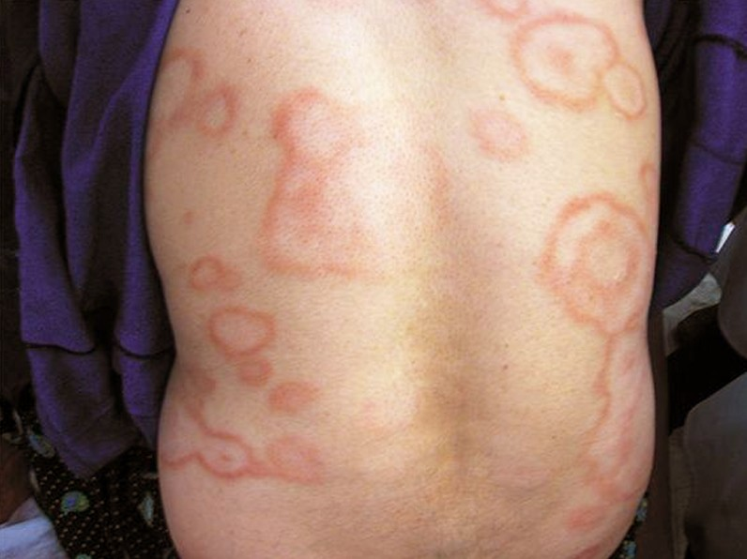
Erythrma Marignatum
Notes:
The rings are barely raised and are non-itchy. The face is generally spared.

Slide 24
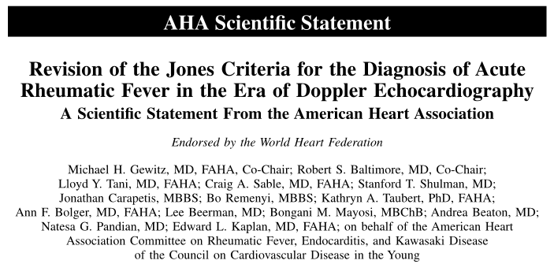
Revised Jones Criteria 2015

Slide 25
2015 Revision of Jones Criteria
1. In accordance with the degree of prevalence of ARF/RHD in the population:
Low risk populations have been defined as those with ARF incidence < 2:100000 school-age children or all age prevalence of RHD of < 1:1000 population per year.
Children not from low risk population have been considered to be at moderate or high risk.
Notes:
Low risk and high risk populations .

Slide 26
2015 Revision of Jones Criteria
2. Advocated the use of Echocardiography in all cases of confirmed or suspected ARF or RHD, to diagnose valvulitis( subclinical carditis) and has been included as a major criterion to diagnose carditis
3. Aseptic monoarthritis has been included as a major criteria in moderate or high risk population

Slide 27
2015 Revision of Jones Criteria
4. Polyarthralgia has been recognized as a major manifestation for moderate or high risk population
5. Fever >38.5 c, ESR >60 and or CRP > 3mg/dl for low risk population, and fever >38 and ESR >30 and or CRP > 3mg/dl for moderate or high risk population.

Slide 28
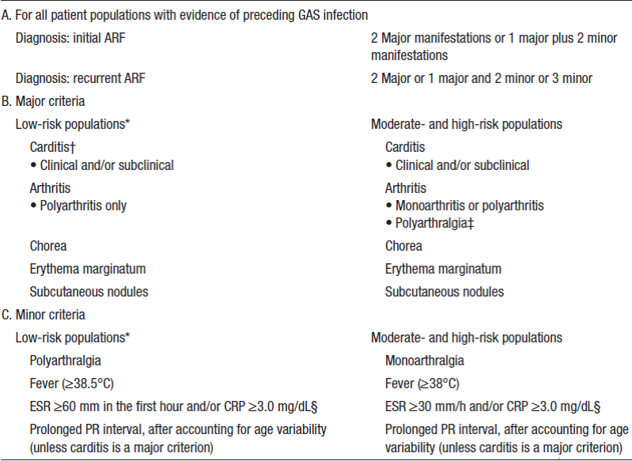
2015 Revised Jones Criteria

Slide 29
2015 Revised Jones Criteria
A firm DIAGNOSIS requires:
2 Major manifestations or 1 Major and 2 Minor manifestations and
Evidence of a recent streptococcal infection.

Slide 30
2015 Revised Jones Criteria
Evidence of Preceding GAS Infection:
Increased or rising ASO titer or Anti-DNAse B titer
A positive throat culture

Slide 31
Rheumatic Fever Recurrences
Reliable past history of ARF: 2 major or 1 major and 2 minor or 3 minor manifestations sufficient for diagnosis.
Presence of antecedent streptococcal infection.
When minor manifestations only present exclude other causes.

Slide 32
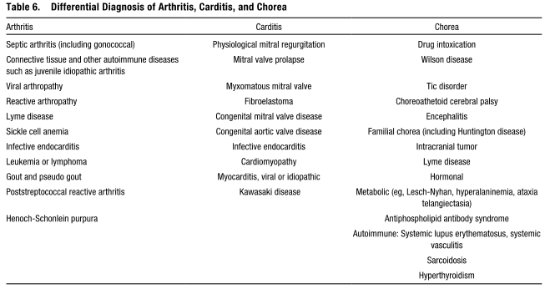
DDX of ARF

Slide 33
Investigations
Recommended for all cases:
CBC
ESR
CRP
Blood cultures (if febrile)
Throat swap before Abx (Group A Strep)
Antistreptococcal serology: ASO and Anti-DNAse B titers. (repeat in 10-14 days if –ve first test)

Slide 34
Investigations
Recommended for all cases:
ECG (prolonged PR or arrhythmia).
CXR.
Echocardiogram (2015).

Slide 35
Treatment of ARF
Bed rest
Salicylates : Aspirin
75-100 mg /kg/day given as 4 divided doses for 6 -8 weeks. Attain a blood level 20-30 mg/dl
Penicillin: Procaine Penicillin 4 million units/day x10 days.
Prednisolone:2mg/kg/day taper over 6 weeks, Given when there is severe carditis.
Heart Failure Treatment: diuretics, ACEI

Slide 36
Chronic Rheumatic Heart Disease
Most commonly in Mitral-70%
Frequently in Aortic-40%
Less frequently Tricuspid-10%
Rarely pulmonary valve-2%
Mitral Stenosis is more common in females (3:1), while males have higher incidence of Aortic Regurgitation

Slide 37
Mitral Stenosis (MS)
The normal MVA= 4 - 5 cm²
In severe MS <1.5 cm²
High LAP
The rise in LAP causes a similar rise in pulmonary capillaries, veins and artery.

Slide 38
Confluent verrucae located on the atrial surface of the mitral valve consistent with acute rheumatic involvement of the heart
Pediatric Cardiology; Mar2008, Vol. 29 Issue 2, p299

Slide 39
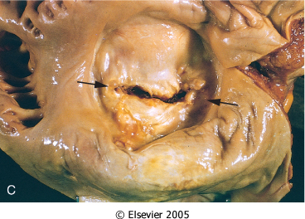
Mitral Stenosis
Notes:
Mitral stenosis with diffuse fibrous thickening and distortion of the valve leaflets, commissural fusion (arrows), and thickening and shortening of the chordae tendineae. Marked dilation of the left atrium is noted in the left atrial view

Slide 40
Clinical Features of MS (Symptoms)
Dyspnea
Fatigue
Palpitation
Hemoptysis (10%)
Hoarseness ( Ortner’s syndrome)
Dysphagia
Storke or peripheral embolization

Slide 41
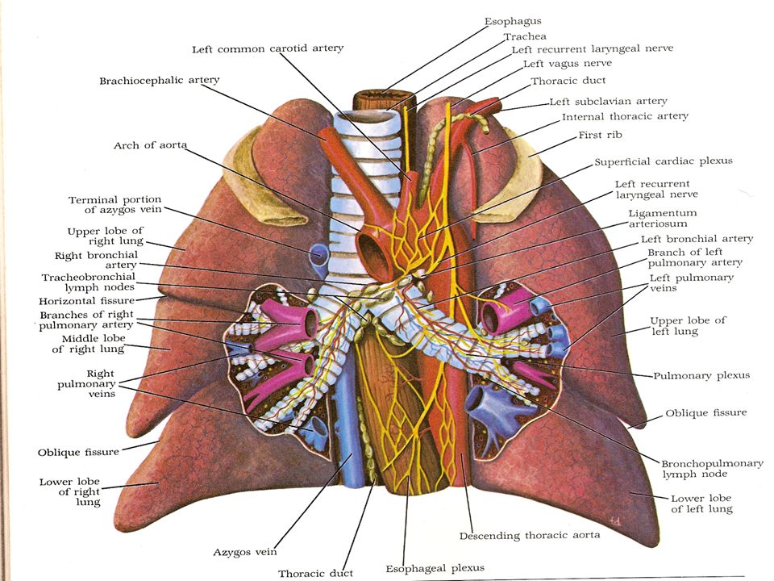

Slide 42
Clinical Features of MS (Physical Exam.)
Cyanosis (Mitral facies,malar flush)
Tapping apex ( S1)
Parasternal heave
Diastolic thrill
Accentuated S1 , accentuated S2
Opening snap
Mid-diastolic rumble

Slide 43
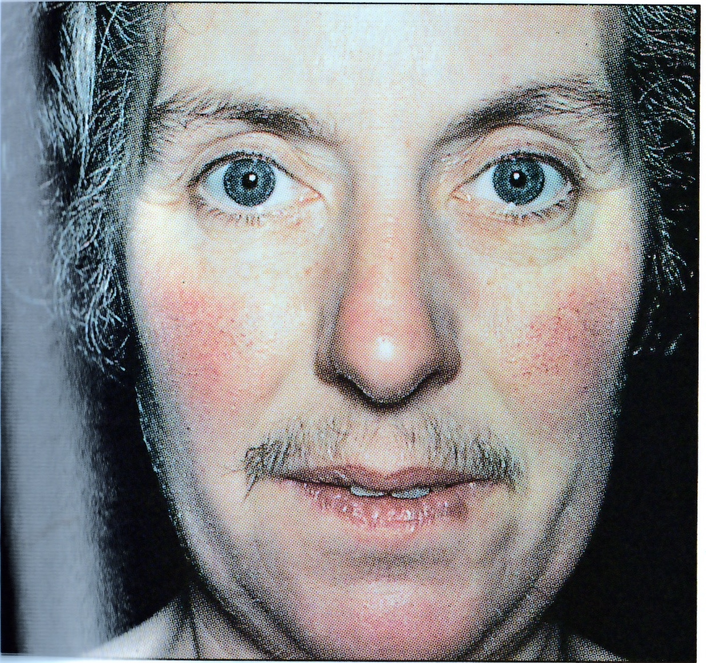
Notes:
Mitral malar flush. Unclear etiology

Slide 44
Investigations
CXR
Straightening of the left heart border
Double density
Kerley B lines , CA in MV
ECG:
LAE, P Mitrale ,RV dominance
Echodoppler

Slide 45
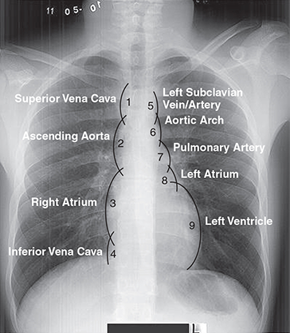

Slide 46
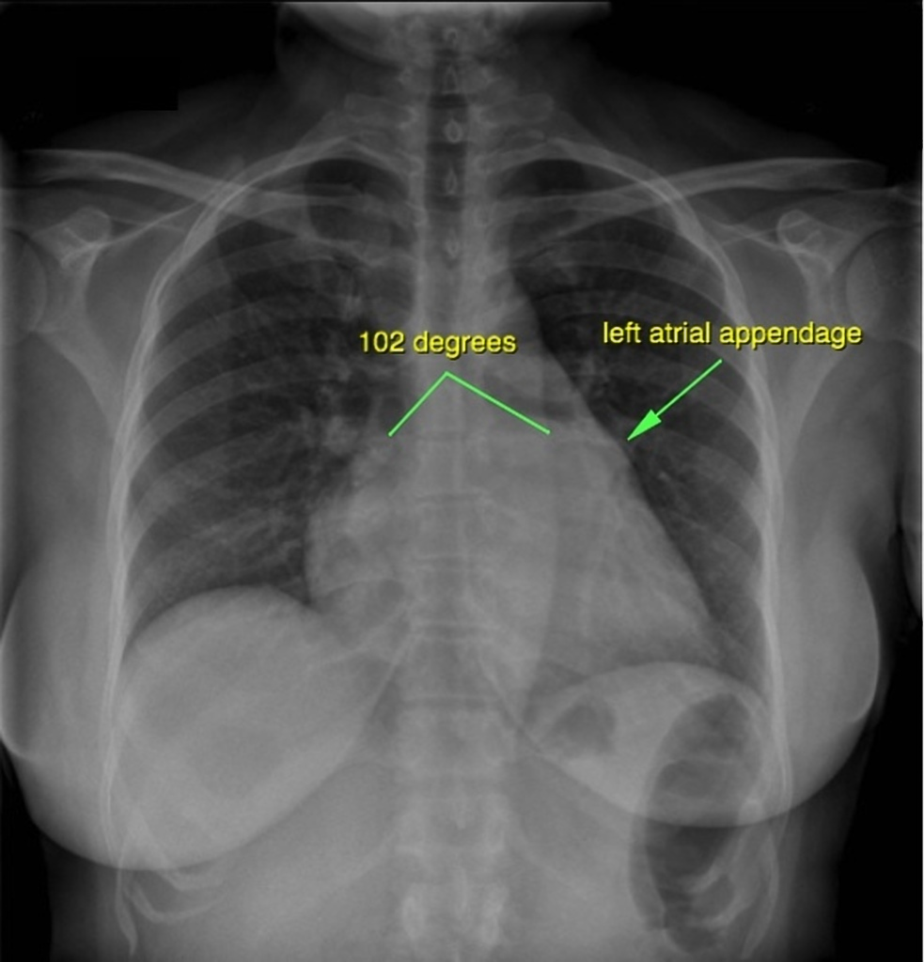

Slide 47
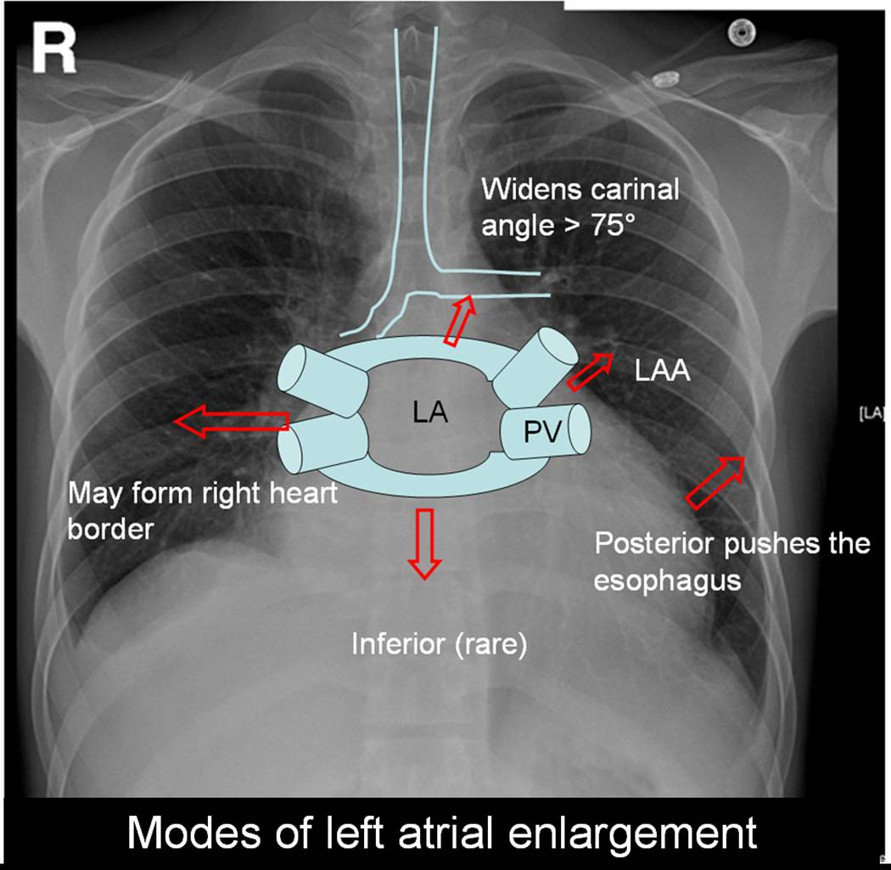

Slide 48
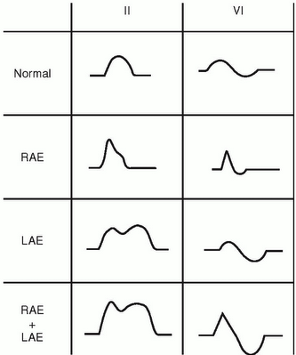

Slide 49
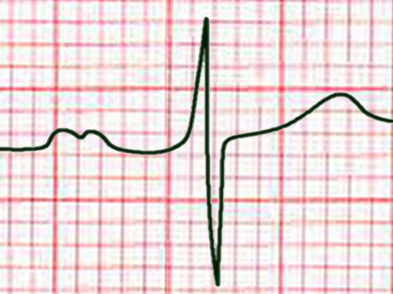

Slide 50
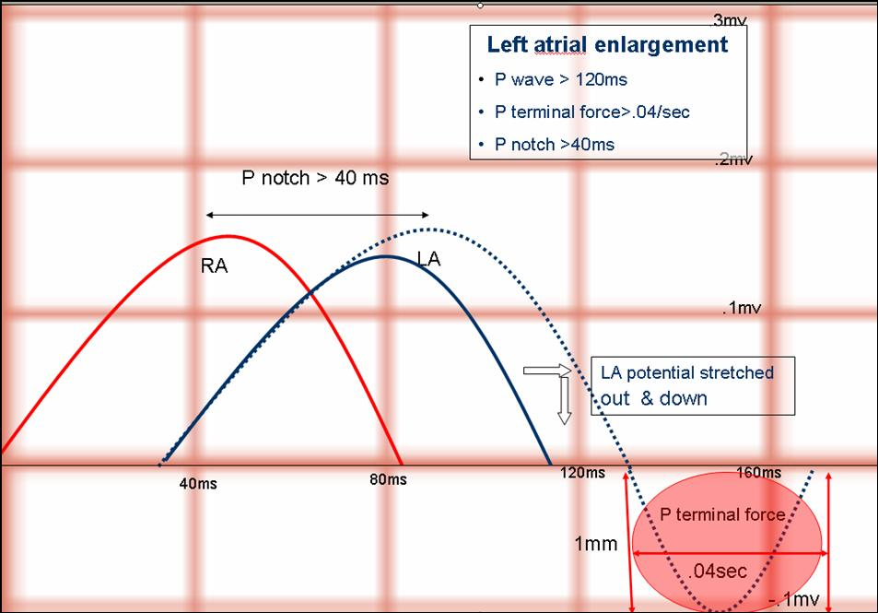

Slide 51
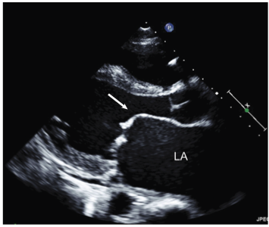
Echo In Mitral Stenosis
Notes:
Fig. 1.1 Two-dimensional echocardiography in mitral stenosis. (a) Parasternal long-axis view through a stenotic mitral valve, demonstrating typical diastolic doming of the anterior leaflet.

Slide 52
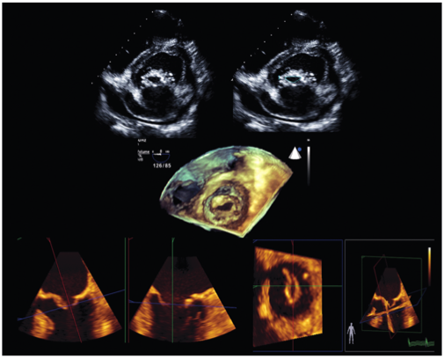

Slide 53
Notes:
Mitral stenosis with diffuse fibrous thickening and distortion of the valve leaflets, commissural fusion (arrows), and thickening and shortening of the chordae tendineae. Marked dilation of the left atrium is noted in the left atrial view

Slide 55
Management
B-Blockers ,CCB
Digoxin ( AF )
Diuretics
Warfarin
Balloon Valvuloplasty
Mitral valve replacement

Slide 56
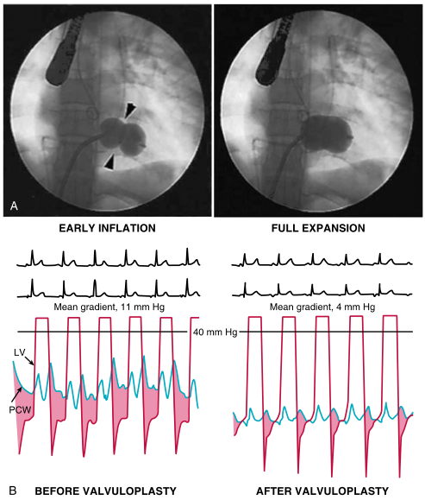
Notes:
Fig. 4.4 Inoue catheter for mitral balloon valvotomy. The balloon-tipped catheter is positioned across the stenotic valve and inflated. The narrowed orifice is subjected to the force from the transiently inflated balloon. When the procedure is successful, these forces break the scar tissue and allow greater opening of the mitral valve leaflets. This technique is a balloon commissurotomy that has evolved from the earlier extensive experience with closed and open surgical commissurotomy.

Slide 57
Mitral Regurgitation (MR)
Asymptomatic
Dyspnea , orthopnea, PND
Displaced PMI, Thrill
Soft S1,
Pansystolic murmur
Diagnosis confirmed and staged by echo.
Treatment is surgical

Slide 58
Aortic Regurgitation (AR) signs
Water-hammer / collapsing pulse
Wide pulse pressure
Corrigan’s sign
De Musset sign
Muller sign
Quincke’s pulse
Hill’s sign
Diagnosis confirmed and staged by echo.

Slide 59
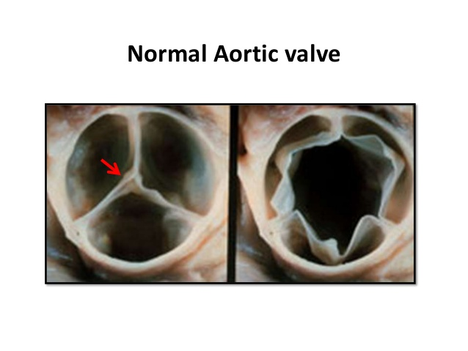
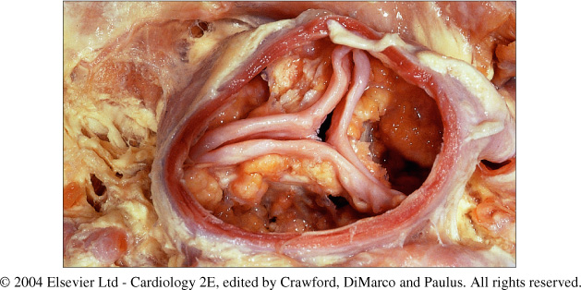
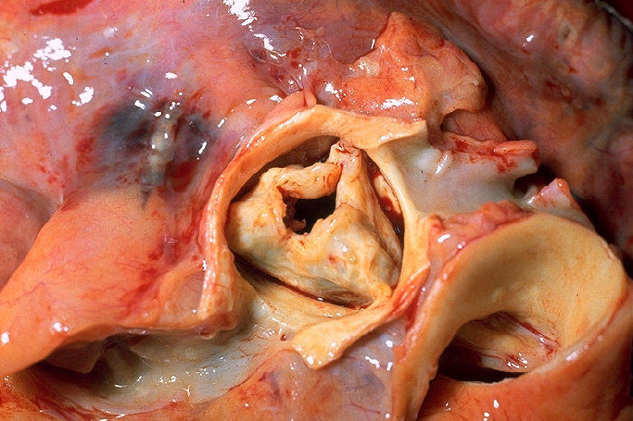
Aortic Stenosis
Notes:
Fig. 9.3 Gross pathology of degenerative aortic stenosis. The figure shows the masses of lipo-calcification on the aortic side of all three leaflets and the absence of commissural fusion.

Slide 60
Symptoms of AS
Angina
Syncope
Dyspnea

Slide 61
Signs of Severe AS
Arterial Pulse wave form : Plateau
Small (Parvus)
Slow rise (Tardus)
Sustained not displaced PMI
Systolic thrill
S4

Slide 62
Signs of Sever AS
Late peaking of murmur
Single S2 : Soft or absent A2
Paradoxical splitting of S2

Slide 63
Aortic Valve Disease
Treatment:
Aortic valve Replacement (SAVR)
Transcathter Aortic Valve Replacement (TAVI)

Slide 64
Secondary Prevention of Rheumatic Fever
Agent | Dose | Mode
Penicillin G | 1.2 Million Units every 4 weeks (every 3 weeks in high risk situations) | IM
Penicillin V | 250 mg twice daily | Oral
Sulfadiazine | 1 g once daily | Oral
For individuals allergic to penicillin and sulfadiazine
Erythromycin | 250 mg twice daily | Oral

Slide 65
Duration of Secondary Rheumatic Fever Prophylaxis
Category | Duration
Rheumatic fever with carditis and residual heart disease (persistent valvar disease) | 10 y since last episode or until age 40y (which ever is longer) sometimes life long.
Rheumatic fever with carditis but NO residual valvular heart disease. | 10 y since last episode or until age 21y (which ever is longer).
Rheumatic fever without carditis | 5 y since last episode or until age 21y (which ever is longer).

Slide 66
Good Luck …. Qustions

