Slide 1
Heart Failure Prognosis & Management
Waleed AlHabeeb, MD, MHA Consultant Heart Failure Cardiologist Assistant Professor of Medicine

Slide 2
Heart failure prevalence is expected to continue to increase¹
21 MILLION
ADULTS WORLDWIDE ARE
LIVING WITH HEART FAILURE
AND THIS NUMBER IS EXPETED TO RISE^{1,2}
AGING POPULATION²
INCREASING PREVALENCE OF RISK FACTORS²
IMPROVED POST-MI SURVIVAL²
A person at age 40 has a 1 in 5 lifetime risk of developing heart failure, and more than 1 million hospitalisations due to heart failure are reported annually in Europe.^{1,4}
MI = myocardial infarction
1. Mozaffarian D, Benjamin EJ, Go AS, et al; for American Heart Association Statistics Committee and Stroke Statistics Subcommittee. Heart disease and stroke statistics—2015 update: a report from the American Heart Association. Circulation. 2015;131(4):e29-e322. 2. Mosterd A, Hoes AW. Clinical epidemiology of heart failure. Heart. 2007;93(9):1137-1146. 3. Velagaleti RS, Vasan R. Epidemiology of heart failure. In: Mann DL, ed. Heart Failure: A Companion to Braunwald's Heart Disease. 2nd ed. St Louis: Saunders; 2011. 4. Ponikowski P, Anker SD, AlHabib KF, et al. Heart failure: preventing disease and death worldwide. ESC Heart Failure. 2014;1(1):4-25.

Slide 3
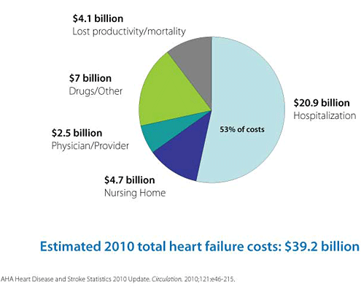

Slide 4
~50% OF PATIENTS DIE WITHIN
5 YEARS OF DIAGNOSIS
~1^{IN}4 HEART FAILURE PATIENTS
DIE WITHIN 1 YEAR OF DIAGNOSIS
www.heartfailure.com

Slide 5

www.heartfailure.com

Slide 6
Heart failure progressive clinical course
Normal heart
Chronic HF
Death
Beginning of congestive HF
ADHF episode:
Congestion, hospital admission
Viability of the heart/survival
Later ADHF episode:
Emergency treatment,
CPAP and ICU
Initial phase
Final year
Modified from Gheorghiade M, et al. Am J Cardiol 2005;96:11G–17G

Slide 7
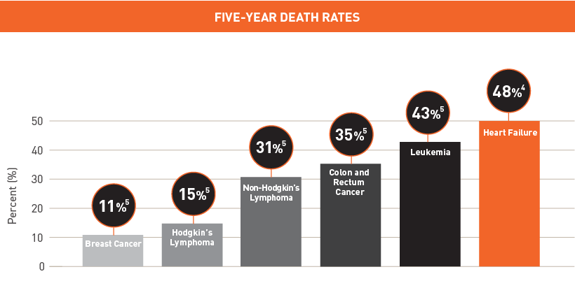
Heart failure is deadlier than many cancers

Slide 8
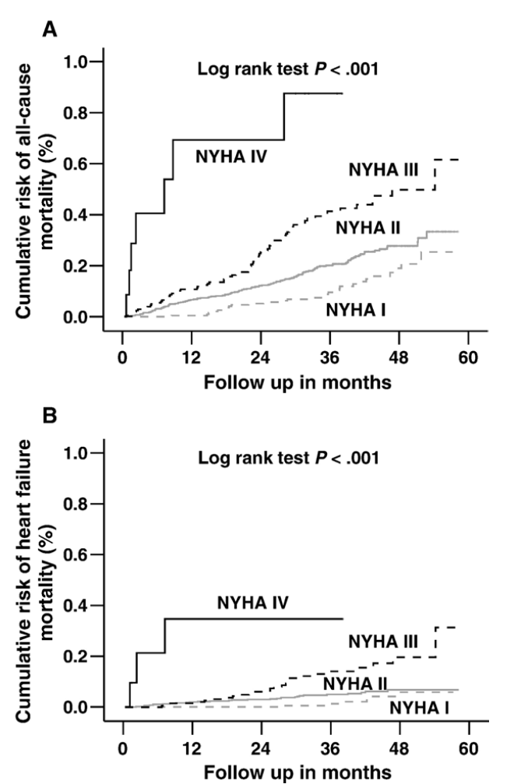
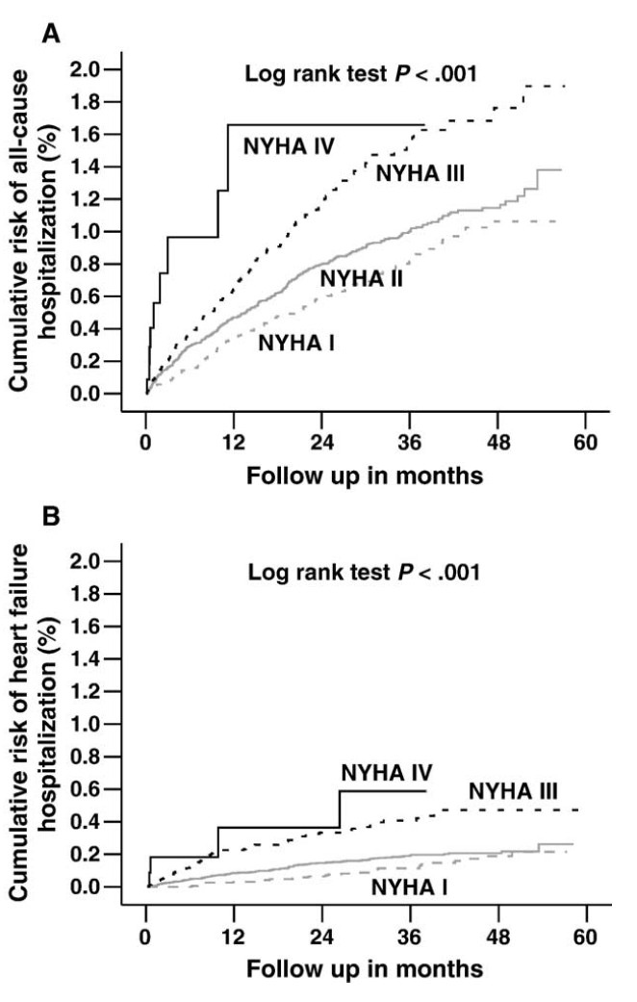
Am Heart J 2006;151:444- 50

Slide 9
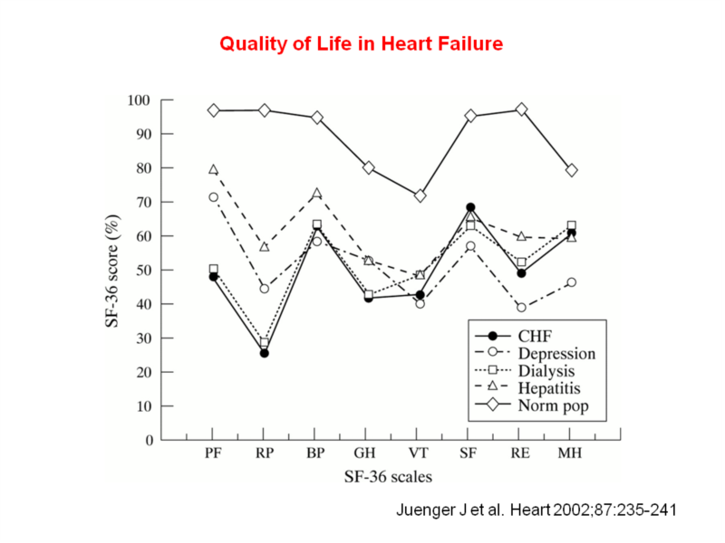

Slide 10
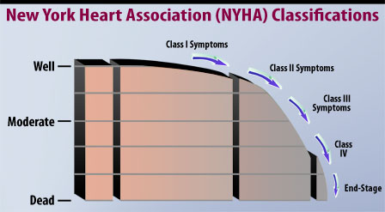

Slide 11
Definition
Heart failure is a complex clinical syndrome
Can result from:
structural or functional cardiac disorder
impairs the ability of the ventricle to fill with or eject blood

Slide 12
Inability of the heart to pump blood at an output sufficient to meet the body’s demands

Slide 13
Characterized by:
signs and symptoms of intravascular and interstitial volume overload and/or
manifestations of inadequate tissue perfusion

Slide 14
Heart failure may result from an acute insult to cardiac function, such as a large myocardial infarction, valvular diseas, myocarditis, and cardiogenic shock
More commonly, from a chronic process

Slide 15
Common Causes
Coronary artery disease
Hypertension
Dilated cardiomyopathy
Valvular heart disease
Notes:
15

Slide 16
Common Causes
Coronary artery disease
Hypertension
Valvular heart disease
Dilated cardiomyopathy
Cor-pulmonale
Notes:
16

Slide 17
Cardiomyopathy
"heart muscle diseases of unknown cause"
Diseases of the myocardium associated with cardiac dysfunction

Slide 18
Classification
Dilated cardiomyopathy (DCM)
Hypertrophic cardiomyopathy (HCM)
Restrictive cardiomyopathy (RCM)
Arrhythmogenic right ventricular cardiomyopathy/dysplasia (ARVC/D)
Unclassified cardiomyopathies

Slide 19
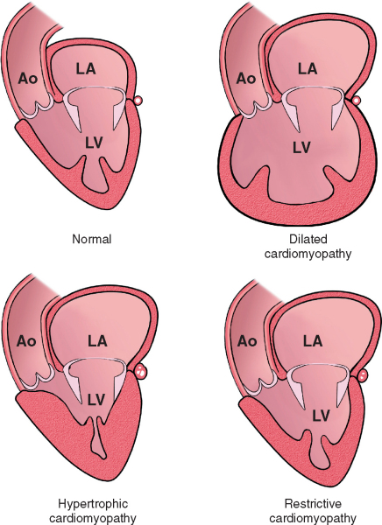

Slide 20
Dilated Cardiomyopathy
Dilated cardiomyopathy is characterized by ventricular dilation and impaired contractile performance, which may involve the left or both ventricles

Slide 21
May develop as a consequence of prior myocarditis or as a result of a recognized toxin, infection, predisposing cardiovascular disease (e.g., hypertension, ischemic or valvular heart disease
When no cause or associated disease is identified, dilated cardiomyopathy has been termed idiopathic
50 to 60% of such patients have familial disease, and disease-causing mutations currently can be identified in 10 to 20% of such families.

Slide 22
A trigger with immune-mediated pathogenesis in genetically predisposed individuals
One third of probands and family members develop low-titer, organ-specific autoantibodies to cardiac α-myosin
Viral persistence has also been implicated as an ongoing trigger of immune-mediated damage

Slide 23
Alcoholic Cardiomyopathy
Alcohol and its metabolite, acetaldehyde, are cardiotoxins acutely and chronically.
Myocardial depression is initially reversible but, if sustained, can lead to irreversible vacuolization, mitochondrial abnormalities, and fibrosis
The amount of alcohol necessary to produce symptomatic cardiomyopathy in susceptible individuals is not known
Abstinence leads to improvement in at least 50% of patients with severe symptoms, some of whom normalize their left ventricular ejection fractions

Slide 24
Chemotherapy
Doxorubicin (Adriamycin) cardiotoxicity causes characteristic histologic changes on endomyocardial biopsy, with overt heart failure in 5 to 10% of patients who receive doses greater than or equal to 450 mg/m2 of body surface area
Cyclophosphamide and ifosfamide can cause acute severe heart failure and malignant ventricular arrhythmias
5-Fluorouracil can cause coronary artery spasm and depressed left ventricular contractility.
Trastuzumab has been associated with an increased incidence of heart failure

Slide 25
Skeletal Myopathies
Duchenne's muscular dystrophy and Becker's X-linked skeletal muscle dystrophy typically include cardiac dysfunction
Maternally transmitted mitochondrial myopathies such as Kearns-Sayre syndrome frequently cause cardiac myopathic changes

Slide 26
Peripartum Cardiomyopathy
Peripartum cardiomyopathy appears in the last month of pregnancy or in the first 5 months after delivery in the absence of preexisting cardiac disease
Lymphocytic myocarditis, found in 30 to 50% of biopsy specimens, suggests an immune component
The prognosis is improvement to normal or near-normal ejection fraction during the next 6 months in more than 50% of patients.

Slide 27
Hypertrophic Cardiomyopathy
Genetically determined myocardial disease
Defined clinically by the presence of unexplained left ventricular hypertrophy
Pathologically by the presence of myocyte disarray surrounding increased areas of loose connective tissue

Slide 28
Usually familial, with autosomal dominant inheritance.
Abnormalities in sarcomeric contractile protein genes account for approximately 50 to 60% of cases

Slide 29
Pathology
Typically, heart weight is increased and the interventricular septum is hypertrophic,
Any pattern of thickening may occur
Histologically, the hallmark of hypertrophic cardiomyopathy is myocyte disarray.

Slide 30
Clinical expression of left ventricular hypertrophy usually occurs during periods of rapid somatic growth,
May be during the first year of life or childhood but more typically during adolescence and, occasionally, in the early 20s

Slide 31
Most patients are asymptomatic or have only mild or intermittent symptoms.
Symptomatic progression is usually slow, age related, and associated with a gradual deterioration in left ventricular function over decades

Slide 32
Symptoms may develop at any age, even many years after the appearance of LVH
Occasionally, sudden death may be the initial presentation

Slide 33
Restrictive Cardiomyopathy
Characterized by impaired filling and reduced diastolic volume of the left and/or right ventricle despite normal or near-normal systolic function and wall thickness

Slide 34
Primary forms are uncommon,
Secondary forms, the heart is affected as part of a multisystem disorder,
Usually present at the advanced stage of an infiltrative disease (e.g., amyloidosis or sarcoidosis) or a systemic storage disease (e.g., hemochromatosis).

Slide 35
Restrictive cardiomyopathy may be familial
Part of the genetic and phenotypic expression of hypertrophic cardiomyopathy caused by sarcomeric contractile protein gene abnormalities

Slide 36
Secondary forms:
- amyloidosis, hemochromatosis, several of the glycogen storage diseases, and Fabry's disease
Reported in association with skeletal myopathy and conduction system disease as part of the phenotypic spectrum caused by mutations in lamin A or C.

Slide 37
CAUSES OF RESTRICTIVE CARDIOMYOPATHIES
INFILTRATIVE DISORDERS
Amyloidosis Sarcoidosis
STORAGE DISORDERS
Hemochromatosis Fabry's disease Glycogen storage diseases
FIBROTIC DISORDERS
Radiation Scleroderma Drugs (e.g., doxorubicin, serotonin, ergotamine)
METABOLIC DISORDERS
Carnitine deficiency Defects in fatty acid metabolism
ENDOMYOCARDIAL DISORDERS
Endomyocardial fibrosis Hypereosinophilic syndrome (Lofler's endocarditis)
MISCELLANEOUS CAUSES
Carcinoid syndrome

Slide 38
Pathophysiology
Increased stiffness of the endocardium or myocardium, induces ventricular pressures to rise disproportionately to small changes in volume until a maximum is reached.

Slide 39
Stages, Phenotypes and Treatment of HF

Slide 40
Nomenclature
Heart failure vs.
Cardiomyopathy
LV dysfunction
Pulmonary edema

Slide 41
Classification
Left vs. Right
Systolic vs. Diastolic
High output vs. low output

Slide 42
Heart Failure Syndrome
The initial manifestations of hemodynamic dysfunction are a reduction in stroke volume and a rise in ventricular filling pressures under conditions of increased systemic demand for blood flow
This stimulates a variety of interdependent compensatory responses involving the cardiovascular system, neurohormonal systems, and alterations in renal physiology

Slide 43
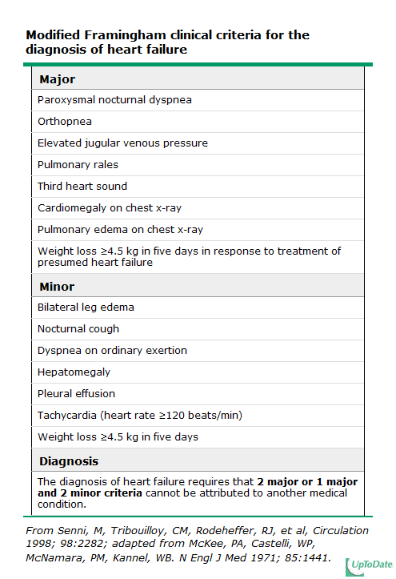
Notes:
43

Slide 44
Evaluation

Slide 45
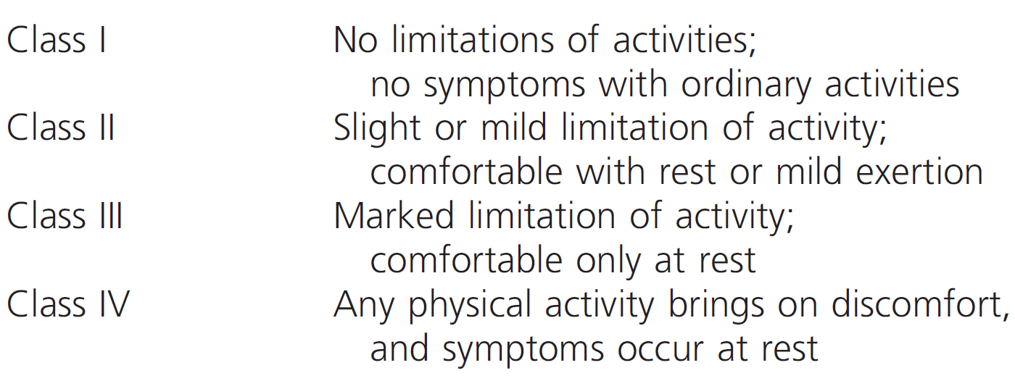
NYHA Classiffication
Notes:
45

Slide 46
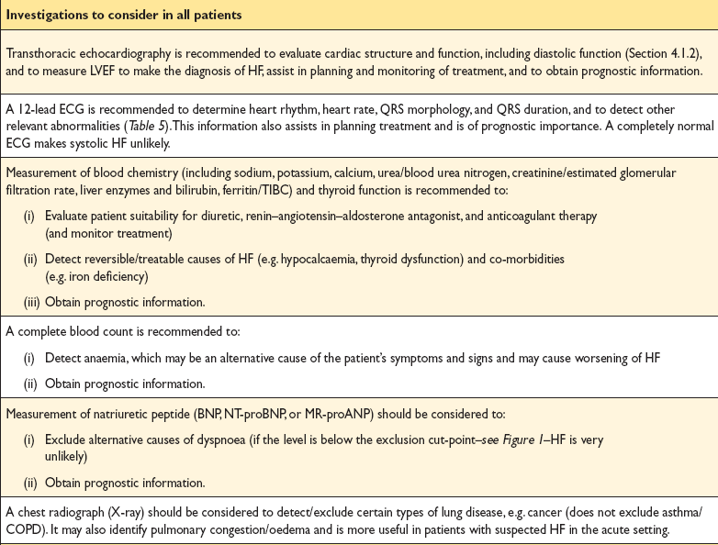

Slide 47
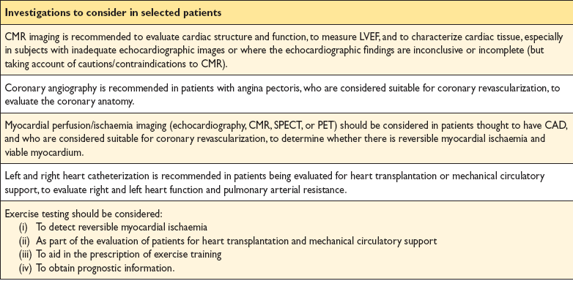

Slide 48
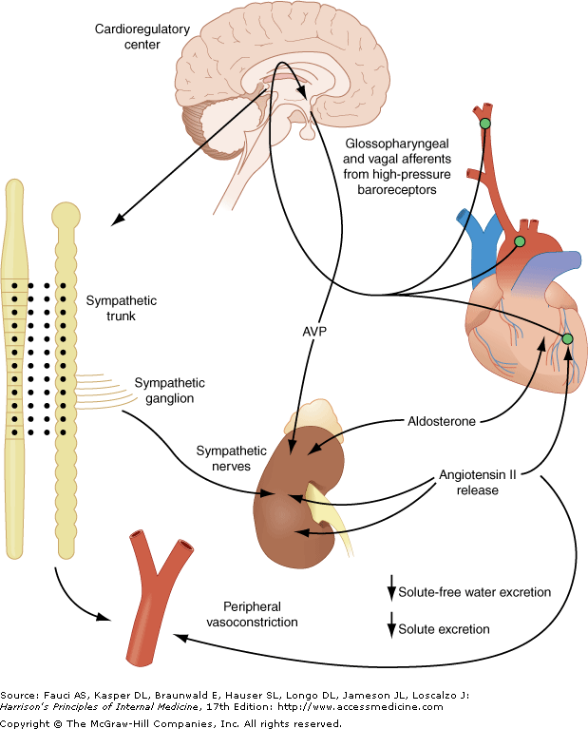

Slide 49
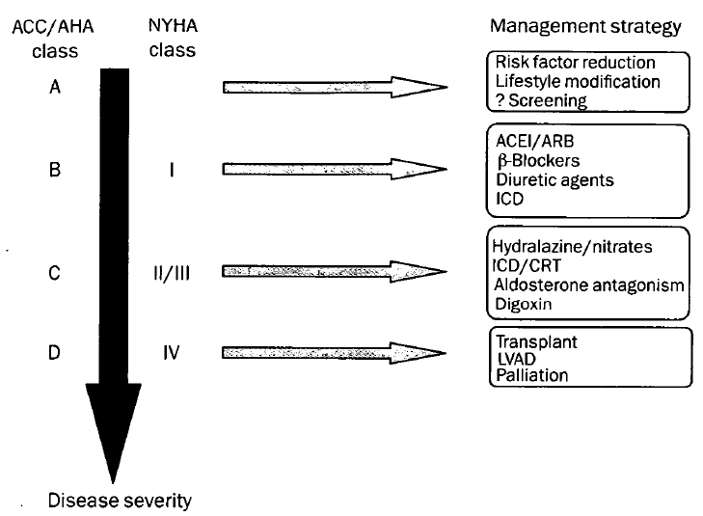
Therapy

Slide 50
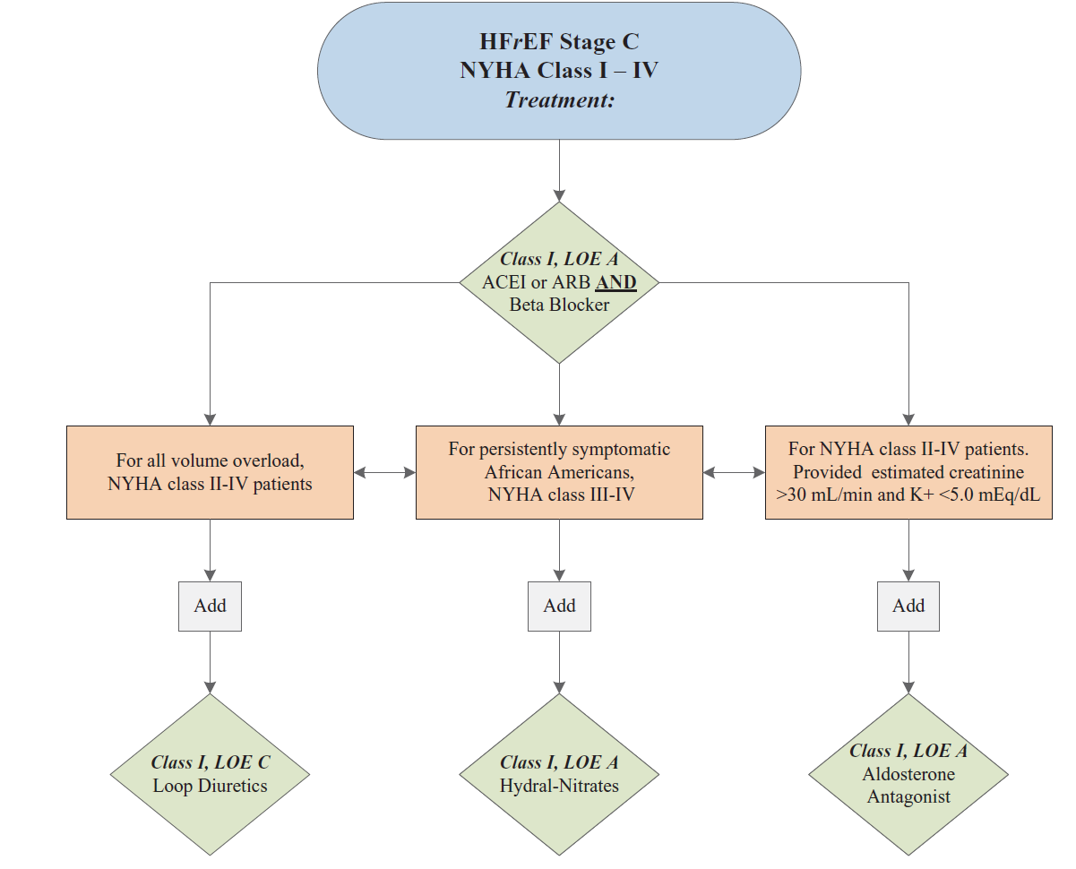
ACC/AHA 2013

Slide 51
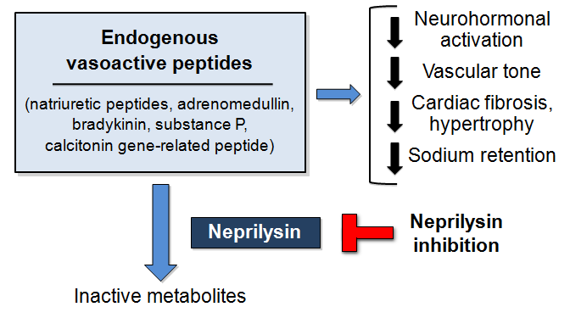
Natriuretic Peptides

Slide 52
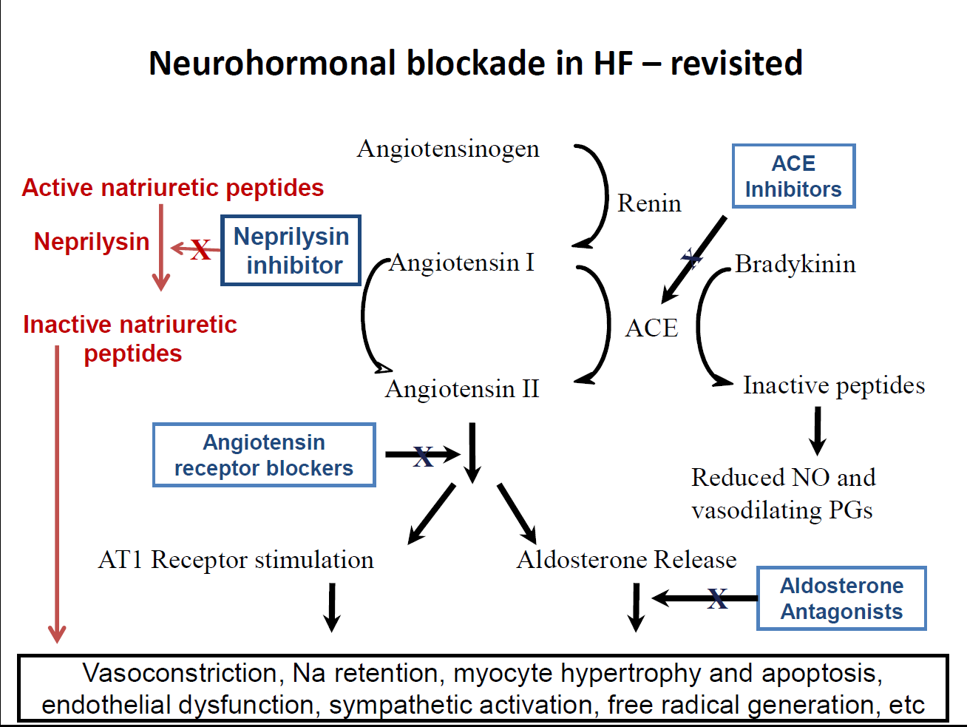

Slide 53
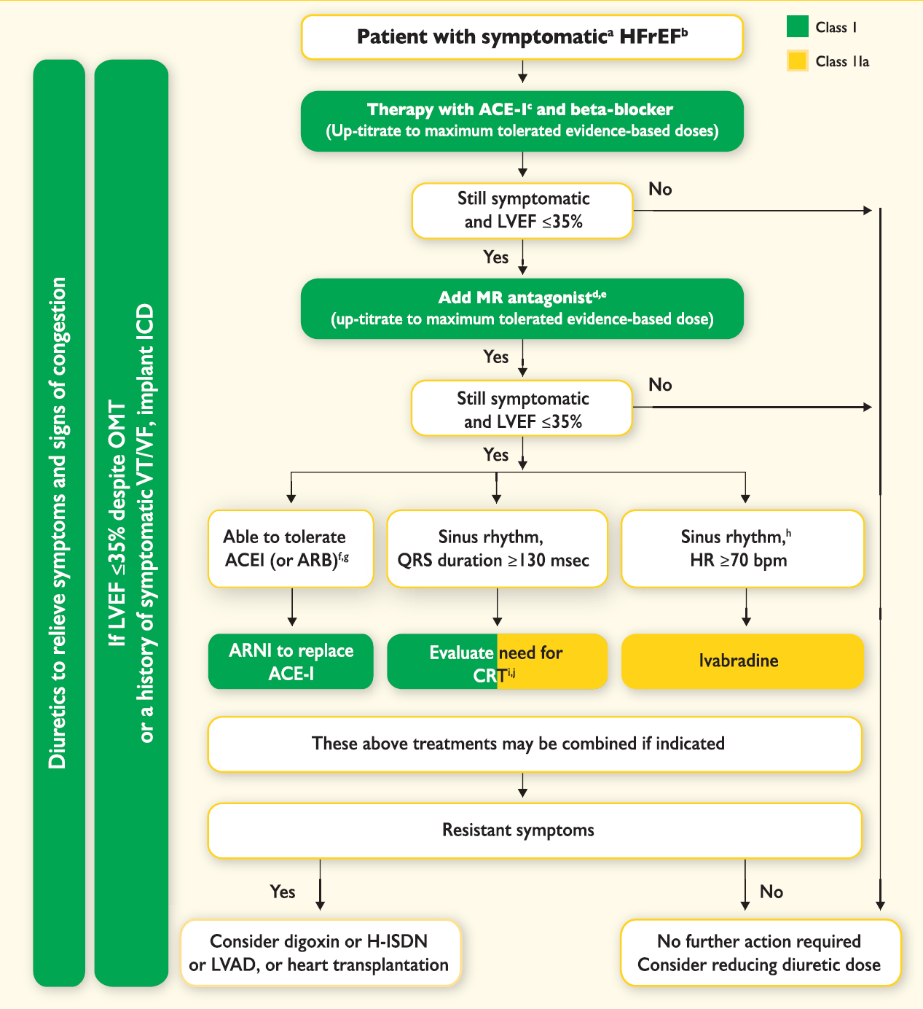
Ponikowski et al. Eur Heart J 2016;37:2129–2200

Slide 54
56 Y/O gentleman
Diagnosed dilated cardiomyopathy
LVEF 25%
NYHA class II
O/E B/P 112/68 HR 82 bpm
JVP 7 cm water,
Soft S3 and grade 2 PSM
Chest clear,
No LL edema and warm extremities

Slide 55
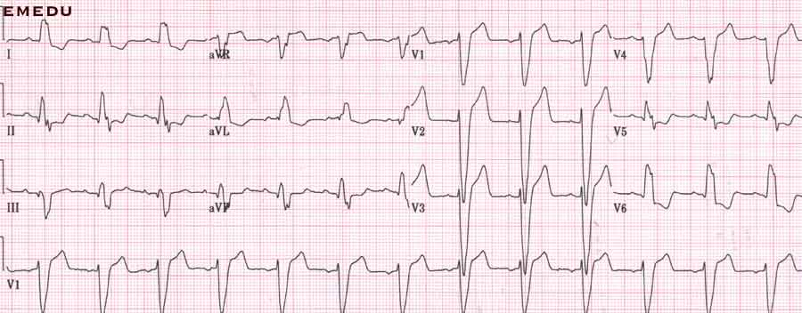

Slide 56
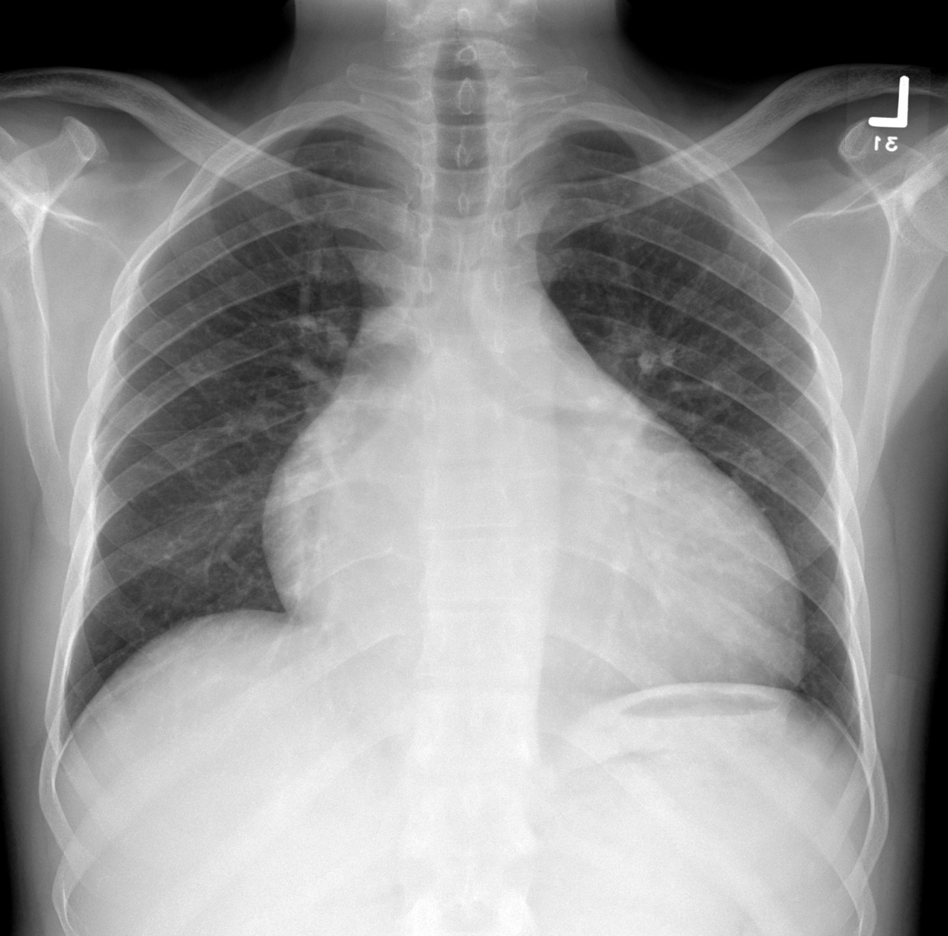

Slide 57
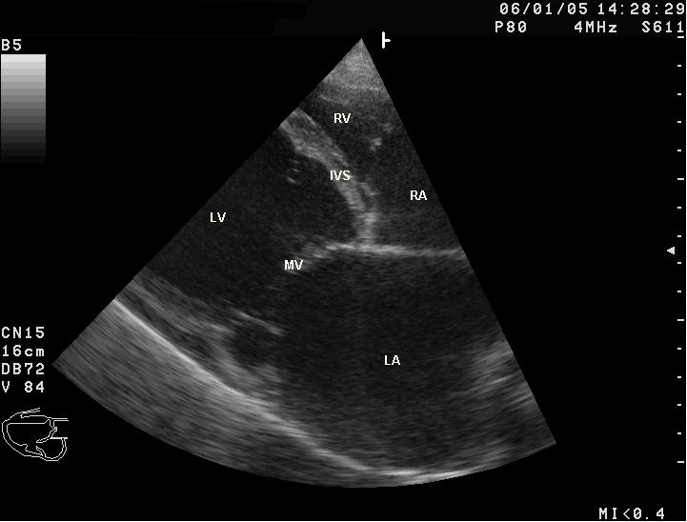

Slide 58
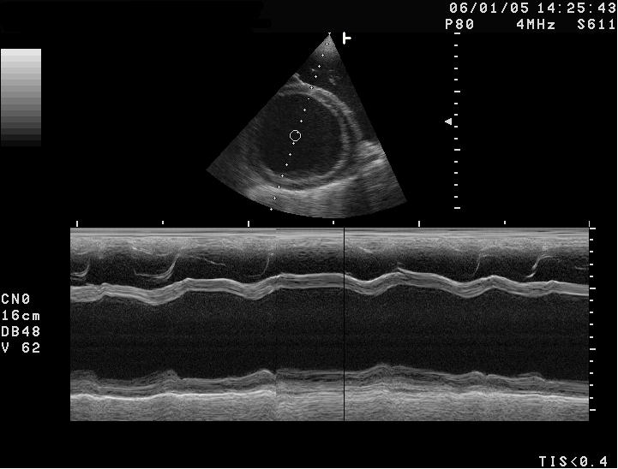

Slide 59
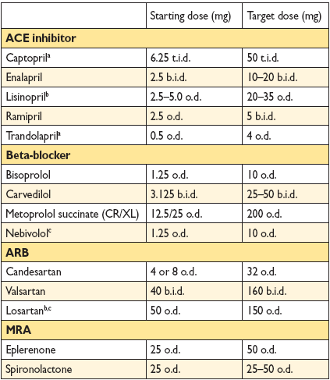

Slide 60
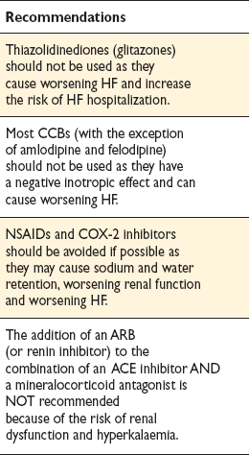
Treatments (or combinations of treatments) that may cause harm in patients with symptomatic (NYHA class
II–IV) systolic heart failure

Slide 63
Acute Heart Failure

Slide 64
FACTORS THAT MAY PRECIPITATE ACUTE DECOMPENSATION OF CHRONIC HEART FAILURE

Slide 65
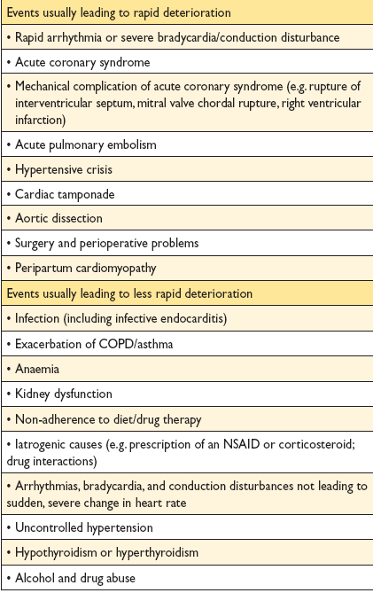

Slide 66
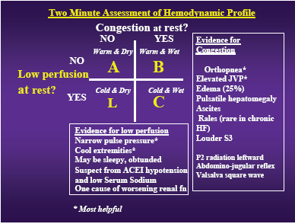
Notes:
66

Slide 67
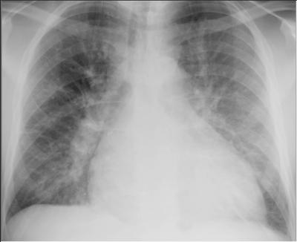

Slide 68
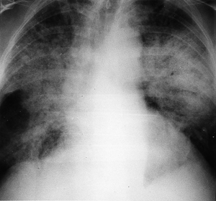

Slide 70
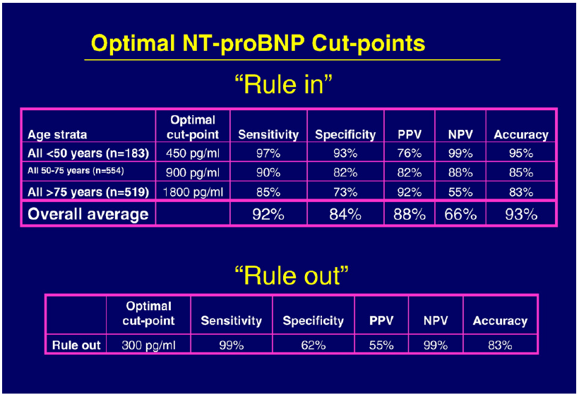

Slide 71
