Slide 1
Heart Failure Management
Waleed AlHabeeb, MD, MHA Assistant Professor of Medicine Consultant Heart Failure Cardiologist

Slide 2
Heart failure prevalence is expected to continue to increase¹
21 MILLION
ADULTS WORLDWIDE ARE
LIVING WITH HEART FAILURE
AND THIS NUMBER IS EXPECTED TO RISE^{1,2}
AGING POPULATION²
INCREASING PREVALENCE OF RISK FACTORS²
IMPROVED POST-MI SURVIVAL²
A person at age 40 has a 1 in 5 lifetime risk of developing HF, and more than
1 million hospitalizations due to HF are reported annually in Europe^{1,4}
HF=heart failure; MI=myocardial infarction
1. Mozaffarian et al. Circulation 2015;131:e29–e322. 2. Mosterd and Hoes. Heart 2007;93:1137–46. 3. Velagaleti and Vasan Epidemiology of heart failure. In: Mann, ed. Heart Failure: A Companion to Braunwald's Heart Disease. 2nd ed. St Louis: Saunders; 2011. 4. Ponikowski et al. ESC Heart Failure 2014;1:4–25

Slide 3
HF is associated with high mortality rates
~50%
OF PATIENTS DIE WITHIN
5 YEARS OF DIAGNOSIS¹
HF PATIENTS DIE WITHIN
1 YEAR OF DIAGNOSIS²
~1 ^{IN} 4
1. Roger et al. JAMA 2004;292:344–50; 2. Levy et al. N Engl J Med 2002;347:1397–402

Slide 4
HF progressive clinical course
Normal heart
Chronic HF
Death
Beginning of congestive HF
ADHF episode:
Congestion, hospital admission
Viability of the heart/survival
Later ADHF episode:
Emergency treatment,
CPAP and ICU
Initial phase
Final year
ADHF=acute decompensated heart failure; CPAP=continuous positive airway pressure; ICU=Intensive Care Unit
Modified from Gheorghiade et al. Am J Cardiol 2005;96:11G–17G

Slide 5
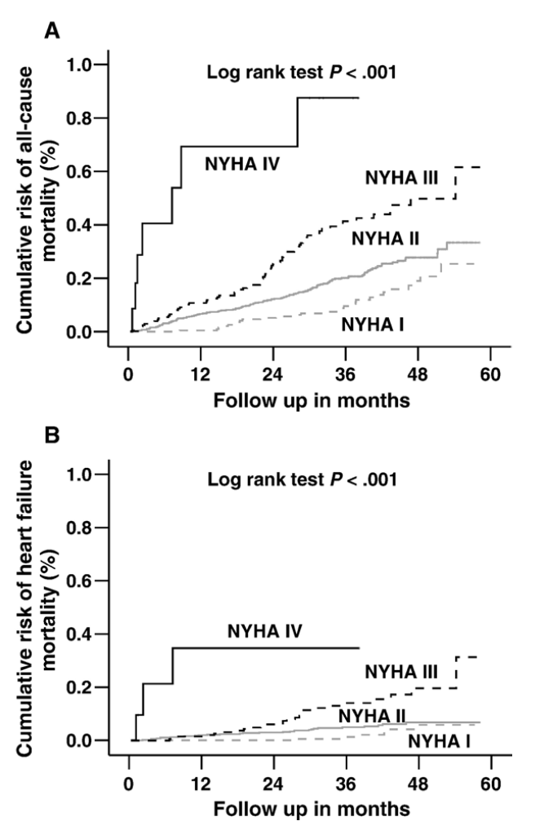
All cause mortality and HF mortality by NYHA functional class
Ahmed et al. Am Heart J 2006;151:444–50

Slide 6
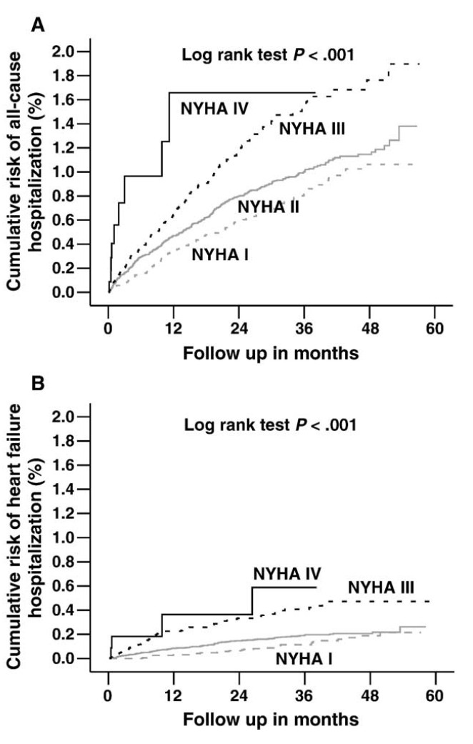
All cause hospitalization and hospitalization due to HF by NYHA functional class
Ahmed et al. Am Heart J 2006;151:444–50

Slide 7
HFHF is deadlier than many cancers is deadlier than many cancers
48%²
40%¹
34%¹
29%¹
Percentage
14%¹
10%¹
1. National Cancer Institute. Cancer stat fact sheets. Available at: http://seer.cancer.gov/statfacts. Accessed 31 May 2016; 2. Roger et al. JAMA 2004;292:344–50

Slide 8
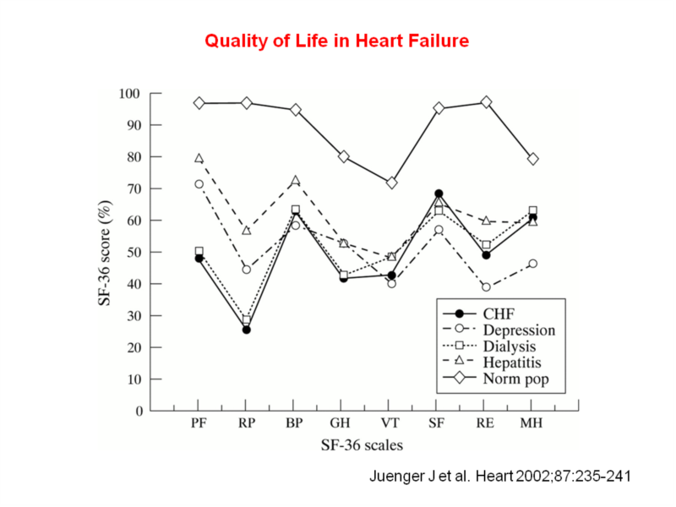
Quality of life of patients with chronic HF is similar to other chronic diseases
BP=bodily pain; CHF=chronic HF; GH=general health perceptions; MH=mental health; PF=physical functioning;
RE=role limitations caused by emotional problems; RP=role limitations due to physical limitations; SF=social functioning; SF-36=short-form
health survey; VT=vitality
Juenger et al. Heart 2002;87:235–41

Slide 9
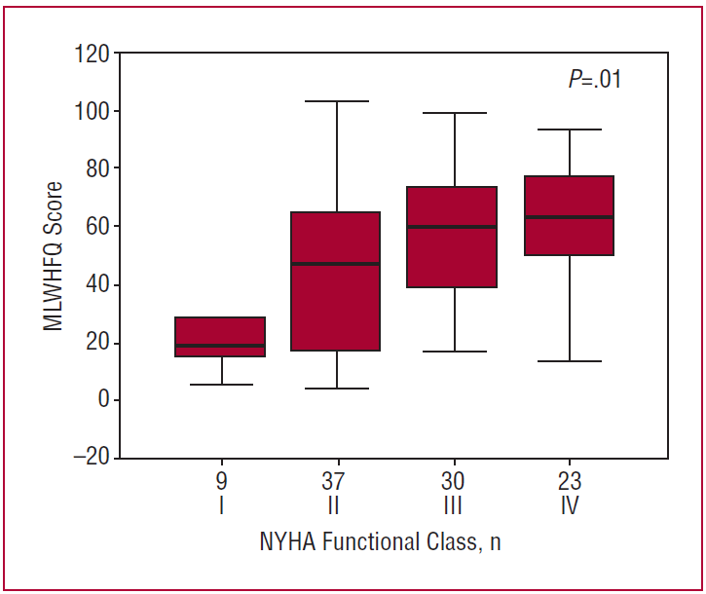
Rev Esp Cardiol. 2007;60(10):1093-6

Slide 10
Stages, Phenotypes and Treatment of HF

Slide 11
LV function in Heart Failure
Classification | Ejection Fraction | Description
I. Heart Failure with Reduced Ejection Fraction (HFrEF) | ≤40% | Also referred to as systolic HF. Randomized clinical trials have mainly enrolled patients with HFrEF and it is only in these patients that efficacious therapies have been demonstrated to date.
II. Heart Failure with Preserved Ejection Fraction (HFpEF) | ≥50% | Also referred to as diastolic HF. Several different criteria have been used to further define HFpEF. The diagnosis of HFpEF is challenging because it is largely one of excluding other potential noncardiac causes of symptoms suggestive of HF. To date, efficacious therapies have not been identified.
a. HFpEF, Borderline | 41% to 49% | These patients fall into a borderline or intermediate group. Their characteristics, treatment patterns, and outcomes appear similar to those of patient with HFpEF.
b. HFpEF, Improved | >40% | It has been recognized that a subset of patients with HFpEF previously had HFrEF. These patients with improvement or recovery in EF may be clinically distinct from those with persistently preserved or reduced EF. Further research is needed to better characterize these patients.

Slide 12
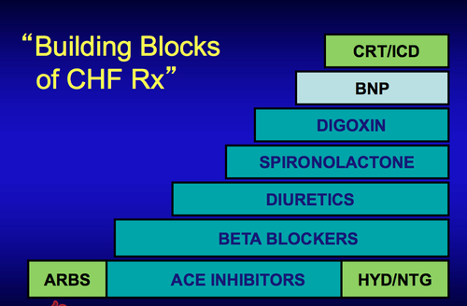
Medications

Slide 13
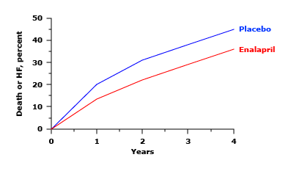
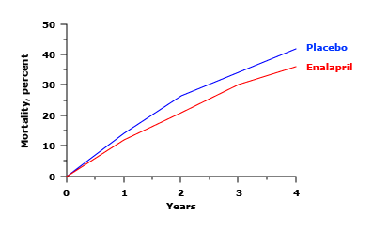
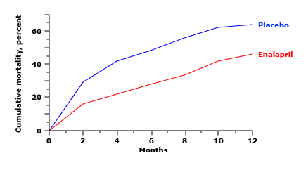
Angiotensin Converting Enzyme Inhibitors
asymptomatic LV dysfunction
in moderate HF
in advanced HF
CONSENSUS, N Engl J Med 1987; 316:1429.

Slide 14
ACE inhibitors are recommended for routine administration to symptomatic and asymptomatic patients with LVEF ≤ 40%. (Strength of Evidence A)
ACE inhibitors should be titrated to doses used in clinical trials, as tolerated
HFSA Guidelines 2010

Slide 15
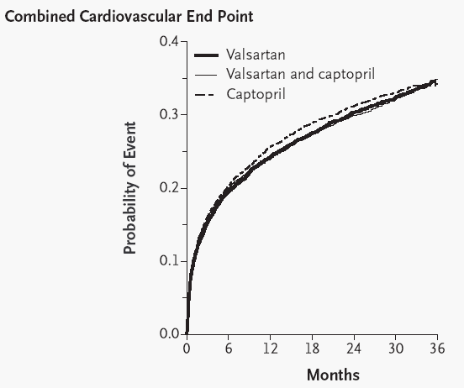
Angiotensin Receptor Blockers
ACEI remain the first choice for inhibition of the renin-angiotensin system in chronic HF,
ARBs can be considered
a reasonable alternative
VALIANT
N Engl J Med 2003;349:1893-906

Slide 16
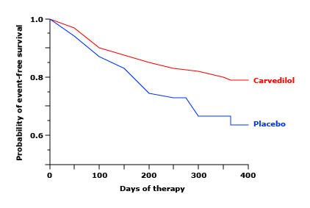
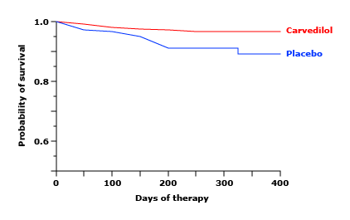
Beta Blockers
N Engl J Med 1996; 334:1349.

Slide 17
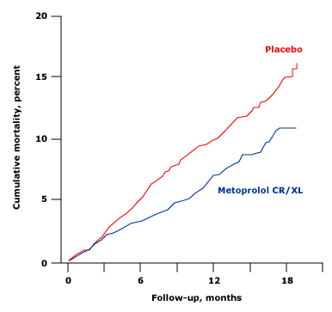
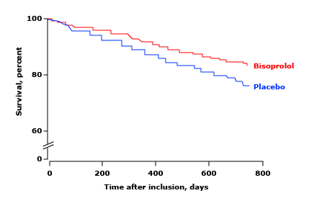
The MERIT-HF Study Group, Lancet 1999; 353:2001
CIBIS-II Investigators and Committees. Lancet 1999; 353:9

Slide 18
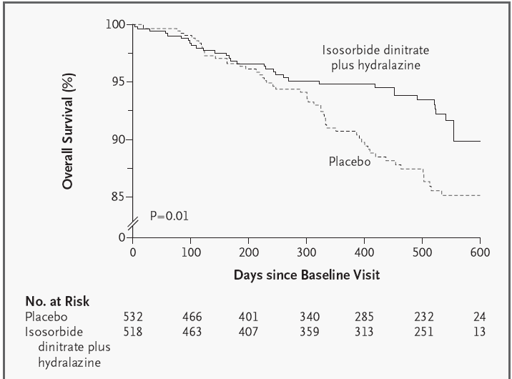
Hydralazine / Nitrates
A-HeFT
N Engl J Med 2004;351:2049-57

Slide 20
Treatment with a combination of hydralazine plus nitrate in patients with HF and reduced LVEF who are unable to take ACE inhibitor or ARB
Patients with persistent NYHA class III to IV HF and LVEF <40 percent despite optimal therapy the addition of the combination of hydralazine and an oral nitrate is recommended

Slide 21
MRA
NYHA class II-IV
Post MI, LVEF <40%
HF symptoms or DM
Spironolactone vs. Eplerenone
N Engl J Med 2003;348:1309-21

Slide 22
Aldosterone receptor antagonists (or mineralocorticoid receptor antagonists) are recommended in patients with NYHA class II–IV HF and who have LVEF of 35% or less, to reduce morbidity and mortality.

Slide 23
Aldosterone receptor antagonists are recommended to reduce morbidity and mortality following an acute MI in patients who have LVEF of 40% or less who develop symptoms of HF or who have a history of diabetes mellitus

Slide 24
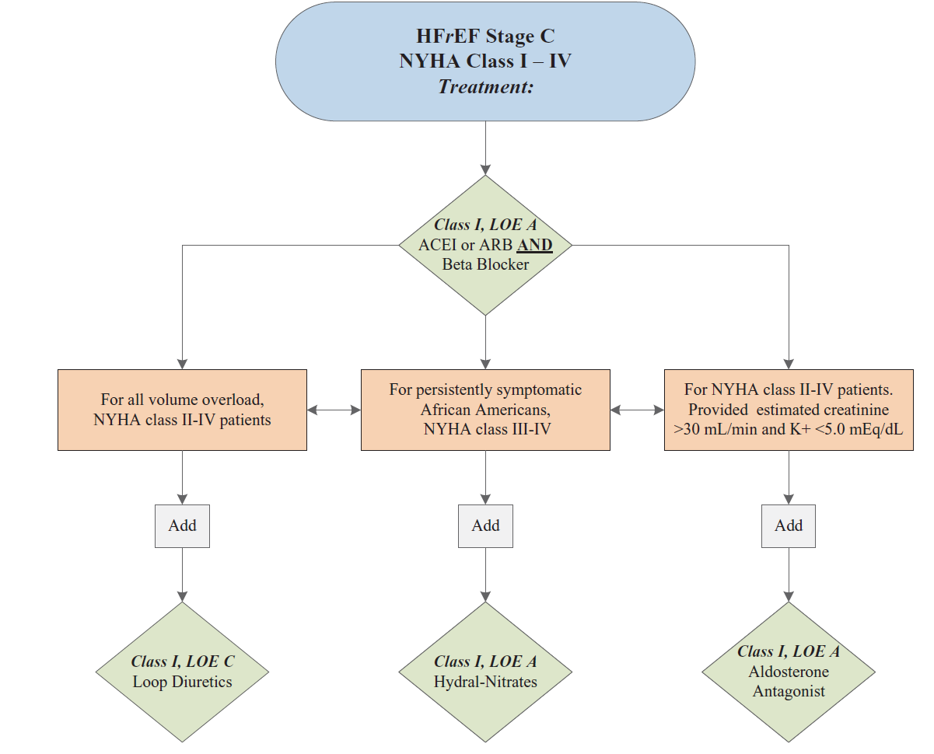

Slide 25


Ivabradine reduced death from heart failure
Death from HF (%)
10
HR = 0.74
P = 0.014
Placebo
26%
5
Ivabradine
0
0
6
12
18
24
30
Months
Swedberg K, et al. Lancet. 2010;online August 29.

Slide 26
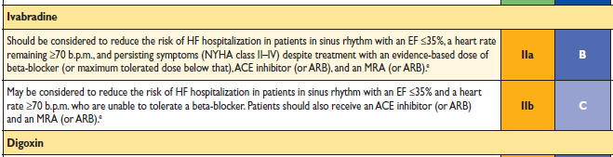
ESC Guidelines

Slide 27
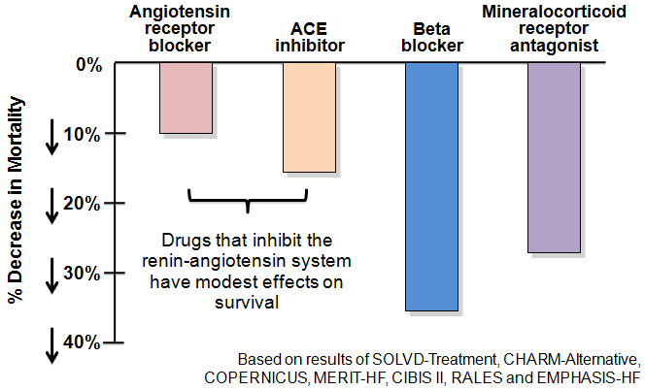
Drugs That reduce Mortality in Heart Failure With Reduced EF

Slide 28
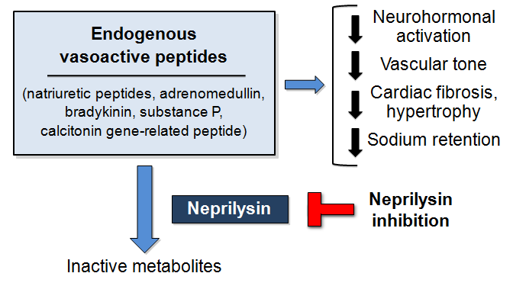
Neprilysin Inhibition Potentiate Actions of Vasoactive Peptides That counter Maladaptive Mechanisms in Heart Failure

Slide 29
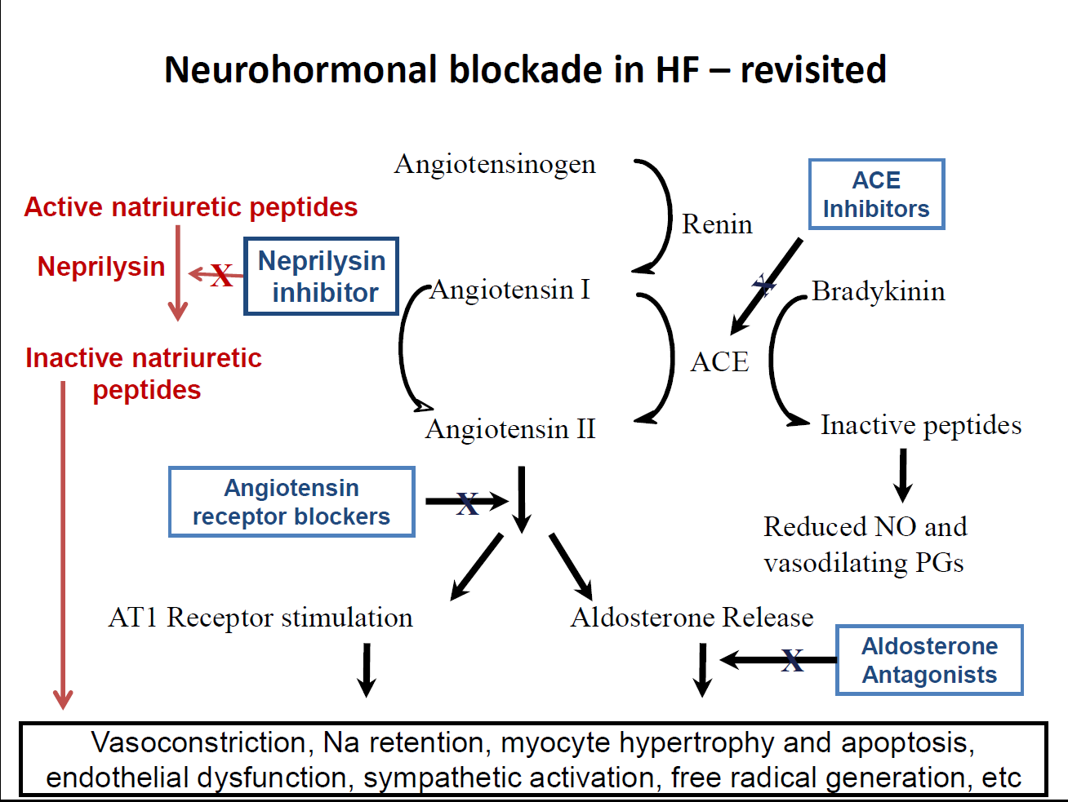

Slide 30
PARADIGM-HF: Cardiovascular Death or Heart Failure Hospitalization (Primary Endpoint)
40
Enalapril
(n=4212)
1117
32
914
24
LCZ696
(n=4187)
Kaplan-Meier Estimate of
Cumulative Rates (%)
16
HR = 0.80 (0.73-0.87)
P = 0.0000002
Number needed to treat = 21
8
0
0
180
360
540
720
900
1080
1260
Patients at Risk
Days After Randomization
LCZ696
Enalapril
4187
4212
3922
3883
3663
3579
3018
2922
2257
2123
1544
1488
896
853
249
236

Slide 31
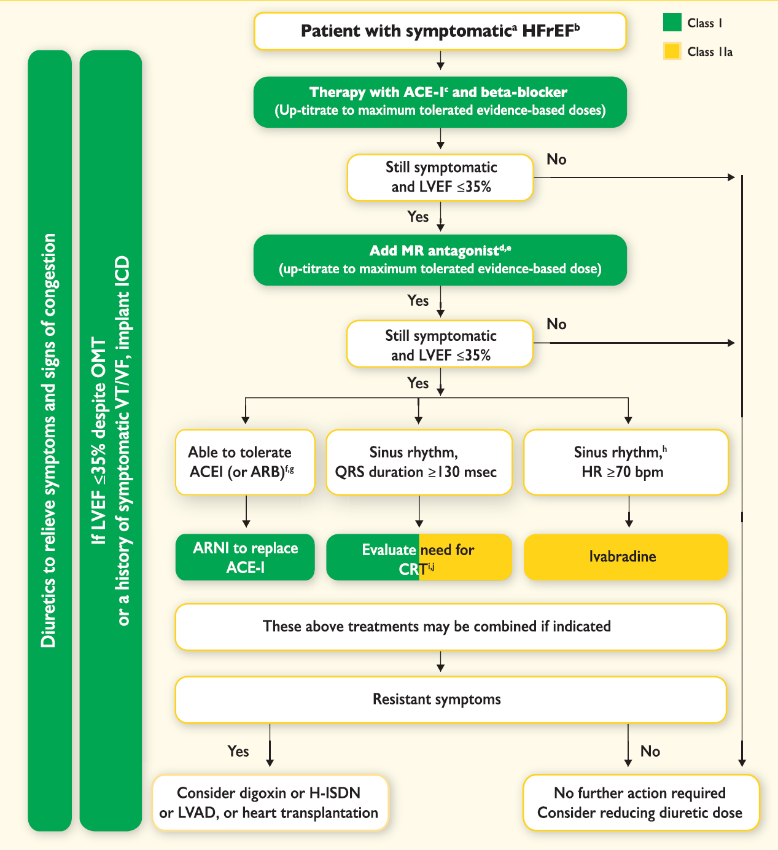
Ponikowski et al. Eur Heart J 2016;37:2129–2200

Slide 32
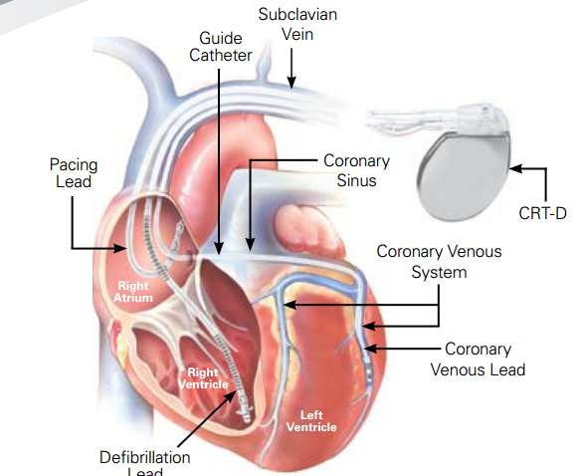
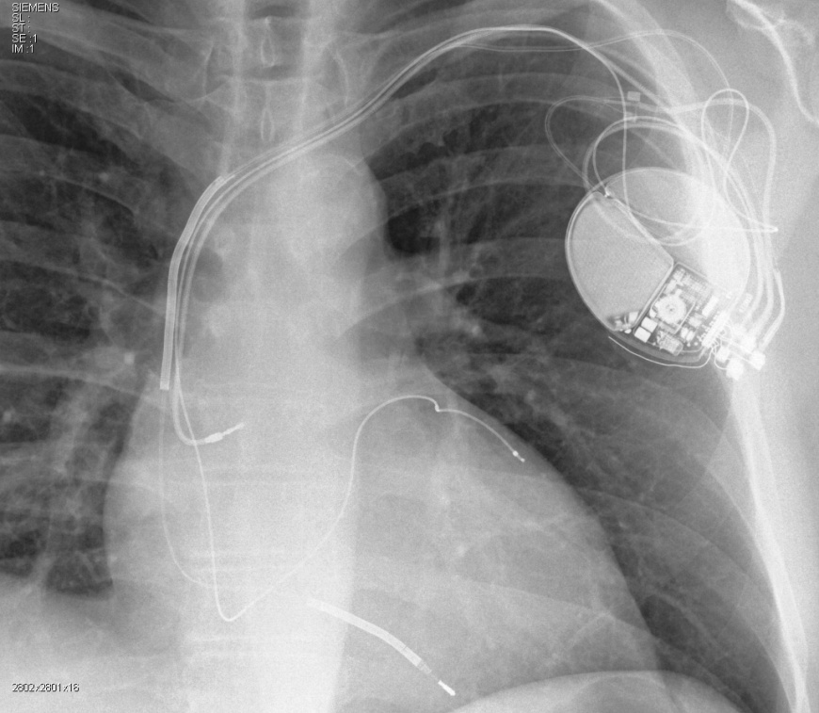
Devices

Slide 33
Indications for CRT Therapy
Notes:
380624 slide 37

Slide 34

Advanced heart failure
Defined as persistent symptoms (NYHA class III–IV) that limit daily life despite routine therapy with agents of known benefit
End-stage, refractory heart failure, probably accounts for 5% to 10% of the total population
This group, consumes >60% of health-care expenditures for all patients with heart failure

Slide 35
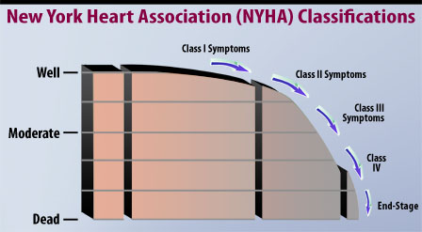

Slide 36
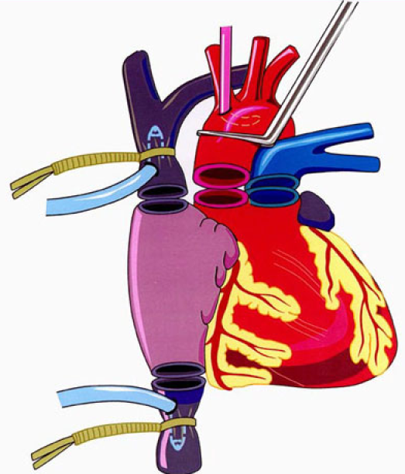
Heart Transplantation
Orthotopic cardiac transplantation remains the definitive therapy for terminal heart failure
5-year survival of 70%,
10-year survival of 60%,
Markedly improved quality of life
Donor organ availability has remained static even as the waiting list for heart transplant grows

Slide 37
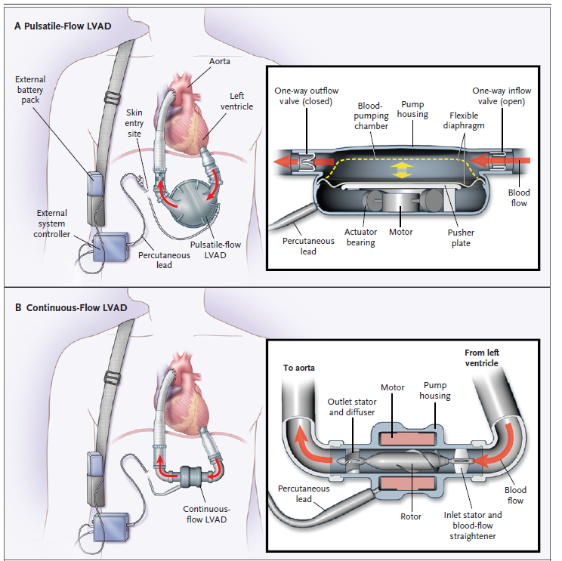

Slide 38
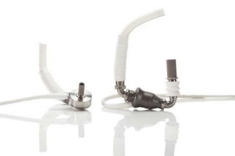
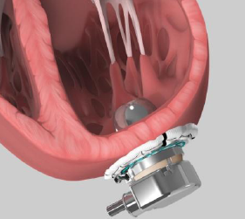

Slide 39
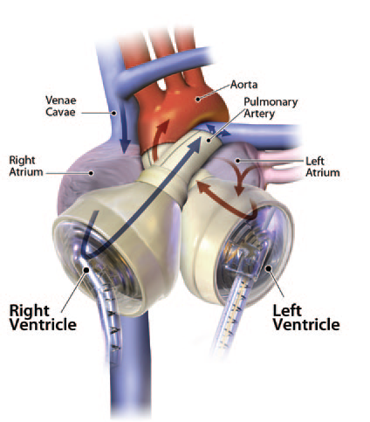
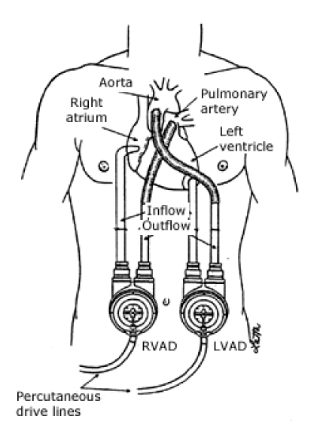
BiVAD

Slide 40

THANK YOU

