Slide 1
Heart Failure Management and Prognosis
Dr. Rashed Alfagih MBBS MHSc
Consultant Cardiologist KFCC

Slide 2
Presentation
Chronic or Subacute.
Acute.

Slide 3
Management
Correction of reversible causes
Ischemia
Valvular heart disease
Thyrotoxicosis, anemia and other high output status
Shunts
Arrhythmia
Tachy. Like : A fib, flutter or Brady. Like : CHB.
Medications
Ca channel blockers, some antiarrhythmics, NSAIDs,

Slide 4
Management tools
Life style modifications:
Diet, Fluid intake, exercise, Smoke cessation, Wt.
Pharmacological interventions:
Oral medication.
Immunization.
Surgical interventions:
Device therapy.
Assisting devices.
Transplant.

Slide 5
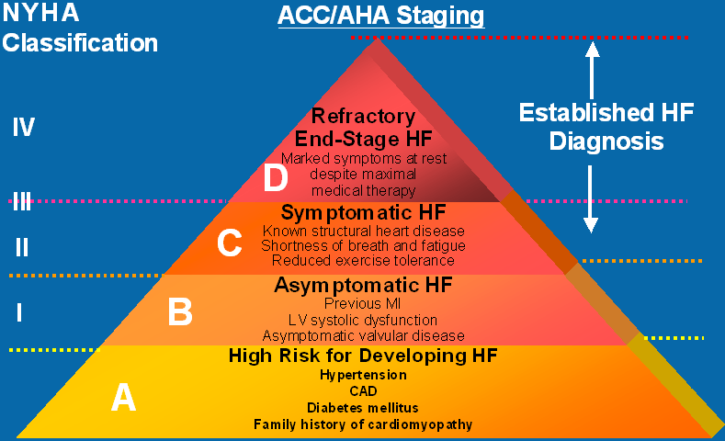
Stages of Heart Failure

Slide 6
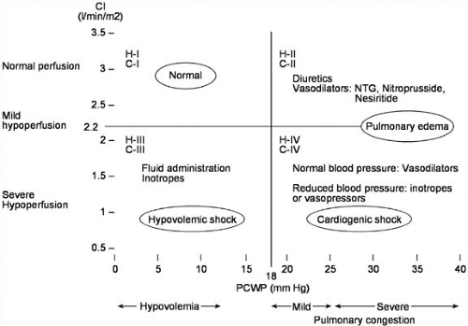
Forrester Classification
Am J Cardiol 1977;39:137–145

Slide 7
Forrester Classification
 |  | Congestion at Rest
 |  | No | Yes
Low Perfusion at rest | No | Warm & Dry | Warm & Wet
 | Yes | Cold & Dry | Cold & Wet
Eur J Heart Fail. 1999 Aug;1(3):251-7.
Notes:
Congestion: Orthopnea,/PND, JVP, Ascites, edema and rales.
Low perfusion: Narrow pulse pressure, Sleepy/obtunded, Low serum Na, Cool extremities, Hypotension with ACEi and renal dysfunction.

Slide 8
Diet and Activity
Salt restriction (2g of Na = 5 g NaCL)
Fluid restriction (1.5 to 2 L / day) about 8 cups
Daily weight (tailor therapy)
Gradual exertion programs (rehabilitation program)

Slide 9
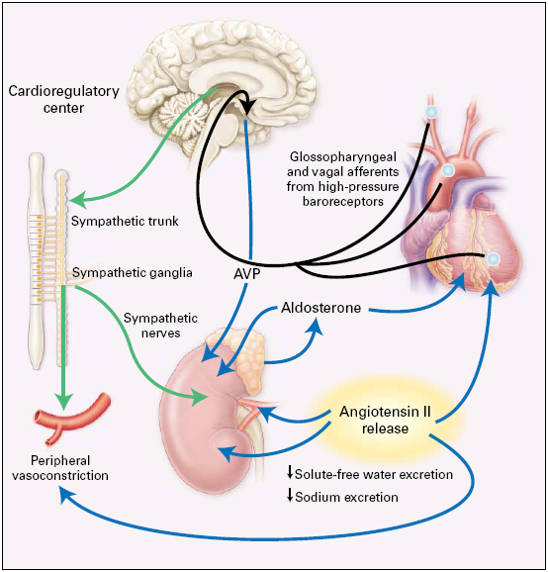

Slide 10
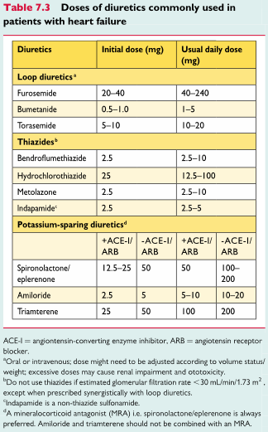
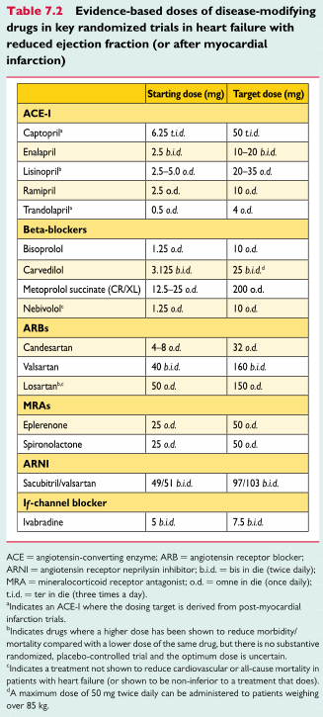

Slide 11
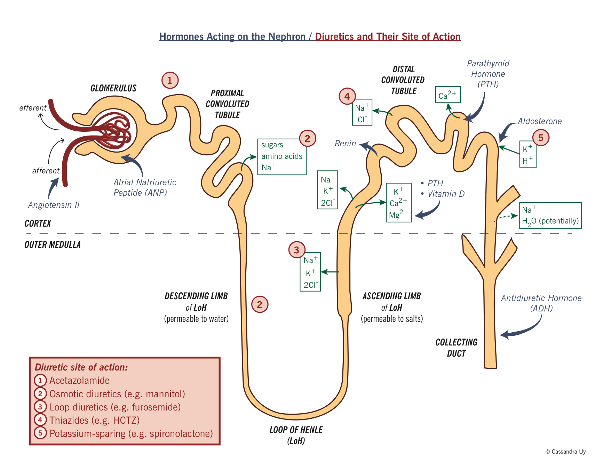

Slide 12
Diuretic Therapy
The most effective symptomatic relief
Mild symptoms
HCTZ
Chlorthalidone
Metolazone
Block Na reabsorbtion in loop of henle and distal convoluted tubules
Thiazides are ineffective with GFR < 30 --/min

Slide 13
Diuretics (cont.)
Side Effects
Pre-renal azotemia
Skin rashes
Neutropenia
Thrombocytopenia
Hyperglycemia
↑ Uric Acid
Hepatic dysfunction

Slide 14
Diuretics (cont.)
More severe heart failure → loop diuretics
Lasix (20 – 320 mg QD), Furosemide
Bumex (Bumetanide 1-8mg)
Torsemide (20-200mg)
Mechanism of action: Inhibit chloride reabsortion in ascending limb of loop of Henle results in natriuresis, kaliuresis and metabolic alkalosis
Adverse reaction:
pre-renal azotemia
Hypokalemia
Skin rash
ototoxicity

Slide 15
K⁺ Sparing Agents
Triamterene & amiloride – acts on distal tubules to ↓ K secretion
Spironolactone (Aldosterone inhibitor)
recent evidence suggests that it may improve survival in CHF patients due to the effect on renin-angiotensin-aldosterone system with subsequent effect on myocardial remodeling and fibrosis

Slide 16
Inhibitors of renin-angiotensin- aldosterone system
Renin-angiotensin-aldosterone system activation is early in the course of heart failure and plays an important role in the progression of the syndrome
Angiotensin converting enzyme inhibitors
Angiotensin receptors blockers
Spironolactone

Slide 17
Angiotensin Converting Enzyme Inhibitors
They block the R-A-A system by inhibiting the conversion of angiotensin I to angiotensin II → vasodilation and ↓ Na retention
↓ Bradykinin degradation ↑ its level → ↑ PG secretion & nitric oxide
ACE Inhibitors were found to improve survival in CHF patients
Delay onset & progression of HF in pts with asymptomatic LV dysfunction
↓ cardiac remodeling

Slide 18
Side effects of ACE inhibitors
Angioedema
Hypotension
Renal insuffiency
Rash
Cough

Slide 19
Angiotensin II receptor blockers
Has comparable effect to ACE I
Can be used in certain conditions when ACE I are contraindicated (angioneurotic edema, cough)

Slide 20
Angiotensin Receptor- Neprilysin inhibitor (ARNi)
Recent FDA approval (2015)
The only product available (valsartan/sacubitril)
Valsartan = ARB
Sacubitril = prodrug for sacubitrilat Inhibit neprilysin which breakdown the vasoactive peptides.
Used if patient LVEF <= 35% and still symptomatic with ACE/ARB
In this specific group of patients it improves M&M.

Slide 21
If- Channel blocker
Ivabradine ; Inhibit the Na inflow during the SA nodel action potential phase 4.
Degrease the heart rate.
Only use it if HR not controlled by BB and remains > 70 bpm and the patient has sinus rhythm.
In this group if patients it improve M&M.

Slide 22
Digitalis Glycosides (Digoxin, Digitoxin)
The role of digitalis has declined somewhat because of safety concern
Studies have shown that digitals does not affect mortality in CHF patients but causes significant:
Reduction in hospitalization
Reduction in symptoms of HF

Slide 23
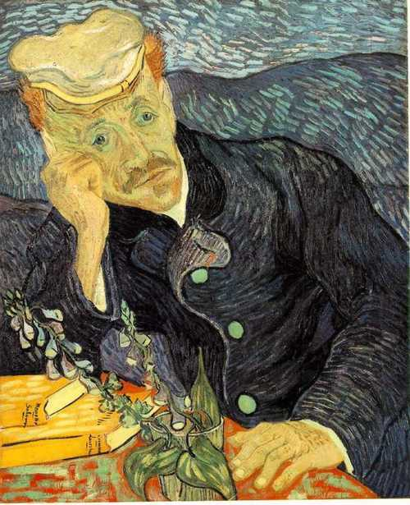
Notes:
In the 19th century, Digitalis was widely used; its uses went beyond treating edema, including epilepsy, mania, asthma, and among others. (Vincent van Gogh) was diagnosed as having Epilepsy and Mania, so he was said to have been prescribed Digitalis by his attending physician, who was interestingly enough, painted by Van Gogh beside a Foxglove plant, where Digitalis is derived

Slide 24
Digitalis (cont.) Mechanism of Action
+ve inotropic effect by ↑ intracellular Ca & enhancing actin-myosin cross bride formation (binds to the Na-K ATPase → inhibits Na pump → ↑ intracellular Na → ↑ Na-Ca exchange
Vagotonic effect
Arrhythmogenic effect

Slide 25
Digitalis Toxicity
Narrow therapeutic to toxic ratio
Non cardiac manifestations
Anorexia,
Nausea, vomiting,
Headache,
Xanthopsia sotoma,
Disorientation

Slide 26
Digitalis Toxicity
Cardiac manifestations
Sinus bradycardia and arrest
A/V block (usually 2nd degree)
Atrial tachycardia with A/V Block
Development of junctional rhythm in patients with a fib
PVC’s, VT/ V fib (bi-directional VT)

Slide 27
Digitalis Toxicity Treatment
Hold the medications.
Observation.
In case of A/V block or severe bradycardia → atropine followed by temporary PM if needed.
In life threatening arrhythmia → digoxin-specific fab antibodies.
Lidocaine and phenytoin could be used – try to avoid D/C cardioversion in non life threatening arrhythmia.

Slide 28
β Blockers
Has been traditionally contraindicated in pts with CHF
Now they are the main stay in treatment on CHF & may be the only medication that shows substantial improvement in LV function
In addition to improved LV function multiple studies show improved survival
The only contraindication is severe decompensated CHF

Slide 29
Vasodilators
Reduction of afterload by arteriolar vasodilatation (hydralazin) → reduce LVEDP, O₂ consumption,improve myocardial perfusion, stroke volume and COP
Reduction of preload By venous dilation (Nitrate) → ↓ the venous return →↓ the load on both ventricles.
Usually the maximum benefit is achieved by using agents with both action.

Slide 30
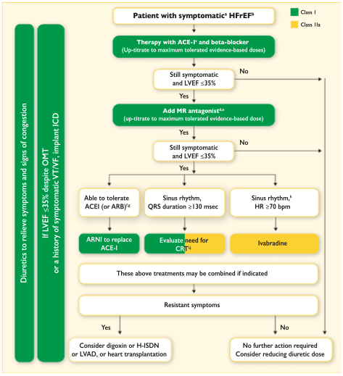
ESC 2016 Heart Failure guidelines

Slide 31
Positive inotropic agents
These are the drugs that improve myocardial contractility (β adrenergic agonists, dopaminergic agents, phosphodiesterase inhibitors),
Dopamine, Dobutamine, Milrinone, Amrinone
Several studies showed ↑ mortality with oral inotropic agents
So the only use for them now is in acute sittings as cardiogenic shock

Slide 32
Anticoagulation (Warfarin)/NOAC
Atrial fibrillation
H/o embolic episodes
Left ventricular apical thrombus

Slide 33
Antiarrhythmics
Most common cause of SCD in these patients is ventricular tachyarrhythmia
Patients with h/o sustained VT or SCD → ICD implant

Slide 34
Antiarrhythmics (cont.)
Patients with non sustained ventricular tachycardia
Correction of electrolytes and acid base imbalance.

Slide 35
Biventricular Pacing
Biventricular pacing (only in patient with Wide QRS complexes & CHF).

Slide 36
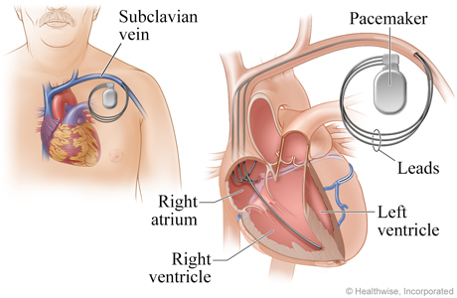

Slide 37
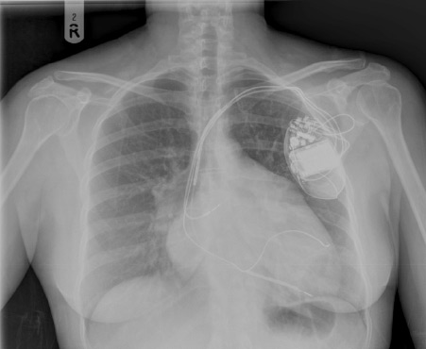

Slide 38
Assisting devices
Temporary ventricular assist devices.
Implantable ventricular assist devices.

Slide 39
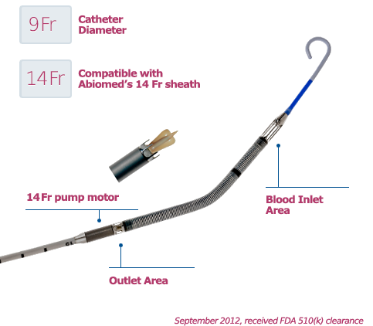
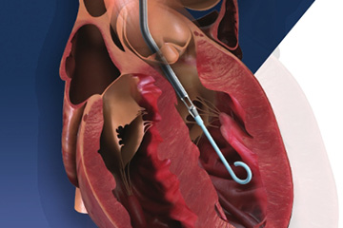
Notes:
Ampella up to 2.5 and 3.5 percutaneous 5 L by cut down.

Slide 40
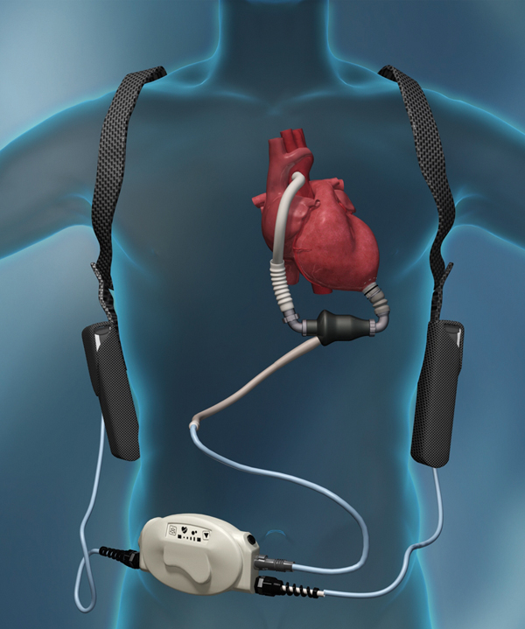
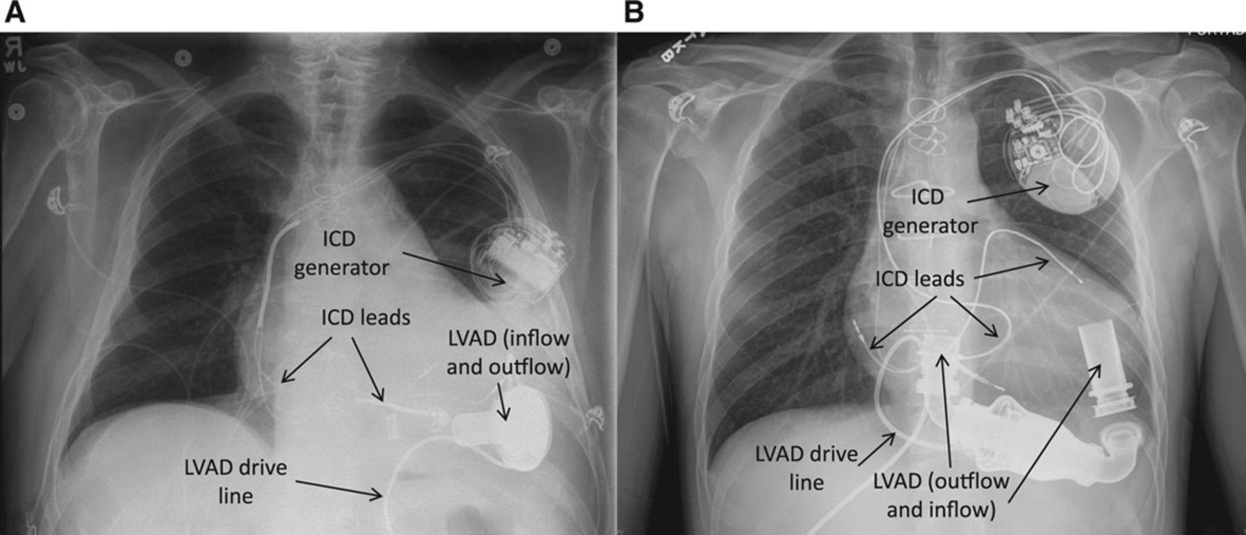
Notes:
HVAD and Heart Mate II

Slide 41
Cardiac Transplant
It has become more widely used since the advances in immunosuppressive treatment.
Survival rate:
1 year 80% - 90%
5 years 70%

Slide 42
Prognosis
Annual mortality rate depends on patients symptoms and LV function.
5% in patients with mild symptoms and mild ↓ in LV function.
30% to 50% in patient with advances LV dysfunction and severe symptoms.
40% – 50% of death is due to SCD.

