Slide 1
Bronchial Asthma 3rd year Medical Students
Dr R Nadama MD MRCP(lond) MRCP(UK), FRCP(Lond), EDARM, FCCP

Slide 2
Objectives
Definition
Epidemiology
Pathophysiology
Types
Diagnosis
Management
Summary

Slide 3
Asthma
Word “asthma” is derived from the ancient Greek word for “panting.”
Although asthma is a clearly recognized clinical entity, agreement on a precise definition of asthma has proved elusive.
Asthma has been more often described than defined.

Slide 4
Definition
Asthma is a chronic inflammatory disorder of the airways in which many cells play a role: in particular, mast cells, eosinophils, neutrophils.
T lymphocytes, macrophages, and epithelial cells.
In susceptible individuals, this inflammation causes recurrent episodes of coughing, wheezing, breathlessness, and chest tightness.
These episodes are usually associated with widespread but variable airflow obstruction (airway hyper-responsiveness) that is often reversible either spontaneously or with treatment.

Slide 5
Epidemiology
Any age, 75% Dx age <7
Remission around puberty
Prevalence on the rise. likely Multifactorial
Wide geographical variation (4-25%)
Females 40% higher prevalence
Severe asthma 10 % but morbidity / costs

Slide 6
Saudi Arabia Figures
Asthma affects >2 million Saudis
Asthma control: 5% were controlled, 31% partially controlled, 64% uncontrolled.

Slide 7
Etiology
Although asthma is multifactorial in origin, inflammation is believed to be the cornerstone of the disease and is thought to result from inappropriate immune responses to a variety of antigens in genetically susceptible individuals.

Slide 8
Causes
Hygiene Hypothesis
Atopy
Genetics
Smoking – controversial
Obesity – New under Ix

Slide 9
Cause - Hygiene Hypothesis

Slide 10
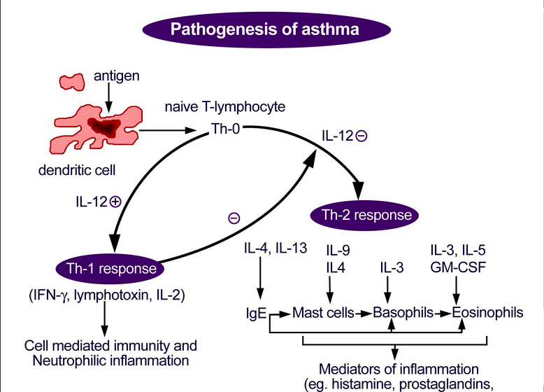

Slide 11
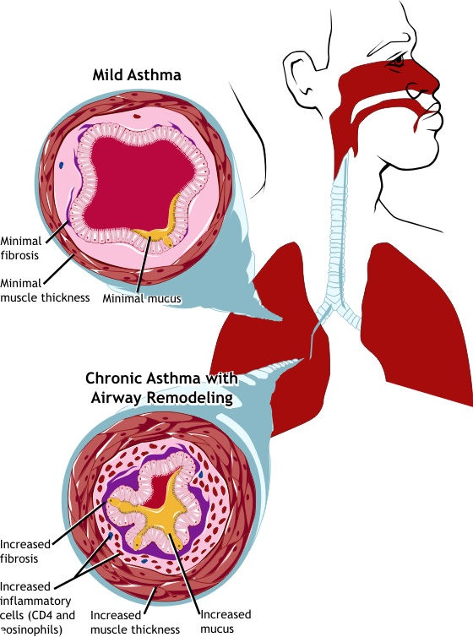

Slide 12
Asthma Types

Slide 13
Types
Phenotypes
Endotypes
Mixed or overlapping features

Slide 14
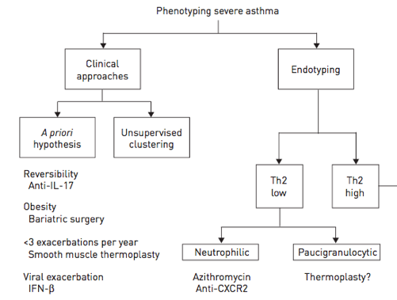

Slide 15
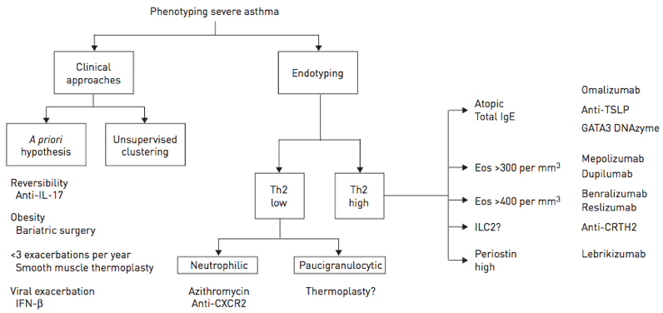

Slide 16
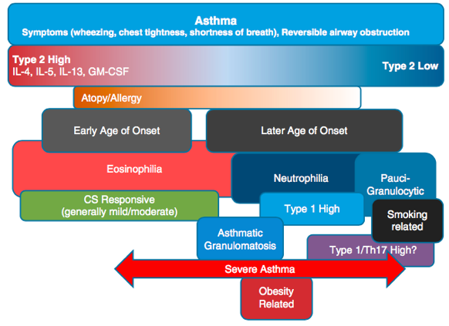

Slide 17
Asthma Types
Early onset (<12years)
Childhood-onset asthma a relatively homogeneous group
Allergic Asthma (Atopic) Usually a strong allergic Hx
FH of asthma.
Late onset (>12years)
Adult-onset asthmatics are a very mixed group Heterogeneous
Late onset – Atopic (34%) have less severe disease. Those with severe disease are less likely to be atopic
Non Atopic (52%) have mild-to-moderate persistent asthma
Late onset eosinophilic asthma
AERD Aspirin Exacerbated Respiratory Disease

Slide 18
Diagnosis
History
Examination
Test

Slide 19
History

Slide 20
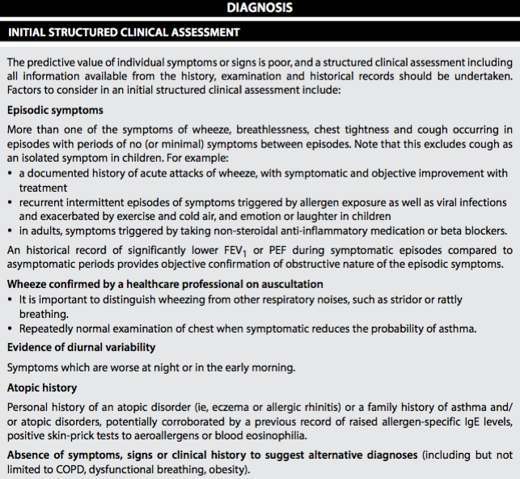
Notes:
(British/SIGN Guidelines Sept 2016)

Slide 21
Notes:
(British/SIGN Guidelines Sept 2016)

Slide 22
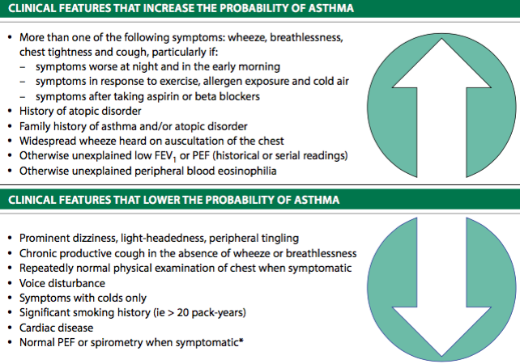
Notes:
BTS 2014

Slide 23
Differential Diagnosis

Slide 24
Other Illness with wheezing / SOB
COPD (Smoker)
Heart failure
Airway obstruction (Tumors, FB)
Vocal cord dysfunction
May Coexist and complicate Dx of asthma
GERD, OSA, ABPA

Slide 25
Examination

Slide 26
Examination
Upper respiratory tract (nasal secretion, mucosal swelling, nasal polyp)
Chest (Wheezing or prolonged phase of forced exhalation, Chest hyper-expansion, accessory muscles)
Skin (atopic dermatitis, eczema)

Slide 27
Wheezing
Wheezing—high-pitched whistling sounds when breathing out
A lack of wheezing and a normal chest examination do not exclude asthma

Slide 28
Wheeze

Slide 29
Investigations

Slide 30
Tests
Spirometry – Routine
Usually if alternate Dx considered
Full Lung Functions
CXR / CT Chest
FBC
Airway Hyper-responsiveness tests (If spiro normal)

Slide 31
Asthma Dx – variable airflow limitation
Confirm presence of airflow limitation
Document that FEV₁/FVC is reduced <0.75 (at least once)
Confirm variation in lung function or Reversibility
Excessive bronchodilator reversibility (FEV₁ >12% and >200mL)
Excessive diurnal variability twice-daily PEF monitoring

Slide 32
Typical spirometric tracings
Flow
Volume
Normal
FEV₁
Asthma (after BD)
Normal
Asthma (before BD)
Asthma (after BD)
Asthma (before BD)
1
2
3
4
5
6
Volume
Time (seconds)
Note: Each FEV₁ represents the highest of three reproducible measurements

Slide 33
Diagnostic Approach

Slide 34
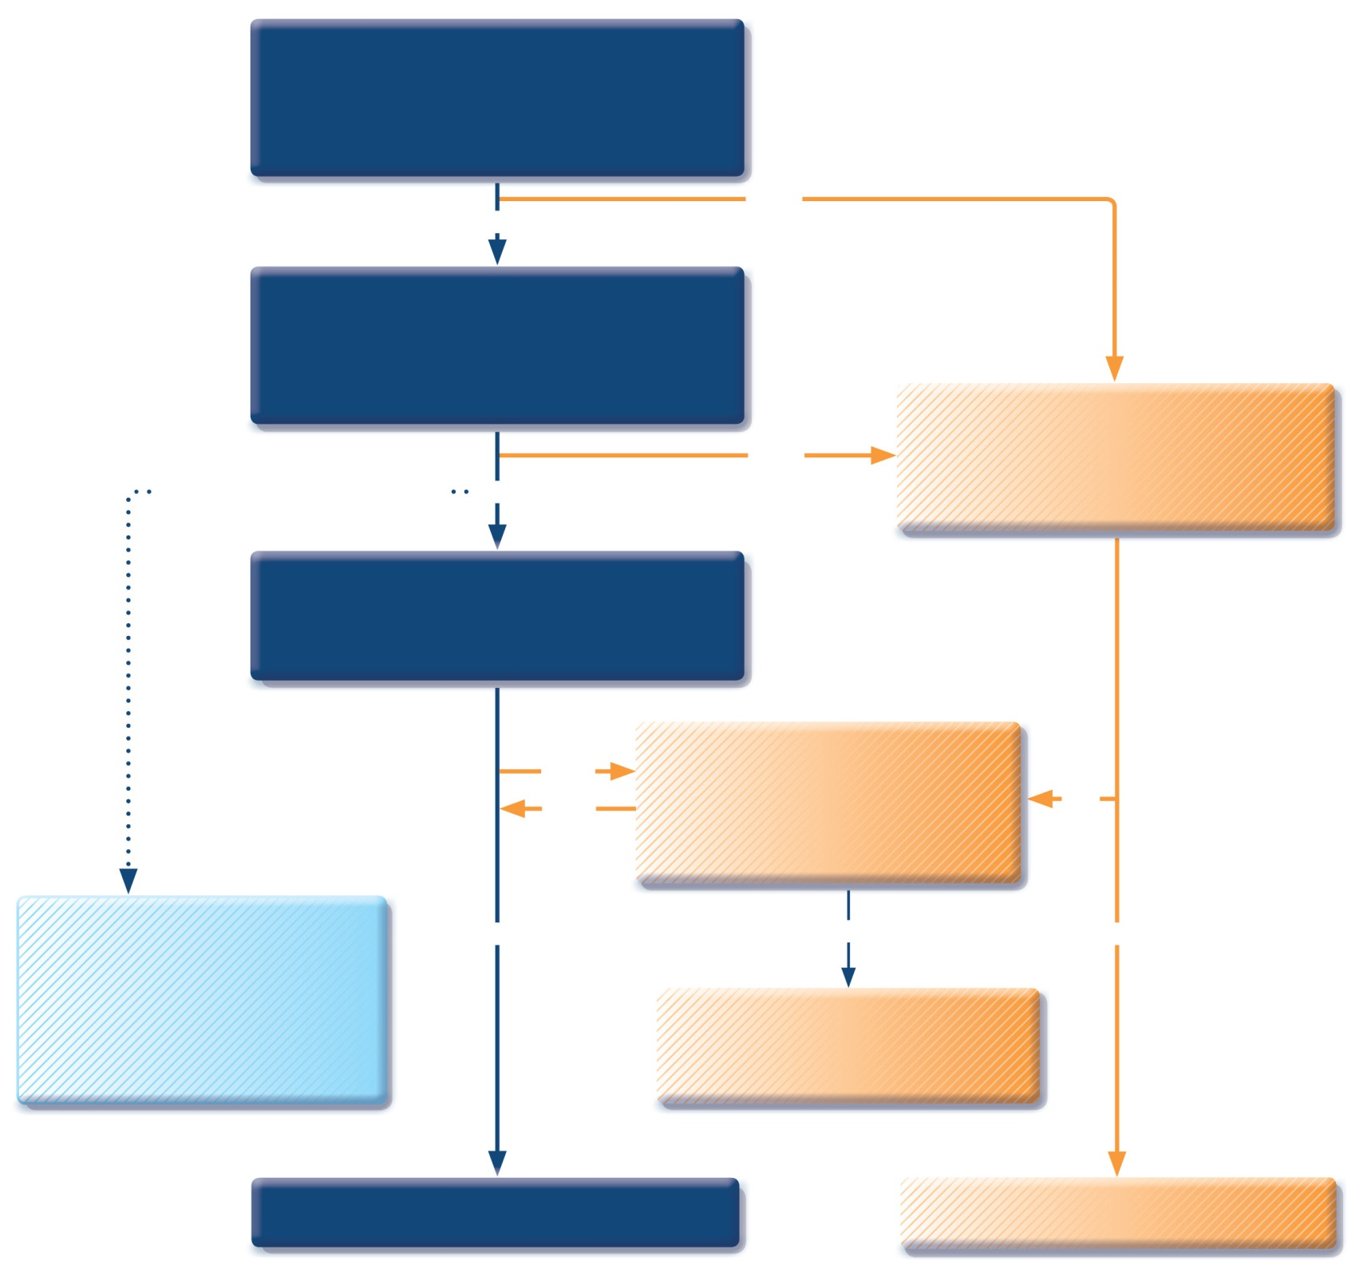
Patient with respiratory symptoms
Are the symptoms typical of asthma?
YES
NO
Detailed history/examination for asthma
History/examination supports asthma diagnosis?
Further history and tests for alternative diagnoses
Alternative diagnosis confirmed?
Clinical urgency, and other diagnoses unlikely
NO
YES
Perform spirometry/PEF with reversibility test
Results support asthma diagnosis?
Repeat on another occasion or arrange other tests
Confirms asthma diagnosis?
NO
YES
NO
Empiric treatment with ICS and prn SABA
Review response
Diagnostic testing within 1-3 months
YES
NO
YES
Consider trial of treatment for most likely diagnosis, or refer for further investigations
Treat for ASTHMA
Treat for alternative diagnosis
GINA 2017, Box 1-1 (4/4)
© Global Initiative for Asthma

Slide 35
Management

Slide 36
Components of Asthma Management
Monitoring
Education
Control of environmental factors
Pharmacologic Rx

Slide 37
Monitoring
Symptoms
Peak Flow (Home)
Spirometry (Clinic)
Novel FENO and Sputum eosinophils
Assess Severity and Control of asthma

Slide 38
Education
Compliance
Inhalers techniques
Asthma Action plans
Specific directions for daily management and for adjusting medications in response to increasing symptoms or decreasing PEFR

Slide 39
Environmental Factors
Triggers (Aeroallergens, Irritants)
Co-morbid conditions (Obesity, GERD, Rhinitis, ABPA, VCD, stress)
Medications (Aspirin, Beta Blockers)
Infections (Vaccinations)

Slide 40
Pharmacologic Management

Slide 41
Aims
Notes:
(British/SIGN Guidelines Sept 2016)

Slide 42
GINA assessment of symptom control
A. Symptom control
In the past 4 weeks, has the patient had: | Well-controlled | Partly controlled | Uncontrolled
Daytime asthma symptoms more than twice a week? Yes No | None of these | 1-2 of these | 3-4 of these
Any night waking due to asthma? Yes No
Reliever needed for symptoms* more than twice a week? Yes No
Any activity limitation due to asthma? Yes No
Level of asthma symptom control
*Excludes reliever taken before exercise, because many people take this routinely
GINA 2017, Box 2-2A

Slide 43
Assessment of risk factors for poor asthma outcomes
Independent* risk factors for exacerbations include:
Ever intubated for asthma Uncontrolled asthma symptoms Having ≥1 exacerbation in last 12 months Low FEV₁ (measure lung function at start of treatment, at 3-6 months to assess personal best, and periodically thereafter) Incorrect inhaler technique and/or poor adherence Smoking Elevated FeNO in adults with allergic asthma Obesity, pregnancy, blood eosinophilia
Risk factors for exacerbations include:
Ever intubated for asthma Uncontrolled asthma symptoms Having ≥1 exacerbation in last 12 months Low FEV₁ (measure lung function at start of treatment, at 3-6 months to assess personal best, and periodically thereafter) Incorrect inhaler technique and/or poor adherence Smoking Obesity, pregnancy, blood eosinophilia
UPDATED 2017
* Independent of the level of symptom control
GINA 2017, Box 2-2B (2/4)

Slide 44
Approach
Notes:
(British/SIGN Guidelines Sept 2016)

Slide 45
Pharmacologic Treatment
Relievers
Short Acting Beta agonist
Preventer
Steroids
Long acting Beta Agonist and LAMA
Leukotriene's receptors Antagonist
Theophylline
Personalized Medicine
eg Anti IgE or Anti IL5

Slide 46
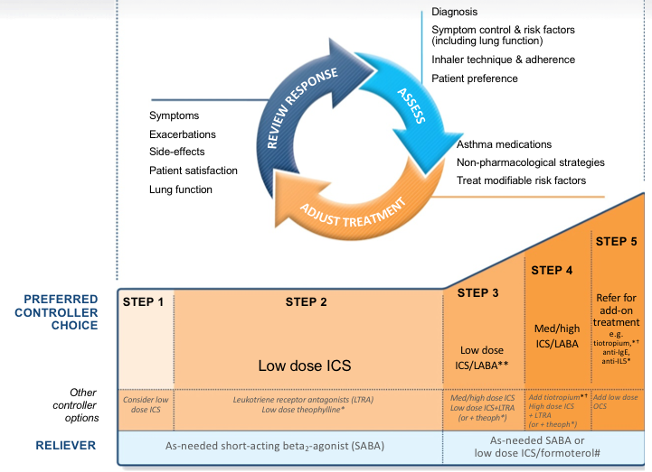
Notes:
GINA 2017

Slide 47
Notes:
GINA 2017

Slide 48
Asthma Self Management
Communicate and educate patient
A written asthma action plan includes all the information you need to look after your asthma well, so you’ll have fewer symptoms and significantly cut your risk of an asthma attack.

Slide 49
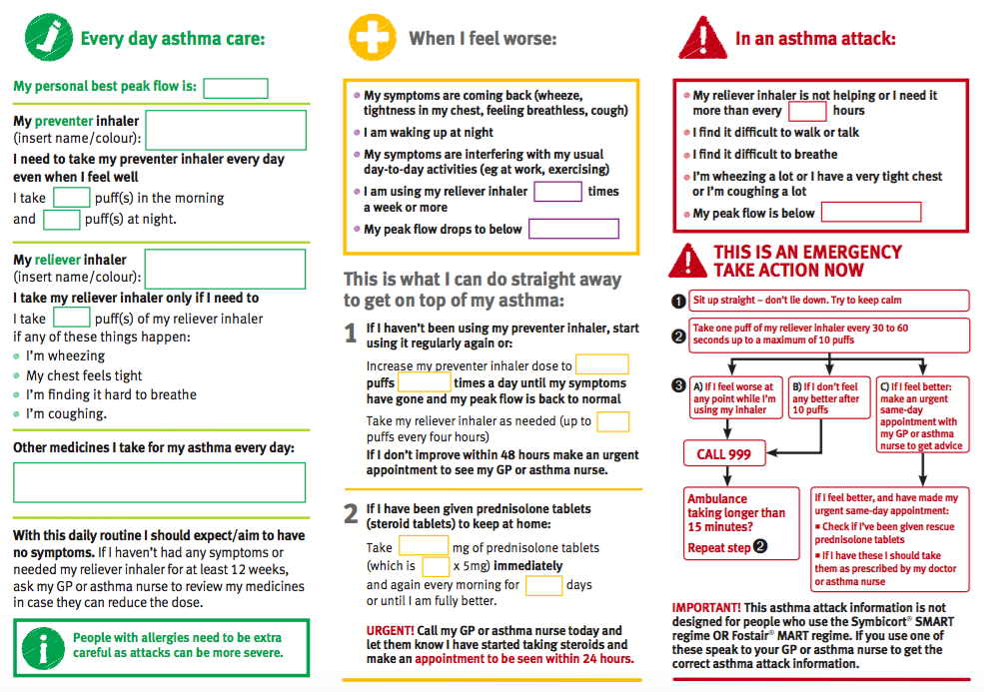

Slide 50
Managing exacerbations in acute care settings
INITIAL ASSESSMENT
A: airway B: breathing C: circulation
Are any of the following present?
Drowsiness, Confusion, Silent chest
NO
YES
Further TRIAGE BY CLINICAL STATUS according to worst feature
Consult ICU, start SABA and O₂, and prepare patient for intubation
MILD or MODERATE
Talks in phrases
Prefers sitting to lying
Not agitated
Respiratory rate increased
Accessory muscles not used
Pulse rate 100–120 bpm
O₂ saturation (on air) 90–95%
PEF >50% predicted or best
SEVERE
Talks in words
Sits hunched forwards
Agitated
Respiratory rate >30/min
Accessory muscles being used
Pulse rate >120 bpm
O₂ saturation (on air) < 90%
PEF ≤50% predicted or best
Short-acting beta₂-agonists
Consider ipratropium bromide
Controlled O₂ to maintain saturation 93–95% (children 94-98%)
Oral corticosteroids
Short-acting beta₂-agonists
Ipratropium bromide
Controlled O₂ to maintain saturation 93–95% (children 94-98%)
Oral or IV corticosteroids
Consider IV magnesium
Consider high dose ICS
If continuing deterioration, treat as severe and re-aassess for ICU
ASSESS CLINICAL PROGRESS FREQUENTLY
MEASURE LUNG FUNCTION in all patients one hour after initial treatment
FEV1 or PEF 60-80% of predicted or personal best and symptoms improved
MODERATE
Consider for discharge planning
FEV1 or PEF <60% of predicted or personal best,or lack of clinical response
SEVERE
Continue treatment as above and reassess frequently
GINA 2017, Box 4-4 (1/4)

Slide 51
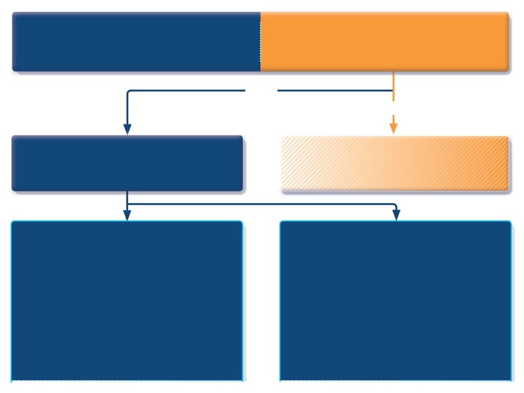
INITIAL ASSESSMENT
A: airway B: breathing C: circulation
Are any of the following present?
Drowsiness, Confusion, Silent chest
^{NO}
^{YES}
Further TRIAGE BY CLINICAL STATUS according to worst feature
Consult ICU, start SABA and O₂, and prepare patient for intubation
MILD or MODERATE
Talks in phrases
Prefers sitting to lying
Not agitated
Respiratory rate increased
Accessory muscles not used
Pulse rate 100–120 bpm
O₂ saturation (on air) 90–95%
PEF >50% predicted or best
SEVERE
Talks in words
Sits hunched forwards
Agitated
Respiratory rate >30/min
Accessory muscles being used
Pulse rate >120 bpm
O₂ saturation (on air) < 90%
PEF ≤50% predicted or best
GINA 2017, Box 4-4 (2/4)

Slide 52
MILD or MODERATE
Talks in phrases
Prefers sitting to lying
Not agitated
Respiratory rate increased
Accessory muscles not used
Pulse rate 100–120 bpm
O₂ saturation (on air) 90–95%
PEF >50% predicted or best
SEVERE
Talks in words
Sits hunched forwards
Agitated
Respiratory rate >30/min
Accessory muscles being used
Pulse rate >120 bpm
O₂ saturation (on air) < 90%
PEF ≤50% predicted or best
Short-acting beta₂-agonists
Consider ipratropium bromide
Controlled O₂ to maintain saturation 93–95% (children 94-98%)
Oral corticosteroids
Short-acting beta₂-agonists
Ipratropium bromide
Controlled O₂ to maintain saturation 93–95% (children 94-98%)
Oral or IV corticosteroids
Consider IV magnesium
Consider high dose ICS
GINA 2017, Box 4-4 (3/4)

Slide 53
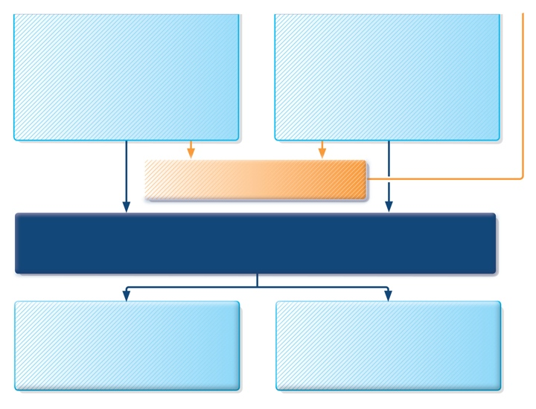
Short-acting beta₂-agonists
Consider ipratropium bromide
Controlled O₂ to maintain saturation 93–95% (children 94-98%)
Oral corticosteroids
Short-acting beta₂-agonists
Ipratropium bromide
Controlled O₂ to maintain saturation 93–95% (children 94-98%)
Oral or IV corticosteroids
Consider IV magnesium
Consider high dose ICS
If continuing deterioration, treat as severe and re-assess for ICU
ASSESS CLINICAL PROGRESS FREQUENTLY
MEASURE LUNG FUNCTION in all patients one hour after initial treatment
FEV₁ or PEF 60-80% of predicted or personal best and symptoms improved
MODERATE
Consider for discharge planning
FEV₁ or PEF <60% of predicted or personal best,or lack of clinical response
SEVERE
Continue treatment as above and reassess frequently
GINA 2017, Box 4-4 (4/4)

Slide 54
Key Messages
Asthma is a chronic inflammatory condition associated with significant morbidity and mortality which is preventable and manageable with appropriate treatment and effective patient communication

Slide 55
Key Messages
Asthma is a chronic inflammatory condition associated with significant morbidity and mortality which is preventable and manageable with appropriate treatment and effective patient communication

Slide 57
References
International Clinical Guidelines GINA, BTS, SINA
National Asthma Education and Prevention Program: Expert panel report III: Guidelines for the diagnosis and management of asthma. Bethesda, MD: National Heart, Lung, and Blood Institute, 2007. (NIH publication no. 08-4051) www.nhlbi.nih.gov/guidelines/asthma/asthgdln.htm
Smith HR, Irvin CG, Cherniack RM. The utility of spirometry in the diagnosis of reversible airways obstruction. Chest 1992; 101:1577
Gender differences in prevalence, diagnosis and incidence of allergic and non-allergic asthma: a population-based cohort; Thorax 2012;67:625-631 doi:10.1136/thoraxjnl-2011-201249
Al Frayh AR, Shakoor Z, Gad El Rab MO, Hasnain SM. Increased prevalence of asthma in Saudi Arabia. Ann Allergy Asthma Immunol 2001;86:292-6. [PUBMED]

