Slide 1
Chronic Diarrhea
Suliman Alshankiti

Slide 2
Objectives
To have an overview regarding chronic diarrhea:
Definition
Pathophysiology
Classification
Approach
To discuss common causes of chronic diarrhea:
Celiac Disease
Whipple Disease
Tropical Sprue
Small Bowel Bacterial Overgrowth
Exocrine Pancreatic Insufficiency
Bile Salt-Induced Diarrhea

Slide 3
Definition
Diarrhea
Chronic Diarrhea
Maldigestion
Malabsorption

Slide 4
maldigestion
Why make the distinction?
… to provide a framework for remembering/classifying the responsible physiological mechanisms
malabsorption
Also, post mucosal disorders such as lymphagiectasia and abetlloproteinemia

Slide 6
Pathophysiology
Each day, 9–10 L of fluid enter the jejunum.
Small intestine absorbs 90% of this fluid load
The colon absorbs 90% of the remaining load (about 900 ml/24 hours); leaving approximately 80–100 ml excreted each day in feces.
A normal colon can compensate by absorbing up to 3000–4000 ml/24 hours

Slide 8
Osmotic Diarrhea
Poorly absorbed substances that remain in the lumen of the intestine and obligate retention of water within the lumen by virtue of their osmotic effects
Ingestion of poorly absorbed agent (eg, magnesium)
Loss of nutrient transporter (eg, lactase deficiency)
Lactose (in individuals with lactase deficiency)
Fructose
Mannitol
Sorbitol
Lactulose
Magnesium
Phosphate
Sulfate

Slide 9
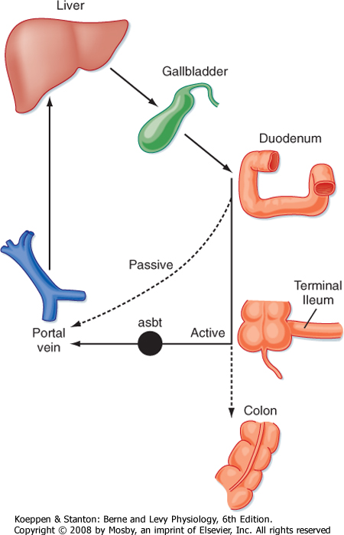
Secretory Diarrhea
Infections
Reduction of mucosal surface area by surgery or disease
Absence of an ion-transport mechanism
Inflammation
Dysregulation
Circulating secretagogues (endocrine)
Pancreatic Insufficiency
Bile Acid-Induced Diarrhea

Slide 10
Fecal Osmotic Gap (FOG)
FOG= 290 − 2 X (stool Na + stool K)
FOG of >50 mosm/kg is suggestive of an osmotic diarrhea and a gap of >100 mosm/kg is more specific.

Slide 11
Clinical Classification
Fatty
Bloating, flatulence, greasy malodorous stools that can be difficult to flush, weight loss, s/s of vitamin deficiencies (peripheral neuropathy, easy bruising)
Anemia, coagulopathy, hypoalbuminemia, osteopenia
Watery
Large volume, variable presentation
Inflammatory
Blood, mucus, pus, abd pain, fever, small volume
Positive fecal leukocytes, gross or occult blood, ESR/CRP, leukocytosis

Slide 12
Fatty Diarrhea
Maldigestion = inadequate breakdown of triglycerides
Malabsorption = inadequate mucosal transport of digestion products
Pancreatic exocrine insufficiency (eg, chronic pancreatitis)
Inadequate luminal bile acid concentration (eg, advanced primary biliary cirrhosis)
Mucosal diseases (eg, Celiac sprue, Whipple’s disease)
Mesenteric ischemia
Structural disease (eg, short bowel syndrome)
Small intestinal bacterial overgrowth (bile salt deconjugation)

Slide 13
Chronic Inflammatory Diarrhea

Slide 14
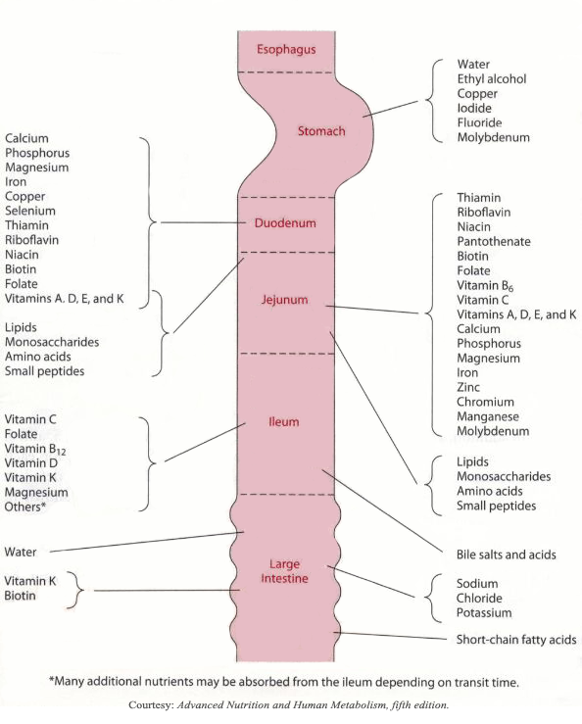

Slide 15
Review of Nutrient/Vitamin Absorption
Duodenum/Jejunum | Ileum | Colon
Carbohydrates / simple sugars | Vitamin B12 | Short-chain fatty acids
Fats | Bile salts | Vitamin K**
Amino acids | Magnesium | Biotin**
Iron
Fat-soluble vitamins (A, D, E, K)
Calcium
Magnesium
Other Vitamins
Minerals
** In part produced by bacterial gut flora

Slide 18
Common Medications and Toxins Associated with Diarrhea
Acid-reducing agents (H2 blockers, PPIs)
Magnesium-containing antacids
Anti-arrhythmics (eg, digitalis, quinidine)
Antibiotics
Anti-neoplastic agents
Antiretrovirals
Beta blockers
Colchicine
Levothyroxine
SSRIs
Furosemide
Metformin
NSAIDs, ASA
Prostaglandin analogs (ie, misoprostil)
Theophylline
Amphetamines
Caffeine
Alcohol
Narcotic/opioid withdrawal

Slide 21
Culture (more useful only for acute), O&P, Giardia Ag, C diff, Coccidia, Microsporidia, Cryptosporidiosis
Fecal leukocytes (or marker for neutrophils: lactoferrin or calprotectin)
Fecal occult blood
Stool electrolytes for osmolar gap = 290 – 2[Na + K]
Stool pH (<6 suggests CHO malabsorption due to colonic bacterial fermentation to CO2, H2, and short chain FA)
Fat content (48h or 72h quantitative or Sudan stain)
Laxative screen (if positive, repeat before approaching pt)

Slide 22
Additional Studies
Imaging
Small bowel series
CT/MRI or CT/MR enterography
Endoscopy with small bowel biopsy and aspirate for quantitative culture
Colonoscopy, including random biopsies

Slide 24
Differential Diagnosis: Watery Diarrhea
Osmotic (poorly absorbable substance in lumen)
Secretory (malabsorption or secretion of electrolytes, H2O)
Carbohydrate malabsorption (eg, lactase deficiency, diet high in fructose or sugar alcohols)
Osmotic laxatives (Mg, PO4, SO4)
Very broad differential – see next slide

Slide 25
Differential Diagnosis: Watery (Secretory) Diarrhea
Bacterial toxins
Abnormal motility
DM-related dysfunction
IBS
Post-vagotomy diarrhea
Diverticulitis
Ileal bile acid malabsorption
Malignancy
Colon CA
Lymphoma
Rectal villous ademoma
Vasculitis
Congenital chloridorrhea
Inflammatory
Microscopic colitis
Endocrinopathies
Hyperthyroidism
Adrenal insufficiency
Cardinoid syndrome
Gastrinoma, VIPoma, Somatostatinoma
Pheochromocytoma
Idiopathic
Epidemic (Brainerd)
Sporadic
Medications, stimulant laxative abuse, toxins

Slide 26
Differential Diagnosis: Inflammatory Diarrhea
IBD (Crohn’s, UC)
Ischemic colitis
Malignancy
Colon CA
Lymphoma
Diverticulitis
Radiation colitis
Infectious
Invasive bacterial (Yersinia, TB)
Invasive parasitic (Amebiasis, strongyloides)
Pseudomembranous colitis (C diff infection)
Ulcerating viral infections (CMV, HSV)

Slide 27
Fatty Diarrhea
Maldigestion = inadequate breakdown of triglycerides
Malabsorption = inadequate mucosal transport of digestion products
Pancreatic exocrine insufficiency (eg, chronic pancreatitis)
Inadequate luminal bile acid concentration (eg, advanced primary biliary cirrhosis)
Mucosal diseases (eg, Celiac sprue, Whipple’s disease)
Mesenteric ischemia
Structural disease (eg, short bowel syndrome)
Small intestinal bacterial overgrowth (bile salt deconjugation)

Slide 28
Signs and Symptoms of Malabsorption
Malabsorption of | Clinical features | Lab findings
Calories | Wt loss w/ normal appetite
Fat | Pale voluminous stool, steatorrhea | Stool fat >6 g daily
Protein | Edema, muscle atrophy, amenorrhea | Low albumin, low protein
Carbohydrates | Watery diarrhea, flatulence, milk intolerance | Stool pH < 6; stool osmotic gap >100; increased breath hydrogen
Vitamin B12 | Anemia, subacute combined degeneration of spinal cord (paresthesias, ataxia, loss of position/ vibratory sense) | Macrocytic anemia; low B12 level; increased MMA and homocysteine levels; abnormal Schilling test
Folic acid | Anemia | Macrocytic anemia; decreased serum/RBC folate; increased homocysteine level

Slide 29
Signs and Symptoms of Malabsorption
Malabsorption of | Clinical features | Lab findings
Iron | Anemia, glossitis, pagophagia | Microcytic anemia; decreased serum iron and ferritin levels; increased TIBC
Calcium and Vitamin D | Paresthesia, tetany, pathologic fractures, positive Chvostek and Trusseau signs | Low serum calcium; abnormal DEXA; elevated Alk Phos
Vitamin A | Follicular hyperkeratosis, night blindness | Decreased serum carotene
Vitamin K | Easy bruising, bleeding disorders | Elevated INR; decreased Vitamin K-dependent coagulation factors (2, 7, 9, 10)
Vitamin B (general) | Cheilosis, painless glossitis, angular stmatitis, acrodermatitis

Slide 30
Celiac Disease

Slide 31
Introduction
Small intestinal malabsorption of nutrients following the ingestion of wheat gluten or related proteins from rye and barley.
A characteristic, though not specific, villous atrophy of the small intestinal mucosa.
Prompt clinical and histologic improvement following strict adherence to a gluten free diet.
Clinical and histologic relapse when gluten is reintroduced

Slide 33
Pathophysiology
The disease affect the mucosa with marked variation
Loss of normal villous structure - flattening
Intestinal crypts are elongated and open onto a flat absorptive surface
Leaky mucosa with increased permeability due to structural changes of the tight junctions between damaged absorptive cells
Marked increase in cellularity of the lamina propria – plasma cells and lymphocytes

Slide 34
Presentation
Asymptomatic
Non-specific GI symptoms
Diarrhea
Bloating
Dyspepsia
Nutritional deficiency:
Anemia (Iron & folate)
Osteoporosis
Fat soluble vitamin deficiencies:
Vit A: poor night vision, follicular hyperkeratosis
Vit D: hypocalcemia, osteoporosis
Vit K: easy bruising & bleeding, elevated INR
Dermatitis herpatiformis
Elevated ALT & AST
Malignancy
T-cell lymphoma
Small bowel adenoCa

Slide 35
Dermatitis Herpatiformis

Slide 36
At Risk
Type 1 DM (3-6%)
Autoimmune thyroid disease (6-8%)
Down’s syndrome
Connective tissue disease
IgA deficiency (2-3%)

Slide 37
Serology
Anti-tissue transglutaminase antibody (IgA)
Sensitivity 95%; specificity 97.5%
Endomysial antibody (IgA)
Sensitivity 85-98% (~93) Specificity 97-100% (~99)
IgA anti-gliadin antibodies
Sensitivity 75-90% (~80) Specificity 82-95% (~85)
IgG anti-gliadin antibodies
Sensitivity 69-85% (~75) Spec 73-90% (~80)
Can be used in IgA deficient patients

Slide 38
Endoscopy
Normal
Loss of mucosal folds
Flattening of mucosa
Scalloping of mucosa
Ulcerations

Slide 39
Histology

Slide 40
Management
Education
Gluten-free diet: avoid wheat, barley, rye & oat
Correct nutritional deficiencies (Iron, Ca, Vit D)
Anticipate complications

Slide 41
Whipple Disease
Chronic systemic infection by Tropheryma whipplei
Has GI, CNS, CVS, MSK & skin manifisations
Malabsorption – weight loss, diarrhea (watery or fatty) and abdominal pain
Caused by bacterial and macrophage-predominant inflammatory cell infiltration of the small intestinal mucosa and obstruction of mesenteric lymph nodes

Slide 42
Whipple Disease
CNS
Progressive dementia
Supranuclear ophthalmoplegia
Altered LOC
Oculo-masticatory & oculo-facial skeletal dysfunction
CVS
Endocarditis – MV most common
Myocarditis
Pericarditis
MSK
Oligo or polyarthralgias
Skin (common)
Hyperpigmentation

Slide 43
Whipple Disease
Whitish to yellow plaque-like patches in 75% of patients (representing lipid droplets and/or lymphangiectasia)

Slide 44
Whipple Disease
Foamy macrophages on routine H&E
Numerous PAS-positive granular particles (pink/purple appearing)
Lysosomes filled with T. whipplei

Slide 45
Whipple Disease
2 weeks with Abx to cross BBB: Ceftriaxone 2g IV daily monotherapy or Pen G 2 MU IV q4h) PLUS streptomycin…
THEN…
Septra DS tab BID x 1 year.

Slide 46
Small Bowel Bacterial Overgrowth (SBBO)
Normal Microbiom:
Stomach 0-10³ CFU/ml
Jejunum 0-10⁴
Gram + aerobes (oral streptococci, lactobacillus); no gram –ve aerobes
Ileum 10⁵-10⁹
Colon 10¹⁰-10¹²
Anaerobes: bacteroides, peptostreptococcus, lactobacillus, bifidobacterium, clostridium
Facultative aerobes: e. coli, enterococcus, staphylococcus

Slide 47
Small Bowel Bacterial Overgrowth
Normal barriers that prevent SBBO:
Gastric acid & pancretic enzymes (chronic pancreatitis, low HCl from surgery, diseases or PPI)
Intact bowel structure (Surgery, diverticulum)
Cleansing effect of bowel motility – inter-digestive migrating motor complex (dysmotility)
Gut immunity – intraluminal secretory IgA (immunodeficiency)
Competent ileocecal valve (scaring from inflammation, surgery)
Competition by other bacteria (antibiotics)

Slide 48
Small Bowel Bacterial Overgrowth
Effect of SBBO:
Bile acids metabolism – deconjugated bile acids
Bilirubin metabolism – deconjugated bilirubin
CHO metabolism – C02, H2, D-lactic acid, organic acids (short chain fatty acids)
Lipid metabolism – short chain fatty acids
Protein metabolism – amines, ammonia

Slide 49
Small Bowel Bacterial Overgrowth
Bloating, diarrhea, abdominal pain, weight loss, neuropathy
B12 deficiency – utilized for nutrition
Elevated folate level - produced by bacteria
Vitamin A,D,E,K deficiency – therefore bruising, night blindness, bone diseases
Iron deficiency
Hypoproteinemia, hypoalbuminemia
Fat and CHO malabsorption

Slide 50
Small Bowel Bacterial Overgrowth
Jejunal culture – gold standard;
C¹⁴-labeled bile acid breath test
C¹⁴-xylose breath test
H breath test
Schilling’s test

Slide 52
Small Bowel Bacterial Overgrowth- Schilling’s test

Slide 53
Small Bowel Bacterial Overgrowth
Treat underlying cause
e.g. discontinue acid suppressive meds, treat inflammatory Crohn’s disease, remove strictures, etc…
Nutrition – replace fat soluble vitamins, B12
Low CHO diet to limit bacteria substrate
7 – 10 days of antibiotics
Metronidazole, Amox/Clav, Tetracycline, Doxycycline, Amoxicillin
May need to cycle Abx to avoid resistance
Bowel cleanse with PEG
Prokinetic
Octreotide – at low dose, has a promotility effect;
causes hypomotility at higher doses
Probiotics – minimal evidence

Slide 54
Tropical Sprue
Is characterized by villous atrophy and crypt hyperplasia
Most tropical regions of Asia, Africa, the Middle East, the Caribbean and Central and South America
It is an acquired defect – not present in newborns. Travelers from the industrialized world may develop it.
Cause
Not known, but seems to be due to continuous bacterial contamination of the upper small bowel and nutritional deficiency

Slide 55
Tropical Sprue
Chronic diarrhea often with steatorrhea, anorexia, abdominal cramps, bloating
B12 and folate deficiency
If suspicion is high – jejunal aspirate and biopsy
Management:
Folate & B12 Supplement
tetracycline for 3-6 months

Slide 56
Bile Acid-Induced Diarrhea

Slide 57
Exocrine Pancreatic Insufficiency

Slide 58
Exocrine Pancreatic Insufficiency

Slide 59
Take Home Messages
Chronic diarrhea (>4 weeks) can be osmotic, secretory, inflammatory or fatty diarrhea.
Fecal osmotic gap is helpful to point toward osmotic diarrhea
Iron, Ca & folate are absorbed in proximal bowel; while B12 is absorbed in ileum.

Slide 60
Take Home Messages
Celiac disease:
Should always be suspected in patients with iron-def anemia, diarrhea or dyspepsia.
Anti-TTG is most helpful.
Biopsy shows villus atrophy.
Gluten-free diet
Watch for complications: nutritional & malignancy

Slide 61
Take Home Messages
Whipple Disease:
Chronic systemic infection by Tropheryma whipplei
Has GI, CNS, CVS, MSK & skin manifisations
Biopsy: Foamy macrophages & PAS-positive granular particles
SBBO:
Look for & treat underlying causes
B12 def
Schilling’s test
Tropical Sprue:
Hx of travel to tropical area for long period

Slide 62
Take Home Messages
Exocrine pancreatic insufficiency:
Mainly in patients with chronic pancreatitis
Steatorrhea
Improves with pancreatic enzymes replacement therapy
Bile acid-induced diarrhea:
Watery diarrhea
Improves with cholestyramine

