Slide 1
Rad course 366 Radiology of cardiac diseases
Dr. Reshaid Al Jurayyan
Assistant professor and consultant
Department of radiology and medical imaging
King Saud University – Medical City
Riyadh, Saudi Arabia

Slide 2
LECTURE OBJECTIVES:
To list radiological exams used to image to the heart and mediastinal vessels.
To list advantages and disadvantages of each exam in relation to heart and mediastinal vessels imaging.
To Identify normal appearance of the heart and mediastinal vessels on each modality.

Slide 3
What radiological exams are used in imaging heart and mediastinal vessels?
X ray
Angiogram
Echocardiogram
CT scan
MRI
Nuclear scan

Slide 4
What radiological exams are used in imaging heart and mediastinal vessels?
X ray
Angiogram
Echocardiogram
CT scan
MRI
Nuclear scan
ALL ARE USED

Slide 5
X ray

Slide 6
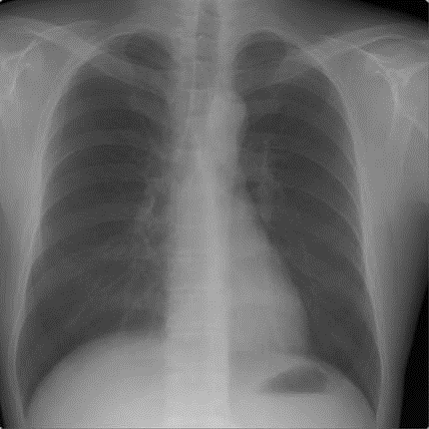
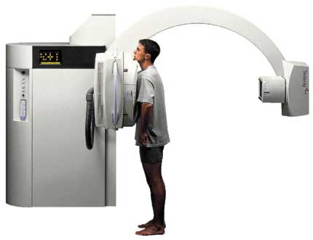
Chest X ray = Radiograph = Plain film

Slide 7
Chest X ray
Advantages :
Widely available, portable, cheap, easy to read.
Proper in assessing heart size.
Proper in assessing heart position (e.g. dextrocardia).
Proper in assessing lung changes secondary to cardiac diseases (e.g. pulmonary edema).
Disadvantages:
Use Ionizing radiation.
Limited assessment of heart cambers and myocardium.
Limited assessment of heart valves (only when calcified).
Limited assessment of pericardium.
Limited assessment of mediastinal vessels.

Slide 8
Normal chest x-ray (Posterior–Anterior view)

Slide 9
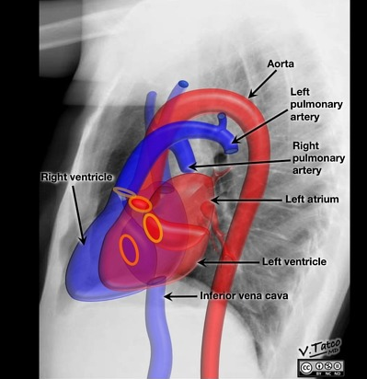
Normal chest x-ray (lateral view)

Slide 10
The Cardiac
Contours)normal(
Aortic knob
Ascending Aorta
Main pulmonary
artery
Indentation for
LA
Right atrium
Left ventricle

Slide 11
Cardio-thoracic
Ratio
One of the easiest
observations to make is something you already know: the cardio-thoracic ratio which is the widest diameter of the heart compared to the widest internal diameter of the rib cage
<50%

Slide 12
Cardiac
displacement
)Pectus excavatum(

Slide 13
DEXTROCARDIA

Slide 14
Echocardiogram

Slide 15
Echocardiogram

Slide 16
Echocardiogram
Advantages:
No Ionizing radiation
Widely available, portable.
Proper in assessing heart morphology (cardiac chambers, myocardium and valves).
Proper in assessing heart function (ejection fraction).
Proper in assessing pericardial effusion.
Disadvantages:
Operator dependent.
Not proper to assess coronary arteries

Slide 17
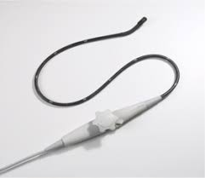
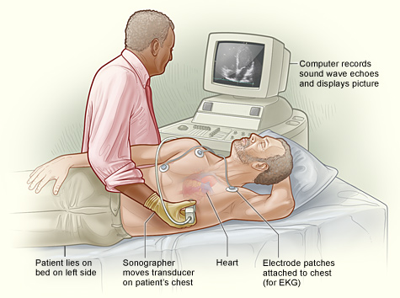
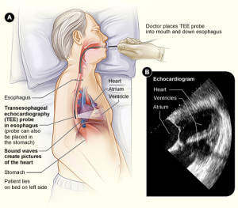
Echocardiogram
Trans-Thoracic
Trans-Esophageal

Slide 18
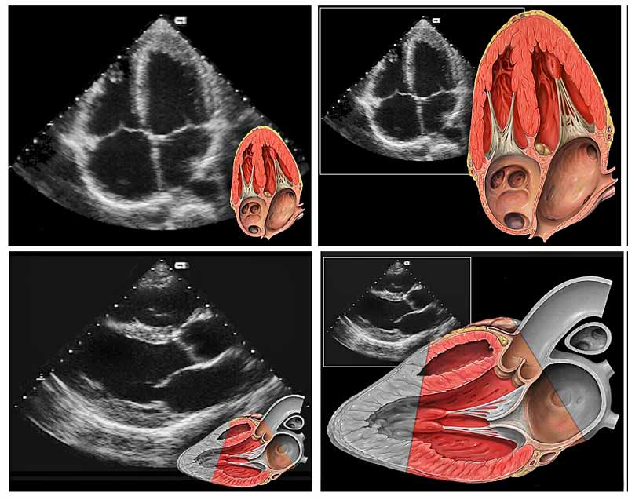
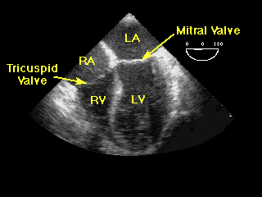
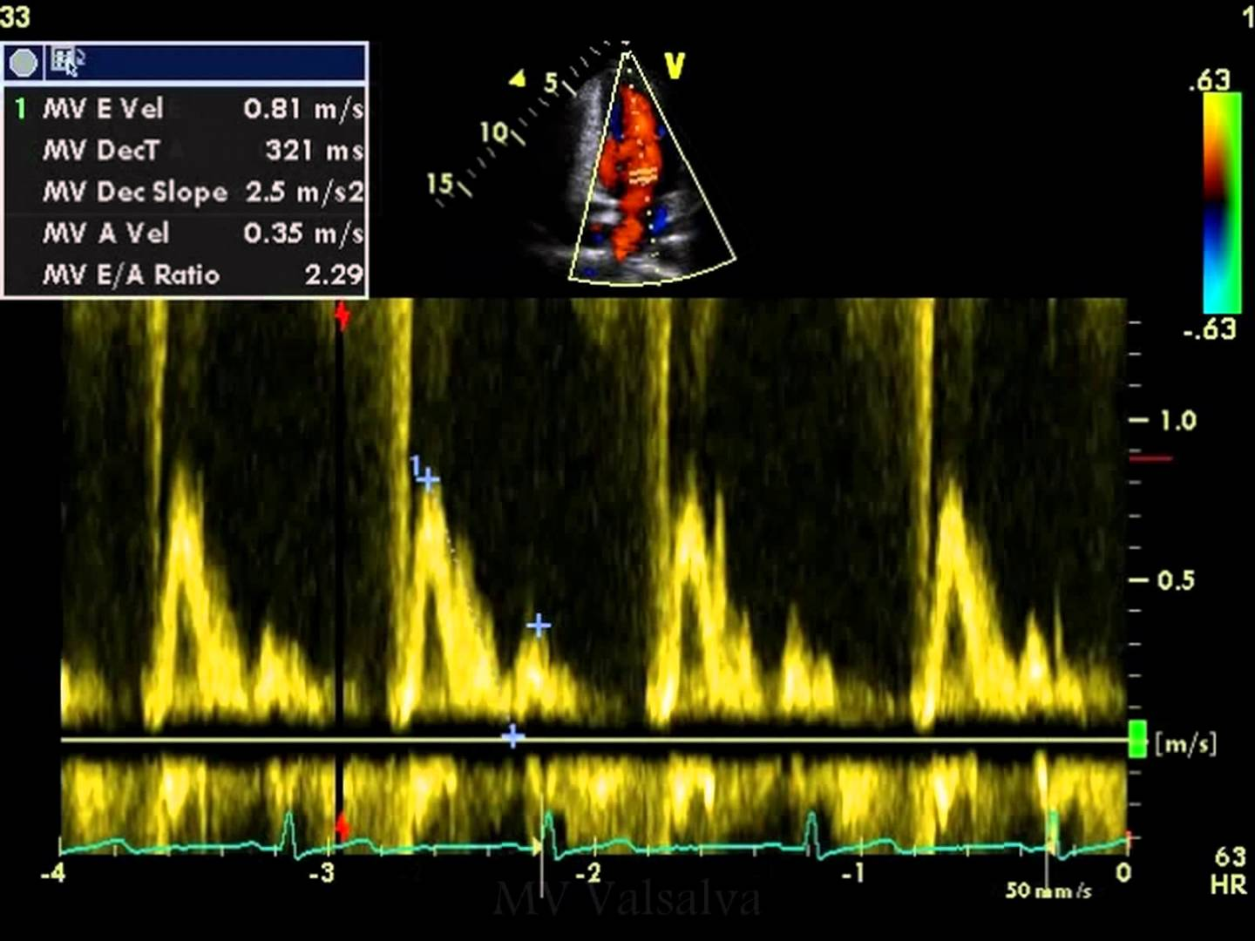
Echocardiogram (normal)

Slide 19
Angiogram

Slide 20
Angiogram= x-ray + I.V. contrast

Slide 21
Angiogram
Cardiac catheterization: assessment of coronary arteries and left ventricle.
Aortogram: assessment of aorta and main branches.
Pulmonary angiogram: assessment of pulmonary arteries.

Slide 22
Angiogram
Advantages:
Minimal invasive procedure and can replace surgery.
Proper in assessing and treating coronary stenosis.
Proper in assessing left ventricle.
Proper in assessing and treating aortic dissection or aneurysm.
A treatment option in extensive pulmonary embolism.
Disadvantages:
Use Ionizing radiation.
Invasive procedure.
Contrast complications.

Slide 23
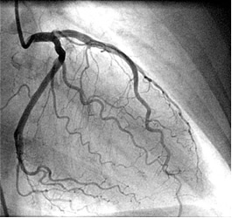
cardiac catheterization

Slide 24
cardiac catheterization
Left ventricle
Coronary arteries

Slide 25
Normal coronary arteries

Slide 26
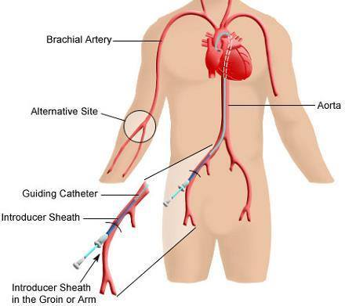
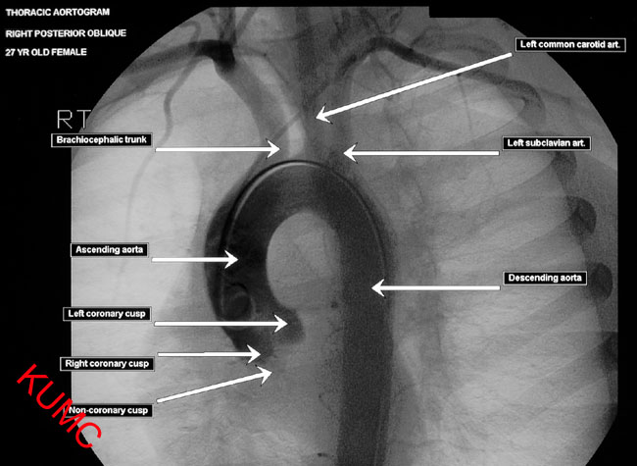
Aortogram

Slide 27
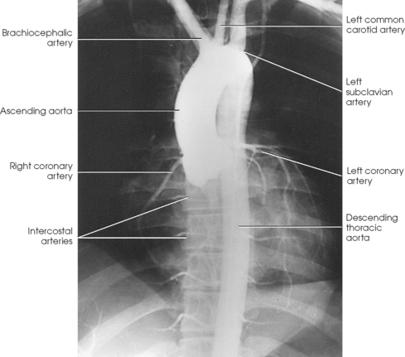
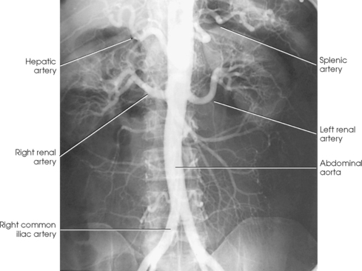
Aortogram
Thoracic aorta
Abdominal aorta

Slide 28
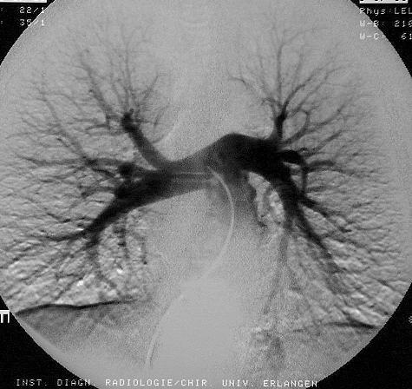
Pulmonary angiogram

Slide 29
Pulmonary angiogram
RPA = Right Pulmonary Artery; LPA = Left Pulmonary Artery; ILA = Interlobar Artery; TA =Truncus Anterior; RUL = Right Upper Lobe; ML = Middle Lobe; RLL = Right Lower Lobe ; LUL = Left Upper Lobe ; L = Lingual ; LLL = Left Lower Lobe.

Slide 30
CT scan

Slide 31
CT scan

Slide 32
CT scan
Advantages :
Widely available, relative cheap.
Proper in assessing pulmonary artery and aorta.
Proper in assessing coronary arteries (e.g. stenosis, calcification).
Proper in assessing heart anatomy.
Proper in assessing structure around the heart and mediastinal vessels (e.g. lungs).
Disadvantages:
Use Ionizing radiation.
Heart rate < 60 beat/min for an adequate cardiac exam.
Intravenous contrast complications.

Slide 33
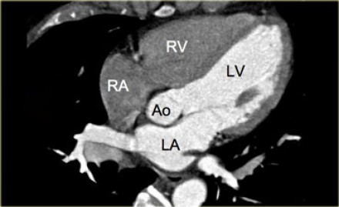
Cardiac CT
Cardiac chambers

Slide 34
Coronary arteries
Cardiac CT

Slide 35
Cardiac CT vs cardiac cath.

Slide 36
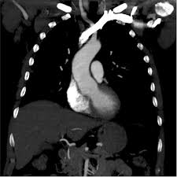
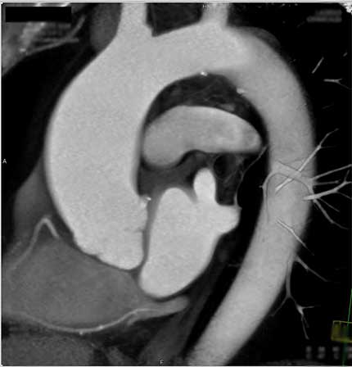
CT aortogram

Slide 37
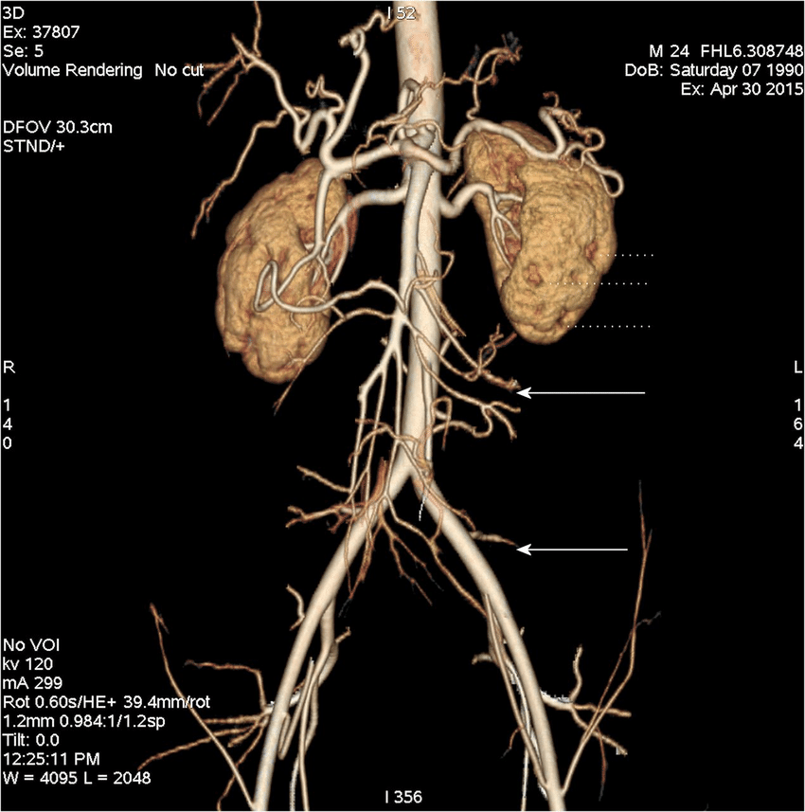
CT aortogram
Volume rendering

Slide 38
CT Pulmonary angiogram

Slide 39
CT Pulmonary angiogram
thrombus
Gold standard exam to diagnose Pulmonary Embolism

Slide 40
MRI

Slide 41
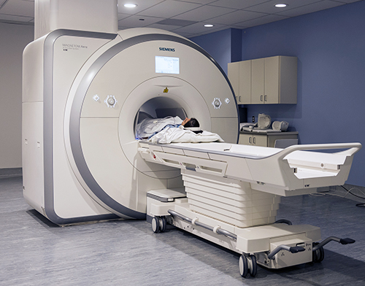
MRI

Slide 42
MRI
Advantages :
No Ionizing radiation.
Better soft tissue Characterization.
Proper in assessing myocardium ( e.g. infarction, infiltrative diseases).
Proper in assessing cardiac valves.
Proper in assessing aorta.
Disadvantages:
Not widely available.
Contra indications (cardiac devices)
Intravenous contrast complications.

Slide 43
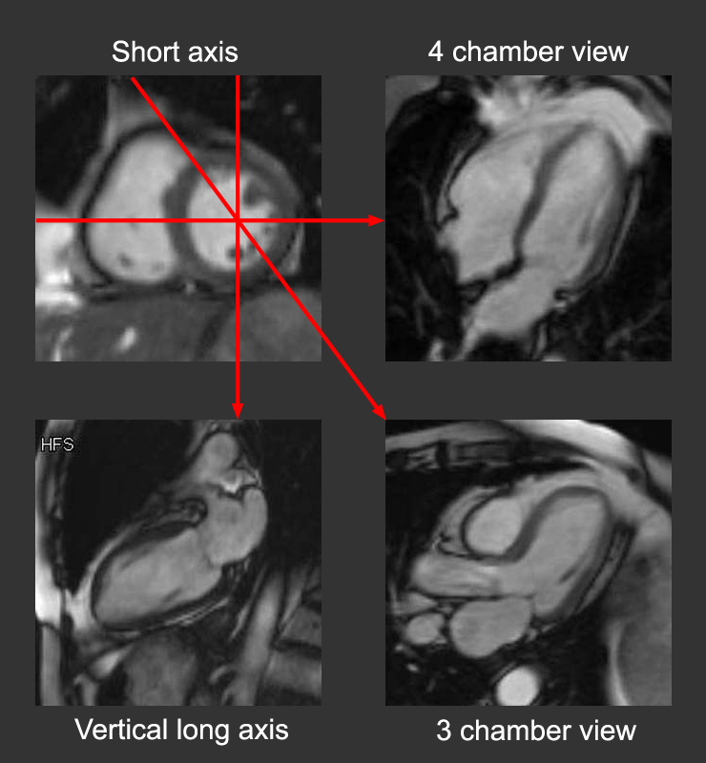
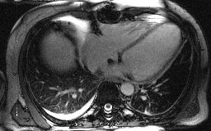
Cardiac MRI

Slide 44
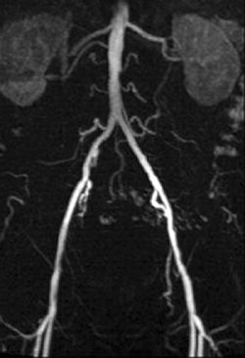
MRI Aortogram

Slide 45
MRI vs CT

Slide 46
Nuclear scan

Slide 47
Nuclear scan

Slide 48
Nuclear scan
Advantages:
Assess physiology/ pathophysiology
Proper in assessing myocardium perfusion ( e.g. ischemia vs infarction).
Proper in assessing lung perfusion (pulmonary embolism) alternative to CT scan.
Disadvantages:
Use ionizing radiation.
Not widely available.
Poor in assessing anatomy.

Slide 49
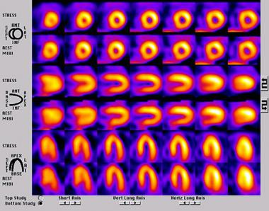
Cardiac scan
A study to assess myocardial perfusion (mainly left ventricle).
Includes a stress and rest phases.
Normal exam shows continuous uptake of left ventricle (no defects).

Slide 50
V/Q scan
A study to diagnose pulmonary embolism.
Alternative to CT scan.
Includes ventilation phase and perfusion phase.
Normal exam shows similar lungs uptake in ventilation and perfusion phases.

Slide 51
Thank you

