Slide 1
Radiology of the respiratory/cardiac diseases (part 2)
Dr. Reshaid Al Jurayyan
Assistant professor & consultant
Radiology & medical imaging department
King Saud university- medical city

Slide 2
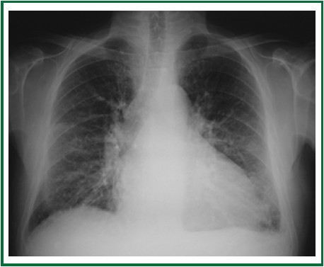
60 year old male presenting to emergency with chest pain.

Slide 3
60 year old male presenting to emergency with chest pain.
Is the heart normal ?
Are the lungs normal ?

Slide 4
60 year old male presenting to emergency with chest pain.
Is the heart normal ? Enlarged
Are the lungs normal ? Pulmonary edema + left +pleural effusion
20cm
30cm

Slide 5
Heart Enlargement on x-ray (causes):
Congestive heart failure.
Ischaemic heart disease.
Valvular disease.
Myocarditis.
Cardiomyopathy.
Congenital heart disorders: e.g. ASD, VSD, PDA, coarctation of the aorta, Ebstein anomaly, tetralogy of Fallot.
Pulmonary disease (leading to right-sided enlargement).
Systemic disease: e.g. Hypertension (left ventricular hypertrophy), renal failure, anaemia
Physiology: e.g. normal “athletic” heart, pregnancy.
Pericardial effusion.

Slide 6
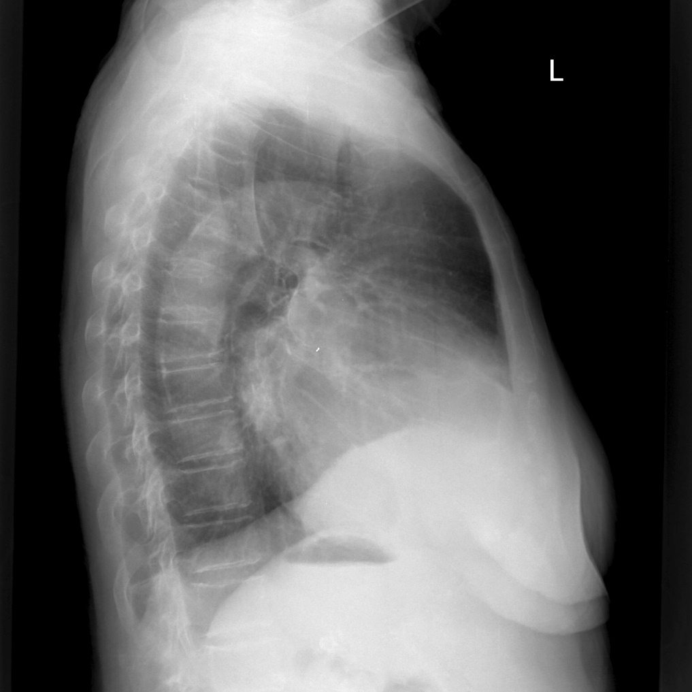
Which heart chamber is enlarged ?

Slide 7
Which heart chamber is enlarged ? Left atrium

Slide 8
Signs of Left atrium (x-ray)
Widening of carina
Displacement of posterior heart border
Double right heart border sign
Enlarged heart size

Slide 9
Which heart chamber is enlarged ?

Slide 10
Which heart chamber is enlarged ? Right ventricle

Slide 11
Which heart chamber is enlarged ? Right ventricle
"boot shaped" heart
Elevated heart apex

Slide 12
Which heart chamber is enlarged ?

Slide 13
Which heart chamber is enlarged ? left ventricle
Enlarged left ventricle
Normal

Slide 14
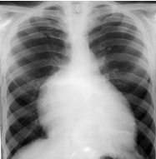
Which heart chamber is enlarged ?

Slide 15
Which heart chamber is enlarged ? Right atrium
Displaced right heart border (NO double border sign)

Slide 16
What is abnormal ?

Slide 17
What is abnormal ? Heart shadow is enlarged.

Slide 18
What could be the cause ? And why?

Slide 19
What could be the cause ? And why? Pericardial effusion. No lung changes (edema).

Slide 20
Who to confirmed the diagnosis ?

Slide 21
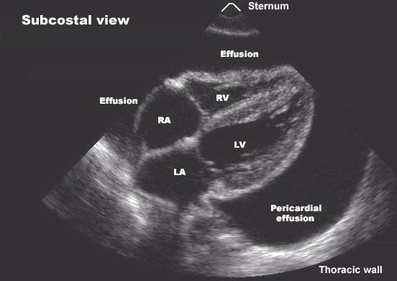
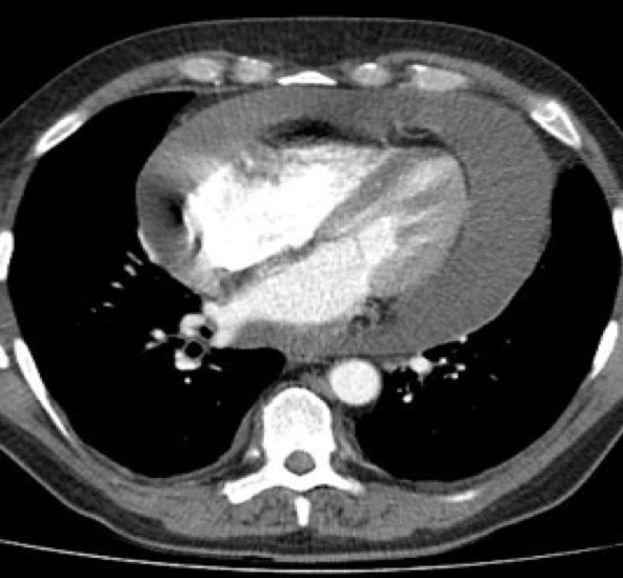
Who to confirmed the diagnosis ? Echocardiograph or CT scan.

Slide 22
What is abnormal ? Heart shadow is enlarged. What could be the cause ? And why? Pericardial effusion. No lung changes (edema). Who to confirmed the diagnosis ? Echocardiograph or CT scan.

Slide 23
Known case of hypertension presenting with chest pain.

Slide 24
Known case of hypertension presenting with chest pain.
What is the arrow pointing at ?

Slide 25
Known case of hypertension presenting with chest pain.
What is the arrow pointing at ?
Aortic arch (aortic knob)

Slide 26
Known case of hypertension presenting with chest pain.
Is it normal ?

Slide 27
Known case of hypertension presenting with chest pain.
Is it normal ?
No, dilated/enlarged.

Slide 28
Known case of hypertension presenting with chest pain.
What will you do next?

Slide 29
Known case of hypertension presenting with chest pain.
What will you do next?
CT Aortogram

Slide 30
Known case of hypertension presenting with chest pain.
What is the arrow pointing at ?
Aortic arch (aortic knob)
Is it normal ?
No, dilated/enlarged.
What will you do next?
CT Aortogram

Slide 31
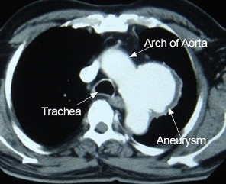
Aortic arch aneurysm

Slide 32
Aortic arch aneurysm (treated with stent)
Before stenting
After stenting

Slide 33
What is abnormal in this chest x-ray?

Slide 34
What is abnormal in this chest x-ray? Enlarged pulmonary arteries

Slide 35
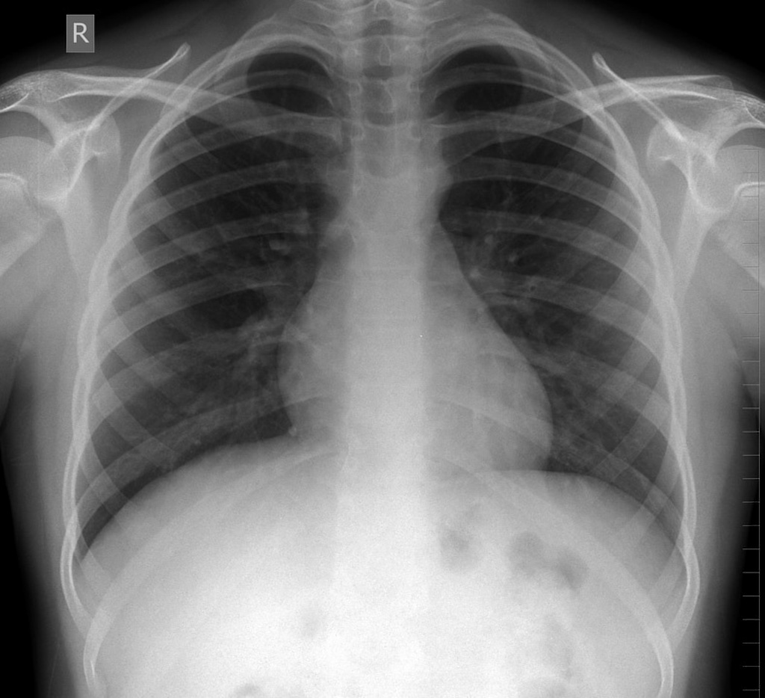
What is abnormal in this chest x-ray? Enlarged pulmonary arteries
Normal

Slide 36
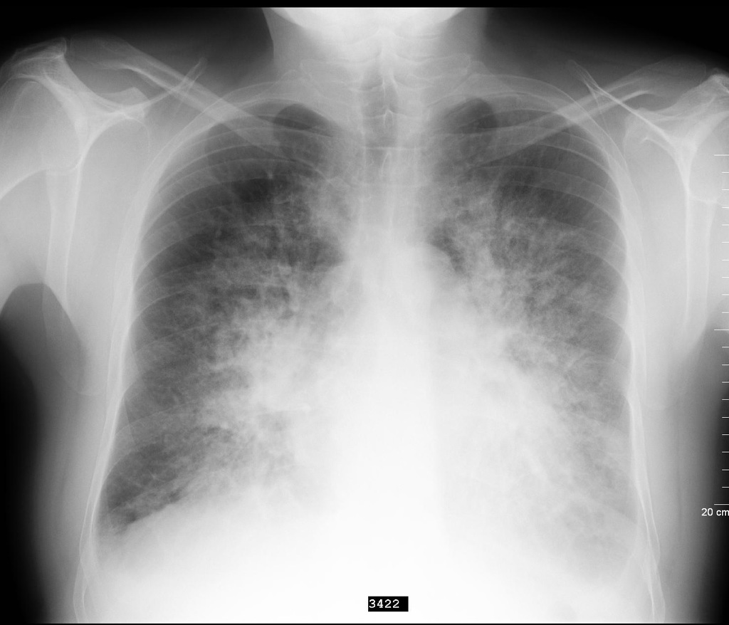
70 year-old female with orthopnea.
What is abnormal in this x-ray?

Slide 37
70 year-old female with orthopnea.
What is abnormal in this x-ray?
Pulmonary edema (cardiogenic)

Slide 38
Signs of pulmonary edema on chest x-ray:
Upper lobe pulmonary venous diversion.
Increased cardio-thoracic ratio (cardiogenic).
Features of pulmonary interstitial edema:
Peri-bronchial cuffing.
Septal lines/ thickening (Kerley lines).
Features of pulmonary alveolar edema:
Air space opacification (batwing distribution).
Pleural effusions.

Slide 39
Signs of pulmonary edema on chest x-ray:
Upper lobe pulmonary venous diversion.

Slide 40
Signs of pulmonary edema on chest x-ray:
Upper lobe pulmonary venous diversion.

Slide 41
Signs of pulmonary edema on chest x-ray:
Increased cardio-thoracic ratio (cardiogenic).

Slide 42
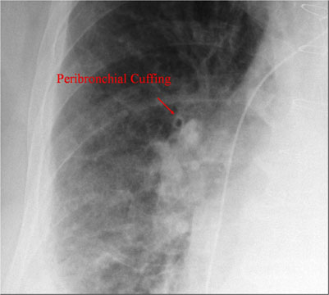
Signs of pulmonary edema on chest x-ray:
Features of pulmonary interstitial edema:
Peri-bronchial cuffing.
Septal lines/ thickening (Kerley B lines).

Slide 43
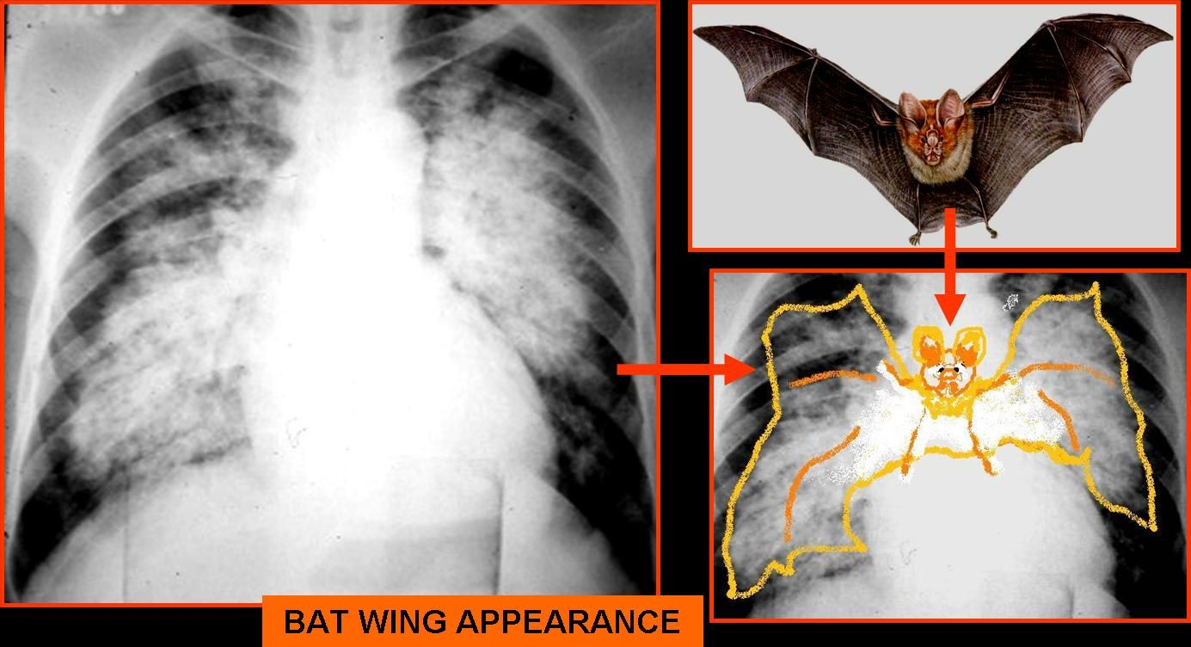
Signs of pulmonary edema on chest x-ray:
Features of pulmonary alveolar edema:
Air space opacification (batwing distribution).

Slide 44
Signs of pulmonary edema on chest x-ray:
Pleural effusions.

Slide 45
Pulmonary edema before and after treatment (diuretics)

Slide 46
Heart valve assessment on echocardiography

Slide 47
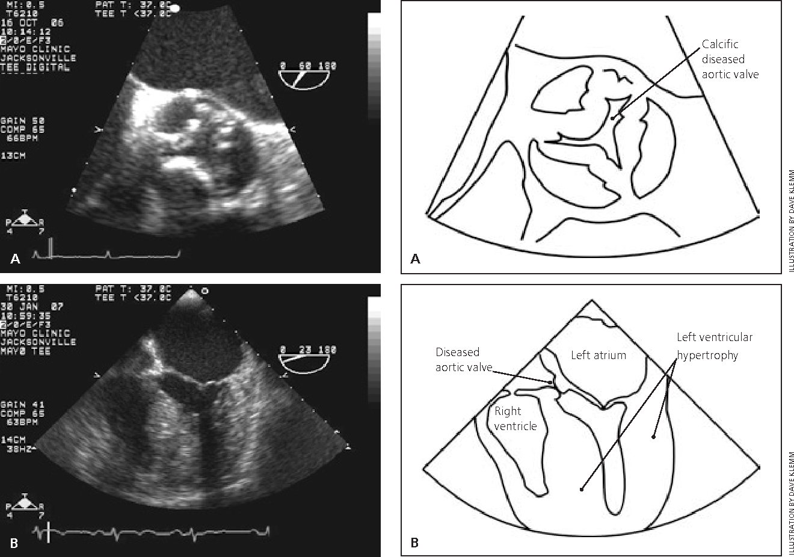
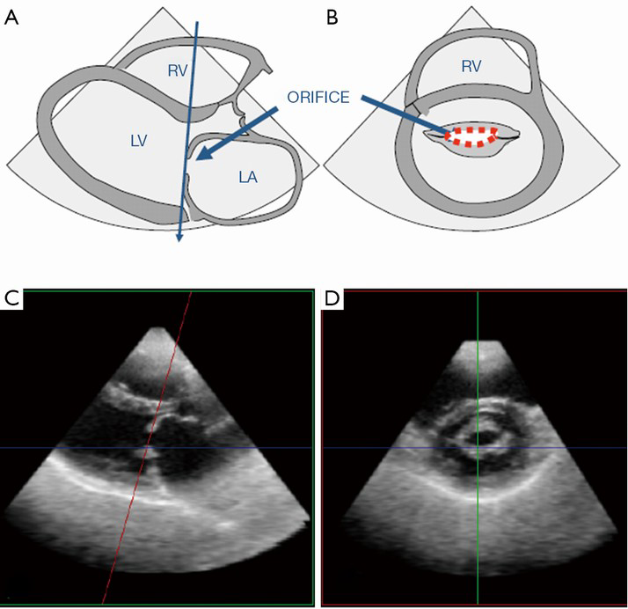
Aortic valve stenosis
Mitral valve stenosis

Slide 48
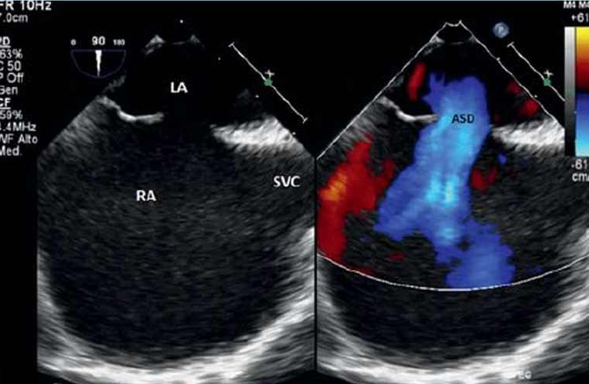
interatrial Septal defect
MRI
Echo.

Slide 49
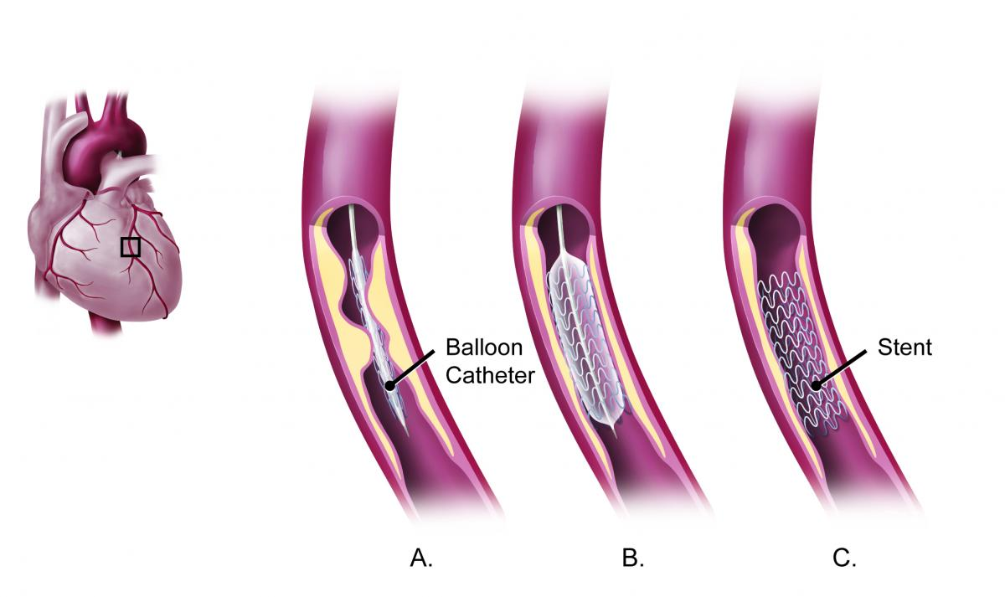
Cardiac cath. (before and after stenting)

Slide 53
MRI myocardial enhancement

Slide 56
What is the diagnosis ?
Stress
Rest

Slide 57
What is the diagnosis ? Myocardial ischemia
Stress
Rest

Slide 58
What is the diagnosis?
V/Q scan

Slide 59
What is the diagnosis? Pulmonary embolism (mis-match between ventilation and perfusion scans)
V/Q scan

Slide 60
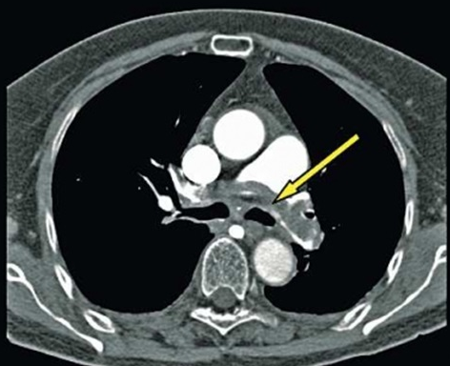
CT pulmonary angiogram
Pulmonary embolism

Slide 61
Thank you

