Slide 1
Radiology of cardiorespiratory disease (interactive lecture)
Dr. Reshaid Al Jurayyan
Assistant professor & consultant
Radiology & medical imaging department
King Saud university- medical city

Slide 2
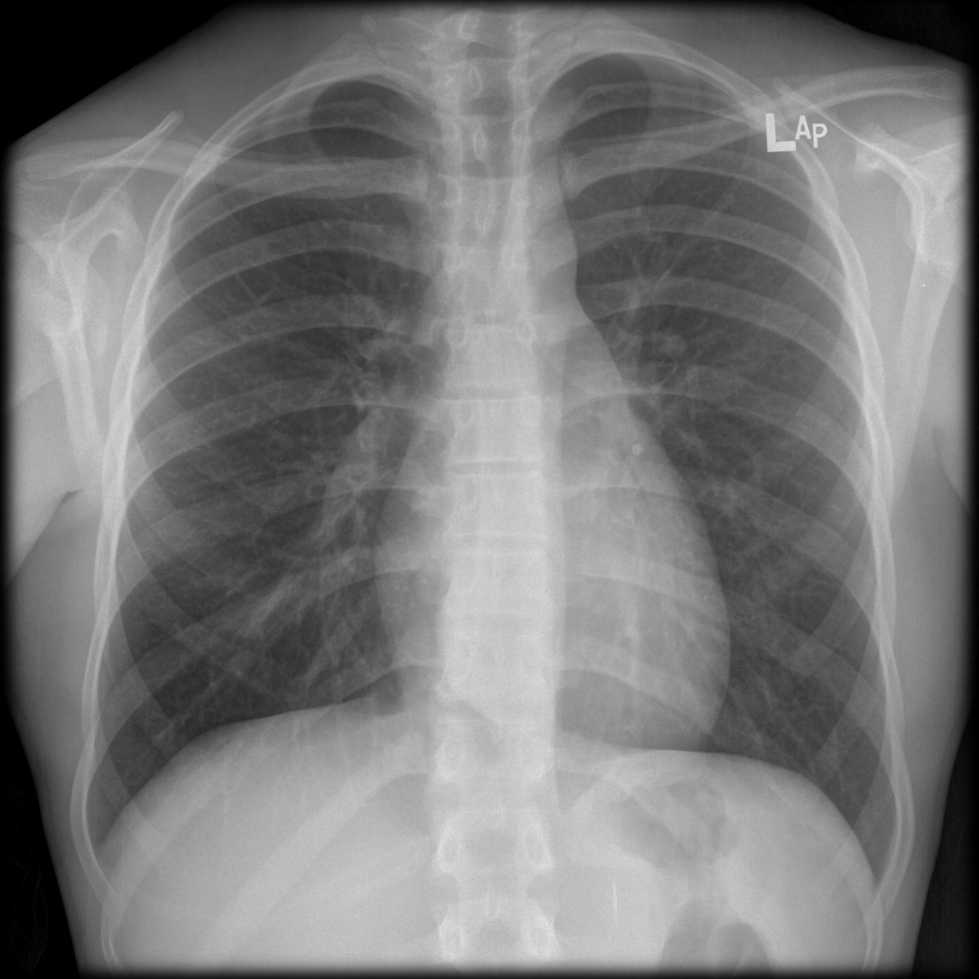
Name the labels:

Slide 3
Name the labels:
Right clavicle
Aortic knob
trachea
Pulmonary artery truck
Right pulmonary artery
Left atrium appendage
Right atrium
Left ventricle
Right hemi diaphragm
Right ventricle
Left hemi diaphragm
Stomach

Slide 4
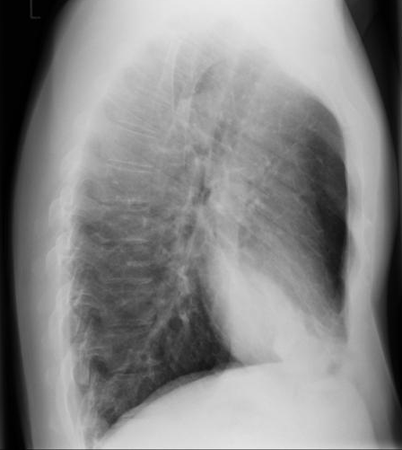
30 year-old with fever.

Slide 5
30 year-old with fever.
Is it a mass or infiltration ??
Which lung lobe is affected?

Slide 6
30 year-old with fever.
Is it a mass or infiltration ??
Infiltration/pneumonia
Which lung lobe is affected?
Right middle lobe

Slide 7
50 year-old smoker. What is the most likely diagnosis?

Slide 8
50 year-old smoker. What is the most likely diagnosis? Left lung mass.

Slide 9
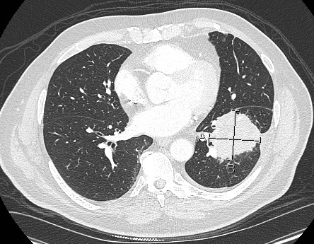
50 year-old smoker. What is the most likely diagnosis? Left lung mass.
CT scan

Slide 10
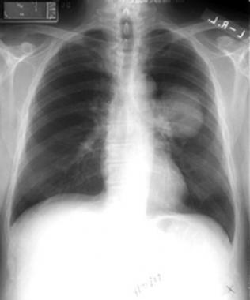
mass
pneumonia

Slide 11
40 year-old female complaining of dyspnea.
What is the most likely diagnosis?

Slide 12
40 year-old female complaining of dyspnea.
What is the most likely diagnosis?
Right pleural effusion.

Slide 13
40 year-old female complaining of dyspnea.
Look for the meniscus sign
What is the most likely diagnosis?
Right pleural effusion.

Slide 14
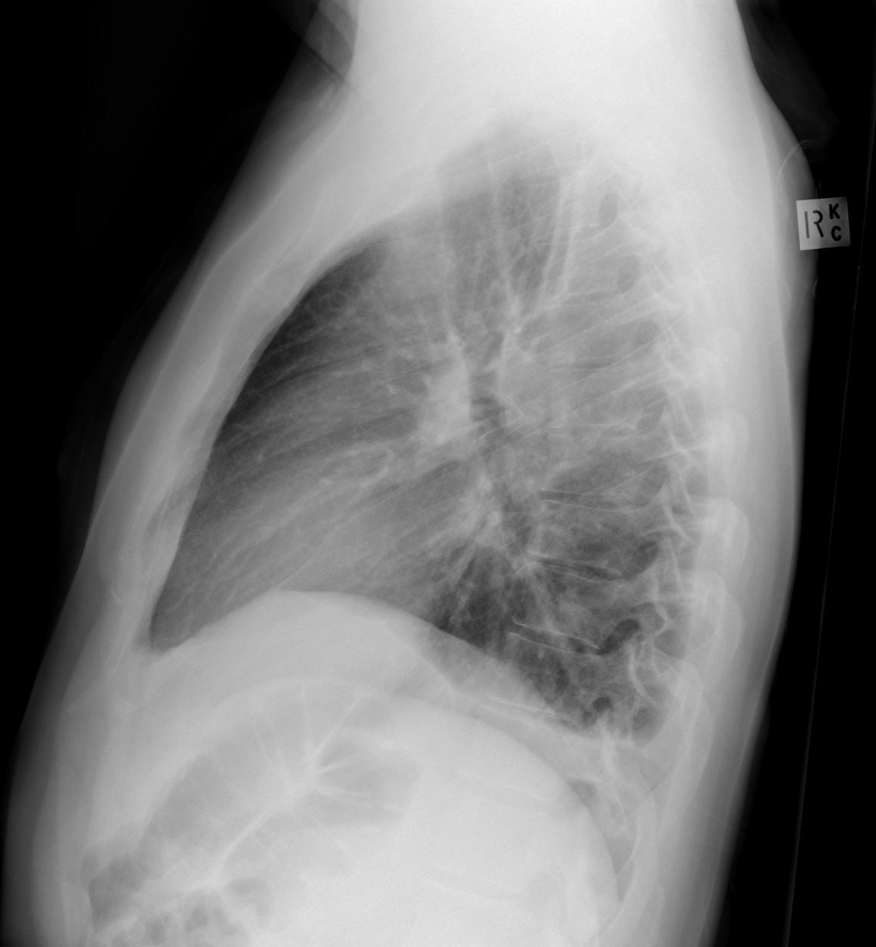
Pleural effusion on lateral view.
Pleural effusion
Normal side

Slide 15
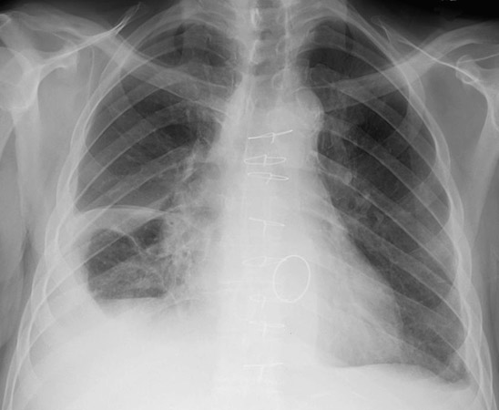
What is this ?

Slide 16
Pleural effusion (fluid tracking into right horizontal fissure)
What is this ?

Slide 17
25 year-old male with with chest pain
L
Which side of the chest is abnormal?
What is the diagnosis?

Slide 18
25 year-old male with with chest pain
L
Which side of the chest is abnormal?
Right side.
What is the diagnosis?
Pneumothorax.

Slide 19
What is the diagnosis ?

Slide 20
What is the diagnosis ?
Hydro-pneumothorax
Look for air/fluid level

Slide 21
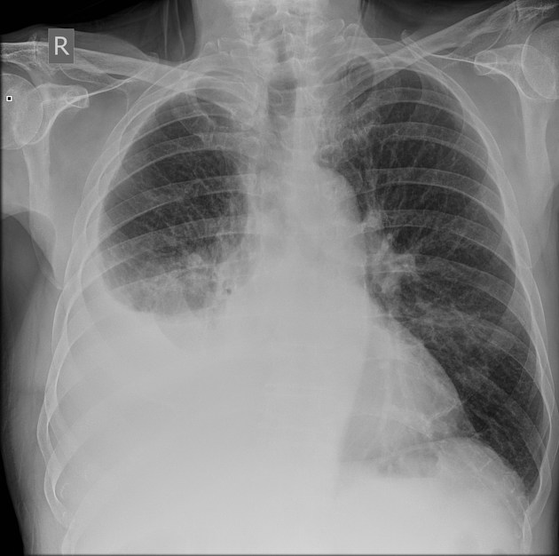
Pleural effusion
Hydro-pneumothorax

Slide 22
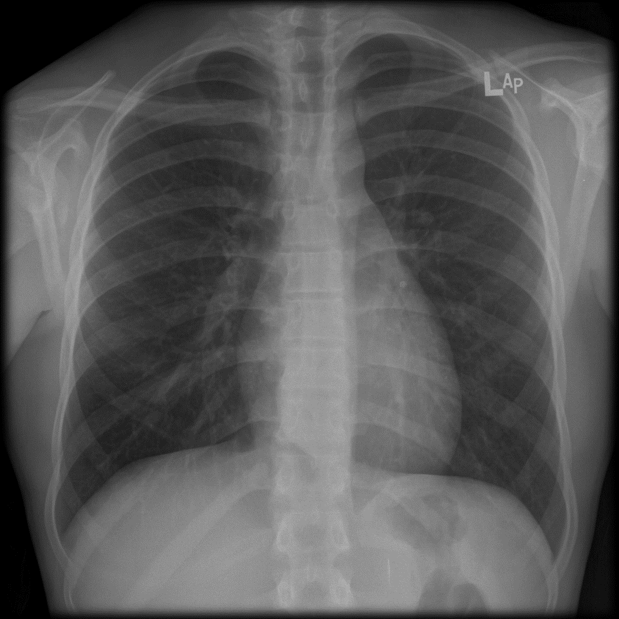
Which film is abnormal? What is the abnormality?

Slide 23
Which film is abnormal? What is the abnormality?
Abnormal
emphysema
Normal

Slide 24
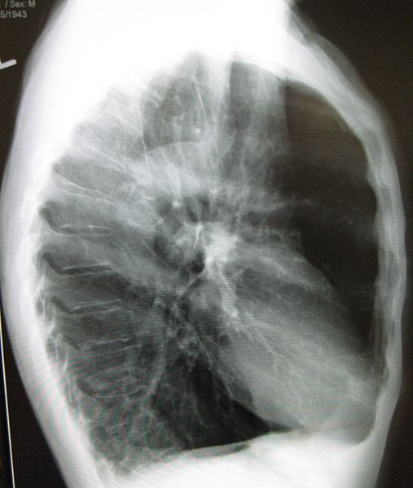
Which film is abnormal? What is the abnormality?
Abnormal
emphysema
Normal

Slide 25
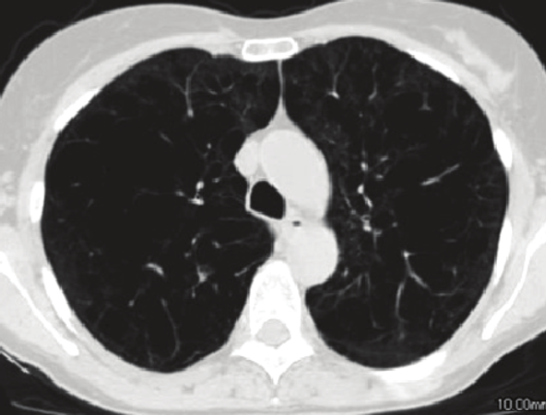
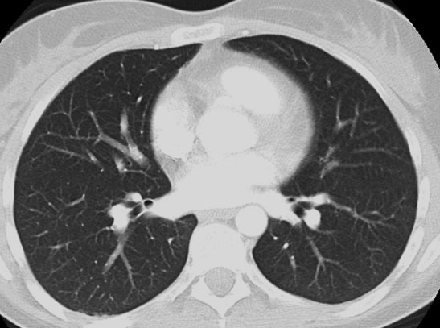
Which film is abnormal? What is the abnormality?
CT scan
Abnormal
emphysema
Normal

Slide 26
What is abnormal ?

Slide 27
What is abnormal ?
Heart shadow is enlarged

Slide 28
What is abnormal ?
Heart shadow is enlarged
Can you figure out which heart chamber is enlarged?

Slide 29
What is abnormal ?
Heart shadow is enlarged
Can you figure out which heart chamber is enlarged?
Right atrium

Slide 30
Left atrium enlargement vs Right atrium enlargement

Slide 31
What is the diagnosis?

Slide 32
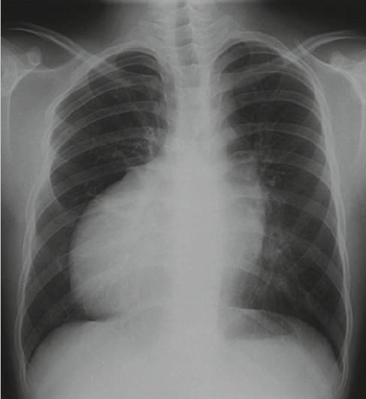
What is the diagnosis?

Slide 33
What is the diagnosis?
Always check for the side label (L or R)

Slide 34
What is the diagnosis?
L
Diagnosis: dextrocardia
Always check for the side label (L or R)

Slide 35
60 year –old male with difficulty in breathing
What is the most likely diagnosis ?

Slide 36
60 year –old male with difficulty in breathing
What is the most likely diagnosis ?
Cardiogenic Pulmonary edema (interstitial)

Slide 37
60 year –old male with difficulty in breathing
What is the most likely diagnosis ?
Cardiogenic Pulmonary edema (interstitial)

Slide 38
60 year –old male with difficulty in breathing
What is the most likely diagnosis ?
Cardiogenic Pulmonary edema (interstitial)
Kerley B lines

Slide 39
60 year –old male with difficulty in breathing
What is the most likely diagnosis ?
Cardiogenic Pulmonary edema (interstitial)
Peri broncheal cuffing

Slide 40
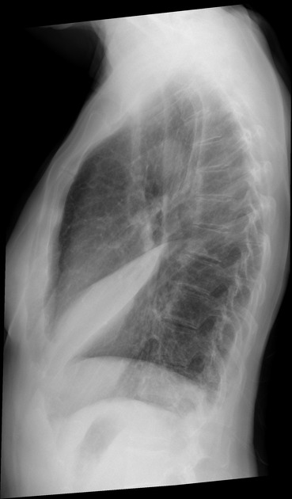
What do you see in this x ray ?

Slide 41
What do you see in this x ray ? Right middle lobe collapse.

Slide 42
Right upper lobe collapse

Slide 43
Left upper lobe collapse

Slide 44
Left lower lobe collapse

Slide 45
Right lower lobe collapse

Slide 46
50 year-old with severe chest pain.
What is abnormal?

Slide 47
50 year-old with severe chest pain.
What is abnormal?
The aorta is enlarged.
What will you do next?

Slide 48
50 year-old with severe chest pain.
What is abnormal?
The aorta is enlarged.
What will you do next?
CT scan (CT aortogram)

Slide 49
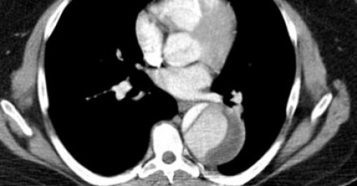
What is the diagnosis ?

Slide 50
What is the diagnosis ? Aortic dissection.

Slide 51
40 year-old female with chest pain after a 7 hours flight. She had previous deep vein thrombosis in her lower limbs.
What are you suspecting this patient has?

Slide 52
40 year-old female with chest pain after a 7 hours flight. She had previous deep vein thrombosis in her lower limbs.
What are you suspecting this pataint has?
Pulmonary embolism

Slide 53
40 year-old female with chest pain after a 7 hours flight. She had previous deep vein thrombosis in her lower limbs.
What are you suspecting this patient has?
Pulmonary embolism
Do you see any abnormality in this chest x ray?

Slide 54
40 year-old female with chest pain after a 7 hours flight. She had previous deep vein thrombosis in her lower limbs.
What are you suspecting this patient has?
Pulmonary embolism
Do you see any abnormality in this chest x ray?
No

Slide 55
40 year-old female with chest pain after a 7 hours flight. She had previous deep vein thrombosis in her lower limbs.
What are you suspecting this patient has?
Pulmonary embolism
Do you see any abnormality in this chest x ray?
No
What to do next ?

Slide 56
40 year-old female with chest pain after a 7 hours flight. She had previous deep vein thrombosis in her lower limbs.
What are you suspecting this pataint has?
Pulmonary embolism
Do you see any abnormality in this chest x ray?
No
What to do next ?
CT pulmonary angiogram.

Slide 57
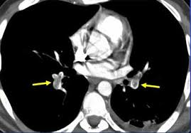
Pulmonary embolism
Thrombus
Thrombus

Slide 58
Pulmonary embolism
CT pulmonary angiogram is the gold standard exam to diagnose PE
Thrombus
Thrombus
The most common x ray finding in PE is ” NORMAL”

Slide 59
What is the diagnosis ?

Slide 60
What is the diagnosis ?
Myocardial ischemia
Myocardial infarction

Slide 61
Thank you

