Slide 1
Radiology of Urinary System Diseases
Dr. Husain Alturkistani
Assistant Professor & Consultant

Slide 2
Objectives
To know the principle disease entities of the urinary system organs and how they look in imaging
To correlate the clinical manifestations with radiological images

Slide 3
Categories:
- Renal Colic
- Infections
- Urosepsis
- Masses
- Renal Failure
- Trauma

Slide 4
Renal Colic
- Caused by renal calculi
- Classic presentation: (sudden onset of severe flank pain radiating inferiorly and anteriorly +/- nausea and vomiting)
- Diagnosis often made clinically
Imaging: to confirm and evaluate calculi

Slide 6
KUB: to assess total stone burden, size, shape, location
Often: US or CT is required in conjunction

Slide 11
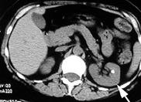
Renal Calculus– CT Scan

Slide 12
Acute Pyelonephritis
- Life threatening infection & medical emergency
- Through lower urinary tract
- Early diagnosis and management has significant impact on patient outcome
- Presentation: (Fever, loin pain, nausea/vomiting)

Slide 13
Pyelonephritis: Wedge shaped hypoperfused lesion

Slide 14
Cystitis
- Presentation: (Fever, suprapubic pain, frequent urination)
- As upper UTI, more common in females

Slide 21
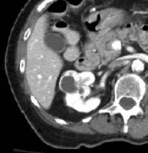

Slide 25
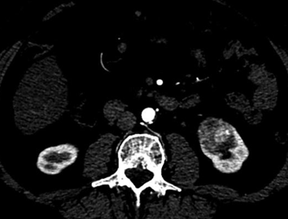
70 y/o female presented with painless hematuria

Slide 30
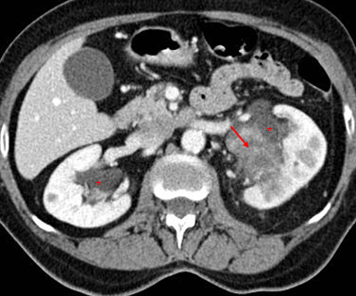

Slide 37
Grade 1-2 injury

Slide 38
Grade 3 injury

Slide 44
Spot Diagnoses

Slide 70
Thank you

