Slide 1
Radiology & investigation of hepatobiliary system
D.Reshaid Aljurayyan
Assit. Professor department of radiology
college of medicine
King Saud university

Slide 2
Lecture outline:
What is hepatobiliary system HBS?
Radiological modalities used in imaging HBS.
Advantages and disadvantages of each radiology modality.
Indications of imaging HBS.

Slide 3
What is hepatobiliary system (HBS)?
It includes liver, gallbladder and biliary ducts.

Slide 4
What are the Radiological modalities used in imaging HBS ?
X Ray.
Ultrasound.
Computed tomography CT scan.
Magnetic resonance imaging MRI.
Nuclear scan.

Slide 5
What is this?

Slide 6
What is this?
Abdomen x-ray
OR
Abdomen radiography

Slide 7
What is this ????

Slide 8
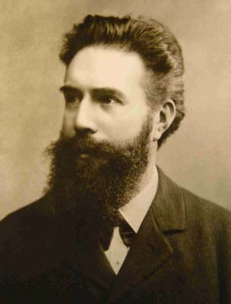
X ray was first observed and documented in 1895 by Wilhelm Conrad Roentgen
First x ray taken in history

Slide 9
What is X ray?
It is energetic form of electromagnetic and ionozintng radiation that can penetrated solid objects and used to take images of the human body.

Slide 10
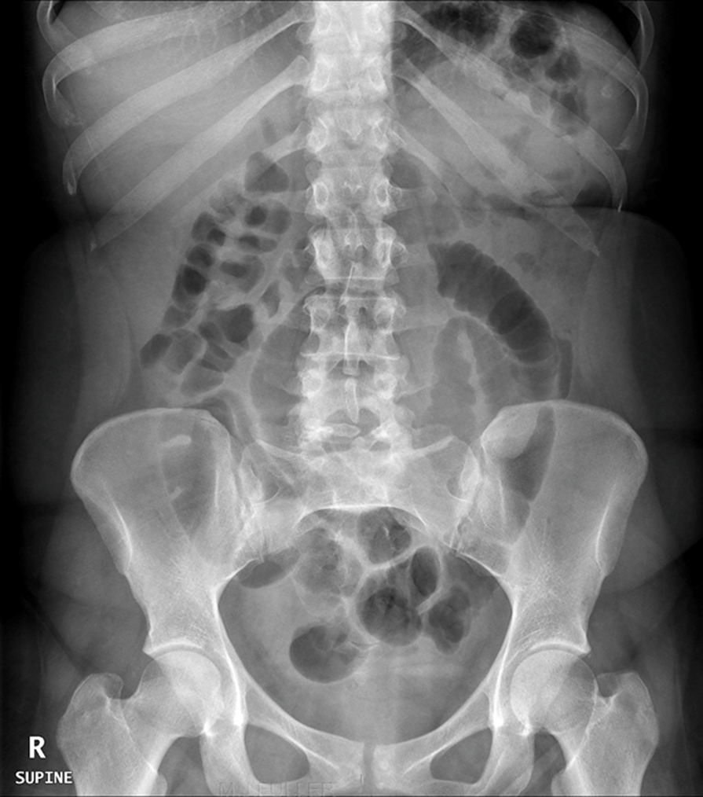
X RAY language
Radio-lucent = black
Radio-opaque= white

Slide 11
X RAY
Advantages:
Quick and widely available
Cheap
Can be done bedside (portable)
Disadvantages:
Use ionizing radiation
Very poor in tissue details including HBS
Very limited in detecting gallbladder stones

Slide 12
What is this?

Slide 13
What is this?
ULTRASOUND

Slide 14
What is US?
A diagnostic technique in which high-frequency sound waves penetrate the body and produce multiple echo patterns.
Diagnostic Medical applications in use since late 1950’s

Slide 15
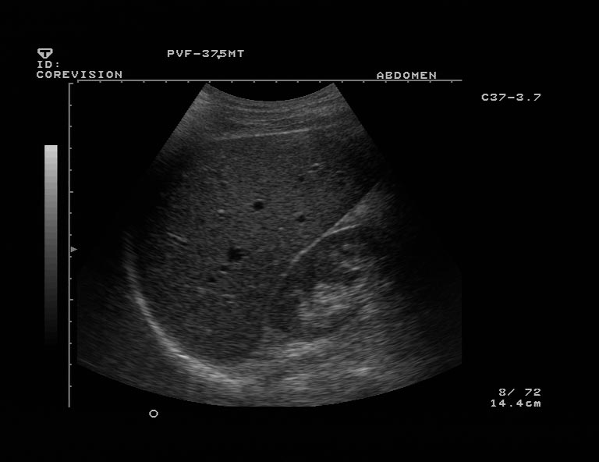
Ultrasound
Advantages :
No radiation
Widely available
Relatively cheap
Very good in evaluating abdomen solid organs
Can be done bedside (portable)
Disadvantages:
Operator dependent
Very limited in evaluating structures with air ( e.g. bowel) or calcification (e.g. bone)

Slide 16
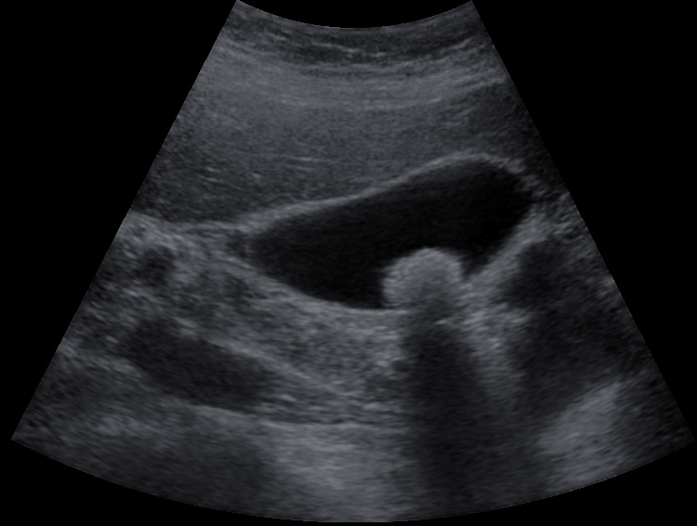
Echo patterns
Hyper-echoic = White
Hypo-echoic = Light Grey
An-echoic = Black
Acoustic shadow: black band behind dense object (e.g. stone)

Slide 17
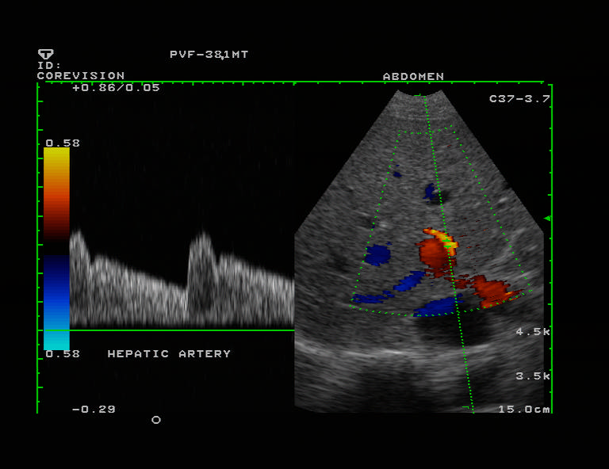
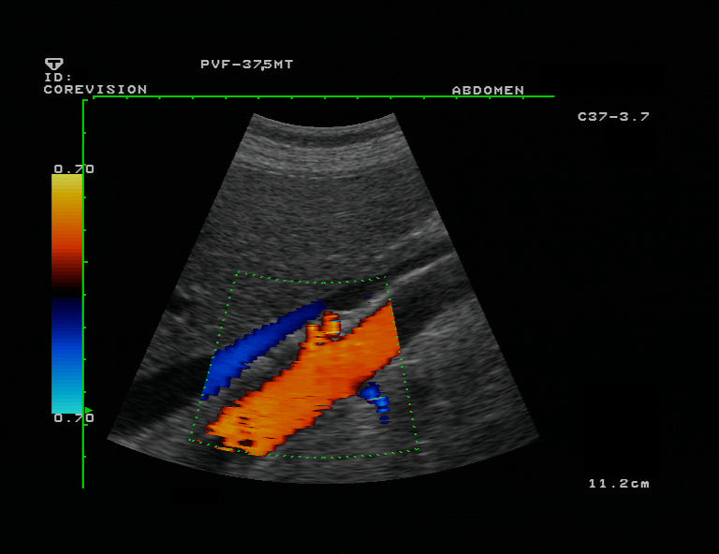
B- MODE.
DUPLEX
COLOR DOPPLER

Slide 18
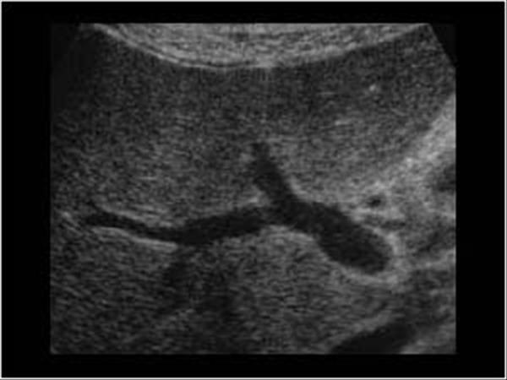
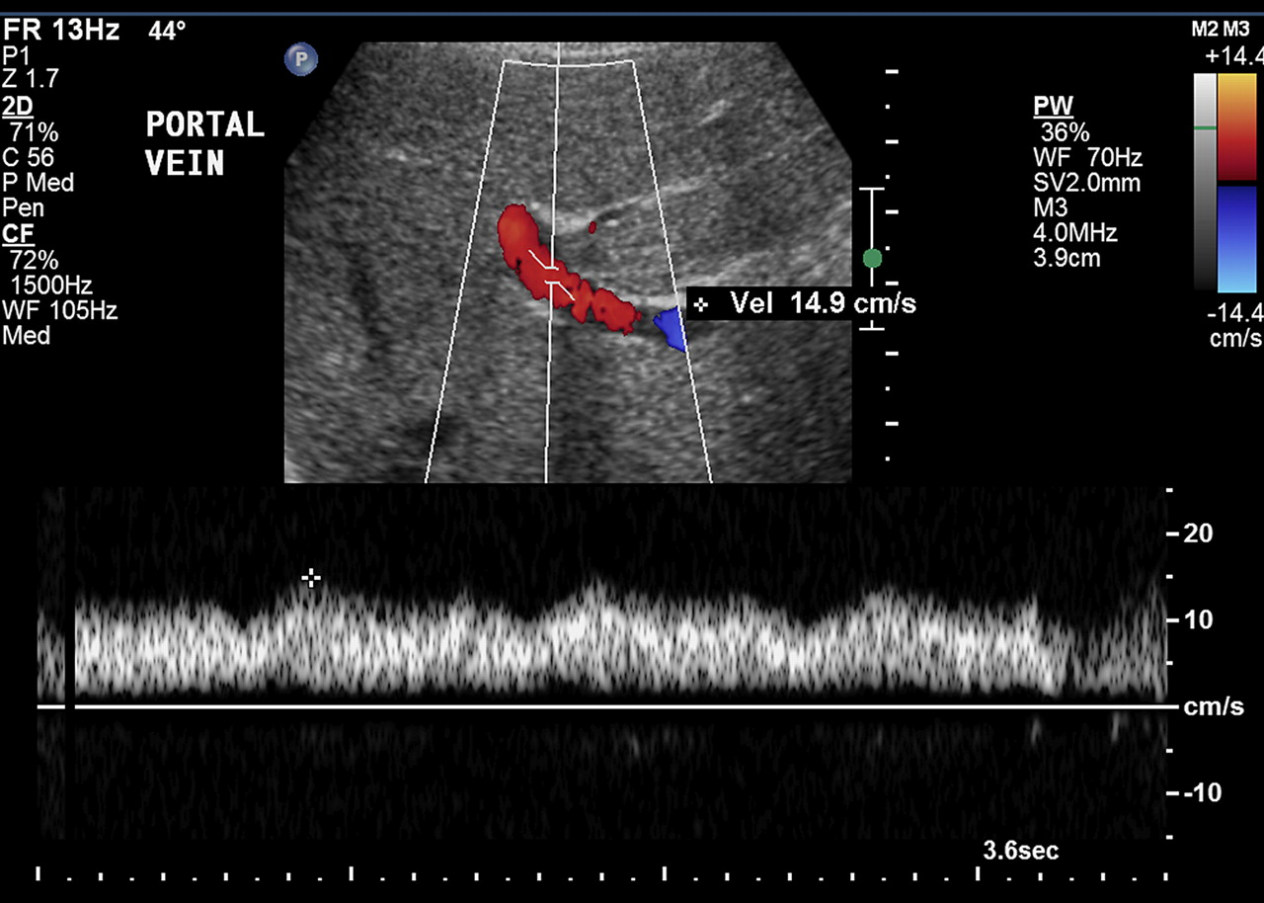
B- MODE
DUPLEX

Slide 19
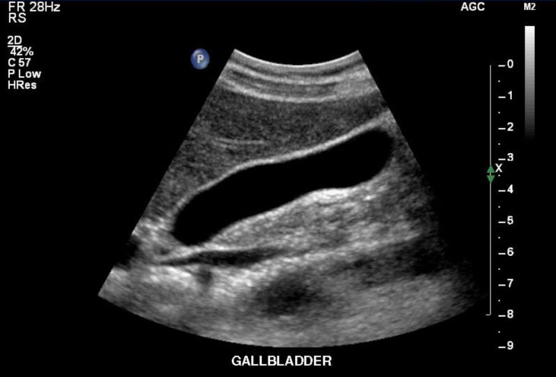

Slide 20
What is this?

Slide 21
What is this?
Computed Tomography
CT scan.

Slide 22
What is CT scan?
A CT scan makes use of computer-processed of many X-ray images taken from different angles to produce cross-sectional tomographic images of specific areas of a scanned object.
CT scan can be done with and without intravenous IV contrast.
CT scan is limmited in evaluating gallstones, Why?

Slide 23
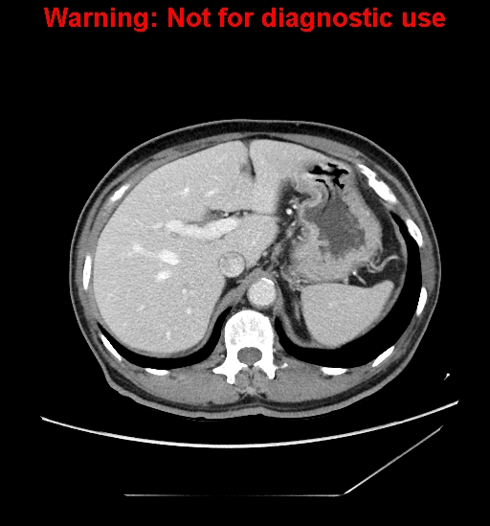
What is different between the tow iamges?

Slide 24
What is different between the tow iamges?
Without IV contrast
With IV contrast

Slide 25
Computed tomography CT scan.
Advantages:
Very good in evaluating solid organs
Available more them MRI
Disadvantages:
Use ionizing radiation
Less available then x-ray and US
Relatively expansive
Intravenous contrast maybe harmfull

Slide 26
CT language
Hyper-dense = white
Hypo-dense=black to grey

Slide 27
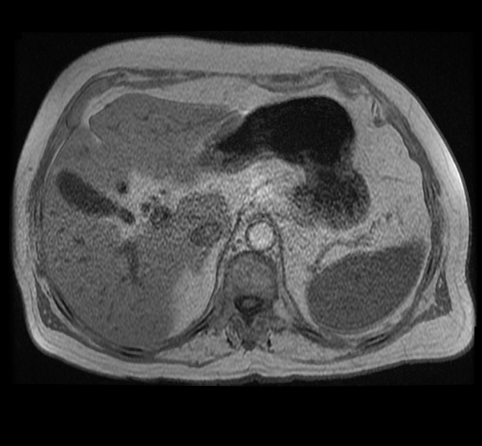
What is this?

Slide 28
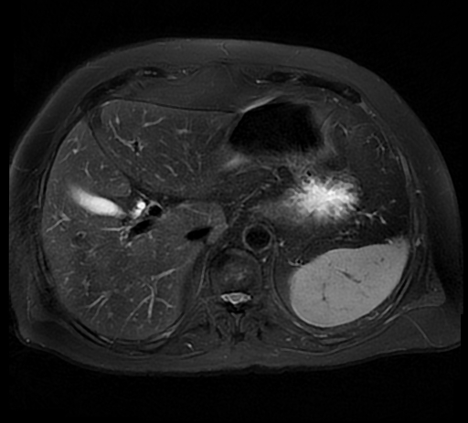
What is this?
Magnetic resonance imaging MRI

Slide 29
A medical imaging technique used in radiology to form pictures of the anatomy using strong magnetic fields and radio waves.
It has no radiation.

Slide 30
Magnetic resonance imaging MRI
Advantages:
Excellent in tissue details
No ionizing radiation
Disadvantages:
Expensive
Long scan time
Less available then other modalities
Intravenous contrast is not safe with poor renal function.

Slide 31
MRI language
Hyper intense signal = more white
Hypo intense signal = more grey/black

Slide 32
What is this?

Slide 33
What is this?
Nuclear scan

Slide 34
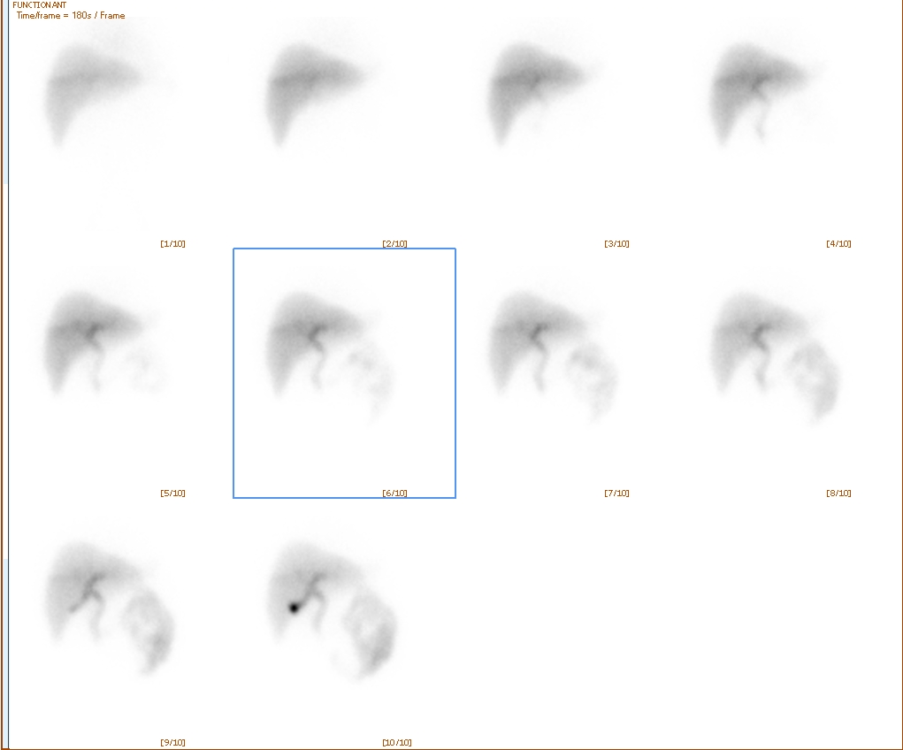
What is nuclear medicine?
Medical specialty involving the application of radioactive substances in the diagnosis and treatment of disease.

Slide 35
Nuclear medicine:
Advantages:
Excellent in evaluating oragn function/physiology
Disadvantages:
Use ionizing radiation
Not widely available
Very poor in evaluating anatomy

Slide 36
THANK YOU

