Slide 1
Cohort Study

Slide 2
Cohort Study
The objective of a cohort study is to investigate whether the incidence of an event is related to a suspected exposure
Steps:
A group of people without the outcome is identified
Followed
Outcome ascertainment

Slide 3
Cohort Study
Q: When the event of interest is a newly developed disease, what we should do with the prevalent cases?

Slide 4
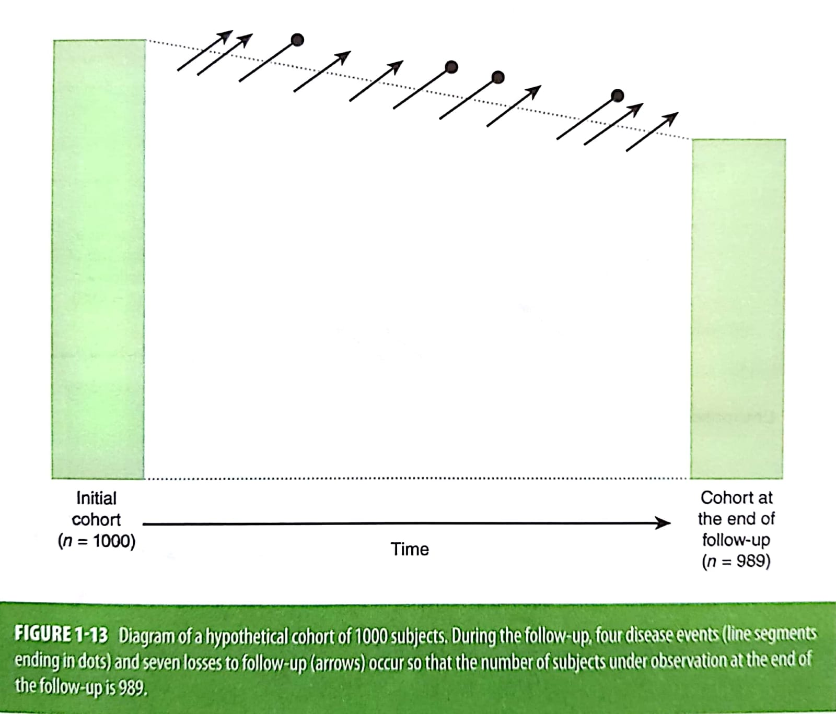
Cohort Study
Incidence can be estimated as the number of events occurring during the follow-up period divided by the number of subjects in the cohort at baseline minus one-half of the losses
4/[1000-(1/2 X 7)] = 4.01/1000

Slide 5
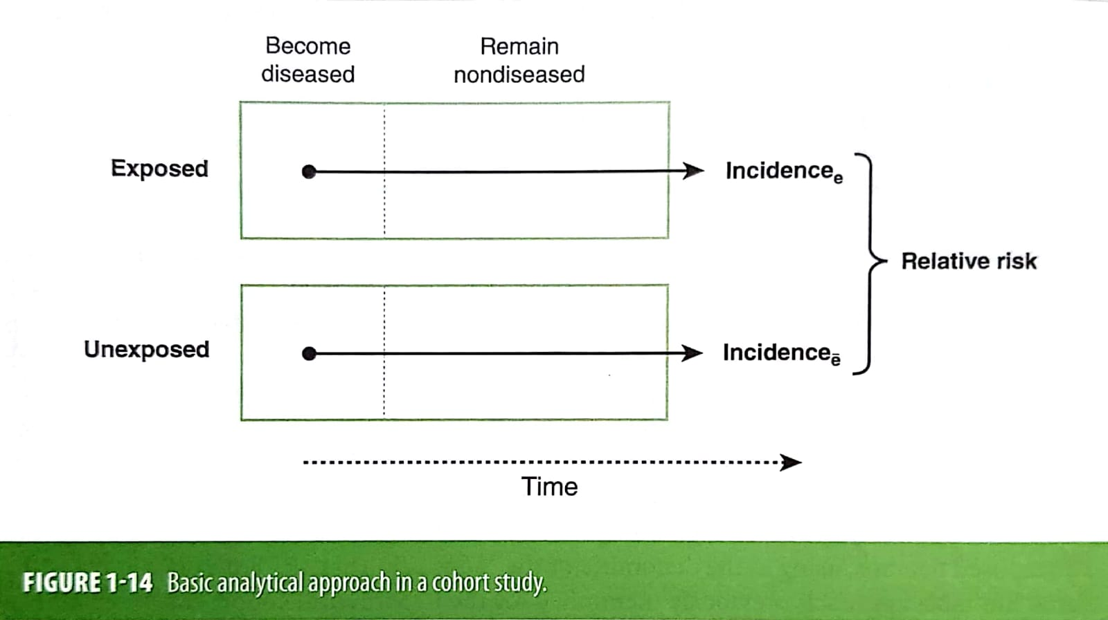
Cohort Study
The subjects are classified according to their exposure status
Then, the incidence of the outcome of interest (usually a disease) is ascertained and compared across exposure categories

Slide 6
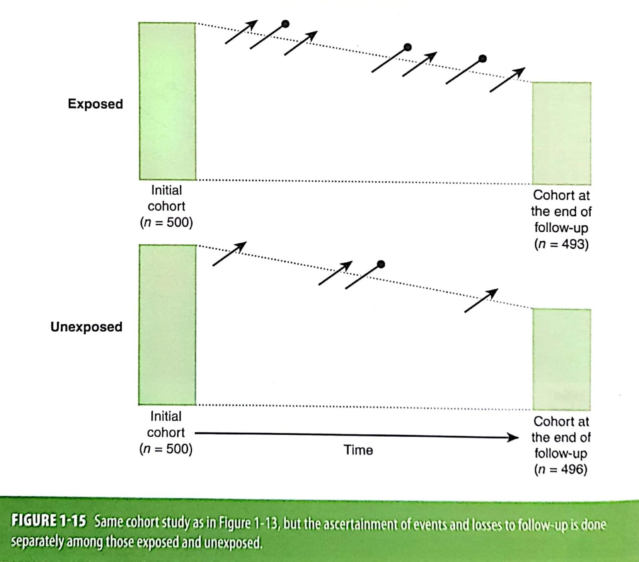
Cohort Study
Example:
Calculate the incidence of disease in exposed
Calculate the incidence of disease in unexposed
Calculate the relative risk (risk ratio)

Slide 7
An important assumption for the calculation of incidence in a cohort study is that individuals who are lost to follow-up are similar to those who remain under observation

Slide 8
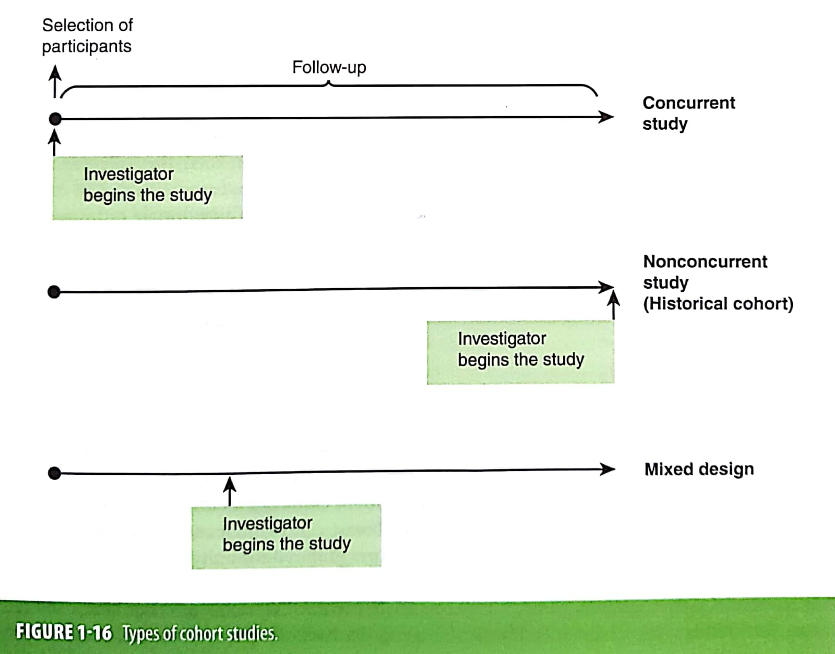
Cohort Study
Prospective cohort (concurrent):
When the cohort is assembled at the present time and is followed up toward the future
Retrospective cohort (nonconcurrent, historical):
A cohort is identified and assembled in the past on the basis of existing records and is “followed” to the present time

Slide 9
Strengths
Is of a particular value when the exposure is rare
Can examine multiple effects of a single exposure
Can elucidate temporal relationship between exposure and disease
If prospective, minimizes bias inn the ascertainment of exposure
Allows direct measurement of incidence of disease in the exposed and nonexposed groups

Slide 10
Limitations
Is inefficient of the evaluation of rare diseases
If prospective, can be extremely expensive and time consuming
If retrospective, requires the availability of adequate records
Validity of the results can e seriously affected by losses to follow-up

