Slide 1
Selecting a Research Topic Dr. Abdulaziz Ali Almezam, MD, MSC, ABCM Family and Community Medicine Department Collage of Medicine, King Saud University

Slide 2
Definition of Research
- The systematic investigation into and study of materials and sources in order to establish facts and reach new conclusions.
-The strict definition of scientific research is performing a methodical study in order to prove a hypothesis or answer a specific question. Finding a definitive answer is the central goal of any experimental process.

Slide 3
Word (Research) Origin& History
1577, "act of searching closely," from M.Fr. recerche (1539), from O.Fr. recercher "seek out, search closely," from re-, intensive prefix, + cercher "to seek for" (see search). Meaning "scientific inquiry" is first attested 1639. Phrase research and development is recorded from 1923.

Slide 4
Type of Research
1.Pure research, basic research, or fundamental research.
2.Applied research.
3.Experimental Development.
Other classification:
Primary Research Vs Secondary Research
Population Based Vs Hospital Based

Slide 5
Basic research
-Basic research is a research carried out to increase understanding of fundamental principles. Pure research generates new ideas, principles and theories, which may not be immediately utilized; though are the foundations of modern progress and development in different fields
-For example, basic science investigations probe for answers to questions such as:
What are Chromosome composed of?
What is the specific genetic code of Albinism cases?
.

Slide 6
Applied research
-Applied research is a form of systematic inquiry
involving the practical application of science.
It is designed to solve practical problems of the
modern world, rather than to acquire knowledge
for knowledge's sake. One might say that the goal
of the applied scientist is to improve the human
condition.
-For example, applied researchers may investigate ways to:
treat or cure a specific disease
improve the vaccine or drug efficiency.

Slide 7
Experimental Development
-The term R&D or research and development refers to a specific group of activities within a business.
-The activities that are classified as R&D differ from company to company, but there are two primary models. In one model, the primary function of an R&D group is to develop new products; in the other model, the primary function of an R&D group is to discover and create new knowledge about scientific and technological topics for the purpose of uncovering and enabling development of valuable new products, processes, and services.

Slide 8
Research Process
1. Define the research question or hypothesis.
2. Develop research teams with a principal investigator for each area.
3. Work on the research protocol and have a general presentation and discussion of proposed projects.
4. For each of the projects define the proposed papers to be published and responsible authors.
5. Start writing the first draft of the paper from day one of the project and have it peer reviewed very early.

Slide 9
Research Process
6. Have a close supervision and engagement in the data collection, processing and analysis phases.
7. Final write-up of the papers followed by an internal discussion-presentation.
8. Peer review of papers by members of the department and external reviewers.
9. Timely submission of papers for publication.
10. Timely follow-up on revisions and resubmission.
11. Public media press release close to the date of publication.

Slide 10
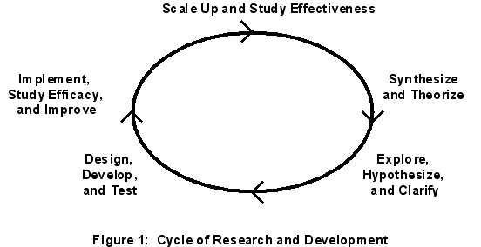
Cycle of Research & Development

Slide 11
]0
Selecting A Research Topic

Slide 12
Importance of Choosing an Idea
- Deciding on an Idea or answerable and relevant research question lies at the heart of all good research projects.
- The right way toward a publishable article.
- Appreciated by decision makers.

Slide 13
Factors to consider in Selecting A Research Problem 1
The topic should be important significant.
Writing a thesis or dissertation is an exercise
to learn how to conduct research.
However, graduate students can learn the
research process on an important topic just
as easy as learning the research process on
a piddle topic!

Slide 14
Factors to consider in Selecting A Research Problem 2
Consider the feasibility of the project.
How much time do you have available?
Do you really want to do a longitudinal study that will
take 3 years to complete for a MS thesis?
How difficult is it.
Are data available?
How much will it cost ?

Slide 15
Factors to consider in Selecting A Research Problem 3
Make sure the topic is ethical to study.

Slide 16
Factors to consider in Selecting A Research Problem 4
You should have a personal interest in the topic. It is the fuel of your work.
By the time you are done, you may really be tired of the topic.

Slide 17
Factors to consider in Selecting A Research Problem 5
The newness of the topic may hold you interest longer, however there is some value in repeating previous research.

Slide 18
Factors to consider in Selecting A Research Problem 6
Make sure the research question is clear.

Slide 19
Factors to consider in Selecting A Research Problem 7
Make sure the research question is clear.

Slide 20
Factors to consider in Selecting A Research Problem 8
The research topic should be broad enough
to allow the student access to enough information,
yet specific enough to make the research scope
reasonable.

Slide 21
Factors to consider in Selecting A Research Problem 9
For example, a student choosing the topic First Aid would find it impossible to include everything about first aid: home remedies, history of emergency services, evolution of first-aid courses. On the other hand, a student choosing to research The Application of Band- Aids to Skin Abrasions probably will not

Slide 22
Factors to consider in Selecting A Research Problem 10
The research topic should be one that is academically and creatively challenging to the student. The topic requires an academic and creative stretch for the student. Be careful not to choose a topic that is limited to simple ideas or has little application or extension possibilities. Such a choice would make the paper

Slide 23
Factors to consider in Selecting A Research Problem 11
Mentorship with an expert on your topic are required for the project, therefore,
consideration of availability of such individuals should be considered during topic
selection.

Slide 24
Health-Care Service Priorities
Priority is given to health-care services that:
-Impose high costs on MOH.
-May be over utilized or underutilized.
-May significantly improve the prevention, treatment,
or cure of diseases and conditions that impose high
direct or indirect costs on patients or society.
-Places a great burden on people, especially those
who are “priority populations”.

Slide 25
Patient Population Priorities
Priority is also given to suggestions that focus
on certain patient populations, including:
Low-income groups, Minority groups, Women
Children, The Elderly, Individuals with special
health-care needs, such as those with disabilities,
those who need chronic care or end-of-life care,
or those who live in inner-city and rural areas.

Slide 26
Priority Conditions
-Arthritis and nontraumatic joint disorders (Muscle, bone, and joint conditions)
-Cancer (Cancer).
-Cardiovascular disease, including stroke and hypertension (Heart and blood
vessel conditions).
-Diabetes mellitus (Diabetes).
-Functional limitations and disability (Functional limitations and physical
disabilities).
-Infectious diseases, including HIV/AIDS (Infectious diseases and HIV/AIDS).
-Peptic ulcer disease and dyspepsia (Digestive system conditions).
-Pregnancy, including preterm birth (Pregnancy and childbirth),
-Pulmonary disease/asthma (Breathing conditions).
-Substance abuse (Alcohol and drug abuse).

Slide 27
Selecting a Research Topic
The ability to develop a good research topic
is an important skill. Sometimes instructors
will assign a specific topic, usually they will ask you to select a topic that interests you.

Slide 28
Generation of Creative Ideas:
1.Divergent Thinking:
Techniques Used: Brainstorm for ideas, Idea Exchange & Idea Links).
Controlling Rules:
a. Avoid judging or evaluating idea.
b. Record a high volume of idea.
c. Build on other ideas.
d. Seek new and interesting combination of ideas.

Slide 29
Generation of Creative Ideas:
2.Convergent Thinking
Techniques Used: (Matrix Converger, Stoplight
Voting, thought Organizers & Idea Generator
Software).
Controlling Rules:
a. Identify positive aspect of ideas.
b. Follow a deliberate system or plan for evaluation.
c. Consider unique and Interesting idea.
d. Keep on track.

Slide 30
Skills Needed For Selection of A Research Topic
-Read general background information
-Focus in on a manageable topic
-Make a list of useful keywords
-Be flexible
-Define your topic as a focused research question
-Research and read more about your topic
-Formulate a thesis statement

Slide 31
Refining the research question 1
• First: the essential literature review will provide
information about the extent to which the topic has
been previously researched and may confirm or
refute the novelty of your own question. The
question itself may need to be re-phrased to fit more
clearly with the required next steps in researching
your topic of interest.

Slide 32
Refining the research question 2
Second: asking questions from colleagues and
checking on current research using methods such as
national research registers may provide further
information about current research in your area of
interest, and possibly avoid duplication of research
effort.

Slide 33
Refining the research question 3
Third: writing the protocol is certain to sharpen up
your ideas about your research – there is nothing
like the challenge of a blank sheet of paper and the
need to write a one-sentence hypothesis to focus the
mind.

Slide 34
Refining the research question 4
Finally, most research requires a supervisor and it is
likely that during the early stages of setting up
a research project your supervisor will have
something to say about your research question.

Slide 35
Testing the question
This is critical, not least because many researchers
are simply too close to their research to see it,
objectively, for what it is.
Edward Huth, a distinguished editor of the Annals
of Internal Medicine, recommended two crucial tests
of any research question:
-The ‘who cares?’ test
- The ‘so what?’ test.

Slide 36
Criteria to help assess your research
Assessment criteria that you and your supervisor
might apply to your research include:
-Novelty -Relevance
-Impact -Feasibility
-Fundability -Publishability
-Ethical issues

Slide 37
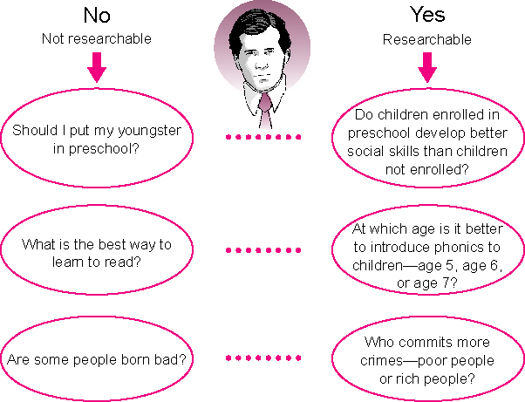

Slide 38
Hypothesis Development 1
1. Public Health Problem and issues of prevention and control.
2. Clinical Observations – case and clinical series.
3. Observations from experimental studies
4. Previous studies and literature.
5. Formal and informal scientific interface.
6. Synthesis of evidence.

Slide 39
Hypothesis Development 2
It is most important to formulate the question that specifies:
Outcome of interest clearly
Determinant(s) of the outcome
Direction of effect of determinant to outcome

Slide 40
Conclusions
Getting the research question right is an essential,
although not always straightforward, step in any
research project. Settling on a research question
is often difficult to do in isolation, so that obtaining
advice from experts and colleagues, collecting
information from the literature and developing an
awareness of the context in which your research is
likely to be undertaken will all contribute to
a successful outcome.

Slide 41
REFERENCES
1.Huth E. How to write and publish papers in the medical sciences. London: Williams & Wilkins, 1990.
2.Rietzschel, E. F., Nijstad, B. A., & Stroebe, W. (2006). Productivity is not enough: A comparison of interactive and nominal brainstorming groups on idea generation and selection. Journal of Experimental Social Psychology, 42, 244–251.
3.Runco, M. A., & Charles, R. E. (1993). Judgments of originality and appropriateness as predictors of creativity. Personality and Individual Differences, 15, 537–546.
4.Shafir, E. (1993). Choosing versus rejecting: Why some options are both better and worse than others. Memory and Cognition, 21, 546–556.

Slide 42
THANK YOU

