Slide 1

Transfusion Medicine
and Therapy
Dr Mohamed Bilal Delvi MD
Associate Professor

Slide 2
Objective
Blood groups
Indication of blood transfusion
Blood components
Blood transfusion complications and treatment
Alternatives to Blood Products

Slide 3
PERSPECTIVE
The era of modern blood transfusion began in the early 1900s with discovery of the ABO red cell antigen system.
World War I it was known that adding citrate enabled the storage of anticoagulated blood.

Slide 4
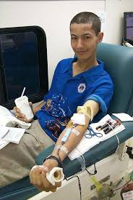

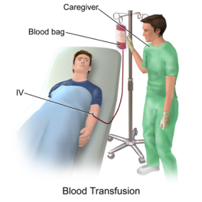
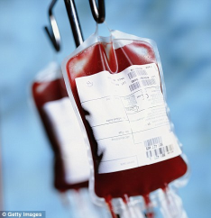
Blood Banking

Slide 5
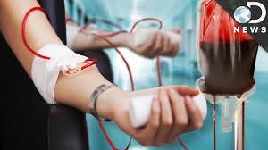
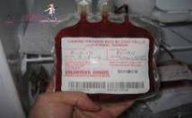
Blood Collection
Blood centers, process more than 90% of the units collected .
Traditional allogenic donation methods still predominate, but increasing use is being made of red cell apheresis technology, by which red cells are separated from the blood at the time of collection, with the rest returned to circulation.

Slide 6
Anticoagulants in Blood
Blood collection bags contain an anticoagulant-preservative of citrate, phosphate, dextrose, and adenine (CPDA-1)
Ensuring a shelf life (viability of at least 70% of the RBCs 24 hours after infusion) of 35 days and hematocrit of 70 to 80% for PRBCs.
Additive solutions (Adsol, Nutricel, Optisol) provide additional nutrients, extending maximum storage to 42 days and lowering viscosity, which makes infusion easier.

Slide 7
Storage of Blood
Storage impairs red cell function. Transfused blood delivers oxygen to the tissues less efficiently.
Refrigerated at 1 to 6° C (usually 4° C), cell metabolism continues and changes occur .
< in pH and in the level of 2,3-DPG.
The deformability of RBCs makes them, over time, more spherical and rigid, thereby increasing resistance to capillary flow.
Cell leakage of potassium(≈ 6 mEq/U).

Slide 8
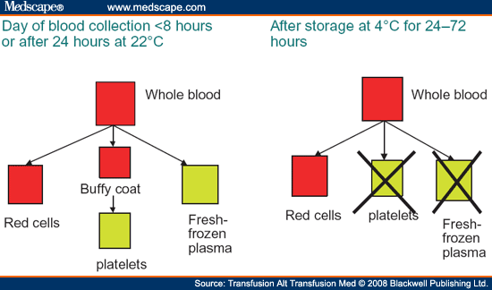

Slide 9
Blood Typing
Identified red blood cell (RBC) :
ABO and related carbohydrate antigens (H, P, I, and Lewis), the 48 Rh system antigens, and more than 200 non-ABO/Rh antigens.
Blood specimen from the patient is sent for the following tests: ABO grouping, Rh typing, and an antibody screen for unexpected (non-ABO/Rh) antibodies.

Slide 10
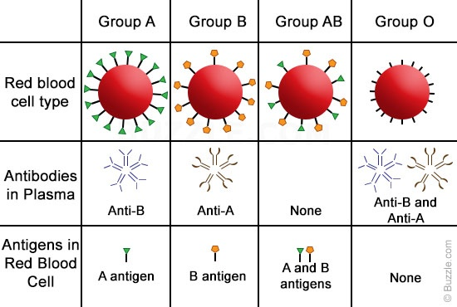
ABO Grouping

Slide 12
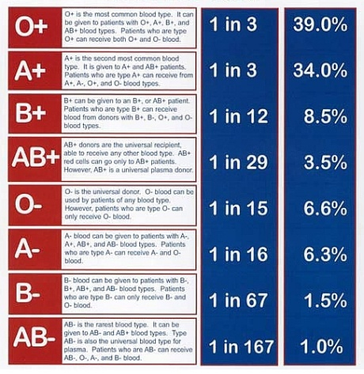

Slide 13
Blood Typing
The “forward type” determines the ABO and Rh phenotype of the recipient’s RBC by using antisera directed against the A, B, and D antigens.
The “reverse type” detects isoagglutinins in the patient’s serum and should correlate with the ABO phenotype, or forward type.

Slide 14
Blood Typing
Those with type AB blood form no ABO group antibodies.(universal recipient).
Those with type O have antibodies against both.(universal donor).
Rh typing can usually be determined by adding a commercial reagent (anti-D) to recipient RBCs.

Slide 15
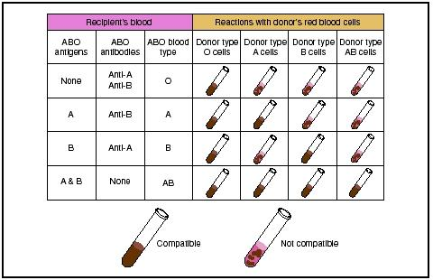

Slide 16
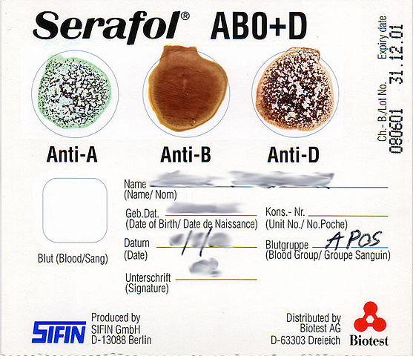

Slide 17
Type and Screen
The type and screen allows quicker selection of appropriate banked blood for complete crossmatch if a transfusion is ordered.
When a blood transfusion is ordered, a formal crossmatch is done by mixing recipient serum with donor RBCs as a final compatibility test prior to transfusion.

Slide 18
Cross Match
This can be done using a Coombs test (with serum incubated to 37° C), or the more rapid “immediate spin crossmatch” at room temperature, which will detect only ABO incompatibility.
Thorough Coombs test can detect incompatibilities that were missed with the antibody screen.

Slide 19
Blood and Products Transfusion
Why?
Increase oxygen carrying capacity
Restoration of red cell mass
Correction of bleeding caused by platelet dysfunction
Correction of bleeding caused by factor deficiencies

Slide 20
Oxygen Delivery
Oxygen Delivery (DO₂) is the oxygen that is delivered to the tissues
DO₂= COP x CaO₂
Cardiac Output (CO) = HR x SV
Oxygen Content (CaO₂):
  - (Hgb x 1.39)O₂ saturation + PaO₂(0.003)
  - Hgb is the main determinant of oxygen content in the blood

Slide 21
Oxygen Delivery (cont.)
Therefore: DO₂ = HR x SV x CaO₂
If HR or SV are unable to compensate, Hgb is the major determinant factor in O₂ delivery

Slide 22
Administration
Legal Aspects:
Two qualified personnel check it at the bedside to prevent a potentially fatal clerical error.
Recipient and unit identification, confirmation of compatibility, expiration date.
60% of transfusions occur perioperatively.
Responsibility of transfusing perioperatively is with the anesthesiologist

Slide 23
Administration
Urgent transfusion situations require flow rates faster than gravity can provide.
Pressure bags are available that completely encase the blood bag and apply pressure evenly to the blood bag surface.
If external pressure is anticipated, large-bore needles are recommended for venous access to prevent hemolysis.

Slide 24
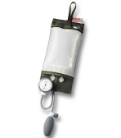
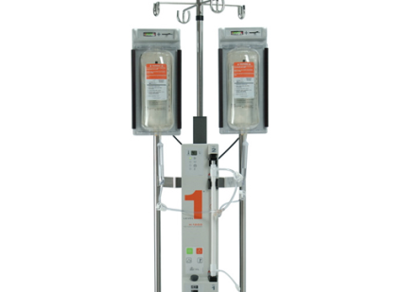
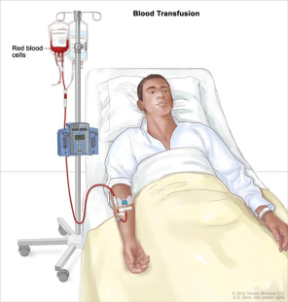
Administration
If only a small-gauge needle is available, the transfusion may be diluted with normal saline, but this may cause unwanted volume expansion.

Slide 25
MANAGEMENT
Patient’s age,
Severity of symptoms,
Cause of the deficit,
Underlying medical condition,
Ability to compensate for decreased oxygen-carrying capacity,
Tissue oxygen requirements are all considered.

Slide 26
Management
Clinical evaluation:
Appearance (pallor, diaphoresis),
Mentation (alert, confused),
Heart rate,
Blood pressure,
Nature of the bleeding (active, controlled, uncontrolled),
Laboratory evaluation :
Hgb,
Hematocrit,
Platelets,
Clotting functions.

Slide 27
When to Transfuse?
TRICC (Transfusion Requirements in Critical Care) trial, demonstrated that in the critical care setting, a transfusion threshold of 7 g/dL was as safe as a threshold of 10 g/dL.
A subgroup analysis generated some concern that patients with ischemic heart disease benefit from higher transfusion threshold

Slide 28
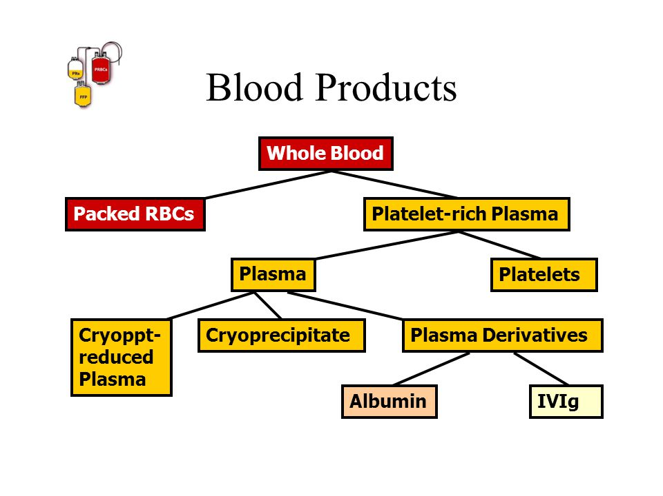

Slide 29
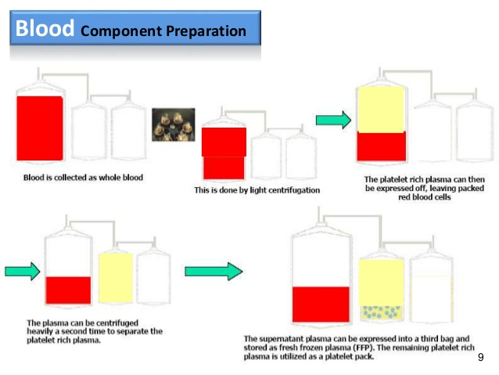

Slide 30
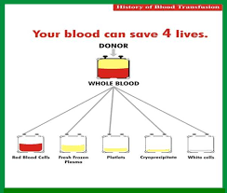
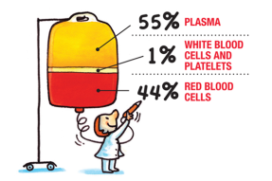
Blood and its components
Whole Blood is not as economical as component therapy, although there has recently been renewed interest in the benefits of using fresh whole blood in military field hospitals.
In modern transfusion medicine whole blood is rarely used.

Slide 31
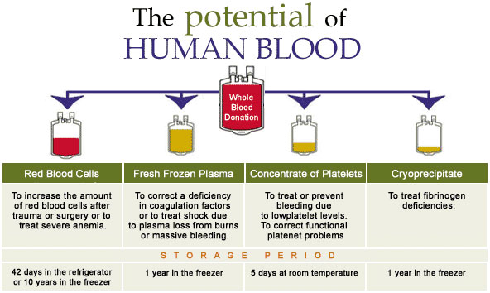

Slide 32
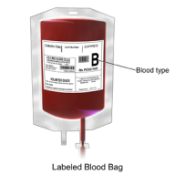
Blood and its components
Packed Red Blood Cells
PRBCs are given to improve oxygen delivery to tissues at the microvascular level.
American Society of Anesthesiologists :
Transfusion is rarely needed with a Hgb concentration greater than 10 g/dL .
Always needed when the Hgb is less than 6 g/dL.
Patients with a Hgb between 6 and 10 mg/dL require careful clinical judgment.

Slide 33
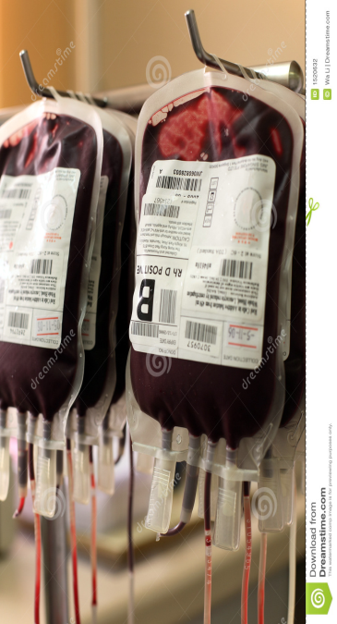
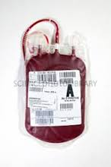
Blood and its components
Packed Red Blood Cells

Slide 34
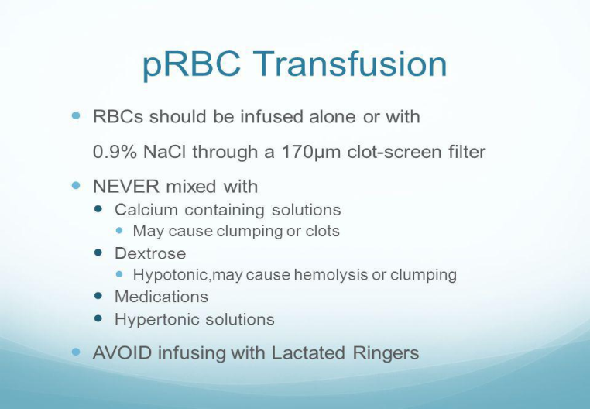
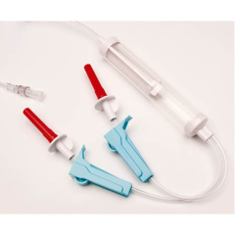
Blood and its components

Slide 35
Blood and its components
PRBCS …
Ischemic heart disease may render patients more intolerant of anemia, although more research is needed to clarify whether transfusion benefits these patients.
Physicians would still transfuse a patient with ongoing hemorrhage and unstable vital signs despite adequate fluid resuscitation, and would occasionally consider withholding transfusion for Hgb levels even lower than 6 g/dL in a young, healthy, asymptomatic patient without ongoing hemorrhage.

Slide 36
Blood and its components
PRBCS
In an average adult, 1 U of PRBCs increases the Hgb by about 1 g/dL or the hematocrit by about 3%.
PRBCs are run through a filter with a large-bore intravenous line with normal saline.
Lactated Ringer’s solution can lead to clotting due to the added calcium, and hemolysis may result with a hypotonic solution.
Most transfusions are given over 60 to 90 minutes (not longer than 4 hours).
Unused blood should be returned promptly to the blood bank because any units unrefrigerated for more than 30 minutes are discarded

Slide 37
Blood and its components
Fresh Frozen Plasma
A unit of FFP typically has a volume of 200 to 250 mL, is ABO compatible, and is given through blood tubing within 2 to 6 hours of thawing.
It contains all clotting factors.
It should be given in doses calculated to achieve a minimum of 30% of plasma factor concentration, traditionally calculated as 10 to 15 mL/kg of FFP.

Slide 38
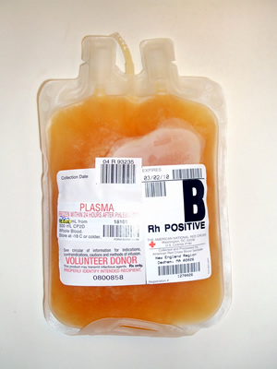
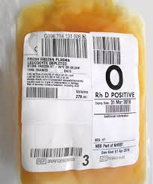
Blood and its components

Slide 39
Blood and its components
Platelets
Cross-matching is unnecessary, but Rh-negative patients should receive Rh-negative platelets .( may cause Rh sensitization).
In adults the traditional dose has been 4 to 6 U (a “six pack”of platelets).
In children it is 1 U/10 kg body weight.

Slide 40
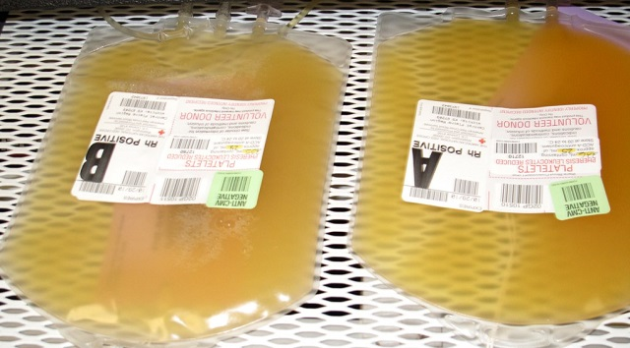
Blood and its components

Slide 41
Blood and its components
CRYOPRECIPITATE
Cryoprecipitate is a source of fibrinogen, factor VIII, and von
Willebrand factor (vWF). It is ideal for supplying fibrinogen tothe volume-sensitive patient.
When factor VIII concentrates are not available, cryoprecipitate may be used since each unit contains approximately 80 units of factor VIII.
Cryoprecipitate may also supply vWF to patients with dysfunctional (type II) or absent (type III) von Willebrand disease.

Slide 42
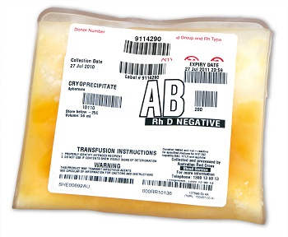
Blood and its components

Slide 43
Blood and its components

Slide 44
Adverse Reactions of Blood Transfusion
The most common reactions are not life threatening, although serious reactions can present with mild symptoms and signs.
Reactions can be reduced or prevented by modified (filtered, washed, or irradiated) blood components.

Slide 45
Adverse Reactions of Blood Transfusion
IMMUNE-MEDIATED REACTIONS
Acute hemolytic transfusion reactions
Immune-mediated hemolysis occurs when the recipient has preformed antibodies that lyse donor erythrocytes.
The ABO isoagglutinins are responsible for the majority of these reactions, although alloantibodies directed against other RBC antigens, i.e., Rh, Kell, and Duffy, may result in hemolysis.

Slide 46
Adverse Reactions of Blood Transfusion
AHTR present with hypotension, tachypnea, tachycardia, fever, chills, hemoglobinemia, hemoglobinuria, chest and/or flank pain, and discomfort at the infusion site.
Transfusion must be stopped immediately, intravenous access maintained, and the reaction reported to the blood bank.
The laboratory evaluation for hemolysis :
Measurement of serum haptoglobin,
Lactate dehydrogenase (LDH), and
Indirect bilirubin levels.

Slide 47
Adverse Reactions of Blood Transfusion
Treatment of AHTR:
The immune complexes that result in RBC lysis can cause renal dysfunction and failure.
Diuresis should be induced with intravenous fluids and furosemide or mannitol.
Tissue factor released from the lysed erythrocytes may initiate DIC.
Coagulation studies like prothrombin time (PT), activated partial thromboplastin time (aPTT), fibrinogen, and platelet count should be monitored in patients with hemolytic reactions.

Slide 48
Adverse Reactions of Blood Transfusion
Febrile nonhemolytic transfusion reaction
The most frequent reaction associated with the transfusion of cellular blood components is a febrile nonhemolytic transfusion reaction(FNHTR).
These reactions are characterized by chills and rigors and a ≥1°C rise in temperature.

Slide 49
Adverse Reactions of Blood Transfusion
Allergic reactions
Urticarial reactions are related to plasma proteins found in transfused components.
Mild reactions treated symptomatically by temporarily stopping the transfusion and administering antihistamines (diphenhydramine, 50 mg orally or IM).

Slide 50
Adverse Reactions of Blood Transfusion
Anaphylactic reaction
This severe reaction presents after transfusion of a few milliliters of the blood component.
Symptoms and signs: difficulty in breathing, coughing, nausea and vomiting, hypotension, bronchospasm, loss of consciousness, respiratory arrest, and shock.
Stopping the transfusion, maintaining vascular access, and administering epinephrine (0.5–1 mL of 1:1000 dilution subcutaneously).
Glucocorticoids may be required in severe cases.

Slide 51
Adverse Reactions of Blood Transfusion
Graft-versus-host disease
Graft-versus-host disease (GVHD) is a frequent complication of allogeneic stem cell transplantation, in which lymphocytes from the donor attack and cannot be eliminated by an immunodeficient host.
Mediated by donor T lymphocytes that recognize host HLA antigens as foreign and mount an immune response
Manifested clinically by fever, a characteristic cutaneous eruption, diarrhea, and liver function abnormalities.

Slide 52
Adverse Reactions of Blood Transfusion
Transfusion-related acute lung injury
Presents as acute respiratory distress, either during or within 6 h of transfusing the patient.
Characterised by respiratory compromise and signs of noncardiogenic pulmonary edema, including bilateral interstitial infiltrates on chest x-ray.
Treatment is supportive, and patients usually recover without sequelae.

Slide 53
Adverse Reactions of Blood Transfusion
NONIMMUNOLOGIC REACTIONS
Fluid overload
Blood components are excellent volume expanders, and transfusion may quickly lead to volume overload.
Monitoring the rate and volume of the transfusion and using a diuretic can minimize this problem.

Slide 54
Adverse Reactions of Blood Transfusion
Hypothermia
Refrigerated (4°C) or frozen (–18°C or below) blood components can result in hypothermia when rapidly infused.
Cardiac dysrhythmias can result from exposing the sinoatrial node to cold fluid.
Use of an in-line warmer will prevent this complication.

Slide 55
Adverse Reactions of Blood Transfusion
Electrolyte toxicity
RBC leakage during storage increases the concentration of potassium in the unit.
Citrate, commonly used to anticoagulate blood components, chelates calcium and thereby inhibits the coagulation cascade.
Hypocalcemia, manifested by circumoral numbness and/or tingling sensation of the fingers and toes, may result from multiple rapid transfusions.
Citrate is quickly metabolized to bicarbonate, calcium infusion is seldom required in this setting.

Slide 56
Adverse Reactions of Blood Transfusion
Iron overload
Each unit of RBCs contains 200–250 mg of iron. Symptoms and signs of iron overload affecting endocrine, hepatic, and cardiac function are common after 100 units of RBCs have been transfused (total-body iron load of 20 g).
Preventing this complication by using alternative therapies (e.g., erythropoietin) and judicious transfusion is preferable and cost effective.
Chelating agents, such as deferoxamine and deferasirox, are available, but the response though is often suboptimal.

Slide 57
Adverse Reactions of Blood Transfusion
INFECTIOUS COMPLICATIONS
Viral infections
Hepatitis C virus
Human immunodeficiency virus type 1
Hepatitis B virus
Cytomegalovirus
Parvovirus B-19
Bacterial contamination

Slide 58
Adverse Reactions of Blood Transfusion
Other infectious agents
Various parasites, including those causing malaria, babesiosis, and Chagas disease, can be transmitted by blood transfusion.
Dengue, chikungunya virus, variant Creutzfeldt-Jakob disease, and yellow fever
Geographic migration and travel of donors shift the incidence of these rare infections.

Slide 59
Adverse Reactions of Blood Transfusion
ALTERNATIVES TO TRANSFUSION
Autologous blood is the best option when transfusion is anticipated.
The cost-benefit ratio of autologous transfusion remains high.
No transfusion is a zero-risk event; clerical errors and bacterial contamination remain potential complications even with autologous transfusions.

Slide 61


