Slide 1
Shock and Metabolic Response to Injury
Ahmed Alburakan, MD, FRCSC, FRCPC
Assistant professor & consultant
Trauma surgery & Critical care
King Saud University

Slide 2
SHOCK

Slide 3
Shock
What is Shock?

Slide 4
Shock
Inadequate oxygen delivery to meet metabolic demand.
Results in global tissue hypoperfusion and metabolic acidosis
Shock can occur with a normal blood pressure, and hypotension can occur without shock

Slide 5
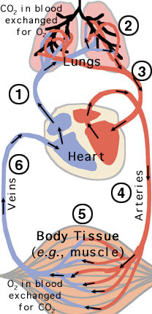
Shock
Oxygen delivery is the function of the circulatory system.
This system is basically:
- Pump (heart)
- Pipes (vessels)
- Solution (blood)
Needs to function at adequate pressure, volume and carrying capacity.

Slide 6
Understanding Shock
Inadequate systemic oxygen delivery activates autonomic responses to maintain systemic oxygen delivery
Sympathetic nervous system
NE, epinephrine, dopamine, and cortisol release
Causes vasoconstriction, increase in HR, and increase of cardiac contractility (cardiac output)
Renin-angiotensin axis
Water and sodium conservation and vasoconstriction
Increase in blood volume and blood pressure

Slide 7
Understanding Shock
Cellular responses to decreased systemic oxygen delivery
ATP depletion → ion pump dysfunction
Cellular edema
Hydrolysis of cellular membranes and cellular death
The body tries to maintain cerebral and cardiac perfusion
Vasoconstriction of splanchnic, musculoskeletal, and renal blood flow
Global cellular reliance on anerobic glycolysis and increased lactate production.
Systemic metabolic lactic acidosis

Slide 8
Multiorgan Dysfunction Syndrome (MODS)
Progression of physiologic effects as shock ensues
Cardiac depression
Respiratory distress
Renal failure
DIC
Result is end organ failure

Slide 9
Types Of Shock
Low Cardiac Output states
Hypovolemic shock (↓↓ solution)
bleeding
Dehydration
Cardiogenic shock (↓↓ pump)
Impaired inflow
Primary pump dysfunction
Impaired outflow
Low peripheral resistance states (↑↑pipes)
Neurogenic shock
Loss of sympathetic tone
Vasogenic Shock
Septic
Anaphylactic

Slide 10
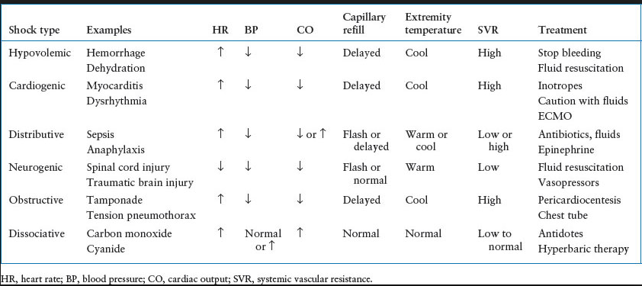
Types Of Shock

Slide 11
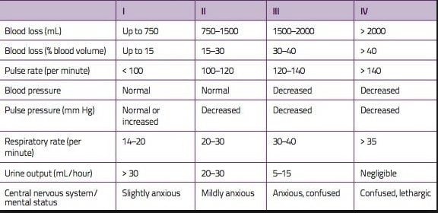
Classes of Hypovolemic Shock

Slide 12
Treatment of Shock
Goal: Restore perfusion
Method: Depends on type of Shock
Reverse the cause.

Slide 13
End Points of Resuscitation in Shock management
Normal vital signs ( can be misleading)
Normal serum lactate levels
Evidence of adequate tissue perfusion!!
- normal mental status.
- normal urine output.
- normal liver function.
etc.

Slide 14
What Type of Shock is This?
68 yo M with hx of HTN and DM presents to the ER with abrupt onset of diffuse abdominal pain with radiation to his low back. The pt is hypotensive, tachycardic, afebrile, with cool but dry skin.

Slide 15
What Type of Shock is This?
68M with hx of HTN and DM presents to the ER with abrupt onset of diffuse abdominal pain with radiation to his low back. The pt is hypotensive, tachycardic, afebrile, with cool but dry skin.
Hypovolemic shock

Slide 16
What Type of Shock is This?
A 34F presents to the ER after dining at a restaurant where shortly after eating the first few bites of her meal, became anxious, diaphoretic, began wheezing, noted diffuse pruritic rash, nausea, and a sensation of her “throat closing off”. She is currently hypotensive, tachycardic and ill appearing.

Slide 17
What Type of Shock is This?
A 34F presents to the ER after dining at a restaurant where shortly after eating the first few bites of her meal, became anxious, diaphoretic, began wheezing, noted diffuse pruritic rash, nausea, and a sensation of her “throat closing off”. She is currently hypotensive, tachycardic and ill appearing.
Anaphylactic

Slide 18
Metabolic Response to Injury
Notes:
Metabolism of substrates and micronutrients is altered by starvation and trauma. During periods of starvation, metabolic processes slow down to conserve energy and adapt to calorie deprivation. After trauma, the body’s hormonal situation changes, increasing the demand for energy, proteins, and micronutrients. If nutritional requirements are not recognized and met during starvation or trauma, there may be a loss of body mass, body protein, and impairment or loss of body functions.

Slide 19
Mediating the Response
The Acute Inflammatory Response
Cellular activation
Inflammatory mediators (TNF, IL1, etc)
Paracrine Vs endocrine effects
Notes:
Lesson objectives are:
Explain the differences between metabolic responses to starvation and trauma.
Explain the effect of trauma on metabolic rate and substrate utilization.
Determine calorie and protein requirements during metabolic stress.
This session will also review macronutrients during metabolic stress, highlighting the role of conditionally-essential nutrients in specific situations.

Slide 20
Mediating the Response
The Endothelium
Selectins, Integrins, and ICAMs
Nitric Oxide
Tissue Factor
Notes:
Lesson objectives are:
Explain the differences between metabolic responses to starvation and trauma.
Explain the effect of trauma on metabolic rate and substrate utilization.
Determine calorie and protein requirements during metabolic stress.
This session will also review macronutrients during metabolic stress, highlighting the role of conditionally-essential nutrients in specific situations.

Slide 21
Mediating the Response
Afferent Nerve Stimulation
Sympathetic Nervous System
Adrenal Gland Medulla
Notes:
Lesson objectives are:
Explain the differences between metabolic responses to starvation and trauma.
Explain the effect of trauma on metabolic rate and substrate utilization.
Determine calorie and protein requirements during metabolic stress.
This session will also review macronutrients during metabolic stress, highlighting the role of conditionally-essential nutrients in specific situations.

Slide 22
Mediating the Response
The Endocrine System
Pituitary Gland (GH, ACTH, ADP)
Adrenal Gland (Cortisol, Aldosterone)
Pancreatic (Glucagon, ↓ Insulin)
Others (Renin, Angiotensin, ↓ Sex hormones, ↓ T4)
Notes:
Lesson objectives are:
Explain the differences between metabolic responses to starvation and trauma.
Explain the effect of trauma on metabolic rate and substrate utilization.
Determine calorie and protein requirements during metabolic stress.
This session will also review macronutrients during metabolic stress, highlighting the role of conditionally-essential nutrients in specific situations.

Slide 23
Consequences of the Response
Limiting injury
Initiation of repair processes
Mobilization of substrates
Prevention of infection
Distant organ damage
Notes:
Lesson objectives are:
Explain the differences between metabolic responses to starvation and trauma.
Explain the effect of trauma on metabolic rate and substrate utilization.
Determine calorie and protein requirements during metabolic stress.
This session will also review macronutrients during metabolic stress, highlighting the role of conditionally-essential nutrients in specific situations.

Slide 24
Metabolic Response to Fasting
The carbohydrate deposits of the body last about 18 to 20 hours and new glucose is produced through gluconeogenesis of amino acids from the lean body mass
Notes:
The metabolic response to fasting is an adaptation by the body to preserve protein by using alternative sources of energy.
The carbohydrate deposits of the body last about 18 to 20 hours and new glucose is produced through gluconeogenesis of amino acids from the lean body mass.
Ruderman NB. Muscle amino acid metabolism and gluconeogenesis. Annu Rev Med 1975;26:248.

Slide 25
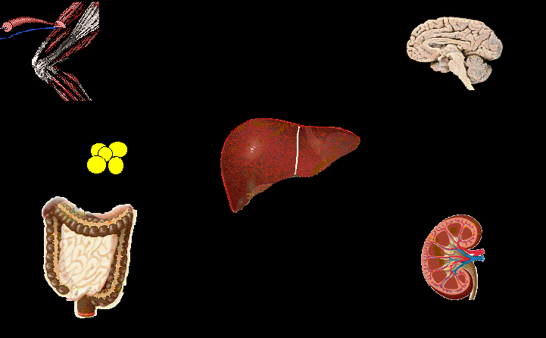
Starvation – Early Stage
Muscle
Alanine / Pyruvate
Brain
Glucose
Glutamine
Glycerol
Gluconeogenesis
Fat
Ketogenesis
Ketones
AGL
Liver
Ureagenesis
Ketones
Urea
NH₃
Kidney
Intestine
Notes:
The initial response to fasting is mediated by a drop in serum insulin and an increase in glucagon. During this period energy is provided mainly by glucose from gluconeogenesis. However, lipolysis generates free fatty acids which are oxidized into ketones.

Slide 26
Starvation – Late Stage
Muscle
Alanine / Pyruvate
Brain
Glucose
Glutamine
Glycerol
Gluconeogenesis
Fat
Ketogenesis
Ketones
AGL
Liver
Ureagenesis
Ketones
Urea
NH₃
Kidney
Intestine
Notes:
After several days, most of the body organs are using ketones (acetoacetic, propionate, and butyric acids) for energy and gluconeogenesis decreases to half of the early phase. Brain, red blood cells, and nerve tissue still rely partially on glucose for energy.

Slide 27
Metabolic Response to Starvation
Hormone Norepinephrine Norepinephrine Epinephrine Thyroid Hormone T4 | Source Sympathetic Nervous System Adrenal Gland Adrenal Gland Thyroid Gland (changes to T3 peripherally) | Change in Secretion ↓ ↓ ↓ ↑ ↑ ↓ ↓ ↓
Landberg L, et al. N Engl J Med 1978;298:1295.
Notes:
Conservation of energy is one of the basic adaptive responses to calorie reduction; when food is in short supply, metabolic activity decreases to spare fuel.
Adjustments in the energy requirements of the body in response to changes in caloric intake occur through the action of several hormones, primarily norepinephrine and thyroid hormone. Norepinephrine is produced by the sympathetic nervous system and the adrenal glands, located near the kidneys. Thyroid hormone T4 is produced by the thyroid gland, and is modified in the periphery to the active hormone T3. Both norepinephrine and T3 participate in the decrease in metabolic activity when calorie intake decreases.
Landsberg L, et al. N Engl J Med 1978;298:1295.

Slide 28
Energy Expenditure in Starvation
12
8
Normal Range
Nitrogen Excretion (g/day)
4
Partial Starvation
Total Starvation
0
10
20
30
40
Days
Long CL et al. JPEN 1979;3:452-456
Notes:
The two lines on this graph show another adaptive response to severely reduced calorie intake.
Urinary nitrogen excretion gradually decreases, indicating conservation of body protein and demonstrating adaptation to starvation.
Long CL et al. JPEN 1979;3:452-456

Slide 29
Metabolic Response to Injury
Ebb Phase
Flow Phase
Energy Expenditure
Time
Cutherbertson DP, et al. Adv Clin Chem 1969;12:1-55
Notes:
Trauma causes major alterations in energy and protein metabolism.
The response to trauma can be divided into the ebb phase and the flow phase. The ebb phase occurs immediately after trauma and lasts from 24-48 hours followed by the flow phase. After this, comes the anabolism phase and finally, the fatty-replacement phase.
Cuthbertson DP, et al. Adv Clin Chem 1969;12:1-55.

Slide 30
Metabolic Response to Injury: Ebb Phase
Characterized by hypovolemic shock
Priority is to maintain life/homeostasis
↓ Cardiac output
↓ Oxygen consumption
↓ Blood pressure
↓ Tissue perfusion
↓ Body temperature
↓ Metabolic rate
Cuthbertson DP, et al. Adv Clin Chem 1969;12:1-55 Welborn MB. In: Rombeau JL, Rolandelli RH, eds. Enteral and Tube Feeding. 3rd ed. 1997
Notes:
The ebb phase is characterized by hypovolemic shock. Cardiac output, oxygen consumption and blood pressure all decrease, thereby reducing tissue perfusion. These mechanisms are usually associated with hemorrhage. Body temperature drops. The reduction in metabolic rate may be a protective mechanism during this period of hemodynamic instability.
Cuthbertson DP, et al. Adv Clin Chem 1969;12:1-55 Welborn MB. In: Rombeau JL, Rolandelli RH, eds. Enteral and Tube Feeding. 3rd ed. Philadelphia, PA: WB Saunders; 1997.

Slide 31
Metabolic Response to Injury: Flow Phase
↑ Catecholamines
↑ Glucocorticoids
↑ Glucagon
Release of cytokines, lipid mediators
Acute phase protein production
Cuthbertson DP, et al. Adv Clin Chem 1969;12:1-55 Welborn MB. In: Rombeau JL, Rolandelli RH, eds. Enteral and Tube Feeding. 3rd ed. 1997
Notes:
The ebb phase is characterized by hypovolemic shock. Cardiac output, oxygen consumption and blood pressure all decrease, thereby reducing tissue perfusion. These mechanisms are usually associated with hemorrhage. Body temperature drops. The reduction in metabolic rate may be a protective mechanism during this period of hemodynamic instability.
Cuthbertson DP, et al. Adv Clin Chem 1969;12:1-55 Welborn MB. In: Rombeau JL, Rolandelli RH, eds. Enteral and Tube Feeding. 3rd ed. Philadelphia, PA: WB Saunders; 1997.

Slide 32
Metabolic Response to Injury
Fatty Acids
Glucose
Amino Acids
Fatty Deposits
Liver & Muscle (glycogen)
Muscle (amino acids)
Endocrine Response
Notes:
Endocrine response in the form of increased catecholamines, glucocorticoids and glycogen, leads to mobilization of tissue energy reserves. These calorie sources include fatty acids and glycerol from lipid reserves, glucose from hepatic glycogen (muscle glycogen can only provide glucose for the involved muscle) and gluconeogenic precursors (eg, amino acids) from muscle.

Slide 33
Metabolic Response to Injury
28
24
20
16
12
8
4
0
Nitrogen Excretion (g/day)
10 20 30 40
Days
Long CL, et al. JPEN 1979;3:452-456
Notes:
This slide illustrates nitrogen losses in relation to trauma. With respect to protein, the greater the trauma, the greater the effect on the nitrogen balance. Similar to metabolic rate, patients experience nitrogen losses according to the severity and duration of the trauma.
The normal range is indicated by the shaded area. The amount of protein requirement relative to calories increases in patients with metabolic stress.
Long CL, et al. JPEN 1979;3:452-456.

Slide 34
Severity of Injury: Effects on Nitrogen Losses and Metabolic Rate
Major
Surgery
Cirugía
mayor
Moderate to Severe
Burn
Quemadura
moderada a grave
Nitrogen Loss in Urine
Sepsis
Severe
Sepsis
Infecci
grave
Infection
ó
n
Cirug
Elective
Surgery
í
a
electiva
Basal Metabolic Rate
Adapted from Long CL, et al. JPEN 1979;3:452-456
Notes:
This graph illustrates that severity of injury correlates to increasing urinary nitrogen loss and increasing energy needs. Elective surgery being least traumatic and the lowest nitrogen loss in urine, whereas burn results in an increase in basal metabolic rate and urinary loss of nitrogen.
Adapted from Long CL, et al. JPEN 1979;3:452-456.

Slide 35
Comparing Starvation and Injury
Metabolic rate Body fuels Body protein Urinary nitrogen Weight loss | Starvation conserved conserved slow | Trauma or Disease wasted wasted rapid
The body adapts to starvation, but not in the presence of critical injury or disease.
Popp MB, et al. In: Fischer JF, ed. Surgical Nutrition. 1983.
Notes:
The metabolic response to starvation can be contrasted to trauma or disease:
Metabolic rate drops during starvation, while in trauma patients it rises in proportion to the trauma severity.
Body fuels and body proteins are conserved during starvation, but are wasted during trauma.
Urinary nitrogen values fall with inadequate protein and calorie intake, but increase in response to metabolic stress.
Weight loss is slow in underfed patients but rapid in trauma patients.
Changes in body composition with trauma usually occur two to three times faster than during starvation.
Popp MB, et al. In: Fischer JF, ed. Surgical Nutrition. Boston: Little, Brown and Company; 1983.

Slide 36
Modifying the Response
Medication (before or after injury)
Nutritional status
Severity of injury
Temperature
Anesthetic technique
Notes:
Lesson objectives are:
Explain the differences between metabolic responses to starvation and trauma.
Explain the effect of trauma on metabolic rate and substrate utilization.
Determine calorie and protein requirements during metabolic stress.
This session will also review macronutrients during metabolic stress, highlighting the role of conditionally-essential nutrients in specific situations.

Slide 37
Summary
Injury (Trauma or Surgery) leads to a metabolic response
Metabolic response to injury is an adaptive response
Metabolic response could overwhelm the body and lead to increased morbidity and mortality
We can modify the metabolic response before and sometimes after injury
Notes:
In summary, the body responds differently to starvation and trauma. Starvation is associated with a decreased metabolic rate, which allows the body to adapt to reduced intake. After trauma, metabolic changes are associated with increased nutritional requirements. If nutritional requirements are not met during trauma, loss of protein and body mass can produce significant impairment.

Slide 38
Metabolic Response to Injury
Questions
Notes:
Metabolism of substrates and micronutrients is altered by starvation and trauma. During periods of starvation, metabolic processes slow down to conserve energy and adapt to calorie deprivation. After trauma, the body’s hormonal situation changes, increasing the demand for energy, proteins, and micronutrients. If nutritional requirements are not recognized and met during starvation or trauma, there may be a loss of body mass, body protein, and impairment or loss of body functions.

