Slide 1
Management of atherosclerotic disease
(PAD, carotid stenosis)
& Acute Limb Ischemia
SURG 351
Sultan AlSheikh, MD, FRCSC, RPVI
Division of Vascular Surgery
October 2018

Slide 2
Outline
Pathophysiology of atherosclerosis
Describe the etiology, clinical features, investigations & management of chronic LL ischemia
Explain the differentiating features & significance of critical limb ischemia
Describe etiology, presenting features & management of acute limb ischemia
Reperfusion injury & its management
Pathogenesis & management of Diabetic foot
Describe the etiology, clinical features, investigations & management of Carotid artery atherosclerotic disease

Slide 3
The Arterial system
Contains 30% of blood volume
Normal systolic pressure <130 mmHg
Arterial capillary pressure 25 mmHg
High pressure /low volume system

Slide 4
The Arterial system
Elastic arteries: Aorta & Beginning of its large branches have preponderance of elastic fibers in media
Muscular arteries: medium sized arteries, distributing arteries exhibit smooth muscles in their walls
Small arteries: major site of autonomic regulation of blood flow

Slide 5
Risk Factors
Non Modifiable
  Age
  Male gender
  Menopause
  Familial predisposition
  Genetic
Other risk factors
  Sedentary life style
  Obesity
  Elevated homocysteine
Modifiable – Major Factors
  Smoking
  HTN
  DM
  Dyslipidemia
  Stressfull & competitive life style
  Type A personality
  High carbohydrate intake

Slide 6
Pathophysiology of atherosclerosis
Endothelial injury
  Chemical
  Physical
  Atheroma
Hypertension, increases this stress

Slide 7
Pathophysiology of atherosclerosis
Increased permeability to lipids and inflammatory cells
Leucocytes adhere into the subendothelial space and digest lipids to become foam cells
Protease and free radicals liberated
Cytokines attract leucocytes and smooth muscle cells

Slide 8
Pathophysiology of atherosclerosis
Smooth muscle cells exit the media
Proliferate, take on the characteristics of fibroblasts and produce collagen, raising the atheroma

Slide 9
Pathophysiology of atherosclerosis
Proliferation forms an endothelial cap, which may rupture, ensuing further endothelial injury
This results in thrombosis and distal embolization

Slide 10
Mechanisms of injury in atherosclerotic disease
Critical stenosis compensated by collateral vessels
  symptomatic on exercise
Acute thrombosis of a critical stenosis
  little change in symptoms due to collateral development

Slide 11
Mechanisms of injury in atherosclerotic disease
Acute thrombosis of noncritical stenosis
  Severe symptoms due to poorly developed collaterals
Atheroembolism from ruptured plaque
Thromboembolism
  severe ischemia because of lack of collateral supply

Slide 12
The aortoiliac segment above the inguinal ligament (inflow)
The femoropopliteal segment and the infrapopliteal segment (outflow)

Slide 13
Peripheral Arterial Disease (PAD)
Chronic
  Slow gradual luminal stenosis secondary to plaque
  Collateral development compensate
  Symptoms proportional to disease burden
  Exertional symptoms appear first
Intermittent Claudication (IC)
Critical limb ischemia (CLI)
Diabetic foot (DF)
Acute
  Sudden occlusion in the absence of adequate collaterals
  Embolism
  Thrombosis
  Injury
Acute Limb Ischemia (ALI)

Slide 14
IC Epidemiology
Up to 5% of people >60 years
1–2% of patients will deteriorate if they comply with best medical treatment (BMT)
The annual mortality rate is 5–10% per year,
  2–3-times higher than non-claudicant
  Marker of atherosclerosis, and most of these patients succumb to myocardial infarction (MI), stroke and limb loss
The emphasis is on the preservation of life.

Slide 15
IC Clinical features
Claudication pain is a muscular pain
  Not present at rest
  Comes on walking a particular distance, which is known as the claudication distance
  It is quickly relieved by resting
  It is repetitive; the patient will develop the pain after walking the claudication distance

Slide 16
IC Clinical features
The site of claudication gives a clue to site of arterial disease:
  Bilateral thigh and/or buttock: aortoiliac arteries
  Unilateral thigh and/or buttock: iliac arteries
  Calf: femoropopliteal arteries
  Foot (instep): tibial arteries

Slide 17
IC Clinical features
Impotence
Weakness / decreased mobility
Skin changes
Toe nail changes
Muscle wasting

Slide 19
Critical Limb Ischemia (CLI)
Caused by multiple lesions affecting different arterial segments in the affected limb
  Rest pain
  Tissue loss in the form of an ulcer or gangrene

Slide 20
Critical Limb Ischemia (CLI)
Rest pain
Exacerbated by lying down or elevation of the foot
Classically felt at night and is relieved by sleeping with feet hanging over the bed or sleeping on a chair
The patient may present with foot swelling

Slide 21
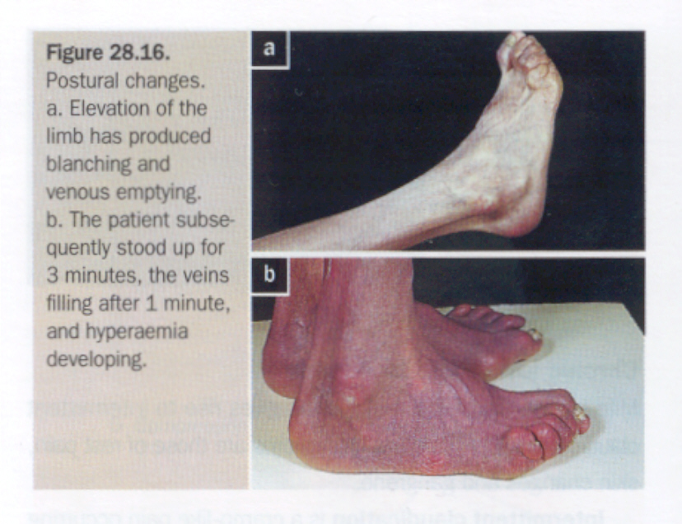
CLI Examination findings
Skin is thin and dry
Pallor, particularly on elevation
Brittle Nails
Muscle wasting
Reduced temperature

Slide 22
CLI Examination findings
Pallor, particularly on elevation
Upon dependency, the foot becomes bright red; this is known as dependent rubor or ‘sunset foot’, and is due to reactive hyperaemia (Buerger’s test)
Superficial veins that fill sluggishly in the horizontal position and empty upon minimal elevation (venous guttering)

Slide 23
CLI Examination findings
All patients must have their pulse status recorded
  This includes, carotid, subclavian, brachial, radial, ulnar, femoral, popliteal, posterior tibial and dorsalis pedis
The pulses are recorded as normal, weak or absent
The presence of a thrill and/or bruit denotes turbulent flow
Ankle/brachial pressure index should be recorded

Slide 24
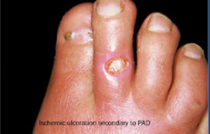
Tissue Loss
Arterial Ulcers
  Often located on toes or foot
  Pale and with necrotic floor,
  Irregular margins
  Painful
  Surrounding ischemic features

Slide 25
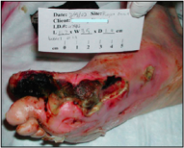
Ulcer Examination
Inspection
Site (location)
Number
Size
Shape
Floor - The exposed part of an ulcer ( Inspection)
Edges – Part between the margin and the floor of an ulcer (Undermined, Punched out, Sloping, Rolled, Raised)
Depth
Exudate (Discharge)
Surrounding area
Margin- Line of demarcation between normal and abnormal

Slide 26
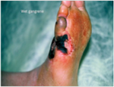
Ulcer Examination
Palpation
Tenderness
Base- the structure on which the ulcer rests (Felt on palpation)
Relation with Deeper structures
Examination of Surrounding Area
Examination of Lymph Nodes
Examination of the pulse

Slide 27
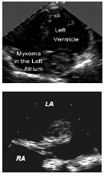
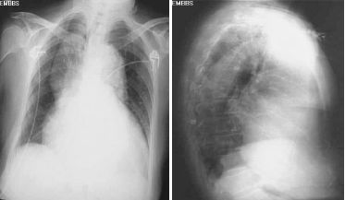
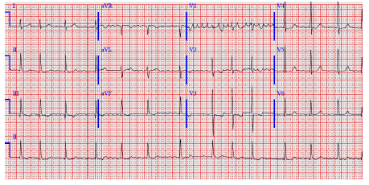
Investigations
CBC, Electrolytes, creatinine, coagulation profile (aPTT, INR)
Type and screen
Lipid profile
Hemoglobin A1c
ECG
Chest Xray
Echocardiogram

Slide 28
IC Investigations
Ankle Brachial Index (ABI)
  0.8-0.4
Toe pressures
  <50 mmHg
Segmental pressure
  20 mmHg reduction
Volume Plethysmography
  Measures arterial volume changes
Duplex Ultrasound
  Stenosis or single occlusion
CT Angiogram
MRA
Invasive Vascular Investigations

Slide 29
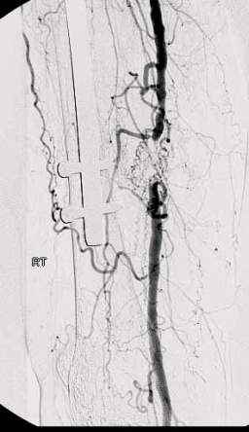
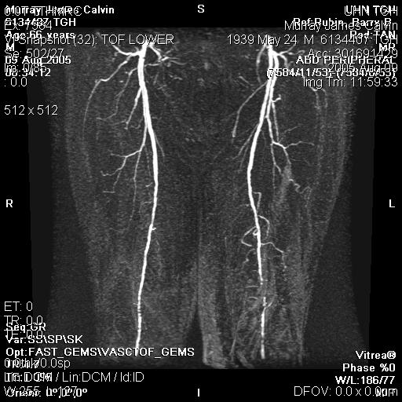
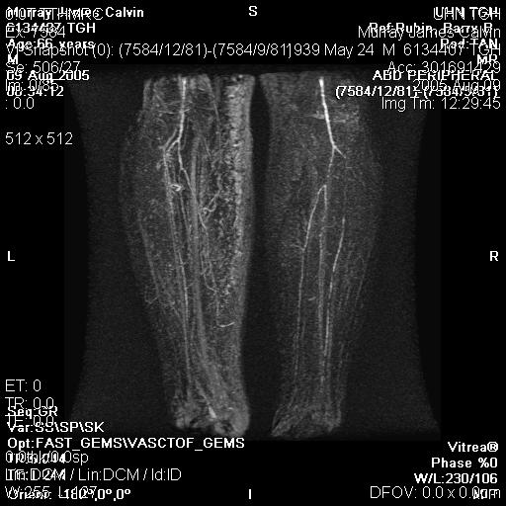
CLI Investigations
Ankle Brachial Index (ABI)
  <0.5
Toe pressures
  < 30 mmHg
Segmental pressure
Volume Plethysmography
Duplex Ultrasound
  Multiple Stenoses or occlusions
CT Angiogram
MRA
Invasive Vascular Investigations

Slide 30
PAD Prevention
Primary Prevention
  Modifiable risk factors – lifestyle changes
Secondary prevention
  Best medical treatment
Treatment
  Endarterectomy
  Percutaneous Angioplasty
  Bypass procedures

Slide 31
PAD Medical Management
All patients should be strongly urged to comply with Best Medical Therapy (BMT):
  Cessation from smoking (most important)
  Control of hypertension, (ACE Inhibitors)
  Prescription of a statin despite the absence of dyslipidemia
  Prescription of antiplatelet agent: aspirin (81 mg daily), or clopidogrel (75 mg daily)
  Regular exercise
  Control of obesity
  The identification and treatment of patients with diabetes (Hb A1c <7%)

Slide 32
PAD Medical Management
Compliance with BMT increases
  Walking distance
  Affords protection against cardiovascular events
  Improves the quality of life and life expectancy
  BMT reduces the overall intervention risks and increases the likely success
Many patients fail to comply

Slide 33
Endovascular and Surgical Interventions
Indications for intervention are:
  Disabling claudication pain
  CLI
Intervention includes
  Balloon angioplasty, with or without stenting
  Surgery

Slide 34
Endovascular Intervention
The lesion is identified
Crossed with a wire
A balloon is inserted and inflated
This enlarges the lumen by disrupting the plaque
In patients with occlusions and complex disease, stents may be deployed

Slide 35
Endovascular Intervention
Drug-eluting balloons and stents reduce the neointimal hyperplasia that can lead to restenosis and occlusion
Favorable lesions - short concentric stenosis
Unfavorable lesions- long eccentric stenosis or occlusion

Slide 36
Surgery
Endarterectomy
Direct removal of atherosclerotic plaque and thrombus, usually done at the carotid and femoral bifurcations

Slide 37
Bypass Grafting
For a bypass operation to be successful in the long term, three conditions must be fulfilled:
There must be high-flow, high-pressure blood entering the graft (inflow)
The conduit must be suitable
The blood must have somewhere to go when it leaves the graft (outflow or run-off)

Slide 38
Bypass Grafting
Two main types of conduit are available:
Autogenous material, most commonly a vein
Prosthetic material, expanded polytetrafluoroethylene (ePTFE) or Dacron

Slide 39
Bypass Grafting
Extraanatomic bypass
Lesser procedures, and preferred in high-risk patients or those that have a limited life expectancy
  Fem-Fem crossover for patients with an occluded iliac
  Axillobifemoral if both iliac arteries are occluded
Do not have as good long-term patency as anatomic

Slide 40
Choice of treatment
Patients symptoms
Comorbidities
Life expectancy
Risk and benefits
Anatomy of the disease
Prior interventions

Slide 41
Diabetic Foot
Approximately 40% of patients with CLI have diabetes
Combination of ischemia, neuropathy and immunocompromise pt
Arteries are often calcified
Severe multisystem arterial disease (CAD, CVD and PAD)

Slide 42
Diabetic Foot
The feet of diabetic patients are very susceptible to sepsis, ulceration and gangrene
Diabetic vascular disease has a tendency for the infrapopliteal vessels

Slide 43
Diabetic Foot
Diabetic neuropathy affects the motor, sensory and autonomic nerves
Diabetic neuropathy may lead to foot ulceration in its own, and also complicates peripheral ischemia

Slide 44
Sensory Neuropathy
Patient incapable of feeling pain
It affects proprioception such that, when walking, pressure is applied at unusual sites
This leads to ulcer formation and joint destruction (Charcot’s Foot)

Slide 45
Motor Neuropathy
The flexors are affected more than the extensors
The extensors are unopposed and the toes become dorsiflexed
This exposes the metatarsal heads to abnormal pressure, and they are a frequent site of callus formation and ulceration

Slide 46
Autonomic Neuropathy
Dry foot deficient in the sweat that normally lubricates the skin and contains antibacterial substances
Causing scaling and fissuring
Abnormal flow in the bones due to loss of autonomic control may also contribute to osteopenia and bony collapse

Slide 47
DF
History
Physical exam
Investigations
Similar to PAD

Slide 48
DF Prevention
Diabetic control (Hb A1c <7%)
Comprehensive behavioral foot care education
  Washing the feet with soap daily and dry it thoroughly
  Use a file to shape the nails (not a clipper)
  Keep the skin moisturized
  Don’t walk barefoot
  Change daily into clean soft socks
  Daily foot inspection for injuries
  Therapeutic foot wear

Slide 49
DF Management
If the blood supply to the foot is adequate
  Excise dead tissue
  Control the Infection
  Protected the foot from pressure (off-loading)
If there is ischemia, the priority is to revascularize the foot, if possible
Many patients present late, with extensive tissue loss and un-reconstructable disease accounting for the very high amputation rate

Slide 50
Acute Limb Ischemia (ALI)
Etiology
Acute limb ischemia is caused most frequently
  Acute thrombotic occlusion of a preexisting stenotic arterial segment (60%)
  Embolism (30%)
  Trauma
Distinguishing between thrombosis and embolism is important because investigation, treatment and prognosis are different

Slide 51
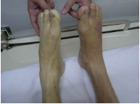
ALI Etiology
More than 70% of peripheral emboli are due to AF
Thrombosis in situ may arise from
  Acute plaque rupture
  Hypovolaemia
  Increased blood coagulability (e.g., in association with sepsis, malignancy)
  Pump failure (e.g., cardiac event)

Slide 52
ALI Classification
On the basis of onset and severity
Incomplete acute ischemia (usually due to thrombosis in situ) can often be treated medically, at least in the first instance
Complete ischemia (usually due to embolus) will normally result in extensive irreversible tissue injury within 6 hours unless the limb is revascularized
Irreversible ischemia mandates early amputation or, if the patient is elderly and unfit, end-of-life care

Slide 53
ALI Clinical features
6 Ps :
Pain
Pallor
Pulselesness
Paresthesia
Paralysis
Poikilothermia

Slide 54
ALI Clinical features
Paralysis (inability to wiggle toes/fingers)
Paraesthesia (loss of light touch over the dorsum of the foot/hand
The other Ps assist the diagnosis

Slide 55
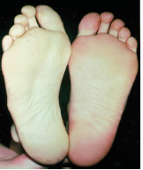
ALI Clinical features
Acute complete ischemia is associated with intense distal arterial spasm and the limb is ‘marble’ white
As the spasm relaxes over the next few hours and then fills with deoxygenated blood, mottling appears
This appears light blue or purple, has a fine reticular pattern, and on pressure, so-called nonfixed mottling
At this stage, the limb is salvageable

Slide 56
ALI Clinical features
As ischemia progresses, blood coagulates in the skin, leading to mottling that is darker in colour and does not blanch
Blistering and liquefaction
Attempts at revascularisation are futile and will lead to life-threatening reperfusion injury

Slide 57
Management
Must be discussed immediately with a vascular surgeon
Blood work, ECG, and cross match
If there are no contraindications, IV heparin (5000-8000 IU) is administered
  to limit propagation of thrombus and protect the collaterals

Slide 58
Management
If ischemia is complete
  The patient proceeds for embolectomy
If ischemia is incomplete
  Preoperative imaging is obtained (simple embolectomy or thrombectomy is unlikely to be successful)
  Preoperative optimization

Slide 59
Acute Embolus
Femoral embolus is associated with ischemia to the upper thigh
Acute embolic occlusion of the aortic bifurcation (saddle embolus) leads to absent femoral pulses and having white or mottled waist & legs
  May also present with paraplegia due to ischemia of the cauda equina

Slide 60
Acute embolus
Embolectomy can be performed under LA or GA
Postoperatively, the patient should continue on IV heparin
Warfarin reduces the risk of recurrent embolism but is associated with an annual risk of significant bleeding of 1–2%
in-hospital mortality from cardiac death or recurrent embolism, e.g. stroke, is 10-20%

Slide 61
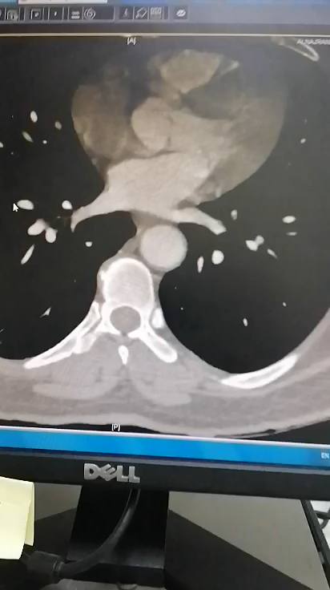
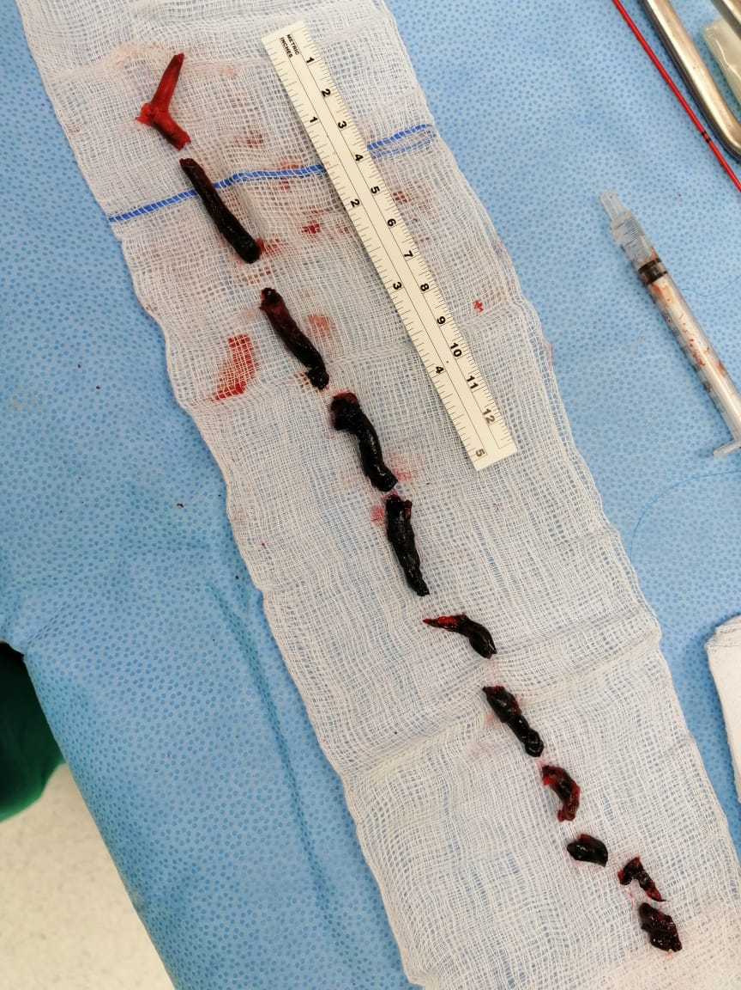
Acute embolus

Slide 62
Thrombosis in situ
Generally occurs in vessels affected by pre existent atherosclerosis
Ischemia is often less severe than with acute embolism
Location of occlusion may play a role in the severity of limb ischemia
Causes include
  Pump failure (e.g., silent or overt MI)
  Hypovolaemia, which may be associated with widespread thrombosis
  Increased blood coagulability (e.g. sepsis, malignancy)

Slide 63
Thrombosis in situ
Many patients can be managed medically
If the limb remains threatened then it may be possible to clear thrombus by
  Thrombectomy
  Endoluminal techniques
  Thrombolysis
  Bypass

Slide 64
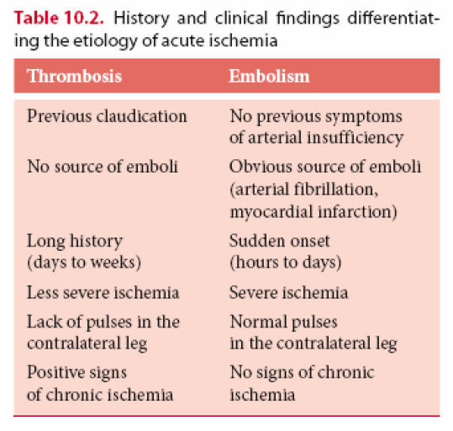
Thrombosis in situ
If an urgent intervention is required, the in-hospital limb loss rate may approach 30%, with an in-hospital mortality rate of 10–20%.

Slide 65
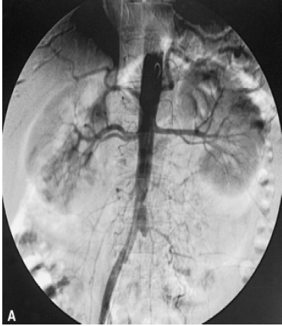
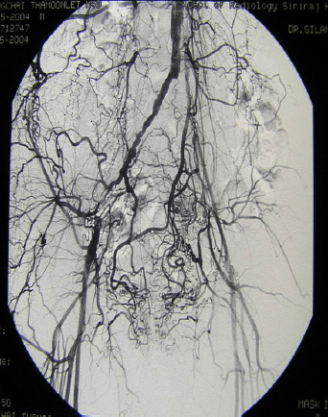
Acute Embolus
Acute Thrombosis

Slide 66
Post Ischemic Syndrome
Compartment syndrome (local)
  Endothelial cell injury leads to increased permeability
  The calf muscles are confined within tight fascial compartments
  The increase in interstitial tissue pressure leads to muscle necrosis despite adequate arterial inflow: compartment syndrome (>25mmHg)
  There is swelling and pain on squeezing the calf muscle or moving the ankle
  Palpable pedal pulses do not exclude compartment syndrome

Slide 67
Post Ischemic Syndrome
Management
Prevention through expeditious revascularisation
Low threshold for fasciotomy to relieve the pressure

Slide 68
Post Ischemic Syndrome
Reperfusion injury (systemic)
  Caused by activated neutrophils, free radicals, enzymes, hydrogen ions, carbon dioxide, potassium and myoglobin released from reperfused tissue
Leads to
  Acute respiratory distress syndrome (ARDS)
  Myocardial stunning
  Endotoxaemia
  Acute Tubular Necrosis
  Multiple organ failure and death

Slide 69
Post Ischemic Syndrome
Reperfusion injury (systemic)
Treatment
  Hydrate the patient
  Communication with the anesthesiologist and intensivist
  Protect the heart with calcium
  Prevent and treat hyperkalemia before reperfusion
  Correct acidosis and produce alkalosis in anticipation to reperfusion
  Use inotropic support liberally

Slide 70
Cerebrovascular disease CVD
Stroke
  An episode of focal neurological dysfunction lasting >24 hours, of vascular etiology
Transient ischaemic attack
  Symptoms last for less than 24 hours
Amaurosis fugax
  Transient incomplete unilateral loss of vision, never synchronously bilateral
  A veil or curtain coming across the eye

Slide 71
CVD Pathophysiology
Approximately 80% of strokes are ischemic
About half of these are thought to be due to atheroembolism from the carotid bifurcation
The origin of the internal carotid artery is most common site of atheroma formation
The tighter the degree of stenosis, the more likely it is to cause symptoms

Slide 72
CVD Pathophysiology
Emboli entering the ophthalmic artery leads to amaurosis fugax or permanent monocular blindness on the same side (ipsilateral)
If they enter the middle cerebral artery they may cause hemiparesis and hemisensory loss on the opposite side (contralateral)
If the dominant hemisphere is affected there may also be dysphasia

Slide 73
CVD Clinical Assessment
Complete History
Risk factor assessment
It is important to exclude other causes of cerebral ischemia and haemorrhage
Complete Neurological exam
‘Carotid’ bruit has no reliable relationship to the severity of the internal carotid artery disease and the risk of stroke

Slide 74
CVD Investigation
Doppler (duplex) ultrasound
Magnetic resonance angiography (MRA)
Computed tomographic angiography (CTA)
Intraarterial digital subtraction angiography is associated with risk of TIA/stroke as it is an invasive procedure

Slide 75
CVD Investigation
Doppler (duplex) ultrasound
Magnetic resonance angiography (MRA)
Computed tomographic angiography (CTA)
Intraarterial digital subtraction angiography is associated with risk of TIA/stroke as it is an invasive procedure

Slide 76
Asymptomatic CVD Management
Are treated with BMT
Risk of developing TIA/stroke are low (<10% at 5 years)
The RRR is 50%, the ARR would be only 1% per year
The number needed to prevent one TIA or stroke is at least 20–30
The number needed to treat for symptomatic disease is less than 10

Slide 77
Carotid endarterectomy (CEA)
CEA with BMT is associated with a significant reduction in recurrent stroke, compared with BMT alone
  ICA stenosis (> 50%)
  Life expectancy of at least 2y
  Can be undertaken with a stroke and/or death rate of <5%
  The intervention can be performed soon

Slide 78
Carotid endarterectomy (CEA)
The sooner the better
Performed under GA or LA
Patients with major stroke and little in the way of recovery are not candidates for carotid intervention
Patients with an occluded ICA are not candidates for carotid intervention

Slide 79
Carotid Artery Stenting (CAS)
The role of (CAS) remains controversial
Avoids a neck wound and the risks of cranial nerve injury
Reduces the risk of MI
Short-term risks of clinical and subclinical strokes are greater than CEA

Slide 80
Carotid stenting
CAS should be reserved for patients where CEA is not possible or desirable because of anatomic and clinical factors
  (e.g., recurrent stenosis after previous surgery or radiation arteritis)

Slide 81
THANK YOU
Principles and Practice of Surgery
Garden and Parks
Chapter 12. Vascular and endovascular surgery

