Slide 1
Anorectal Diseases

Slide 2
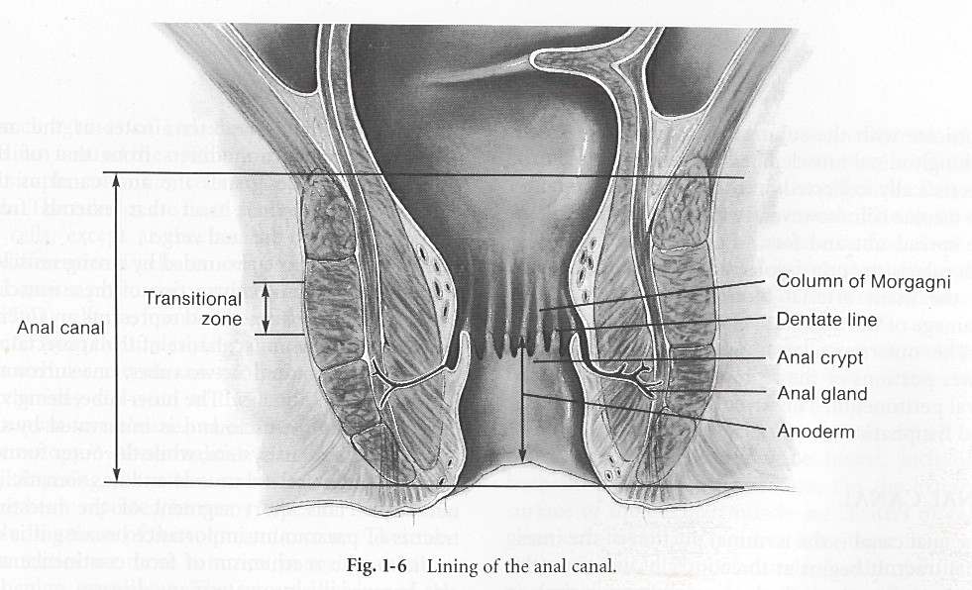

Slide 3
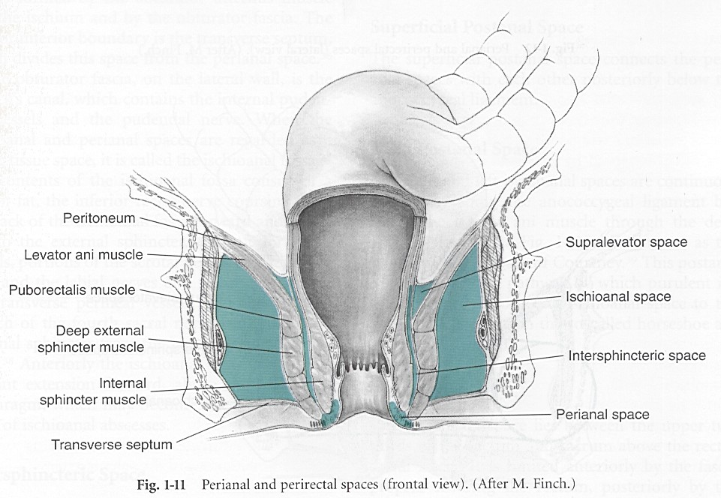

Slide 4
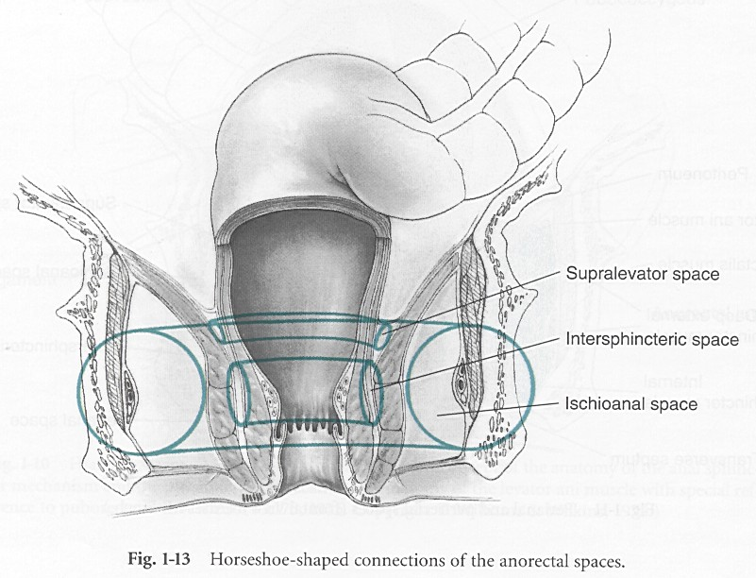

Slide 5
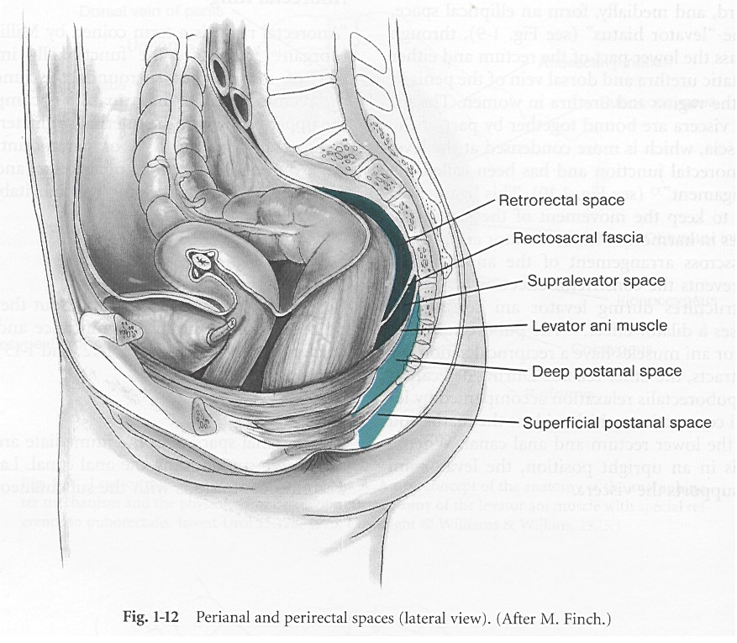

Slide 6
Perianal Fistula
Follows the abscess
Abscess is the acute issue and fistula is the chronic problem
40% of drained abscesses end with fistula

Slide 7
Evaluation
External opening, Tract, Internal opening
Clinical exam is the key
Radiological imaging mainly MRI

Slide 8
Treatment
Almost always surgical
Treating the internal opening
Treatment of underlying pathology

Slide 9
Haemorrhoids
Vascular structures in the anal canal
Helps in the continence
Internal or External

Slide 10
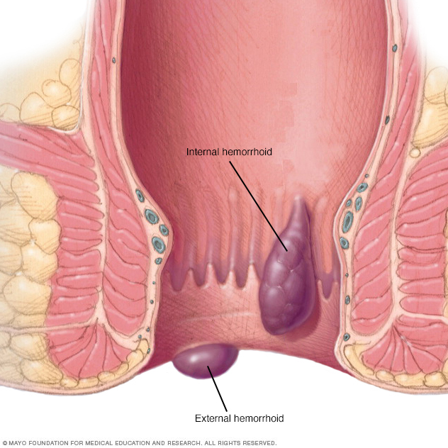

Slide 11
Pathophysiology
Increased intrapelvic pressure
Constipation, diarrhea
Engorgement

Slide 12
Grades
Based on history
Grade 1: Bleeding
Grade 2: Prolapse with spontaneous reduction
Grade 3: Manual reduction
Grade4: Won’t go back

Slide 13
Treatment
Scope
Treat underlying problem
Banding
Surgical

Slide 14
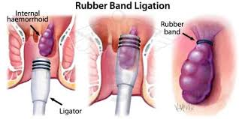

Slide 15
Fissure
Tear in the anal canal
Causes severe pain, sometimes bleeding
Related to ischemia
90 – 99% posterior midline

Slide 16
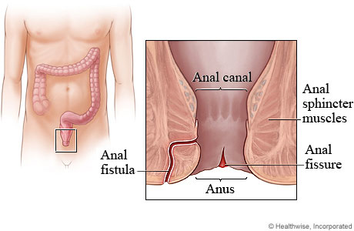

Slide 17
Treatment
Treat the constipation
Vasodilators
Botox
Surgery

Slide 18
Rectum
Location & description:
About 13 cm long
Start in the front of the third sacral vertebra
Follow the curve of the sacrum & coccyx
Ends at the tip of the coccyx
The lower part dilated to form rectal ampulla
Peritonial cover:
Upper 1/3:Cover anterior &lateral surface
Middle 1/3:Cover the anterior surface only
Lower 1/3:No peritonial covar

Slide 19
Continue :
Anterior Relations in MALE:
Upper 2/3 :SIGMOID COLON &COILS of ileum
Lower 1/3:
Siminal vesicles
Vas deference
Bladder
Prostate
Posterior:
Sacrum &coccyx
Levator anai –pirifomis &coccygeus
Sacral plexus &sympathatic chain
Anterior relations in female
Upper 2/3:sigmoid &coils of ileum
Lower 1/3:
Posterior surface of
the vagina
Posterior :
same

Slide 20
Continue
Blood Supply:
Arteries:
Superior rectal artery…….from….Inferior mesenteric a.
Middle rectal artery…….From…Internal iliac a.
Inferior rectal artery….From….internal pudendal a.
Veins:
Superior rectal vein…to..portal vein
Middle rectal vein…to..internal iliac vein
Inferior rectal vein…to…internal pudendal vein

Slide 21
Anal canal
Surgeons: Begins at the anorectal junction (when pass through the levator ani muscles) about 4 cm down to the anal verge.
Anatomist: part of the intestinal tract that start at dentate line to the anal verge.
The masculature of the anorectal tube regarded as two tubes,one surrounding the other.

Slide 22
Continue…Anal canal
Linings of the canal:
Dentate line about 2cm above the anal verge
Columns of Morgagni: 6-14 longitudinal folds at dentate line with Small anal crypts at the lower end & between the the adjacent folds
Surgical significance:
Foreign material may lodge in them,obestructing the ducts &cause sepsis

Slide 23
Anal mucosa:
Above dentate line :Columnal epithelium
Below Dentate line:Squamous epithelium
TRANSITIONAL ZONE:
Interposed between uninterruted colorectal & anal epithelium
Anoderm:
The area below the dentate line .Not a true ski because it is devoid the accessory skin structure(hair .sebaceous glands)

Slide 24
Anorectal spaces:
1.Perianal space
2.Ischioanal Space
3.Intersphincteric Space
4.Supralevator Space
5.Submucous space
6.Superficial Postanal space
7.Deep postanal space
8.Retrorectal space

Slide 25
Superior rectal artery
Direct continuation of the inferior mesenteric artery
Chief arterial supply for the MUCOUSA.of the rectum
It enters the pelvis by descending in the root of the sigmolid misocolon
Pierce the Mascular coat &supply the mucosa
Anastomose with Inferior &Middle Rectal Arteries
Middle rectal artery
Branch of the Internal iliac artery
Supply the muscular coat of the rectum
Can not solaly provide the blood supply to the rectum in case of superior rectal artery ligation

Slide 26
Inferior rectal artery
Rise from Internal pudendal artery
Travel the ischiorectal fossa &supply the anal canal &external sphincter muscles
Median Sacral Artery
Arise from the back of the AORTA at 1.5 cm above the biforcation
Descends over the last two lumber vertebrae,the sacrum,and the coccyx
The SURGICAL SIGNIFICANCE of the median sacral arteryis that during rectal excion .Yhe vessel exposed in the front of the sacrum,
This vessel may demonesterate troublesome lleeding

Slide 27
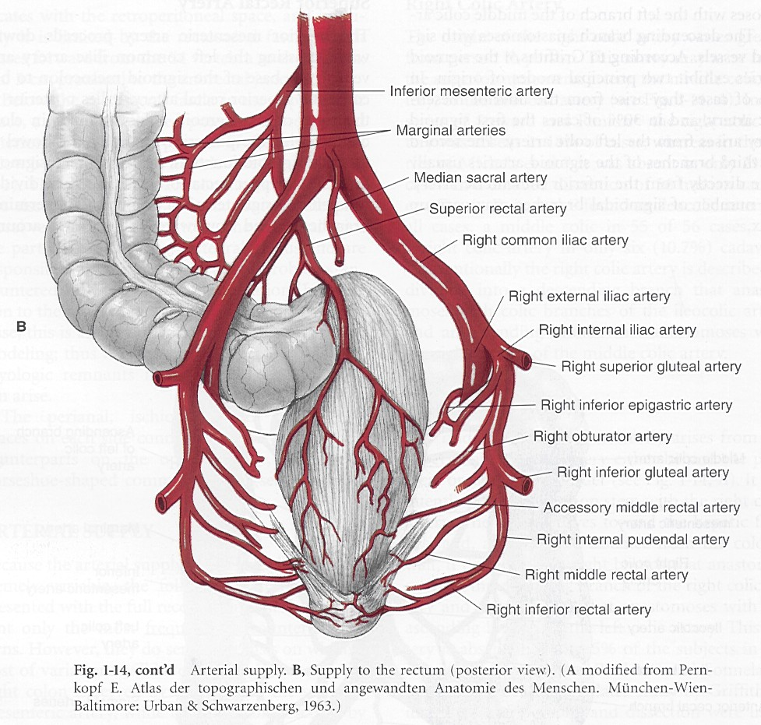

Slide 28
VENOUS DRAINGE OF THE COLON &RECTUM
Superior Mesenteric Vein:
Drain Veins from Rt.colon &Transverse colon lies Rt.&front to S.M.A.
Joined the Splenic vein to form Portal vein
Inferior Mesenteric Vein:
Drain the superior rectal vein
Receive blood from the left colon,rectum&the upper part of the anal canal

Slide 29
Conti.Venous drainage:
Superior rectal vein:
Drain the rectum &upper part of the anal canal,Where the internal hemorhoidal plexus is situated to portal vein
Middle rectal vein:
Drain the rectum &upper part of the anal canal to SYSTEMIC circulation by internal iliac veins
Inferior rectal vein:
Drain the lower part of the anal canal ,where the external hemorrhoidal plexus is located,via internal pudendal vein then to internal iliac vein …SYSTEMIC circulation

Slide 30
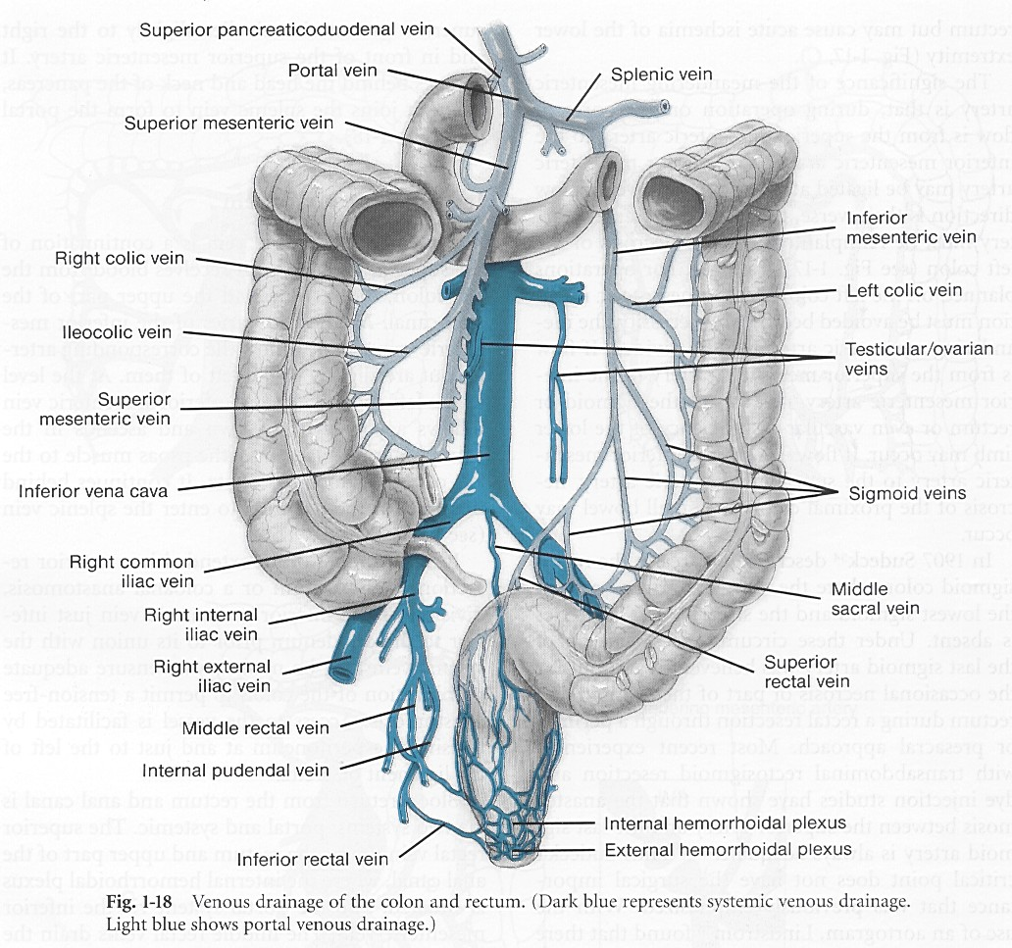

Slide 31
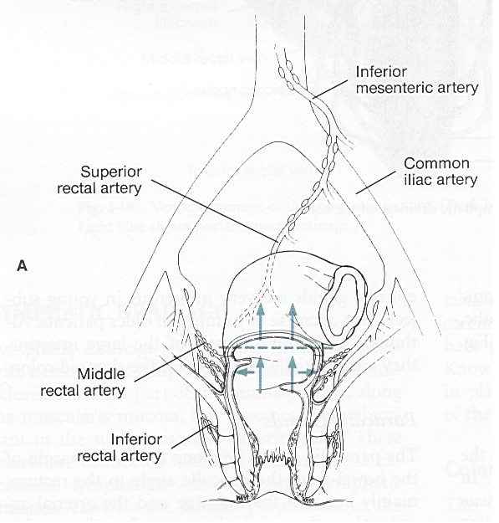
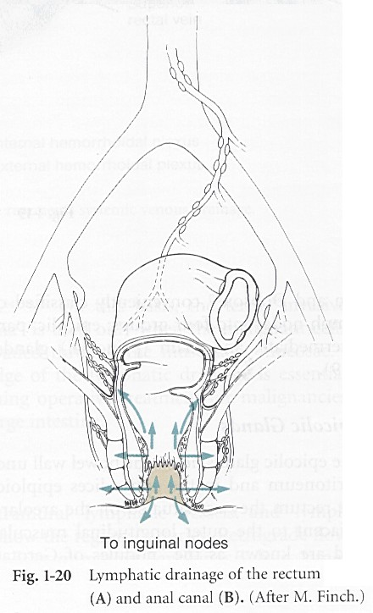

Slide 32
Rectum lymphatic draing
Upper &middle Rectum:
Lymph drain along the superior rectel artery into inferior mesenteric lymph nodes
Lower Rectum:
Superiorly drain to inferior mesenteric lymph nodes
Laterally,via lymph vessels along the middle rectal vein into internal iliac nodes
Rectal epicolic lymph nodes located on the areolar tissue adjacent to longitudinal muscle coat &known as(nodules of Gerota)

Slide 33
Anal canal lymphatics
ABOVE the dentate line :
Drain up through superior rectal lymphatics to inferior mesenteric nodes
Drain laterally via middle &inferior rectal lymphatics through ischioanal fossa to the internal iliac nodes
BELOW the dentate line:
Drain to the inguinal nodes
Clinical Significance-Spread of Ca-rectum:
Lymphatic drain 5 cm from the anal verge spread to….posterior vaginal wall-uterus-cervix-Broad ligament-fallopian tubes-ovaries &clu-de-sac
10 cm above the anal verge spread only to broad ligament &clu-de-sac
15 cm no spread to the genital orgnes

Slide 34
NERVE SUPPLY:
Colon:
Sympathatic &parasympathatic (Vagus) innervation from the superior mesenteric lymph plexus till the proximal 2/3 of the transverse colon
Innervation for the distal 1/3 of the transverse colon down to sigmoid colon drived from pelvic splanchnic nerves throgh the inferior mesenteric plexus
Sigmoide colon &rectum:
Inferior hypogastric plexus which is sensitive only to streach
Anal canal:
Upper half:
Sensitive to streach only ,innervated by hypogastric plexus
Lower half:
Sensitive to pain-pressure-touch-temp,innervated by inferior rectal nerve

Slide 35
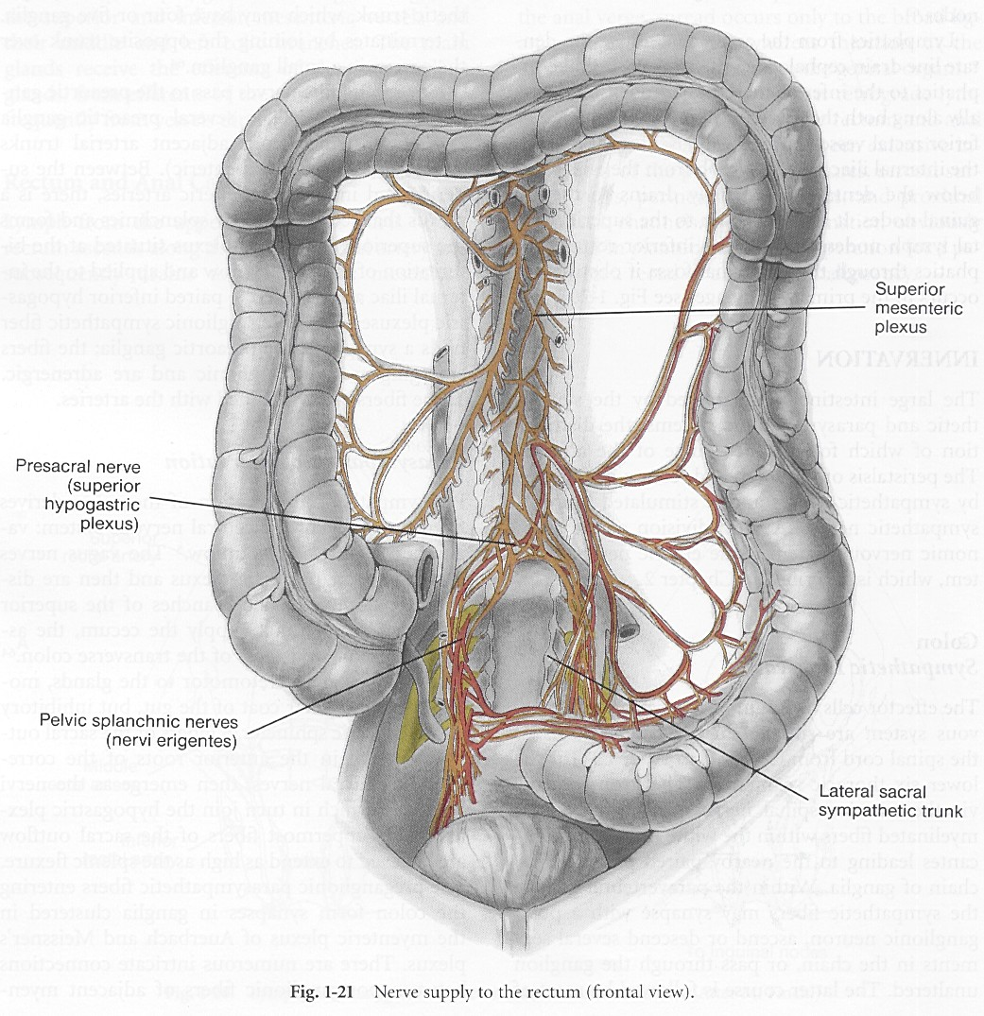

Slide 36
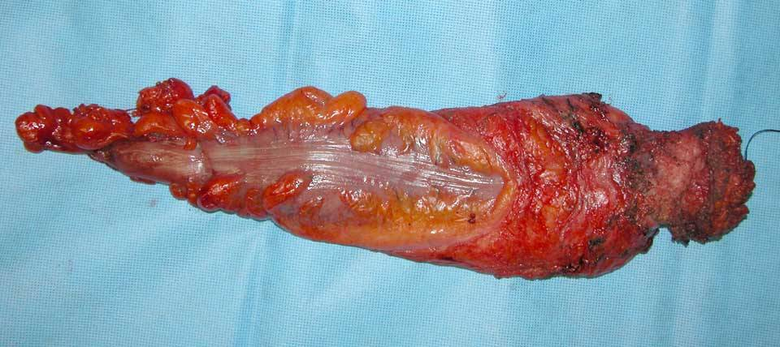

Slide 37
