Slide 1
Common surgical disease of the liver and portal hypertension

Slide 2
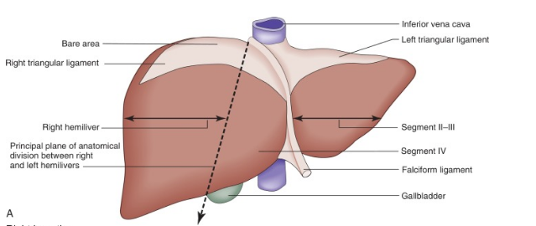
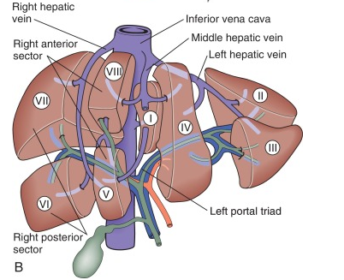

Slide 3
Liver functhion:
Responsible for storing
  glucose as glycogen, or converting it to lactate
Utilization of:
  Amino acids for hepatic and plasma protein synthesis or catabolised to urea.
Metabolism of :
  lipids, bilirubin and bile salts, drugs and alcohol.
Production of the coagulation factors
  I, V, XI,
  Vit. K-dependent factors: II, VII, IX and X as well as proteins C and S and antithrombin.
Largest reticuloendothelial organ:
  Kupffer cells : remove damaged red blood cells, bacteria, viruses and endotoxin

Slide 4
Radiology:
US:
  Noninvasive
  It assess intra- and extrahepatic bile duct dilatation or gallbladder distension It detect space occupying lesion in the liver and pancreas
  It evaluate vascular system of the liver
  It detect gallstones

Slide 5
CT:
  Identify and stage hepatic, bile duct and pancreatic tumours
  It demonstrates the:
    Dilated biliary tree to the level of the obstruction,
    Vascular abnormality or invasion
    Lymphadenopathy or distant metastasis
  Positron emission tomography (PET-CT)
    Tumor staging
    Distant Metastasis

Slide 6
MRI:
  Identify and stage hepatic, bile duct and pancreatic tumours
  It demonstrates the:
    Dilated biliary tree to the level of the obstruction,
    Vascular abnormality or invasion
    Lymphadenopathy or distant metastasis
  Liver biopsy
    Liver disease
    Liver mass

Slide 7
Congenital abnormality:
Liver Cyst
Cavernous haemangiomas

Slide 8
Liver Cyst
  Histology:
  lined by biliary epithelium and contain serous fluid
  Dose not communicate with biliary system
  Incidence:
  Sporadic or Polycystic disease
  Symptoms : rare
  Due mass effect on surrounding structure
  Diagnosis:
  US , CT or MRI
  Traetment: symptomatic only
  Surgical : deroofing or resection
  Aspiration

Slide 9
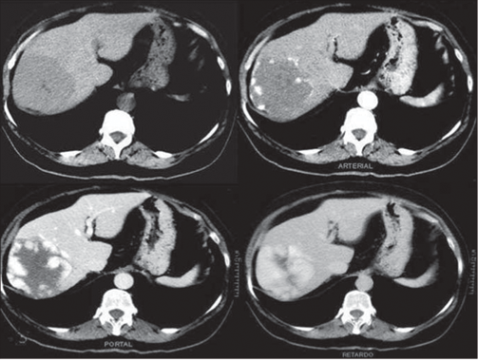
Cavernous haemangiomas
  Histology:
  made of cavernous vascular spaces lined by flattened endothelium
  Prevalence:
  Most common benign tumours of the liver
  W:M, 6:1
  Symptoms: rare
  Due mass effect on surrounding structure
  Diagnosis:
  US , CT or MRI
  Centripetal ‘filling in’ of contrast during dynamic imaging with CT or MRI
  Traetment:
  Observation
  Symptomatic:
      Surgical : resection
      Rupture: Angioembolization

Slide 10
Hepatic infections
Pyogenic liver abscess
Amoebic liver abscess
Hydatid disease

Slide 11
Pyogenic liver abscess:
  Source of infection:
  Biliary system
    Cholelithiasis, Benign strictures, Acute cholangitis, Periampullary tumors
  Portal vein
    Abdominal sepsis
      Anorectal abscess, Pelvic abscess ,Postoperative sepsis, Intestinal perforation, Pancreatic abscess, appendicitis or diverticulitis
  Hepatic artery:
    Septic focus anywhere in the body
      Endocarditis, Vascular sepsis, Ear, throat, nose, or , dental infection
  Direct spread from a contiguous organ:
    Cholecystitis or empyema of the gallbladder
    Gastroduodenal perforation
    Colonic perforation
  Follow blunt or penetrating injury
  Cryptogenic :
    infection is indeterminate

Slide 12
Organism:
  Gram positive aerobes :
    Streptococcus milleri
    Staphylococcus aureus
    Enterococcus spp.
  Gram negative aerobes:
    Escherichia coli
    Klebsiella pneumonia
    Pseudomonas aeruginosa
    Proteus spp.
    Enterobacter cloacae
  Gram positive anaerobes:
    Bacteroides spp.
    Fusobacterium spp.

Slide 13
Clinical feature:
Symtotom:
  Fever
  Right hypochondrium abdominal pain
  Swinging pyrexia
  Chills and rigors
  Marked toxicity
  General malaise and anorexia
  jaundice.
Examination:
  Look ill
  May be jaundiced
  Vital sign: Tachycardia, high tempreture , +/- hypotension
  Abdominal exam: enlarged and tender liver.

Slide 14
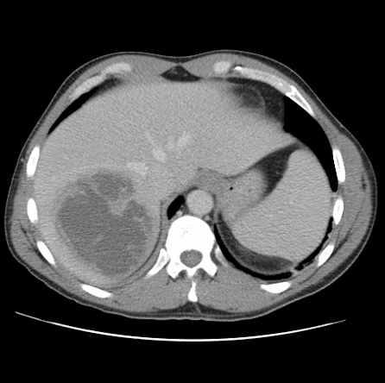
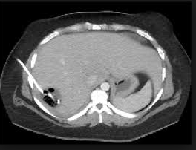
Investigation:
  Labs:
    CBC: ⬆ WBC
    LFT: elevated
    Coagulation profile: normal or elevated
    Blood and pus Culture
  Radiology:
    AXR : air in the liver ( gas forming infection)
    CXR: right side pleural effusion
    US: hypoechoic lesion with thick wall , biliary dilatation
    CT: central hypodense region and peripheral contrast enhancement during the portal phase of examination
Treatment:
  Percutaneous drainage abscesses under ultrasound or CT guidance
  Antibiotic therapy

Slide 15
Amoebic liver abscess
  Pathogenesis:
    protozoal parasite infests the large intestine.
    Ingested cyst in the large intestine ➔ Trophozoites ➔ penetrate the mucosa ➔portal venous system ➔liver.
  Organism:
    Entamoeba histolytica
  Clinical feature:
    Symptom: Right upper quadrant pain ,anorexia, nausea, weight loss and night sweats, diarrhea.
    Physical examination: Tender enlargement of the liver +/- jaundice

Slide 16
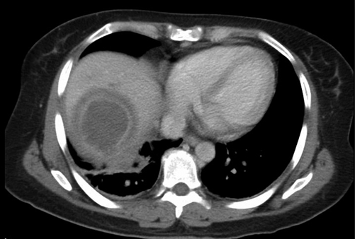
Investigation:
Labs:
  CBC: ⬆ WBC
  Direct and indirect serological tests: (amoebic protein)
    Indirect haem-agglutination [IHA]
    Enzyme-linked immunosorbent assay [ELISA
  Stools: amoebae or cysts
Radiology:
    US: well-defined margins; they are hypoechoic lesion
    CT: well-defined lesions with complex fluid, enhancing wall with a peripheral zone of edema around the abscess
Treatment:
Antibiotics:
  Metronidazol
  Diloxanide furoate (carrier)
Percutaneous aspiration:
  No improvement after 3 days of antibiotics
  Pyogenic abscess

Slide 17
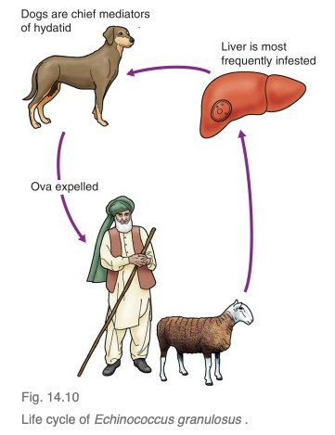
Hydatid disease
  Pathogenesis:
  infestation one of two forms of tapeworm in the gastrointestinal system.
  Ingested ova hatch in the duodenum ➔ portal system ➔ liver
  Hydatid cyst :
    Pericyst: host tissue formed by the body as a reaction to the parasite
    Ectocyst: external layer of the cyst
    Endocyst: germinative layer
  Organism:
    Echinococcus granulosus and E. multilocularis
  Clinical feature:
    Abdominal pain or no symptom
    Rupture: anaphylaxix
    Communication with Biliary system: obstructive jaundice

Slide 18
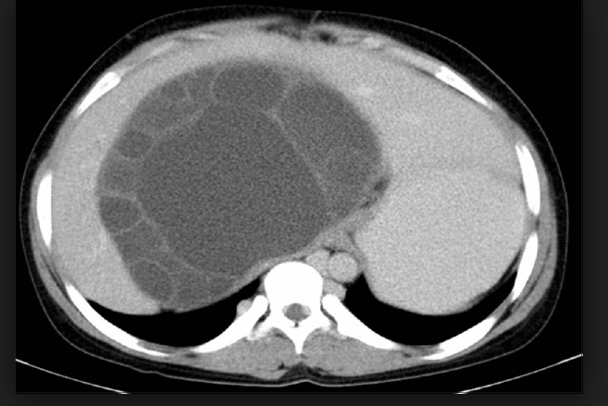
  Investigation:
    Labs:
      CBC: eosinophilia
      Serology test:
        Immunoelectrophoresis (IEP) : Not for followup
        enzyme-linked immunosorbent assay (ELISA): IgE or IgG₄ ( 4 years) , IgM ( 6 months)
        Immonoblotting: first-line test
    Radiology:
      AXR: calcification
      US, CT MRI: well-defined, circumscribed cystic lesions with a clear membrane , daughter cysts
  Treatment :
      Medical : albendazole or mebendazole
      Surgical :
        Deroofing
        Percystectomy
        Liver resection
      Puncture–aspiration–injection–reaspiration (PAIR)

Slide 19
Tumours of the liver
Benign hepatic tumours :
  Focal nodular hyperplasia (FNH)
  Liver cell adenoma
Malignant tumours of the liver :
  Primary:
    Hepatocellular carcinoma (hepatoma)
    Cholangiocarcinoma
    Angiosarcoma
    Hepatic mucinous cystic neoplasm
  Metastatic tumours

Slide 20
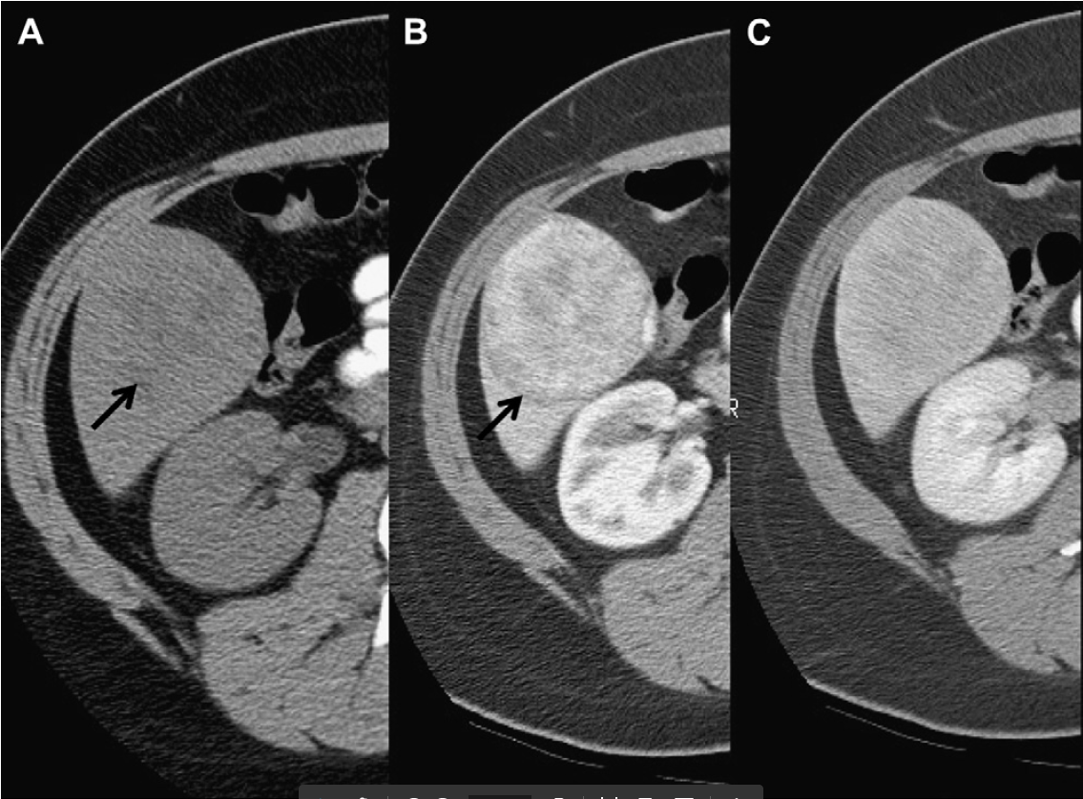
Liver cell adenoma
  W:M , 9:1
  Estrogen and anabolic steroid play a causative role.
Clinical feature:
  Right Upper Quadrant pain
Complication:
  Rupture
  Malignant transformation
Investigation:
  US , CT, MRI
Treatment:
  Female :
    < 5 cm : stop oral OCP
    > 5 cm : surgery
  Male: surgery
  Rupture: Angioembolization

Slide 21
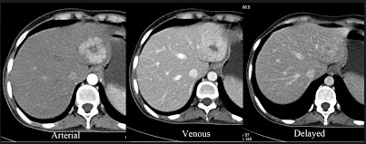
Focal nodular hyperplasia (FNH)
  Mostly Female
Clinical feature:
  Right Upper Quadrant pain
Investigation:
  US , CT, MRI
Treatment:
  Observation

Slide 22
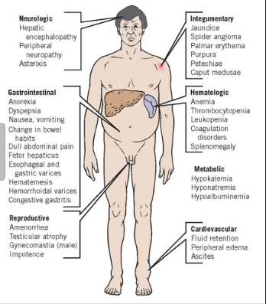
Hepatocellular carcinoma (hepatoma)
    M> F
    Liver cirrhosis : Hib B or C, alcholic
    Aflatoxin
    Non cirrhosis : Hib B.
Clinical feature:
  Liver cirrhosis:
    liver disease symptoms
    abdominal pain, weight loss, abdominal distension, fever and spontaneous intraperitoneal haemorrhage
  Non cirrhosis :
    abdominal pain or swelling

Slide 23
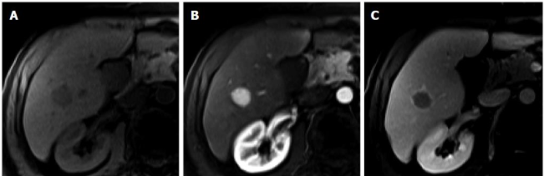
Investigation:
  LFT, CBC, coagulation profile
  Screening:
    US abdomen
    Alpha-fetoprotein (AFP)
  CT , MRI : liver lesion with arterial enhancement and early washout on portovenous phase
  Diagnosis:
    > 1 cm: one image with characteristic feature
    Cytology: if the nodule is > 1 cm and feature is not typical
    < 1 cm: 3-6 month followup

Slide 24
Treatment :
  Transplantation:
    Milan criteria: single tumour of 5 cm or less in diameter, or with no more than three tumour nodules each one 3 cm or less in size
  Liver resection:
    Non cirrhotic patient
    Child A liver cirrhosis
  Locoregional therapy:
    TACE
    Local ablation : RFA, microwave energy
  Chemotherapy:
    Sorafenib

Slide 25
Cholangiocarcinoma
Adenocarcinoma may arise anywhere in the biliary tree
Risk factor:
  chronic parasitic infestation of the biliary tree
  Choledochal cysts
Clinical feature:
  Jaundice
  Abdominal pain, weight loss, anorexia
Investigation:
  Labs:
    LFT : obstructive Jaundice
    CBC , Coagulation Factor , CA 19-9
  Radiology:
  CT , MRI , MRCP, ERCP, PTC
Treatmant:
  Curative:
    Resection
  Metastatic:
    Palliative chemotherapy

Slide 26
Metastatic malignant tumor:
    Gastrointestinal tract
    Breast
    ovaries
    Bronchus
    Kidney
  Diagnosis:
    Tumor marker: CEA, CA 19-9, CA 125
    Radiology : CT , MRI, PET CT
  Treatment:
    Resection
    Palliative chemotherapy

Slide 27
Portal hypertension
Pressure (P) = Flow (F) X Resistance (R)
Portal pressure : 3 – 6 mm Hg
  PP > 10 : shunting
  PP>12: bleeding
Normal elevation:
  Eating
  Exercise
  Valsalva
Changes in either F or R affect the pressure.

Slide 28
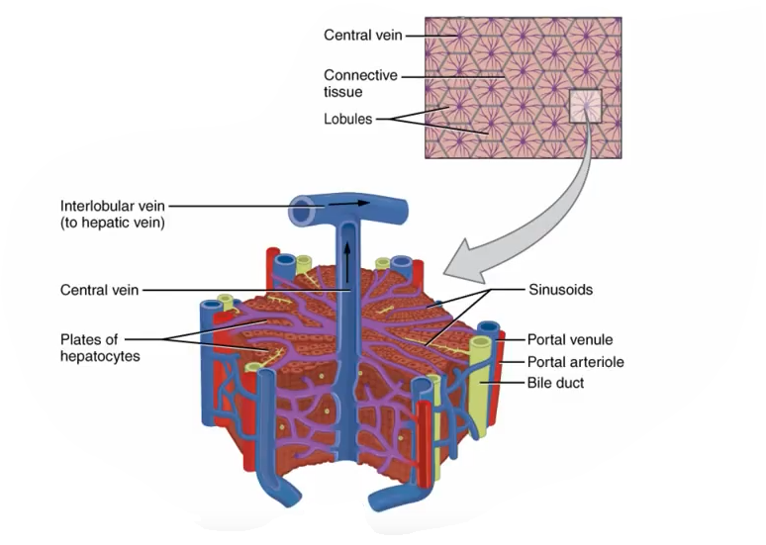
Liver disease :
  ↓ portal vascular radius.
  splanchnic arteriolar vasodilatation
    Decreased sensitivity to caticolamin
    Increased endogenous vasodilator ( NO, prostacycline).

Slide 29
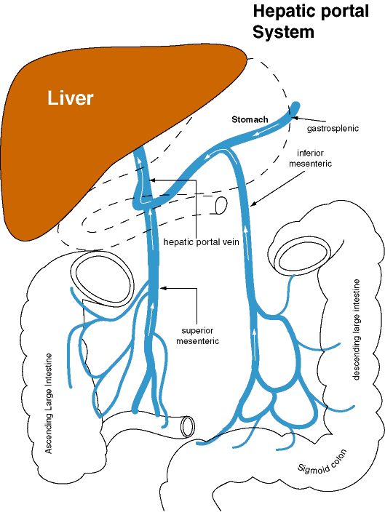

Slide 30
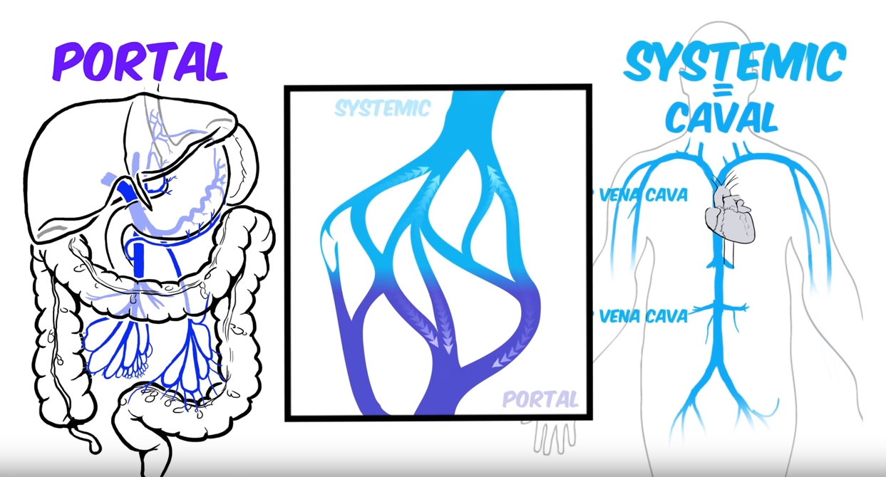

Slide 31
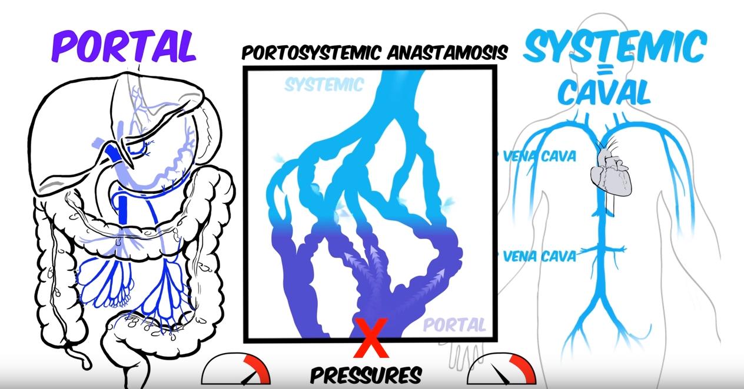

Slide 32
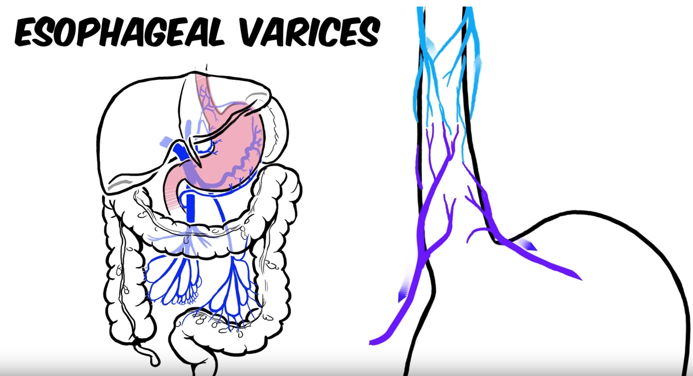
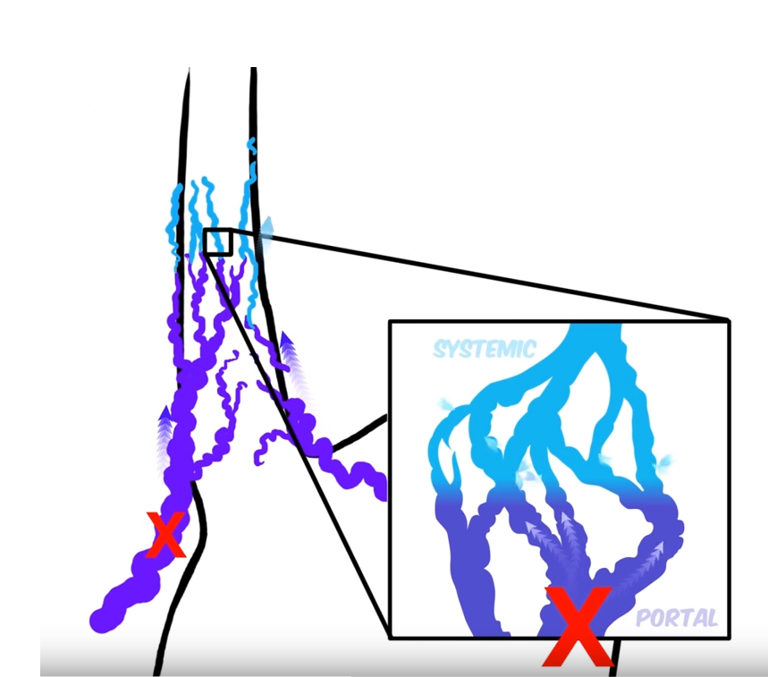

Slide 33
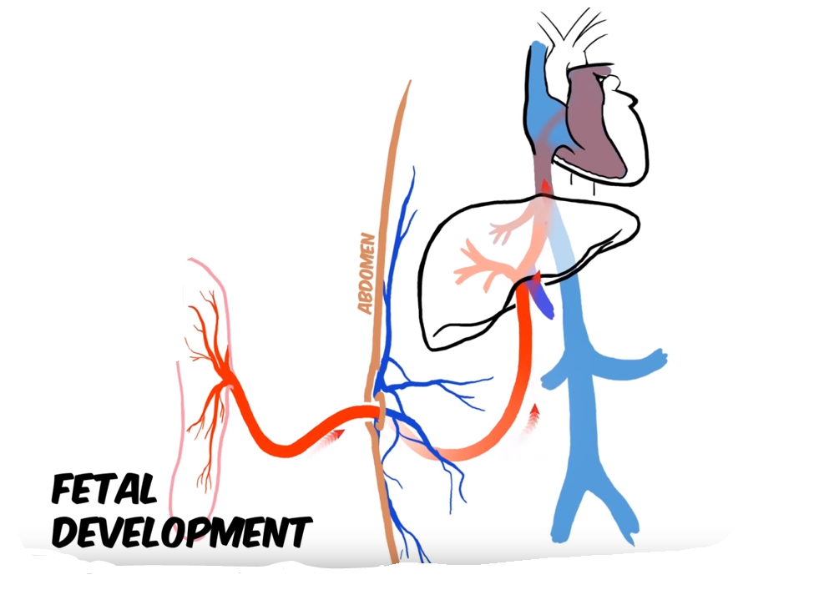
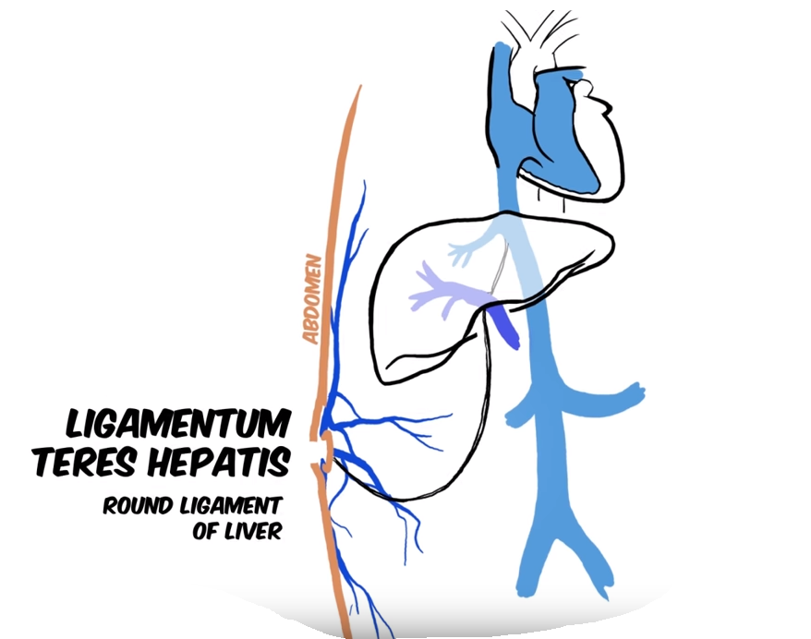
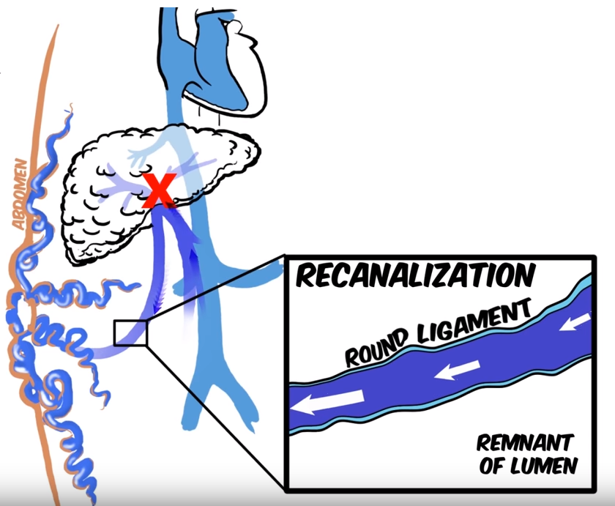

Slide 34
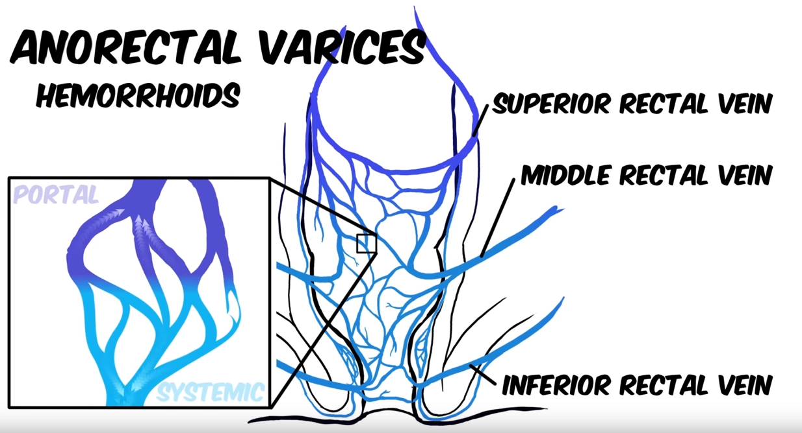
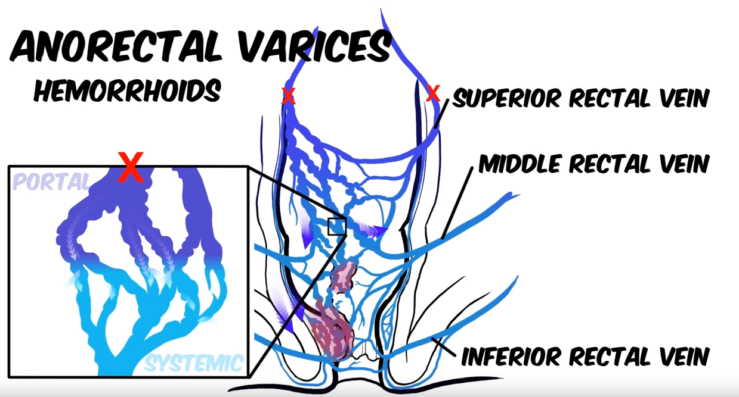

Slide 35
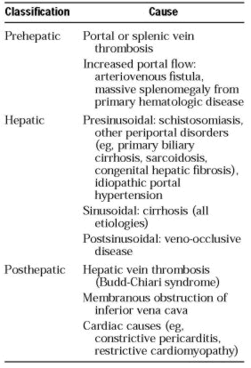
Causes of Portal HTN

Slide 36
Mortality/Morbidity
Variceal hemorrhage most common complication of PH
90% with cirrhosis develop varices.
30% of these bleed.
The first episode is estimated to carry a mortality of 30-50%.

Slide 37
Clinical feature
Symptom:
  Heamtmesis +/_ melenal
  Chronic liver disease symptom
Examination:
  Hypotension, tachycardia
  Stigmata of liver disease

Slide 38
Assesment
Acute setting :
  ABC
  History
Elective setting:
  History of chronic liver disease
  Other differential diagnosis
  Stigmata of liver disease

Slide 39
Investigation:
Labs:
  Acute setting
    CBC , LFTs, Albumin, PT/PTT, U&E, CXR
    Cross match
  Chronic setting:
    Hepatitis serology,ANA, Antimitochondrial antibodies, Alpha 1-antitrypsin deficiency
Radiology:
    CXR
    US, CT
Endoscopy
Hepatic venous pressure gradient

Slide 40
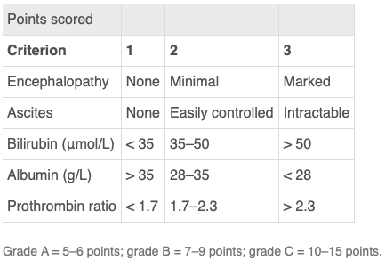

Slide 41
Treatment
Endoscopy:
  Endoscopic variceal ligation (EVL)
  Sclerotherapy
Pharmacology:
  Octreotide
  Vasopressin
Balloon tamponade:
  Minnesota
  Sengstaken–Blakemore tube
Transjugular intrahepatic portosystemic stent shunting (TIPSS)
Surgical:
  Shunt:
    Slective
    Non-selective
  Devascularization

Slide 42
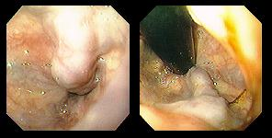
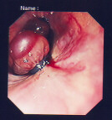

Slide 43
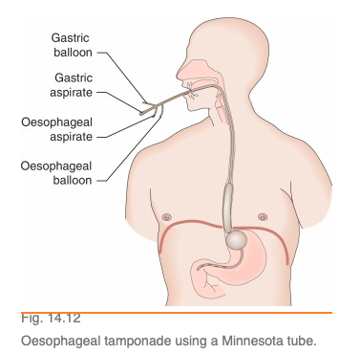
Balloon tamponade

Slide 44
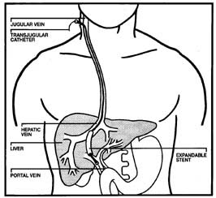
TIPSS

Slide 45
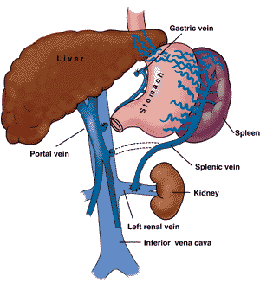
Shunts

Slide 46
Thanks

