Slide 1
Introduction to Non-communicable Disease (NCDs) Prevention and Control
Dr . Ali Al-hazmi

Slide 2
OBJECTIVES
Definition of non-communicable diseases
Epidemiology of non-communicable diseases
Disability as a consequence of NCDs
Goals of NCD prevention and control
Current challenges in NCD control
Discuss and understand the global frame work of prevention and control of NCDs

Slide 3
Definition of non-communicable diseases
also known as chronic diseases
tend to be of long duration and are the result of a combination of genetic, physiological, environmental and behaviours factors (WHO).
A disease that has a prolonged course, that does not resolve spontaneously, and for which a complete cure is rarely achieved (CDC)
https://www.who.int/news-room/fact-sheets/detail/noncommunicable-diseases

Slide 4
Characteristics of non-communicable diseases
• Complex etiology (causes)
• Multiple risk factors
• Long latency period
• Non-contagious origin (noncommunicable)
• Prolonged course of illness
• Functional impairment or disability

Slide 5
Types of non-communicable diseases
cardiovascular diseases (like heart attacks and stroke)
Cancers
chronic respiratory diseases (such as chronic obstructive pulmonary disease and asthma)
Diabetes
Chronic neurologic disorders (e.g., Alzheimer’s, dementias)
Arthritis/Musculoskeletal diseases
Unintentional injuries (e.g., from traffic crashes)
………….

Slide 6
Epidemiology of non-communicable diseases

Slide 7
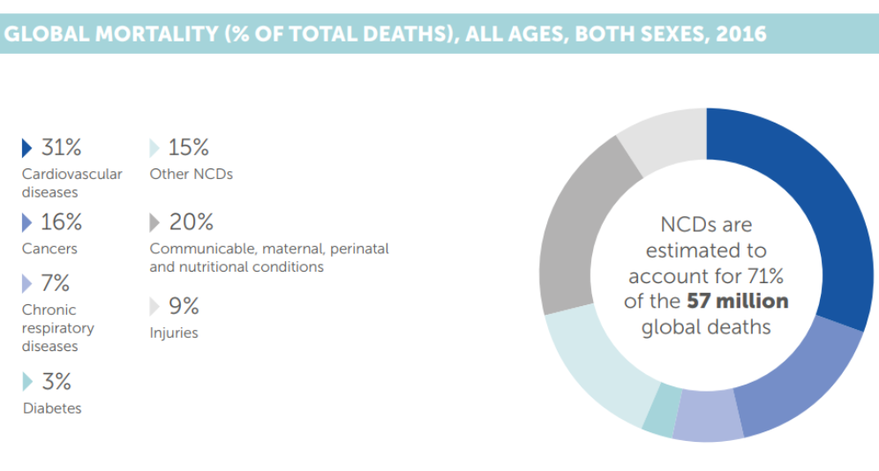

Slide 8
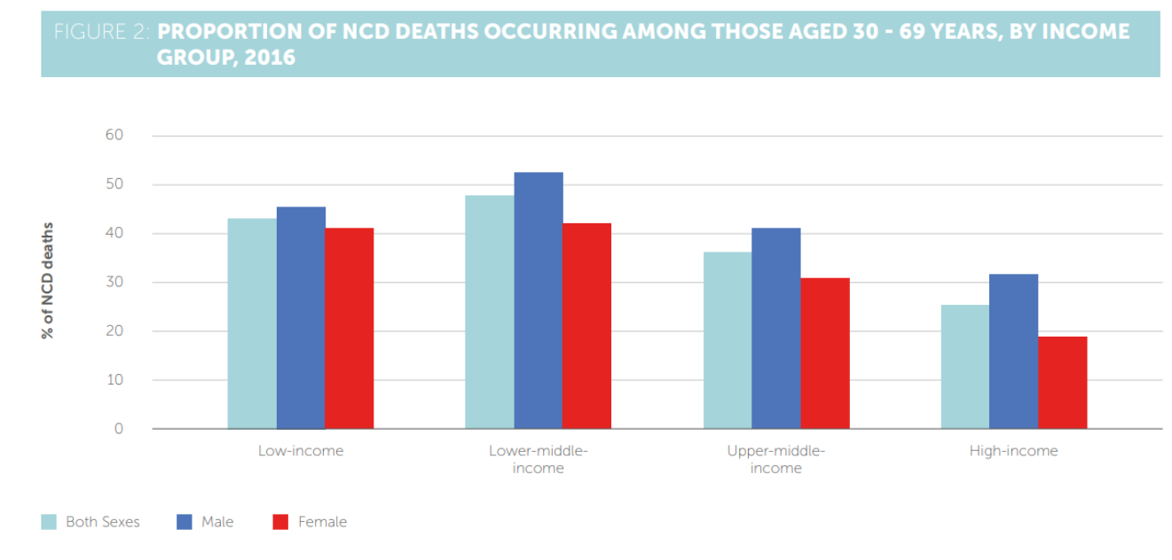

Slide 9
Epidemiology of non-communicable diseases
Key facts
Noncommunicable diseases (NCDs) kill 41 million people each year, equivalent to 71% of all deaths globally.
Each year, 15 million people die from a NCD between the ages of 30 and 69 years; over 85% of these "premature" deaths occur in low- and middle-income countries.
Cardiovascular diseases account for most NCD deaths, or 17.9 million people annually, followed by cancers (9.0 million), respiratory diseases (3.9million), and diabetes (1.6 million).

Slide 10
Epidemiology of non-communicable diseases
Key facts
These 4 groups of diseases account for over 80% of all premature NCD deaths.
Tobacco use, physical inactivity, the harmful use of alcohol and unhealthy diets all increase the risk of dying from a NCD.
Detection, screening and treatment of NCDs, as well as palliative care, are key components of the response to NCDs.

Slide 12
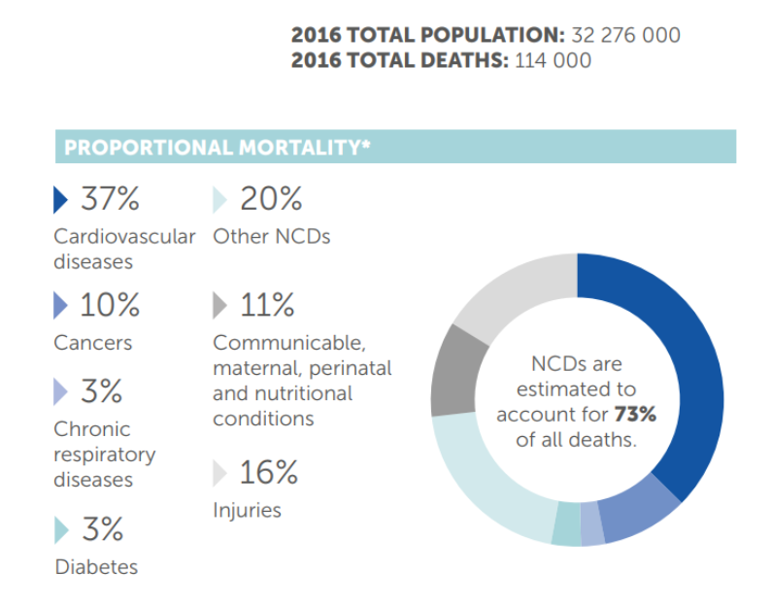

Slide 13
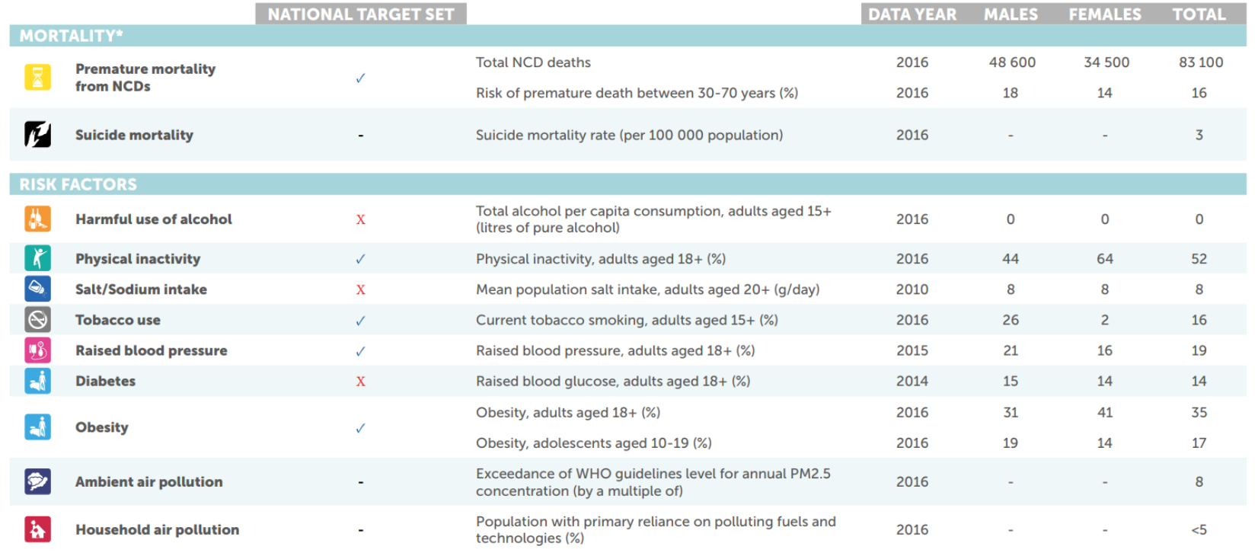

Slide 15
https://www.who.int/nmh/countries/sau_en.pdf

Slide 16
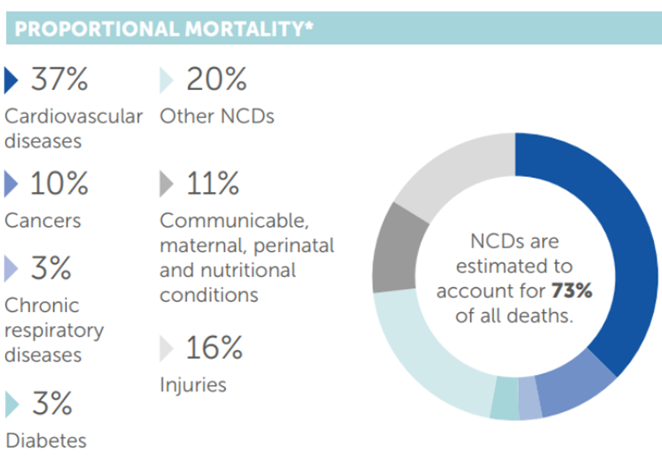
Disability as a consequence non-communicable diseases
What are the disability of non-communicable diseases?

Slide 17
Goals of NCD prevention and control
To reduce disease incidence To prevent / delay onset of disability To alleviate severity of disease To prolong the individuals’
Change of the public's perception of NCD from one of "inevitability" to that of "preventability

Slide 18
Goals of NCD prevention and control
Primary and Secondary Prevention of NCDs
Planning NCDs policies and control measures
Stakeholders Collaboration
Patient Empowerment Programs
Capacity Building for Health Professionals
Surveillance of NCDs
Research and Information Systems
Health Promotion: Enhancement of Community Participation

Slide 19
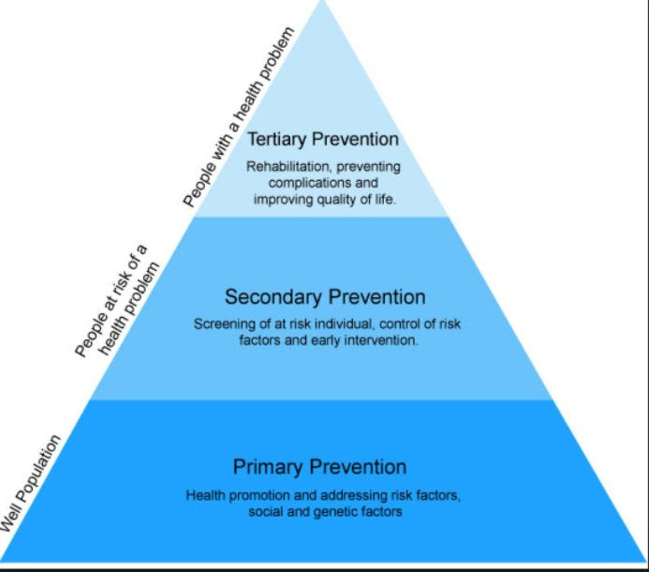
Goals of NCD prevention and control

Slide 20
Discuss and understand the global frame work of prevention and control of NCDs

Slide 21
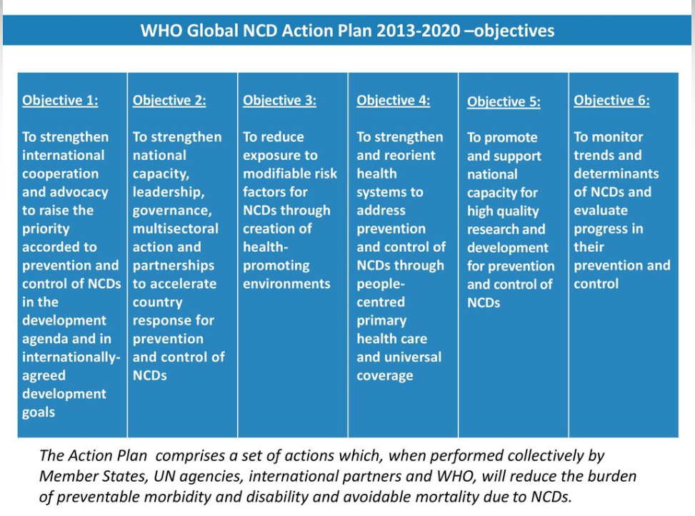

Slide 22
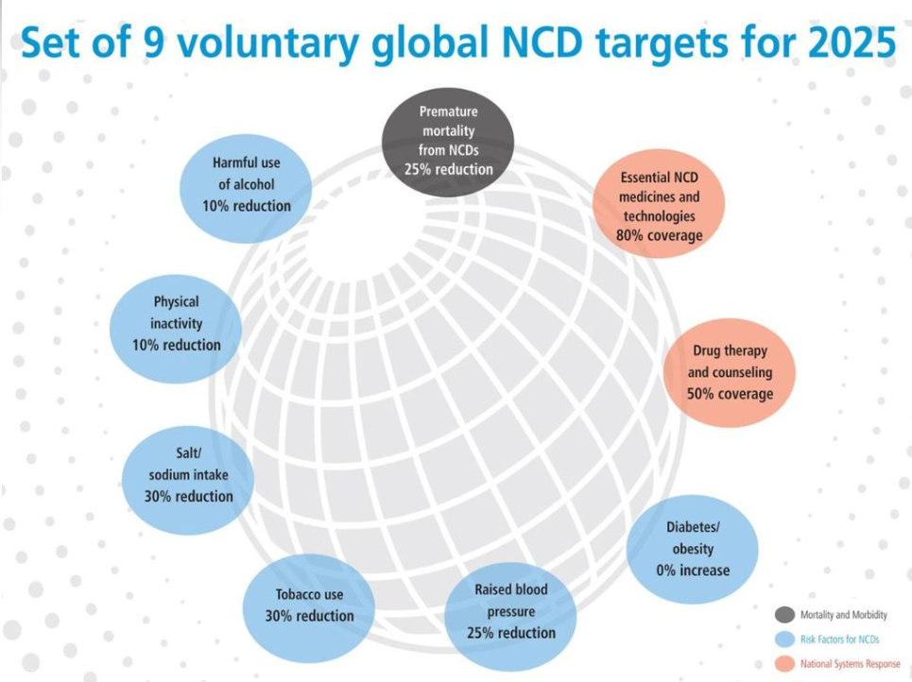

Slide 23
https://www.who.int/ncds/management/WHO_Appendix_BestBuys_LS.pdf

Slide 24
WHAT IS IN THIS DOCUMENT
provides policymakers with a list of ‘best buys’ and other recommended interventions to address noncommunicable diseases
A list of options is presented for each of the four key risk factors for NCDs (tobacco, harmful use of alcohol, unhealthy diet and physical inactivity) and for four disease areas (cardiovascular diseases, diabetes, cancer and chronic respiratory diseases).

Slide 25
