Slide 1
Diseases related to environmental hazards
YEAR
1439-1440 Hajji
2018 - 2019 Gregorian
 | By the end of the session students should be able to
 | 1. Understand diseases related to environmental changes; Internationally and Nationally Respiratory diseases (asthma, allergies, respiratory problems) 2. Cancers and chronic diseases 3. Vector-borne diseases and zoonotic diseases 4. Water born, water related diseases 5. Food born and nutrition related diseases

Slide 3
Categories of human health consequences of climate change:
Asthma, Respiratory Allergies, and Airway Diseases
Cancer
Cardiovascular Disease and Stroke
Foodborne Diseases and Nutrition
Heat-Related Morbidity and Mortality
Human Developmental Effects
Mental Health and Stress-Related Disorders
Neurological Diseases and Disorders
Vectorborne and Zoonotic Diseases
Waterborne Diseases

Slide 4
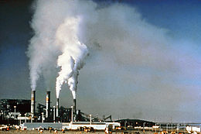
DISEASES RELATED TO AIR POLLUTION.

Slide 5
Air quality
primary pollutants include
Nitrogen oxides (NOx) - especially nitrogen Carbon monoxide - is a colourless, odorless, non-irritating but very poisonous gas
Carbon dioxide (CO2) - a colourless, odorless, non-toxic greenhouse gas associated with ocean acidification, emitted from sources such as combustion, cement production, and respiration

Slide 6
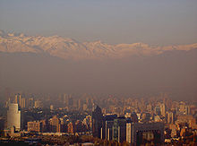
Particulate matter - Particulates, alternatively referred to as particulate matter (PM) or fine particles, are tiny particles of solid or liquid suspended in a gas.
Toxic metals, such as lead, cadmium and copper.

Slide 7
Chlorofluorocarbons (CFCs) - harmful to the ozone layer emitted from products currently banned from use.
Ammonia (NH3) - emitted from agricultural processes.

Slide 8
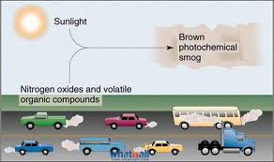
Secondary pollutants
are not emitted directly. Rather, they form in the air when primary pollutants react or interact.
include:
Particulate matter formed from gaseous primary pollutants and compounds in photochemical smog.

Slide 9
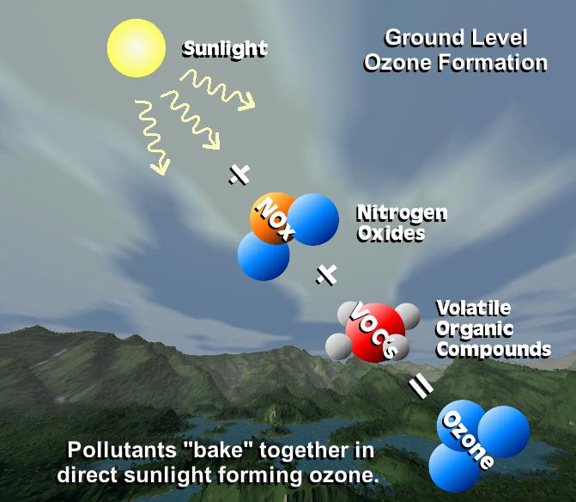
Secondary pollutants
Ground level ozone (O3) formed from NOx and VOCs. Ozone (O3) is a key constituent of the troposphere.

Slide 10
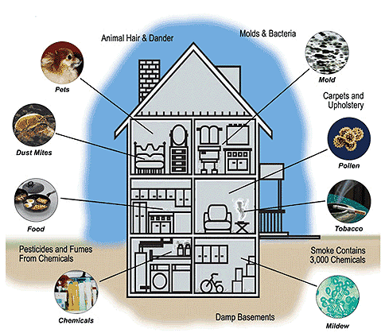

Slide 11
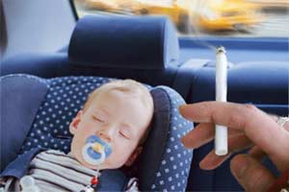
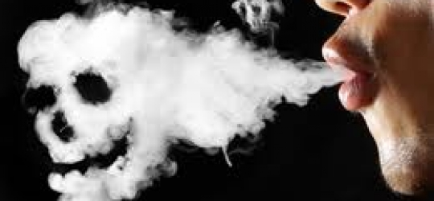
SECOND-HAND SMOKE
Second-hand smoke is tobacco smoke which affects persons other than the 'active' smoker.

Slide 12
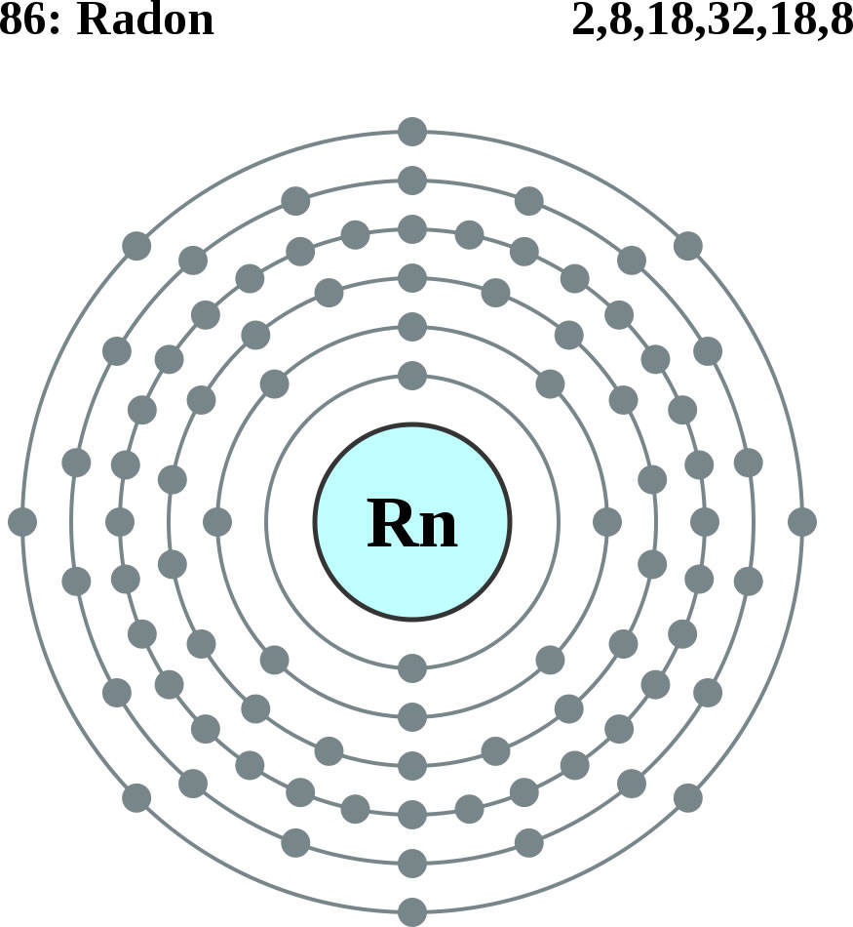
RADON
Radon is an invisible, radioactive atomic gas that results from the radioactive decay of radium, which may be found in rock formations beneath buildings or in certain building materials themselves.

Slide 13
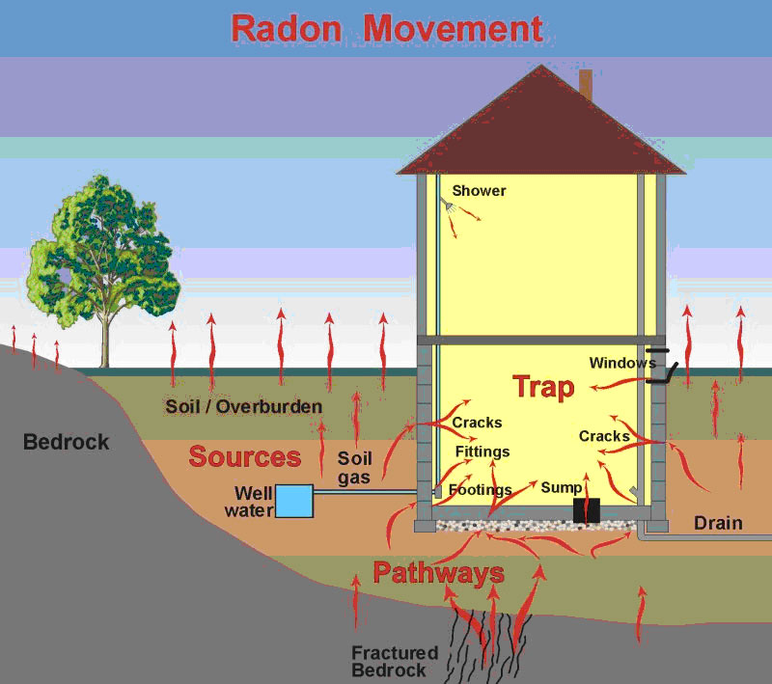
Radon is probably the most pervasive serious hazard for indoor air in the United States and Europe, probably responsible for tens of thousands of deaths from lung cancer each year.

Slide 14
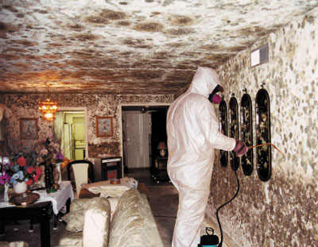
MOULDS AND OTHER ALLERGENS
These biological chemicals can arise from a host of means, but there are two common classes:
Moisture induced growth of mold colonies and
Natural released into the air such as animal dander and plant pollen.

Slide 15
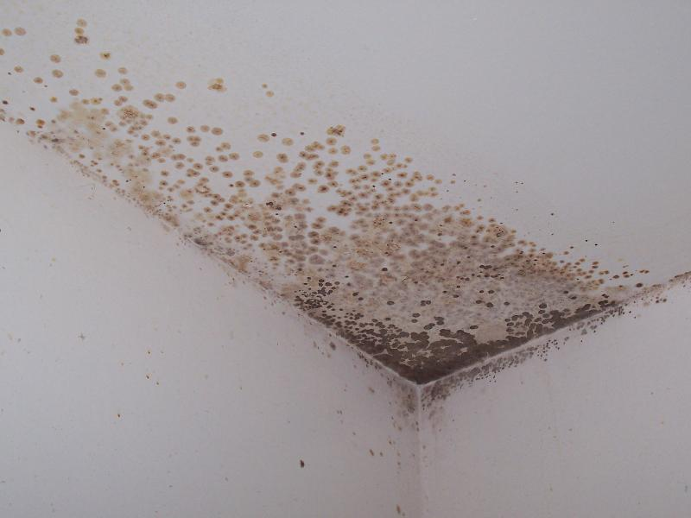
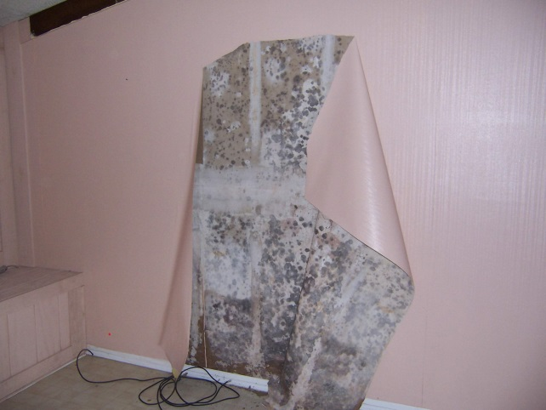
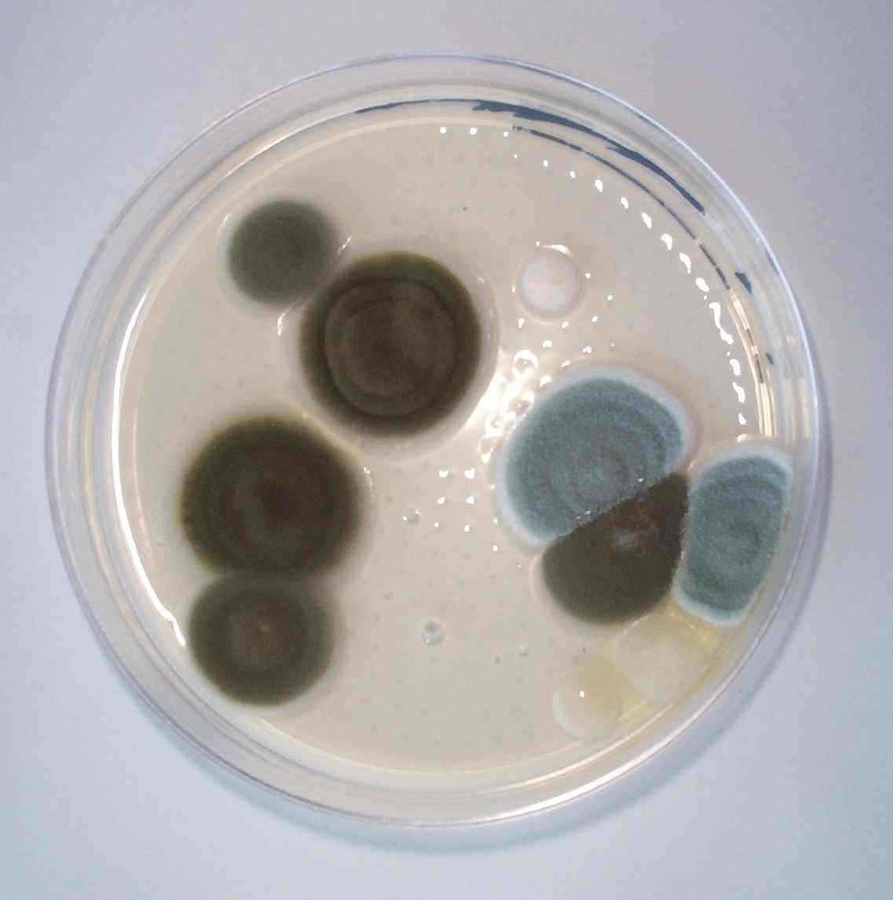
There are some varieties of mould that contain toxic compounds (mycotoxins).

Slide 16
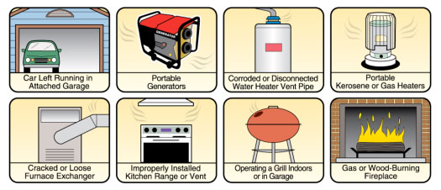
CARBON MONOXIDE
A colourless, odourless gas that is a byproduct of incomplete combustion of fossil fuels.
Common sources of carbon monoxide are tobacco smoke, space heaters using fossil fuels, defective central heating furnaces and automobile exhaust.

Slide 17
VOLATILE ORGANIC COMPOUNDS
Concentrations of many VOCs are consistently higher indoors (up to ten times higher) than outdoors.
Examples include: paints and lacquers, paint strippers, cleaning supplies, pesticides, building materials and furnishings, office equipment such as copiers and printers, correction fluids and carbonless copy paper, graphics and craft materials including glues and adhesives, permanent markers, and photographic solutions.

Slide 18
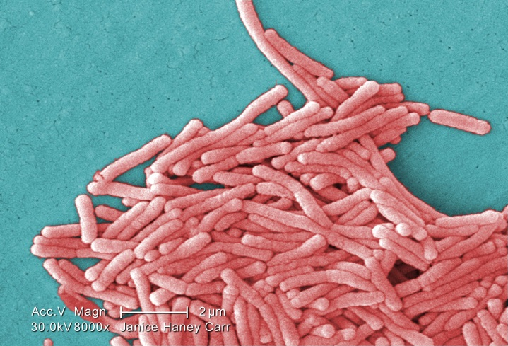
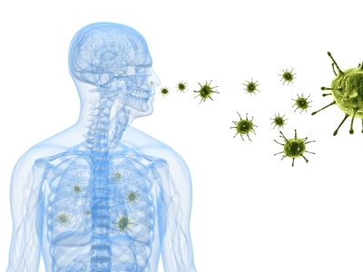
LEGIONELLA
Legionellosis or Legionnaire's Disease is caused by a waterborne bacterium Legionella that grows best in slow-moving or still, warm water.
The primary route of exposure is through the creation of an aerosol effect, most commonly from evaporative cooling towers or showerheads.

Slide 19
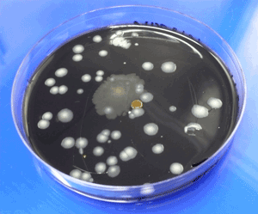
Legionella testing typically involves collecting water samples and surface swabs from evaporative cooling basins, shower heads, and other locations where warm water collects

Slide 20
ASBESTOS FIBRES
Asbestos is found in older homes and buildings, but it is most dangerous in schools and industrial settings

Slide 21
common diseases caused by food and water pollution
Dysentery
Dysentery is a combination of nausea, abdominal cramps coupled with severe diarrhoea. In cases of acute dysentery, one may also experience a high fever and traces of blood in the faecal matter. There are two types of dysentery—Bacillary dysentery, caused by bacteria and Amoebic dysentery caused by amoebae. When either of these is ingested through contaminated water or food, one will develop dysentery within a gestation period of four days.

Slide 22
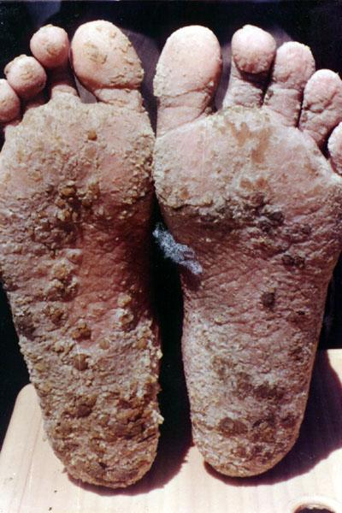
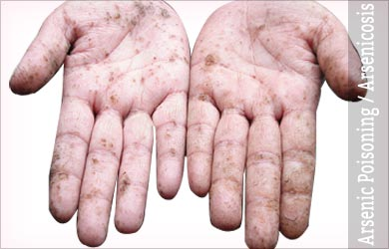
2. Arsenicosis
Arsenic is a poisonous substance often released as wastewater by industrial units situated on the banks of rivers. Arsenicosis or Arsenic Poisoning is caused due to chronic exposure to small amounts of arsenic through drinking water. This disease is characterised by painful skin lesions (keratosis), which can progress to cancer. It can also affect your lungs, kidneys, and bladder.

Slide 23
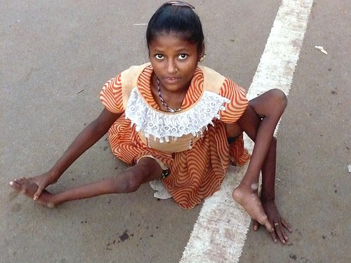
3. Polio (Infantile Paralysis)
Poliomyelitis is commonly known as polio. It’s an acute viral infection caused by a virus, which passes through water from the faeces of an infected individual. This disease affects the central nervous system. Once an individual contracts this virus, they suffer from fever, headache, and seizures, followed by paralysis.

Slide 24
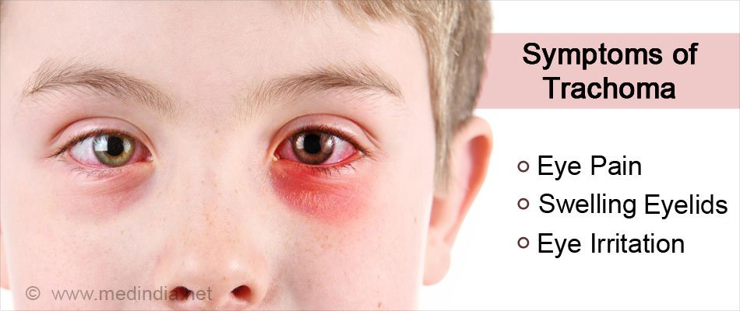
4. Trachoma (Eye Infection)
This infection is caused by bacterium Chlamydia Trachomatis that’s found in contaminated water. Trachoma results in a coarsening of the inner surface of the eyelids. This leads to pain in the eyes, lesion on the outer surface or cornea, and eventual blindness. Trachoma spreads because of poor sanitation and hygiene conditions.

Slide 25
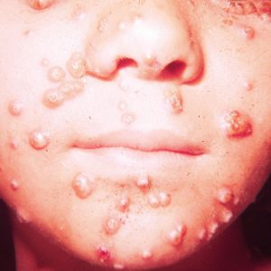
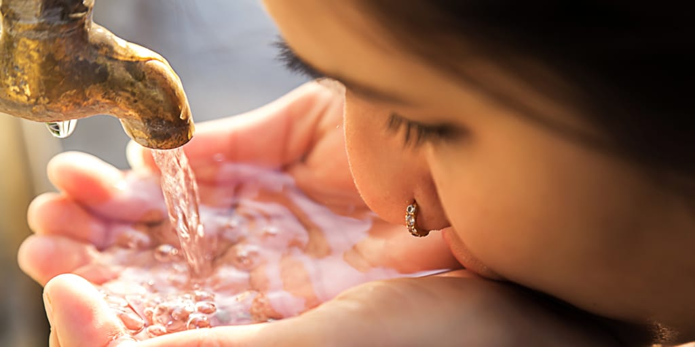
5. Typhoid fever
Across the world annually, around 12 million people are affected by Typhoid fever. This infection is caused by Salmonella Typhi bacteria. This disease is contracted by consuming contaminated food or water. The bacteria pass through the intestinal tract and can be identified in stool samples. Its symptoms include nausea, loss of appetite, and headache.

Slide 26
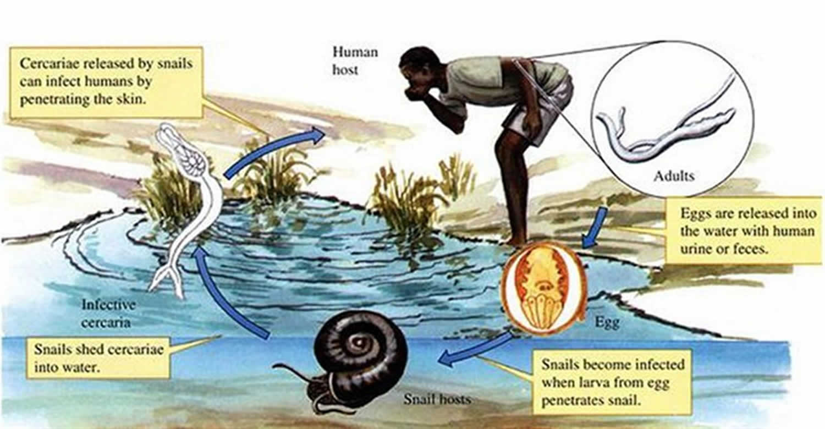
6. Schistosomiasis
This disease is caused by worms that are spread by freshwater snails living in polluted water. It’s very common in rural areas where people use local water bodies for bathing and recreational purposes. The worms in the water penetrate into one’s skin while in contact with the contaminated water, causing infections in the liver, lungs, intestines, and bladder.

Slide 27
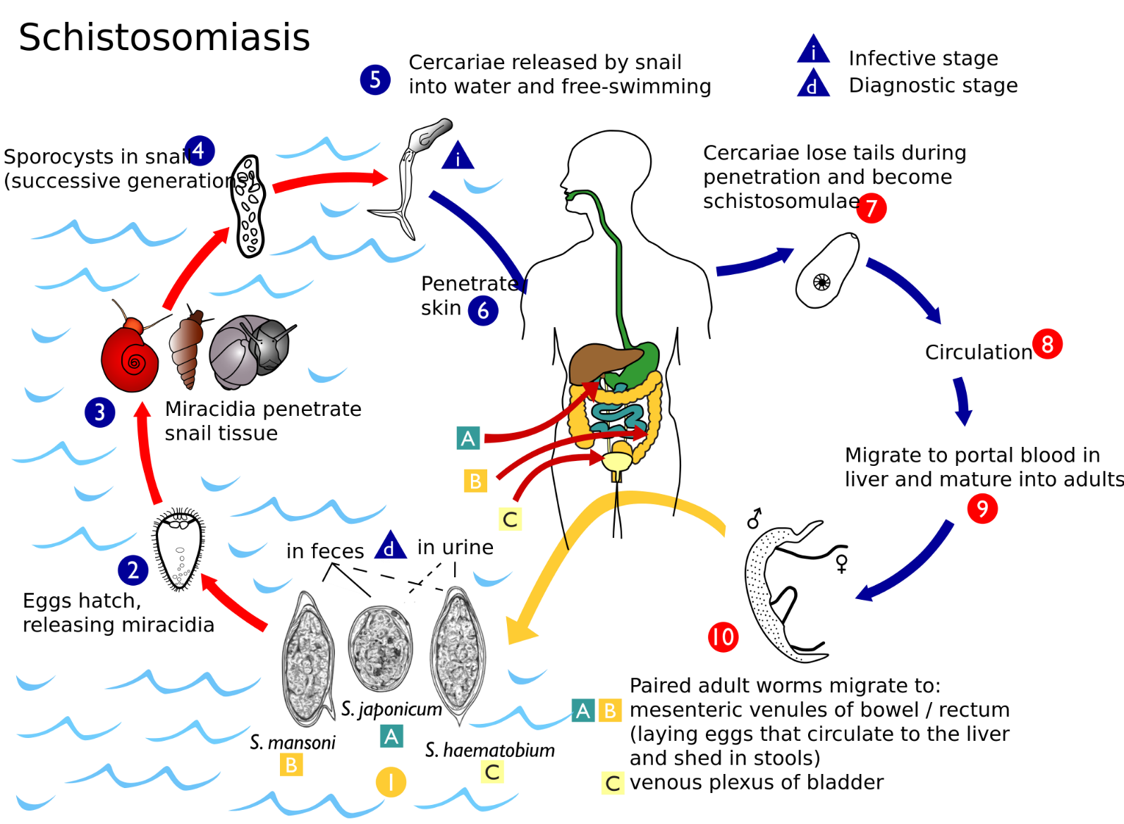

Slide 28
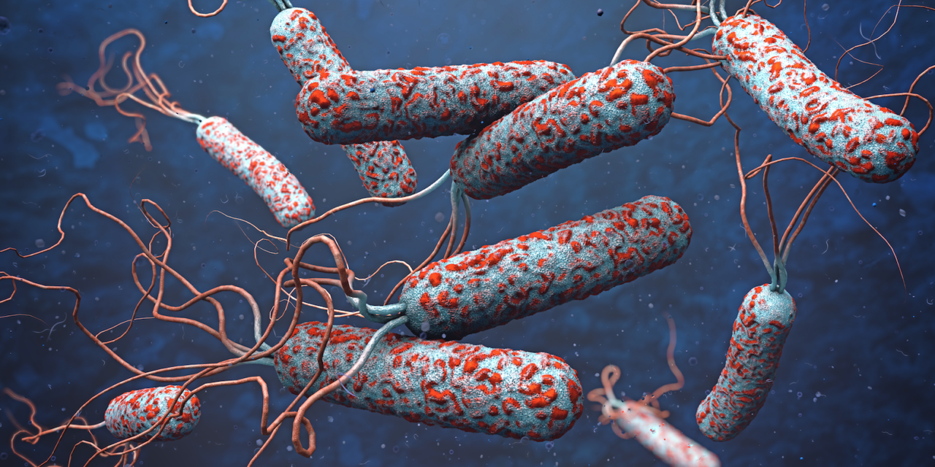
7. Cholera
Cholera is an infection of the small intestine by the bacterium Vibrio Cholerae. This disease can kill within hours if not treated on time. Symptoms of cholera include diarrhoea and vomiting, as well as abdominal cramps and headache. According to the WHO, every year, there are 21,000 to 143,000 deaths worldwide due to this infection.

Slide 29
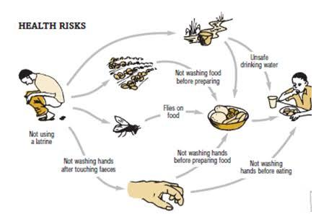
8. Diarrhoea
Diarrhoea is one of the most common diseases caused by water pollution. It is most often caused by water-borne viruses. But bacteria and parasites from water contaminated with faeces are also common causes. It results in passage of loose, watery stools that can cause dehydration and death to young children and infants.

Slide 30
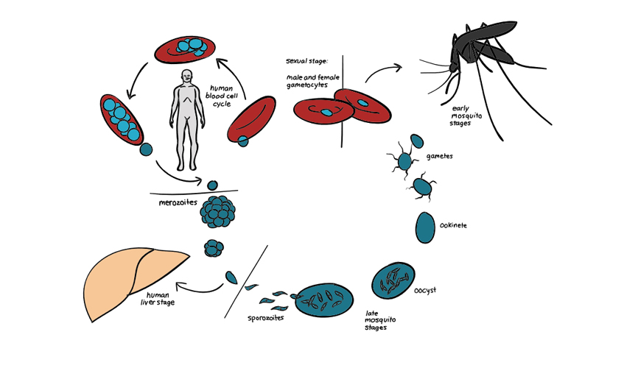
9. Malaria
Water pollution has resulted in increased breeding of parasite-carrying mosquitoes. Malaria is a disease caused by parasites, which are spread by female mosquitoes called Anopheles. When mosquitoes bite a person infected with malaria, they can spread the infection to other people. This disease causes high fever, headache, and shivering. In severe cases, it can even lead to complications like severe anaemia, coma, and death.

Slide 31
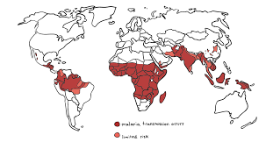

Slide 32
10. Lead poisoning
Lead poisoning is caused due to consumption of water contaminated with lead, often coming from old pipes as well as surface water pollution. This disease is particularly harmful to children and can cause a number of health problems, including organ damage, nervous system disorders, anaemia, high blood pressure, kidney disease and problems with the reproductive system.
Prevention is better than cure! Here’s how you can steer clear from these diseases
People of all ages can be prone to the diseases mentioned above. However, you can keep these diseases at bay by practising proper hygiene. The simplest of all prevention measures is to consume pure drinking water. Also, it is of utmost importance that you wash your hands properly using soap, using clean toilets, bathing daily, and avoiding sharing of personal items. Preventive vaccinations must be administered for diseases like polio at the right time to eliminate the risk of contracting the disease.

Slide 33
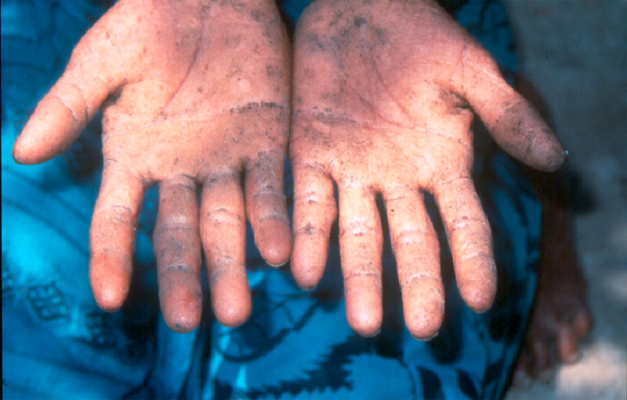
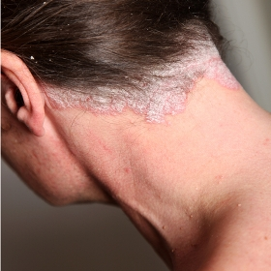
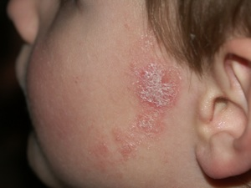
lead poisoning

Slide 34
DISEASES CAUSED BY VECTORS AND RODENTS.
Chagas disease
Insect: Assassin Bugs/ Kissing bugs/ Triatomine bug Organism: protozoan: Trypanosoma cruzi
Chagas disease is also referred to as American trypanosomiasis. There are 150 species of the bug and more than 100 species of mammal carry the protozoan parasite. It is classified by WHO as a neglected tropical disease, with 8 million people infected, mainly in central and South America, and an estimated 10,000 deaths caused by complications from the disease.

Slide 35
Insect: Assassin Bugs/ Kissing bugs/ Triatomine bug
Organism: protozoan: Trypanosoma cruzi

Slide 36
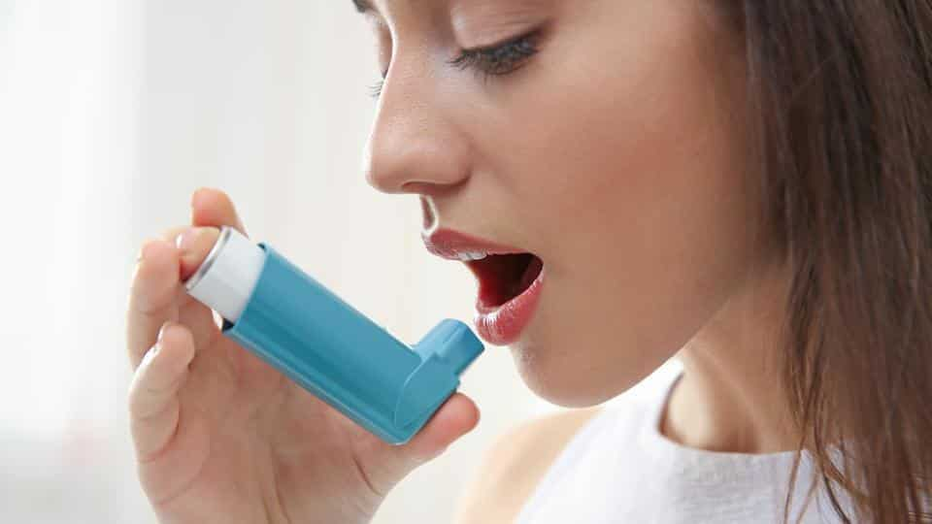
Asthma
Insect: House dust mites & Cockroaches. Organism: none known (allergic response).
Asthma is not caused by an infectious organism but by an allergic reaction to particles shed by organisms, mainly house dust mites and cockroaches. So it does not strictly come under vector-borne disease.
The main cause is house dust mites, which are arachnids less than one millimetre long that feed mainly on human skin scales. Pollen, spores of microorganisms, fungal mycelia and bacteria have also been found in the gut of house dust mites. They live in the small spaces provided by mattresses, carpets, duvets, pillows and furniture materials, whether natural or synthetic, as both provide ideal shelter.

Slide 37
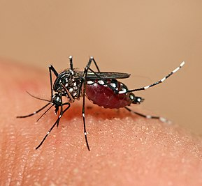
Dengue
Insects: Mosquitoes Organism: Dengue virus
Dengue is the most important mosquito-borne viral disease in the world, according to WHO, which has targeted it as one of 17 Neglected Tropical Diseases for major campaigns for awareness and eradication. It is endemic in over 100 countries across the tropics, from central and South America, Africa, South and Southeast Asia and to the Pacific Islands. It has increased rapidly over the last few decades in urban sprawls that provide ideal conditions for breeding. The WHO estimates that there are 50-100 million infections a year and half the world’s population live in countries where it is endemic.

Slide 38
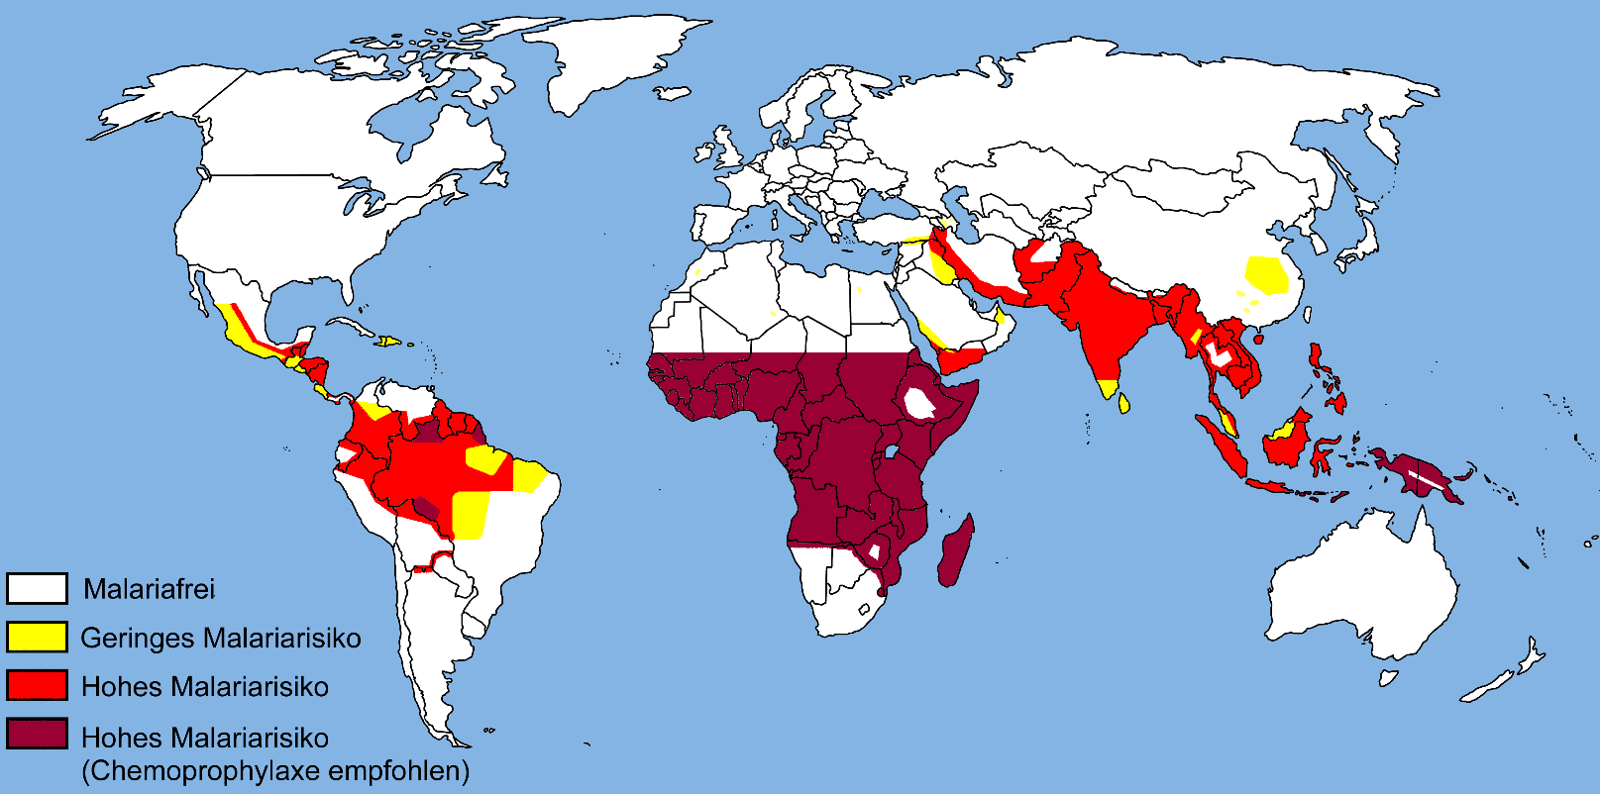
Malaria
Insect: mosquitoes Organism: protozoan, Plasmodium falciparum, P. vivax, P. ovale, P. malariae, P. knowlesi

Slide 39
West Nile Fever
Insect: Mosquito. Organism: Flavivirus, West Nile virus
The disease was virtually unknown outside Uganda, where it was first identified in 1937, until the 1990s, when there was an outbreak in Algeria. It is now present in all temperate and tropical continents, with even the US experiencing an outbreak in 2012 that killed 286 people. The European Centre for Disease Prevention and Control monitors infections in Europe and in 2015 reported eight human cases of WNF in EU Member States up to August: Austria (1), Italy (4), Bulgaria (1), Romania (1) and Austria (1). Eight cases were detected in neighbouring countries: Israel (7) and Serbia (1). It even produces an interactive map of cases.

Slide 40
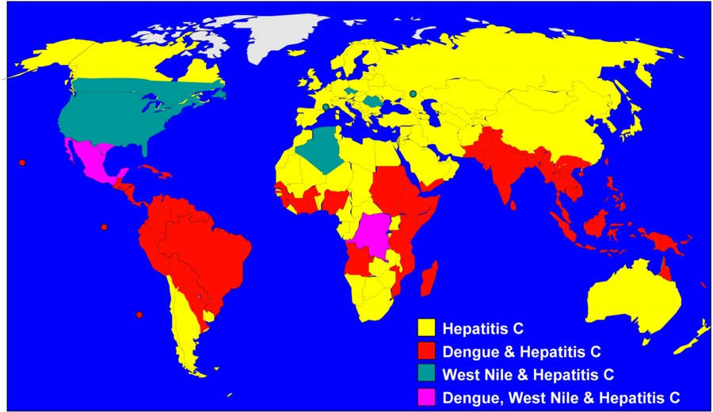

Slide 41
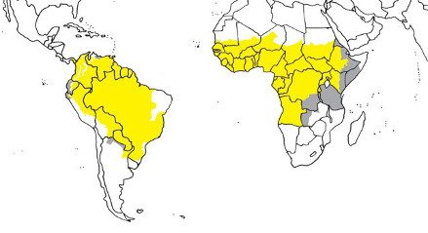
Yellow fever
Insects: Mosquitoes Organism: Virus, Flavivirus
Yellow fever is a haemorrhagic fever that originated in the central belt of Africa but spread to South America in the 17th century with the slave trade. It is endemic in 34 countries in Africa where the majority of the estimated 30,000 deaths from 200,000 infections a year occur

Slide 42
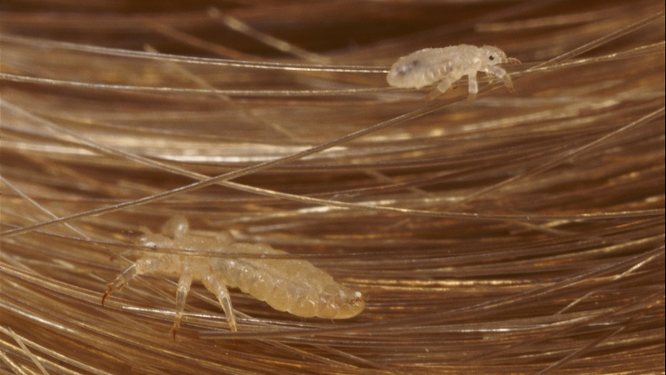
Epidemic typhus
Insect: Louse. Organism: bacteria, Rickettsia prowazekii
As with other louse-borne fevers, typhus tends to occur in conditions of overcrowding and poor hygiene such as refugee camps and prisons. It occurs mainly in central and eastern Africa, central and South America, and Asia. Recent outbreaks have occurred in Burundi, Ethiopia and Rwanda. Infection occurs from crushing the lice or rubbing the skin where the lice are feeding and defecating and carrying the bacteria to wounds and mucous membranes. Some cases in the US have been associated with flying squirrels nesting in houses over winter, but the means of infection is still unknown as the patients did not have lice.

Slide 43
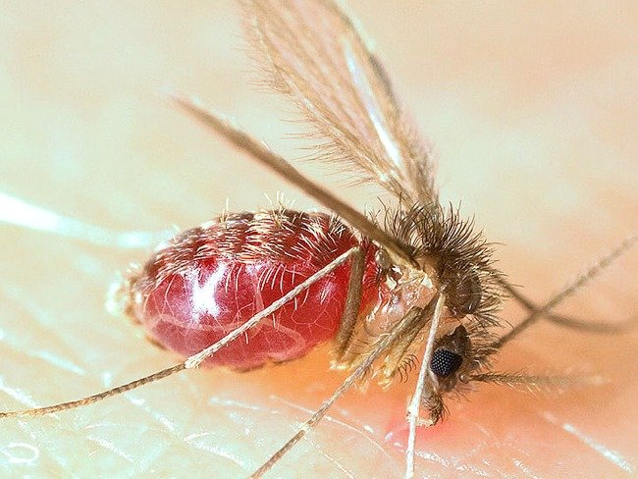
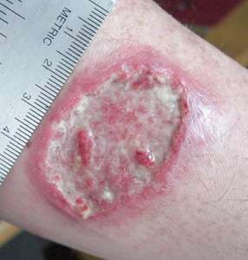
Leishmaniasis
Insect: Sandflies Organism: protozoa, Leishmania spp
Leishmaniasis is spread by bites from female sandflies. These are tiny flies 1.5-3.0 mm long with large black eyes and hairy bodies, wings and legs. They breed in forest areas, caves and adobe brick houses where most of the infection of humans takes place. Rodents, dogs and other mammals are reservoirs for the disease.

Slide 44
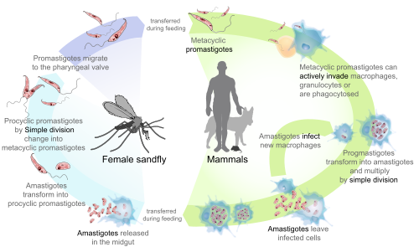
Leishmaniasis

Slide 45
Salmonellosis
Insect: house flies, blow flies, flesh flies, cockroaches Organism: bacteria, Salmonella enterica
Salmonellosis is caught mainly from contaminated water, foods, especially raw poultry, minced beef, and raw eggs. Poor hygiene in vegetable and fruit harvesting, and pets, especially reptiles, baby chicks and ducklings are also sources of infection. Avoidance of contact, general hygiene and hand hygiene are the most important means of prevention.
Symptoms include diarrhoea, fever, vomiting, and abdominal cramps. Most people recover in a few days without treatment other than replacement of fluid lost by the body. Once a person is infected however, the disease is easily transmitted to other people through poor hand hygiene and poor sanitation.

Slide 46
Environmental Estrogen: Xenoestrogens Interrupt Our Natural Hormone Balance , Sources of Xenoestrogens
Commercially-raised meat and dairy products
Drinking water source which contaminated with petroleum derivatives
Shampoos, lotions, soaps, toothpastes, cosmetics and other personal care products
Soft plastics used as packaging materials are often treated with chemical compounds called phthalates, a xenoestrogen, to increase its flexibility.
Artificial food additives
Foods that contain soy protein and soy protein isolate
Dryer sheets are loaded with xenoestrogens to make your clothes feel soft and fresh.
Birth control pills and conventional hormone replacement therapy (HRT)
Disposable menstrual products

Slide 47
References
Delmont J, Brouqui P, Poullin P, Bourgeade A. (1994) Harbour-acquired Plasmodium falciparum malaria. Lancet. Jul 30; 344(8918):330-1
US Centers for Disease Control: http://www.cdc.gov/
WHO. Public Health Significance of Urban Pests. WHO, Copenhagen, 2008.
European Centre for Disease Prevention and Control: http://ecdc.europa.eu/
WHO. A global brief on vector-borne diseases. WHO, Geneva, 2014.
Cases of sleeping sickness drop to lowest level in 75 years http://www.who.int/trypanosomiasis_african/cases_drop_to_lowest_since_75_years/en/
WHO. Investing to overcome the global impact of neglected tropical diseases: third WHO report on neglected diseases 2015. WHO, Geneva.

