Slide 1
Introduction to
Occupational health
YEAR
1439-1440 Hajji
2018 - 2019 Gregorian
 | Objectives
 | Enlist and understand the effects of exposure of a worker to Physical hazards, Heat and cold, Light, Noise, Vibration, UV light, Ionizing radiation, Chemical hazards, Local effects of chemicals, Inhalation of partials, fumes, and gases, Absorption of various metals and their compounds, Ingestion, Biological hazards, Infectious and parasitic agents, Mechanical hazards, Physiological hazards, Fatigue, Depression, and anxiety

Slide 2
Examples of famous industrial accidents
September 21, 1921: Oppau explosion in Germany. Occurred when a tower silo storing 4,500 tonnes of a mixture of ammonium sulfate and ammonium nitrate fertilizer exploded at a BASF plant in Oppau, now part of Ludwigshafen, Germany, killing 500–600 people and injuring about 2,000 more.

Slide 3
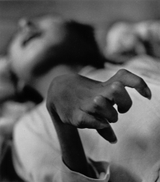
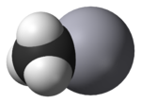
1932-1968: The Minamata disaster was caused by the dumping of mercury compounds in Minamata Bay, Japan.
It is estimated that over 3,000 people suffered various deformities, severe mercury poisoning symptoms or death from what became known as Minamata disease. is a medical specialty dealing with disorders of the nervous system.
Methylmercury, an organic mercury compound released in factory wastewater and the cause of Minamata disease

Slide 4
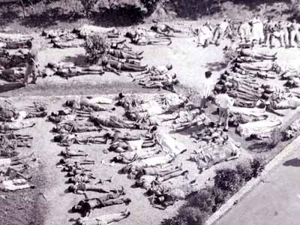
December 3, 1984: The Bhopal disaster in India is the largest industrial disaster on record..
A faulty tank containing poisonous methylisocyanate leaked at a Union Carbide plant. About 20,000 people died and about 570,000 suffered bodily damage.

Slide 5
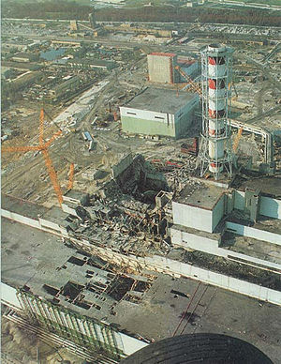
April 26, 1986: Chernobyl disaster.
At the Chernobyl Nuclear Power Plant in Ukraine a test on reactor number four goes out of control, resulting in a nuclear meltdown.
The ensuing steam explosion and fire killed up to 50 people with estimates that there may be up to 4,000 additional cancer deaths over time among the approximately 600,000 most highly exposed people.

Slide 6
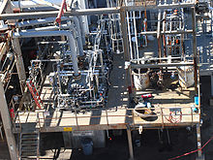
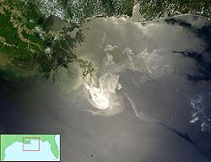
March 23, 2005:
Texas City Refinery explosion. An explosion occurred at a British Petroleum refinery in Texas City, Texas.
April 20, 2010: Deepwater Horizon oil spill in the Gulf of Mexico.

Slide 7
Occupational health can be divided into many divisions and the integration of those divisions is very important. These divisions are:
Occupational health Divisions
Occupational diseases.
Occupational safety.
Occupational toxicology.
Occupational environment.
Analysis of biological samples
Occupational Ergonomics.
Air pollution.
Occupational Legislation.

Slide 8
Internal factors affect Workers:
Internal factors affect Workers are including the worker health, age, genetics, and physical fitness.
Workers with family history of certain diseases are not encourages expose to chemicals and radiation hazards. Even at low exposure level.
Also a young worker of highly physical fitness shows much resistant to occupational diseases than aged one.

Slide 9
External factors affect Workers
Physical factors: such as the exposure to heat stress noise vibration electromagnetic fields, and radiation.
Chemical factors: exposure to dust, gases, and acid vapors.
Biological factors: such as food deficiency, vitamin deficiency, Anthrax for wool industries, Cow Pox for cow farms, Schistosomiasis for agricultural fields.
Occupational social factors: for workers how immigrates seeking jobs from rural area to urban areas which may cause social problems.

Slide 10
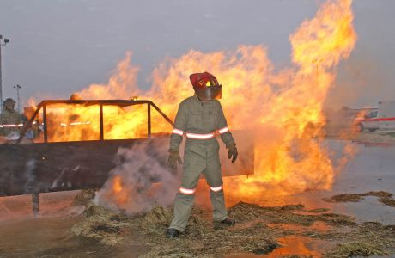
Occupational Hazards:
Physical hazards may include noise, temperature extremes, illumination extremes, ionizing or non-ionizing radiation, and ergonomics.

Slide 11
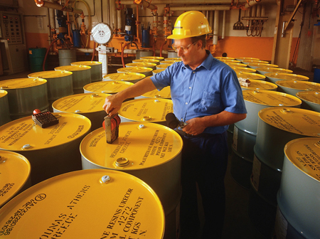
Chemical hazards related to Dangerous Goods or Hazardous Substances are frequently investigated by Occupational Hygienists.
Other related areas including Indoor air quality (IAQ) and safety may also receive the attention of the Occupational Hygienist.

Slide 12
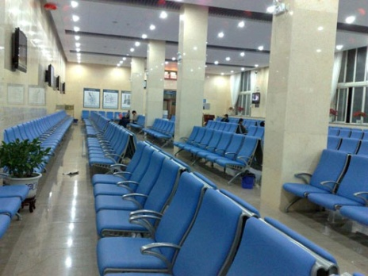
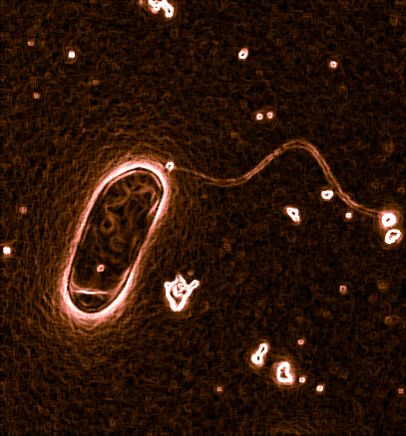
Biological hazards may stem from the potential for legionella exposure at work or the investigation of biological injury or effects at work, such as dermatitis may be investigated.
Legionella is a pathogenic Gram negative bacterium, including species that cause legionellosis or Legionnaires' disease

Slide 13
Appropriate controls are selected from the hierarchy of control: by
Elimination, MUSCUT
Substitution;
Engineering,

Slide 14
Substitution
Substitution of a More Hazardous Chemical by a Less Hazardous Chemical
Task | Hazardous Chemical | Substitute
Extraction solvents | Ethyl ether; Methyl-t-butyl ether (MTBE)1 | Hexanes1
Oxidation of organic compounds | Chromate ion | Hypochlorite ion1
Qualitative test for heavy metals | Sulfide ion | Hydroxide ion1
Freezing point lowering | Benzene | Cyclohexane; Sodium chloride solution

Slide 15
Engineering

Slide 16
Engineering

Slide 17
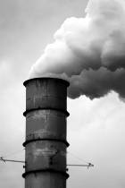
Heavy metal exposure occurs through three primary routes:
Inhalation. Common examples include workers scraping or sanding lead paint and workers in factories where heavy metals are melted and processed.
In the days before leaded gasoline was banned, those living alongside heavily traveled roads faced significant exposure through tailpipe emissions.

Slide 18
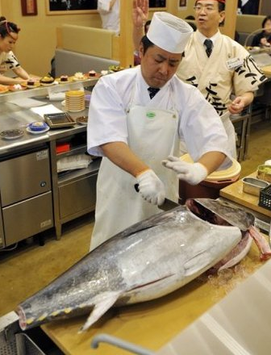
Ingestion. The leading cause of lead poisoning in children is eating old paint chips.
A major source of elevated mercury levels in humans comes from eating contaminated fish. And people can drink arsenic from wells contaminated by arsenic-containing pesticides.

Slide 19
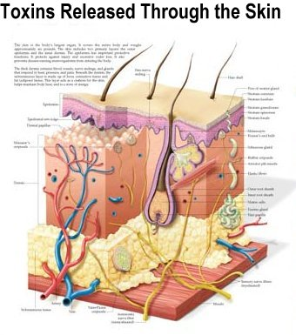
Skin absorption. Day to day contact with heavy metals can cause poisoning.
Dermal exposure is a serious concern for workers in fields where the irrigation water contains naturally-occuring arsenic (such as Asian rice paddies).

Slide 20
References
Forbes BA, Sahm DF, Weissfeld AS. Bailey and Scott’s Diagnostic Microbiology. 12th ed. US: Mosby Elsevier Science; 2007.
Central for Disease Control: www.cdc.gov
American Industrial Hygiene Association Journal.
Annals of Occupational Hygiene and Safety.
Journal of Analytical Chemistry.
NIOSI Pocket Guide to Chemical Hazards.
Journal of Air and Waste Management
http://jb.asm.org
http://jcm.asm.org
http://pathmicro.med.sc.edu/book/welcome.htm
www.foodhygienecd.net
www.foodhygiene.com
www.ourfood.com

Slide 21
THANK YOU

