Slide 1
Diseases related to occupational hazards
YEAR
1439-1440 Hajji
2018 - 2019 Gregorian
 | Objectives
 | understand major diseases related to occupational hazards Physical hazards, heat, light, pressure, noise, radiation, electricity, mechanical factors, Chemical agents Gases, fumes, dust, metals and their compounds, solvents, Biological agents, Occupational cancers, Occupational dermatosis

Slide 2
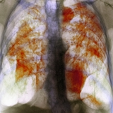
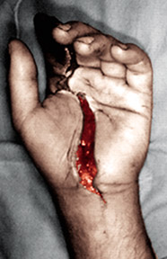
Occupational disease:
The term "occupational disease" refers to those illnesses caused by exposures at the workplace.
They should be separated, conceptually, from injuries that may also occur at workplaces due to a variety of hazards.

Slide 3
Occupational diseases may occur in varying time frames,
from the instantaneous development of illness following exposure to toxic chemicals
to decades between onset of exposure and the development of disease, as occurs with many occupationally related cancers.

Slide 4
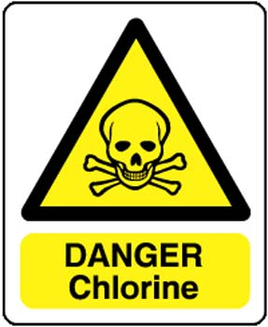
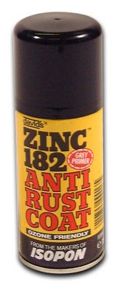
Examples of varying time frames include
instantaneous reactions to exposure to chemicals such as chlorine or ammonia gas;
a delay of some six to twelve hours with fumes of aerosolized zinc, as occurs when welding on galvanized steel;

Slide 5
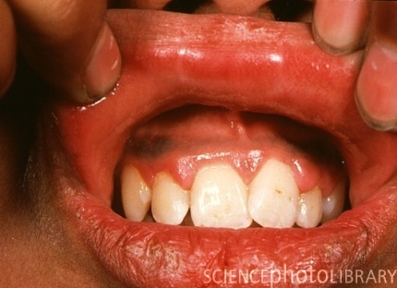
a delay of weeks to months with lead poisoning;
a delay of decades with occupational carcinogens;
the finding of congenital malformations in children whose parents may have been exposed to hazardous materials.

Slide 6

Although not all occupational exposures that cause illness lead to death, considerable numbers of deaths each year are associated with workplace exposures.
While it is relatively easy to count deaths due to occupational injuries, it is much more difficult for delayed illnesses.

Slide 7

More than 6,200 fatal occupational injuries occur in the United States each year, with more than 40 percent associated with transportation, and most of these related to motor-vehicle fatalities.

Slide 8
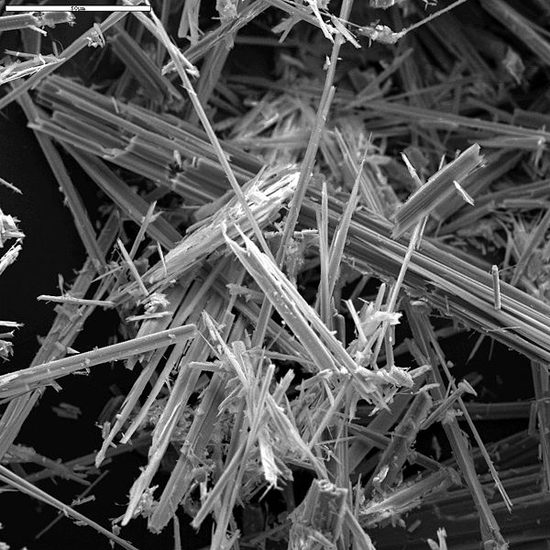
As noted above, deaths from occupational illness for most diseases are hard to enumerate.
The only diseases for which reasonably good data exists are the pneumoconiosis, such as asbestosis, coal-workers pneumoconiosis, and silicosis.

Slide 9


Slide 10
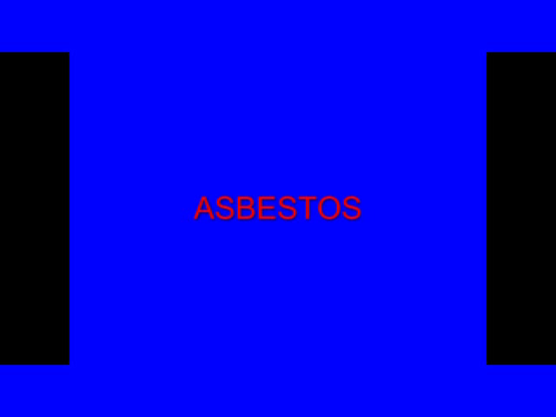

Slide 11


Slide 12
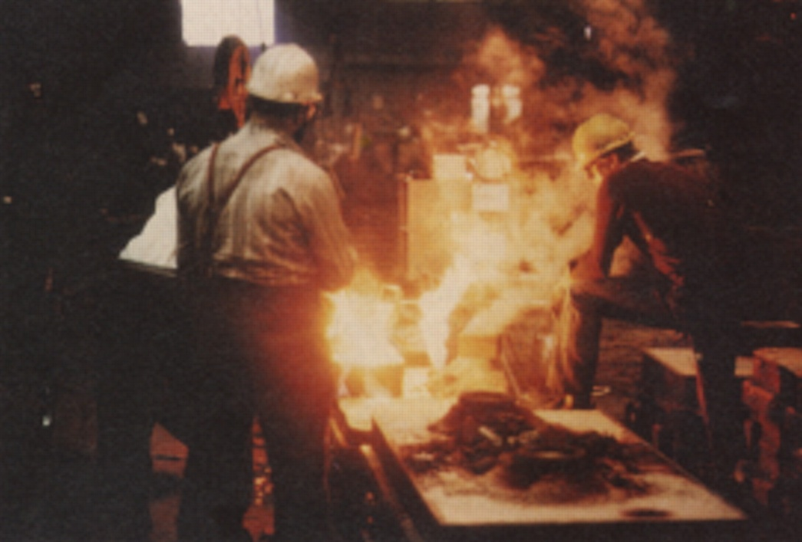

For many other diseases, such as those from chemical exposure, various occupational cancers, and other problems, individual fatalities are difficult to recognize and record.

Slide 13
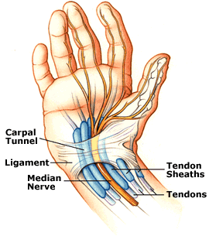
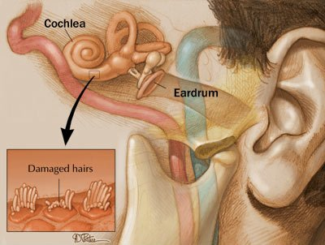
Among the occupational diseases most commonly reported, those relating to repeated trauma, such as carpal tunnel syndrome, tendonitis, and
noise–induced hearing loss

Slide 14
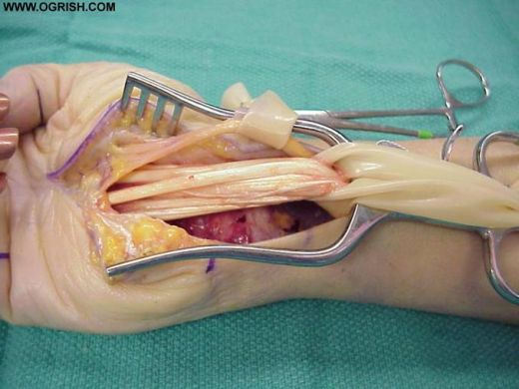
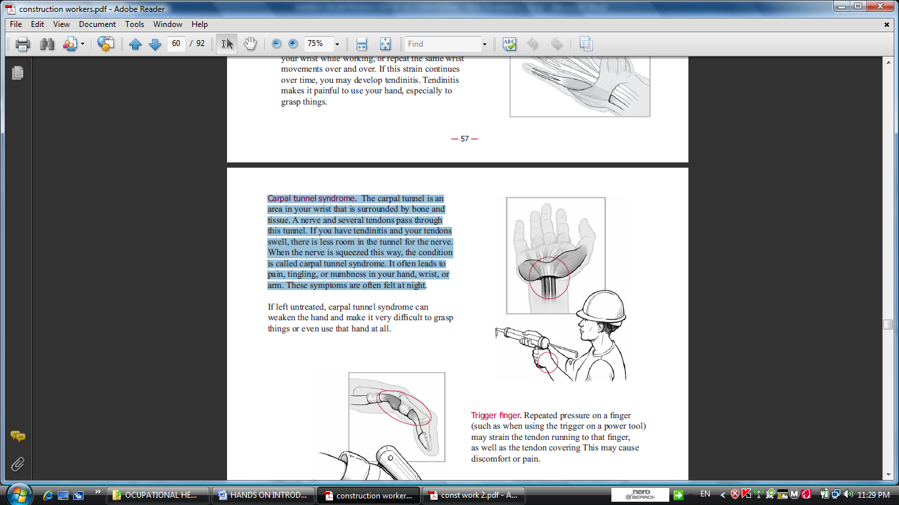


For those cases of carpal tunnel syndrome with workplace absence, half needed twenty-five or more days away from work.

Slide 15
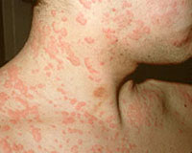
Skin diseases represented about 13 percent of work related illnesses.
Occupational Dermatitis is often an inflammatory skin reaction caused by occupational contact factors.
Dermatitis, or inflammation of the skin cases required time away from work.

Slide 16
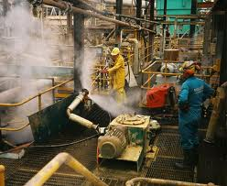
1. Noise:
Noise is most obviously a problem in industries such as manufacturing and construction, it can also be an issue in a wide range of other working environments

Slide 17
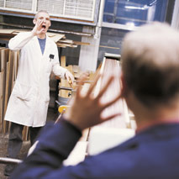
One in five of Europe’s workers have to raise their voices to be heard for at least half of the time that they are at work and 7% suffer from work-related hearing difficulties.
Noise induced hearing loss is the most common reported occupational disease in the EU.

Slide 18

What is noise?
Noise is an unwanted sound;
its intensity (‘loudness’) is measured in decibels (dB).
The decibel scale is logarithmic, so a three-decibel increase in the sound level already represents a doubling of the noise intensity.

Slide 19
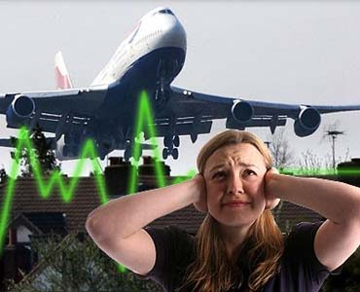
For example, a normal conversation may be about 65 dB and someone shouting typically can be around 80dB.
The difference is only 15 dB but the shouting is 30 times as intensive

Slide 20
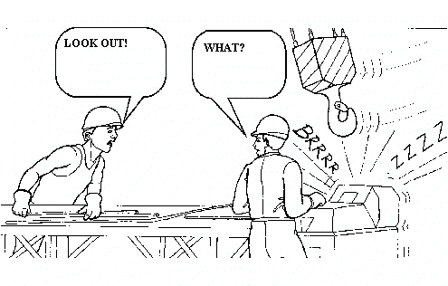
The duration of exposure is also very important. To take this into account, time-weighted average sound levels are used. For workplace noise, this is usually based on an 8-hour working day.

Slide 21
PERMISSIBLE NOISE EXPOSURES
Duration per day, hours | Sound level dBA slow response
8 | 90
6 | 92
4 | 95
3 | 97
2 | 100
1 1/2 | 102
1 | 105
1/2 | 110
1/4 or less | 115

Slide 22
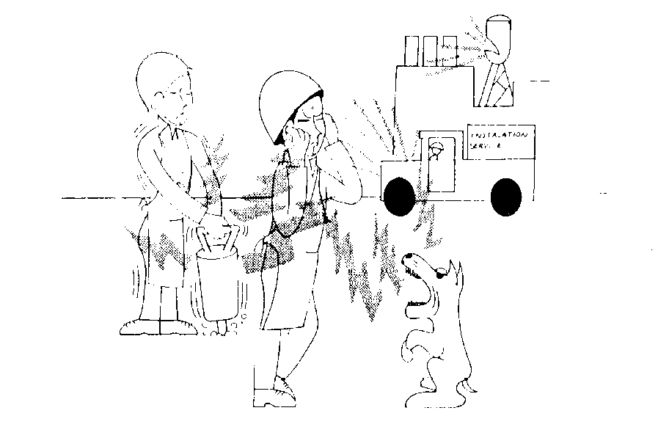
What problems can noise cause?
Increasing the risk of accidents by masking warning signals;
Physiological effects
Increase the risk of hearing loss;
Being a causal factor in work-related stress.

Slide 23

Who is at risk?
Anyone who is exposed to noise is potentially at risk.
The higher the noise level, and the longer you are exposed to it, the more risk you have of suffering harm from noise.

Slide 24

Noise is being recognized as a problem in service sectors such as education and healthcare, bars and restaurants.
A study of noise in kindergartens found some averaging noise levels over 85dB

Slide 25

During a performance of Swan Lake, a conductor was recorded as being exposed to 88dB

Slide 26

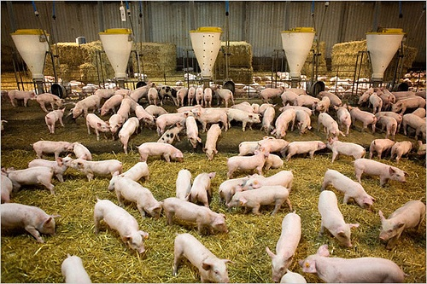
Truck drivers can be exposed to 89dB
Noise on pig farms has been measured up to 115dB

Slide 27

2. Heat Stress
Workers who are exposed to extreme heat or work in hot environments may be at risk of heat stress.
Exposure to extreme heat can result in occupational illnesses and injuries.

Slide 28
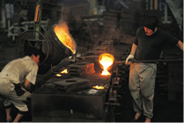
Heat stress can result in
heat stroke,
heat exhaustion,
heat cramps, or
heat rashes.

Slide 29

Heat can also increase the risk of injuries in workers as it may result in
sweaty palms,
fogged-up safety glasses,
dizziness.
Burns may also occur as a result of accidental contact with hot surfaces or steam.

Slide 30

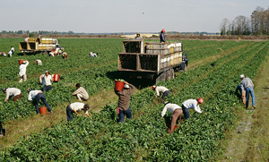
Workers at risk of heat stress include outdoor workers and workers in hot environments such as
firefighters, bakery workers, farmers, construction workers, miners, boiler room workers, factory workers, and others.

Slide 31
References
Forbes BA, Sahm DF, Weissfeld AS. Bailey and Scott’s Diagnostic Microbiology. 12th ed. US: Mosby Elsevier Science; 2007.
Central for Disease Control: www.cdc.gov
American Industrial Hygiene Association Journal.
Annals of Occupational Hygiene and Safety.
Journal of Analytical Chemistry.
NIOSI Pocket Guide to Chemical Hazards.
Journal of Air and Waste Management
http://jb.asm.org
http://jcm.asm.org
http://pathmicro.med.sc.edu/book/welcome.htm
www.foodhygienecd.net
www.foodhygiene.com
www.ourfood.com

Slide 32
THANK YOU

