Slide 1
Health System
in Saudi Arabia
Dr. Bader Al-Ibrahim
Field Epidemiology Training Program
Ministry Of Health

Slide 2
Health System in Saudi Arabia
Lecture Objectives
To know why should a medical student
understand the health system
To understand what is a health system
To know the components of a health system
To Know the strengths and weaknesses of
the current health system
To know the challenges facing the current
Saudi health system
To know the future changes in the Saudi
Health System Strategy

Slide 3
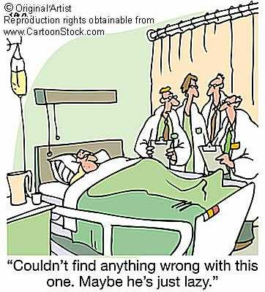
Health System in Saudi Arabia
Why should a medical student understand the health system
You belong to it
(you are part of the system)
To participate in the system’s
improvement process
To understand the medico-legal aspects of
patient care

Slide 4
Health System in Saudi Arabia
Health System
Definitions
What is Health:
“Health is a state of complete physical, mental and social well-being and not merely the absence of disease or infirmity”
(WHO) 1948

Slide 5
Health System in Saudi Arabia
Health System
Definitions
What is a System ?
A SET OF INTERRELATED AND INDEPENDENT PARTS DESIGNED TO ACHIEVE A SET OF GOALS.
What is a Health System ?
A health system is the total of all the organizations, institutions and resources whose primary purpose is to improve health.

Slide 6
Health System in Saudi Arabia
Health System Needs
A health system needs to provide services
that are:
Responsive,
Financially fair,
Treating people decently.
(WHO)

Slide 7
Health System in Saudi Arabia
Health System Needs
A health system needs
information,
staff,
funds,
communication,
supplies,
transport, and
overall guidance and direction.

Slide 8
Health System in Saudi Arabia
Health System: Components
Financing Resources
Legislative Authorities
Health Regulators
Health Care Providers
Human Resources
Medical supplies providers
Pharmaceutical producers
Judiciary Services

Slide 9
Health System in Saudi Arabia
Health System: Components
Financing Resources:
Governmental
Out of pocket.
Charity.
Donation.

Slide 10
Health System in Saudi Arabia
Health System: Components
Legislative Authorities:
The Royal Cabinet:
    Al Shora Council
    The Bureau of Experts

Slide 11
Health System in Saudi Arabia
Health System: Components
Health Regulators:
The National Organizations:
    The National Health Council
    Ministry of health
    The Saudi Commission for Health Specialties
    Council of Co-operative Health Insurance
    The Saudi Food and Drug Authority

Slide 12
Health System in Saudi Arabia
Health System: Components
Health Care Providers:
Ministry of Health
Ministry of Defense and Aviation
National Guards
Ministry of Interior
Specialized Hospitals (KFSH, KKESH)
Universities (Ministry of Higher Education)

Slide 13
Health System in Saudi Arabia
Health System: Components
Health Care Providers:
Ministry of Social welfare
The Private Health Providers
The big Companies:
Saudi Aramco,
SABIC,
Saudi Electric Company,
Saudi Airlines
Charity Health Providers
The Saudi Red Crescent
Notes:
Charity Health Providers:
Prince Fahad Bin Salman Charity Association For Renal Failure Patients Care.
Charity Zamzam Association for Health Services volunteers .

Slide 14
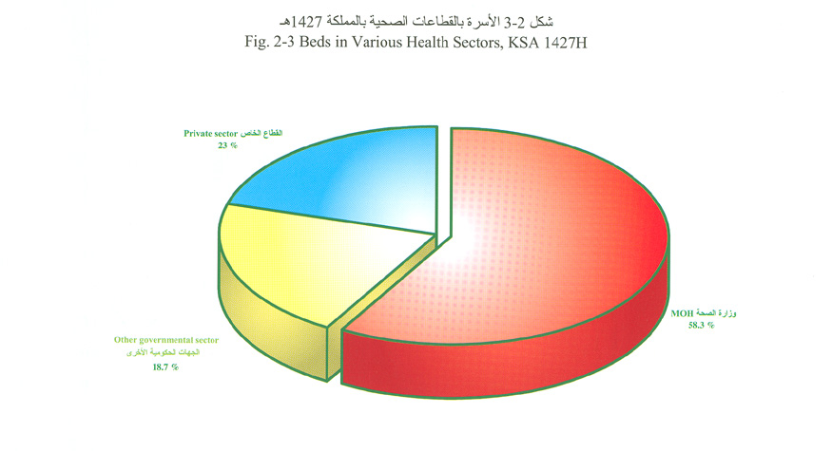
Health System in Saudi Arabia
Health System: Components
Health Care Providers:
Hospital Beds distribution according to sectors
Private Sector 23 %
MOH 58.5%
Other
Governmental
Sectors 18.7%
Source: MOH Annual report 2007

Slide 15
Health System in Saudi Arabia
Health System: Components
Health Care Providers:
Level of Care
PRIMARY HEALTH CARE
2325 PHCCs
SECONDARY
HEALTH CARE
Around 484
67% Govermental
TERIEARY
HEALTH
CARE

Slide 16
Health System in Saudi Arabia
Health System: Components
Human Resources:
Rates per 10,000 Population (MOH)
Physicians including Dentists | 13.5​
Dentists | 1.13​
Pharmacists | 1.1​
Nurses including Midwives | 31.9​
Allied Health Personnel | 18.1​

Slide 17
Health System in Saudi Arabia
Health System: Components
Human Resources:
Total Health Manpower in KSA
Physicians including Dentists | 89٫675​
Dentists | 13٫935​
Pharmacists | 25٫119​
Nurses including Midwives | 180٫821​
Allied Health Personnel | 107٫323​

Slide 18
Health System in Saudi Arabia
Health System: Components
Medical supplies providers:
Medical supplies (consumables)
Medical Equipment
Medical Instruments
Medical Devices
Around 30 Medical Supplies
Factories in KSA

Slide 19
Health System in Saudi Arabia
Health System: Components
Pharmaceutical Producers:
Medications
Medical Solutions
Immunizations

Slide 20

Health System in Saudi Arabia
Health System: Components
Judiciary Services
Committee for Private sector violations
Medico-legal committee.
Health Insurance Violation Committee

Slide 21
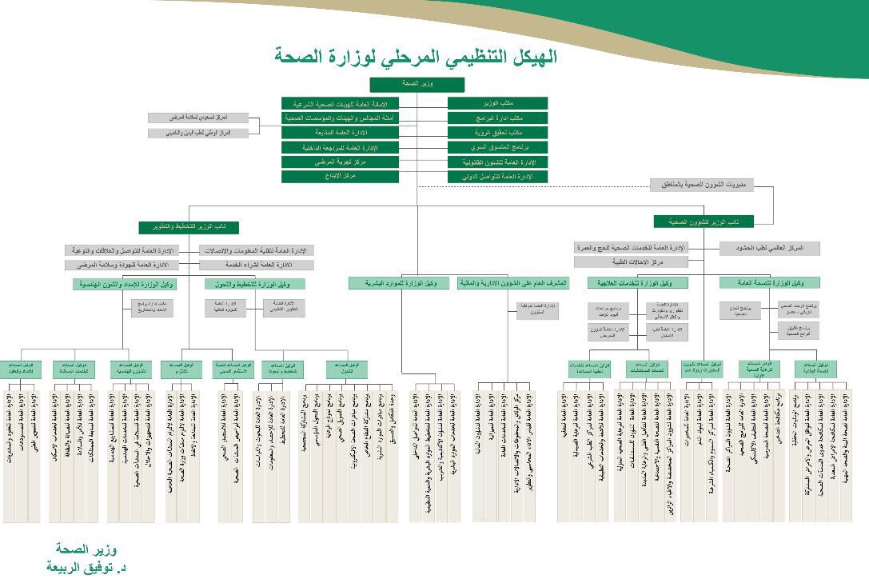
Health System in Saudi Arabia
Ministry of Health Organizational Chart

Slide 22
Health System in Saudi Arabia
Role of Provincial Health Director
Manage Patient Care
Supervise the private sector
Supervise reporting of infectious diseases among all health providers
Co-operate with health related agencies
Participate in the health development planning

Slide 23
Health System in Saudi Arabia
STRENGTHS AND WEAKNESSES OF THE CURRENT HEALTH SYSTEM
Strengths:
Universal (covers everybody) (NHS)
Accessible
Comprehensive
( primary, secondary and tertiary)
Safe
Equitable

Slide 24
Health System in Saudi Arabia
Vital Statistics
Crude Birth Rate/ 1000 population | 17.23​
Crude Death Rate/1000 population | 2.9​
Life Expectancy at Birth (years)
Males | 73.5​
Females | 76.1​
Total | 74.8​
Total Fertility Rate | 2.4​
Neonatal Mortality Rate/1000 live birth | 2.74​
Infant Mortality Rate/1000 live birth | 4.82​
Under 5 years Mortality Rate/1000 live birth | 8.05​
Maternal Mortality Ratio/ 100٫000 live birth | 12​

Slide 25
Health System in Saudi Arabia
STRENGTHS AND WEAKNESSES OF THE CURRENT HEALTH SYSTEM
Weaknesses:
Weak Primary care
Multi - sectoral:
  Duplication of services among Providers
  Difficult to Co-ordinate
  Waste of resources

Slide 26
Health System in Saudi Arabia
CHALLENGES FACING
THE CURRENT HEALTH SYSTEM
Financial
Budget allocated to the health sector by the Ministry of Health :
1956: 39.549.458 SR
1958: 68.480.000 SR
1960: 116.395.000 SR
2009: 40.43 billion SR
2010: 61.20 billion SR
2019: 172 billion SR

Slide 27
Health System in Saudi Arabia
CHALLENGES FACING
THE CURRENT HEALTH SYSTEM
Financial
Data for decision-making/policy-making .
Manpower
Population:
  Growth
  Aging
  Demanding
Changes in Disease patterns (NCD)
New medical technologies and
new medications

Slide 28

HIGH COST OF HAELTH CARE
Health System in Saudi Arabia
Population growth of 3.1% per annum
Increased demand on health services
Rise in the cost of health care

Slide 29


A delivery system that prevents abuse and excessive use
Health System in Saudi Arabia
HIGH COST OF HAELTH CARE
a managed health care model,
under the
National Health Insurance

Slide 30
New Model Of Care

Slide 31
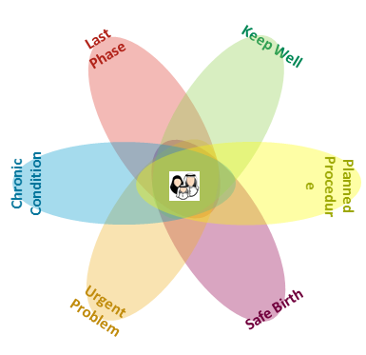

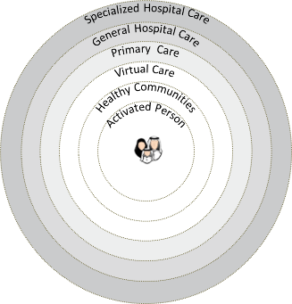
Model of Care (MoC) is based on six systems of care that center around ensuring patient well-being and contributing to a healthier society
Model of Care design
Last phase
Keep Well
Six Systems of Care
Draws the patient journey through clinical pathways
Specialized Hospital Care
General Hospital Care
Primary Care
Virtual Care
Healthy Communities
Activated Person
Chronic Care
Physical wellbeing
Mental wellbeing
Planned Care
Social wellbeing
Six Layers of Service
Identify patients services at every level of service
Urgent Care
Safe Birth
Notes:
(1 min)
Together we designed the new Model of Care….(patient centric, empowered in all layers…)

Slide 32
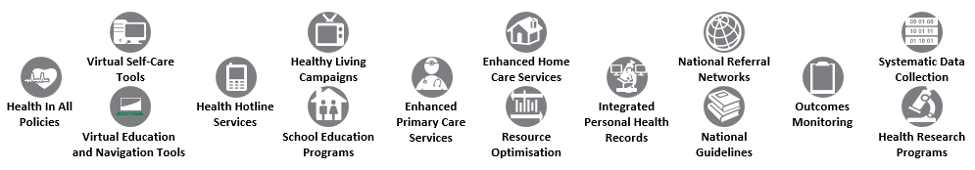
MoC will be delivered through the 42 interventions spread across Systems of Care, which will be rolled out across all the clusters
Model of Care Interventions
Interventions cross-cutting all Systems of Care
Interventions specific to Systems of Care
Keep Well | Planned Care | Safe Birth | Urgent Care | Chronic Care | Last Phase
Health Coach Program | One-Stop Clinics | Premarital Screening | Resource Control Center | Chronic Disease Screening | Patient and Family Support
Community-Based Wellness Programs | Pathway Optimisation | Preconception Care Services | Urgent Care Clinics | Case Coordination | Hospice Care Services
Workplace Wellness Programs | Length of Stay Reduction Initiatives | Maternity Care Services | Population-Based Critical Care Centers | Continuing Care Services | Multidisciplinary Team Development
School Wellness Programs | Step-Down and Post-Discharge Services | National Birth Registry
Healthy Food Promotion |  | Postnatal Care Services
Health Edutainment Programs |  | Neonatal Care Services
Promoting the Saudi CDC |  | Well Baby Clinics
CDC

Slide 33
Currently, each Cluster is running specific pilots corresponding to a given System of Care
Model of Care Interventions
C1
C1
W1
E1
C2
C2
Keep Well | Planned Care | Safe Birth | Urgent Care | Chronic Care | Last Phase
Health Coach Program | One-Stop Clinics | Premarital Screening | Resource Control Center | Chronic Disease Screening | Patient and Family Support
Community-Based Wellness Programs | Pathway Optimisation | Preconception Care Services | Urgent Care Clinics | Case Coordination | Hospice Care Services
Workplace Wellness Programs | Length of Stay Reduction Initiatives | Maternity Care Services | Population-Based Critical Care Centers | Continuing Care Services | Multidisciplinary Team Development
School Wellness Programs | Step-Down and Post-Discharge Services | National Birth Registry
Healthy Food Promotion |  | Postnatal Care Services
Health Edutainment Programs |  | Neonatal Care Services
Promoting the Saudi CDC |  | Well Baby Clinics
CDC

Slide 34
MoC aim is to create comprehensive Integrated Care Systems for holistic care delivery based on the Model of Care
How does MoC fit into Integrated Care Systems?
Model of Care interventions will be responsible for delivery of all health services from preventive to curative to a defined population according to their needs over time and across different levels of the health system
Notes:
(2 min)
Integrated Care Systems are …(the definition). We will have 15-20 Integrated Care Systems in Saudi. Designed around a new Saudi specific designed Model of care that serves the needs of our population, and it will be implemented by our existing workforce in a new setup.
This means no longer having a centralized training system. We can expand our residency programs. We can train people in all areas around the country. Utilize virtual learning even outside Saudi like Canada and Australia do it.

Slide 35
The objective of the MoC workstream is to design and implement KSA’s future healthcare delivery system
Key activities of MoC workstream
Work in progress
MoC design
MoC implementation support
1
2
Data gathering and conceptualization
MoC design
Consensus generation & validation
Continuous design improvement
Pilot preparation and implementation
Rollout planning
National rollout
Continuous implementation tracking and validation
Transformation
Continuous design improvement
Continuous compliance monitoring
Design performance data gathering
Gaps and improvements identification
Research, R&D, Training & Certification
Scheduled design revisions & updates
MoC consultancy services
Advocating for implementation of design updates
Provider performance data and feedback gathering (KPI’s)
Inspection and monitoring of MoC pathways compliance at providers
MoC compliance licensing
End state

Slide 36
We are currently nearing the end of Phase III and are preparing for Phase IV
MoC roadmap and progress so far
Phase IV: Conduct national roll out
We’re prepping for this
Phase III: Launch pilots and continue preparations
We’re here
Phase II: Prepare for pilot implementation
Phase I: Design the MoC
Source: Ministry of Health, A.T. Kearney

Slide 37
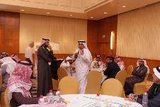
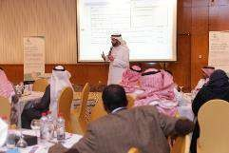
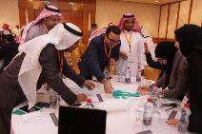

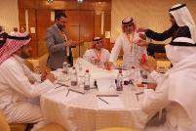
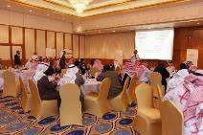
In Phase I, citizens, experts and workforce were engaged to design the new Model of Care…
Phase I: MoC design effort
60,000+ citizens participated in Public Survey around the patient centric design
2500+ healthcare professionals engaged in e-discussions
1000+ healthcare professionals surveyed to identify improvement opportunities
400+ healthcare professionals from around the country participated in assessing the current system
3 Care Design Group sessions were held to address key issues in KSA healthcare delivery, shortlist necessary interventions, and design the SoCs¹
1. System of Care

Slide 38

In Phase II, preparation initiated for implementation by detailing a pathway for each System of Care, 6 national interventions and a national cost-benefit analysis
Phase II: Pathway development and implementation preparation
Workstream 1
Workstream 2
2a
2b
Regional Pathway Development
5 Systems of Care were detailed¹ by 5 National Pathfinders
National Implementation Planning
6 Cross-cutting interventions + Keep Well were detailed by a centralized team of experts
King Saud Medical City
King Fahad Medical City
King Khaled Eye S. Hospital
Cross-cutting interventions
Keep Well interventions
Safe Birth & Planned Care
Last Phase & Planned Care
Planned Care
National Guidelines
School Wellness
King Fahad S. Hospital
Virtual Education and Navigation Tools
Health Coach Program
Chronic Care
Enhanced Primary Care Services
King Abdullah Medical City
Central
Eastern
Western
Urgent Care
Healthy Living Campaigns
Cost benefit analysis
2c
A top-down estimate of the economic impact of all the Systems of Care and all the cross-cutting interventions
Developing national Systems of Care designs into implementable regional pathways

Slide 39
In Phase III, 5 pathway development projects (pilots) launched and continued detailing interventions
Phase III: Pilots implementation
Pathway pilot implementation
National interventions development
3a
3b
Ownership of pathways transferred to clusters
Specialized Care
Urgent Care Pilots
Central Cluster 1
Central Cluster 2
Ophthalmology
Oncology
Mental Health Services
Acute Coronary Syndrome
Stroke
Trauma
Safe Birth & Planned Care
Last Phase & Planned Care
Jeddah Pilot
Eastern Cluster
Cross-Cutting
Hypertension
Central
Chronic Care
Resource optimization
Health Hotline
National Referral Networks
Health in All Policies & GIS
Western
Eastern
Western Cluster 1
Urgent Care
Cost benefit analysis
3c
A bottom-up economic impact estimation of the Model of Care based on learnings from the pathway implementation projects

Slide 40



currently planning MoC cluster rollouts as the first step towards national rollout
Phase IV: National rollout
Focus areas for rollout planning
Rollout planning tracks
In progress
Capability building
Develop capabilities to implement and maintain MoC
Planning for MoC roll out in current clusters
Planning for MoC roll out in unclustered providers
Engagement and adoption
Create a sense of ownership at clinical and community-level to support roll-out
C1
E1
W1
C2
Rollout Tracks
Planning for MoC roll out support mechanisms needed for implementation
Initiated
Funding
Secure the required funding for national implementation of MoC
Planning for MoC roll out for national interventions
illustrative

Slide 41


