Slide 1
Maternal Health

Slide 2
Definitions
Maternal health: refers to the health of women during pregnancy, childbirth and the postpartum period.
Health indicators: a measurable characteristic that describes the health of a population (e.g., life expectancy, mortality, disease incidence or prevalence, or other health states)
Notes:
Give an example of health indicator

Slide 3
Facts:
Fact 1
Nearly 830 women die every day due to complications during pregnancy and childbirth.
Fact 2
Women die in pregnancy and childbirth for 5 main reasons

Slide 4
Major causes of maternal mortality:

Slide 5
Facts:
Fact 3
More than 135 million women give birth per year
About 20 million of them are estimated to experience pregnancy-related illness after childbirth. The list of morbidities is long and diverse, and includes fever, anaemia, fistula, incontinence, infertility and depression. Women who suffer from fistula are often stigmatized and ostracized by their husbands, families and communities.
Fact 4
About 16 million girls aged between 15 and 19 give birth each year
They account for more than 10% of all births. In the developing world, about 90% of the births to adolescents occur in marriage. In low- and middle-income countries, complications from pregnancy and childbirth are the leading cause of death among girls 15-19.

Slide 6
Facts:
Fact 5
Maternal health mirrors the gap between the rich and the poor
Fact 6
Most maternal deaths can be prevented

Slide 7
Notes:
In tthis figure we can see that is the number of women death generally increased in poor countries >>
Also< there are decreased of Maternal coditions , tb , in rich countries as will as in TB And hiv percentage>>

Slide 8
Facts:
Fact 7
Many women don’t see a skilled health professional enough during pregnancy
Although a large proportion of women see skilled health personnel at least once during their pregnancy, only about half receive the recommended minimum of at least 4 visits during the pregnancy. Women who do not receive the necessary check-ups miss the opportunity to detect problems and receive appropriate care and treatment. This also includes immunization and prevention of mother-to-child transmission of HIV/AIDS.
Fact 8
About 22 million abortions continue to be performed unsafely each year
Over 5 million of these result in complications some of which may end in death. Almost every one of these deaths and complications could have been prevented through sexuality education, contraceptive use, and the provision of safe, legal induced abortion, and care for complications of unsafe abortions.

Slide 9
Health Systems Indicators
ddddd
DEFINITION:
variables that reflect the state of health of persons in a community.
Notes:
efore going through health indicators you should know about its definition : Definition: Health indicators are variables that reflect the state of health of persons in a community. hey inform about the quality of health care, and access of health care, and they are considered as quantitative measures.

Slide 10
Health Systems Indicators (Maternal)
dddff
Health indicators could be used to:
Assess the health care needs.
Compare health status of different areas or groups of people over time, one country with other countries or worldwide.
Monitoring and evaluation of health services, activities and programs-access, quality, effectiveness and equality.
Notes:
hey inform about the quality of health care, and access of health care, and they are considered as quantitative measures.

Slide 11
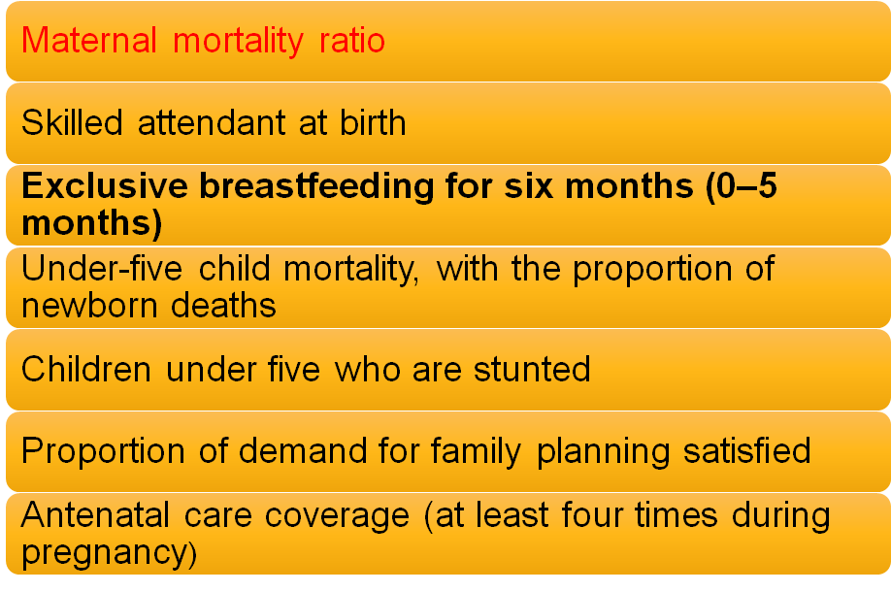
Maternal health indicators:

Slide 12
Health Systems Indicators (Maternal)

Slide 13
Health Systems Indicators (Maternal)
Proportion Maternal Death:
Proportion of all female deaths due
to maternal causes = (N of maternal
deaths in a period/Number of all
female deaths in same period) * 100

Slide 14
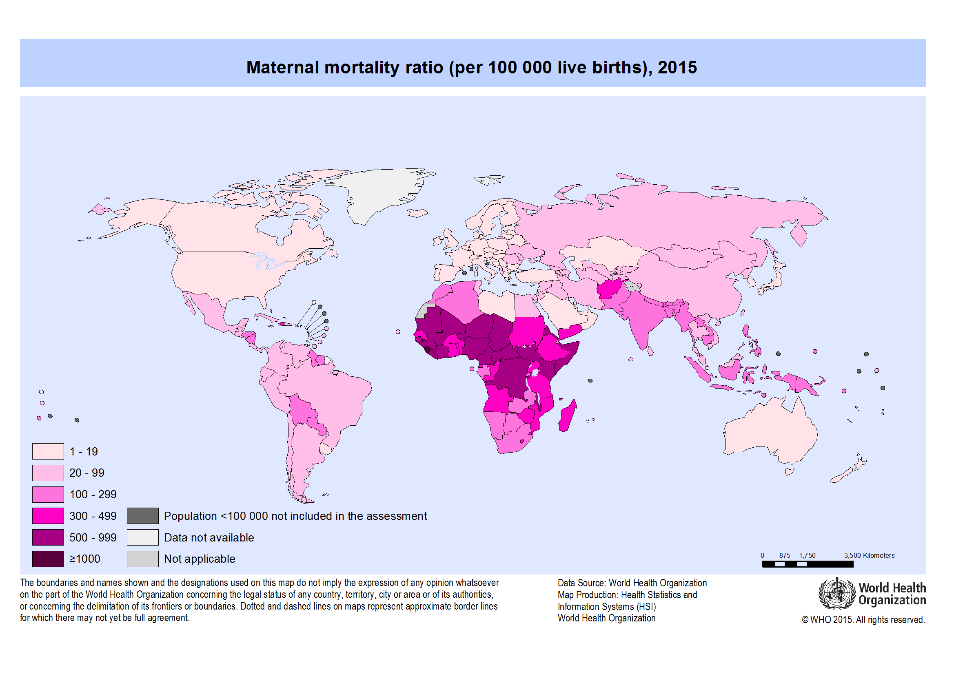

Slide 15
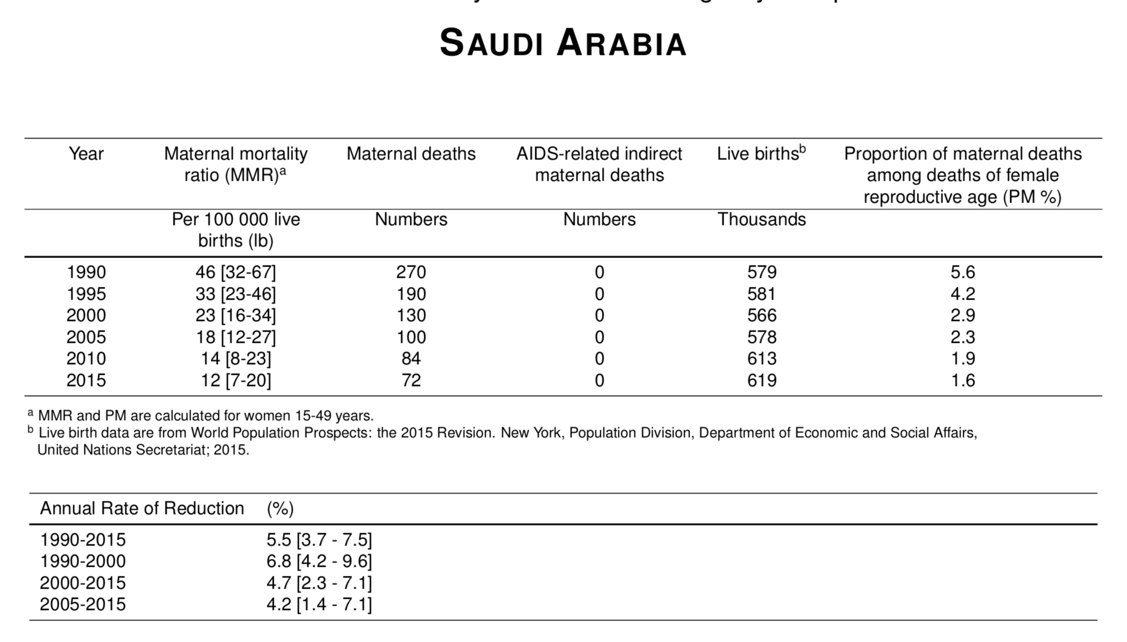
Health Systems Indicators (Maternal)
Notes:
The percentage of MMr from 1990 to 2015 decreased by 75%
The percentage of Live births from 1990 to 2015 increased by 7 %
The percentage of maternal deaths from 1990 to 2015 decreased by 73%

Slide 16
Health Systems Indicators (Infant)

Slide 17
Perinatal Mortality rate: Deaths between 28th week of gestation to less than 7 days of life expressed as per 1000 of total births (live and still) Reflects maternal health status, quality of maternal care and obstetric services
Neonatal Mortality rate: Deaths in the first 28 days of life expressed as per 1000 of total live births. Reflects primarily quality of obstetric care and neonatal care as well as maternal nutrition and health status

Slide 18
Post neonatal Mortality rate: Deaths between 28 days of life to less than 1 year expressed as per 1000 of total live births. Reflects infants' health care, nutrition and sanitation of the environment
Under-5 Mortality: Deaths below 5 years expressed as per 1000 of the number of children below the age of 5 years.

Slide 19
Maternal mortality ratio
Maternal mortality rate
Perinatal mortality rate
Neonatal mortality rate
Postnatal mortality rate
Deaths between 28 week of gestation to less than 7 days of life expressed as per 1000 of total births.
Deaths in the first 28 days of life expressed as per 1000 of total live births
Number of maternal deaths in a given period per population of women who are reproductive age
Deaths between 28 days of life to < 1 year expressed as per 1000 of total live births
Number of maternal deaths per live births

Slide 20
Maternal mortality ratio
Maternal mortality rate
Perinatal mortality rate
Neonatal mortality rate
Postnatal mortality rate
Deaths between 28 week of gestation to less than 7 days of life expressed as per 1000 of total births.
Deaths in the first 28 days of life expressed as per 1000 of total live births
Number of maternal deaths in a given period per population of women who are reproductive age
Deaths between 28 days of life to < 1 year expressed as per 1000 of total live births
Number of maternal deaths per live births

Slide 21
Trends in maternal mortality 1990 - 2015
Maternal mortality fell by almost half between 1990 and 2015
Maternal mortality ratio (maternal deaths per 100,000 live births in women aged 15 to 49), by region, 1990, 2010 and 2015
Ref: http://data.unicef.org/maternal-health/maternal-mortality.html#sthash.Eu3mJpN1.dpuf

Slide 22
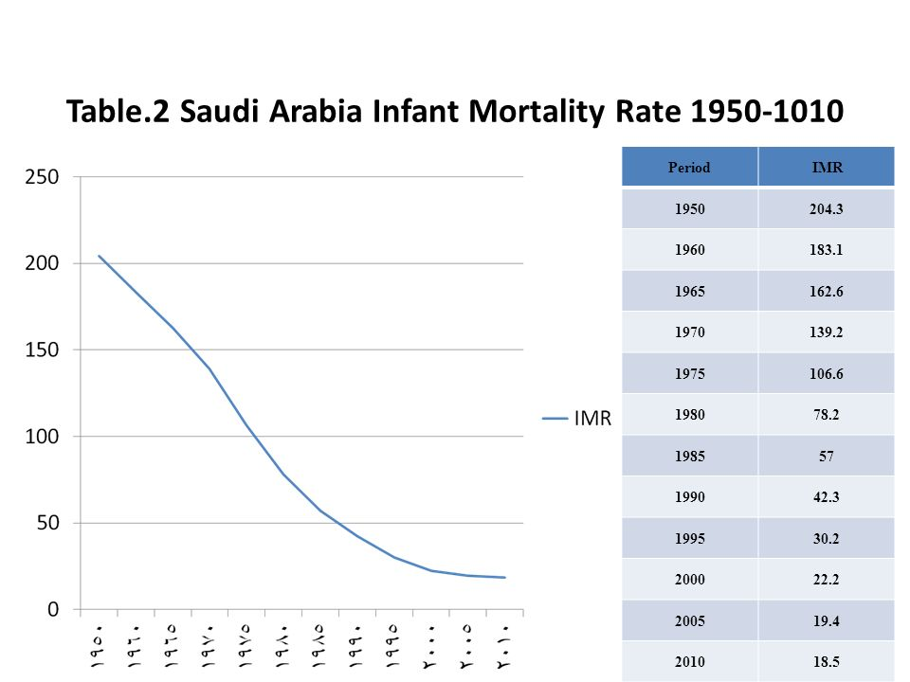
Health Systems Indicators (Infant)

Slide 23
Why has the maternal mortality declined?

Slide 25
Global response
Sustainable Development Goal 3
3.1 By 2030, reduce the global maternal mortality ratio to less than 70 per 100 000 live births.

Slide 26
Successful Interventions for Maternal Care
Antenatal care
Nutrition support (anemia)
Personal hygiene, dental care, rest and sleep
Immunization (mother and the new born)
Education on delivery and care of the new born
Identifying high risk pregnancies
Emphasizing on ANC visits and maintenance of AN card
Importance and management of lactation
Advise on birth spacing
Ref: WHO recommendations on maternal health, guidelines to improve maternal health. 2017.

Slide 27
Factors Affecting Pregnancy and Childbirth
Maternal health and fetal development | Pregnancy and childbirth
•Maternal nutrition •Smoking •Drinking •Diseases •Drugs •Maternal age •Prenatal care | •Preconception •health status •Age •Access to appropriate preconception •interconception health care • Poverty

Slide 28
Stages of maternal care
Preconception
Antenatal Care
Postpartum

Slide 29
1. Preconception:
Preconception health care :
Is the medical care of a woman or man receives from the doctor or other health professionals that aimed to increase the chance of having a healthy baby.

Slide 30
1. Preconception:
What is involved in preconception counseling?
Questionnaire, Blood work, Urinalysis ..etc
A)Maternal behaviors like : Tobacco use , alcohol use , failure to consume adequate folic acid.
B)Other conditions like : unintended pregnancy , experiencing physical abuse , experiencing high levels of stress.
C)Certain maternal health conditions like : Diabetes , hypertension , obesity

Slide 31
2. Age:
The chances of surviving the first year of life were better for infants born to mothers aged 20-34 years than for those born to mothers of other ages.
The most favorable survival rates were among first births to mothers aged 20-24 and among first and second births to mothers aged 25-29.

Slide 32
Age under 20
Women under the age of 20 have a significantly higher risk of serious medical complications related to pregnancy than those over 20. Teenage mothers are more likely to:
deliver prematurely
have a baby with low birth weight
experience pregnancy-induced hypertension
Nutritional deficiencies.
Notes:
Why bc incomplete development.

Slide 33
Age over 35
The chances of conceiving begin to decline. An older woman who becomes pregnant is also less likely to have a problem-free pregnancy.
Common issues include the following:
Underlying conditions( DM, HTN)
Chromosomal problems
Miscarriage

Slide 34
3. Antenatal Care:
Is the care you receive from healthcare professionals during your pregnancy.
1- folic acid and vitamin D supplements
2- nutrition, diet and food hygiene
3- lifestyle factors : smoking, recreational drug use and drinking alcohol
4- Antenatal screening tests

Slide 35
4. Interconception Health Care:
Interconceptional health care:
interconception health involves helping a woman understand the importance of being healthy between pregnancies and the need to wait at least 18 months before becoming pregnant again to help optimize birth outcome.

Slide 36
5. Poverty:
•The findings in analysis of NMIHS indicate that, for infants born to women living in poverty in the United States in 1988, overall excess mortality risk was approximately 60% compared with infants born to women living above the poverty level.
•hose living in poverty were more likely to smoke, to have poorer dietary habits, lower levels of education, and engage in higher risk and health-demoting practices.

Slide 37
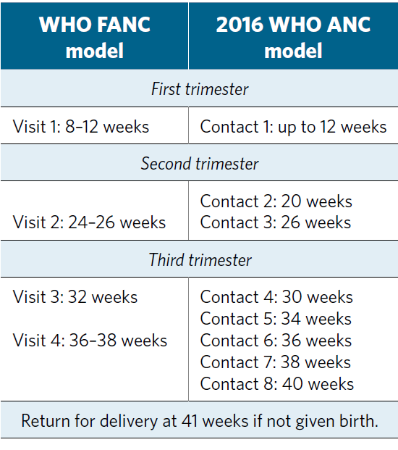
2016 WHO ANC model

Slide 38
Hypertension
Risk Factor in maternal health
HTN
Heart Disease
GDM
Tobacco & alcohol use
STDs
Nutrition
Unhealthy weight
Genetic factor
Postpartum depression

Slide 39
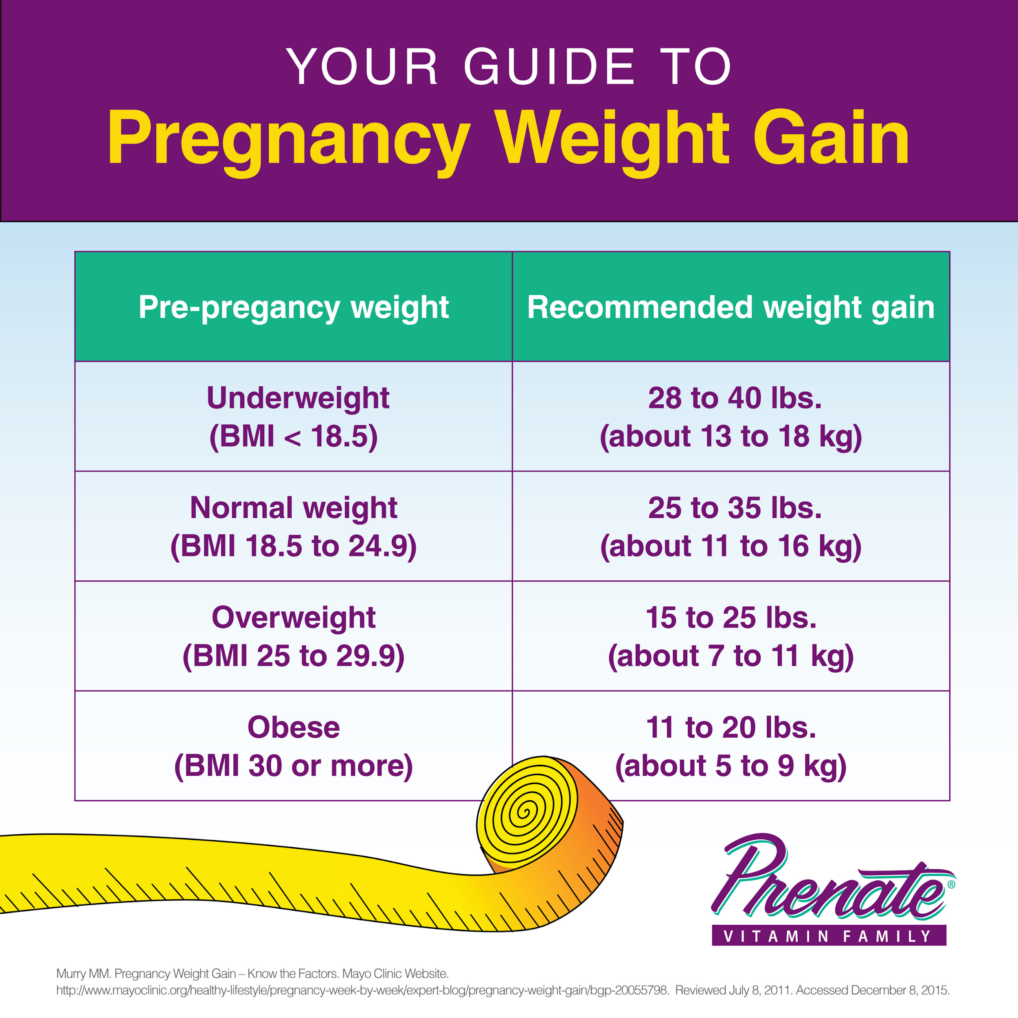
Unhealthy weight
Is It Important to Gain the Recommended Amount of Weight During Pregnancy?
Gaining less Small baby.
Gaining more large baby.

Slide 40
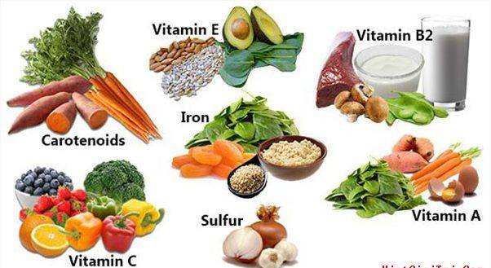
Inadequate nutrition
•Inadequate or deficient in nutrition for mother such as :
Iron → morbidity and mortality, Preterm birth and Neurological dysfunction. Vit A→ Night-blindness.
•Inadequate or deficient in nutrition for neonate such as :
Folate → deficits in the development of the neural tube.
Calcium → restricts fetal skeletal development.
Iron → intrauterine growth retardation and low birth weight.
Notes:
Increased risk of micronutrient deficiency during pregnancy – women who have micronutrient deficiencies when they become pregnant are unlikely to improve their micronutrient status during pregnancy.

Slide 41
Tobacco use
• Smoking effects :
harder for a woman to get pregnant. Premature birth certain birth defects(Cleft lip or cleft palate) Risk of miscarriage(placenta can separate). Sudden Infant Death Syndrome (SIDS).
•Second hand smoke effects: Low birth weight, asthmatic attack and SIDS.

Slide 42
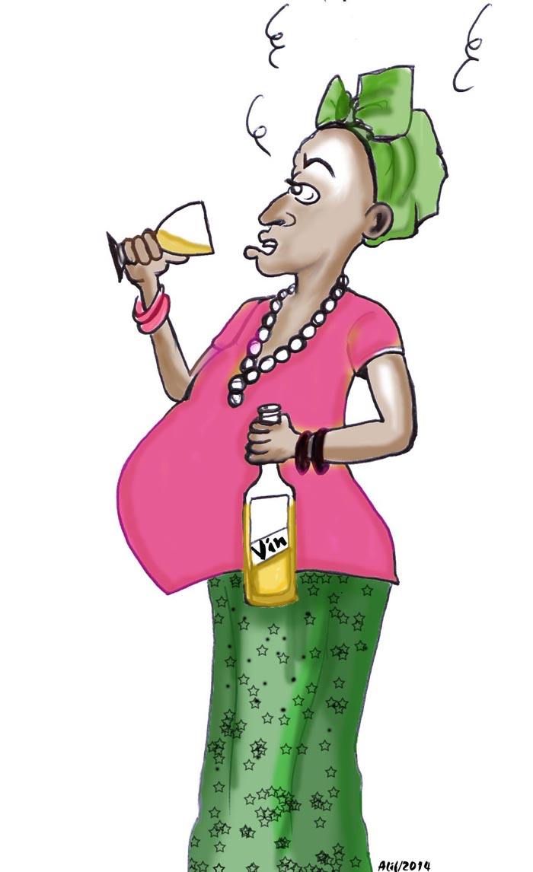
Alcohol
•There is No known safe amount of alcohol use during pregnancy and Alcohol in the mother's blood passes to the baby through the umbilical cord.
•Fetal alcohol spectrum disorders (FASDs):lifelong physical, behavioral, and intellectual disabilities.
Complication of drinking alcohol:
Miscarriage, stillbirth.

Slide 43
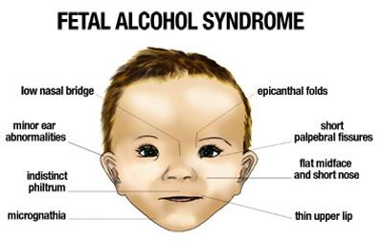
Alcohol

Slide 44
Genetic conditions
•more than 50 percent of miscarriages in the early stages of pregnancy are due to abnormalities of the chromosomes. •Examples:
Cystic fibrosis Marfan syndrome PCKD Neurofibromatosis.

Slide 45
Summary
Preconception and early pregnancy counselling | Smoking, alcohol, illisting drug, diet, supplementation (folate, vit D, Iron), chronic diseases, screening, Review medications, problem in previous pregnancy, vaccinations.
Antenatal care | Pregnancy test, visits(16, 28, 34, 36, 38), if nulliparous (+ 25, 31),

Slide 46
Social and Physical Determinants of Maternal Health

Slide 47
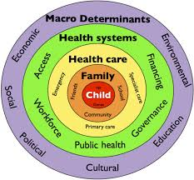
Social and Physical Determinants of maternal Child Health
A range of biological, social, environmental, and physical factors have been linked to maternal, infant, and child health outcomes.
Notes:
1- Race and ethnicity represent social rather than biological constructs that can provide useful information about how environmental, cultural, behavioral, and medical factors can affect patient health.
2-Age: Advanced age is a risk factor for female infertility, pregnancy loss, fetal anomalies, stillbirth, and obstetric complications.

Slide 48
Notes:
Psychological:
exposure to violence
Maternal depression
Sociocultural:
Low maternal education
Reduced access to services
Biological: undernutrition→ iron and iodine def
Diseases e.g. malaria, hiv, parasites
Enviromental exposure e.g. lead in water

Slide 49
1- Biological Determinants:
- Birth weight
- Age of The Mother
Repeated pregnancies (why?)
Birth Spacing: < 1 year = 2-4 times risk of mortality.
Multiple Births
Notes:
low birth weight (< 2.5 kg) & high birth weight (> 4 kg)
Low weight → increase the risk of dm2
Low or high weight → increase the risk of obesity in later life
-AOM: <19 or >30
(risk of miscarriage )
-
- more risk due to low birth weight

Slide 50
2- Social Determinants:
INCOME
EDUCATION
NUTRITION
VIOLENCE
HEALTH CARE QUALITY (DEVELOPING COUNTRIES)
ENVIRONMENTAL CONDITIONS
CULTURE
Notes:
The social environment exerts a strong influence on child health especially through :
Income: how?
Nutrition : breast and formula use,
Violence: (wife beating, infanticide, wars, child abuse, domestic violence)
Cultural Factors :
Religion ,Customs, Early marriages, Sex of child, Quality of mothering, Traditions affecting (cleanliness, eating, clothing, child care)

Slide 51
How to improve the health and well-being of women, infants, children, and families
•approximately 830 women die every day from causes related to pregnancy and childbirth.
•5.9 million children under age five died in 2015, 16000 every day.
•With quality health care, many of these deaths could be prevented.
Notes:
Provide postnatal care in first 24 hours for every birth:
Delay facility discharge for at least 24 hours.
Visit women with home births within the first 24 hours.
Provide every mother and baby four postnatal visits on : First day (24 hours), Day 3 (48–72 hours) , Between days 7–14 and the Sixth week.
approximately 830 women die every day from causes related to pregnancy and childbirth.
5.9 million children under age five died in 2015, 16000 every day.
With quality health care, many of these deaths could be prevented.

Slide 52
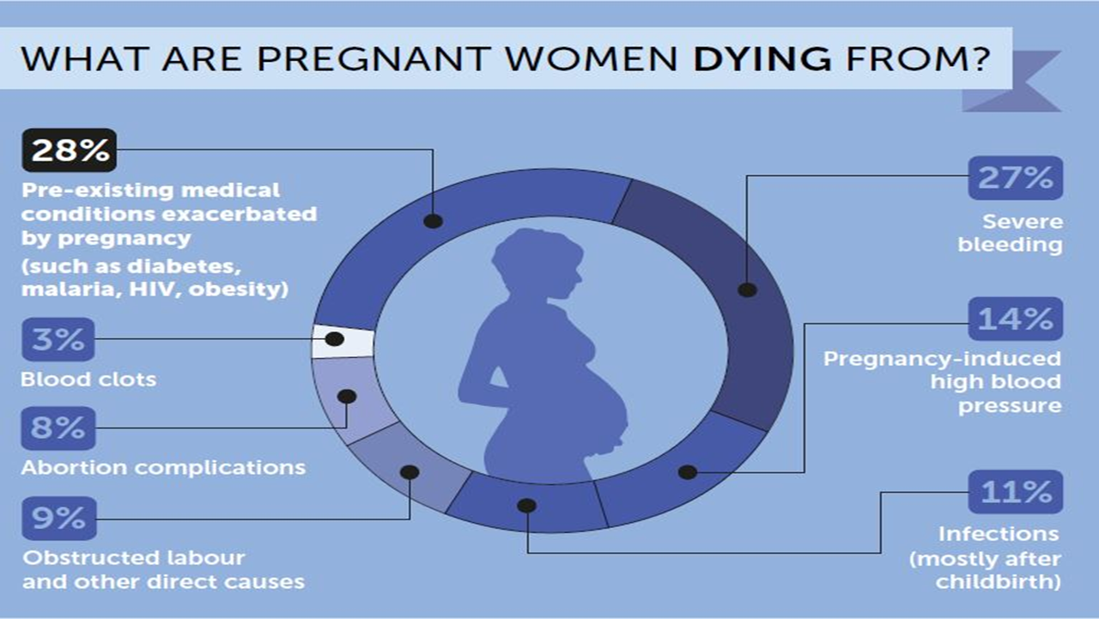

Slide 53
How to improve Maternal health?
•First 24 hours : assessment of vaginal bleeding, uterine contraction, temperature and heart rate should be done routinely during the first 24 hours.
•Breastfeeding should be assessed.
•women should be asked about their emotional wellbeing.
•After 10–14 days, all women should be asked about postpartum depression.
Notes:
1,2,3 → first 24h
5- emotional wellbeing, what family and social support she have
6- iron and fa should be provided for at least 3 months after delivery.

Slide 54
How to improve Maternal health?
•All women should be asked about sexual intercourse and possible dyspareunia as part of an assessment of overall well-being 2–6 weeks after birth.
•Iron and folic acid supplementation should be provided for at least 3 months after delivery.

Slide 55
How to improve maternal health?
Vaccination:
Before pregnancy: measles, rubella
During pregnancy: vaccine to protect against whooping cough .

Slide 56
Thank you

