Slide 1
Methods of prevention and control in NCDs
Dr Armen Torchyan
Department of Family and Community Medicine

Slide 2
Objectives
• Epidemiology as a method to understand the nature, extent and causes of NCDs.
• Interventions for NCD control
• Intrapersonal approaches for NCD control
• Interpersonal approaches
• Organizational level interventions
• Community factors in NCD control
• Health Policy and Legal Interventions

Slide 3
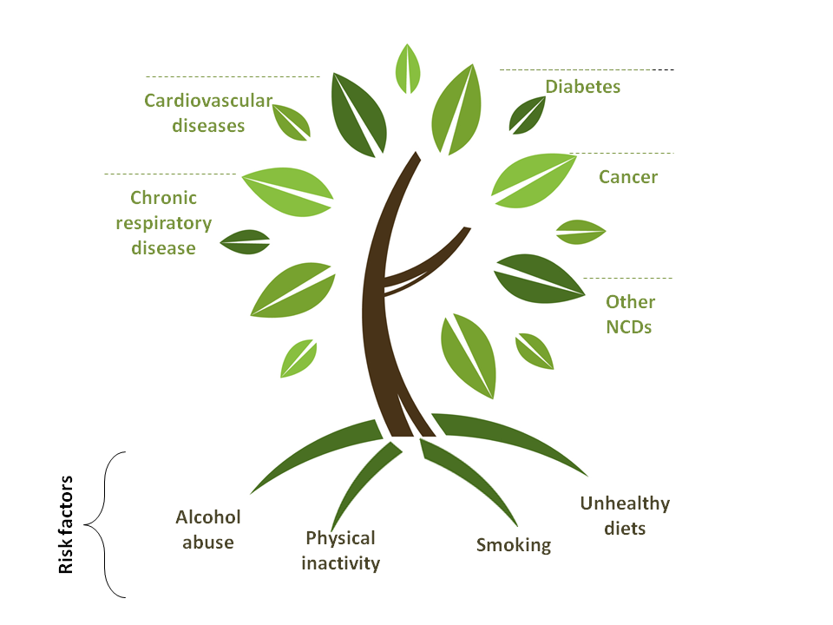
Behavioral
Source: http://emro.who.int
Multiple and interrelated causes

Slide 4
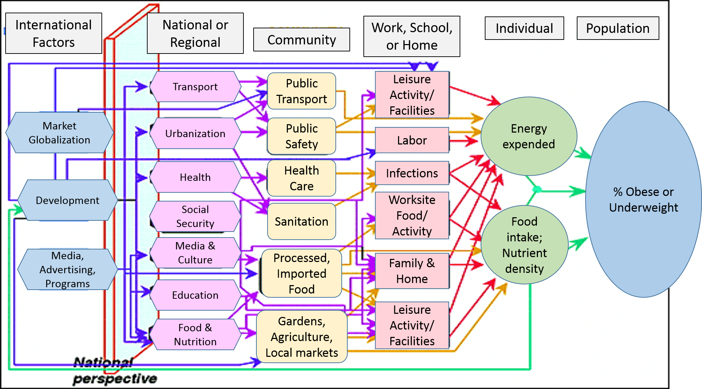

Slide 5
Chronic disease continuum
- Developmental
- Social
- Environmental
- Genetic
Health risk
behaviors and
other factors
Chronic
conditions
Chronic
disease
Determinants

Slide 6
Chronic disease continuum
1. Descriptive epidemiology: Describing the distribution of the continuum in populations by time, person, and place
2. Analytic epidemiology: Discovering the causes of each of the factors along the continuum
3. Intervention and evaluation research: Finding programs that work along the continuum from primary to tertiary prevention
- Developmental
- Social
- Environmental
- Genetic
Health risk
behaviors and
other factors
Chronic
conditions
Chronic
disease
Determinants

Slide 7
Chronic disease continuum
- Developmental
- Social
- Environmental
- Genetic
Selected Risk Factors
- Tobacco Use
- Diet and Nutrition
- Physical Activity
- Alcohol Use
Major Conditions
- Obesity and overweight
- Diabetes
- High blood pressure
- High blood cholesterol
Major Diseases
- Cardiovascular disease
- Cancer
- Chronic Respiratory Diseases
- Mental Disorders
- Neurological Disorders
- Musculoskeletal Problems
- Arthritis
- Chronic Liver Disease
- Kidney Disease
Determinants

Slide 8
Epidemiology
The Centers for Disease Control and Prevention (CDC) currently defines epidemiology as “the study of the distribution and determinants of health-related states in specified populations, and the application of this study to control health problems.”

Slide 9
Epidemiology key words
· Study - Epidemiology is a quantitative discipline based on principles of statistics and research methods.
· Distribution - Epidemiologists study the “distribution” of health events within groups in a population, characterizing health events in terms of person, place, and time. This type of epidemiology is referred to as descriptive epidemiology.
· Determinants - Epidemiologists also search for “determinants” (i.e., causes or factors) that are associated with increased risk or probability of disease. This type of epidemiology, where we move from questions of “who,” “what,” “where,” and “when” and start trying to answer “how” and “why,” is referred to as “analytical epidemiology.”
· Health-related states - Although infectious diseases were clearly the focus of much of the early epidemiological work, the field is no longer limited in this way. Epidemiology as it is practiced today is applied to the whole spectrum of health-related events, which includes NCDs, conditions, and risk factors.
· Populations - One of the most important distinguishing characteristics of epidemiology is that it deals with groups of people rather than with individual patients.
· Control - Epidemiological data and methods steer public health decision-making and aids in developing and evaluating interventions to control and prevent health problems. This is the primary function of applied, field, or consequential epidemiology.

Slide 10
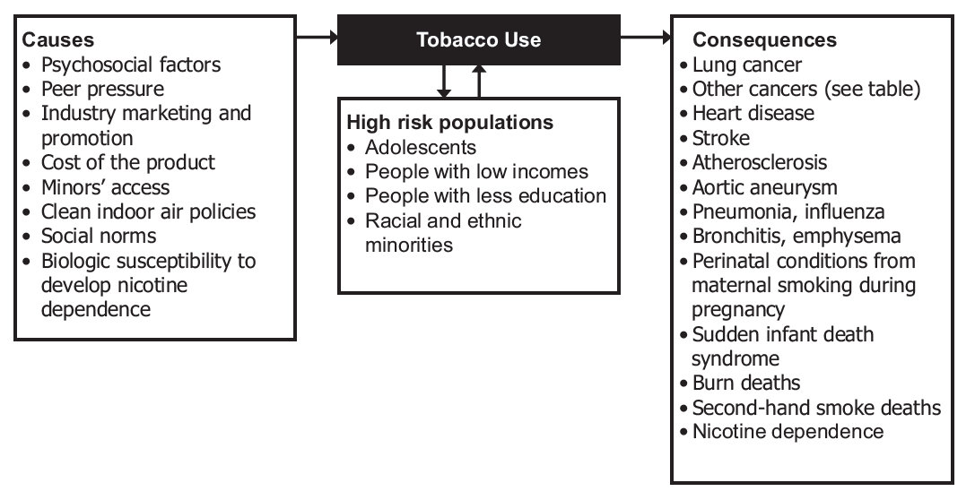

Slide 11
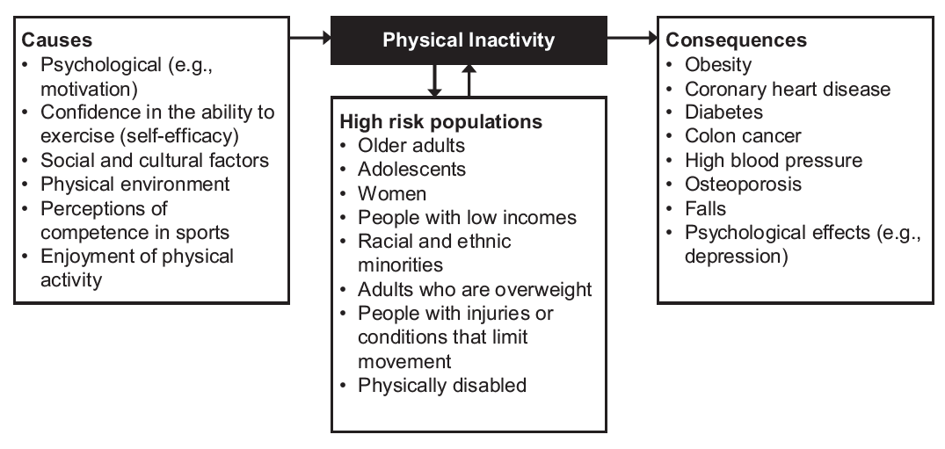

Slide 12
Study Designs
Study Type | Strengths | Limitations
Experimental studies
Randomized clinical trial | -Controls for bias by random assignment | -High cost -Not practical for many exposures (e.g., lifestyle, environmental, social/economic) -Not practical for long latency periods
Randomized community trial | -Can examine population wide exposures -Multicomponent interventions may be more effective | -Very high cost -Often involves small number of study groups
Quasi-experimental studies | -Can be used to study real world program and policy interventions -Can use multiple comparison groups, repeated baseline measures to strengthen design | -Potential for bias in comparison groups -Lack of control of confounding factors
Observational studies
Prospective cohort | -Opportunity to measure risk factors before disease occurs -Can study multiple disease outcomes -Can yield incidence rates as well as relative risk estimates | -Often expensive -Requires large number of subjects -Requires long follow-up period -Difficult to control for all factors related to exposure
Case-control | -Useful for rare diseases -Relatively inexpensive -Relatively quick results | -Possible bias in measuring risk factors after disease has occurred -Possible bias in selecting control group -Identified cases may not represent all cases

Slide 13
Intervention Methods for
NCD Control

Slide 14
Multiple Determinants of NCDs
- Behavioral Determinants
Poor diet, physical inactivity, and smoking
80% of heart disease and stroke,
80% of type 2 diabetes
40% of cancers
- Environmental Determinants
accessible and safe sidewalks
nearby parks,
bike trails
community swimming pools
multiple-television households,
desktop computers, and sophisticated video games
Healthy menu choices in schools, restaurants, and work site cafeterias
- Social Determinants
level of education
level of social or economic stressors
access to health care
transportation
housing
Income inequality
social inclusion or exclusion stemming from sex, race, or age
- Health Care Determinants
more funding on primary prevention
secondary prevention (e.g., screening for hypertension, hyperlipidemia, breast cancer)
tertiary prevention will minimize hospitalizations and provider visits

Slide 15
Evidence-based interventions
Environmental Health Sciences
Social and Behavioral Sciences
NCD control
Health Policy and Management
Epidemiology
Other

Slide 16
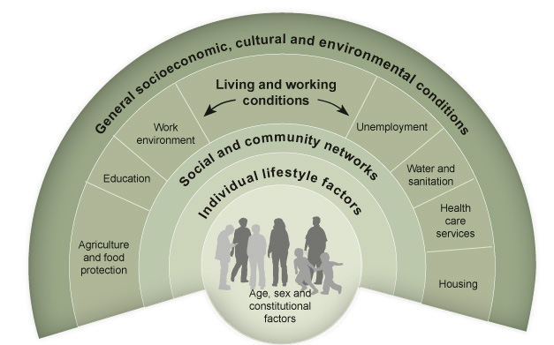
Levels of intervention: Ecological model of health
Source: Dahlgren & Whitehead 1991.

Slide 17
Levels of intervention: Ecological approach
• Intrapersonal factors - altering knowledge, attitudes, skills, and future behavioral intentions at the level of the individual person.
• Interpersonal factors - understanding and accessing the relationships that people have with other individuals in their social network such as friends, peers, and coworkers, family members, neighbors, and others from whom behavioral patterns and behavioral norms are acquired.
• Organizational factors - using organizations such as schools, faith-based groups, work sites, or health care facilities to direct, influence, or support health behavior change and help to define health behavior norms.
• Community factors - catalyzing interest within an area having geographic or political boundaries to leverage power structures to achieve a particular set of health objectives, perhaps to address the most serious health problems among persons typically in the weakest position to advocate on their own behalf (e.g., the rural poor, members of underrepresented minorities, less educated, physically or mentally disabled).
• Policy factors - advocating for and organizing and analyzing policies and procedures, regulations, and laws that favorably influence the fight against chronic diseases.

Slide 18
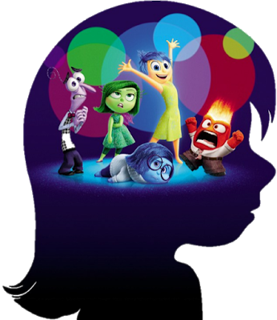
Intrapersonal (Individual) Approaches
Source: http://inteligencia-intrapersonal2016iii.blogspot.com/2016/09/caracteristicas.html

Slide 19
Intrapersonal (Individual) Approaches
- Intrapersonal models or theoretical frameworks draw on the assumption that people can be motivated to take individual action that changes their health knowledge, attitudes, skills, behavioral intentions, and eventual behavior.
Health Belief Model - The HBM suggests that a person's belief in a personal threat of an illness or disease together with a person's belief in the effectiveness of the recommended health behavior or action will predict the likelihood the person will adopt the behavior.
Transtheoretical Model and Stages of Change - The TTM operates on the assumption that people do not change behaviors quickly and decisively. Rather, change in behavior, especially habitual behavior, occurs continuously through a cyclical process.
Theory of Planned Behavior - The theory was intended to explain all behaviors over which people have the ability to exert self-control. The key component to this model is behavioral intent; behavioral intentions are influenced by the attitude about the likelihood that the behavior will have the expected outcome and the subjective evaluation of the risks and benefits of that outcome.
Health Locus of Control Model - who or what is responsible for that which happens to one’s health

Slide 20
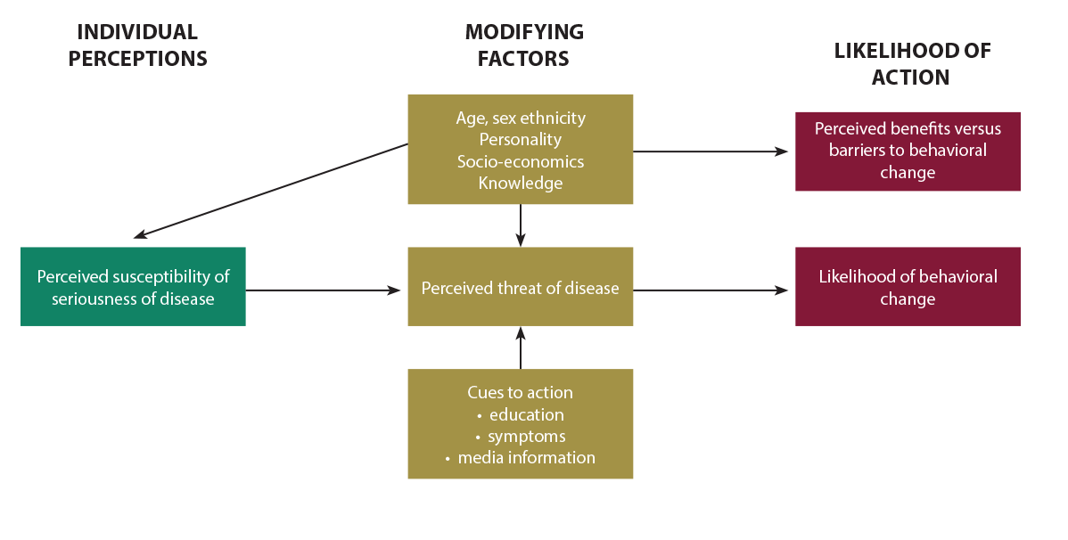
Health Believe model
https://sbccimplementationkits.org/quality-malaria-medicines/health-belief-model/

Slide 21
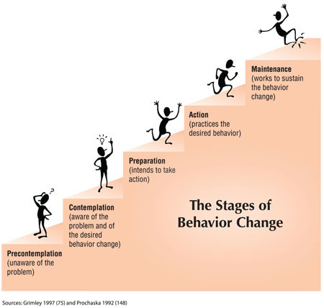
Transtheoretical Model and Stages of Change

Slide 22
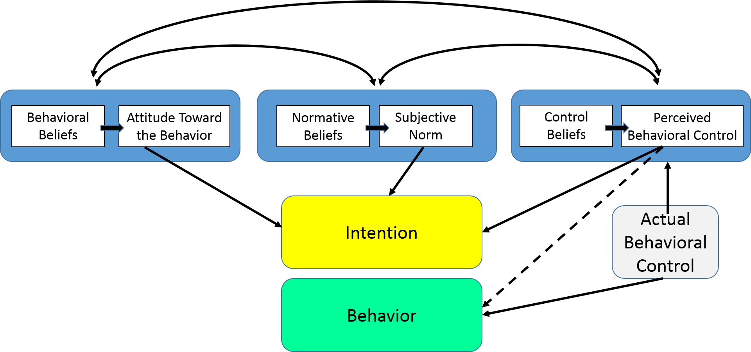
Theory of Planned Behavior

Slide 23
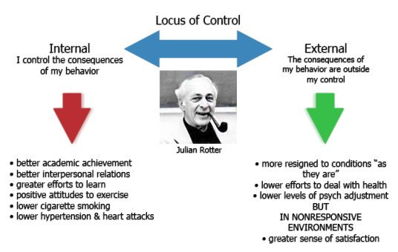
AP Psychology Review

Slide 24
Interpersonal Approaches
Source: https://jarvee.com/social-media-impact-interpersonal-relationships/

Slide 25
Interpersonal Approaches
- Models of interpersonal health behavior assume that the interpersonal environment is one of the most powerful sources of influence for health-related behavior and health status.
- “People’s environments provide the means, model, reinforcements, resources, and sources of influence from which people gain information, skills, self-confidence, self-management competencies, coping behavior, and support” (Glanz, Rimer, and Lewis 2002, p. 265).
Social Cognitive Theory - learning occurs in a social context with a dynamic and reciprocal interaction of the person, environment, and behavior.
Family-Based Interventions - for example, family members have been trained to provide support to individuals who are in programs to stop smoking
Friends and Social Networks - developing new social network linkages through mentor programs, buddy systems, and self-help groups. Groups such as Alcoholics Anonymous, Overeaters Anonymous, and Weight Watchers.
Social Support and Social Networks - impact of social relationships on health status, health behaviors, and health decisions has the potential to make important contributions to the design of effective interventions.
Natural Helpers - respected and trusted members of social networks to whom other network members turn for advice, support, and other types of aid

Slide 26
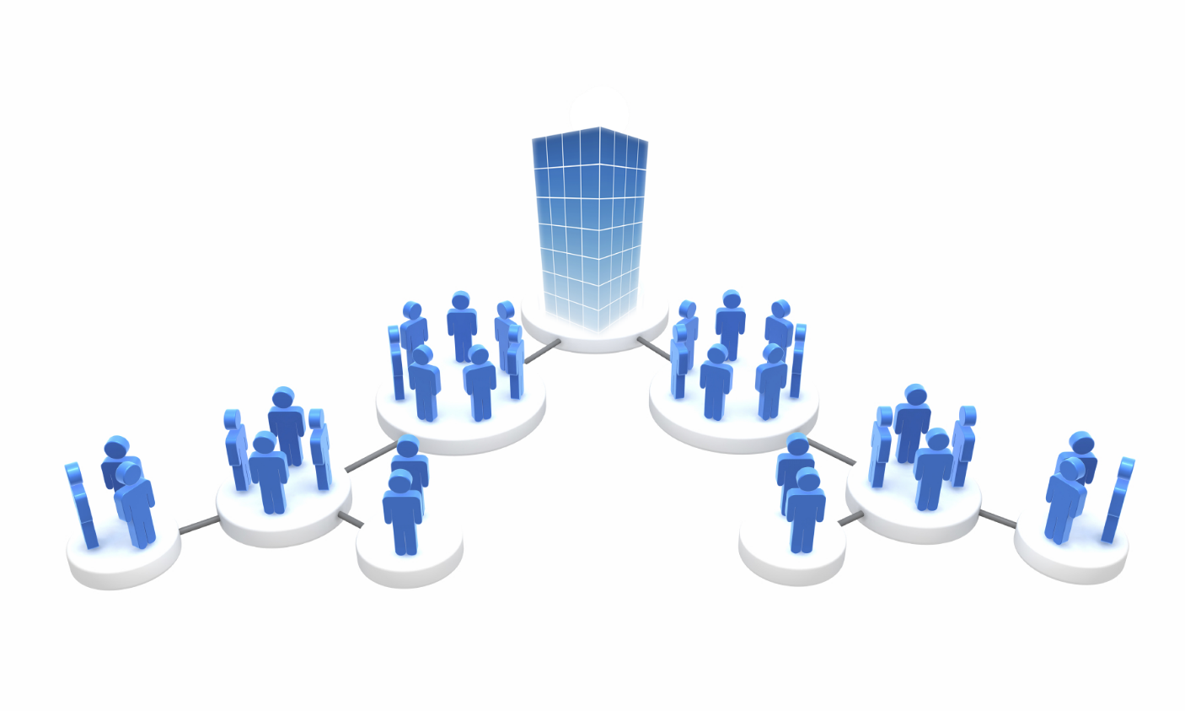
Organizational-Level Venues for Intervention
Source: http://www.art.danielandujar.org/?portfolio=organization

Slide 27
Organizational-Level Venues for Intervention
Health Care System and Clinical Services
Schools
Work Sites
Faith-Based Organizations

Slide 28
Health Care System and Clinical Services
Research has firmly established that physician advice given in the health care setting provides a powerful and motivational message for cardiovascular disease risk reduction, weight loss, dietary change, and physical activity improvement among adolescents, tobacco control and alcohol consumption.
An intervention that has shown effectiveness without being especially burdensome on health care providers or patients is known as the “brief intervention.”
Brief interventions usually last for 5–60 minutes and consist of counseling and education.
Sometimes, there are multiple sessions, perhaps initiated by a primary care provider, and then transitioned to a health education specialist to carry on the intervention.
However, a brief intervention can be as limited as 30 seconds and consist of just one “teachable moment” session conducted by an alert and opportunistic health care provider.
The content, duration, and number of sessions may depend on the provider, the patient’s receptivity and readiness to change, the setting, and previous patient–provider rapport.

Slide 29
Examples of Brief Interventions for Health Promotion
When taking a blood pressure reading, sharing information about the causes and problems of high blood pressure, talking about exercise and proper diet as ways to reduce blood pressure
Encouraging a patient at risk of developing diabetes to talk about the foods they eat, offering nutrition advice, talking about practical ways to shop for food and prepare healthy meals
When treating an infant or child with a respiratory infection, talking to the mother who smokes to find out if she knows about passive smoking, recommending ways of reducing the child’s exposure to smoking, and asking if she is thinking about quitting
Finding out from a patient who drinks alcohol if they are drinking in a harmful way, and if they are, addressing the need to adjust their drinking to a healthier level, perhaps conveying factual information about the health effects of alcohol

Slide 30
Coordinated school health program

Slide 31
Work site health promotion services
fitness centers
on-site exercise classes
weight loss programs
policies related to paid time to exercise at work
healthy vending and/or cafeteria choices

Slide 32
Benefits through workplace interventions
• Improved employee productivity. Employees with multiple health risk factors have been found to be less productive than employees with fewer risk factors (Partnership for Prevention 2001).
• Reduced absenteeism. In an analysis of the effects of work site wellness programs and employee absenteeism, it was determined that there was an average savings of $5.00 for every dollar spent on employee wellness.
• Reduced employee health risks. For a cost of $32 per employee, the Coors Brewing Company “Lifecheck” program reduced employee risk for cardiovascular disease by decreasing high blood pressure, high cholesterol, and weight among its employees (Aldana 1998).
• Reduced health care costs. An analysis of eight work site wellness programs determined a reduction of health care expenses averaging $3.35 for every dollar spent on employee health promotion (Partnership for Prevention 2001).
• Improved corporate image. Work site wellness programs offer further gains to employers by demonstrating social responsibility in addition to promoting the health of employees and their families in addition to retirees (Partnership for Prevention 2001).

Slide 33
Faith-Based Organizations
Can significantly increase knowledge of the disease
Improve screening behavior
Improve readiness to change
Reduce the risk associated with disease and disease symptoms.

Slide 34
Community-Level Interventions

Slide 35
Community
Group’s members must share:
a sense of belonging
common symbols
norms and values
conditions and constraints
and mutual influence

Slide 36
Community interventions
Intervention strategies should be selected based on the needs and priorities of the specific population so as to identify appropriate interventions that are compatible with the population’s knowledge, attitudes, perceptions, and sociocultural and economic circumstances.
Chronic disease prevention and control programs will be more effective if the population of interest is actively involved in prioritizing, developing, and implementing all intervention activities.
Full partnership between public health professionals and local community members can lead to empowerment of individuals and groups and result in more effective management of health issues and economic, social, and political forces in the community.
Community coalitions are often initiated to assist communities in mobilizing resources and coordinating activities that improve the public’s health.
Media advocacy - “the strategic use of mass media in combination with community organizing to advance healthy public policies” .
Media advocacy differs from other uses of mass media in its attempt to shift power back to communities so they can change policies that affect their lives (i.e., addressing the power gap) rather than promote messages about the need for individual behavior change.
By learning to use media to address system-level factors, communities are empowered to participate in the political process.

Slide 37
Health Policy and Legal Interventions
Source: Hill Havurah, 2018

Slide 38
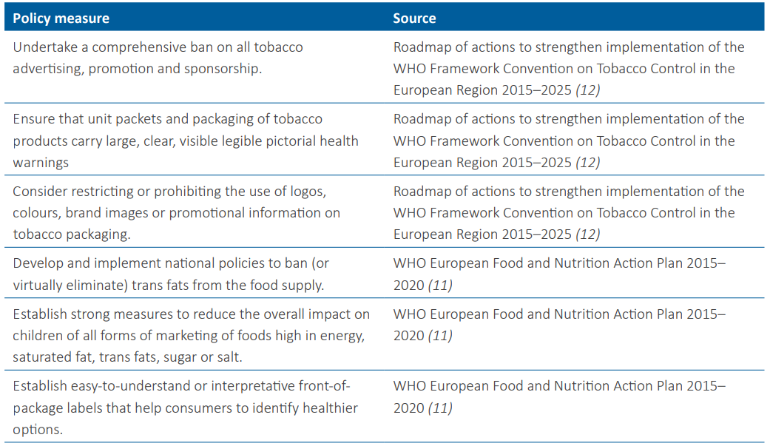

Slide 39
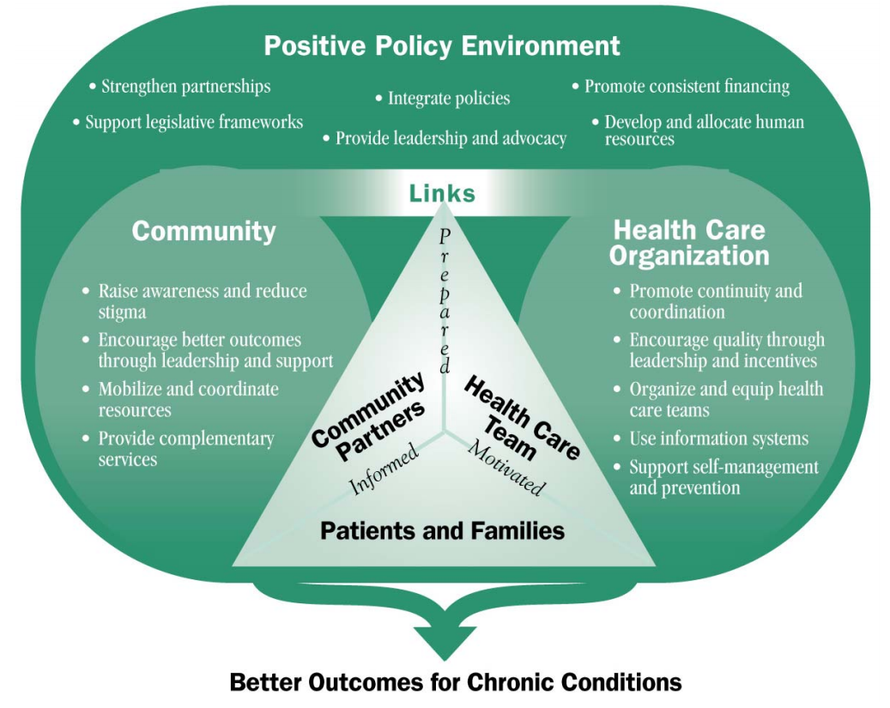
Source: World Health Organization, 2004

Slide 40
References
Remington PL, Brownson RC, Wegner MV. Chronic disease epidemiology and control - 3rd ed. Washington, DC: American Public Health Association; 2010.
LaMorte WW. Behavioral Change Models. Boston University School of Public Health; 2018. Available on: http://sphweb.bumc.bu.edu/otlt/MPH-Modules/SB/BehavioralChangeTheories/index.html
Key considerations for the use of law to prevent noncommunicable diseases in the WHO European Region. Report of an intensive legal training and capacity-building workshop on law and noncommunicable diseases. Moscow, 30 May–3 June 2016.

