Slide 1
Social Determinants of NCDs
Dr Armen Torchyan
Department of Family and Community Medicine

Slide 2
Objectives
• Define the social determinants of NCDs
• Discuss the significance, high risk groups and health consequences of social determinants of NCDs
• Material conditions needed for individual and community well-being
• The relationship between SES and health-risk behaviors
• Psychosocial risk factors influencing NCDs
• Neighborhood factors influencing NCDs
• Evidence-based approaches to improving the social determinants of NCDs

Slide 3
Definition
The social determinants of health are the conditions in which people are born, grow, live, work and age, and the wider set of forces and systems shaping the conditions of daily life. These forces and systems include economic policies and systems, development agendas, social norms, social policies and political systems.

Slide 4
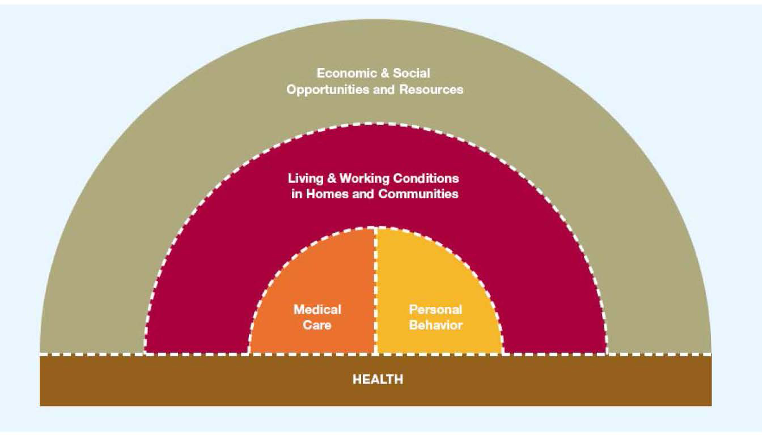
47% of health outcomes

Slide 5
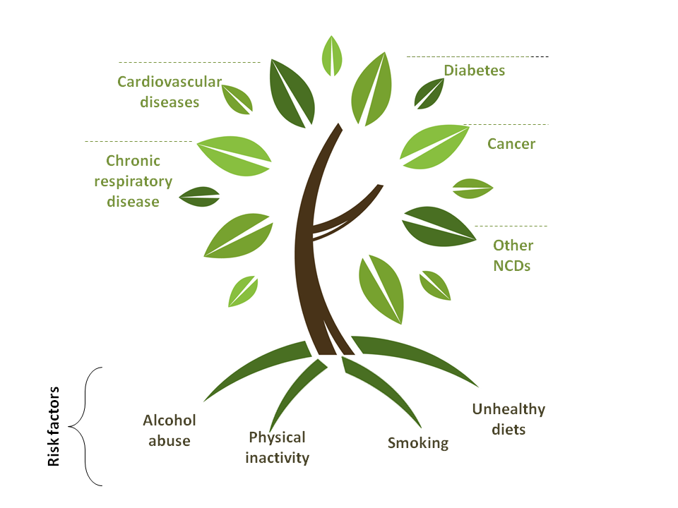
Ability to adhere is largely influenced by individual and contextual social factors
Behavioral
Source: http://emro.who.int
Multiple and interrelated causes

Slide 6
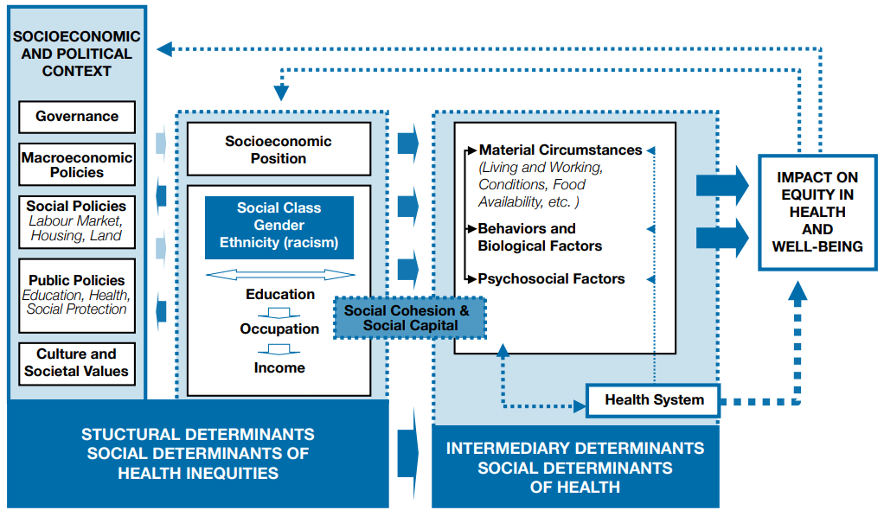
WHO: A conceptual framework for action on the social determinants of health

Slide 7
Powerful determinants of health
Income
Education
Occupation
Health
- Differential exposure to conditions that have more immediate effects on health, such as access to healthy foods, a safe and clean place to live, and the ability to get routine physical exercise.
- Those with less education and less income are more likely to smoke, less likely to engage in physical activity and less physically fit than their higher-income peers and are less likely to consume fiber and fresh fruits and vegetables.
- Education promotes knowledge and life skills, which increase access to information and resources that promote health In addition, education builds occupational opportunities and earning potential, which in turn can lead to better nutrition, housing, schooling, and recreation.

Slide 8
Powerful determinants of health (cont.)
Education is more strongly related to the
onset of illness and chronic conditions,
and
Income is more predictive of health
trajectories and mortality after illness onset.

Slide 9
Intermediate determinants
Material circumstances include factors such as housing and neighborhood quality, consumption potential (e.g. the financial means to buy healthy food, warm clothing, etc.), and the physical work environment.
Psychosocial circumstances include psychosocial stressors, stressful living circumstances and relationships, and social support and coping styles (or the lack thereof).
Behavioral and biological factors include nutrition, physical activity, tobacco consumption and alcohol consumption, which are distributed differently among different social groups. Biological factors also include genetic factors.
The health system plays an important role in mediating the differential consequences of illness in people’s lives.

Slide 10
Material Living Conditions
Socioeconomic status
Higher rates of nearly every major health risk factor or health-damaging process
Financial resources
Food
Shelter
Transportation
Health care
Safe environments
Health inequities over the entire life course
“impact of material and psychological stresses imposed by social inequities and marginalization is felt most intensely during perinatal/early childhood and puberty/ adolescent periods, when developmental genes are expressed and interact with social-physical environments.” Furumoto-Dawson et al. (2007)

Slide 11
Health-Risk Behaviors
Socioeconomic status
Tobacco use
Illicit drug use
Obesity
Physical inactivity
Sexual risk taking
Driving while intoxicated
Not wearing a helmet
others
Risky Behavior

Slide 12
Psychosocial Risk Factors
Stress (both acute and chronic)
Personality factors
traumatic life events
coping and resilience
self-efficacy
self-esteem
cynical hostility
Hopelessness
Social relationships
social support
social networks
sense of job control
experiences of discrimination
use of risky behaviors as a form of self-medication
Socioeconomic status
Risk Factors

Slide 13
Neighborhood Factors
the physical infrastructure and environment shared by residents,
including water, air, and street and sidewalk conditions
the level of risk in the environments in which people work, play, and rest
the quality of public and private services provided to residents, such as garbage removal, police protection, and social services
sociocultural features of neighborhoods, including norms, values, social cohesion, social networks, and civic engagement
the reputation of a neighborhood, which signals how it is perceived by residents and nonresidents, and involves shared community morale.

Slide 14
Neighborhood Factors
- Many features of the built environment and urban design (including land-use patterns, sidewalks, transportation systems, and street connectivity) are associated with physical activity and other features of mobility important to health.
- Neighborhood features such as the absence of grocery stores and the types of food available are associated with dietary features and obesity rates across communities.
- One U.S. study found that features of urban food deserts, such as distance between stores and prices, were associated with obesity, and that price was the main driver of this relationship.
- Above and beyond the individual characteristics of residents, neighborhood characteristics produce both positive and negative impacts on health behaviors, health status outcomes, and health inequities.

Slide 15
Reverse Causality
Socioeconomic position
NCDs
Socioeconomic position
NCDs

Slide 16
Pathophysiology

Slide 17
The Whitehall study
The Whitehall study demonstrated an inverse relationship between social status and coronary heart disease (CHD) mortality among middle aged British men with stable employment, such that those with lower social status based on occupation had higher rates of mortality; this association remained even after controlling for potential behavioral and laboratory-based confounders.
Lack of material goods, health behaviors, illiteracy, or access to quality health care ???

Slide 18
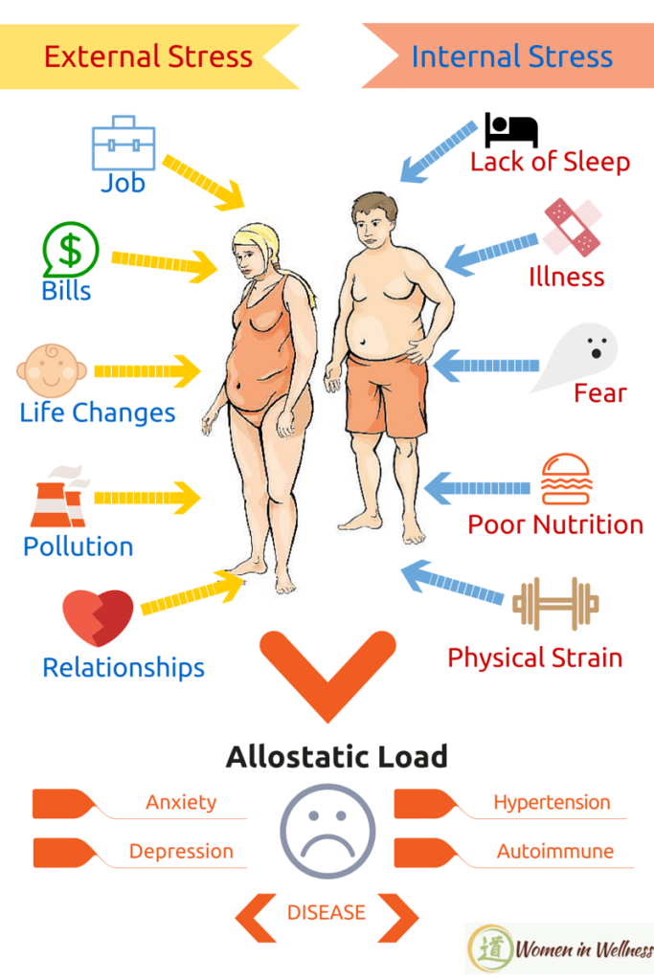
Allostatic load
Allostasis refers to fluctuations in physiologic systems within the body to meet the demands of external stressors.
Allostatic systems allow individuals to respond to a broad range of stressors, not only biologic, such as infection or injury, but also to those stressors that may fall into the category of social determinants of health.
The body’s response to any stressor should involve both turning on an allostatic response and turning off the response once the stressor has passed.
Over time, the “wear and tear” that accumulates as a result of the chronic overactivity or underactivity of allostatic systems is referred to as the allostatic load.

Slide 19
McEwen, B. S. (2016).

Slide 20
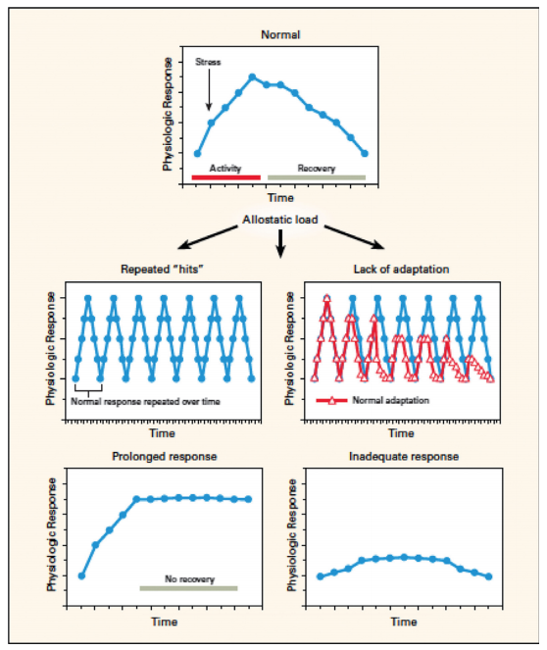
McEwen, B. S. (2016).

Slide 21
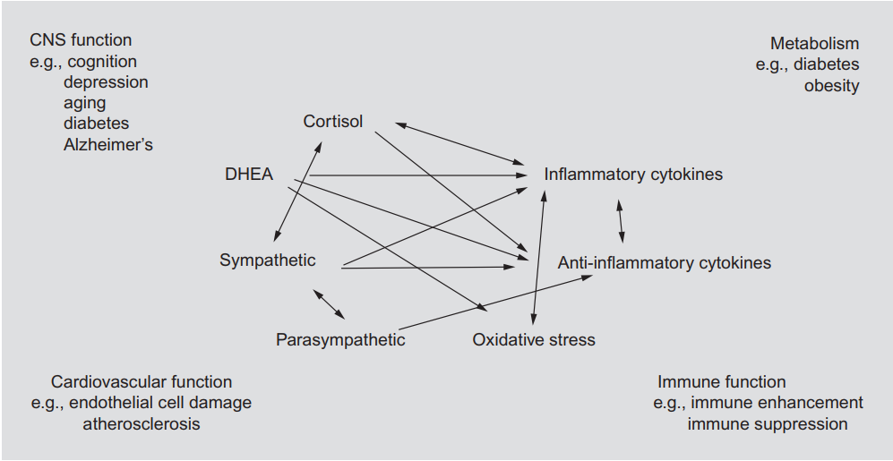
Mediators of allostasis involved in the stress response
McEwen, B. S. (2016).

Slide 22
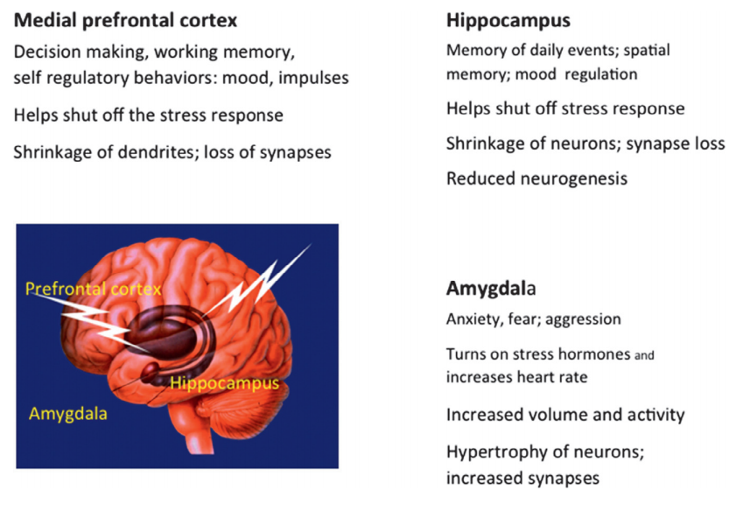
Brain regions that remodel dendrites and synapses.
McEwen, B. S. (2016).

Slide 23
Allostatic load (cont.)
A population-based, longitudinal study in the United States found that negative life events and other types of stressors were more common in lower socioeconomic strata.
Decreased ability to change risk behaviors - helplessness, hopelessness, fatalism, low self-esteem, alienated labor, hostility, anger, and passive coping.
“rooted and shaped by adverse socio-economic conditions during upbringing and adulthood, and . . . are related to adverse health outcomes through complex psychological, behavioral and biological pathways”

Slide 24
Childhood stressors - neuroplasticity
Childhood stressors during development
Changes in the structure and function of the limbic brain
Affected neuroplasticity
Can affect patterns of emotional expression and regulation, stress reactivity, recovery, coping, and perhaps even bodily aging
May affect an individual’s ability to process new information and make decisions on how best to approach challenges
Can potentially lead to elevated HPA activity and repeated stresses through a glucocorticoid cascade
Change in major regulatory system parameters, including cardiovascular, metabolic, and inflammatory system parameters

Slide 25
Childhood stressors - neuroplasticity
Early childhood stress and exposure to disadvantage establishes a health trajectory that is difficult for an individual to change despite subsequent upward social mobility.
Independent of adult SES, childhood SES has been shown to predict blood pressure.
There has also been a suggested association with low SES in childhood and diminished cortisol-mediated signaling through adulthood, which in turn facilitates excessive inflammatory responding in cells of immune system and excessive cortisol release by the HPA axis.
Inflammatory markers were found to be higher among adults who had low SES as children, even after controlling for adult SES
Among British adult women, parent’s occupation status more was found to have a greater impact on insulin resistance, dyslipidemia, and obesity than adult occupation status

Slide 26
Discrimination and Stress
Self-reported experiences of discrimination on the basis of on race, ethnicity, and social class demonstrates significant associations with a number of health outcomes.
The research literature is most developed in the case of perceived racial/ethnic discrimination and mental health disorders (i.e., depression, anxiety disorders) and the physical health outcomes of hypertension and low birth weight.

Slide 27
Key Interventions

Slide 29
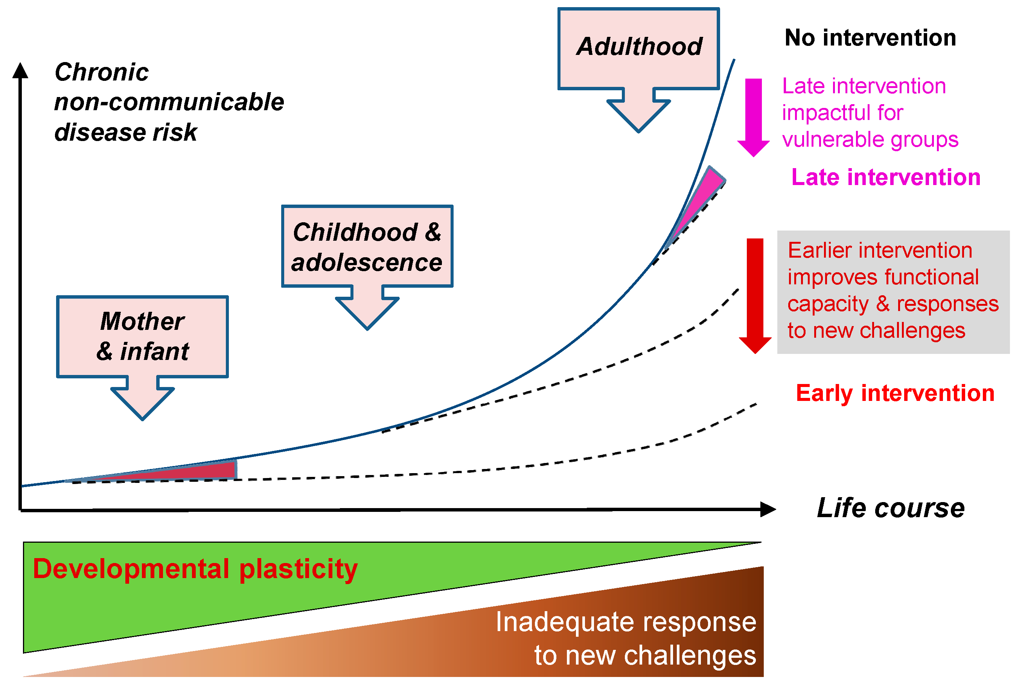
Baird et al, 2017

Slide 30
Improving health
“Despite an increasing awareness about the social determinants of health, many people still believe that health is largely improved by reducing unhealthy behaviors and increasing access to health care”
Remington PL (2010)

Slide 31
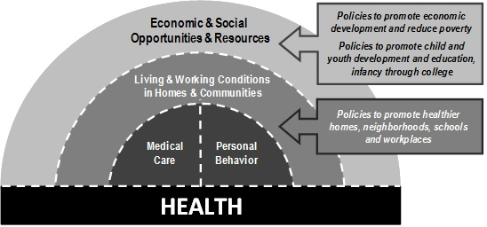

Slide 32
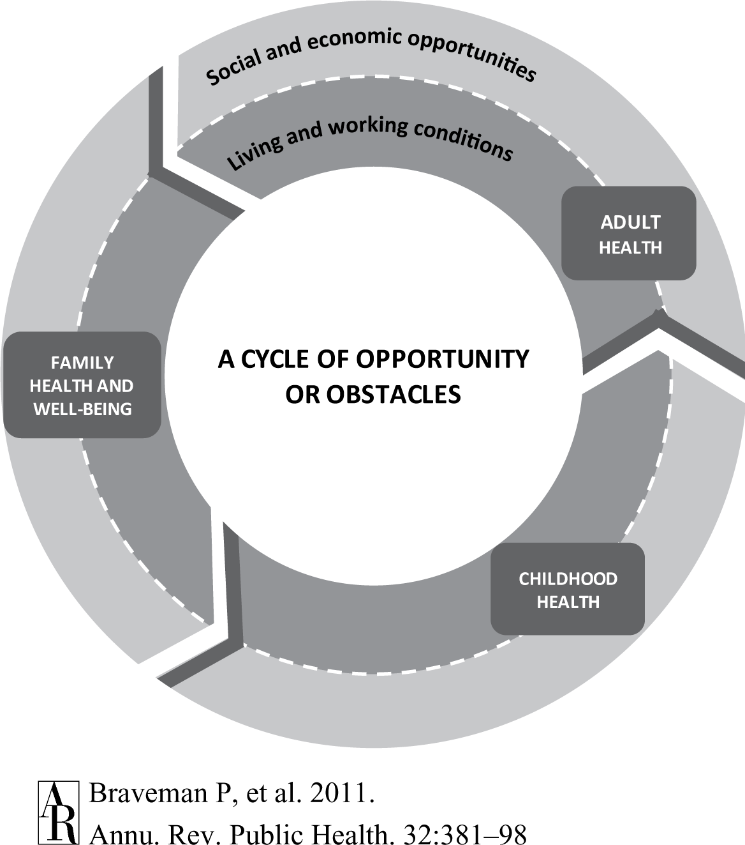

Slide 33
Education
Early childhood education is associated with:
improved graduation rates and earnings
improved adult health status
lower behavioral risk factors
lower criminal activity

Slide 34
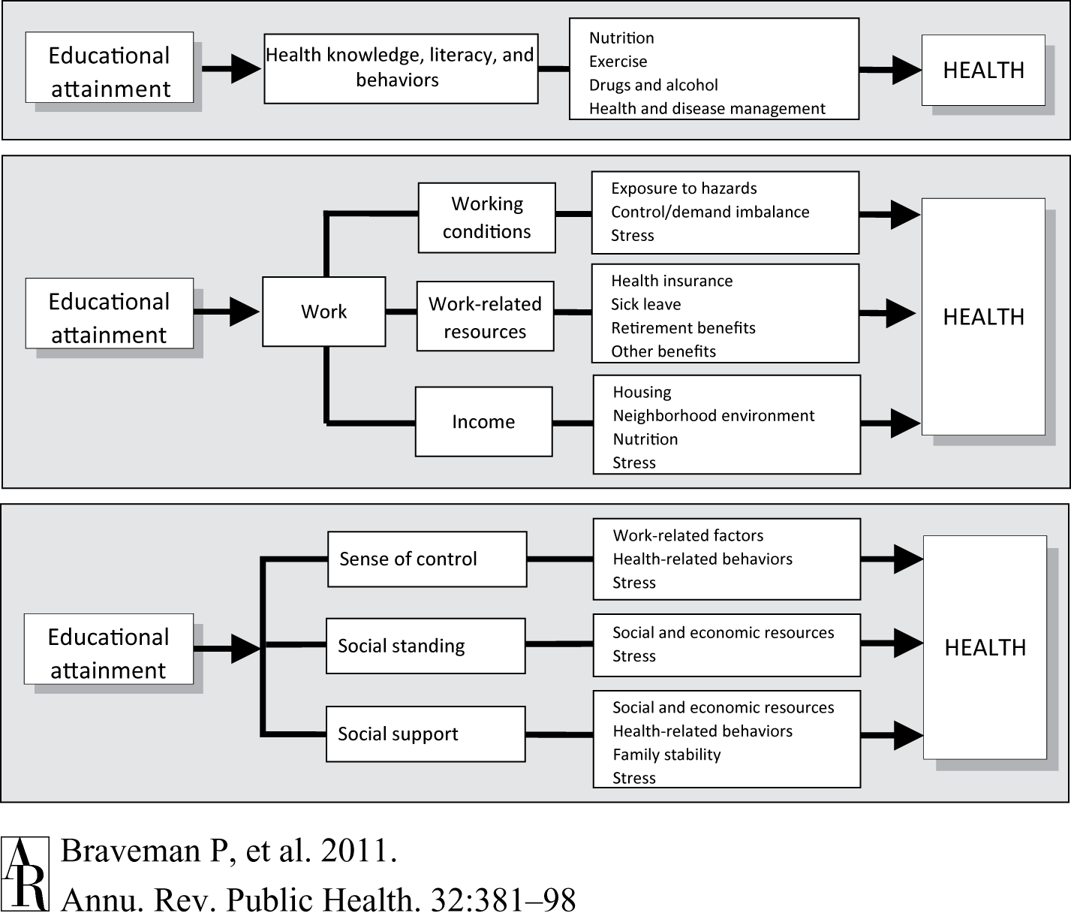

Slide 35
Employment and Income
Improved financial security
Social status
Personal development
Social relations
Self-esteem
Protection from physical and psychosocial hazards
Access to health care
Safe houses and neighborhoods
Healthy and affordable foods
Time and safe space for physical activity

Slide 36
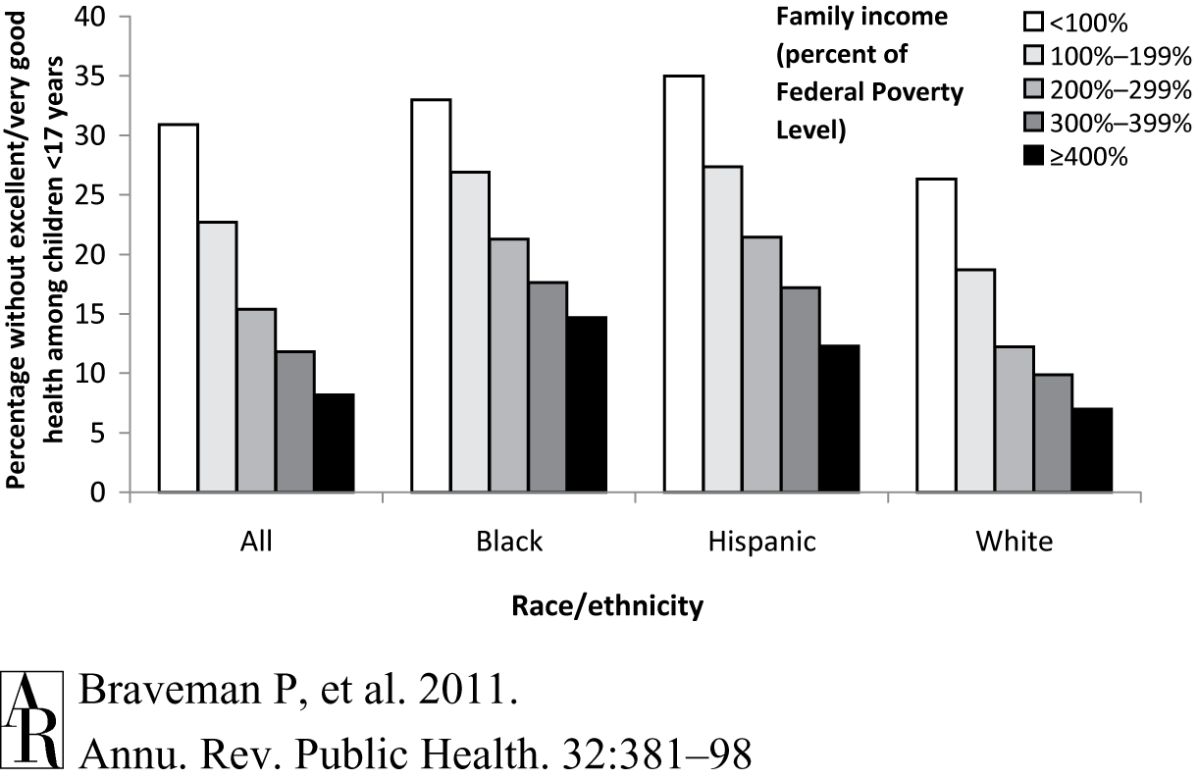

Slide 37
Fair Employment and Decent Work
Full and fair employment and decent work as a national policy agenda.
Strengthened representation of workers in the creation of policy, legislation, and programs relating to employment and work.
Provide quality work for men and women with a living wage that takes into account the real and current cost of healthy living.
Protect all workers.
Implement core labor standards for formal and informal workers.
Develop policies to ensure a balanced work-home life.
Reduce the negative effects of insecurity among workers in precarious work arrangements.

Slide 38
Housing access and quality

Slide 39
Equity from the start
“Each one of you is your own person, endowed with rights, worthy of respect and dignity. Each one of you deserves to have the best possible start in life, to complete a basic education of the highest quality, to be allowed to develop your full potential and provided the opportunities for meaningful participation in your communities.”
Nelson Mandela and Graça Machel (UNICEF, 2000)

Slide 40
References
McEwen BS. Chapter 5 - Central Role of the Brain in Stress and Adaptation: Allostasis, Biological Embedding, and Cumulative Change. In: Fink G, editor. Stress: Concepts, Cognition, Emotion, and Behavior. San Diego: Academic Press; 2016. p. 39-55.
CSDH (2008). Closing the gap in a generation: health equity through action on the social determinants of health. Final Report of the Commission on Social Determinants of Health. Geneva, World Health Organization.
Remington PL, Brownson RC, Wegner MV. Chronic Disease Epidemiology, Prevention, and Control, 4th edition. Washington, DC: American Public Health Association; 2016.

