Slide 1
INJURY EPIDEMIOLOGY
YEAR
1439-1440 Hajji
2018 - 2019 Gregorian
session Description | Objectives
Topics covered | Describe the concepts of injuries, why do they occur and their epidemiology ​​ Describe important differences between various types of injuries​ (what is meant here? Intentional and unintentional?) Understand principles of injury prevention and control​ Appreciate the burden of injuries in KSA

Slide 2
HEADLINES
Injuries: concepts and definitions
Classification of injuries
Magnitude of the problem
Prevention and control efforts
Application to road traffic incidents

Slide 3
CONCEPTS & CLASSIFICATIONS

Slide 4
Definitions - Injury
“Acute exposure to agents such as mechanical energy, heat, electricity, chemicals, and ionising radiation interacting with the body in amounts or at rates that exceed the threshold of human tolerance.
In some cases, injuries result from the sudden lack of essential agents such as oxygen or heat.”
(Source: Gibson, 1961; Haddon, 1963)

Slide 5
Definitions - Violence
“The intentional use of physical force or power, threatened or actual, against oneself, another person, or against a group or community, that either results in or has a high likelihood of resulting in injury, death, psychological harm, maldevelopment or deprivation”
(WHO, 1996)

Slide 6
Epidemiologic Triad of Injuries
Host (person)
Agent (that injures: energy)
Environment (vector / vehicle that conveys the agent / energy)

Slide 7
Nature of Energy
Mechanical
Thermal / Chemical
Electrical
Asphyxiation

Slide 8
Nature of Energy: Mechanical 1
If a person must stop suddenly, as in a crash of a vehicle, that energy must be dissipated in the vehicle, environment, or individual’s tissues
When the vehicle stops, the occupant will continue to move at the pre-crash speed into interior structures, or into the materials in the exterior environment if ejected.

Slide 9
Nature of Energy: Mechanical 1
Stresses: contact with energy source generates forces counter to the load. tension (pulling molecules apart),
compression (pushing molecules together), shear (from a tangential force)

Slide 10
Nature of Energy: Mechanical 2
Strain: extent of deformation, resulting from tension, compression, shear
The shape and elasticity of the materials struck will determine the damage to the tissue.
Devices as seat-belts, air bags and child restraints reduce the severity of injury by reducing contact with less flexible structures (second collision)

Slide 11
Nature of Energy: Thermal & Chemical 1
Deaths and injuries associated with fires, heat & smoke are the result of ignition sources, flammable materials and of the heat and chemical energies generated by burning or heating materials (e.g. cigarettes, matches, gas stoves, electrical circuits / appliances)

Slide 12
Nature of Energy: Thermal & Chemical 1
Physics / chemistry of combustion vary by:
Concentration and type of heat source
Shape / size of a combustible
Oxygen concentration
Vaporization of gases
Presence or absence of catalysts

Slide 13
Nature of Energy: Thermal & Chemical 2
Chemicals may be breathed /
inhaled (as in a fire); ingested;
injected; absorbed
Harms of chemicals are divided into 3 phases:
exposure (poisoning);
toxo-kinetic (chemical’s absorption through the organism’s membranes: GIT, lungs’ air sacs);
toxo-dynamic (interaction of chemical with receptors in target tissues)

Slide 14
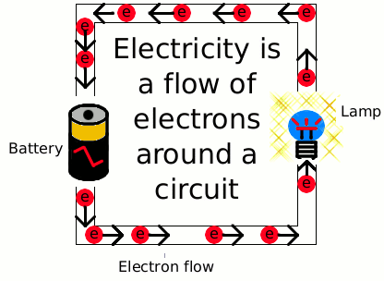
Nature of Energy: Electrical
Atoms are made up of
electrons, protons and
neutrons
The flow of electrons is
“electrical current”
The extent of damage of human tissues in contact with electrical energy increases with amperage.
Skin sensitivity varies 100-fold as a function of wetness (100,000 ohms when dry; 100 ohms when wet)

Slide 15
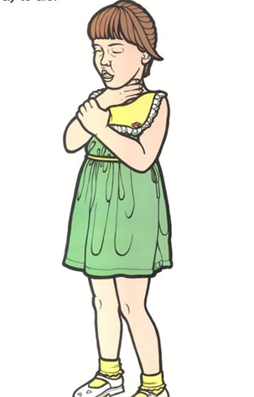
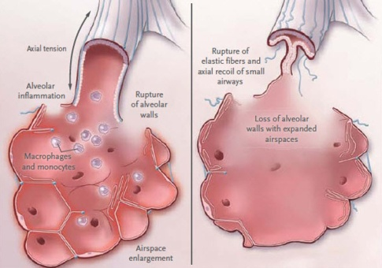
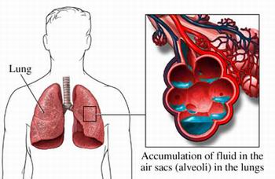
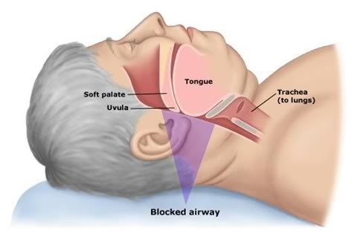
Nature of Energy: Asphyxiation
Humans cannot function with too little energy
Asphyxiation: absence of oxygen to sustain endogenous energy conversion, which causes essential cells (in brain / heart) to be damaged within minutes
Possible causes: objects blocking nose / mouth / trachea; mechanical blow to the trachea; constriction of the trachea; lung obstruction; water in lungs (drowning); lung congestion (endogenous fluids as in pnuemonia / congestive heart failure)

Slide 16
Types of Injuries
Intentional: e.g. violence, suicide, homicide, intentional fire-arm injuries, etc
Non-intentional (accidental): e.g. road-traffic injuries, fires, falls, poisoning, drowning-asphyxia, burns, sports, accidental fire-arm injuries, etc

Slide 17
MAGNITUDE OF THE PROBLEM

Slide 18
Magnitude
Every six seconds someone in the world dies as a result of an injury
Every day more than 14 000 people
die as a result of an injury

Slide 20
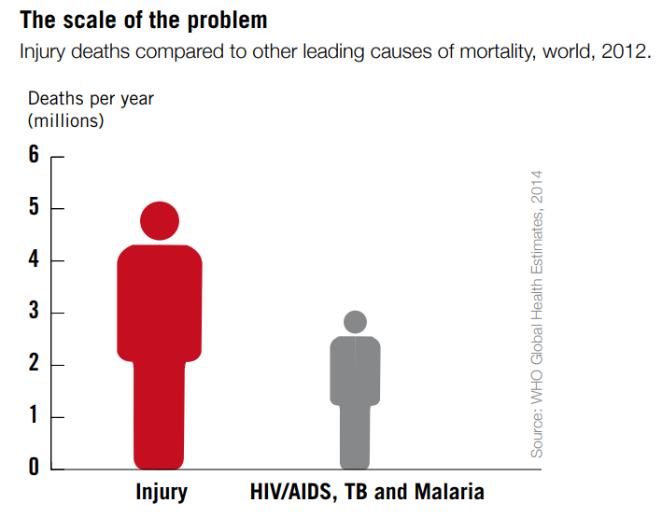
Magnitude

Slide 21
Global & Regional Burden
12% of global burden of disease
More than 90% of injury deaths occur in low- and middle-income countries
Leading causes of morbidity and mortality burden in Eastern Mediterranean Region
Road traffic “incidents” are the leading cause of injury deaths worldwide, which strongly applies to GCC/KSA

Slide 22
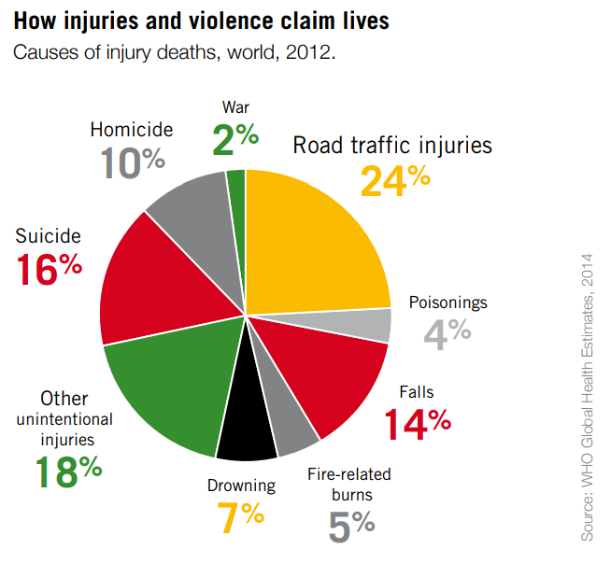
Causes of Injury Deaths

Slide 23
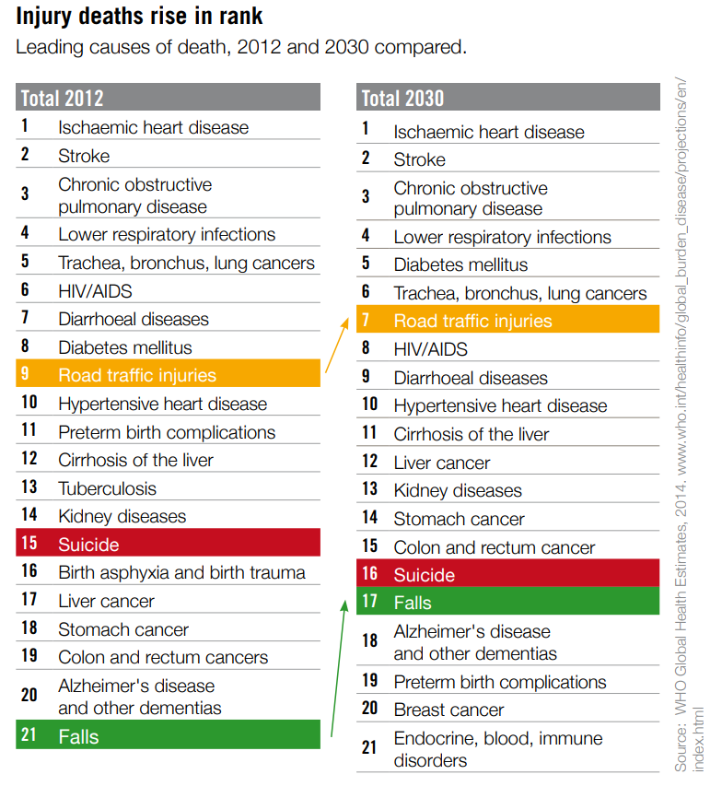
Predicted to rise

Slide 24
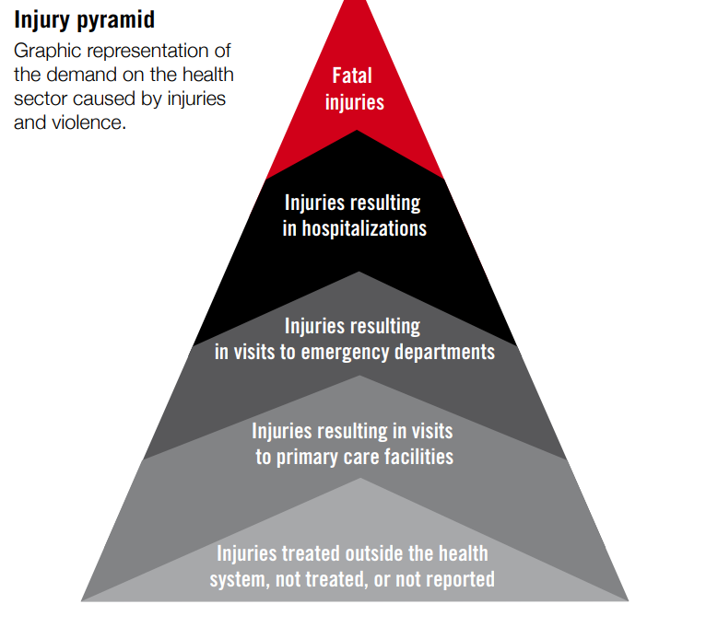
Injury Pyramid
Source: WHO, 2014

Slide 25
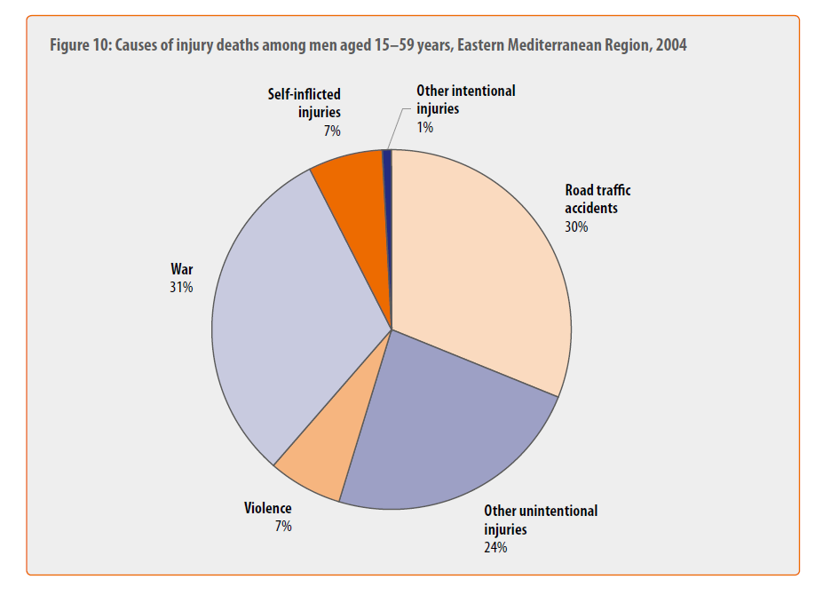
EMRO data

Slide 26
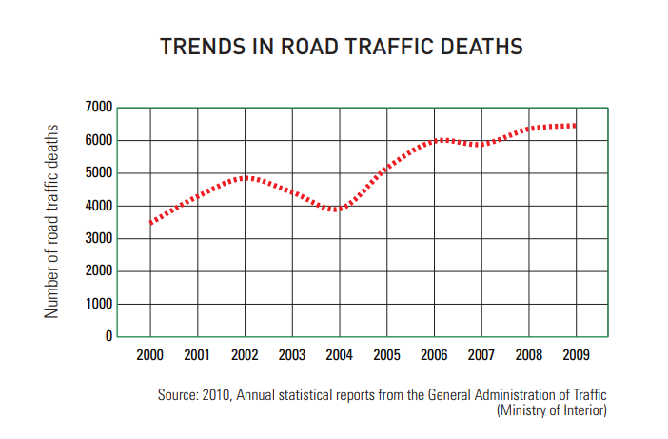
Saudi Arabia – RTA death numbers

Slide 27
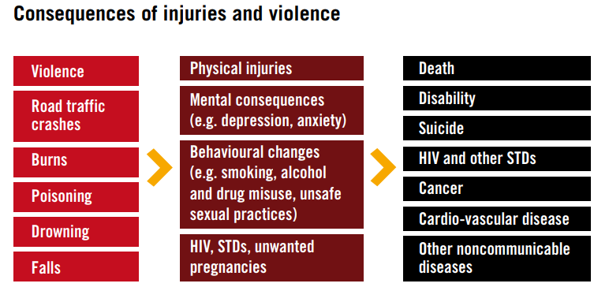
Possible consequences
Source: WHO, 2014

Slide 28
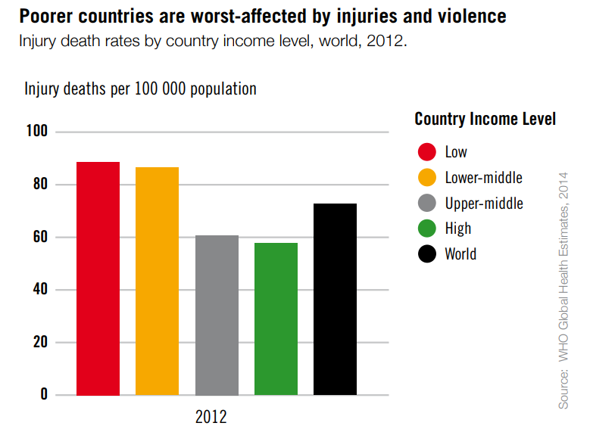
Inequality

Slide 29
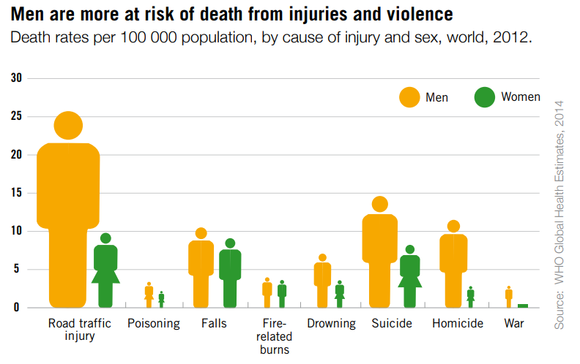

Slide 30
Types of Data & Potential Sources of Information
Mortality
Death certificates
Reports from mortuaries
Morbidity and Health-related
Hospitals
Medical records
Self Reported
Surveys
Media

Slide 31
Community-based
Demographic records
Local government records
Law enforcement
Police records
Prison records
Economic-social
Institutional or agency records
Special studies
Source: adapted from Krug et al., eds., 2002

Slide 32
PREVENTION & CONTROL

Slide 33
LEVELS & CONCEPTS
Primary prevention:
Raising awareness of the community, at its different levels, as to methods of avoiding injuries. This includes health promotion / health education activities and applying preventive measures accordingly
Secondary prevention:
Early detection, proper evaluation and management of injuries at different levels of healthcare delivery (primary, secondary and tertiary facilities)
Tertiary prevention:
Management of complications of injuries, especially disabilities, including rehabilitative measures and approaches, improvement of quality of life of injury victims, as well as palliative care, when needed

Slide 34
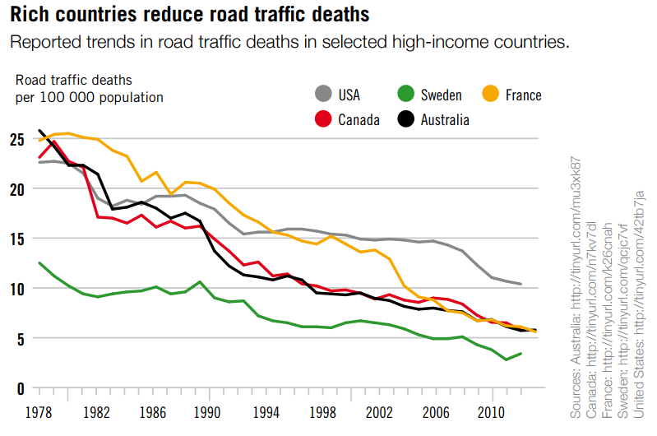
Prevention and Control

Slide 35
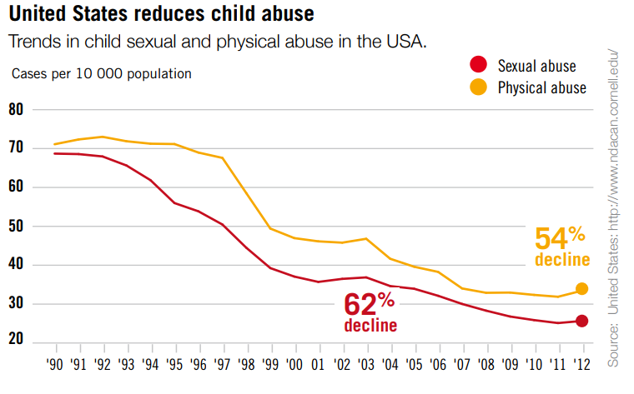
Prevention and Control

Slide 36
Source:
WHO, 2014

Slide 37
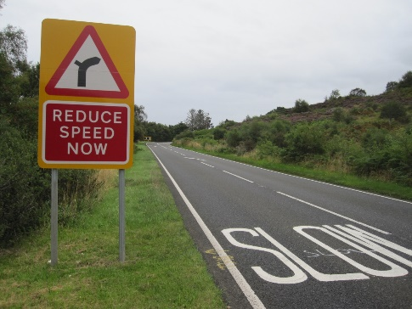
Measures - Road traffic crashes
• Setting and enforcing laws on speeding
• Setting and enforcing laws on drinking and driving
• Setting and enforcing laws on motorcycle helmets
• Setting and enforcing laws on seat-belts
• Setting and enforcing laws on child restraints
• Developing safer roadway infrastructure, including engineering measures to
reduce speeds in urban areas and separate different types of road users
• Implementing vehicle and safety equipment standards
• Setting and enforcing laws on daytime running lights for motorcycles
• Introducing a graduated driver licensing system for novice drivers
Source: WHO, 2014

Slide 38
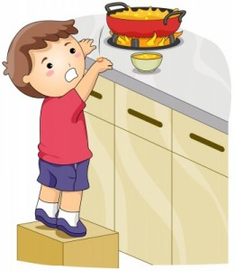
Measures - Burns
• Setting and enforcing laws on smoke detectors
• Setting and enforcing laws on hot tap water temperatures
• Developing and implementing a standard for child-resistant lighters
• Treating burns patients in a dedicated burns center
Source: WHO, 2014

Slide 39
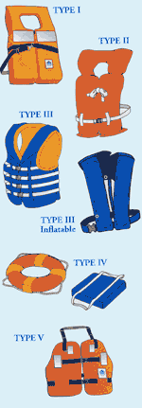
Measures - Drowning
Source: WHO, 2014
• Installing barriers controlling access to water
• Providing capable child care for pre-school children in safe places away from water
• Teaching school-age children basic swimming, water safety and safe rescue skills
• Training bystanders in safe rescue and resuscitation
• Wearing of personal flotation devices

Slide 40
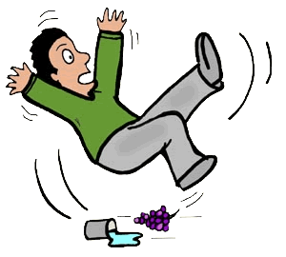
Measures - Falls
• Setting and enforcing laws requiring window guards for tall buildings
• Redesigning furniture and other products
• Establishing standards for playground equipment
Source: WHO, 2014

Slide 41
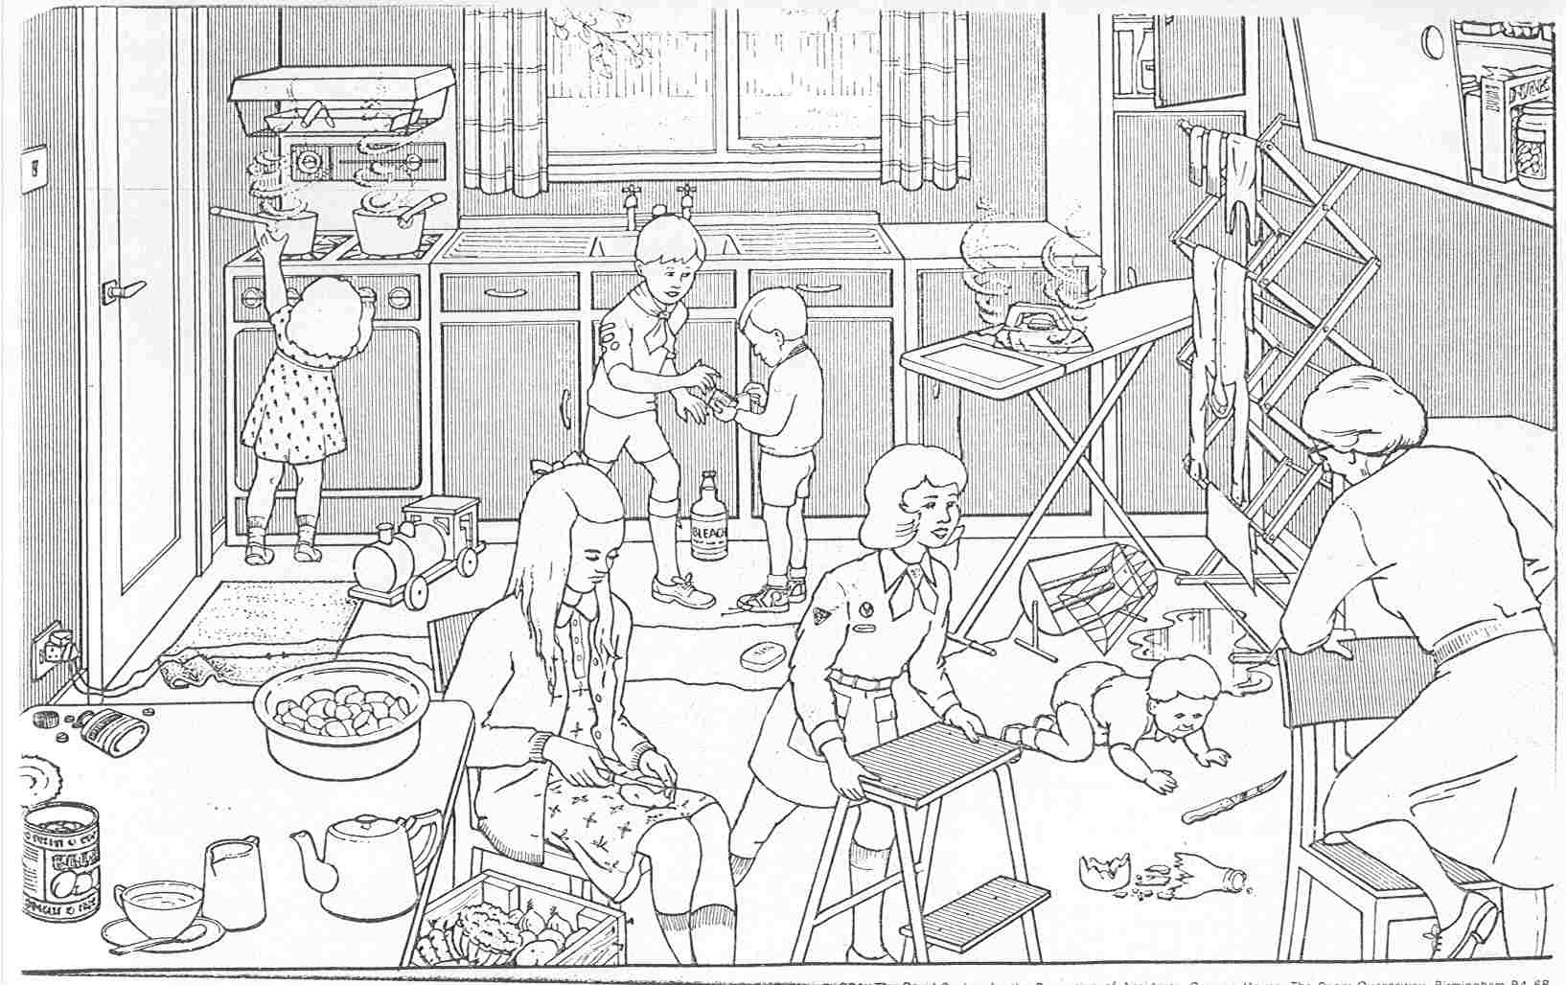

Slide 42
Measures - Poisoning
• Setting and enforcing laws for child resistant packaging of medicines and poisons
• Removing toxic products
• Packaging drugs in non-lethal quantities
• Establishing poison-control centers
Source: WHO, 2014

Slide 43
Measures – Interpersonal violence
• Developing safe, stable and nurturing relationships between children and their parents or caregivers
• Developing life skills in children and adolescents
• Reducing the availability and harmful use of alcohol
• Reducing access to guns and knives
• Changing cultural and social norms that support violence
• Reducing violence through victim identification, care and support programmes
Source: WHO, 2014

Slide 44
Measures - Suicide
• Reducing access to common means, such as firearms, pesticides and certain medications
• Implementing policies and interventions to reduce the harmful use of alcohol
• Ensuring early detection and effective treatment of mental disorders, particularly depression and alcohol use disorders
• Ensuring management of people who have attempted suicide or are at risk, including assessment and appropriate follow-up
• Training primary health care workers and other ‘gatekeepers’ who are likely to interact with people at risk of suicide
• Adoption of responsible reporting of suicide by the media
Source: WHO, 2014

Slide 45
KSA EFFORTS

Slide 46
http://moh-ncd.gov.sa/injury/index.php

Slide 47
Surveillance System
Education
Capacity Building

Slide 48
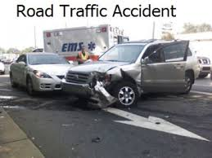
APPLICATION TO ROAD TRAFFIC INCIDENTS

Slide 49
APPLICATION TO RTI - 1
Host: victim: e.g. driver, passenger, pedestrian, etc
Agent: mechanical / thermal energy
Environment: vehicle(s) of incident

Slide 50
APPLICATION TO RTI - 2
If a person must stop suddenly, as in a crash of a vehicle, that energy must be dissipated in the vehicle, environment, or individual’s tissues
When the vehicle stops, the occupant will continue to move at the pre-crash speed into interior structures, or into the materials in the exterior environment if ejected.
Stresses: contact with energy source generates forces counter to the load. Types: tension (pulling molecules apart), compression (pushing molecules together), shear (from a tangential force)

Slide 51
APPLICATION TO RTI - 3
Strain: extent of deformation, resulting from tension, compression, shear
The shape and elasticity of the materials struck will determine the damage to the tissue.
Devices as seat-belts, air bags and child restraints reduce the severity of injury by reducing contact with less flexible structures (second collision)

Slide 52
APPLICATION TO RTI - 4
Primary prevention:
Raising awareness of the community, at its different levels, as to methods of avoiding RTI. This includes legislations, health promotion activities and applying preventive measures (seat-belts, child restraints, air- bags, good roads, following traffic rules, etc)
Secondary prevention:
Early detection, proper evaluation and management of RTI at different levels of healthcare delivery (especially tertiary facilities: e.g. emergency / trauma facilities and related services)
Tertiary prevention:
Management of complications of RTI, especially disabilities, on medical / social / economic levels, including rehabilitative and physiotherapy measures

Slide 53
National strategic plan to reduce RTI:
National strategic plan that covers the 4Es:
Education: annual traffic weeks.
Saudi Society Organization for Traffic Safety
http://www.salamh.org.sa
Engineering: road infrastructure and vehicles
Enforcement: seatbelt rule, speed limit law
Emergency: Saudi Red Crescent Society (SRCS)

Slide 54
“Prevention is the Vaccine for the Disease of Injury”

Slide 55
References
Robertson LS. Injury epidemiology. Research & control strategies. 3rd edition. Oxford, New York: Oxford University Press, 2007
WHO. World report on violence and health. Geneva: World Health Organization, 2002
Rivara FP. Injury control: a guide to research and program evaluation. Cambridge, New York: Cambridge University Press, 2001
WHO Global Consultation on Violence and Health, Violence: a public health priority. Geneva: World Health Organization, 1996

