Slide 1
Introduction to
ENVIRONMENTAL HEALTH
YEAR
1439-1440 Hajji
2018 - 2019 Gregorian

Slide 2
Objectives
Enlist and elaborate on the common environmental problems (Global warming, Ozone depletion, Green house effects)
Understand the effects of Environmental pollution and degradation on health
Enlist and understand causes of Air, Water, soil, and food contamination
Comprehend the water cycle and the WHO criteria for water quality
Understand different measures of water, noise, and air pollution
Understand role of international and the national agencies in environmental safety and regulations

Slide 3
Health is
"a state of complete physical, mental and social well-being and not merely the absence of disease or infirmity“

Slide 4
Public health
is
"the science and art of preventing disease, prolonging life and promoting health
through the organized efforts and informed choices of society, organizations, public and private, communities and individuals. “

Slide 5
1.1. Environment:
In general, environment refers to the surroundings of an object

Slide 6
Ecology
Environment
Health

Slide 7
Ecology
The science of the relationships between organisms and their environments.
Also called BIONOMICS.

Slide 8
The ultimate goal of ecology is to understand the
nature of environmental influences on individual organisms,
their populations and communities, on landscapes and, ultimately, the biosphere (all life on Earth).
If ecologists can achieve an understanding of these relationships, they will be able to contribute to the development of systems by which humans will be able to wisely use ecological resources, such as forests, agricultural soils, and hunted animals such as deer and fish.

Slide 9
Environment
In general, environment refers to the surroundings of an object.
Health
A state of complete physical, mental and social well-being and not merely the absence of disease or infirmity

Slide 10
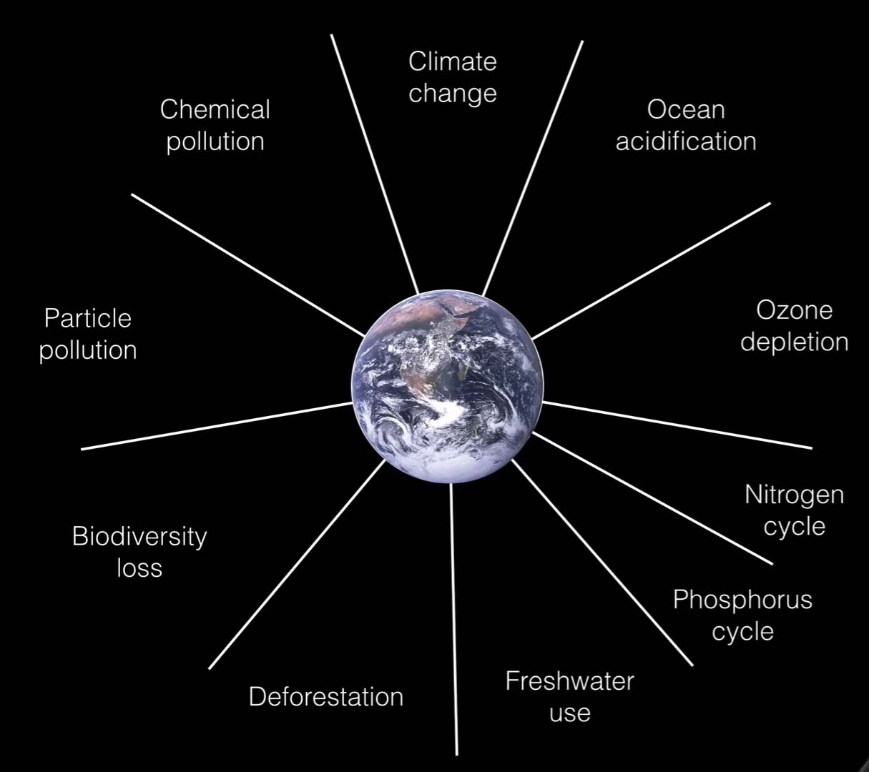

Slide 11
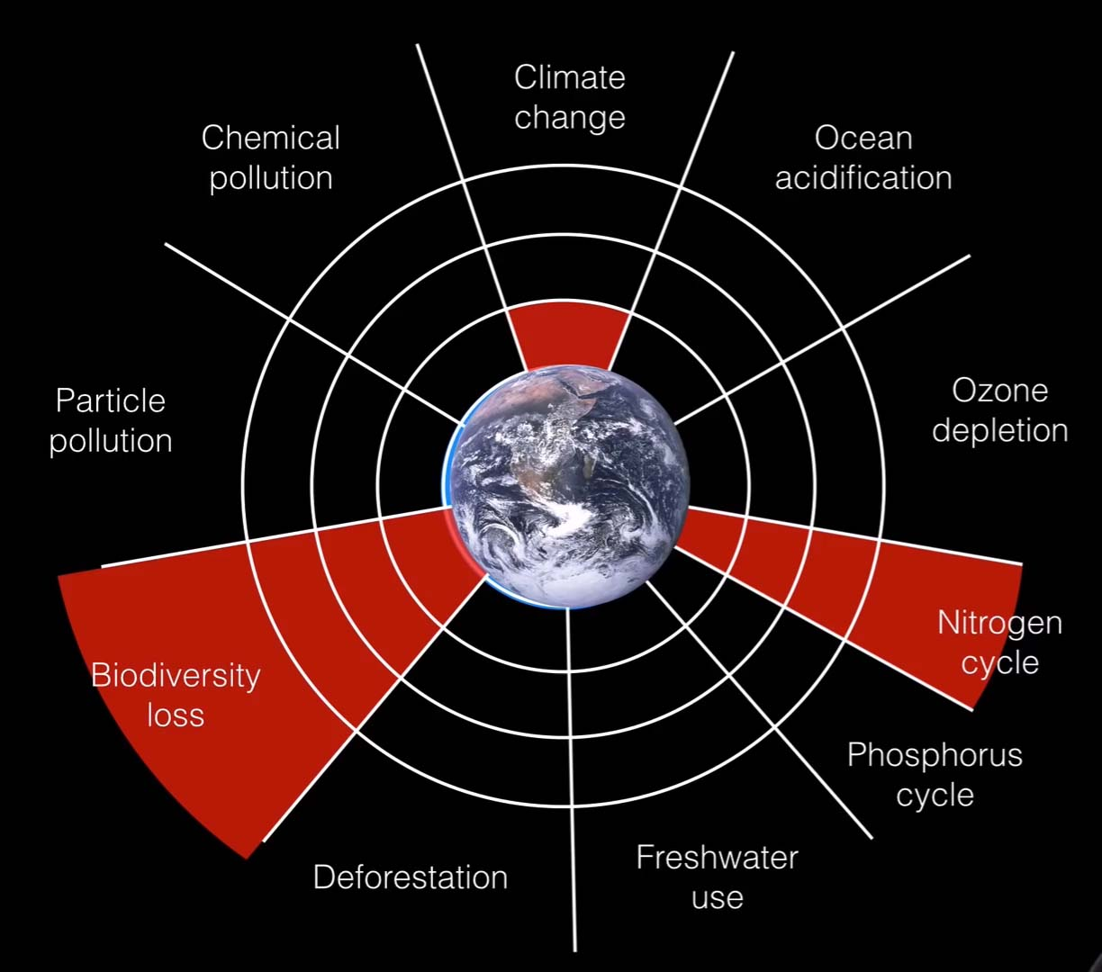

Slide 12
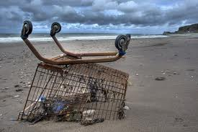
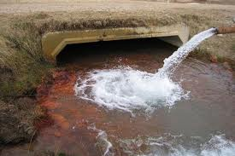
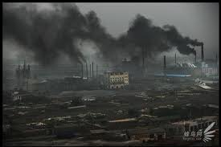
Pollution:
Pollution is the introduction of pollutants or contaminants into a natural environment that causes instability, disorder, harm or discomfort to the ecosystem i.e. physical systems or living organisms.

Slide 13
Pollution can take the form of chemical substances or energy, such as noise, heat, or light.
Pollutants, the elements of pollution, can be foreign substances or energies, or naturally occurring;
When naturally occurring, they are considered Pollutants when they exceed natural levels.

Slide 14
1.3. Environmental health
Environmental health is the branch of public health that is concerned with all aspects of the natural and built environment that may affect human health.

Slide 15
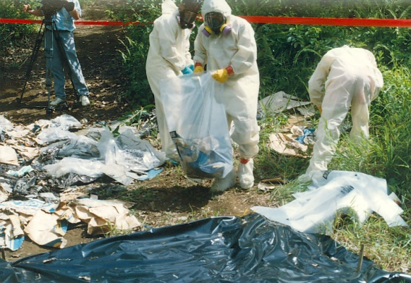
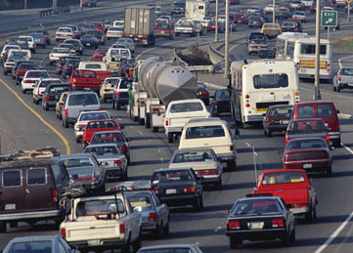
Environmental health:
Those aspects of the human health and disease that are determined by factors in the environment.
It also refers to the theory and practice of assessing and controlling factors in the environment that can potentially affect health.

Slide 16
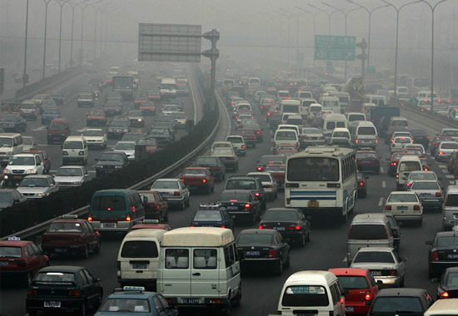
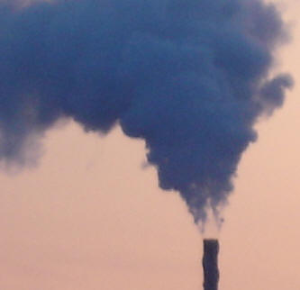
Concepts of Environment and health
Air quality, including both ambient outdoor air and indoor air quality, which also comprises concerns about environmental tobacco smoke.

Slide 17
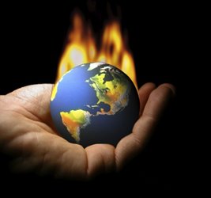
Climate Change And Public Health
What Causes Climate Change?
“Climate forcing”
whether natural or manmade (anthropogenic) are events that cause changes in the atmosphere and are a significant cause of global climate change.

Slide 18
Greenhouse gases trap heat in the atmosphere and warm the Earth.
While some greenhouse gases occur naturally, human activities are amplifying the natural greenhouse effect and impacting the concentrations of gases in the atmosphere, thereby contributing to climate change.

Slide 19
Global Emissions by Gas
Carbon dioxide (CO2) - Fossil fuel use is the primary source of CO2.
Methane (CH4) - Agricultural activities, waste management, and energy use all contribute to CH4 emissions.
Nitrous oxide (N2O) - Agricultural activities, such as fertilizer use, are the primary source of N2O emissions.
Fluorinated gases (F-gases) - Industrial processes, refrigeration, and the use of a variety of consumer products
Black carbon (BC) is a solid particle or aerosol, not a gas, but it also contributes to warming of the atmosphere.

Slide 20
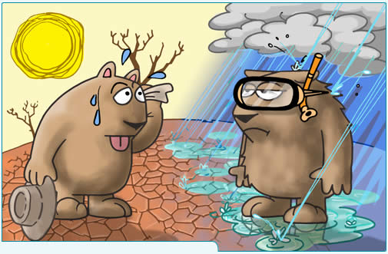
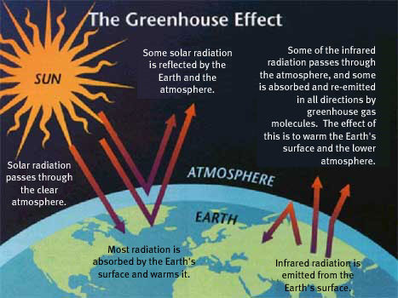
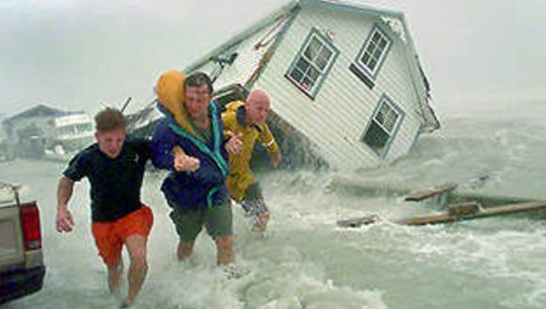
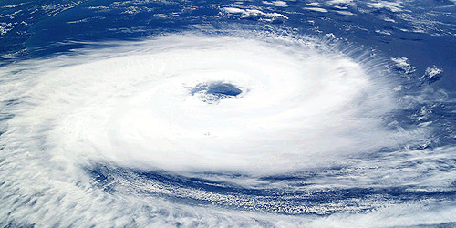
Climate change and its effects on health.

Slide 21
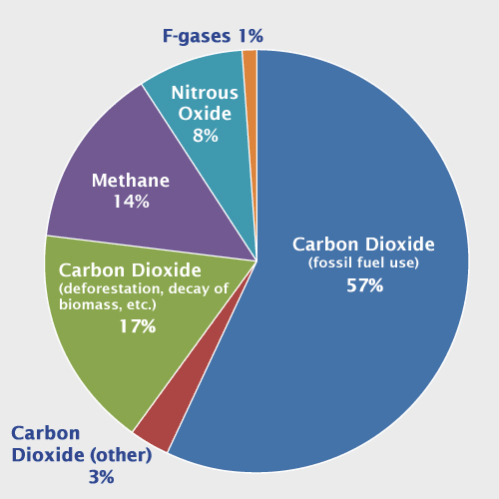
Global Emissions by Gas

Slide 22
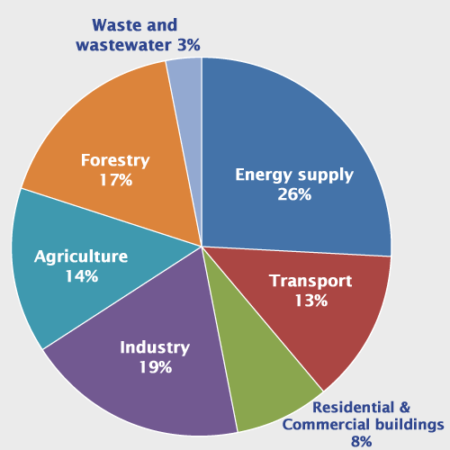
Global Emissions by Source

Slide 23
Projecting the Future of Climate Change
January–December Global Surface Mean Temperature Anomalies

Slide 24
Variations in Earth’s Average Surface Temperature Over the Past 20,000 Years

Slide 28
Ground-level Ozone Formation

Slide 30
Categories of human health consequences of climate change:
Asthma, Respiratory Allergies, and Airway Diseases
Cancer
Cardiovascular Disease and Stroke
Foodborne Diseases and Nutrition
Heat-Related Morbidity and Mortality
Human Developmental Effects
Mental Health and Stress-Related Disorders
Neurological Diseases and Disorders
Vectorborne and Zoonotic Diseases
Waterborne Diseases

Slide 31
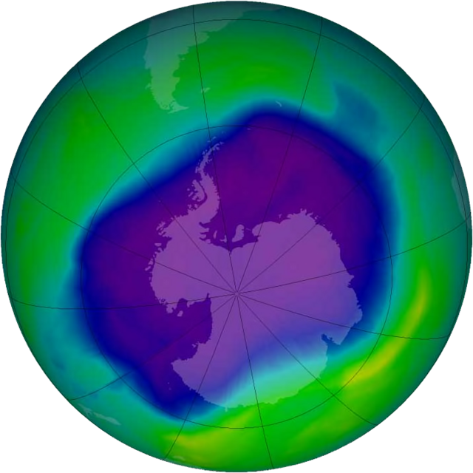
Ozone Hole
Image of the largest Antarctic ozone hole ever recorded (September 2006), over the Southern pole

Slide 32
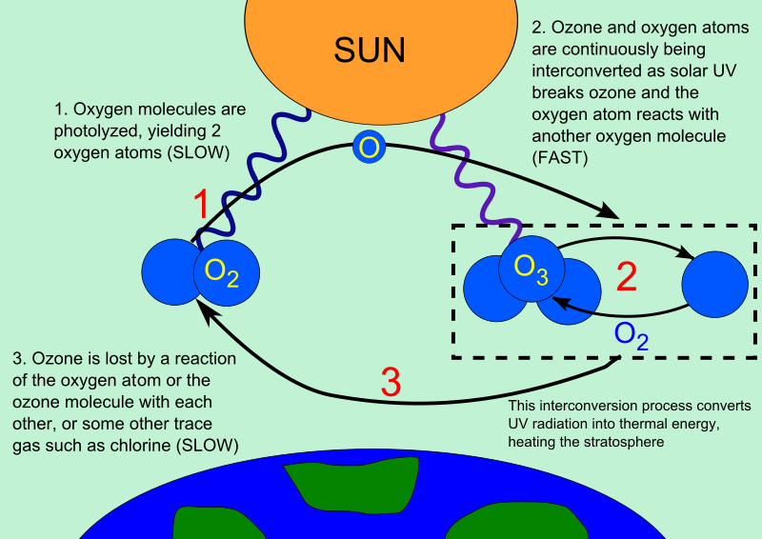

Slide 33
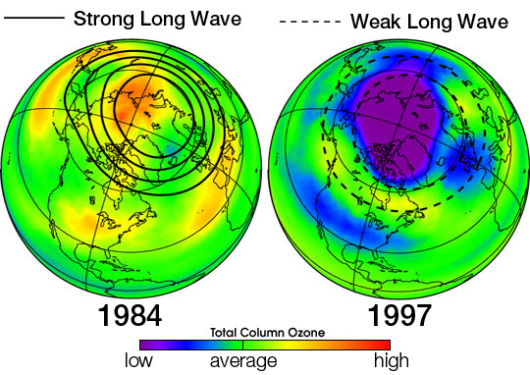

Slide 34
Environmental Health Concerns

Slide 35
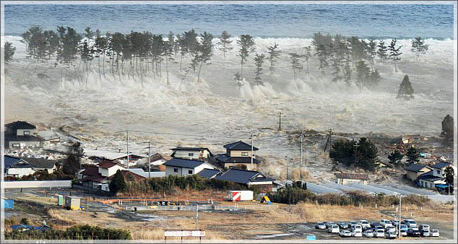
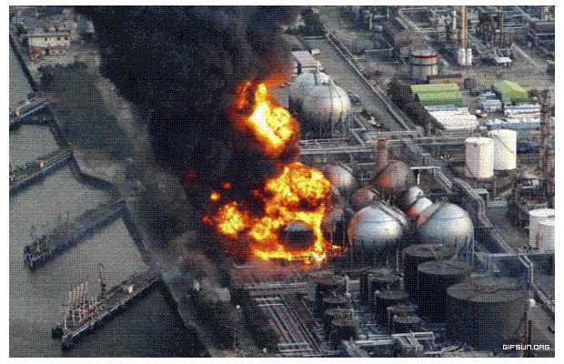
Disaster preparedness and response.

Slide 36
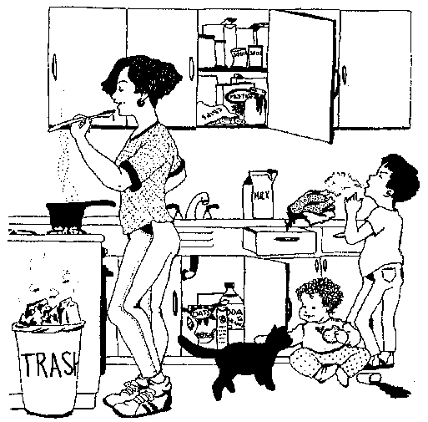
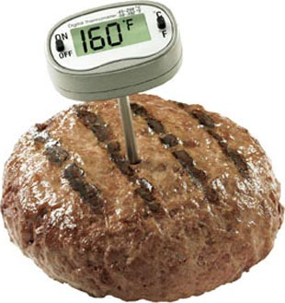
Food safety,
including in agriculture, transportation, food processing, wholesale and retail distribution and sale.

Slide 37
Hazardous materials management
including hazardous waste management, contaminated site remediation, the prevention of leaks from underground storage tanks and the prevention of hazardous materials releases to the environment and responses to emergency situations resulting from such releases.

Slide 38
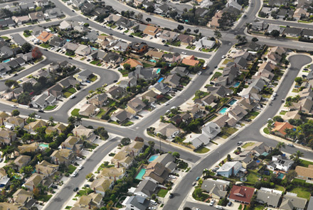
Housing, including substandard housing abatement
Childhood lead poisoning prevention.
Land use planning, including smart growth.

Slide 39
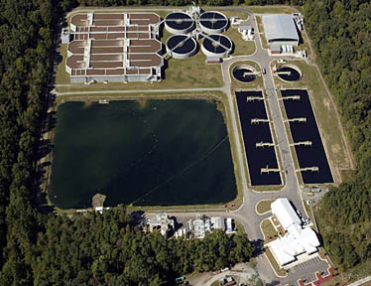
Liquid waste disposal, including city wastewater treatment plants and on-site waste water disposal systems, such as septic tank systems and chemical toilets.

Slide 40
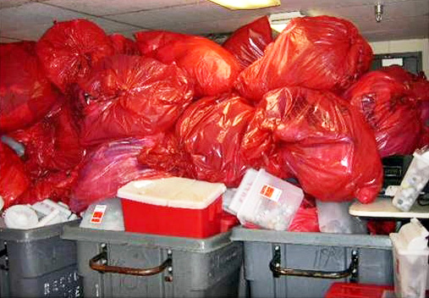
Medical waste management and disposal.

Slide 41
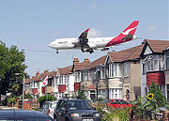
Noise pollution control.
Occupational health and industrial hygiene.
Radiological health, including exposure to ionizing radiation from X-rays or radioactive isotopes.

Slide 42
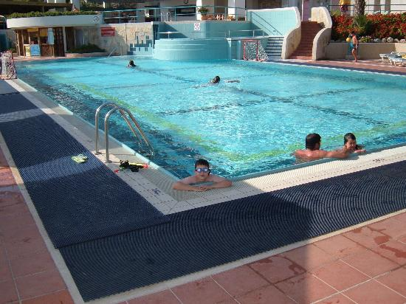
Recreational water illness prevention, including from swimming pools, spas and ocean and freshwater bathing places.

Slide 43
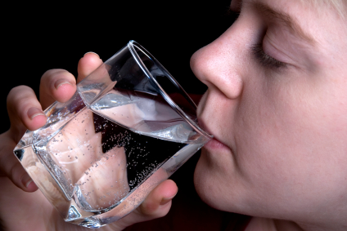
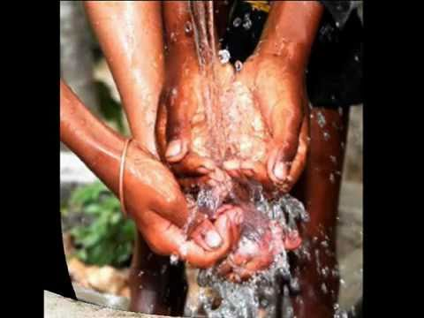
Safe drinking water.

Slide 44
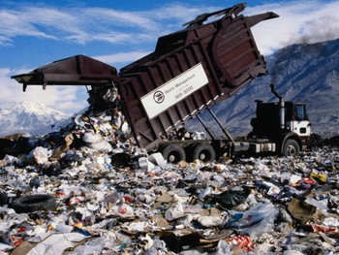
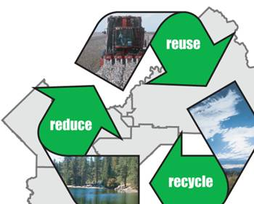
Solid waste management, including landfills, recycling facilities, composting and solid waste transfer stations

Slide 45
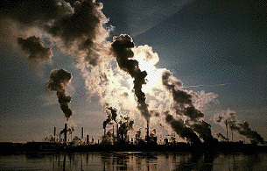
Toxic chemical exposure whether in consumer products, housing, workplaces, air, water or soil.

Slide 46
Household Hazardous Waste
Paints and solvents
Automotive wastes (used motor oil, antifreeze, etc.)
Pesticides (insecticides, herbicides, fungicides, etc.)
Mercury-containing wastes (thermometers, switches, fluorescent lighting, etc.)
Electronics (computers, televisions, cell phones)
Aerosols / Propane cylinders
Cleaning agents
Refrigerant -containing appliances
Some specialty Batteries (e.g. lithium, nickel cadmium, or button cell batteries)
Radioactive waste (some home smoke detectors are classified as radioactive waste because they contain very small amounts of a radioactive isotope of americium).

Slide 47
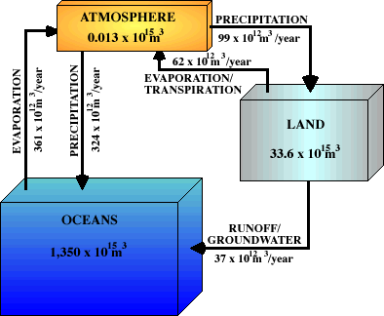
WATER POLLUTION

Slide 48
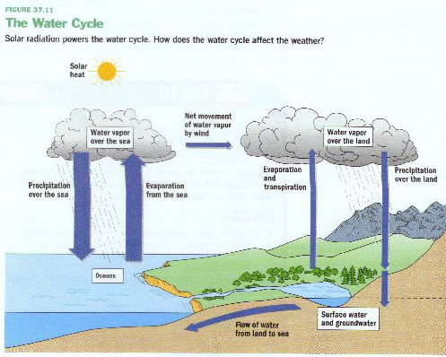
Evaporation and Transpiration
Condensation and Precipitation
Runoff and infiltration
Streams
Groundwater – held in aquifers

Slide 49
Sources of Pollution & Causes of Contamination
Improper Waste Disposal
Improper Well Construction
Poor Site Selection
Wells Not Properly Abandoned
Improper Waste Storage
Lack of Information on Hazardous Sites or Activities

Slide 50
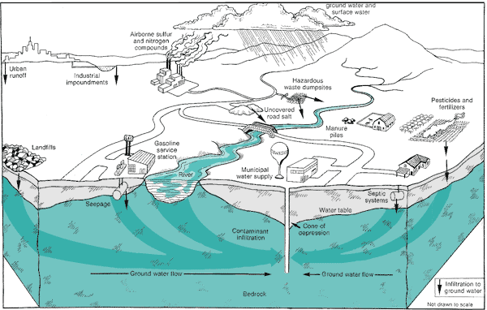

Slide 51
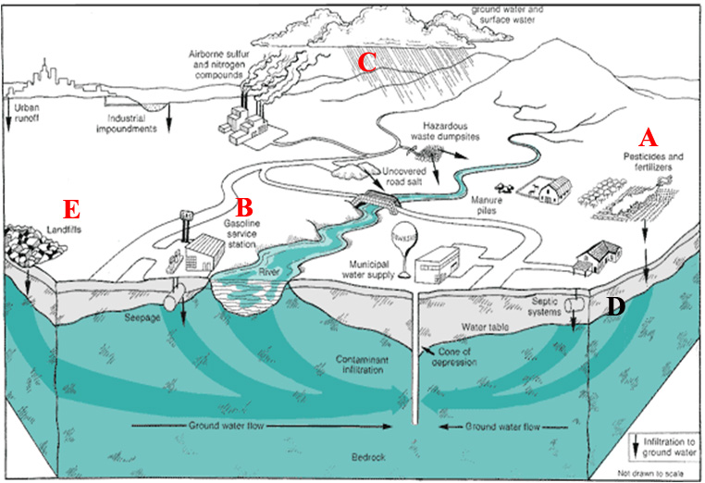

Slide 52
Water Disinfection
1. Chlorination. using chlorine
2. Ozonization. using ozone
3. Bromination. using bromine.
4. Iodination. using iodine.
5. Exposure to Ultra Violet Rays using UV Rays.
6. Heating. By boiling
7. Addition of lime. using lime.
8. Exposure to Ultra Sonic Waves.

Slide 53
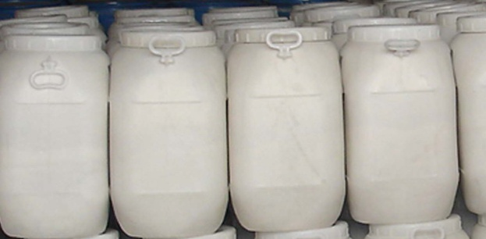
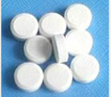
Chlorination is the most common method for ease of control and low cost in addition to its effectively.
Applying Chlorination in rural areas:
This could be carried out with any powder or solution containing Cl2 as:
a. Chlorinated lime = Bleaching powder, 25-35% Cl2
b. HTH = High test hypochlorite powder, 70-75% CI2.
c. Sodium hypochlorite solution, 15% Cl2

Slide 54
Ex. Water quantity = 100 m³/day.
Residual Cl₂ required = 0.5 ppm
Cl₂ demand = 0.6 ppm
Cl₂ dose = 1.1 ppm
So every 1 m³ needs 1.1 gm CI₂­
100 m3 need 100 x 1.1 = 110 gm Cl₂/day
for one month 110 x 30 = 3300 gm Cl₂
Every 1 gm of HTH contains 0.75 gm CI₂
100x1.1x30
So amount of HTH needed = --------------= 4400 gm HTH / month
0.75
= 4.4 Kg HTH / month

Slide 55
References
World Health Organization: www.who.int
Central for Disease Control: www.cdc.gov
American Industrial Hygiene Association Journal.
Annals of Occupational Hygiene and Safety.
Journal of Analytical Chemistry.
NIOSI Pocket Guide to Chemical Hazards.
Journal of Air and Waste Management
Air Pollution Handbook Occupational Diseases by D. Hinter
Williams T, Moon A, Williams M. Food, environment and health. World
Health Organization, Geneva; 1990.
THANK YOU

