Slide 1
Geriatric Health
Dr. Armen Torchyan
Department of Family and Community Medicine
College of Medicine

Slide 2
Objectives
Differentiate between Geriatrics and Gerontology
Describe physiological and pathological aging
Understand health problems of elderly globally
Explain the demographic changes associated with ageing of the population
Discuss existing Global programs for elderly care

Slide 3
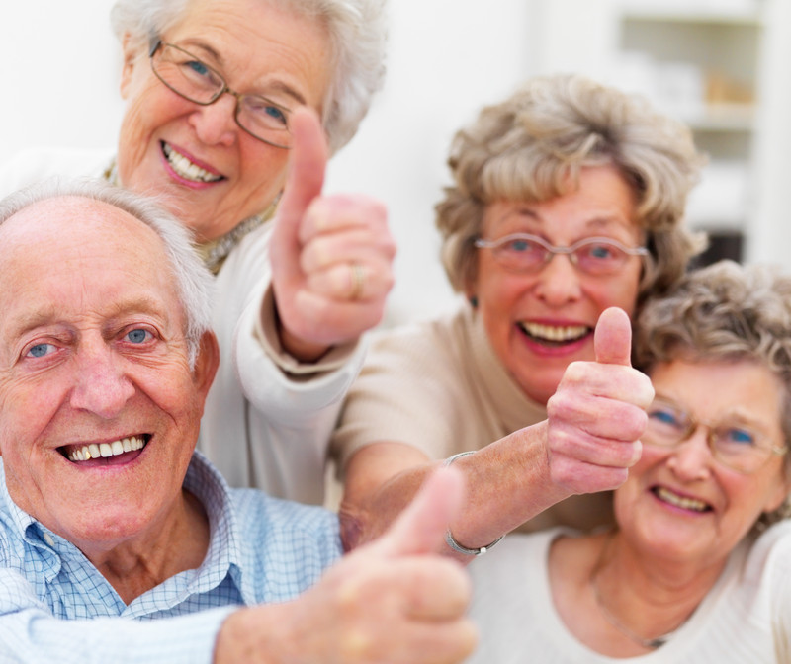
Introduction
"You do not heal old age. You protect it; you promote it; you extend it“,
Sterling Ross
Gerontology - the study of the physical and psychological changes which are incident to old age.
Geriatrics - the care of the aged is called clinical gerontology or geriatrics.

Slide 4
CLASSIFICATION OF ELDERLY POPULATION
Classified into
Young old (60 to less than 75 years)
Old (75 years to less than 85 years)
Oldest old (85 years and above)
Frail elderly (above 60 years with cognitive impairment or a disability)

Slide 5
GLOBAL LIFE EXPECTANCY AT BIRTH
Life expectancy at birth (in years)
About 1.2 billion people over the age of 60 expected to be in 2025 and this number will raise to reach 2 billion by 2050; 70% will be living in low and middle income countries.
Source: US Bureau of census

Slide 6
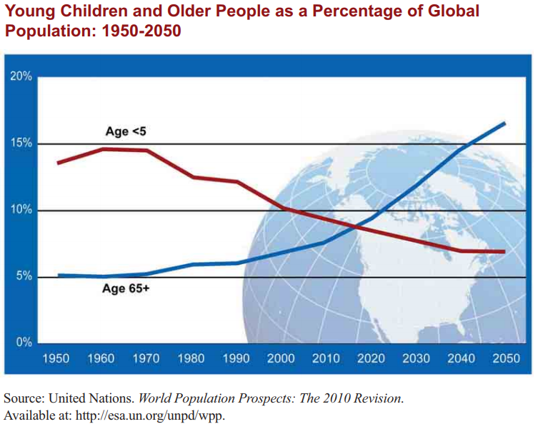

Slide 7
LIFE EXPECTANCY AT BIRTH, KSA
Years
Source: Ministry of Economy and Planning, Central Department of Statistics and Information

Slide 8
Percentage & number of the elderly (60+ years), KSA
Percent of total population
Number of Elderly
Source: Ministry of Economy and Planning, Central Department of Statistics and Information

Slide 9
Increase longevity is associated with an increase in:
EFFECTS OF AGEING
10 years
60 years
80 years
Increase dependency and the need for medical and social care
Chronic & degenerative diseases
Functional disability
Functional disability
Chronic disease
Depression
Depression

Slide 10
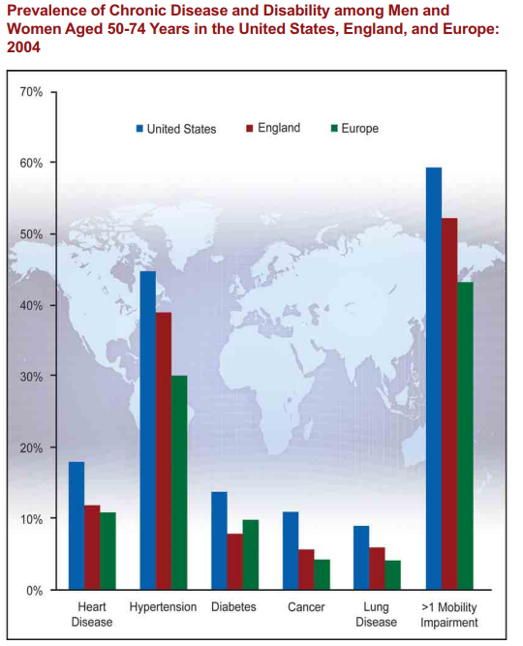

Slide 11
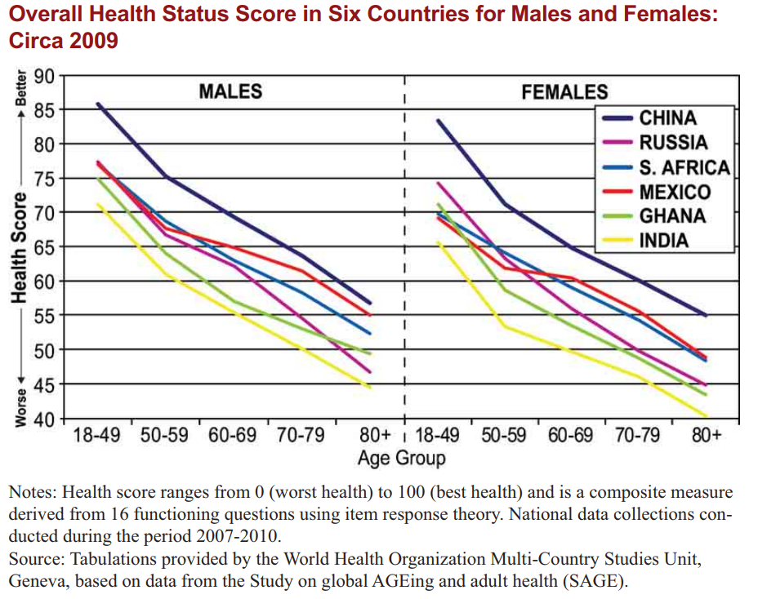

Slide 12
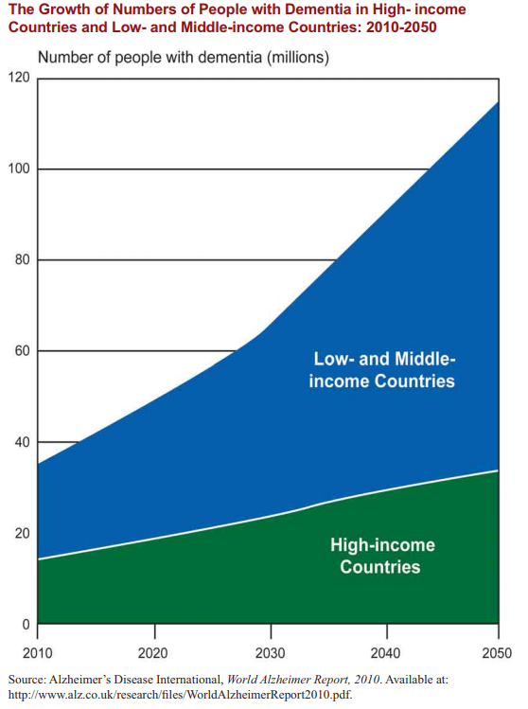

Slide 13
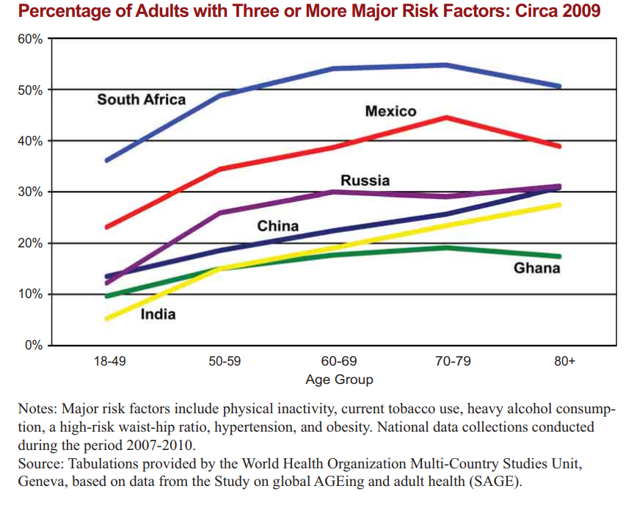

Slide 14
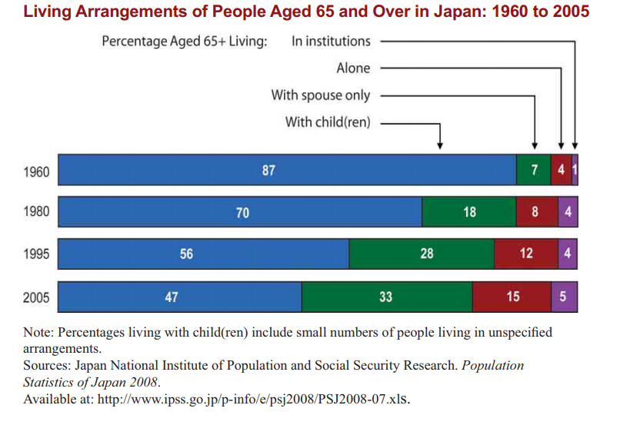

Slide 15
PROBLEMS OF THE ELDERLY
PHYSICAL PROBLEMS
MENTAL PROBLEMS
SOCIAL PROBLEMS
Chronic/degenerative diseases
Nutrition problems
Impairment of special senses
Unintentional injuries
Deterioration of functional abilities
Polypharmacy
Cognitive impairment :
(Dementia)
Psychological problems:
(Depression)
Low social contact
Low social involvement
Decrease income
Unsuitable living conditions

Slide 16
GLOBL CHALLENGES FACING THE INCREASE IN THE ELDERLY POPULATION
Strains on the social security systems;
Demands for health care and social services;
Needs for trained-health workforce in gerontology;
Needs for long-term care, particularly for dementia; and
Counteract pervasive ageism that denies older people the rights and opportunities available for other adults.

Slide 17
Health Problems (cont.)
Physical and mental health problems among the elderly are characterized by
Insidious onset
Multitude of ailments
Rapid deterioration

Slide 18
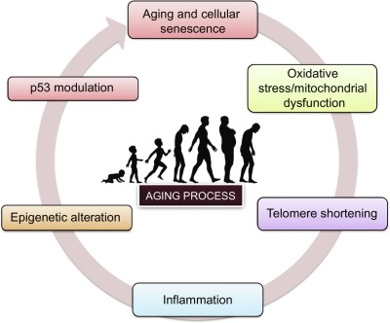
Physiological aging
senile cataract
glaucoma
nerve deafness
osteoporosis affecting mobility
emphysema
failure of special senses
changes in mental outlook.
others
Senescence - Deterioration in the vitality or the lowering of the biological efficiency that accompanies ageing.
P.H. Reddy et al, 2017

Slide 19
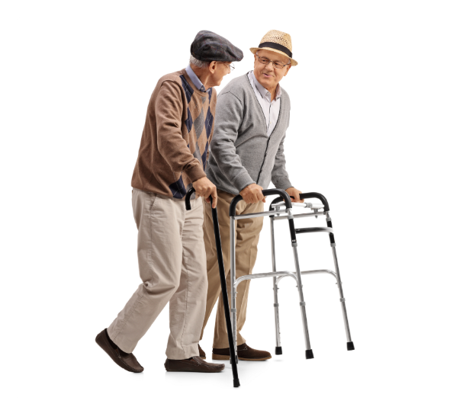
Long-term illness
Degenerative diseases of heart and blood vessels
Cancer
Accidents
Diabetes
Diseases of locomotor system
Respiratory illnesses
Genitourinary system

Slide 20
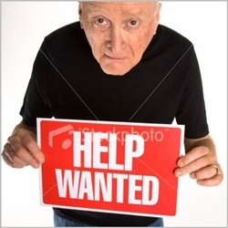
Psychological problems
MENTAL CHANGES
SEXUAL ADJUSTMENT
EMOTIONAL DISORDERS
https://sailejakalekar.wordpress.com

Slide 21
NUTRITION PROBLEM
Primary malnutrition: Reduced intake due to social or economic reasons
Secondary malnutrition: Excess loss and reduced absorption
Overweight and obesity: imbalance between intake and expenditure of energy

Slide 22
POLYPHARMACY
Polypharmacy is defined as taken more than 5 drugs at a time including
Prescribed medications
Over the counter medications
Herbal treatment
Polypharmacy is the result of
Presence of multitude of diseases
Physician’s aim to control physical problems
Polypharmacy may have adverse health effects on the elderly in the form of side effects and drug interaction.

Slide 23
IMPAIRED SPECIAL SENSES
Vision impairment
Cataract
Corneal opacity
Macular degeneration
Hearing impairment
Deterioration of smell
Increase dependence on others
Psychological problems (frustration of not hearing others)
Social isolation
Increase rate of unintentional injuries

Slide 24
UNINTENTIONAL INJURIES
Mostly falls in the elderly own home
Less likely falls outside the home
Fractures
Being bed bound
Slow recovery
Unable to regain their status
Increase dependency

Slide 25
INSTRUMENTAL ACTIVITIES OF DAILY LIVING
Reflects the abilities of the elderly to live independently
It includes
Housekeeping
Shopping
Cooking
Use of transportation
Use of telephone
Dealing with money
Taking medications

Slide 26
ACTIVITIES OF DAILY LIVING
Reflects the abilities of the elderly for self-care
It includes
Bathing
Dressing
Grooming (take care of appearance)
Feeding
Continence (control urine and stool)
Ambulating (moving about)
Transfer (moving from one place to another inside the house)

Slide 27
DEPRESSION
Commonest psychological disorder among the elderly
Insidious onset and progressive course
Often not recognized by the elderly or the caregivers
Manifested by executive dysfunction

Slide 28
DEPRESSION
Depression
Physical dysfunction
Physical illhealth
Social problems
More physical dysfunction
More social isolation

Slide 29
CARE FOR THE ELDERLY

Slide 30
Framework for Healthy Ageing
WHO, 2017

Slide 31
CARE FOR THE ELDERLY
The aim of the elderly care is
Promote healthy ageing; growing old and delaying ill-health
Provide a comprehensive care at the PHC for early detection and treatment of physical and mental health problems
Provide a social support to ensure a decent and safe living
Establish long and short term community based services to provide care for the elderly and alleviate tension on the family

Slide 32
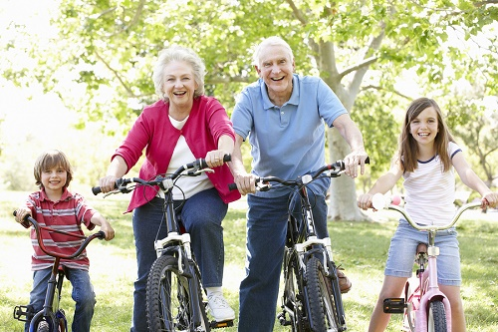
PROMOTE HEALTHY AGEING
Promoting healthy ageing has its roots in adopting a healthy life style through the lifespan including
Maintaining acceptable level of physical activity
Adherence to a healthy diet
Healthy weight
Avoid the use of any tobacco products
Avoid the use of alcohol
Social activities

Slide 33
EARLY DETECTION AND MANAGEMENT
Comprehensive health assessment of the elderly at PHC to screen for major health problems through
History
Medical problems
Unintentional injuries
Medications
Use of standardized tools for the screening for
Nutrition problems
Hearing impairment
Incontinence
Functional abilities
Depression
Dementia

Slide 34
SOCIAL EVALUATION AND SUPPORT
Social contact (living in a family, presence of caregiver, frequency of contact with caregiver, nature of relation with caregiver)
Social activities (having a profession, friends, hobbies, special interest, outing and extent of satisfaction with social activities)
Living conditions (comfort and safety in the house and extent of satisfaction with living conditions)
Economic status (tangible wealth, monthly income, extent of coverage of needs)

Slide 35
COMMUNITY-BASED SERVICES
Elderly day care centers: Elderly clubs to maintain social interaction
Elderly day health centers: Day hospitals for elderly who need nursing care
Home services: Provide social and nursing services to elderly in their own homes
Residential or institutional care
Elderly homes (long term care for elderly who can’t live independently in their own homes)
Nursing homes (long term care for elderly with health problems requiring continuous medical and nursing care)

Slide 36
References
Park, K. (2015). Park's textbook of preventive and social medicine.
Global health and ageing. WHO; US National Institute of Aging. October 2011

