Slide 1
King Saud University – College of medicine.
Forensic Medicine and Forensic Toxicology-FORM 321
March 7, 2019
Dr. Khaldoon Aljerian
Group 1
Presenter: Abdulaziz Alangari

Slide 2
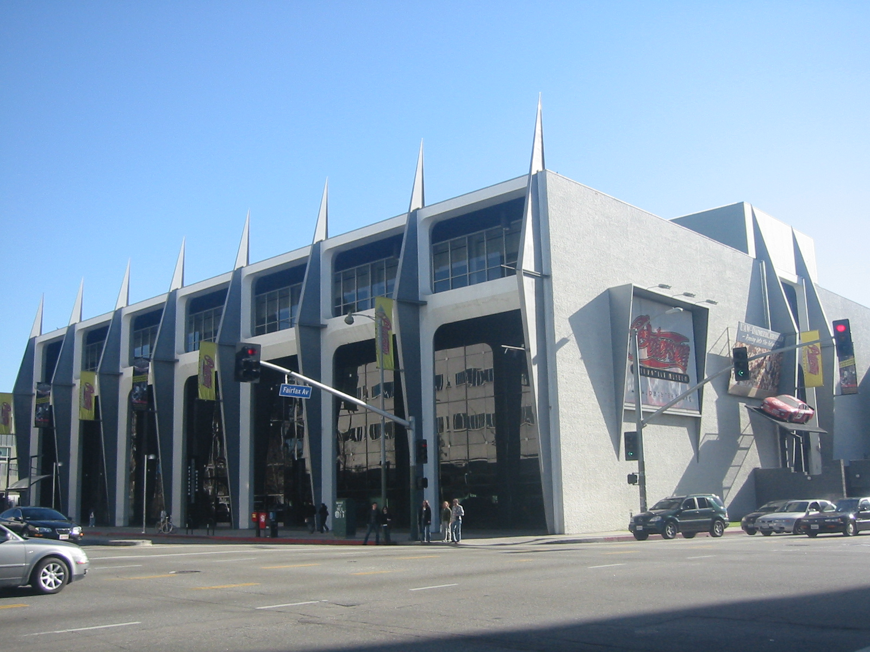
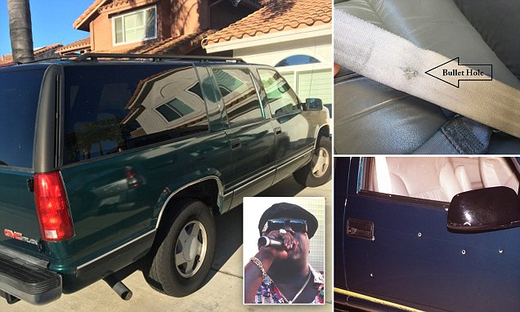

Slide 3
Case Scenario:
On march 9, 1997 at the Peterson auto museum in Los Angeles, California, Christopher Wallace (also known as Biggie Smalls) left the museum at 1 in the morning with 4 friends. Biggie’s car was stopped at a stop light by a black Chevy which fired at Biggie, hitting him 4 times. of the four people in the car, Biggie was only hit. Biggie was rushed into the hospital where doctors performed an emergency thoracotomy but he was pronounced dead at 1:15 a.m.
Fifteen years later, his autopsy report was released. According to the report, three of the four shots were not fatal. The fourth bullet was fatal, entering through his right hip and striking several vital organs, including his colon, liver, heart, and the upper lobe of his left lung, before stopping in his left shoulder area.

Slide 4
Discussion:
What is the cause of death?
What is the manner of death?

Slide 5
References:
https://www.dailymail.co.uk/news/article-4280648/SUV-Biggie-Smalls-shot-dead-goes-sale-1-5m.html
https://en.wikipedia.org/wiki/Murder_of_the_Notorious_B.I.G.

