Slide 1
Forensic Medicine Course
21st Feb2019
1st session
Supervisor: Dr.Khaldoon AlJerian
Group 1
Presenter : Mohammed Alayed

Slide 2
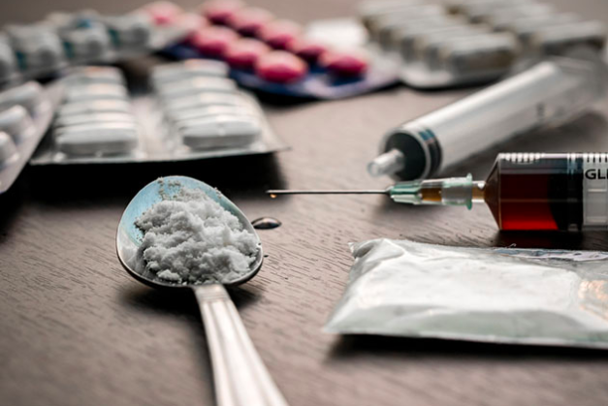
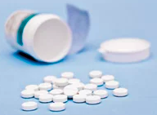

Slide 3
Case A 17-year-old adolescent girl with a history of depression and opioid dependence, for which she was taking buprenorphine until 2 weeks earlier, presented to the ED via emergency medical services (EMS) after her father found her lying on the couch unresponsive and with shallow respirations. Naloxone was administered by EMS and her mental status improved.

Slide 4
Discussion:
Difference between poisons and toxin ?
Difference between exposure and hazard ?
What is a toxic response ?

Slide 5
References
Simpson's Forensic Medicine, 13th Edition
Hayes A.W. (ed): Principles and Methods of Toxicology. Raven Press. New York, 1986.
https://www.mdedge.com/clinicianreviews/article/103540/toxicology/case-studies-toxicology-one-last-kick-transverse-myelitis
:

