Slide 1
King Saud University - College of Medicine
Forensic Medicine, Session 3, 21/2/2019
Supervisor: Dr.Khaldoon AlJerian
Group 1
Presenter: Basel almeflh

Slide 2
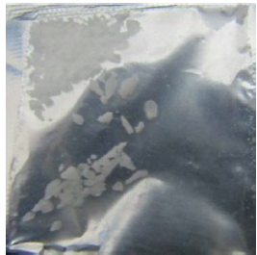
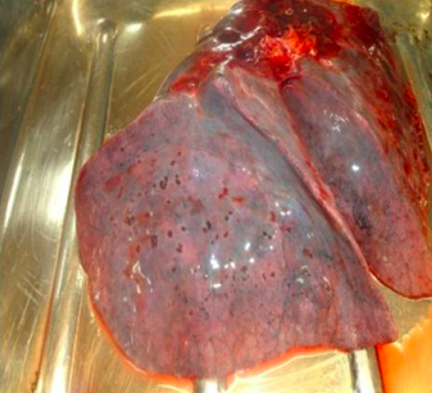
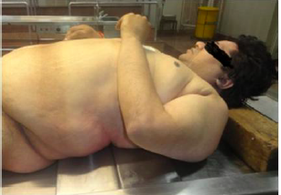
Scene observation

Slide 3
Case Scenario
A 40 year old male was brought to the emergency room with history of accidental poisoning with gold polishing chemical containing cyanide, he was conscious on arrival but his condition started to get worse with loss of consciousness and declining blood pressure and pulse till the BP and pulse were not recordable. He was then declared dead, 6 hours after poisoning.

Slide 4
Discussion:
What are the postmortem changes seen in this case?
What are the symptoms of cyanide poisoning?

Slide 5
References:
Simpson's Forensic Medicine 13th ed. - J. Payne-James, et. al. (Hodder-Arnold, 2011)
2) http://medind.nic.in/jbc/t12/i2/jbct12i2p104.pdf

