Slide 1
King Saud University – College of Medicine
Forensic Medicine 21/Feb/2019
Dr. Khaldoon AlJerian
Group B1
Presenter: Moaid Adel Alyousef

Slide 2
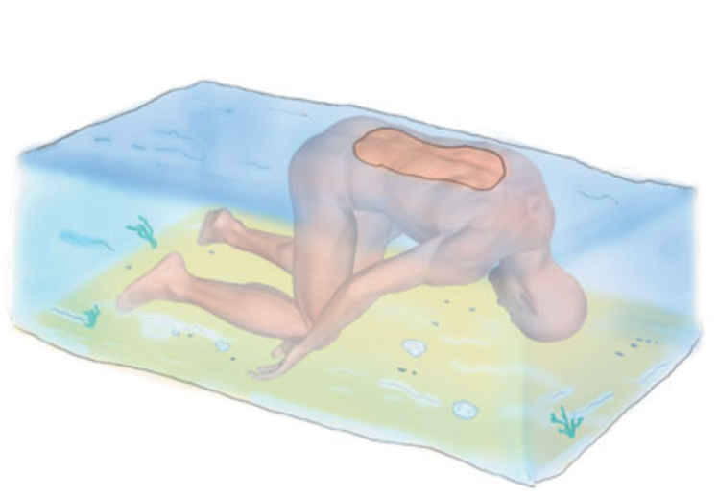
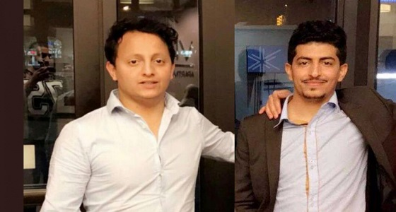
Heroic river rescue
Mr. Theeb alyami 27 and Mr. Jaser alrakah 25

Slide 3
On Friday, June 29, 2018..
CASE SCENARIO
at 5:14 p.m. officers from Police Department responded to Red Bridge Road after receiving a 911 call for the report of swimmers in distress.
Upon arriving witnesses recounted how tow adults were overtaking by the current while they aid tow children how had gone in water and began to have difficulty staying above it.
One of the victims was located that evening and the dive team assist in the recovery of the deceased .
On Monday a call was received reporting that body of a man near the dam was seen, the fir department responded and located the 2nd victim.

Slide 4
DISCUSSION
Q1/ What is the body position in early stage of Immersion?
Q2/ What is the first change of the body in water?
Q3/ What are the factors can alter the speed of decomposition?

Slide 5
Refrences
Simpson's Forensic Medicine, 13th Edition by Jason Payne-James, Richard Jones, Steven B Karch, John Manlove
http://hampdenda.com/investigation-into-wilbraham-drowning-continues/

