Slide 1
College of medicine
Forensic Medicine
Death and injury in infancy
21/2/2019
7th chapter
Group 1
Supervisor: dr. khaldoon aljerian
Presenter : Muhammad almutlaq

Slide 2
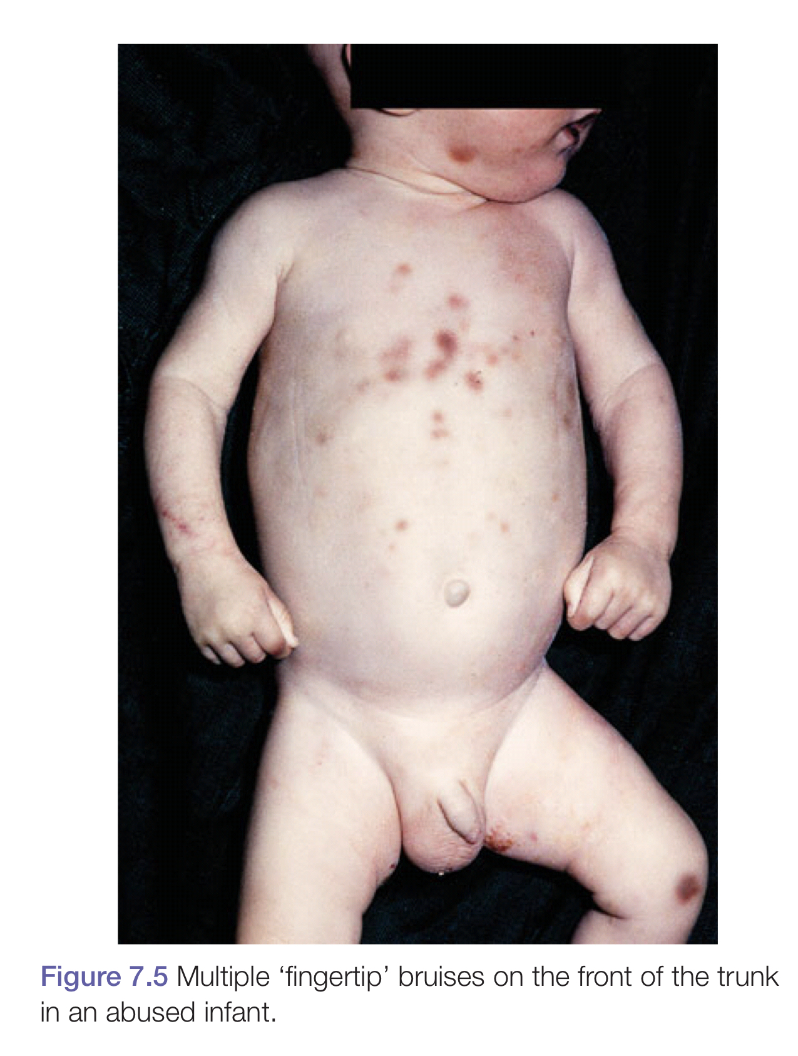
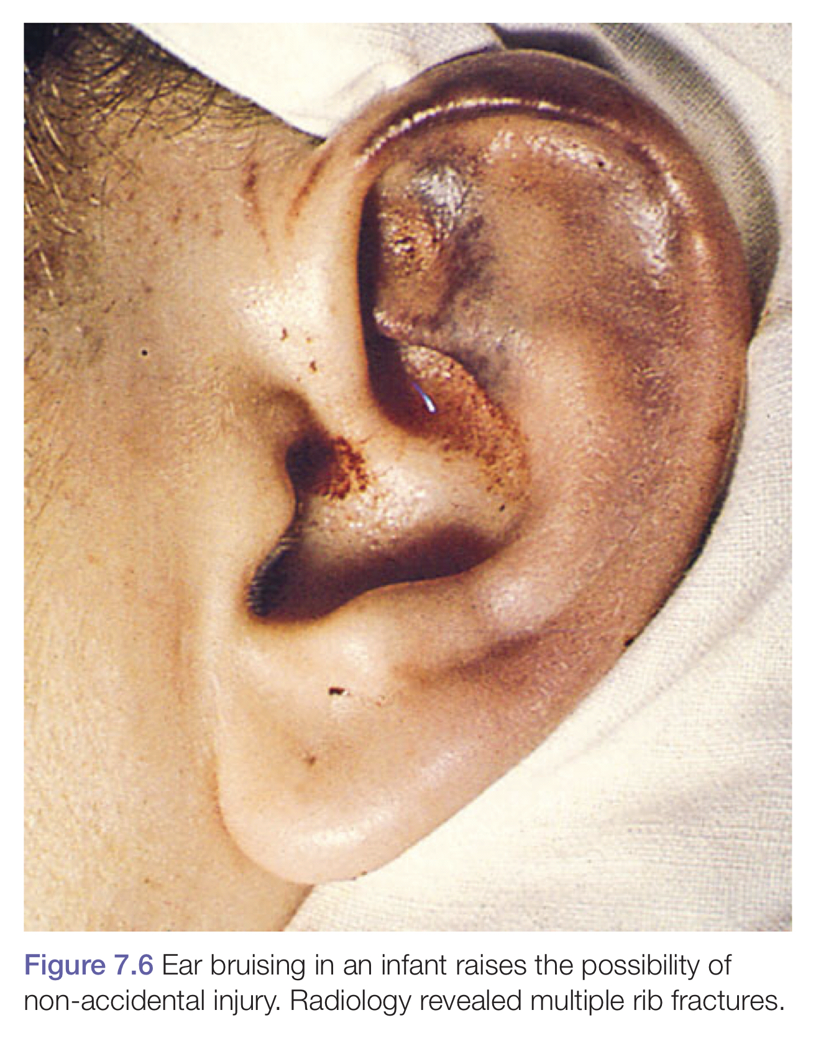

Slide 3
Case scenario
- Case of a 9 month old infant abused by his drunk father, the mother brought him to the hospital with multiple bruises.
- On examination :
There is multiple fingertip bruises on his trunk, hands, legs, and ear.
- X ray revealed multiple rib fractures.

Slide 4
discussion:
Bruising of the arms and legs around the upper arms, forearms, wrists, ankles and knees. What these manifestations indicate?
Is it common to see accidental rib fractures in children?
If you found healing fractures in this case, what that indicates?

Slide 5
References:
Simpson's Forensic Medicine, 13th Edition

