Slide 1
Ballistic injuries
King saud university – college of medicine
Forensic medicine , 21st Feb 2019
Group b1
Supervisor : dr.Khaldoon alJerian
Presenter : Abdullah hashem

Slide 2
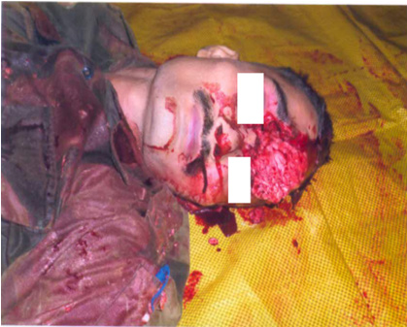
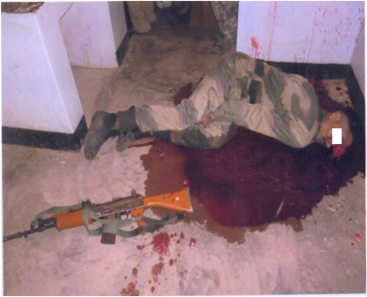
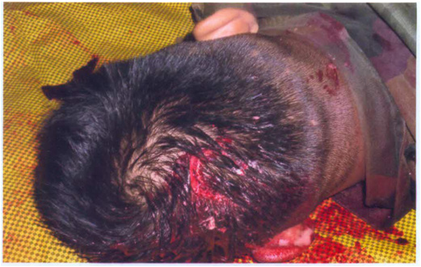
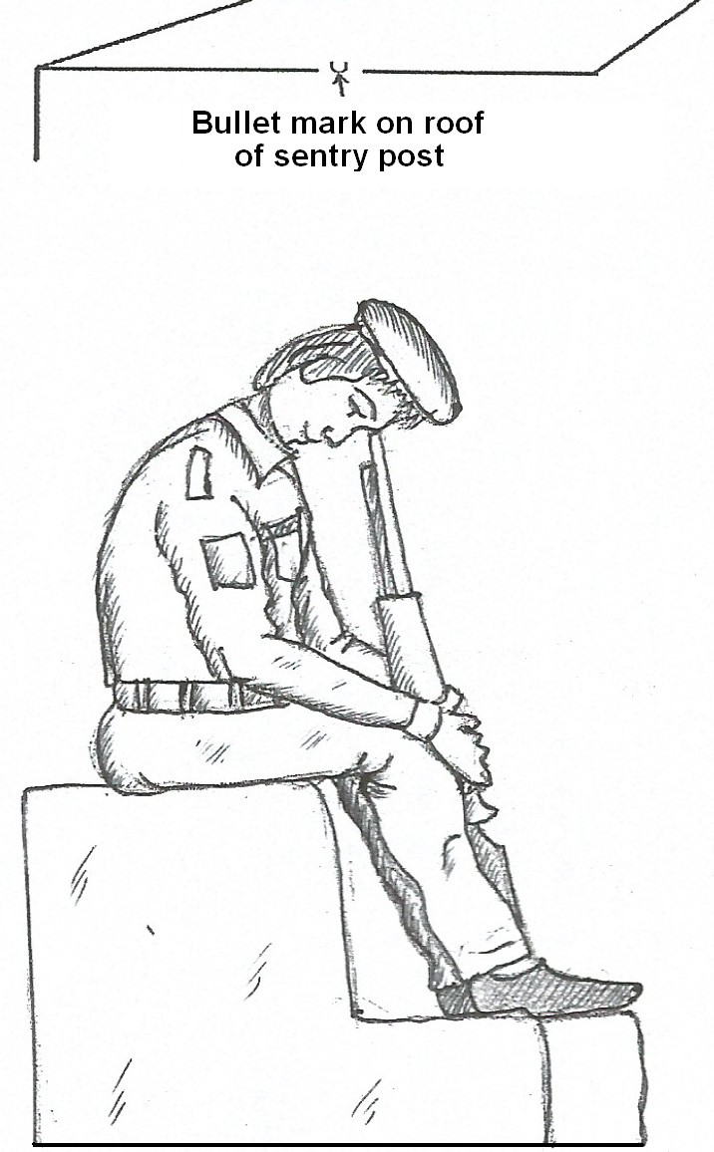
Pictures

Slide 3
Case scenario
A rifleman who was assigned with sentry duty committed a suicide with his service firearm having bullet wounds on the back side situated in occipital bone and another wound in the forehead.

Slide 4
Discussion :
What are the types of firearms ?
Examples of ballistic injuries ?
What is the Medico legal result in this case ?
What is the Toxicological result ?

Slide 5
References
Simpson's Forensic Medicine, 13th Edition
Mystery of Bullet Wound- A Case Study https://medcraveonline.com/FRCIJ/FRCIJ-04-00117.pdf

