Slide 1
Heat, Cold & Electrical Trauma
Forensic Medicine Course
21st of February 2019
Supervisor: Dr. Khaldoon Aljerian
Group: B1
Presenter: Saud Tariq Al Shenaifi

Slide 2
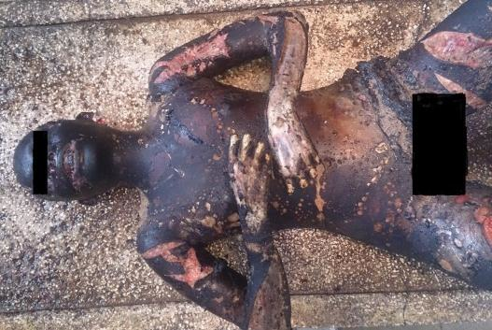
Scene Observation

Slide 3
Case Scenario
A 25-year-old female was brought dead to a tertiary care hospital following fatal thermal burn injuries. The body was brought for post-mortem examination. History revealed that the deceased was recovered from a burnt house without knowing the cause of burn.

Slide 4
Discussion
What are some common types of heat injuries?
How do postmortem burn victims usually present as upon examination?
What is a pugilistic attitude and how does it occur?

Slide 5
References
https://www.researchgate.net/publication/264424828_Forensic_approach_to_a_case_of_death_due_to_burn_injury_a_case_report
Simpson's Forensic Medicine 13th ed. - J. Payne-James, et. al. (Hodder-Arnold, 2011)

