Slide 1
College of medicine
Forensic Medicine Course
21th Feb 2019
3rd session
Supervisor: Dr.Khaldoon AlJerian
Group B2
Presenter : Bader alshehri

Slide 2
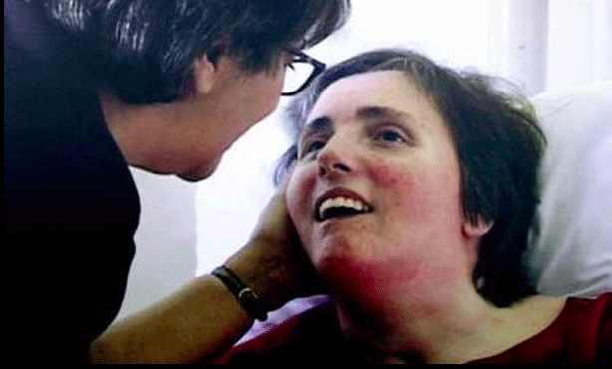
Scene Observation:

Slide 3
Case Scenario
After a heart attack a young women was comatose and came out of her coma unresponsive with no detectable brain activity in a persistent vegetative state. what created a battle between her husband, who wanted to end her life support, and her parents, who wanted to keep her alive.

Slide 4
Discussion questions:
1- What id death? What is the two types of death?
2- What is the definition of Vegetative state ?
3- What are the criteria for the diagnosis of death following irreversible cessation of brain stem function ?

Slide 5
References:
Simpson's Forensic Medicine, 13th Edition
https://www.nationalgeographic.com/science/phenomena/2011/08/02/deader-than-dead-people-in-vegetative-states-are-viewed-as-deader-than-corpses/

