Slide 1
Principles of forensics practice
Chapter: 1
KSU-college of medicine
Forensic course , feb 21 / 2019
supervised by: khaldoon alJerian
Group Name: group 2
Presented by: yazeed Almutairi

Slide 2
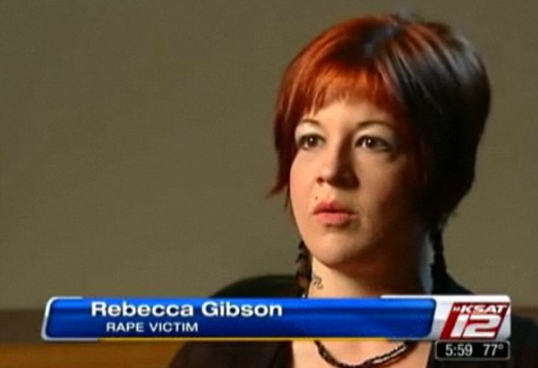
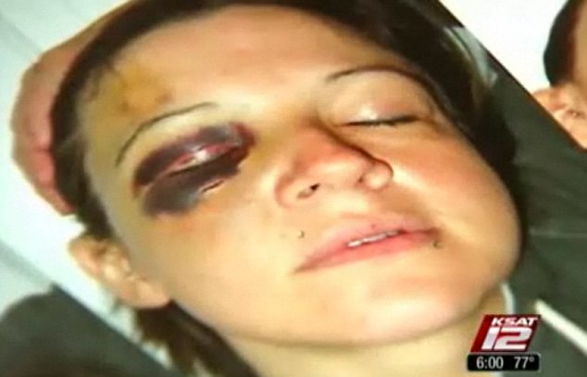

Slide 3
Case:
Rebecca Gibson a 29 old woman reported to the police that
she was sexually assaulted.
DNA was collected.
PE: bruises and vaginal bleeding.

Slide 4
Discussion:
The doctor was summoned by the court to provide medical information about the case,
discuss the difference between a Professional witness and an Expert witness.

Slide 5
References:
Simpson's Forensic Medicine, 13th Edition
https://www.gettyimages.co.uk/detail/photo/doctor-in-witness-stand-high-res-stock-photography/6111-000571
https://www.dailymail.co.uk/news/article-2108247/Police-officer-punched-rape-victim-face-cowered-naked-closet.html

