Slide 1
King saud university – college od medicine
Forensic Medicine - 21st Feb 2019
Supervisor: Dr. Khaldoon AlJerian
Group : B2
Presenter : Rakan Bahammam

Slide 2
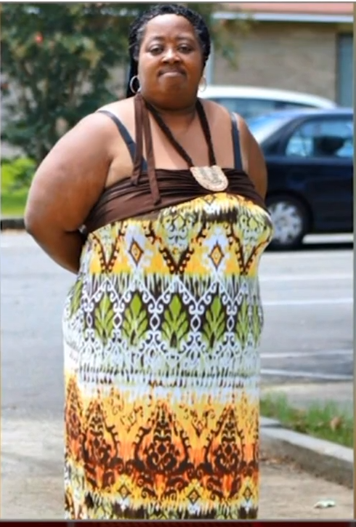
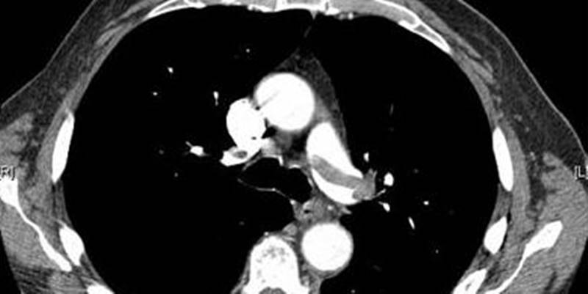

Slide 3
Case Scenario
57 –year-old women was admitted for abdominal pain.
She refused discharge, complaining of shortness of breath.
The hospital called the police, she was taken outside.
collapses and lies on the parking lot, and rushed back to the hospital.
Medical examiner report indicated she died from pulmonary embolism.

Slide 4
Discussion
WHO definition of a sudden death ?
What is the major cause of sudden death within the respiratory organs?
Predisposing factor of deep vein thrombosis?

Slide 5
References
https://edition.cnn.com/2016/01/07/us/florida-woman-removed-hospital-dies/index.html
Simpson's Forensic Medicine, 13th Edition

