Slide 1
College of medicine
Forensic Medicine Course
21th Feb 2019
5th session
Supervisor: Dr.Khaldoon AlJerian
Group B3
Presenter : Omar Alqattan

Slide 2
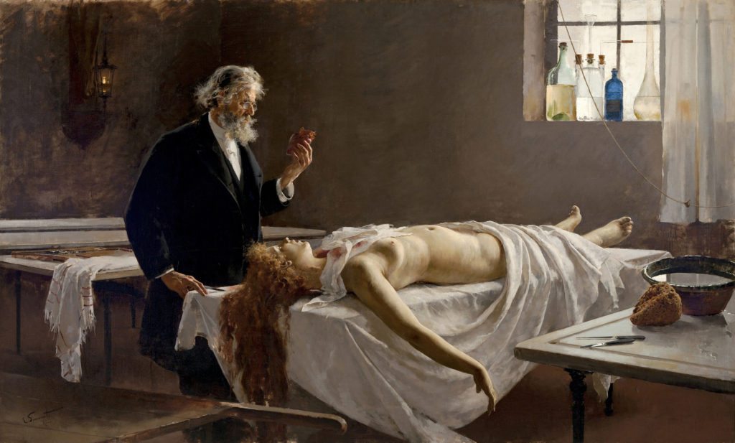

Slide 3
Improper autopsy procedures that may raise doubts about the accuracy of death rulings in homicide cases
Chief medical examiner would rarely be present during autopsy and would let technicians preform procedures

Slide 4
discussion:
What was the improper autopsy procedure ?
What could be the consequences of this?

Slide 5
References:
Simpson's Forensic Medicine, 13th Edition
http://www.sfexaminer.com/allegations-improper-autopsies-far-reaching-implications/
https://www.annmarieackermann.com/milestones-history-forensic-autopsy/

