Slide 1
King Saud University - College of Medicine
Forensic Medicine, February 21 2019
Supervisor: Dr.Khaldoon AlJerian
Group 3
Presenter: Saleh altwaijri

Slide 2
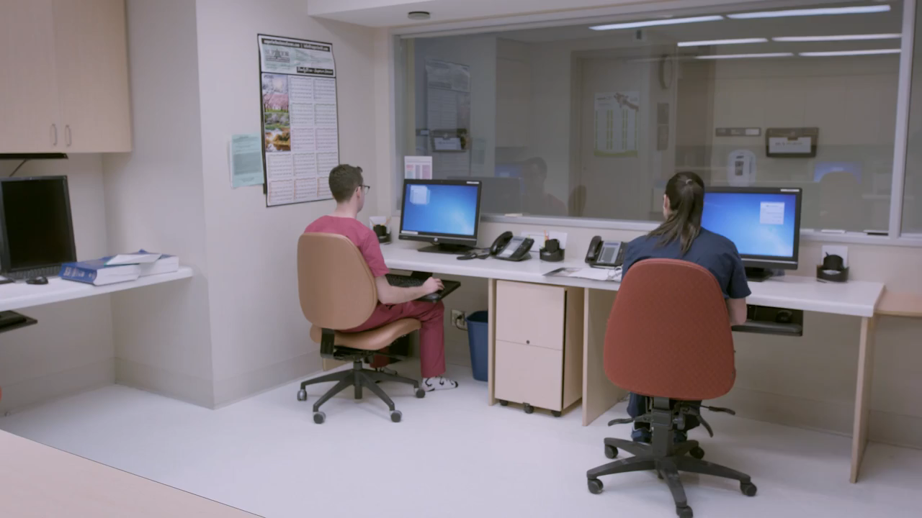
Video

Slide 3
Dr. Sara: Oh, hi Dr. Johannson.
Dr. Johannson: Oh, hi.
Dr. Sara: Can I help you? Are you here to see someone?
Dr. Johannson: No no, I just wanted to check this chart … Mrs. Corelli.
Dr. Sara: Oh, I didn’t know she was booked for radiology today.
Dr. Johannson: I don’t know that she is.
Dr. Sara: Oh?
Dr. Johannson: She’s one of my wife’s golfing buddies. She didn’t make tee off this week … and didn’t say why so my wife was worried so when I saw Mrs. Corelli’s name here, I thought I would just check so I could reassure my wife and tell her she’s okay.
Dr. Sara: But she’s not your patient?
Dr. Johannson: Well, I haven’t received a requisition for tests … yet. Do you have a problem with that?

Slide 4
Case scenario
Dr. Johannson a radiology consultant viewed the charts of a patient of an another consultant for personal purposes .

Slide 5
Discussions
Who “owns” the patient chart? Is it the hospital, the attending physician, the patient?
How should Dr.Sara respond to the question: “Do you have a problem with that?”?
In which conditions confidentiality may not apply?

Slide 6
Questions ?

Slide 7
References:
Simpson's Forensic Medicine 13th ed. - J. Payne-James, et. al. (Hodder-Arnold, 2011)
2) https://www.youtube.com/watch?v=b2_sf7dJa5k

